Slide 1
UMASEP: a suite of models for predicting SEP events in real-time
Marlon Núñez
University of Malaga, Spain

Slide 2
Contents
1. The UMASEP submodels for predicting event occurrence
- WCP: The Well-connected prediction submodel
- PCP: The Poorly-connected prediction submodel
- SOD: The Solar data-based prediction submodel
2. The UMASEP tools
- Each tool and its submodels
- Prediction of the SEP intensity and fluence
3. Conclusions

Slide 3
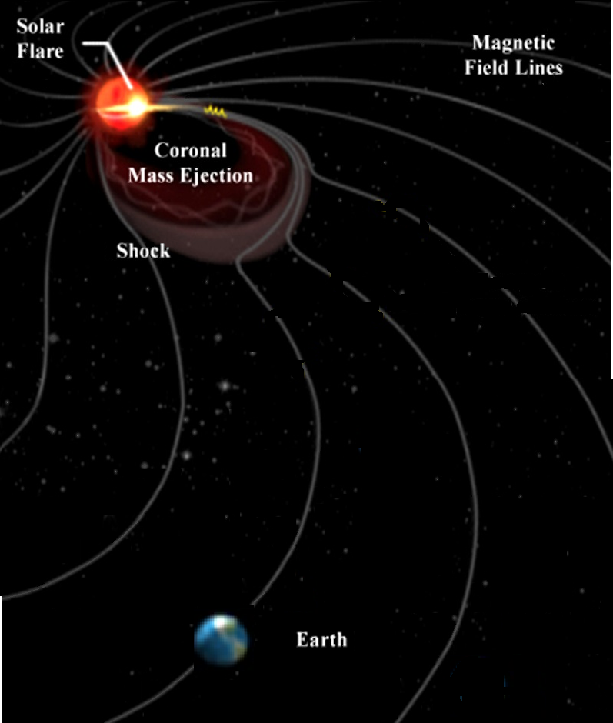
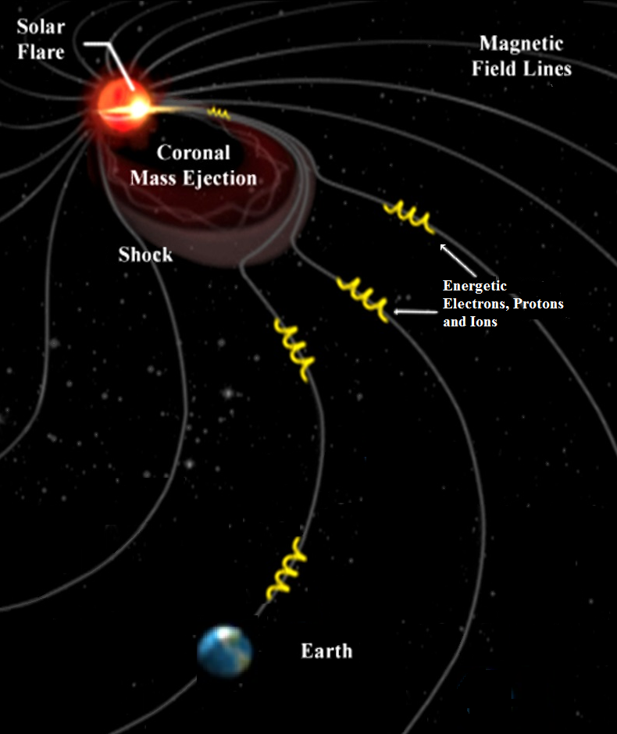
UMASEP submodels for predicting SEP event occurrence
Each UMASEP tool is an ensemble of submodels.
The SEP event occurrence submodels analyze data as follows:
The Well-Connected Prediction submodel (WCP) analyzes solar and in-situ proton data
The Poorly-connected Prediction submodel (PCP) analyzes in-situ proton data only
The Solar Data-based submodel (SOD) analyzes solar data only

Slide 4
The Well-Connected Prediction (WCP) submodel
Summary of the approach:
There is a magnetic connection if the highest slopes of a differential proton flux are correlated with the highest slopes of SXRs. This analysis is made using the recent L-size interval.
If there is a magnetic connection and the peak of the associated SXR flare surpasses a threshold, then an SEP event is predicted.
UMASEP scheme
Rises in SXR flux
Solar
SXR flux
Proton flux
(near-Earth)
If
an SXR / diff proton
flux correlation > m,
the flare peak > f
then
SEP event prediction
d /dt
SEP event prediction
Rises in diff. proton flux
d /dt

Slide 5
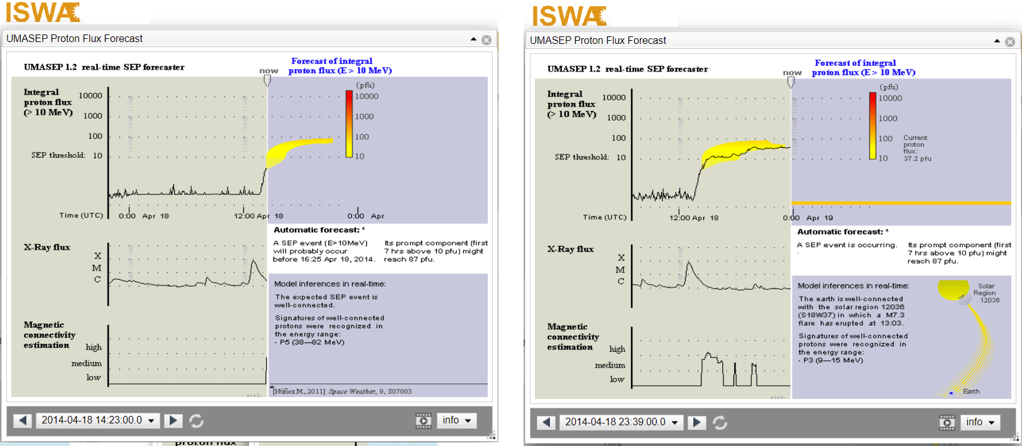
A real-time prediction of the WCP submodel
A real-time prediction of the WCP submodel of the UMASEP-10 tool:
April 18th, 14:23, 2014 … 9 hours later
The warning time was 40 min

Slide 6
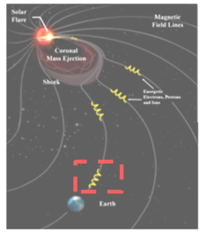
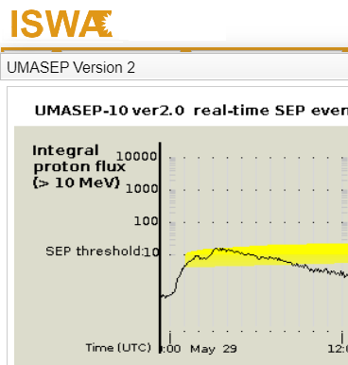
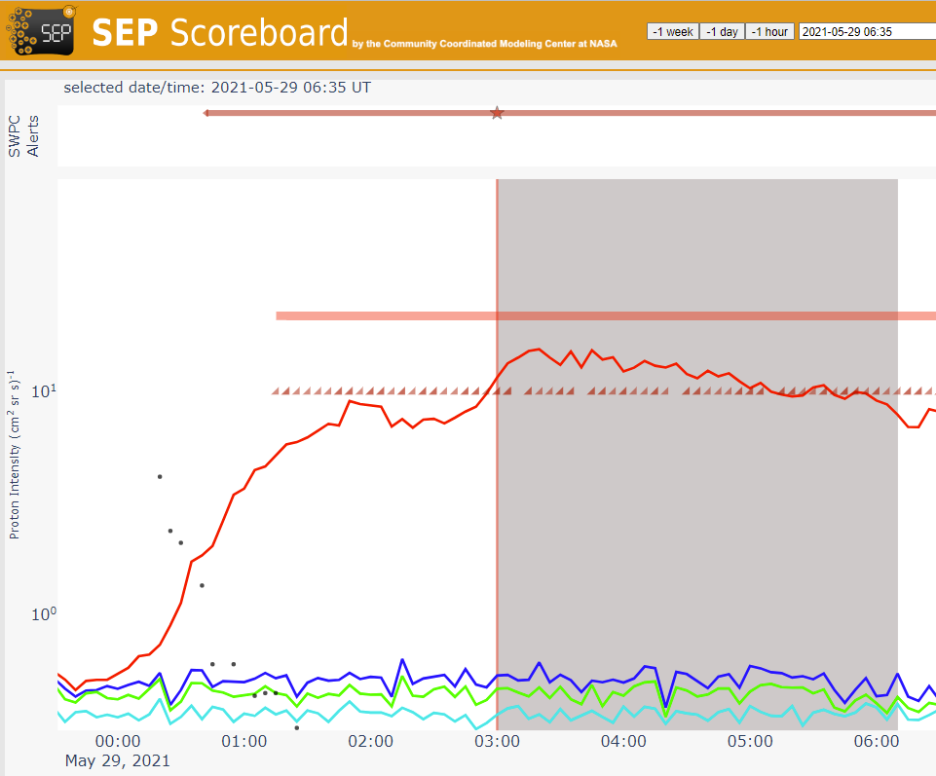
The Poorly-Connected Prediction (PCP) submodel
Summary of the approach:
If the current gradual (integral/differential) proton flux is similar to the gradual (integral/differential) proton flux of some historic SEP events (i.e. there is a pattern) and if the current integral proton flux surpasses a threshold, a poorly-connected SEP event is predicted.
Two real-time predictions of the PCP submodel of the UMASEP-10 tool:
February 25, 2014
Warning Time: 4 h
May 29, 2021
Warning Time: 1 h 35 min
132

Slide 7
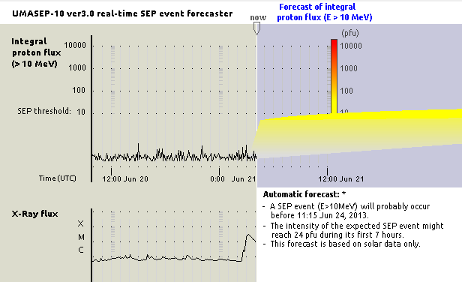
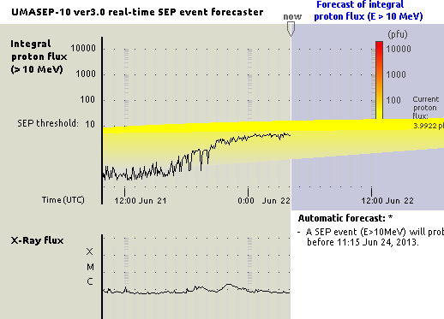
The Solar Data-based Prediction (SOD) submodel
Summary of the approach:
If the current solar flare and radio data (e. g. flare peak intensity, duration and heliolocation, radio burst type, duration) are similar or stronger than those of historic events, a SEP prediction is issued.
The SOD submodel of UMASEP-10 was trained using machine learning techniques and all SWPC event.txt files of solar cycles 23-24.
2013: June 21, 4:00 SOD predicted
an SEP event for the next 3 days
SEP occurrence
2.5 days later
… a day after the SOD prediction…
... 10 pfu
218

Slide 8
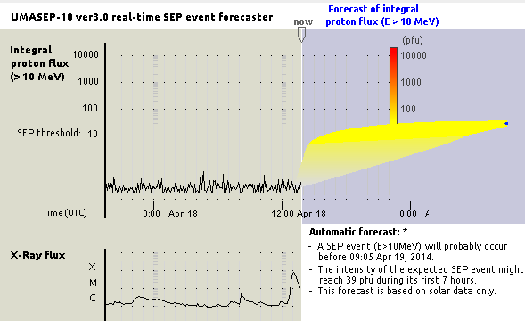
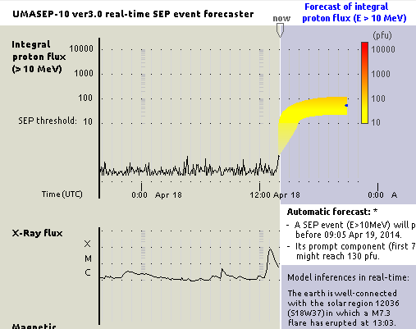
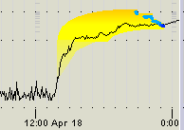
The submodels working together
After a prediction of a submodel, another submodel may issue a new prediction. If this happens, UMASEP updates the old prediction by taking into account several rules. For example:
The old Prediction Window is replaced with the new Prediction Window
If the first prediction is from SOD, the new and old intensity bands are merged:
New predicted intensity band = [ Min of SOD/WCP/PCP , Max of SOD/WCP/PCP ]
3. … (there are more ensemble rules)
2014 April 18, 13:40 (SOD prediction)
April 18, 13:55 (WCP prediction)
SEP occurrence
15:25
10 pfu
Flare peak
13:00
254

Slide 9
The SOD provides a notably larger Average Warning Time without sacrificing the CSI index
Performance of UMASEP-10 for SC24:
POD FAR CSI AWT
Version 2.1 (no SOD) (Núñez, 2022) 91.1% 12.8% 80.4% 2:46 h
Version 3.1 (including SOD) 97.6% 16.3% 82.1% 5:55 h
200

Slide 10
Contents
1. The UMASEP submodels for predicting event occurrence
- WCP: The Well-connected prediction submodel
- PCP: The Poorly-connected prediction submodel
- SOD: The Solar data-based prediction submodel
2. The UMASEP tools
- Each tool and its submodels
- Prediction of the SEP intensity and fluence
3. Conclusions

Slide 11
Each UMASEP tool and its submodels
Tool | Predicted SEP occurrence (SWPC threshold) | Submodels
 |  | WCP submodel | PCP submodel | SOD submodel
UMASEP-10 | >10 MeV
UMASEP-30 | >30 MeV |  |  | Planned
UMASEP-50 | >50 MeV |  |  | Planned
UMASEP-100 | >100 MeV |  |  | Planned
HESPERIA UMASEP-500 | >500 MeV / GLEs |  | n/a | -
All submodels and tools run simultaneously (every 1 or 5 min)
Notes:
A good SEP forecasting tool needs to consider parameters /
phenomena that can be obtained or inferred early in a solar
event and which are available close to ﬂ are maximum. This
timing requirement may make the use of CME-based
parameters ( e.g., speed ) and CME-related phenomena ( e.g.,
type II occurrence ) problematic.
Dierckxsens et al. ( 2015 ) determined the probability
for the occurrence of an  SEP event near Earth through a
statistical analysis of the relationship between SEP events and
properties of M1 SXR ﬂ ares ( intensity and longitude ) and
CMEs ( speed and angular width ) during Solar Cycle 23. Their
results represent the input for the COMESEP SEP forecast
technique, which has yet to be validated in terms of veri ﬁ cation
measures ( POD, FAR ) .
e FORSPEF
forecasting tool has been developed ( Papaioannou et al. 2015 ) ,
which makes use of a  homogeneous SEP database of the re-
calibrated Geostationary Operational Environmental Satellite
( GOES ) proton data within the energy range of  6.0 – 243 MeV,
covering the period of  1984 – 2003, as well as the SEP associated
solar sources in terms of ﬂ are ( magnitude, location ) and
CME ( width, velocity ) characteristics. FORSPEF provides the probability of SEP occurrence based on information of solar
ﬂ ares with known features. Speci ﬁ cally, the maximum prob-
ability of SEP occurrence is obtained by folding the probabilities
for a solar ﬂ are occurrence ( obtained from the magnetic ﬁ eld
observed in its associated active region ) with the probabilities
derived from the FORSPEF database. No validation in terms of
POD and FAR of the FORSPEF scheme has been performed
so far.
The UMASEP system ( Núñez 2011 ) , exploits the correla-
tions between the sequence of ﬁ rst derivatives of ﬂ are SXR ﬂ ux
and the ﬁ rst derivatives of at least one differential proton ﬂ ux in
the energy range of  9 – 500 MeV, to give a warning that the
> 10 MeV integral channel will reach the SWPC threshold
following SXR bursts of class > C7. When considering the
events of solar cycles 22 and 23 of the NOAA / SWPC SEP list,
UMASEP has a POD = 81% ( 134 / 166 ) for all well- and
poorly connected events and an FAR = 34% ( 69 / 203 ) .
Winter & Ledbetter ( 2015 ) con ﬁ rmed that decametric – hectometric
( 1 – 14 MHz ) type III bursts that accompanied DH type II bursts
were an important diagnostic for SEP event occurrence. They
used a logistic regression analysis with the principal component
derived from radio observations to obtain a prediction method
with an FAR = 22% and a POD = 62% for the period
2010 – 2013.
Theoretically, as shown by Huang et al. ( 2012 ) , an ensemble
prediction model incorporating the complementary information
of solar ﬂ ares and CMEs achieves better performance than each
base prediction model taken separately. Nevertheless, the
optimal choice for SEP precursors should guarantee a reason-
able warning time.
The method developed by Posner ( 2007 ) , exploits the short transit time of
relativistic electrons to forecast SEP events with a lead time of
up to 1 hr. Similarly, ESPERTA provided a median warning
time of ∼ 55 minutes ( computed over 19 successfully predicted

Slide 12
Maximizing the performance of each UMASEP tool
Each UMASEP tool is an ensemble of submodels.
Each submodel is calibrated in an testing scenario in which all submodels work together.
The purpose of the calibration of a single submodel is to maximize the CSI of the ensemble as a whole, using a continuous flow of data of at least a solar cycle.
The FAR yielded by the tool should be low and the POD high

Slide 13
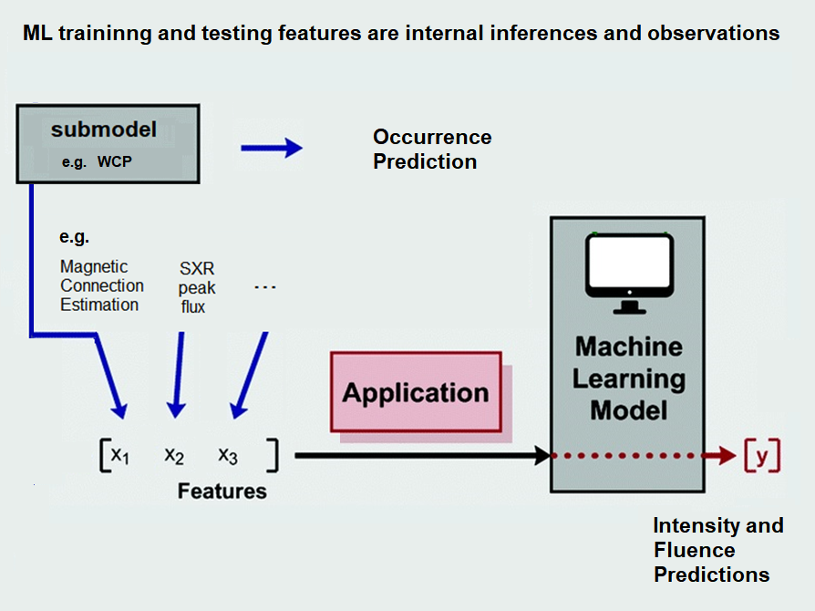
ML-based predictors of the SEP intensity and fluence
Supervised Machine Leaning:
The labels of the training instances are the fluences/ intensities at the first 3─7 h.
The training intensities were taken from the GOES 08─ 15 data
The training fluences were obtained from the SEPEM RDS v3.0 dataset
The resulting MAE error predicting intensities/fluence is in the
range 0.10 – 0.33 orders of magnitude (log₁₀ units)
324

Slide 14
UMASEP prediction of the fluence spectrum
Tool | Predicted SEP fluence | Submodels
 |  | WCP submodel | PCP submodel | SOD submodel
UMASEP-10 | Energy bin 15-22 MeV
UMASEP-30 | Energy bin 32-46 MeV |  |  | Planned
UMASEP-50 | Energy bin 46-66 MeV |  |  | Planned
UMASEP-100 | Energy bin 96-138 MeV |  |  | Planned
HESPERIA UMASEP-500 | >500 MeV/GLEs (no fluence predicted) |  | n/a | -
Notes:
A good SEP forecasting tool needs to consider parameters /
phenomena that can be obtained or inferred early in a solar
event and which are available close to ﬂ are maximum. This
timing requirement may make the use of CME-based
parameters ( e.g., speed ) and CME-related phenomena ( e.g.,
type II occurrence ) problematic.
Dierckxsens et al. ( 2015 ) determined the probability
for the occurrence of an  SEP event near Earth through a
statistical analysis of the relationship between SEP events and
properties of M1 SXR ﬂ ares ( intensity and longitude ) and
CMEs ( speed and angular width ) during Solar Cycle 23. Their
results represent the input for the COMESEP SEP forecast
technique, which has yet to be validated in terms of veri ﬁ cation
measures ( POD, FAR ) .
e FORSPEF
forecasting tool has been developed ( Papaioannou et al. 2015 ) ,
which makes use of a  homogeneous SEP database of the re-
calibrated Geostationary Operational Environmental Satellite
( GOES ) proton data within the energy range of  6.0 – 243 MeV,
covering the period of  1984 – 2003, as well as the SEP associated
solar sources in terms of ﬂ are ( magnitude, location ) and
CME ( width, velocity ) characteristics. FORSPEF provides the probability of SEP occurrence based on information of solar
ﬂ ares with known features. Speci ﬁ cally, the maximum prob-
ability of SEP occurrence is obtained by folding the probabilities
for a solar ﬂ are occurrence ( obtained from the magnetic ﬁ eld
observed in its associated active region ) with the probabilities
derived from the FORSPEF database. No validation in terms of
POD and FAR of the FORSPEF scheme has been performed
so far.
The UMASEP system ( Núñez 2011 ) , exploits the correla-
tions between the sequence of ﬁ rst derivatives of ﬂ are SXR ﬂ ux
and the ﬁ rst derivatives of at least one differential proton ﬂ ux in
the energy range of  9 – 500 MeV, to give a warning that the
> 10 MeV integral channel will reach the SWPC threshold
following SXR bursts of class > C7. When considering the
events of solar cycles 22 and 23 of the NOAA / SWPC SEP list,
UMASEP has a POD = 81% ( 134 / 166 ) for all well- and
poorly connected events and an FAR = 34% ( 69 / 203 ) .
Winter & Ledbetter ( 2015 ) con ﬁ rmed that decametric – hectometric
( 1 – 14 MHz ) type III bursts that accompanied DH type II bursts
were an important diagnostic for SEP event occurrence. They
used a logistic regression analysis with the principal component
derived from radio observations to obtain a prediction method
with an FAR = 22% and a POD = 62% for the period
2010 – 2013.
Theoretically, as shown by Huang et al. ( 2012 ) , an ensemble
prediction model incorporating the complementary information
of solar ﬂ ares and CMEs achieves better performance than each
base prediction model taken separately. Nevertheless, the
optimal choice for SEP precursors should guarantee a reason-
able warning time.
The method developed by Posner ( 2007 ) , exploits the short transit time of
relativistic electrons to forecast SEP events with a lead time of
up to 1 hr. Similarly, ESPERTA provided a median warning
time of ∼ 55 minutes ( computed over 19 successfully predicted

Slide 15
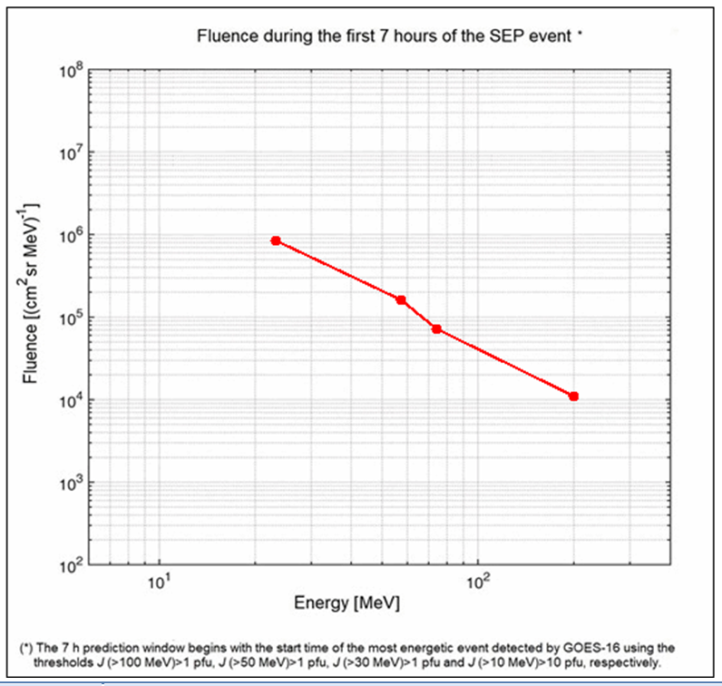
Fluence prediction from UMASEP-10/…/100 tools (SEP event on September 10, 2017)

Slide 16
Contents
1. The UMASEP submodels for predicting event occurrence
- WCP: The Well-connected prediction submodel
- PCP: The Poorly-connected prediction submodel
- SOD: The Solar data-based prediction submodel
2. The UMASEP tools
- Each tool and its submodels
- Prediction of the SEP intensity and fluence
3. Conclusions

Slide 17
Conclusions
The UMASEP suite predicts SEP events for several energy ranges (>10, >30, >50, >100 MeV and GLE events)
Each UMASEP tool has 1, 2 or 3 submodels for the predicting SEP event occurrence:
WCP: analyzes solar and in-situ proton data
PCP: analyzes in-situ proton data (only)
SOD: analyzes solar data (only)
If an SEP occurrence is predicted, the tool triggers a ML-based prediction of the SEP fluence and integral proton flux for the first hours of the expected event.

Slide 18
Thank you!

Slide 19
Back-up slides

Slide 20
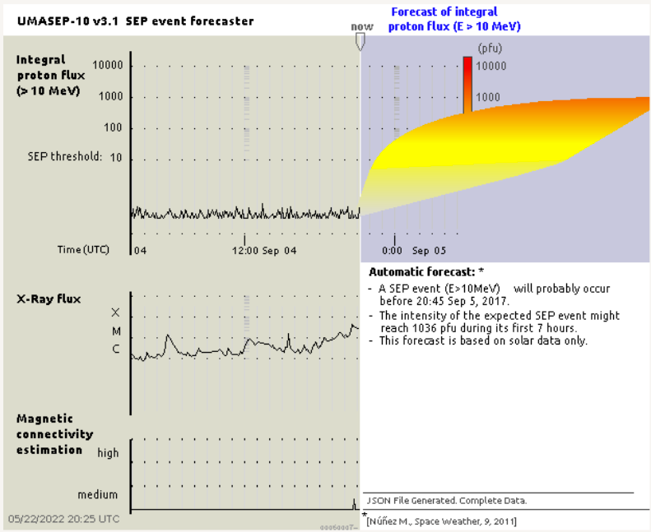
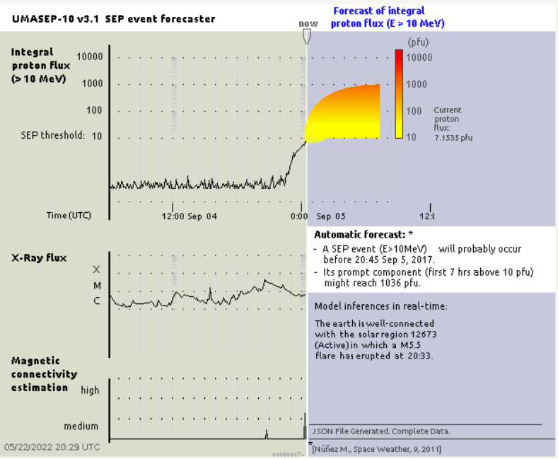
Another example of a sequence of submodel predictions
SOD prediction window
The SOD submodel
triggers at 21:10 (Sept. 4)
WCP prediction window
The WCP submodel
triggers at 00:20 (+)
The M5.5 flare peak at
20:33 (September 4, 2017)

Slide 21
Real-time Performance of UMASEP-10 during 2021-2022
SEP Event WarningTime Result MAError (Intensity)
May 29, 2021 1h 35 min (1:20 2:55) Hit (MAE: 0.15)
October 28, 2021 5 min (17:40-17:45) Hit (MAE: ~0)
January 20, 2022 5 min (07:55- 08:00) Hit (MAE: ~0)
March 28, 2022 15 min (13:10 13:25) Hit (MAE: 0.15 - 0.30)
March 31 , 2022 45 min (5:35-06:20) Hit (MAE: 0.3 - 0.45)
April 2, 2022 2 min (14:28 –14:30) Hit* (MAE: 0 - 0.2 )
2 false alarms in April
FAR= 25% (2/8)
POD= 83%-100% (*the Hit on April 2, 2022 was close to be a missed event)
AWT= 28 minutes
Warning times taken from the SEP Scoreboard

