Slide 1
Run-on-Request and Real-Time Simulation System for AWSoM-R at the CCMC
Igor Sokolov¹, Lulu Zhao¹ and Tamas I Gombosi¹,
Aleksandre Taktakishvili² , Maksym Petrenko² and M. Leila Mays²
THANKS TO: Zhenguang Huang¹, Richard E. Mullinix² , and Masha M. Kuznetsova²
CLaSP, University of Michigan
NASA/CCMC

Slide 2
Currently Available Model (description)
Alfven Wave turbulence based Solar atmosphere model (AWSoM -2014)
Threaded-Field-Line low solar corona (easy to work in Real-time, therefore AWSoM-R -2018,2019,2020):
Eruptive Event Generator based on Gibson-Low magnetic configuration (EEGGL – 2017). Also available at the CCMC as a separate tool.
This all will allow the user to simulate historic or ongoing CME on the NAS Pleiades supercomputer including
  Simulation of the ambient state of the solar corona and inner heliosphere prior to the eruption using the GONG magnetogram
  Superpose CME flux rope, simulate CME, provide synthetic observables.

Slide 3
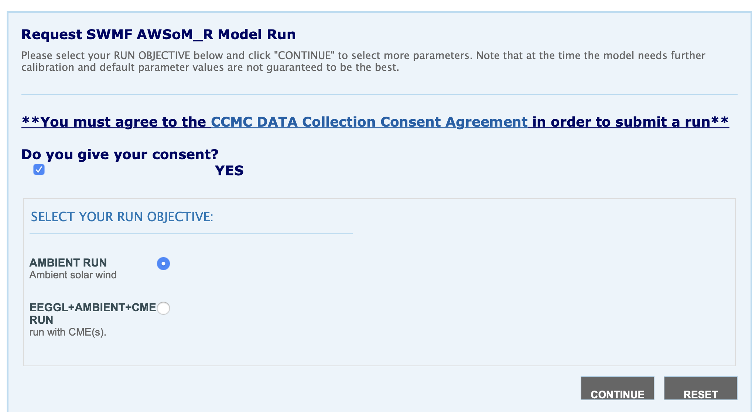
Submission Website for Runs-on-Request
Can be found in a list of models as SWMF-AWSOM

Slide 4
Submission workflow
Select EEGGL+AMBIENT+CME run in previous page
From DONKI or StereoCAT tool figure out:
  CME speed
  Location of the CME source
Use EEGGL to generate the CME parameters
  Magnetogram
Specify the simulation time
  CME traveling time in solar corona (1-24 Rs), e. g. 8 hours (depends on the CME speed)
  Total simulation time, e. g. ~ 5 days
Specify desired simulation output
  C2/C3 image cadence, e. g. 24 min
  3D model output, e. g. 1 hour
Submit

Slide 5
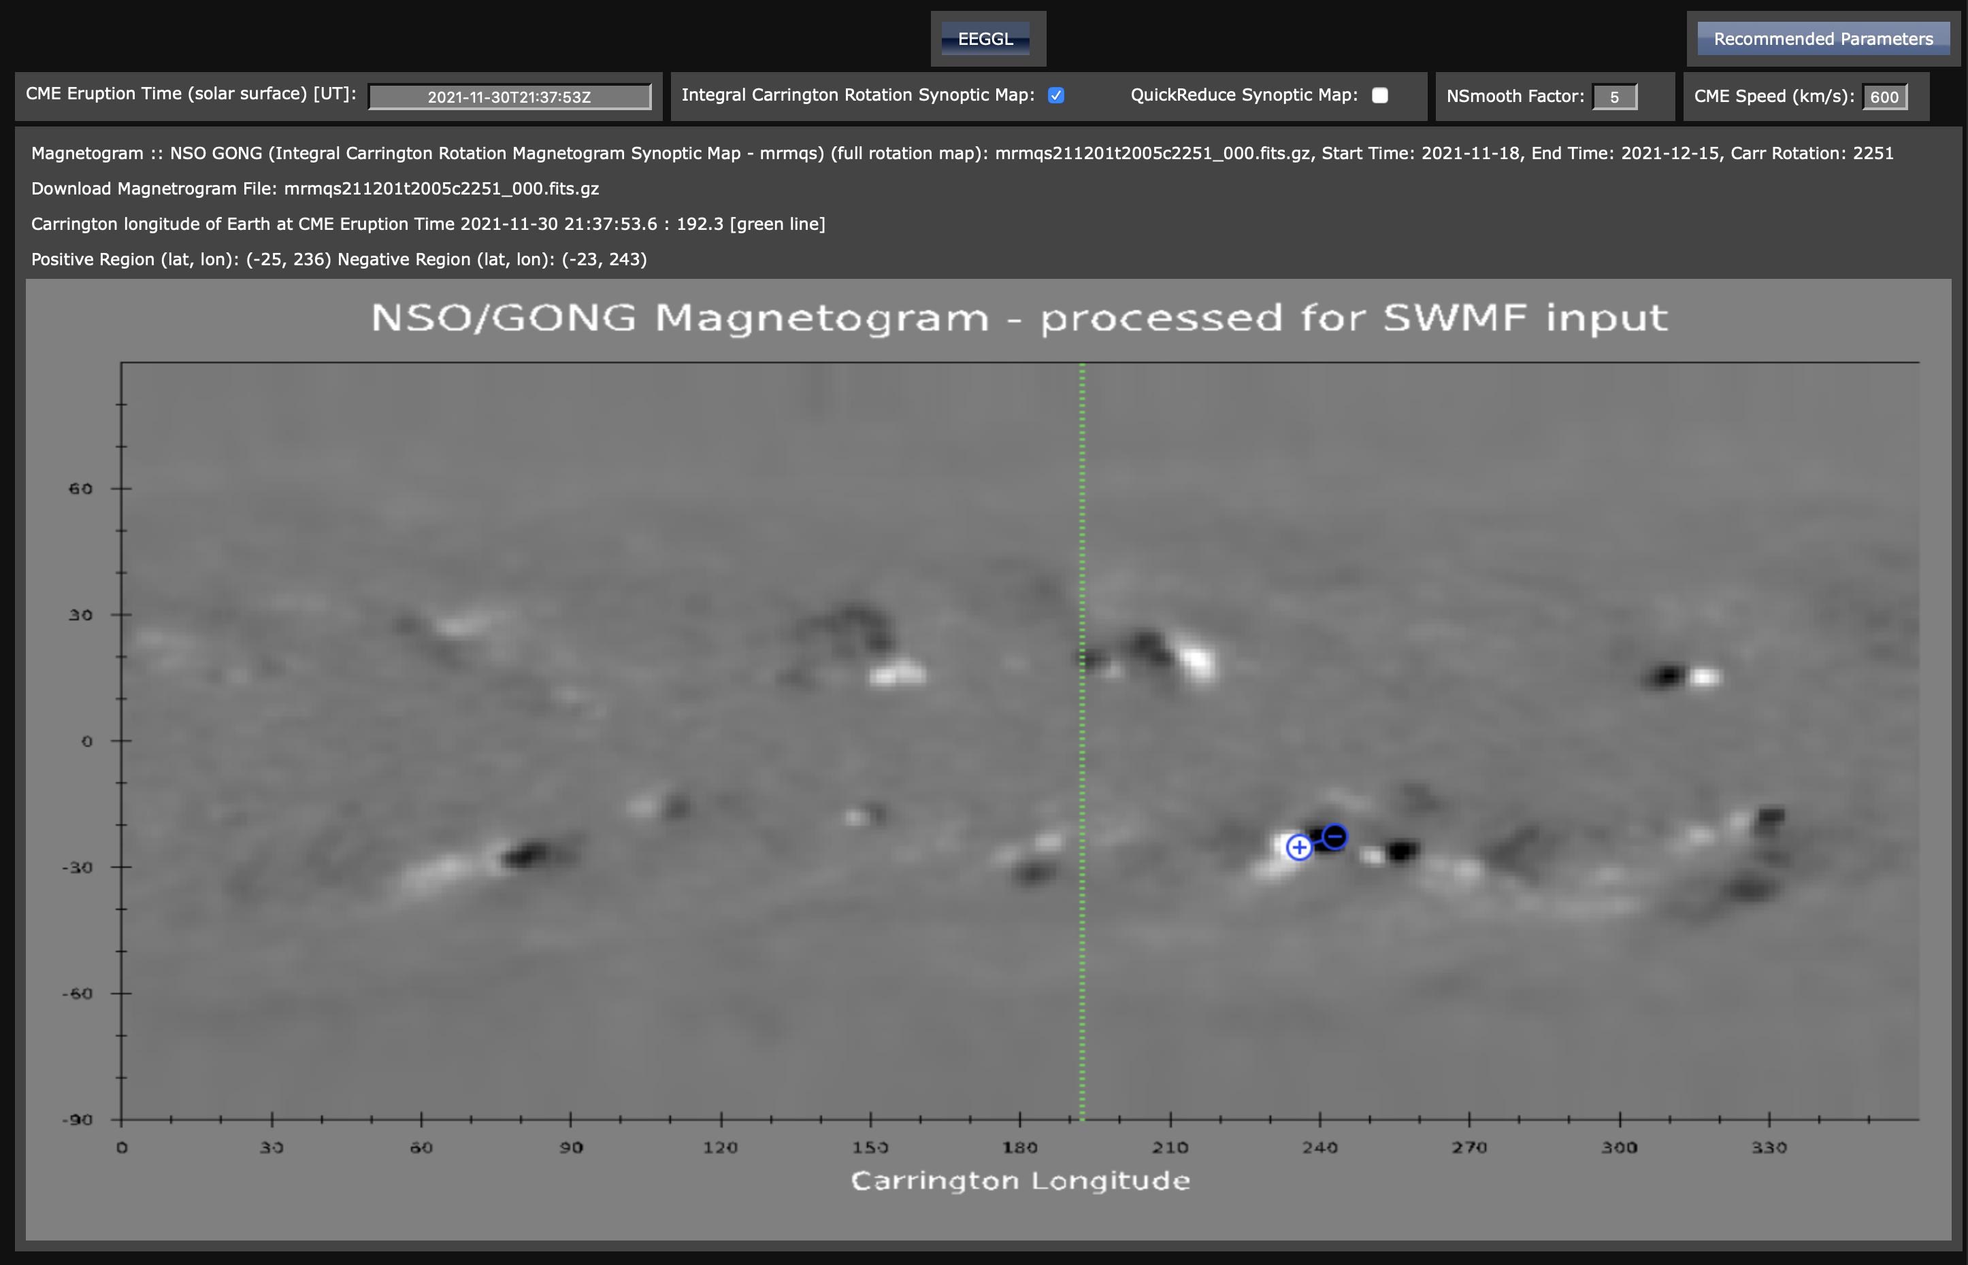
Use updated EEGGL to generate CME parameters
select the type of magnetogram
Input CME speed
Specify CME time
Move the plus (positive polarity) and minus(negative polatiry symbol to the corresponding AR

Slide 6
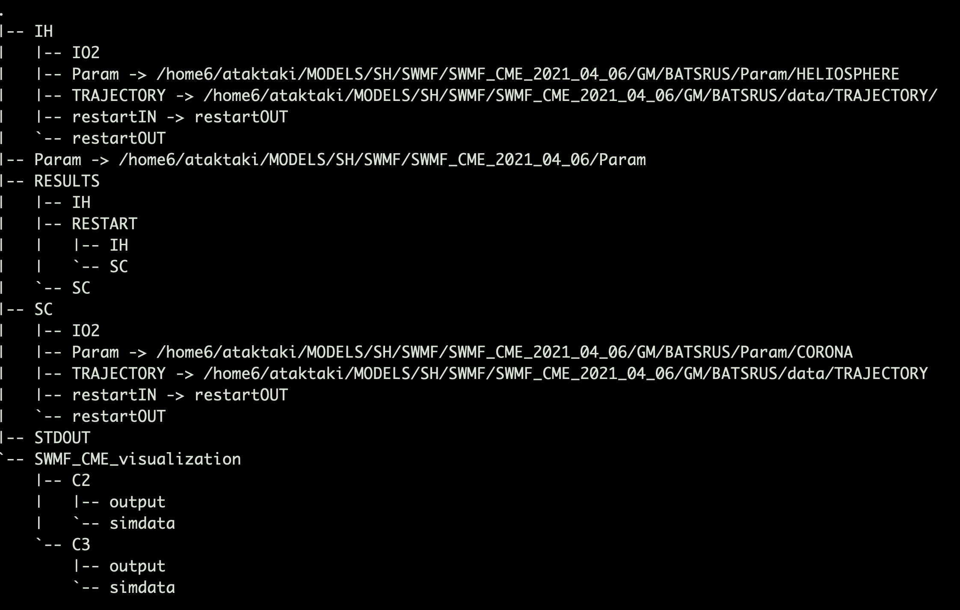
Working Directory Structures on NASA supercomputer Pleiades

Slide 7
Inputs/Outputs
Sample outputs are published in https://ccmc.gsfc.nasa.gov/results/viewrun.php?domain=SH&runnumber=Lulu_Zhao_110821_SH_4
Includes:
  Magnetograms
  2D movie of scaled radial magnetic field overlaid with magnetic field lines
  In-situ plasma parameters (compared with observations)
  Remote sensing (compared with observations)
  Synthetic LASCO C2/C3 movies

Slide 8
Magnetogram
Radial magnetic field from GONG observations
https://gong.nso.edu/data/magmap/
Radial magnetic field input to the MHD simulation

Slide 9
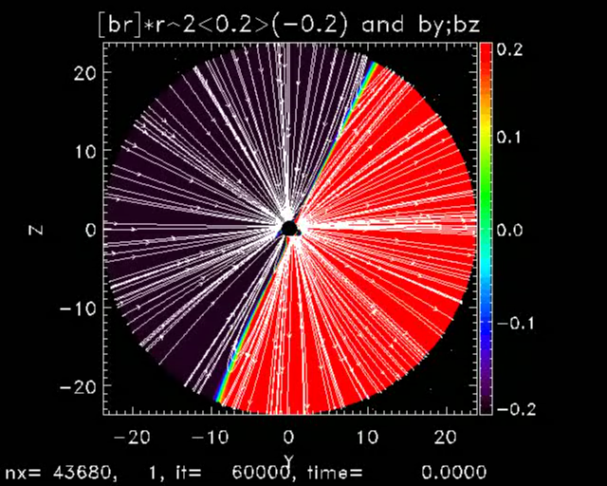
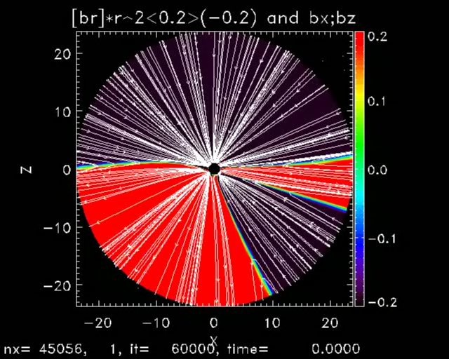
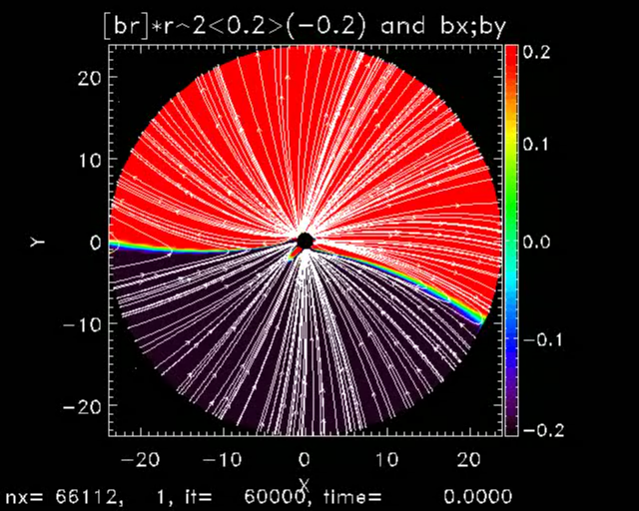
2D cut movies of the scaled radial magnetic field (Br*r²) overlaid with magnetic field lines
x=0 plane
z=0 plane
y=0 plane

Slide 10
In situ plasma parameters
ACE
STEREOA
STEREOB

Slide 11
Remote sensing
Comparison between model simulations (1st rows) and remote sensing observations from STEREOA/EUVI (2nd rows)
Comparison between model simulations (1st rows) and remote sensing observations from STEREOA/EUVI (2nd rows)
Comparison between model simulations (1st and 2nd rows) and remote sensing observations from SDO/AIA (3rd and 4th rows)

Slide 12
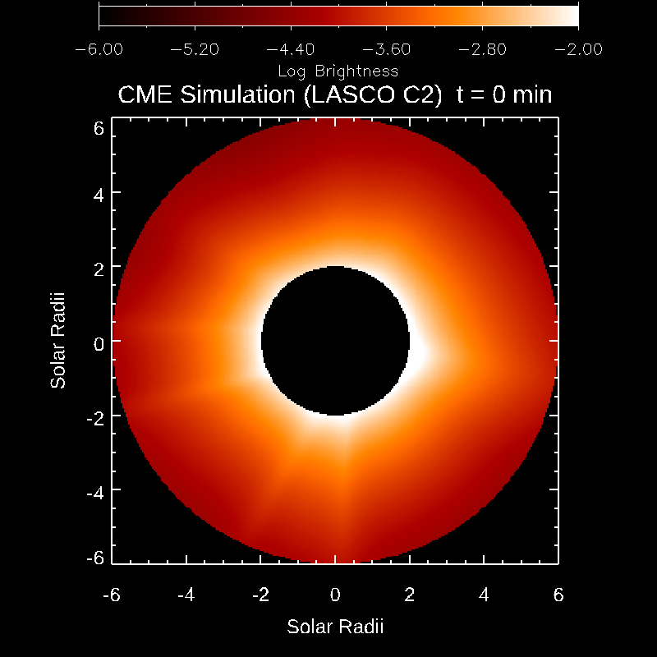
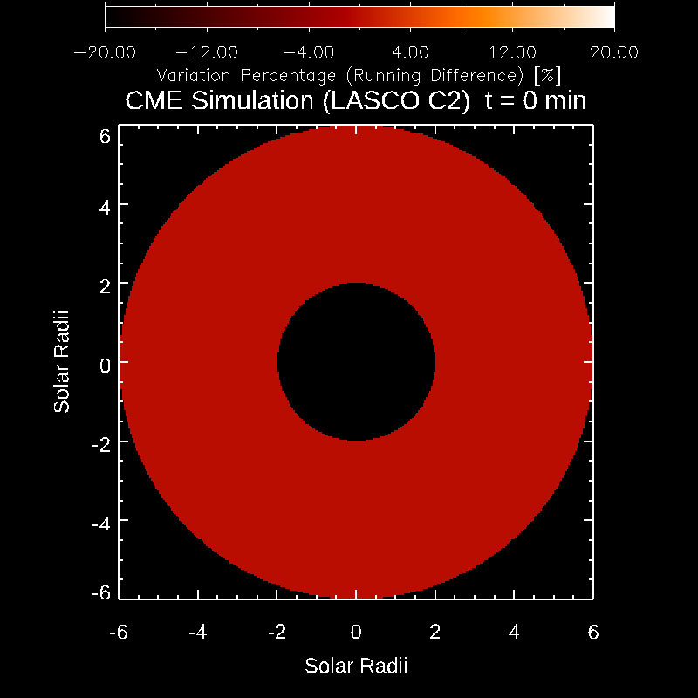

LASCO C2 movies
C2 movies
C2 running difference
C2 running difference in percentage

Slide 13
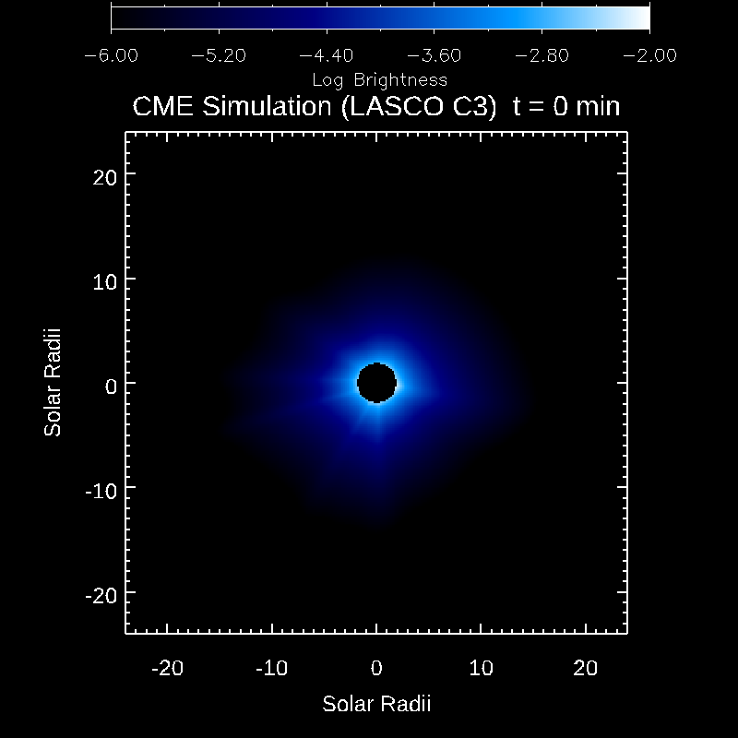
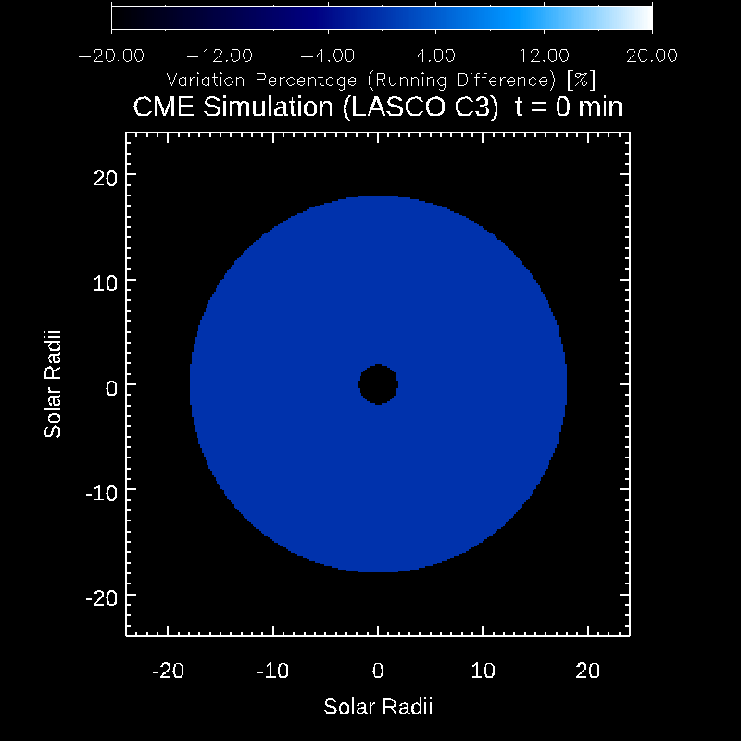

LASCO C3 movies
C3 movies
C3 running difference
C3 running difference in percentage

Slide 14
  Work in Progress, to be Delivered Soon:
Real-time system
  Restarts every 24 hours (or more frequently)
  Uses the latest GONG hourly magnetogram and that dated 24 hours before, interpolate the solar magnetic field in time
  Simulates the ambient state in the solar corona and inner heliosphere with a slowly varying boundary condition
Adaptive Mesh Refinement (AMR) for real-time simulation: exaggerated heliospheric current sheet
What happens in simulating the heliospheric current sheet and how to avoid the problems arising there?

Slide 15
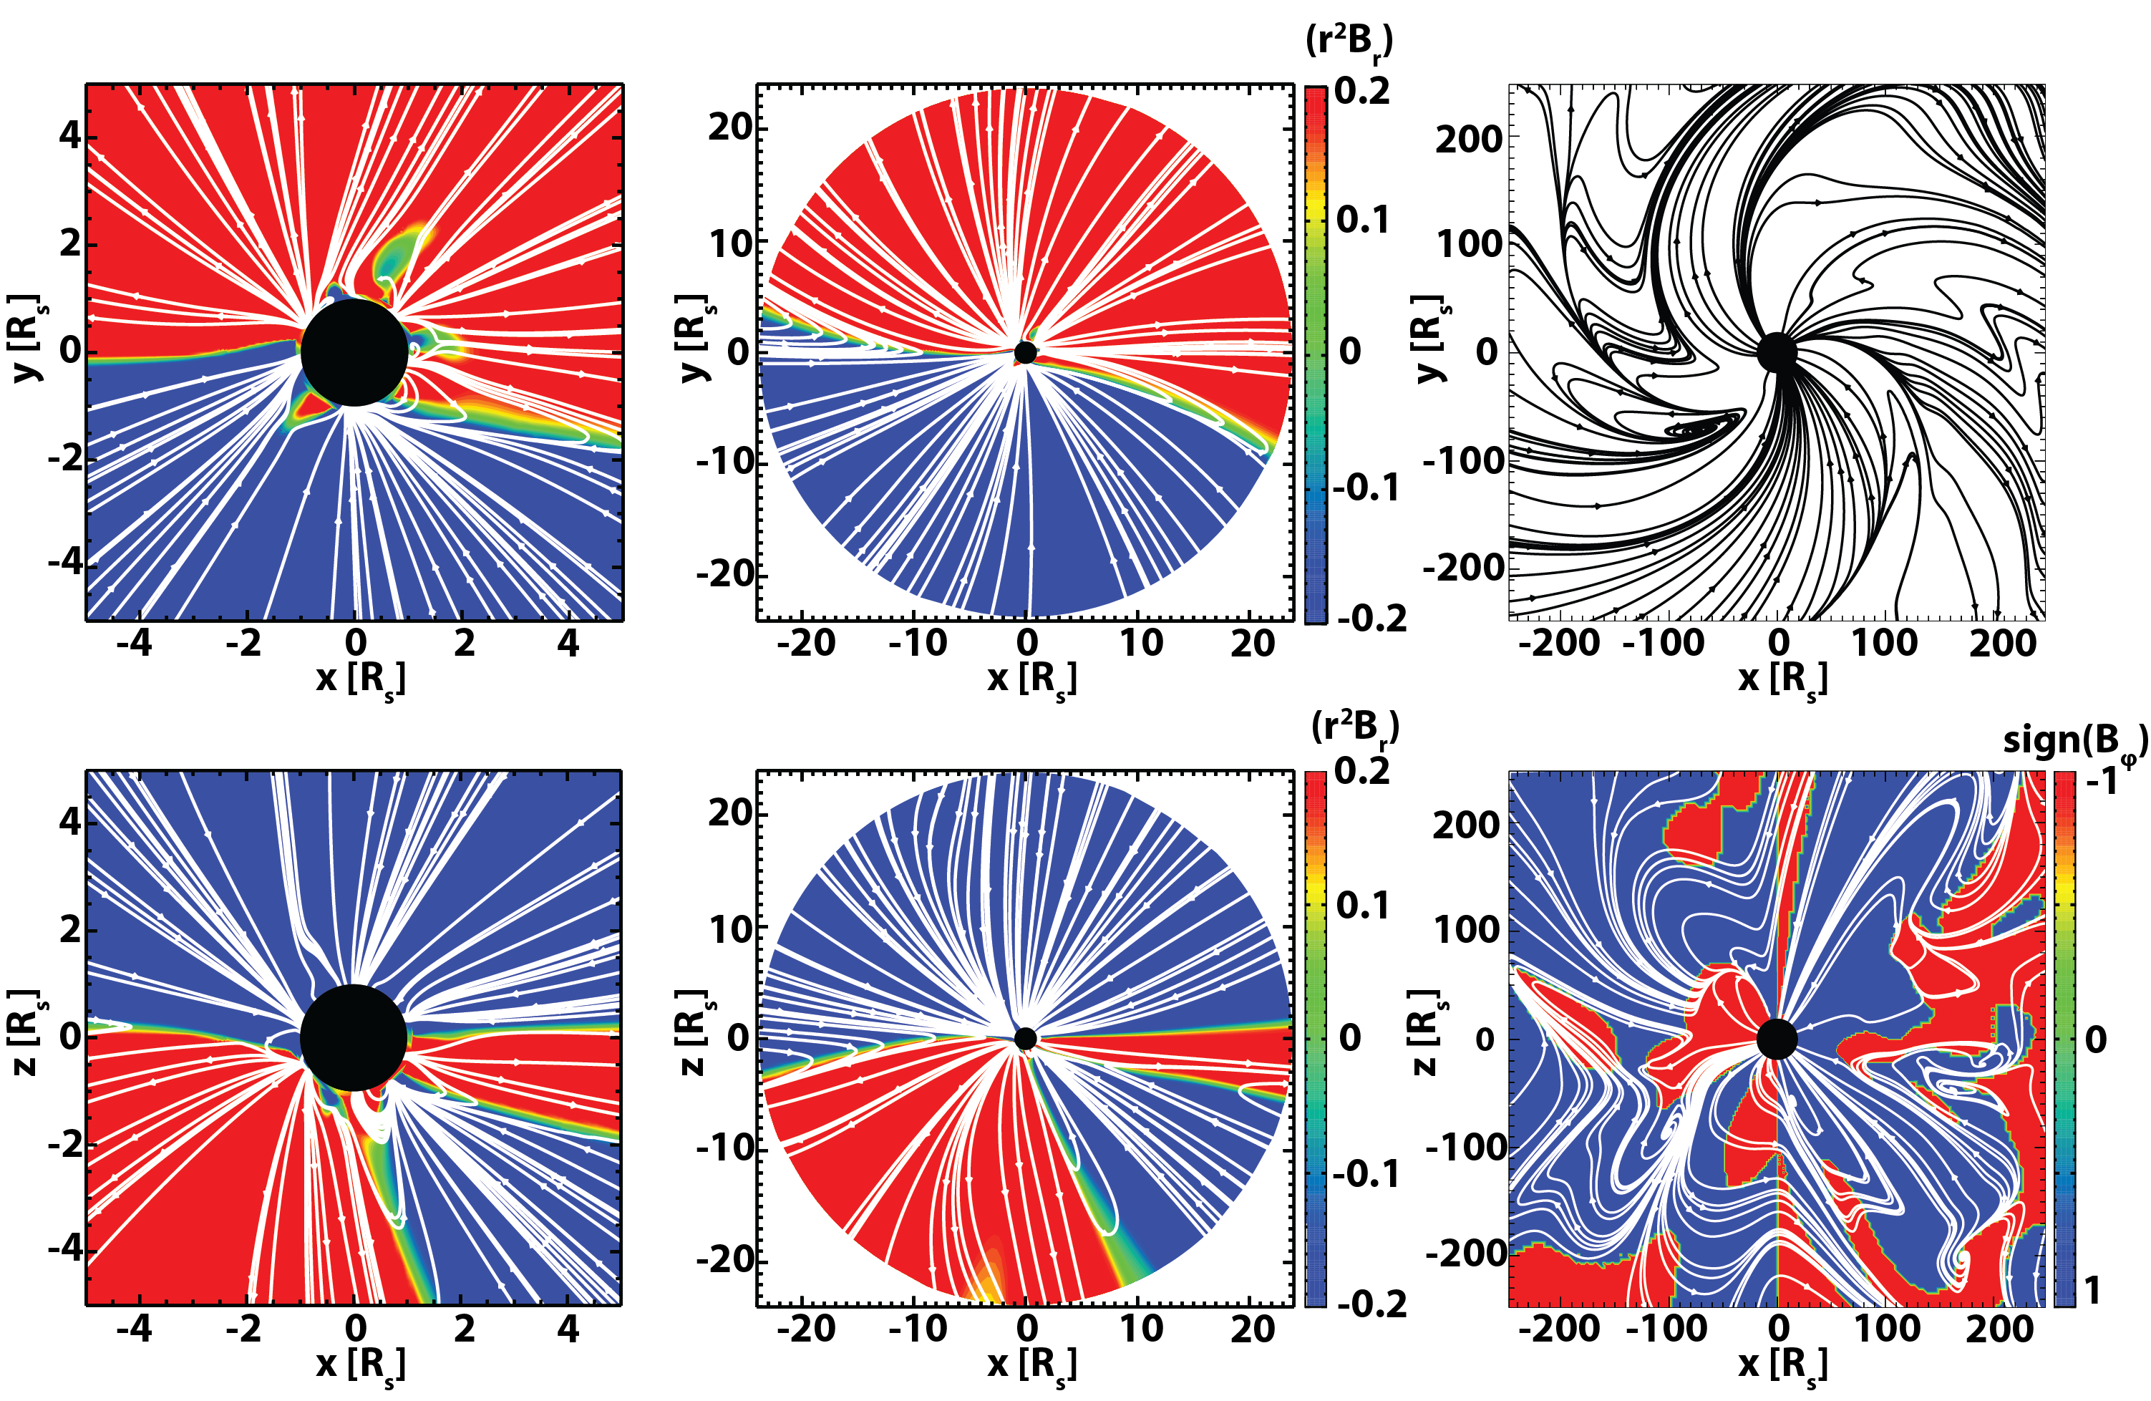
Problem of current MHD

Slide 16
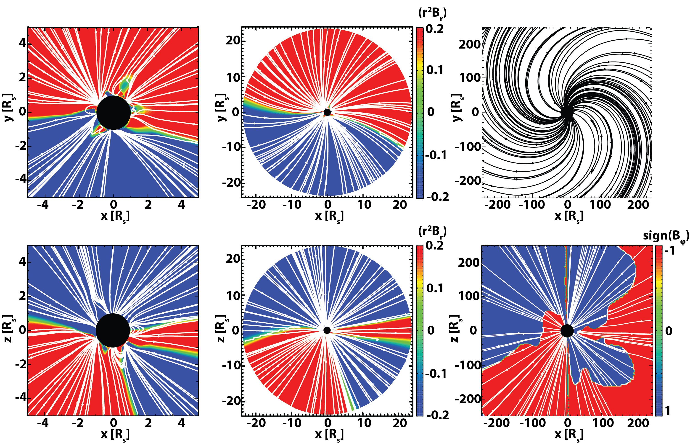
Stream-Aligned (SA)-MHD (Sokolov et al 2022)

Slide 17
Instead of Conclusion/Future Work:
In the presentation by Lulu Zhao it is demonstrated how the Stream-Aligned MHD version of the model
Is used for SEP simulation.

