Slide 1








Community Coordinated Modeling Center
CCMC Team Report
Highlights of New Developments
M. Kuznetsova & CCMC Team
MODELS • DATA • TOOLS • DATABASES • FRAMEWORKS • SERVICES

Slide 2
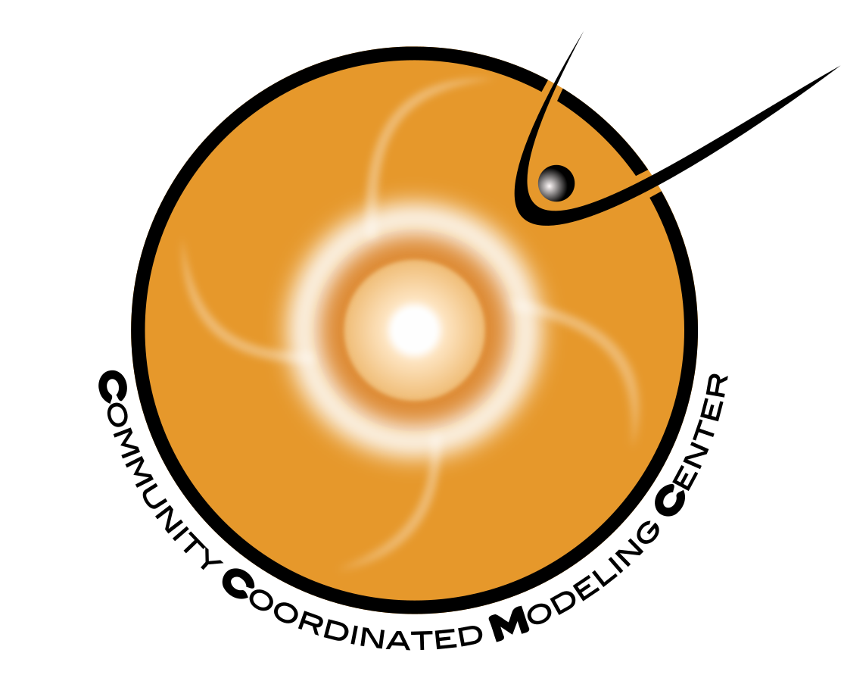
Multi-agency strategic investment in US space weather program
  Facilitate
  space science and space weather research & model development
  Support transition of advances in research to space weather operations
NASA/Heliophysics; NSF
CCMC Core Functions
LWS; Heliophysics Digital Resource Library (HDRL)
NASA Space Weather Research Program (SWRP)
NASA/JSC Space Radiation Analysis Group (SRAG)

Slide 3
CCMC Evolution
2000
  3 Sun workstations, 3 scientists: M. Hesse (Founding Director), L. Rastaetter, M. Kuznetsova
2018
  Indispensable component of the space physics and space weather enterprise
  Trusted relations with model developers and community
  Redundant in-house computational infrastructure at GSFC
  15 staff members (scientists, software developers, and system engineers working together)
2022
  NASA Science Mission Directorate (SMD) Tier 1 activity. Unique capabilities unmatched world-wide.
  Supports research community world-wide and multiple NASA Heliophysics programs (including LWS, HDRL - Heliophysics Digital Resource Library, SWRP - Space Weather Research Program), partner with NASA JSC/SRAG (Space Radiation Analysis Group)
  Computational resources: GSFC (in-house), NASA HECC (e.g. Pleiades), AWS cloud (advised by Goddard CISTO Computational and Information Sciences and Technology Office)
  31 staff members (mix of permanent/temporary, full/part time)
  ~ 2000 runs executed per year. 10-15+ user publications per year
  ~2000 unique users 2018-2022. Users from 170 countries
Notes:
CCMC is SMD Tier 1 activity in recognition of its unique capabilities unmatched worls-wide

Slide 4
Runs on Request – Executed per 6 months

Slide 5

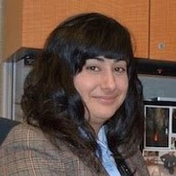
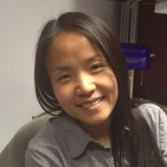
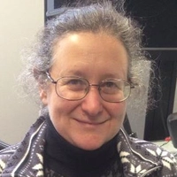
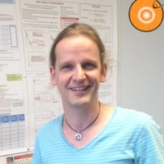
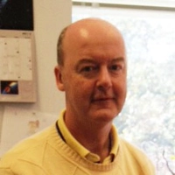


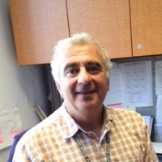
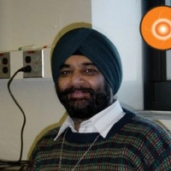



Long-Term CCMC Team Members
Tina Tsui
Collaborative Environments Architect
Leila Mays
Deputy Director, SEP Scientist
Chiu Wiegand
Software Lead
Masha Kuznetsova
Director,
Geospace Scientist
Dr. Lutz Rastaetter
Scientist/Software
Peter Macneice
Solar Scientist
Yihua Zheng
Geospace Scientist
Rick Mullinix
Software Engineer,
ISWA Lead
Dr. Sandro Taktakishvili
Solar Scientist
Sarabjit Bakshi
Infrastructure
Darren De Zeeuw
Scientist/Software
Michelle Mendoza
Runs-on-Request
Coordinator
Kiran Patel
Infrastructure

Slide 6
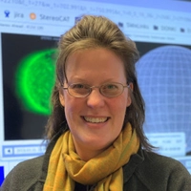
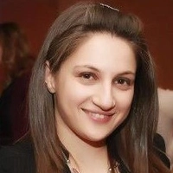
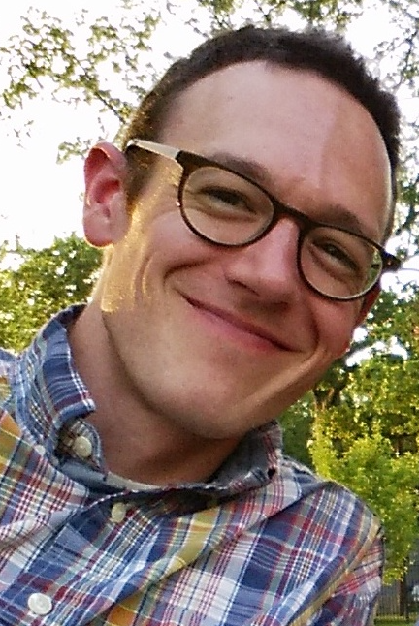

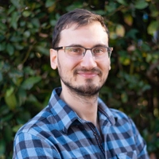


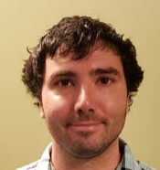
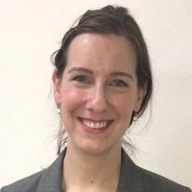

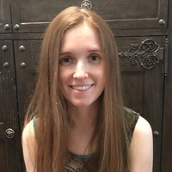


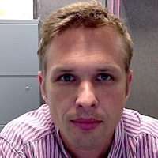
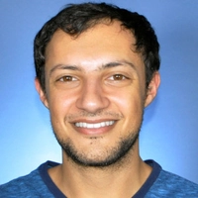




New CCMC Team Members (joined after 2018)
Jocelyn Jones
Software Engineer
SEP Scoreboard
Poly Manessis
Infrastructure Lead
Kyla Roberts
Project Admin
Claudio Corti
SEP Scientist
Corey Bettenhausen
Infrastructure
Chris Light
SEP Scientist
Joshua Pettit
ITM Scientist
postdoc
Dr. Katie Garcia-Sage
Geospace Scientist
Dr. Mostafa El Alaoui
Geospace Scientist
Min-Yang Chou
ITM Scientist
Jack Wang
ITM Scientist
postdoc
Rebecca Ringuette
Software, Kamodo
Jia Yue
ITM Scientist
Mark Moussa
Software Engineer
Instant Runs
Chinwe Didigu
Software Engineer
Continuous Runs
Maksym Petrenko
Software Engineer
Runs-on-Request
Rita Owens
Engineer
Instant Runs
Tyler Schiewe
Software Engineer
Web Architect
Elon Olsson
Software Engineer
OpenSpace

Slide 7
Space Weather at CCMC
Real-time space weather activities that require human-in-the-loop analyses and training, previously performed by CCMC staff, have transitioned from CCMC to Moon-to-Mars (M2M) Office (Director: Yari Collado-Vega, Deputy: Anna Chulaki)
CCMC no longer trains space weather forecasters
CCMC continues to be the primary interface with model developers and the research community for all model/tools onboarding (including real-time)
CCMC is continuing all other real-time space weather activities including developing real-time systems, running real-time simulations, automatic ingesting and serving information through CCMC’s space weather portals and perpetual archives:
  iSWA - integrated Space Weather Analysis system
  DONKI - Database of Notifications, Knowledge, Information
  Scoreboards – pre-event forecast collection, comparative display, and database
M2M analysts provide entries/feeds into into DONKI, iSWA and the CME Scoreboard, when human-in-the-loop actions are required

Slide 8
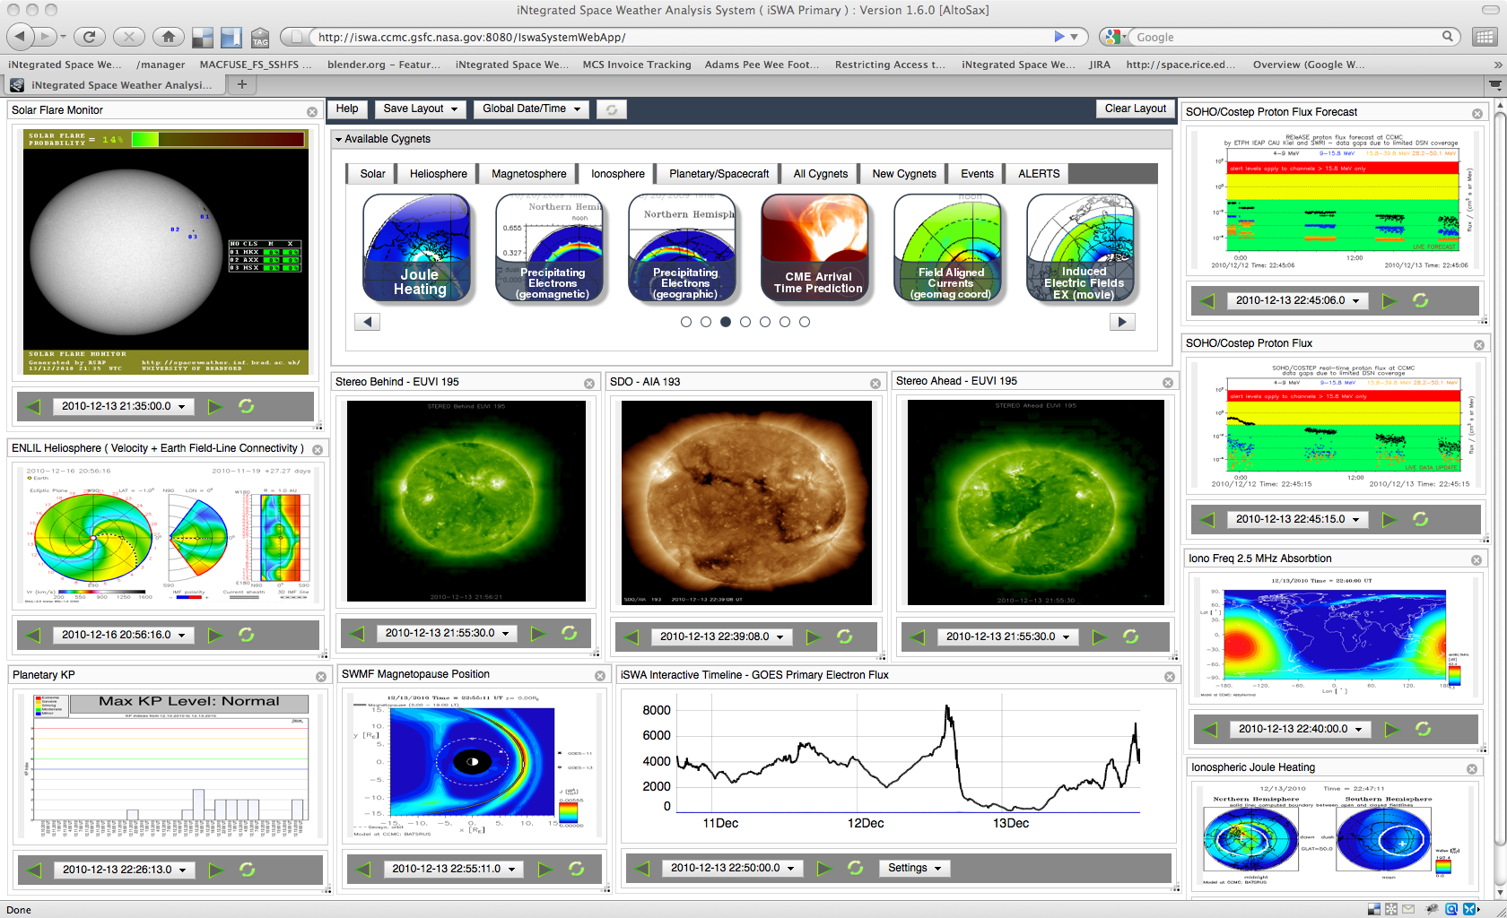
integrated Space Weather Analysis System (iSWA)
Flexible Portal for Ready-to-be-Used SWx Products
Ingest observational and simulated real-time data streams
Simulated data and widgets/cygnets can be streamed from external sources by CCMC partners (plug-and-play)
User configurable display layouts
Ability to go back in time and save layouts
Utilized for SW monitoring, event studies, system science, forecaster training, demos of new capabilities
R. Mullinix
https://iswa.ccmc.gsfc.nasa.gov

Slide 9
Highlights of iSWA Upgrades
Added new real-time observed and simulated data streams: PINE, UMASEP, NAIRAS, HESPERIA, observed F10.7, TEC maps, WSA
Reengineered webservices and all numerical data feeds are available via the iSWA HAPI webservices
  https://iswa.gsfc.nasa.gov/IswaSystemWebApp/hapi
User interface changes
  Added “info” button to each cygnet with individual detailed description
  Added a “Mars” tab (collaboration between CCMC, Maven, and M2M)
  Added “Radiation/Plasma Effects” tab
  Added “Retired” tab
  Cleaned up catalog of products
  Improved timeline plots with downloadable JSON
  Ongoing: designing a modern vision of iSWA Next Gen system

Slide 10
Game-Changing Partnerships
Utilizing Shared Proving Grounds
NASA/CCMC-NOAA/SWPC on R2O2R transition pipeline
  Utilized shared cloud environment to promote secure and convenient collaboration between operational and research teams.
  Initially set up to mirror the operational environment as closely as possible.
  Ongoing project: Implementation and Evaluation of Modeling Suite for ICAO
  Bi-weekly tag-ups
NASA CCMC-SRAG on Integrated Solar Energetic Proton (ISEP) project
  Identify and evaluate new models
  Develop tailored ISEP Alert/Warning Scoreboard Software
  Implement these capabilities within CCMC as a non-operational prototype
  Transition capabilities to M2M office for prototyping by M2M analysts and support of NASA SRAG (NASA in-house R2O2R pipeline)
  CCMC and SRAG work as one team, weekly tag-ups, coordinated hiring
T. Tsui, C. Didigu
L. Mays, J. Jones

Slide 11
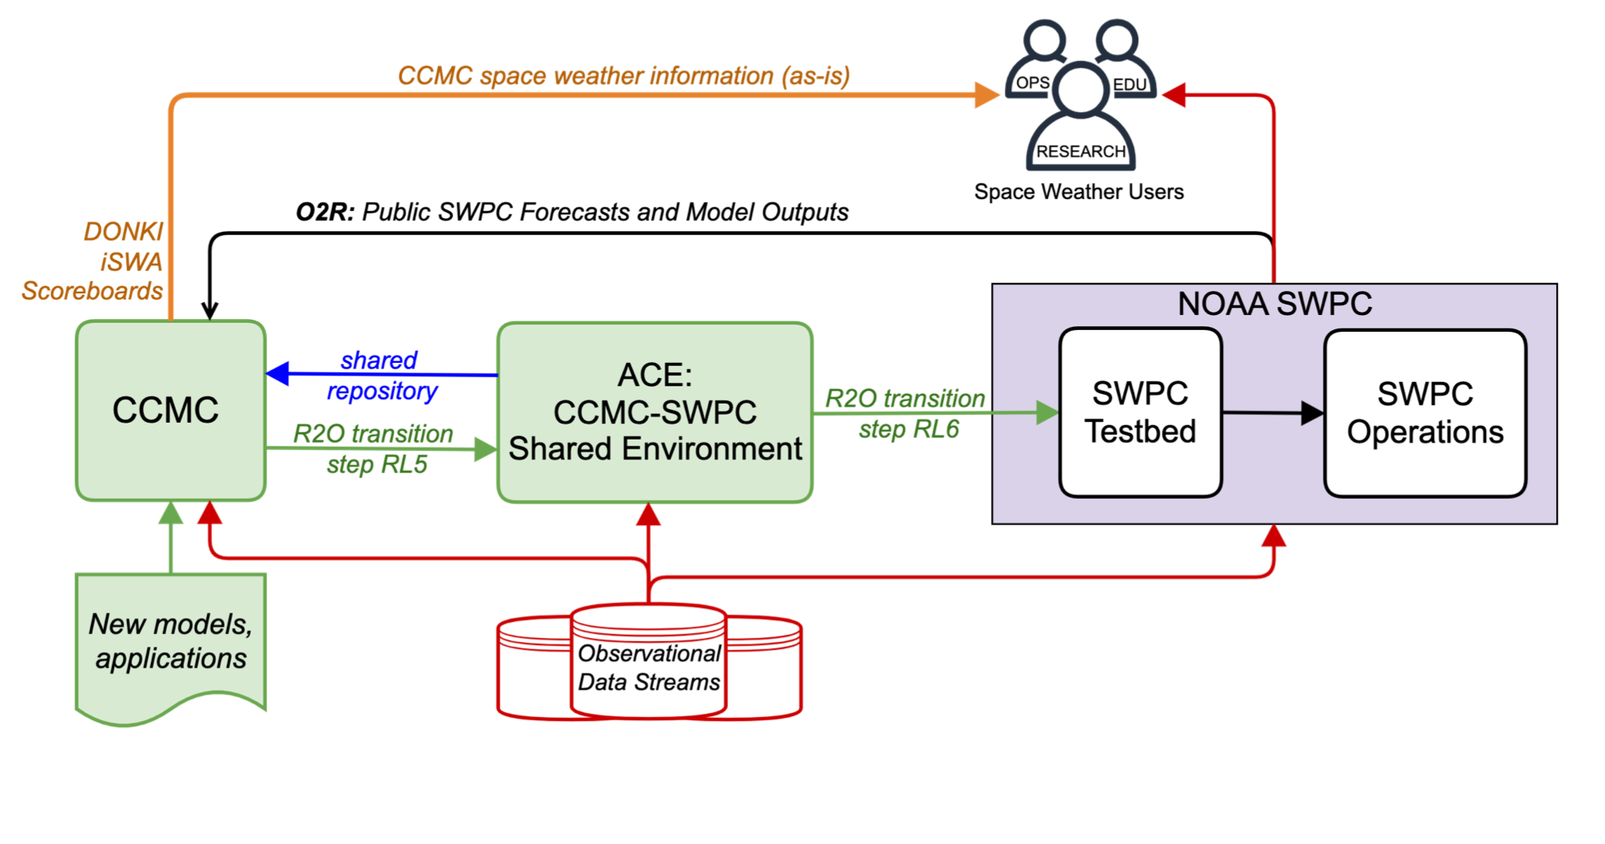
CCMC-SWPC R2O2R Pipeline

Slide 12
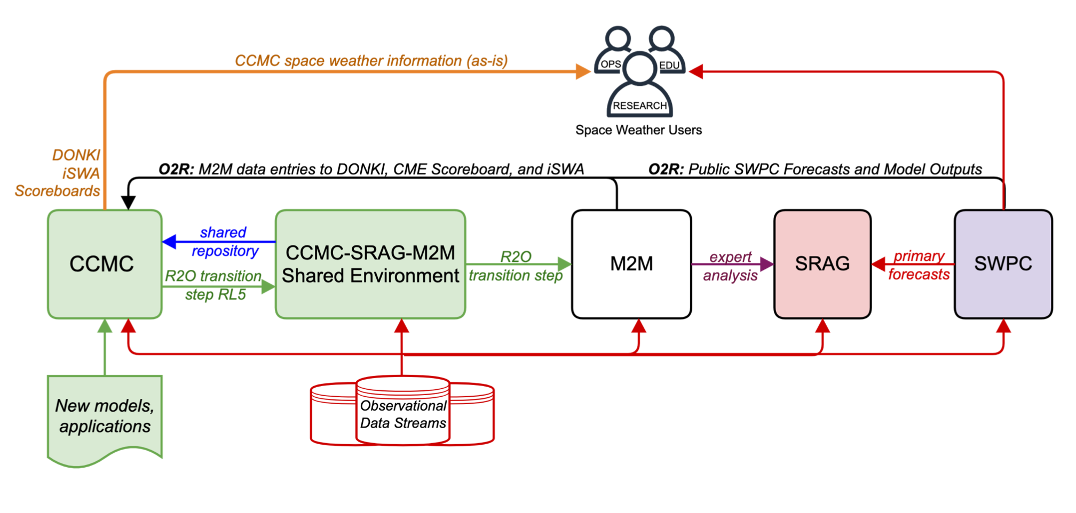
NASA in-house R2O2R Pipeline:
CCMC support of human exploration

Slide 13

Validation
Focus on Essential Space Environment Quantities (ESEQs)
  linked to impacts or passed between domains
  derived from observational data and model outputs
  enable tracking progress against established metrics & benchmarks, multi-model comparisons, scorecards.
Evaluation based on historic time intervals
  Expose potential of new capabilities.
  Evaluating models entering R2O pipelines
  Testing usefulness of upgrades and changes in simulation settings
  Interactive archives of evaluation results
Testing predictions made prior to event onset
  Forecasting methods Scoreboards
Comprehensive
Assessment of
Models and
Events based on
Library tools
CME
Flare
IMF Bz
SEP

Slide 14
Ongoing Modernization:
Easier On-boarding and Implementation of New Models
NASA LWS Strategic Capabilities program
  all deliverables must be installed and tested at CCMC by the end of performance
  development efforts include ongoing inputs from CCMC
CCMC is maintaining shared collaborative environments on the AWS cloud (with NASA security compliance) and at NASA HECC systems.
Establishing and following best practices. Shared GitLab repositories are possible.
CCMC supports containerizing models and applications
Working toward a streamlined onboarding process

Slide 15
Ongoing Modernization:
Next Generation Simulation Services
Focus on user experience – streamline submission interface, create “user portal”
Include information about model capabilities and appropriate utilization in model metadata.
Improve robustness: run health monitoring, replication and automatic failover
More transparency about the run requests, including status updates and error reporting
Improve quality control of simulation results and metadata
Improve speed of simulations/visualizations (Pleiades, GPU)
Enable reproducibility of simulation runs and plots utilized in publications
M. Petrenko, C. Didigu, M. Moussa, R. Owens , L. Rastaetter

Slide 16
Thermosphere Modeling for Satellite Drag
Bringing-in physics-based models and generating libraries of drivers from above and below for a flexible magnetosphere-ionosphere-thermosphere-atmosphere coupled modeling system.
Coupling with orbit propagators that are ready to take any satellite trajectory as input
GDC support: CCMC is preparing simulated GDC data that can be used for
  data assimilation techniques for neutral density models
  test reconstruction techniques of local and global patterns from GDC observational timelines
J. Yue, M-Y. Chou, J. Wang, K. Garcia-Sage, R. Ringuette

Slide 17
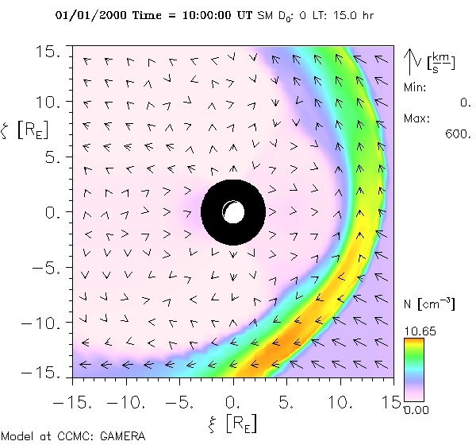
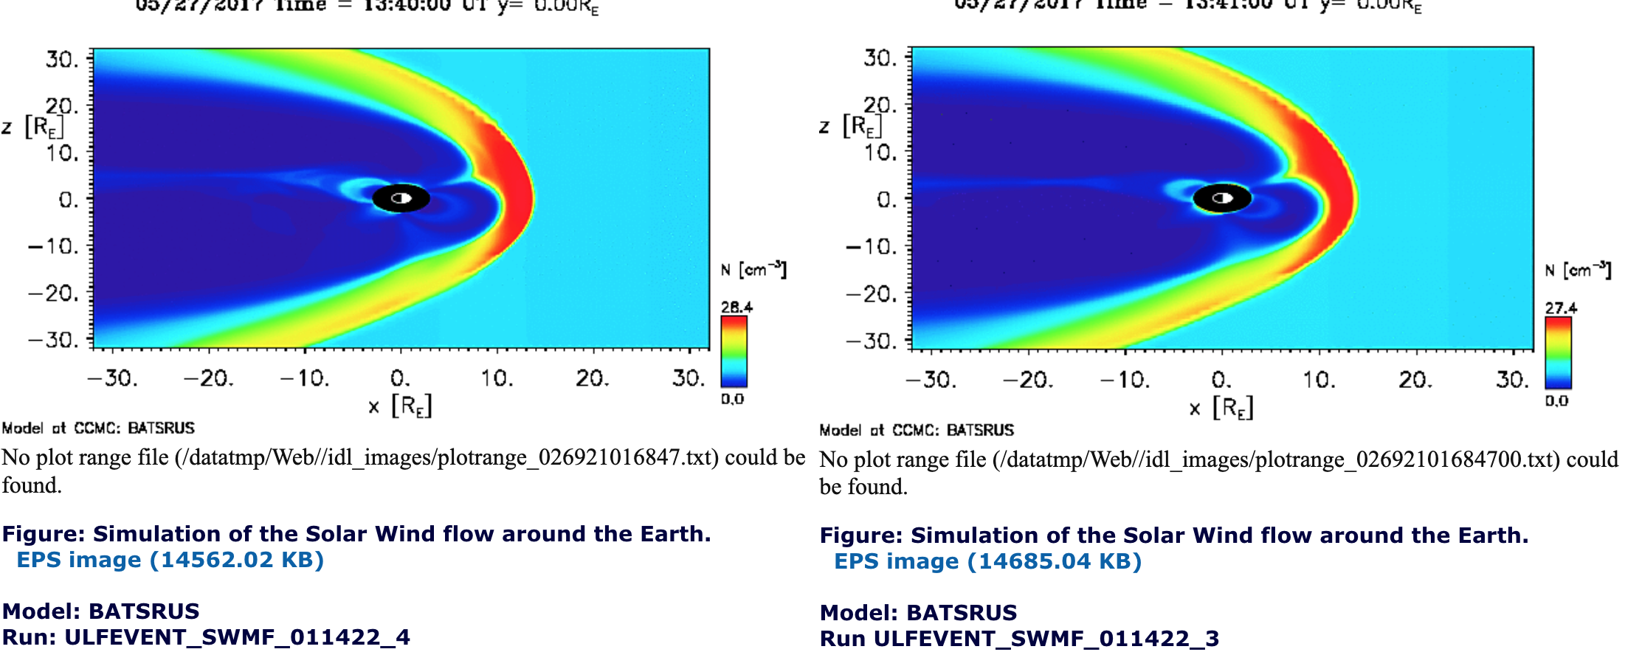
Global Magnetosphere (MHD)
GAMERA
SM coordinates
MLT=15 h
Models
  GAMERA: added to online visualization
  GUMICS-5: support for cell-centered output values
  Delta-B:(ground magnetic perturbations) at a list of positions or on a grid (post-processing request)
Visualization
  Oblique cut slices in online visualization
  Coordinate transformation between SM, GSM and GSE
  Plot ensembles (experimental; hand-add comparison runs)
SWMF RoR upgrade
  “Preset” simulation settings, e.g., “SWPC 2”, “Storm 1”
  “Custom” settings include new selections: several new ionosphere conductance models, increased ionosphere electrodynamics resolution, inner boundary conditions type (including outflow), resistivity type (numerical only, constant, anomalous) + …
Plot Ensemble
High-res. grid Low res. grid
L. Rastaetter, M. El Alaoui, M. Kuznetsova, M. Petrenko

Slide 18
CCMC - SWMF Team Partnership to improve the quality and quantity of science that can be done with CCMC Runs-on-Request
Provide CCMC users with a database of readily available simulation results of all newly occurring storms
Improving modular capability of the ionospheric electrodynamic model
Utilize high-resolution SWMF ionospheric electrodynamics output to drive global ionosphere model GITM
Enable comparisons of outputs from GITM, such as electron density and total electron content (TEC), thermosphere density, temperature and composition with available observations (including GOLD, ICON)
Update GITM and use the most recent solar irradiance model FISM 2.0, to drive GITM to capture short-term solar irradiance impact on the ionosphere-thermosphere system, such as flare

Slide 19
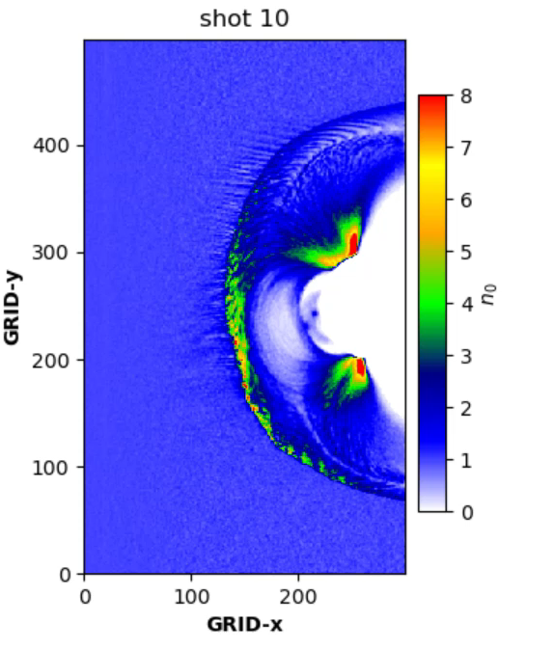
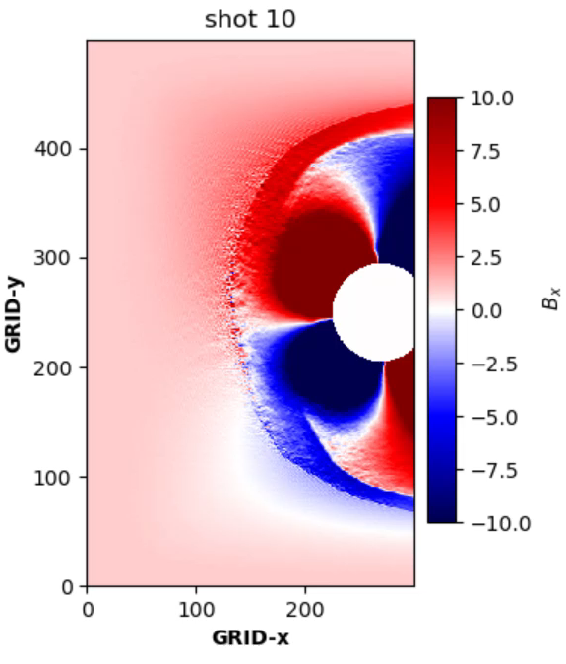
CCMC is Moving Beyond Single-Fluid MHD
Density
Magnetic field (Bx)
Hybrid and particle-in-cell (PIC) approaches enable addressing problems such as
  Reconnection
  waves particle interactions
  particle energization and transport at different regions
Global hybrid models can address turbulence on multiple scales.
M. El Alaoui
Simulations of the solar wind interaction with the Earth’s magnetosphere
with Hybrid Particle Event-Resolving Simulator - HYPERS [Omelchenko]

Slide 20
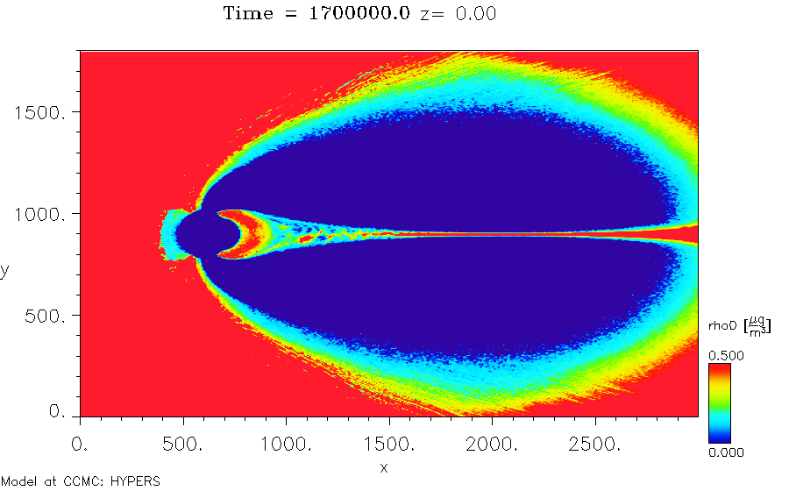
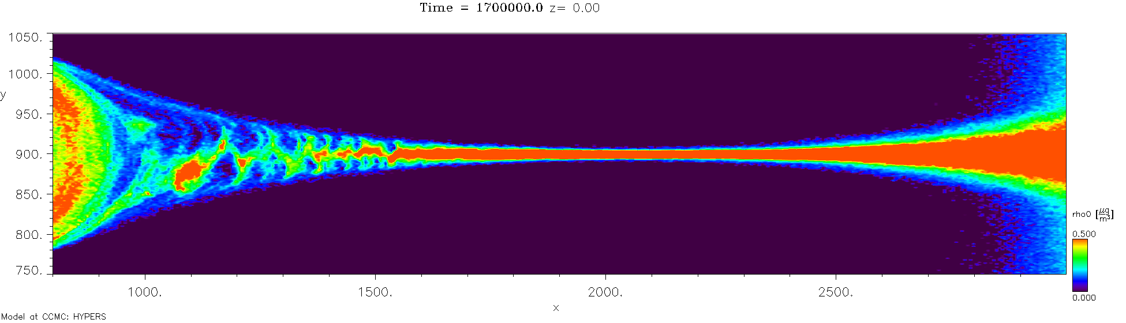
Bridging MHD and Kinetic Scales with HYPERS
Hybrid approaches enable addressing problems on ion scales
Hypers runs executed locally and on Pleiades for several IMF orientations
Input/Output
  Specify the computational domain
  Specify the solar wind and IMF input
  Specify desired simulation output
Density

Slide 21
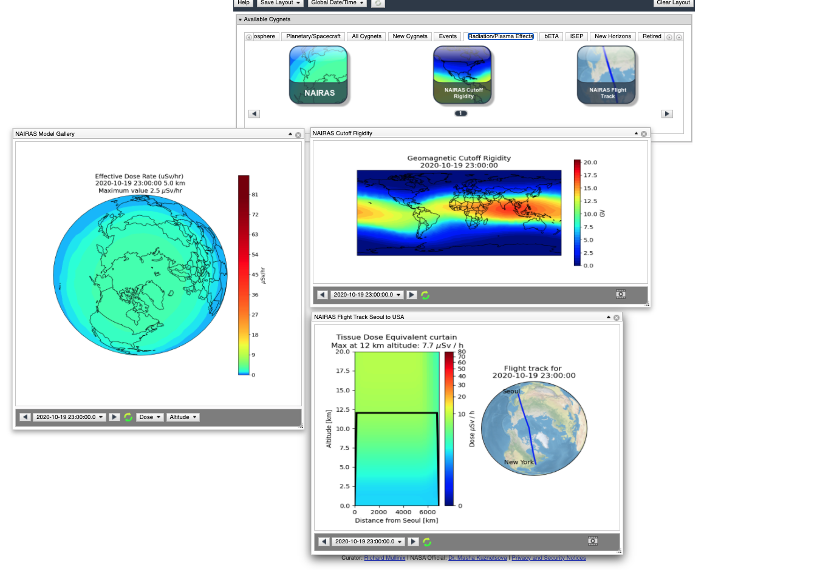
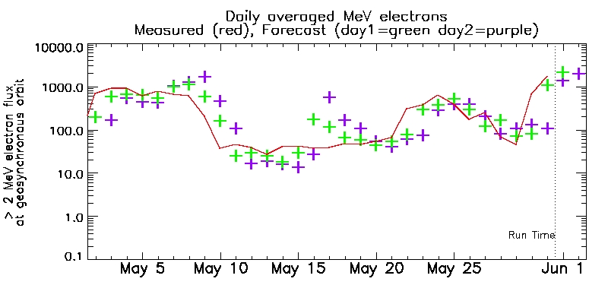
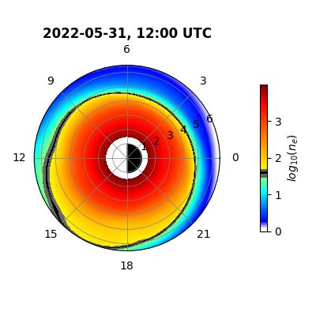
Near-Earth Radiation and Plasma Environment
NAIRAS 3.0 (Nowcast of Atmospheric Ionizing Radiation for Aviation Safety) available for iSWA, soon for ROR
PINE (Plasma density in the Inner magnetosphere Neural network-based Empirical) outputs are available on iSWA
CIMI updated
VERB post-processing tools for extracting fluxes at Van Allen Probes and POES are available
XLF3 Xinlin Li’s radiation belt model on MeV e-flux at GEO is running continuously
Ongoing/planned implementations and updates:
  SEAES-FC (Spacecraft Environment Anomalies Expert System Flow Chart)
  RAM-SCB and AMPS (Adaptive Mesh Particle Simulator)
  Radiation Belt Model by J. Bortnik et al
Progress in the ongoing community-wide internal charging and surface charging modelling challenge
Y. Zheng, L. Rastaetter

Slide 22
Vision for the Future
Solidify CCMC role as a fast response unit to evolving community and agencies needs
Facilitate innovation: move towards high-quality, high-resolution runs, implement ML/AI capabilities, utilize GPUs, go beyond MHD
Engage modelers in models/capabilities on-boarding
Facilitate open science: establish CCMC as a hub for collaborative development and evaluations of open-source models/software
Expand beyond Sun and Earth?

