Slide 1
Comparison and Validation
of GCR Models
T.C. Slaba, S.R. Blattnig, J.W. Norbury
NASA Langley Research Center, Hampton, VA
7th Space Weather and NASA Robotic Mission Ops Workshop
September 29-30, 2015
Goddard Space Flight Center

Slide 2
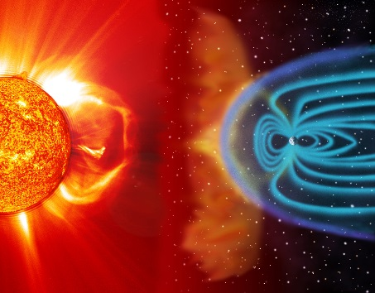
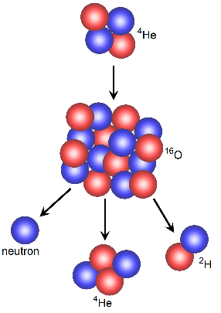
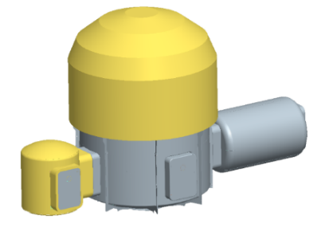
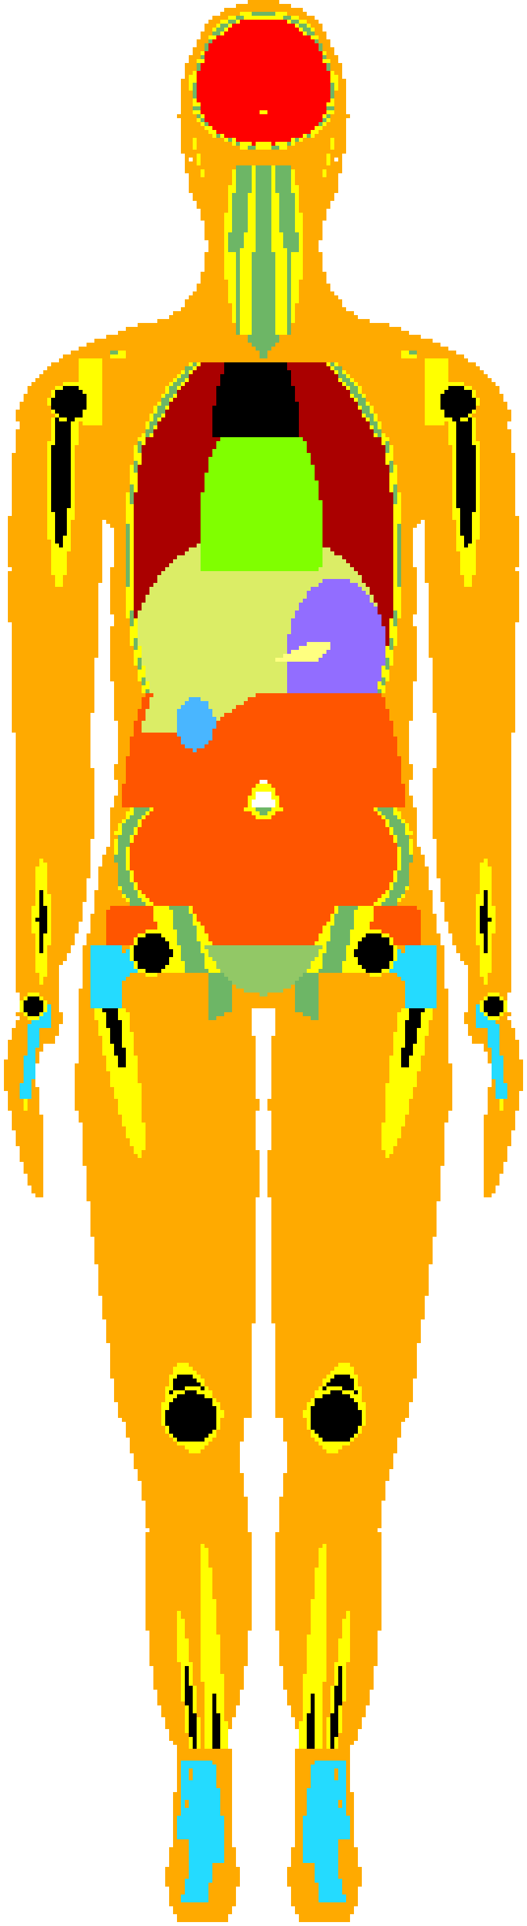
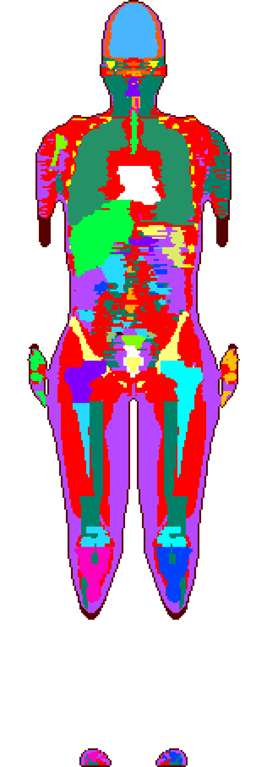
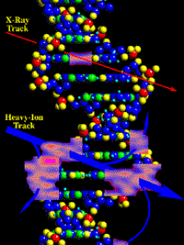
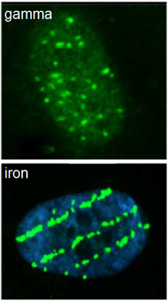
Exposure Analysis Overview
nasa.gov/sites/default/files/14-271.jpg
Environment
models
Shielding models
Physics models
Radiation transport models
Exposure &
Biological response
nasa.gov/centers/johnson/slsd/about/divisions/hacd/hrp/about-space-radiation.html
humanresearchroadmap.nasa.gov/evidence/reports/Carcinogenesis.pdf

Slide 3
Galactic Cosmic Ray Model Description
The Badhwar O'Neill (BON) galactic cosmic ray model⁽¹⁾ is used at NASA as input into radiation transport codes for
  vehicle design, mission analysis, astronaut risk analysis
  other models used as well (discussed in later slides)
The BON model has had several revisions⁽²⁻⁵⁾; all of them are based on the same fundamental framework
  Model equations are solved to describe particle transport through solar system
  Solar activity is described by a single parameter (Φ) related to observed sunspot numbers

Slide 4
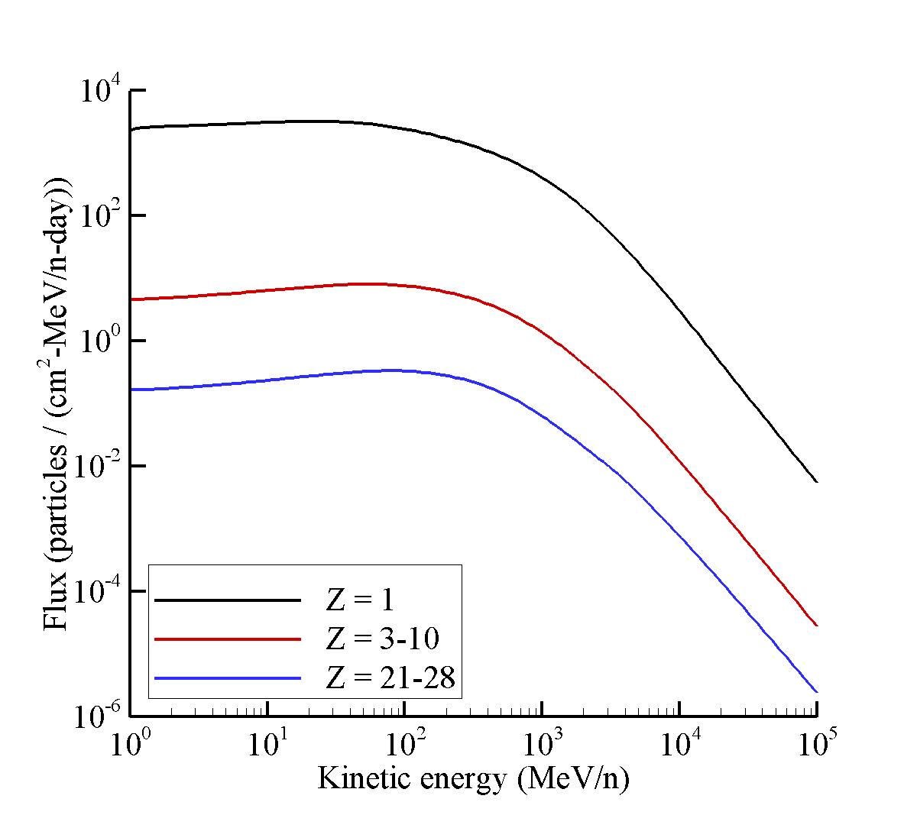
Galactic Cosmic Ray Model Description
The Badhwar O'Neill (BON) galactic cosmic ray model⁽¹⁾ is used at NASA as input into radiation transport codes for
  vehicle design, mission analysis, astronaut risk analysis
  other models used as well (discussed in later slides)
The BON model has had several revisions⁽²⁻⁵⁾; all of them are based on the same fundamental framework
  Model equations are solved to describe particle transport through solar system
  Solar activity is described by a single parameter (Φ) related to observed sunspot numbers
GCR spectrum outside the solar system is the boundary condition for the model (solid lines)
- Referred to as the local interstellar spectrum (LIS)
- Nearly constant over time

Slide 5
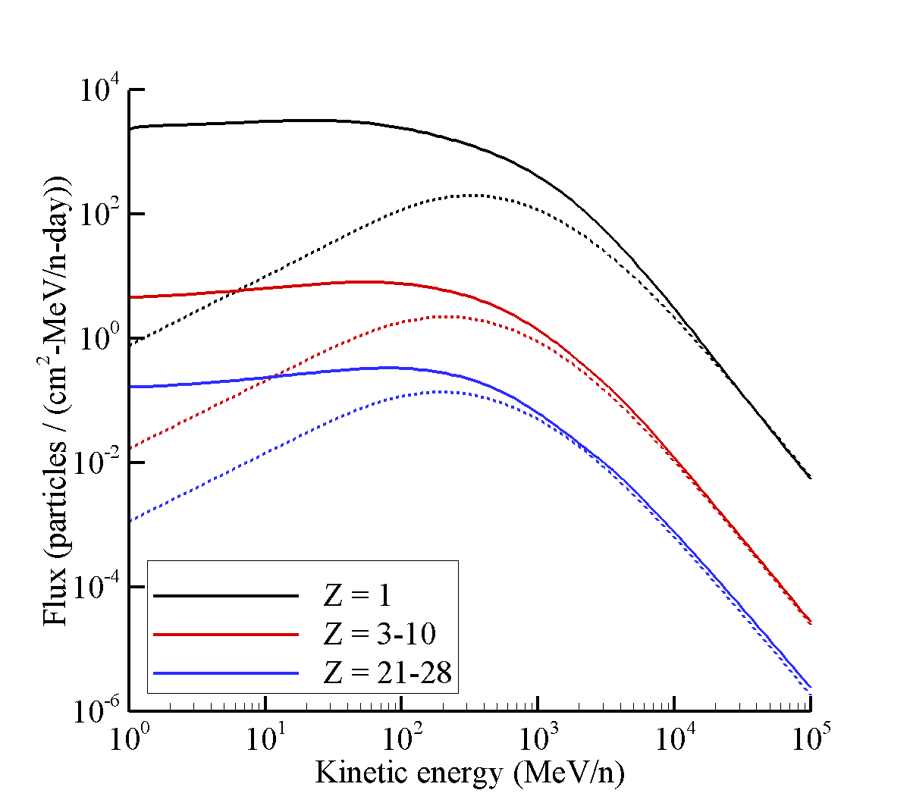
Galactic Cosmic Ray Model Description
The Badhwar O'Neill (BON) galactic cosmic ray model⁽¹⁾ is used at NASA as input into radiation transport codes for
  vehicle design, mission analysis, astronaut risk analysis
  other models used as well (discussed in later slides)
The BON model has had several revisions⁽²⁻⁵⁾; all of them are based on the same fundamental framework
  Model equations are solved to describe particle transport through solar system
  Solar activity is described by a single parameter (Φ) related to observed sunspot numbers
GCR spectrum outside the solar system is the boundary condition for the model (solid lines)
- Referred to as the local interstellar spectrum (LIS)
- Nearly constant over time
GCR spectrum is attenuated near Earth and affected by solar activity level
- Dashed lines show model spectra near Earth during solar minimum (Φ = 475)

Slide 6
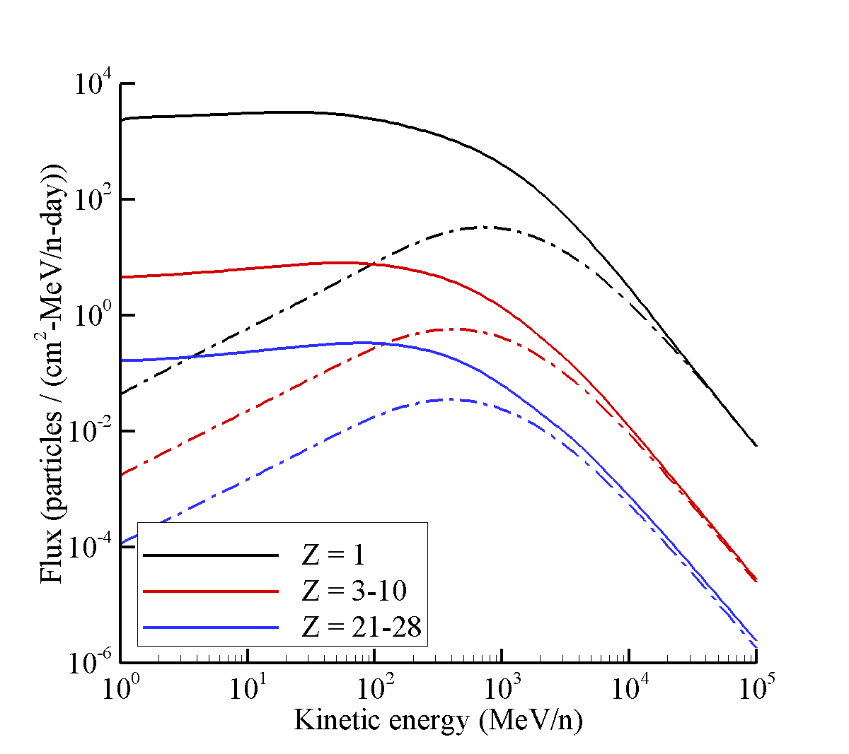
Galactic Cosmic Ray Model Description
The Badhwar O'Neill (BON) galactic cosmic ray model⁽¹⁾ is used at NASA as input into radiation transport codes for
  vehicle design, mission analysis, astronaut risk analysis
  other models used as well (discussed in later slides)
The BON model has had several revisions⁽²⁻⁵⁾; all of them are based on the same fundamental framework
  Model equations are solved to describe particle transport through solar system
  Solar activity is described by a single parameter (Φ) related to observed sunspot numbers
GCR spectrum outside the solar system is the boundary condition for the model (solid lines)
- Referred to as the local interstellar spectrum (LIS)
- Nearly constant over time
GCR spectrum is attenuated near Earth and affected by solar activity level
Dashed lines show model spectra near Earth during solar minimum (Φ = 475)
GCR spectrum is more heavily attenuated during solar maximum
Dashed lines show model spectra near Earth during solar minimum (Φ = 1100)

Slide 7
Galactic Cosmic Ray Model Development
GCR models are developed and validated by using measurements supported by Science Mission Directorate and others over the past 40 years
  Short duration, high energy, balloon and satellite measurements
  Low energy, continuous measurements from ACE/CRIS (most of the available measurements)
  Current gap in measurement database for continuous, high energy measurements^{(6,7)}
  Collaboration with AMS-II will begin to fill this important gap
Name | Flight | Time | Ions (Z) | Energy (GeV/n) | Data pts.
ACE/CRIS | Satellite | 1998-present | 5-28 | 0.05 – 0.5 | 8288
AMS | STS-91 | 1998 | 1, 2 | 0.1 – 200 | 58
ATIC-2 | Balloon | 2002 | 1, 2, 6, 8, 10,…,14, 26 | 4.6 – 10³ | 55
BESS | Balloon | 1997-2000, 2002 | 1, 2 | 0.2 – 22 | 300
CAPRICE | Balloon | 1994, 1998 | 1, 2 | 0.15 – 350 | 93
CREAM-II | Balloon | 2005 | 6-8, 10, 12, 14, 26 | 18 – 10³ | 42
HEAO-3 | Satellite | 1979 | 4-28 | 0.62 – 35 | 331
IMAX | Balloon | 1992 | 1, 2 | 0.18 – 208 | 56
IMP-8 | Satellite | 1974 | 6, 8, 10, 12, 14 | 0.05 – 1 | 53
LEAP | Balloon | 1987 | 1, 2 | 0.18 – 80 | 41
MASS | Balloon | 1991 | 1, 2 | 1.6 – 100 | 41
PAMELA | Satellite | 2006-2009 | 1, 2 | 0.08 – 10³ | 472
TRACER | Balloon | 2003 | 8, 10, 12,…,20, 26 | 0.8 – 10³ | 55
Lezniak | Balloon | 1974 | 4-14, 16, 20, 26 | 0.35 – 52 | 131
Minagawa | Balloon | 1975 | 26, 28 | 1.3 – 10 | 16
Muller | STS-51 | 1985 | 6, 8, 10, 12, 14 | 50 – 10³ | 16
Simon | Balloon | 1976 | 5-8 | 2.5 – 10³ | 46
  82% of available data

Slide 8
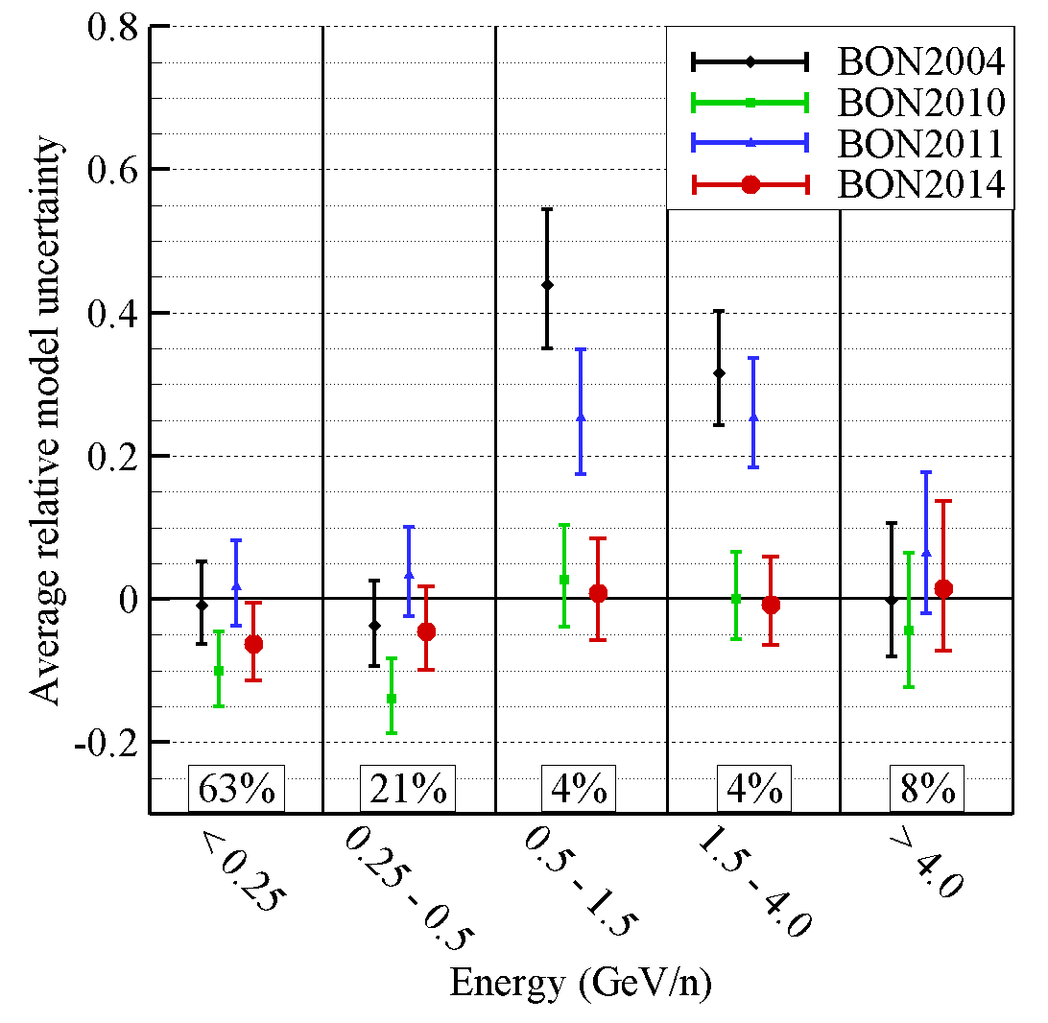
Galactic Cosmic Ray Model Development
Recent work has significantly reduced model uncertainties by taking a more rigorous approach to model calibration and validation – resulted in BON2014⁽¹⁾
  Determined measurements (energies) most important for exposure quantities behind shielding⁽⁶⁾
  Model parameters calibrated using optimization methods with an emphasis on higher energies^{(1,7)}
  Comprehensive validation metrics applied to quantify model uncertainty^{(1,7)}
  Previous efforts focused more heavily on lower energy ACE/CRIS measurements
Significant need for continuous, time-resolved (e.g. monthly) high energy measurements to further reduce model uncertainties⁽⁷⁾
  AMS-II collaboration will begin to fill this important gap
Energy region above 0.5 GeV/n accounts for 95% of exposure⁽⁶⁾
Most of the measurements have been taken below 0.5 GeV/n⁽⁷⁾
Fraction of available measurements in each energy bin

Slide 9
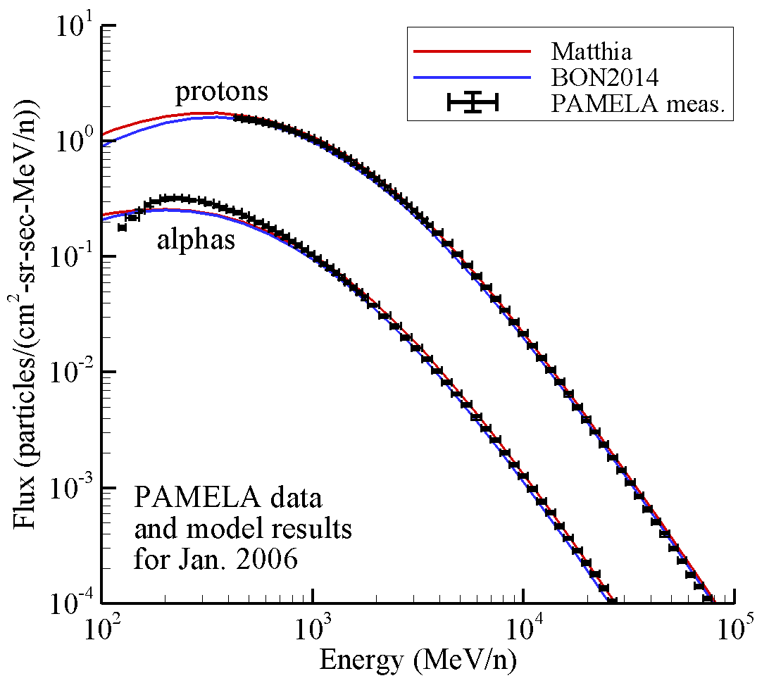
International Models and Comparisons
GCR models tend to agree reasonably well at highest energies where effects of solar modulation are less pronounced
  Most important for exposure quantities behind shielding⁽⁶⁾
Continuous, time-resolved (e.g. monthly) measurements at high energies needed to further reduce uncertainties
  Most important gap is high energy proton and alpha data
  AMS-II collaboration will begin to fill gap
Nymmik (MSU) has developed a semi-empirical model^{(8,9)}
  Used by Russian Space Agency and others (DLR, ESA)
  Official update has not been provided recently
Matthia et al. (DLR) recently developed a simplified form of Nymmik’s model⁽¹⁰⁾
  Shown to be reasonably accurate^{(7,10)}

Slide 10
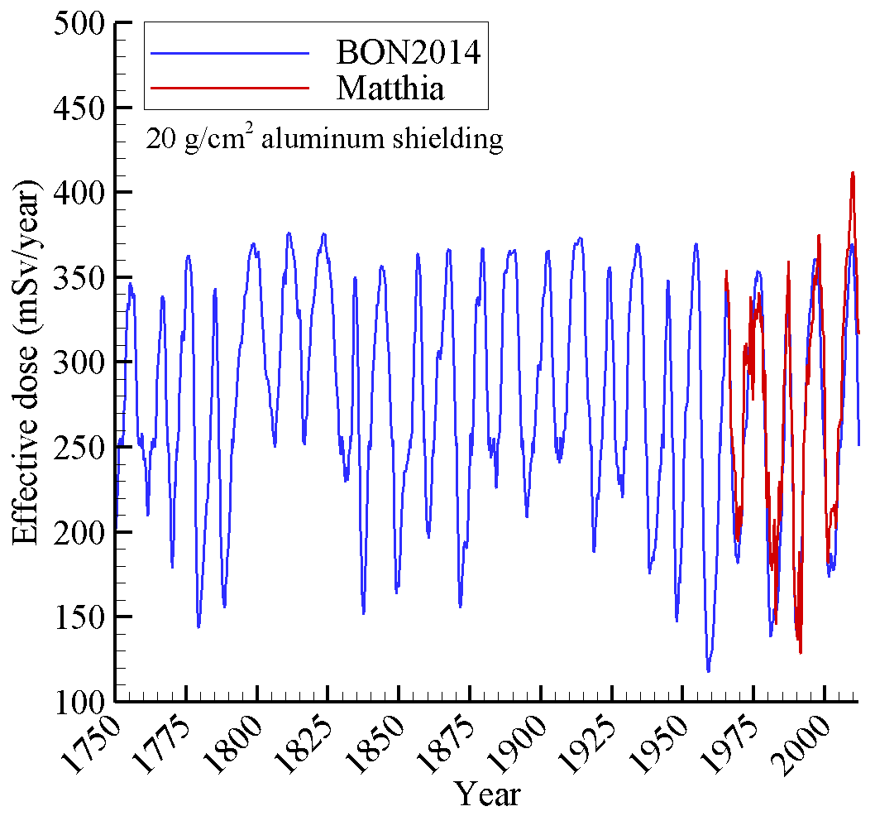
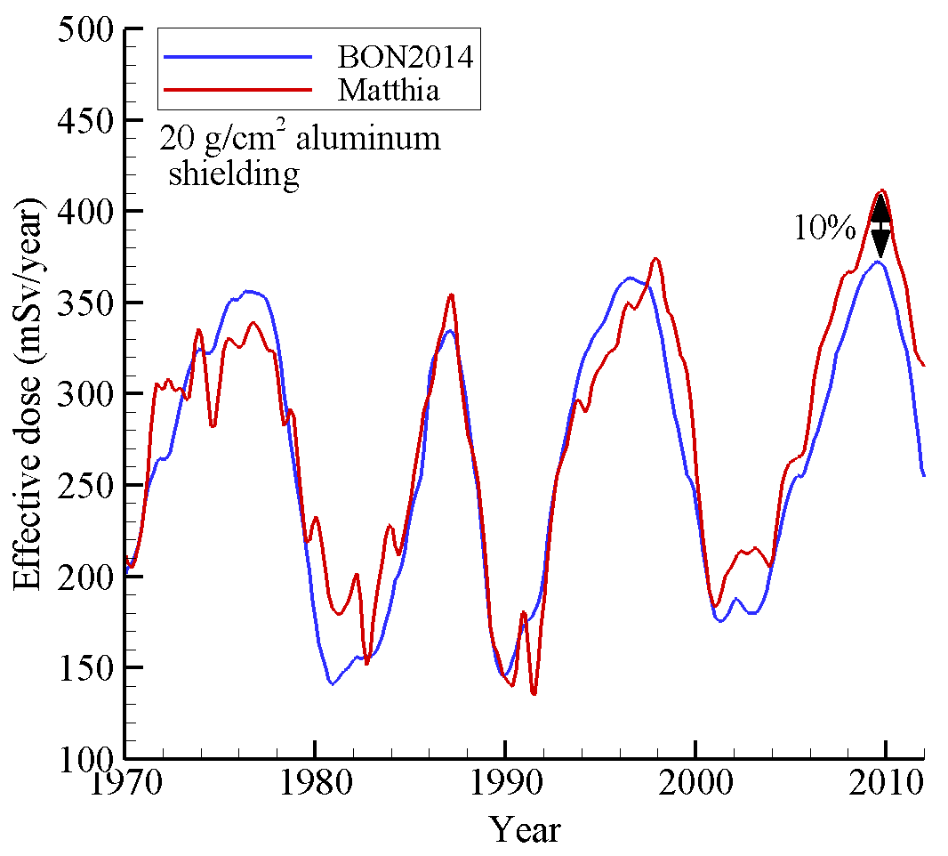
International Model Comparisons
Human exposure quantities behind shielding are in good agreement if updated galactic ray models are used
  Effective dose computed as weighted sum of tissue exposures in detailed human model
  BON2014 and Matthia are within 10% of each other, on average, over past 40 years
  Models tend to agree well at higher energies where impacts of solar activity are reduced

Slide 11
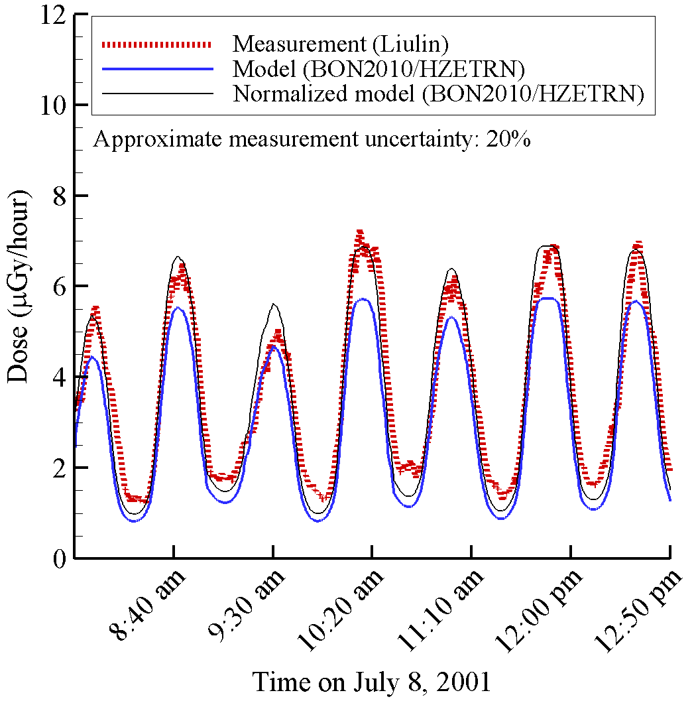
Integrated Model Validation - ISS
For astronaut risk assessment, end-to-end model results are normalized to area dosimeters on the International Space Station (ISS)
  Cancer risk models require more detailed information than area dosimeters provide
  Normalization procedures ensure cancer risk estimates are consistent with available dosimetry
  Normalized end-to-end model uncertainty is within 15%
Direct model evaluation (without normalization) is used in validation and uncertainty quantification efforts
  Direct model evaluation needs to be accurate when dosimetry is unavailable (e.g. projections)
  Integrated model uncertainties for a recent ISS analysis⁽²¹⁾ ranged from 10% - 50% and includes uncertainties associated with
  GCR and geomagnetic field models
  Nuclear physics and transport codes
  Shielding mass distribution of the ISS
  Dosimeter response
Efficiency of NASA’s transport code has allowed detailed validation studies to be performed using minute-by-minute active dosimetry⁽²¹⁾
  Allows rigorous statistical analyses to be performed
  Helped identify deficiencies in geometry models, geomagnetic field models, and high energy nuclear physics

Slide 12
Integrated Model Validation – MSL/RAD
Comparisons between Mars Science Laboratory/Radiation Assessment Detector (MSL/RAD) and NASA models are ongoing
  Cruise dose measurements and models show reasonable agreement⁽²²⁾
  Surface dose measurements and models show reasonable agreement⁽²³⁾
Comparisons between NASA models and MSL/RAD surface measurements of particle fluxes have been made⁽²⁴⁾
  Provides a more rigorous test of models than just dose / dose eq. comparisons
  Surface flux measurements show good agreement for some ions and reveals poor agreement for others
  Highlights the need for continued model development and additional measurements
MSL/RAD cruise exposure rates compared to BON2011/HZETRN model⁽²²⁾
 | Dose (µGy/day) | Dose Eq. (µSv/day) | Avg. Q
BON2011/HZETRN | 0.445 | 1.80 | 4.05
MSL/RAD | 0.481+0.08 | 1.84+0.33 | 3.82+0.25

Slide 13
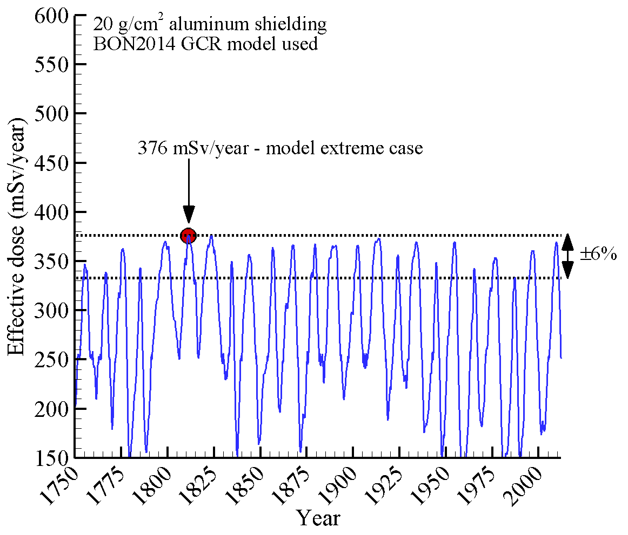
Mission Planning and Shield Design
Past studies utilized static, representative environments for design analysis
  e.g. 1977 solar minimum used as a “design case”
  Solar modulation parameter, Φ = 1100 MV, used as a representative solar maximum
Current studies can now utilize a more robust probabilistic approach, allowing estimates to be provided within a certain confidence level
  Solar activity predictions are notoriously unreliable⁽²⁵⁻²⁷⁾
  Analysis not tied to specific solar activity or time period
Plot at left considers variation in effective dose due to past solar activity as represented by BON2014
  For this shield configuration, effective dose values at solar minimum vary by +6% over the past 265 years
The data shown in the plot can be further analyzed to quantify probability of exceeding a given exposure value
  e.g. 2.5% probability of exceeding 369 mSv/year for this shielding configuration
  This type of analysis does not account for dramatic changes in future solar activity and other uncertainties (e.g. radiobiology)

Slide 14
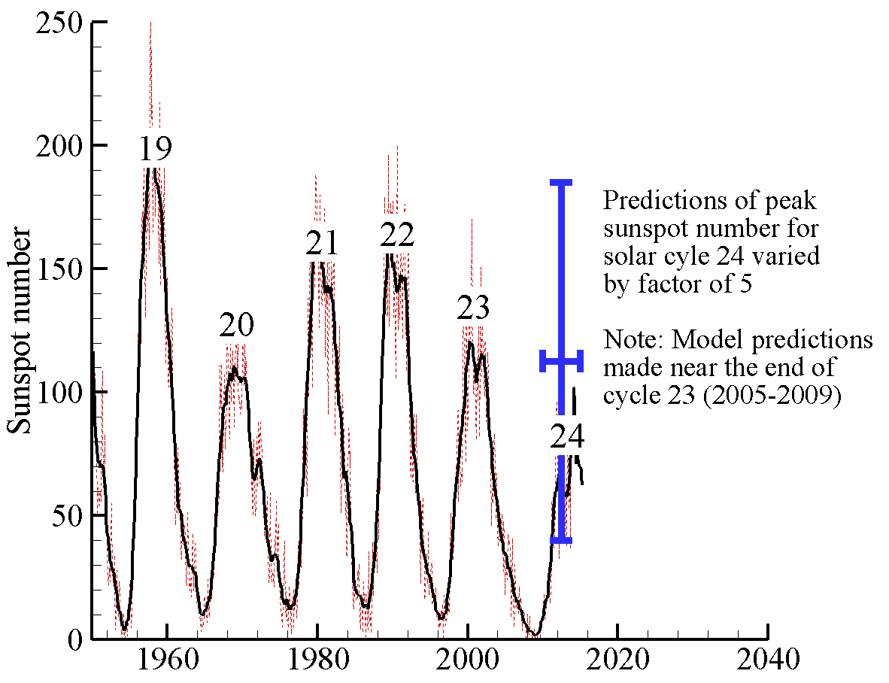
Projecting Solar Activity
Limiting case galactic cosmic ray environment would occur in the absence of solar activity and solar magnetic field
  Same as the environment outside the solar system, which is nearly constant over time
  In this environment, human exposures are ~2x larger than deepest solar minimum seen over past 265 years (unlikely to occur)
  Historical analyses^{(25,26,28)} indicates solar magnetic field will not completely disappear during grand solar minimum (Dalton grand minimum occurred ~1800-1830)
Model predictions of future solar activity (even near term) are uncertain
  Predictions (made near end of cycle 23) of peak activity for cycle 24 varied by factor of 5 ⁽²⁷⁾
  Longer term solar activity (beyond a solar cycle) may be intrinsically unpredictable^{(25,26)}
  Probability of grand solar minimum in next 30 years estimated to be <10%⁽²⁹⁾
  Maybe equally likely to see a strong solar maximum in next 30 years⁽²⁹⁾
  For future mission planning, uncertainties in solar activity predictions and possible schedule slips make it difficult to plan for a specific solar level (e.g. plan mission for solar max)
See reference (27) for discussion of predictions for solar cycle 24

Slide 15
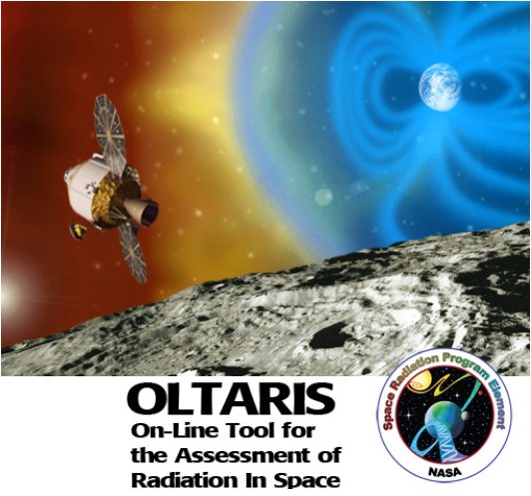
Design Tools
The models used at NASA to support mission planning and vehicle design have been integrated into a web-based framework
  OLTARIS: https://oltaris.nasa.gov
BON and Matthia galactic cosmic ray models
Solar particle events (SPE)
  Fits to historically significant events (i.e.1972, 1989) are available and can be scaled
  User-defined spectra are supported through commonly used fitting functions with few parameters
Environmental models can be evaluated in low Earth orbit, deep space, or on planetary surface
Environmental models are integrated with physics/transport models, detailed human phantom models and various geometry options

Slide 16
Summary
Radiation analysis tools used for ISS operations, mission planning, and vehicle design in deep space and planetary surfaces are rigorously developed and validated
  Measurements from SMD and others used directly for model development and validation
  International models are compared or utilized where possible or appropriate
  Model development and validation efforts are ongoing
Based on recent (~30 years) solar activity and available measurements
  Uncertainty assessment of BON2014 galactic cosmic ray model is +20%
  Normalized end-to-end model uncertainties are within 15%
  End-to-end uncertainties if normalization is not used range from 10%-50%
  Additional measurements needed to further reduce uncertainties (e.g. AMS-II)
Mission planning and vehicle design is moving towards more robust probabilistic approaches
  Allows exposure estimates to be provided within a specified probability
  Allows various sources of uncertainty (solar activity, shielding, radiobiology) to be rigorously accounted for in the analyses

Slide 17
References (I)
(1) O’Neill, P.M., Golge, S., Slaba, T.C., NASA TP 2015-218569, 2015.
(2) O’Neill, P.M. and Foster, C.C., NASA TP 2013-217376, 2013.
(3) O’Neill, P.M., IEEE Trans. Nuc. Sci. 57: 3148-3153, 2010.
(4) O’Neill, P.M., Adv. Space Res. 37: 1727-1733, 2006.
(5) Badhwar, G.D., O’Neill, P.M., Adv. Space Res. 17: 7-17, 1996.
(6) Slaba, T.C. and Blattnig, S.R., Space Weather 12: 217-224, 2014.
(7) Slaba, T.C., Xu, X., Blattnig, S.R., Norman, R.B., Space Weather 12: 233-245, 2014.
(8) Nymmik, R.A., Panasyuk, M.I., Suslov, A.A., Adv. Space Res. 17: 219-230, 1996.
(9) ISO 15390, 2004.
(10) Matthia, D., Berger, T., Mrigakshi, A.I., Reitz, G., Adv. Space Res. 51: 329-338, 2013.
(11) Wilson, J.W., Townsend, L.W., Schimmerling, W., Khandelwal, G.S., Khan, F., Nealy, J.E., Cucinotta, F.A., Simonsen, L.C., Shinn, J.L., Norbury, J.W., NASA RP-1257, 1991.
(12) Slaba, T.C., Blattnig, S.R., Badavi, F.F., J. Comp. Phys. 229: 9397-9417; 2010.
(13) Slaba, T.C., Blattnig, S.R., Aghara, S.K., Townsend, L.W., Handler, T., Gabriel, T.A., Pinsky, L.S., Reddell, B., Radiat. Meas. 45: 173-182; 2010b.
(14) Norman, R.B., Slaba, T.C., Blattnig, S.R., An extension of HZETRN for cosmic ray initiated electromagnetic cascades. Adv. Space Res. 51: 2251-2260; 2013.
(15) Wilson, J.W., Slaba, T.C., Badavi, F.F., Reddell, B.D., Bahadori, A.A., Life Sci. Space Res. 2: 6-22, 2014.
(16) Wilson, J.W., Slaba, T.C., Badavi, F.F., Reddell, B.D., Bahadori, A.A., Life Sc. Space Res. 4: 46-61, 2015.
(17) Slaba, T.C., Blattnig, S.R., Clowdsley, M.S., Rad. Res. 176: 827-841, 2011.
(18) Heinbockel, J.H., Slaba, T.C., Blattnig, S.R., Tripathi, R.K., Townsend, L.W., Handler, T., Gabriel, T.A., Pinsky, L.S., Reddell, B., Clowdsley, M.S., Singleterry, R.C., Norbury, J.W., Badavi, F.F., Aghara, S.K., Adv. Space Res. 47: 1079-1088, 2011.

Slide 18
References (II)
(19) Heinbockel, J.H., Slaba, T.C., Tripathi, R.K., Blattnig, S.R., Norbury, J.W., Badavi, F.F., Townsend, L.W., Handler, T., Gabriel, T.A., Pinsky, L.S., Reddell, B., Aumann, A.R., Adv. Space Res. 47:1089-1105, 2011.
(20) Norbury, J.W. and Miller, J., Review of nuclear physics experimental data for space radiation. Health Phys. 103: 640-642, 2012.
(21) Slaba, T.C., Blattnig, S.R., Reddell, B., Bahadori, A., Norman, R.B., Badavi, F.F., Adv. Space Res. 52: 62-78, 2013.
(22) Zeitlin, C., Hassler, D.M., Cucinotta, F.A., Ehresmann, B., Wimmer-Schweingruber, R.F., Brinza, D.E., Kang, S., Weigle, G., Bottcher, S., Bohm, E., Burmeister, S., Guo, J., Kohler, J., Martin, C., Posner, A., Rafkin, S., Reitz, G., Science 340: 1080-1084, 2013.
(23). Kim, M.Y., Cucinotta, F.A., Nounu, H.N., Zeitlin, C., Hassler, D.M., Rafkin, S., Wimmer-Schweingruber, R.F., Ehresmann, B., Brinza, D.E., Bottcher, S., Bohm, E., Burmeister, S., Guo, J., Kohler, J., Martin, C., Reitz, G., Posner, A., Gomez-Elvira, J., Harri, A., J. Geophys. Res. Planets 119: 1311-1321, 2014.
(24). Ehresmann, B., Zeitlin, C., Hassler, D.M., Wimmer-Schweingruber, R.F., Bohm, E., Bottcher ,S., Brinza, D.E., Burmeister, S., Guo, J., Kohler, J., Martin, C., Posner, A., Rafkin, S., Reitz, G., J. Geophys. Res. Planets 119: 468-479, 2014.
(25). Usoskin, I.G., arXiv:0810.3972v3, 2013.
(26). Usoskin, I.G., Living Rev. Solar Phys. 5: 2008.
  (27). Pesnell, W.D., Solar Physics 281: 507, 2012.
(28). Miyahara, H., Sokoloff, D., Usoskin, I.G., Adv. Geosciences 2: 1-20, 2006.
(29). Solanki, S., Krivova, N., Science 334: 916-917, 2011.
(30). Slaba, T.C. and Blattnig, S.R., Space Weather 12: 225-232, 2014.
(31) Wilson 2005 V&V TP
(32) Billings, M.P., Yucker, W.R., Summary Final Report, MDC-G4655, McDonnell Douglas Company (1973).
(33) Yucker, W.R., Reck, R.J., Report, MDC 92H0749, McDonnell Douglas Company, 1992.
(34) Slaba, T.C., Qualls, G.D., Clowdsley, M.S., Blattnig, S.R., Walker, S.A., Simonsen, L.C., Adv. Space Res. 45: 866-883, 2010.
(35) Bahadori, A.A., Sato, T., Slaba, T.C., Shavers, M.R., Semones, E.J., Van Baalen, M., Bolch, W.E., Phys. Med. Biology, 58: 7183-7207, 2013.

Slide 19
Backup – Solar Activity Predictions
Maximum SSN predictions of various types of models for cycle 24.
The observed maximum (so far) is 82 (horizontal red line).
  From ref (27): Pesnell, W.D. (NASA Goddard Space Flight Center) Solar Physics 281: 507, 2012.

Slide 20
Backup – Deep Solar Minimum
Sunspot numbers in Maunder minimum and near ~1810 were zero
From ref (28): Solanki, S., Krivova, N., Science 334: 916-917, 2011.
Reprinted with permission from AAAS.

Slide 21
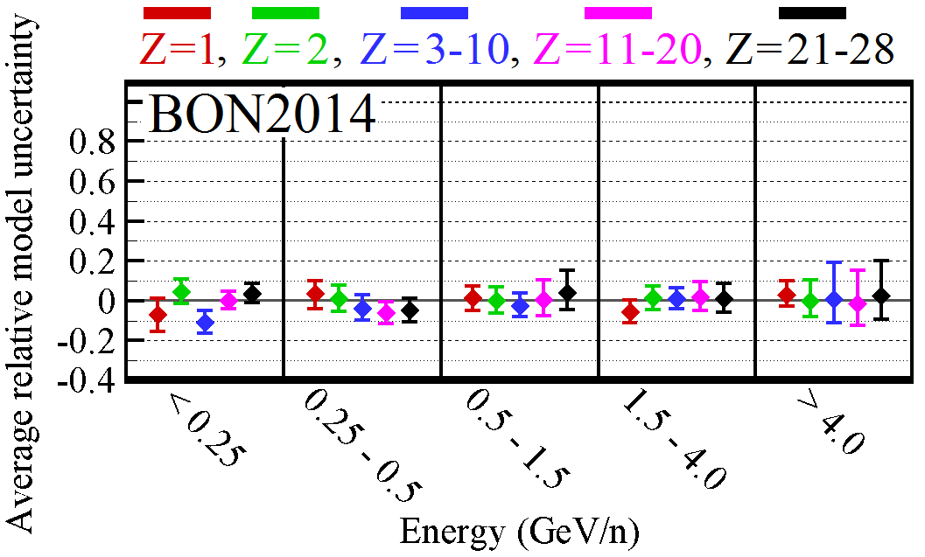
Backup – BON Model Assumptions
The BON GCR model is a semi-empirical model, calibrated to measurements taken near Earth
  Numerical solutions to the Fokker-Planck equation are obtained to describe GCR modulation through the heliosphere
  GCR spectrum outside the solar system, referred to as the local interstellar spectrum (LIS), is the boundary condition for the model and is described with 3 free parameters for each ion
  Solutions to the Fokker-Planck differential equation are obtained under the assumption of a quasi-steady state and radially symmetric interplanetary medium
  Solar wind speed is assumed to be constant at ~400 km/s
  Solar activity is related to sunspot number using a linear fitting function and Nymmik’s empirical time-delay ^{(8,9)}
Free parameters describing the LIS are calibrated by comparing model results near Earth to available measurements
  Recent efforts have taken a more rigorous and comprehensive approach to calibration and validation, resulting in the BON2014 model
  Model uncertainties above 0.5 GeV/n (500 MeV/n) are within measurement error (error bars on plot)
  Model uncertainties below 0.5 GeV/n are slightly larger but mostly within measurement uncertainty
  Model uncertainties below 500 MeV/n have a small impact on exposure quantities behind shielding ⁽⁶⁾

Slide 22
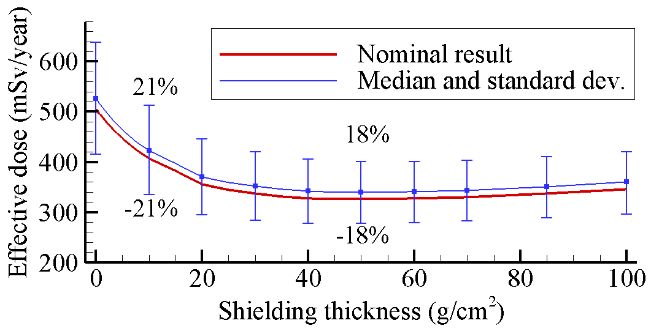
Backup – BON Model Uncertainty
Model uncertainties are rigorously quantified using interval-based uncertainty metrics
  Measurement uncertainty (ranges up to 50% for some data) is included in the analysis
  Uncertainty distributions are obtained for specific ions and energy groups
  Uncertainty propagation methods were developed⁽³⁰⁾ to quantify how errors in the GCR model impact effective dose behind shielding
AMS-II data will provide a unique opportunity to perform independent validation of the available GCR models
  Data was not available when models were calibrated
  Data will be used to improve parameter calibration after independent validation is performed
GCR model uncertainties can be propagated into effective dose behind shielding
  This connects environmental model uncertainty directly to exposure quantities of interest behind shielding
Female effective dose versus aluminum shielding thickness during solar minimum. Error bars represent BON2014 GCR model uncertainty at 1 standard deviation (68% CL)

Slide 23
Backup – Transport Codes
Particle transport through materials is described either with Monte Carlo or deterministic methods
  Monte Carlo: Use random number generators to sample the physical interaction models and track each particle individually as it passes through matter (Geant4, FLUKA, PHITS, MCNP6)
  Deterministic: Solve the relevant Boltzmann transport equation using analytic and numerical methods
NASA's radiation transport code, HZETRN⁽¹¹⁻¹⁵⁾, is deterministic
  Highly efficient compared to Monte Carlo methods (seconds vs. days or longer)
  Efficiency needed to support vehicle design, engineering, and optimization activities
  Extensive verification against Monte Carlo and validation against space flight measurements
HZETRN is based on a converging sequence of physical approximations
  Early versions of the code were based on the straight ahead approximation ⁽¹¹⁾
  Straight ahead approximation has been shown to be accurate for HZE particles ^{(11,31)}
  Recent code developments have included 3D corrections for neutrons and light ions while maintaining overall code efficiency ^{(15,16)}
  Validation and uncertainty quantification efforts for transport codes and associated nuclear physics models are ongoing
  HZETRN agrees with Monte Carlo codes to the extent they agree with each other in most cases ^{(13,15-19)}
  Development, validation and uncertainty quantification of nuclear physics models is ongoing
  Space flight validation efforts (Shuttle, ISS and MSL/RAD) and uncertainty quantification for integrated model-set has been described elsewhere ^{(21-23,31)}

Slide 24
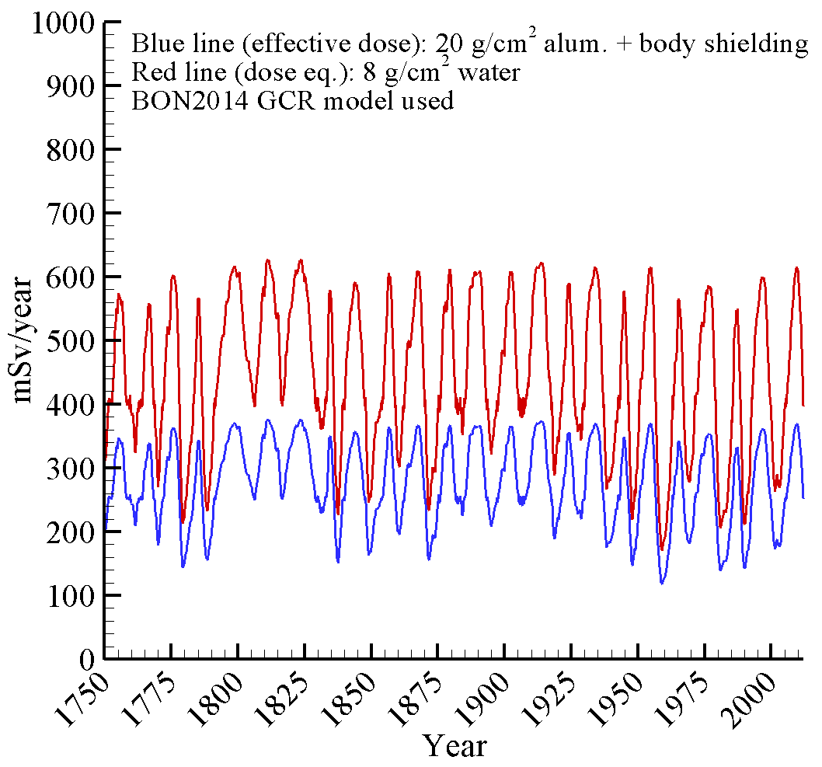
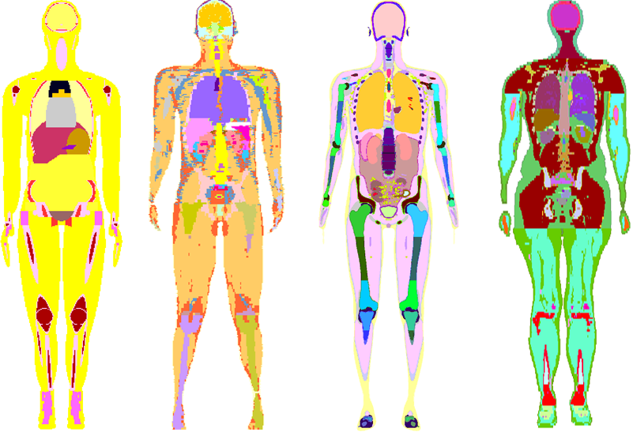
Backup – Human Phantoms
For computing effective dose and astronaut risk, detailed models of the human body are needed to describe body self-shielding for radiosensitive tissues
  The stylized CAM/CAF phantoms developed in the 1970s to match 50th percentile US Air Force personnel have been used extensively in space radiation analyses and tools ^{(32,33)}
  State-of-the-art phantoms, developed to match ICRP anatomical reference values, are also available and have been coupled to HZETRN using various methods ^{(34,35)}
  Variation in exposure quantities caused by differing human phantoms is generally small if state-of-the-art phantoms are used [ref]
Plot below shows effective dose (FAX phantom) and point dose equivalent (no phantom) behind shielding
  Additional tissue shielding provided by body attenuates exposure and variation associated with solar activity
CAM
MAX
MASH
mICRP

