Slide 1
Radiation Hazard for
Deep Space Human Exploration
T.C. Slaba, M.S. Clowdsley
NASA Langley Research Center, Hampton, VA
7th Space Weather and NASA Robotic Mission Ops Workshop
September 29-30, 2015
Goddard Space Flight Center

Slide 2
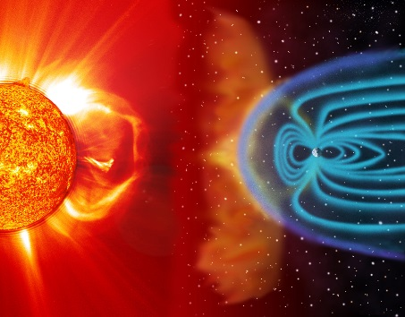
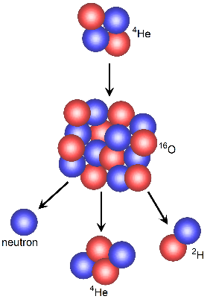
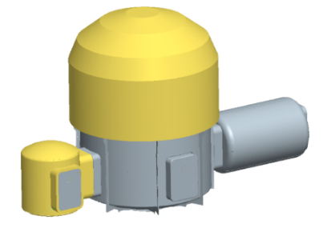
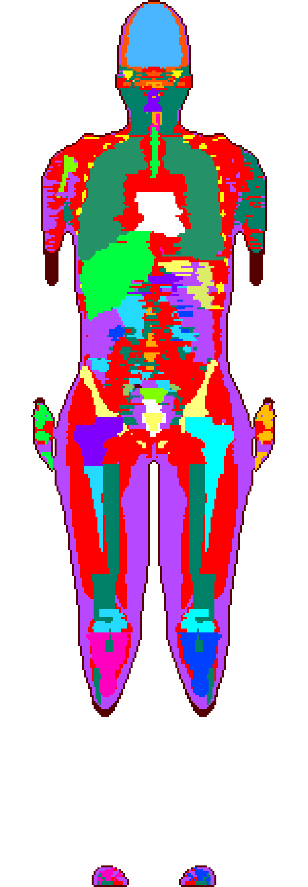
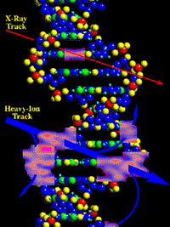
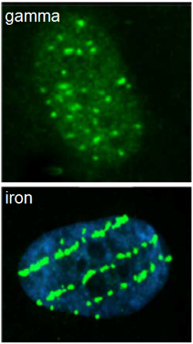
Exposure Analysis Overview
nasa.gov/sites/default/files/14-271.jpg
Environment
models
Shielding models
Physics models
Radiation transport models
Exposure &
Biological response
nasa.gov/centers/johnson/slsd/about/divisions/hacd/hrp/about-space-radiation.html
humanresearchroadmap.nasa.gov/evidence/reports/Carcinogenesis.pdf

Slide 3
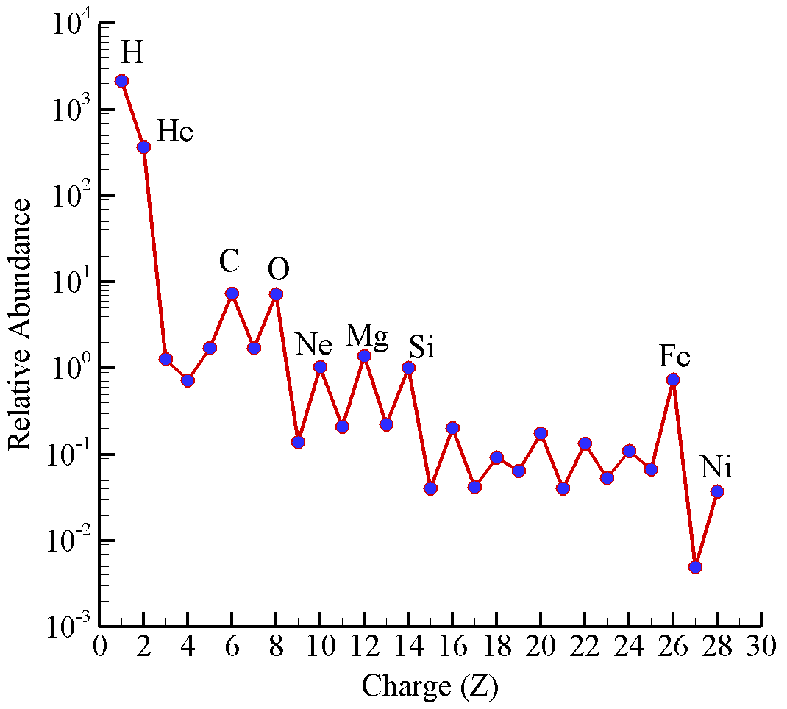
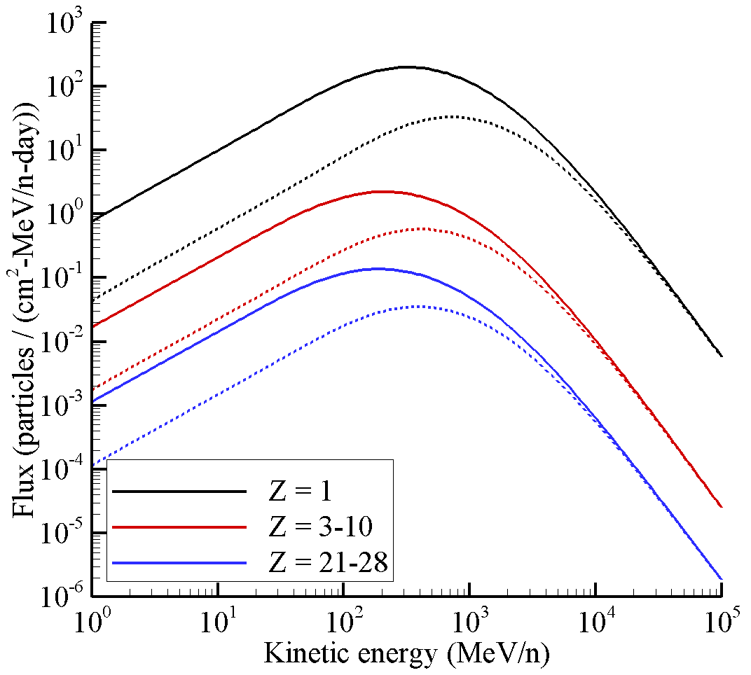
Deep Space Radiation Environments
The GCR environment is omnipresent in space and fluctuates between solar minimum and solar maximum on an approximate 11 year cycle
Exposures differ by approximately a factor of 2 between nominal solar extremes
Broad spectrum of particles (most of the periodic table) and energies (many orders of magnitude)
High energy and complexity of field make it difficult to shield against
solar minimum
solar maximum

Slide 4
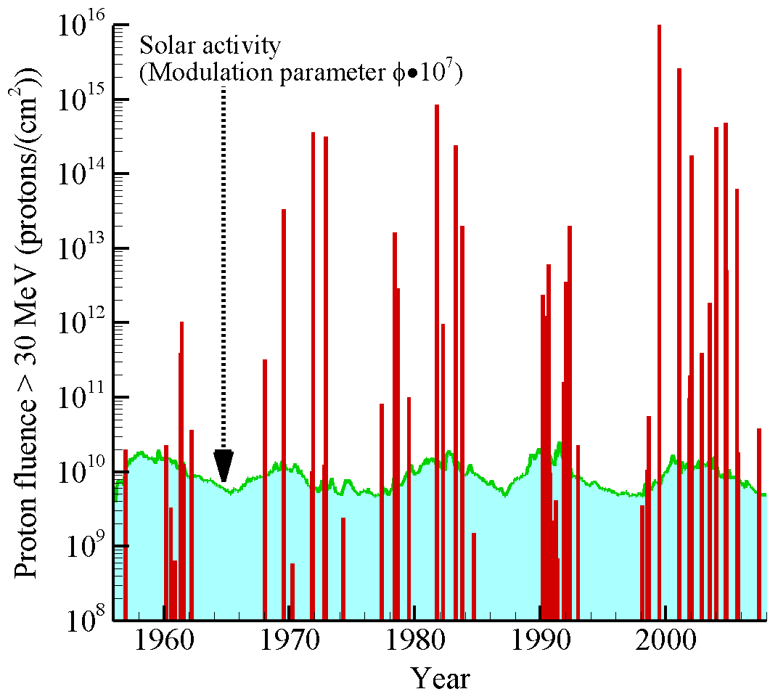
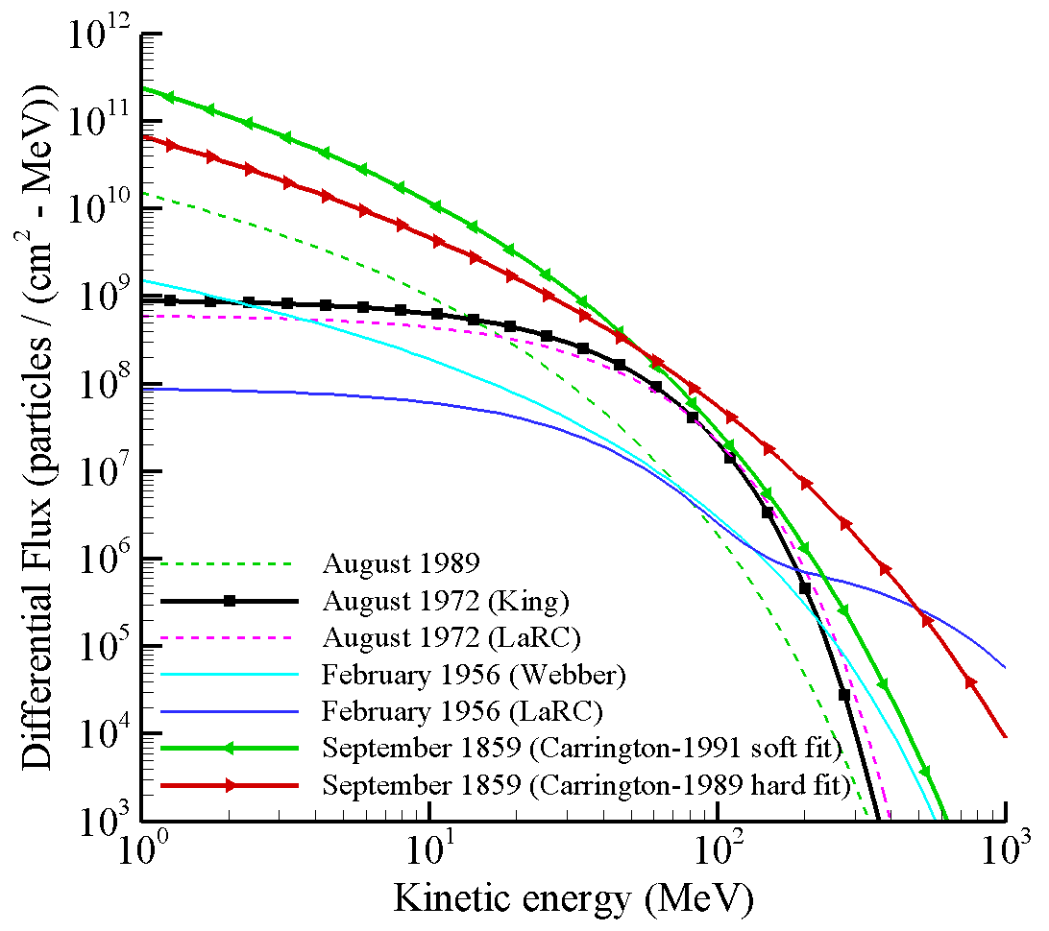
Deep Space Radiation Environments
SPE/GLE are intense bursts of protons from the Sun
Difficult to predict occurrence, spectral shape, or magnitude
More likely to occur during periods of heightened solar activity (solar max)
Energies up to several hundred MeV (may extend up to GeV)
Presents serious acute risk to astronauts if not adequately shielded

Slide 5
Exposure Quantities
Two exposure quantities will be used here
Dose equivalent (mSv)
Radiation quality factor is used to quantify increased biological effectiveness of high LET particles compared to gamma rays
Effective dose (mSv)
Weighted sum of tissue averaged dose equivalent values
Tissue weights quantify relative radiosensitivity of individual tissues
Provides a measure of human mortality risk from radiation exposure
Note: effective dose includes detailed human model and tissue self-shielding
Average human thickness is ~30 g/cm² of tissue

Slide 6
Sensitivity Studies
Sensitivity analysis [1]
Quantify extent to which each SPE or GCR ion/energy contributes to exposure behind shielding
Identifies primary ions/energies that are most important from radiation shielding perspective
Spherical aluminum shielding
Ion (Z) with boundary energy E_{B}
Mixed field at tissue sites with spectrum of local energies (E_{L})
Quantify effective dose as a function of boundary energy E_{B}

Slide 7
Sensitivity Studies - GCR
Energy/ion region measured by ACE/CRIS induces less than 5% of the exposure behind shielding
Region measured by ACE/CRIS (E < 500 MeV/n, Z = 5-28)
Relative contribution of each boundary ion/energy group to effective dose behind 20 g/cm² aluminum during solar minimum [1]. Note: a value of 0.0 indicates relative contribution < 0.1%
 | Boundary energy interval (GeV/n)
 | < 0.25 | [0.25, 0.5] | [0.5, 1.5] | [1.5, 4] | > 4 | Total
Z = 1 | 1.2 | 5.4 | 18.2 | 18.4 | 14.8 | 58.1
Z = 2 | 1.2 | 2.2 | 4.1 | 2.9 | 1.7 | 12.2
Z = 3-10 | 0.0 | 3.3 | 3.8 | 1.3 | 0.8 | 9.1
Z = 11-20 | 0.0 | 0.2 | 6.6 | 2.0 | 1.1 | 10.0
Z = 21-28 | 0.0 | 0.0 | 4.7 | 3.8 | 2.1 | 10.6
Totals | 2.5 | 11.1 | 37.4 | 28.4 | 20.5 | 100.0

Slide 8
Sensitivity Studies - GCR
Z=1 with energies >500 MeV/n induce ~51% of the total exposure behind shielding
Energy region has been only sparsely measured with balloon and satellite instruments
The AMS-02 instrument should begin to fill this very important gap in the measurement database
Relative contribution of each boundary ion/energy group to effective dose behind 20 g/cm² aluminum during solar minimum [1]. Note: a value of 0.0 indicates relative contribution < 0.1%
 | Boundary energy interval (GeV/n)
 | < 0.25 | [0.25, 0.5] | [0.5, 1.5] | [1.5, 4] | > 4 | Total
Z = 1 | 1.2 | 5.4 | 18.2 | 18.4 | 14.8 | 58.1
Z = 2 | 1.2 | 2.2 | 4.1 | 2.9 | 1.7 | 12.2
Z = 3-10 | 0.0 | 3.3 | 3.8 | 1.3 | 0.8 | 9.1
Z = 11-20 | 0.0 | 0.2 | 6.6 | 2.0 | 1.1 | 10.0
Z = 21-28 | 0.0 | 0.0 | 4.7 | 3.8 | 2.1 | 10.6
Totals | 2.5 | 11.1 | 37.4 | 28.4 | 20.5 | 100.0

Slide 9
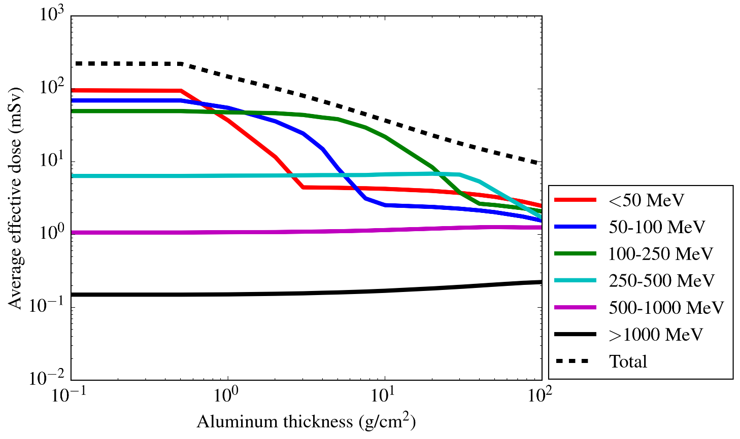
Sensitivity Studies - SPE
Tylka et al. [2] analyzed historical GLEs from 1956-2006
Provided a database of Band function parameters for most of the events (58 in total)
Tylka parameters used to quantify the contribution of various energy groups to effective dose behind shielding
Average effective dose results from all GLEs in database
SPE/GLE intensities and spectral shapes are widely varying
For specific events, relative contribution from energy groups may look very different than the average results

Slide 10
Sensitivity Studies - SPE
On average, it appears as though energy bins >500 MeV contribute very little to effective dose behind shielding
This turns out to be the case for most of the GLEs in the database
Feb 1956 (GLE5) and Sep 1989 (GLE42) are good examples of intense events with pronounced high energy tails that can make significant contributions to the total exposure
Average effective dose results from all GLEs in database
SPE/GLE intensities and spectral shapes are widely varying
For specific events, relative contribution from energy groups may look very different than the average results

Slide 11
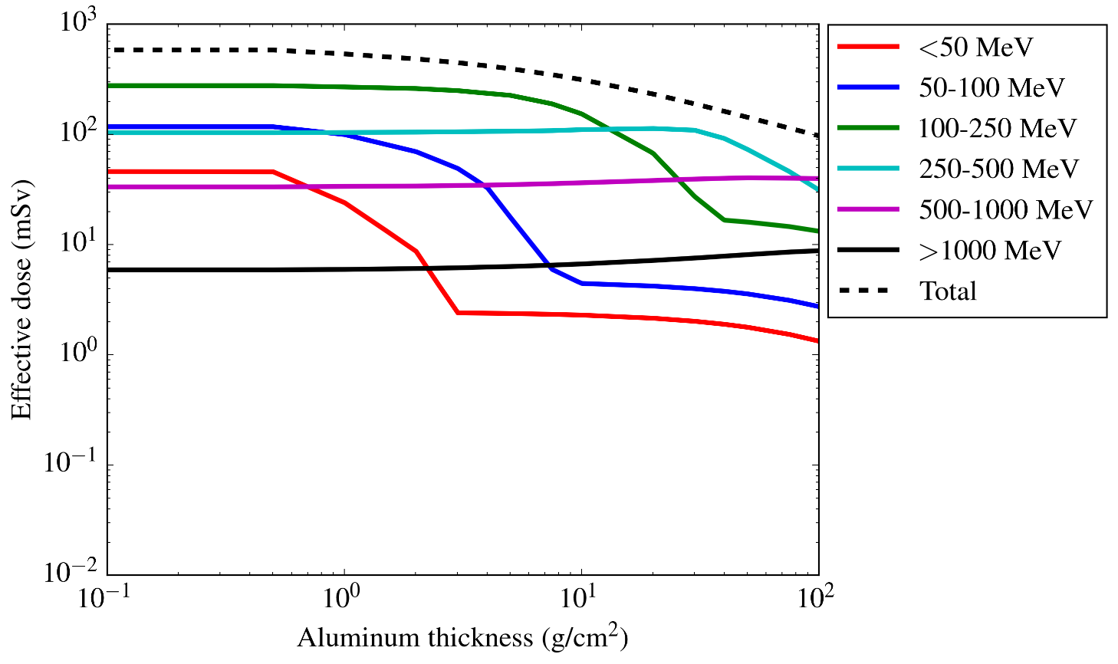
Sensitivity Studies - SPE
For the Feb 1956 event (GLE5), the highest energies (> 500 MeV) make significant contributions to the total exposure beyond ~20 g/cm²
Energy bin between 250-500 MeV still appears to dominate the exposure up to almost 100 g/cm²
Energy bin >1000 MeV contributes less than 10% across all shielding thicknesses
Similar trends seen for Sep 1989 event (GLE42)
AMS-02 measurements could help constrain the high energy tails on future events
Results for February 1956 event

Slide 12
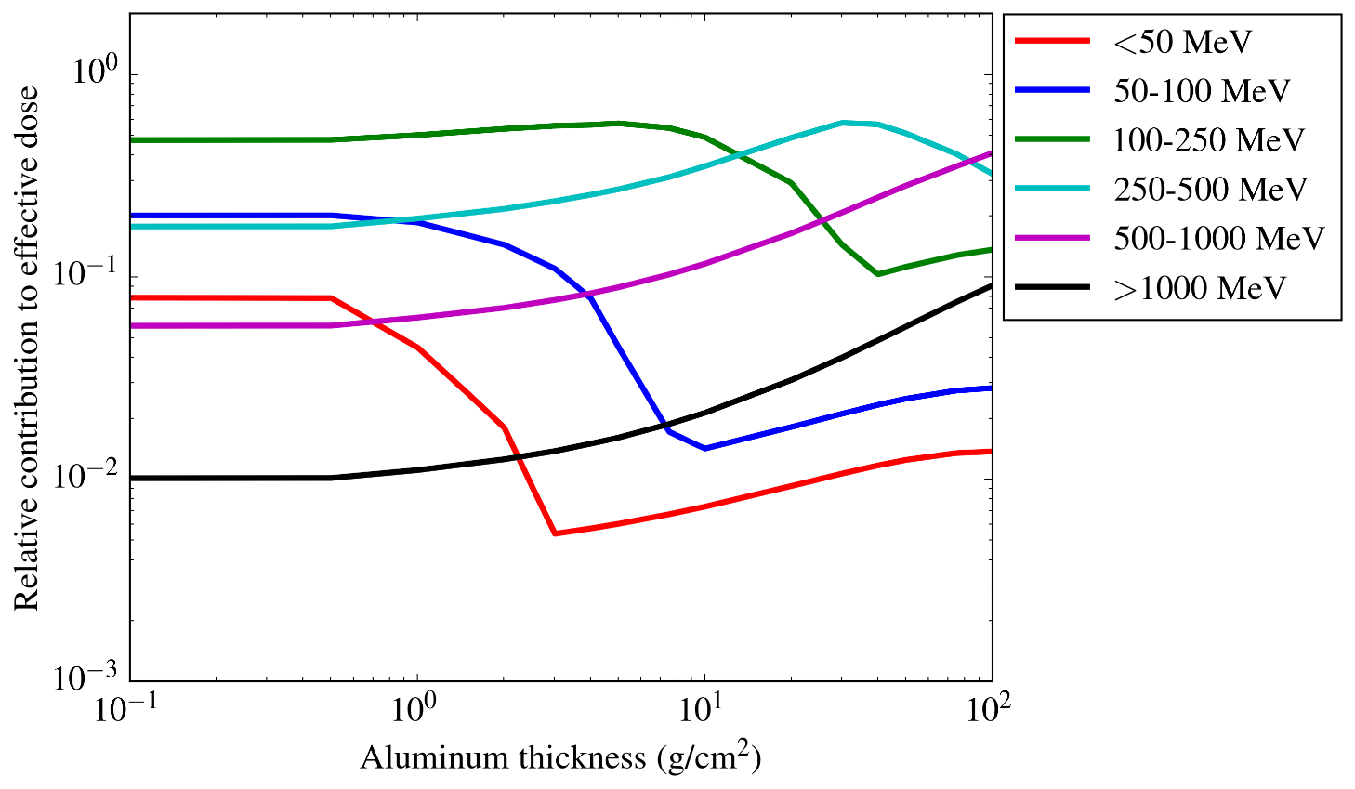
Sensitivity Studies - SPE
For the Feb 1956 event (GLE5), the highest energies (> 500 MeV) make significant contributions to the total exposure beyond ~20 g/cm²
Energy bin between 250-500 MeV still appears to dominate the exposure up to almost 100 g/cm²
Energy bin >1000 MeV contributes less than 10% across all shielding thicknesses
Similar trends seen for Sep 1989 event (GLE42)
AMS-02 measurements could help constrain the high energy tails on future events
Results for February 1956 event

Slide 13
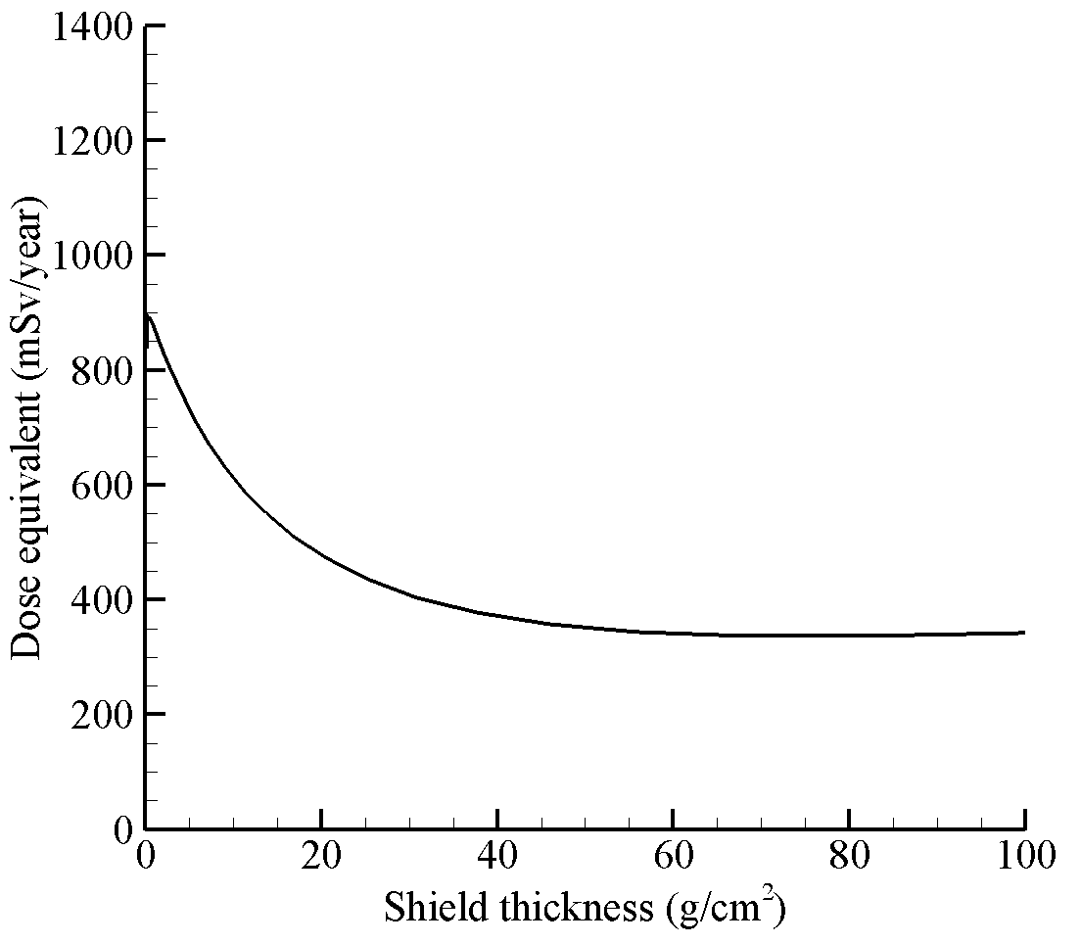
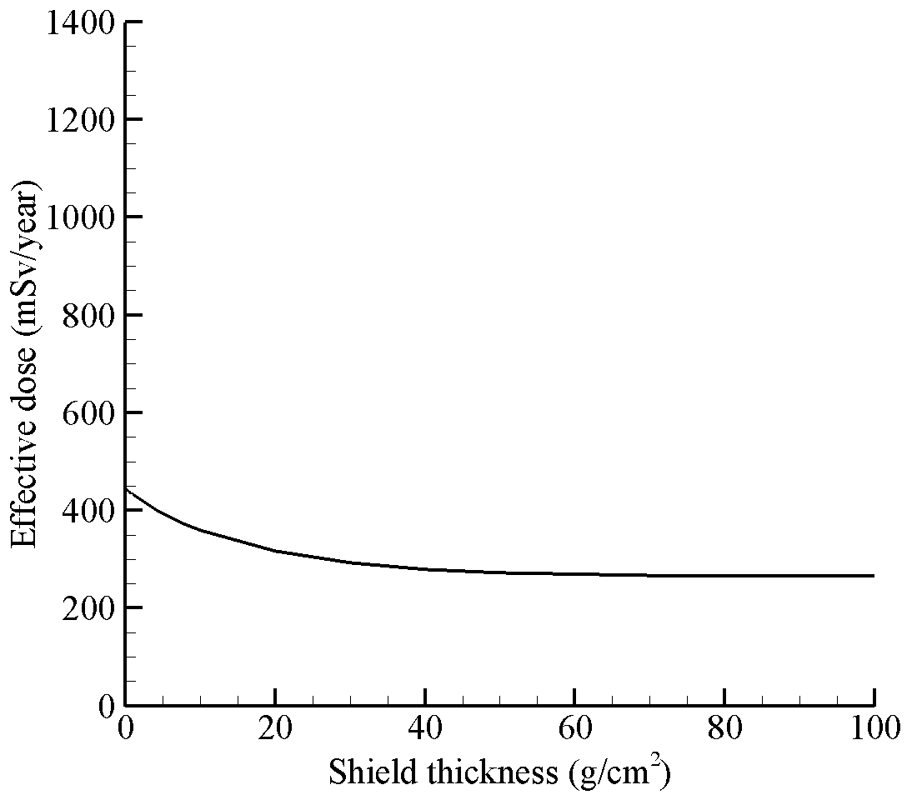
Shielding Design Strategies - GCR
Previous design paradigm for GCR environment
Exposure and risk is not effectively mitigated with passive shielding [3]
Increased shielding (mass) only slightly decreases exposures beyond ~40 g/cm²
Transport performed with HZETRN (straight ahead transport with no pion contributions)
Dose equivalent versus aluminum shield thickness
Effective dose versus aluminum shield thickness
Front shield
Target point
Note: Unless explicitly stated, all GCR results in subsequent slides are for 1977 solar minimum environment

Slide 14
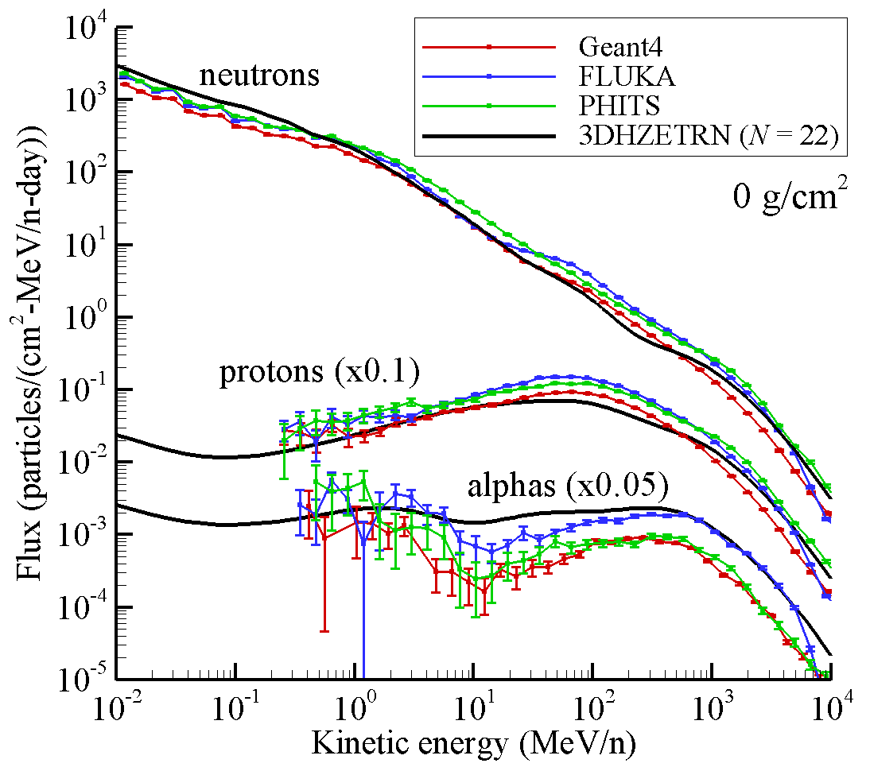
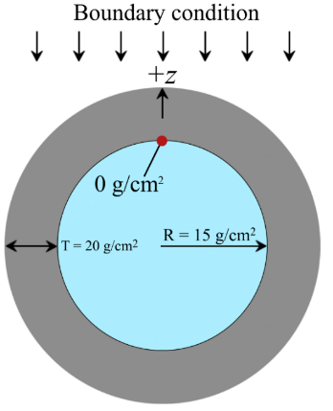
Shielding Design Strategies - GCR
Major updates to HZETRN transport code have recently been compared to Monte Carlo simulations
3D corrections for neutrons and light ions [5,7,8]
Additional contributions from pions, muons and electromagnetic cascade [6]
Current effort underway to assess impact of transport code updates
⁵⁶Fe solar minimum galactic cosmic ray spectrum
Tissue sphere with radius 15 g/cm² surrounded by 20 g/cm² of aluminum

Slide 15
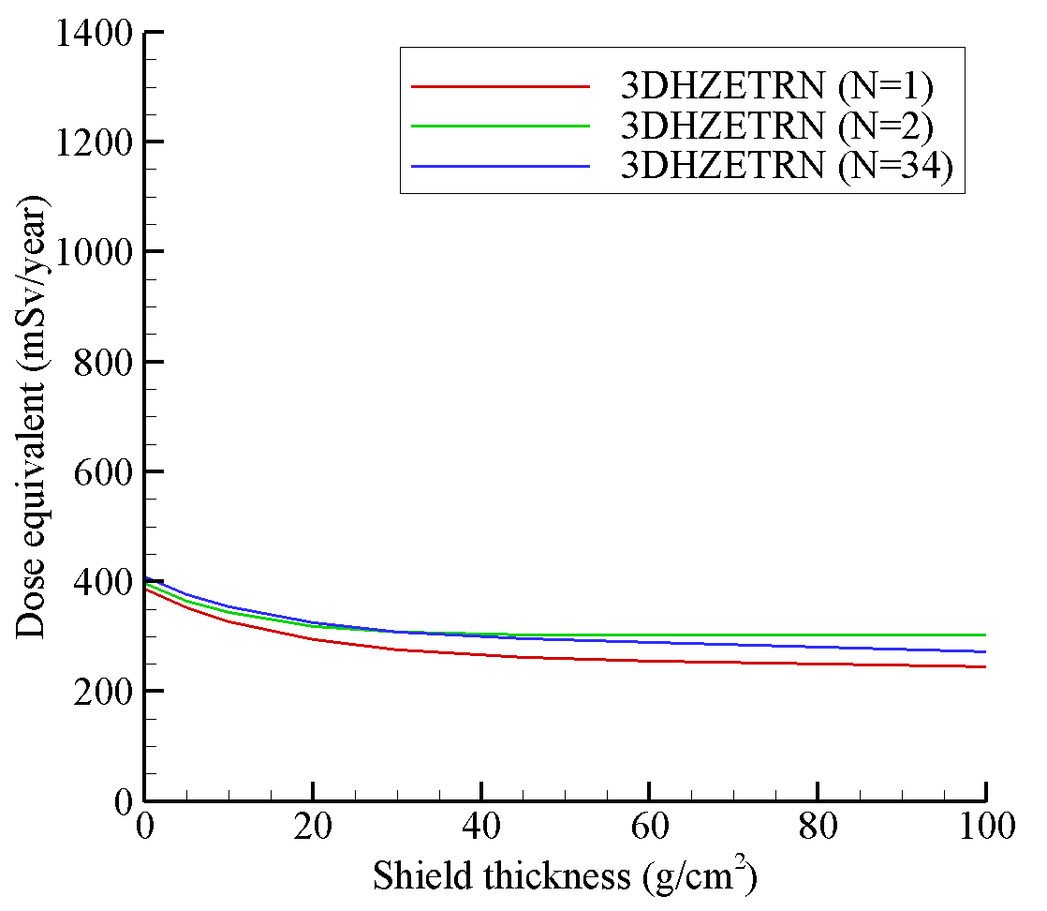
Shielding Design Strategies - GCR
Straight ahead (N=1) and bi-directional (N=2) compare reasonably well to full 3D solution (N=34) in this geometry
Effective dose (not dose equivalent) is used in vehicle and shield design but is more computationally intensive
Simplified geometry used here to provide quick comparison between transport code approximations
30 cm water used to represent tissue self shielding
Crude geometry approximation gives results very close to effective dose values
Dose equivalent versus aluminum shield thickness with 30 cm water absorber
30 cm water
Front shield
Back shield
Target point

Slide 16
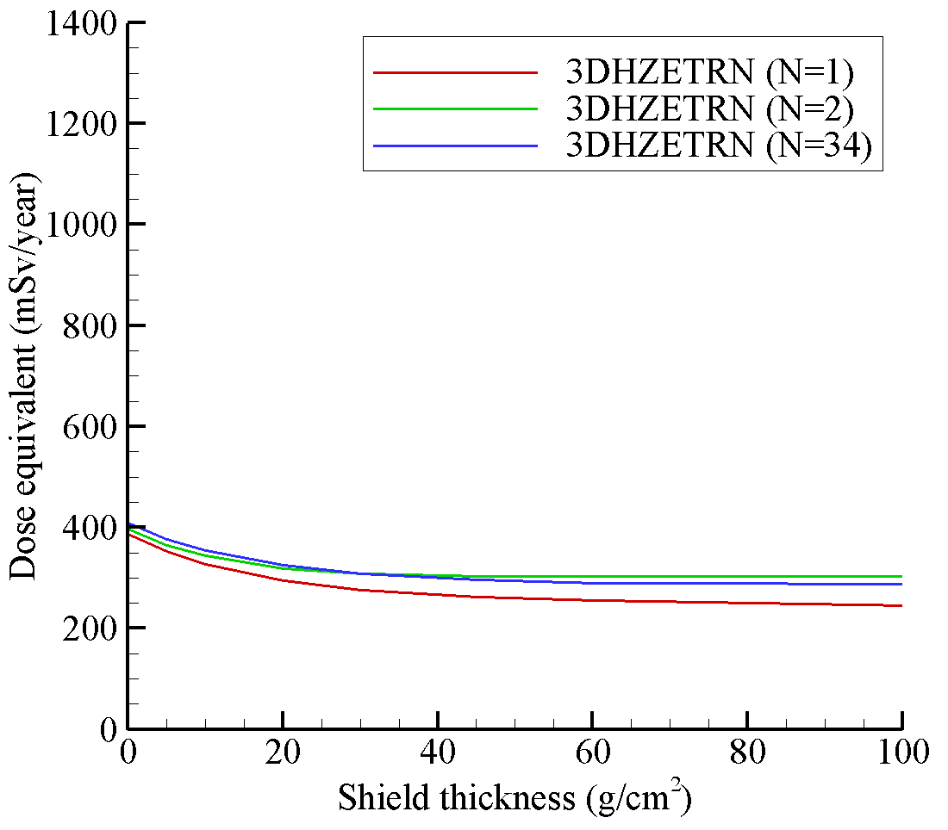
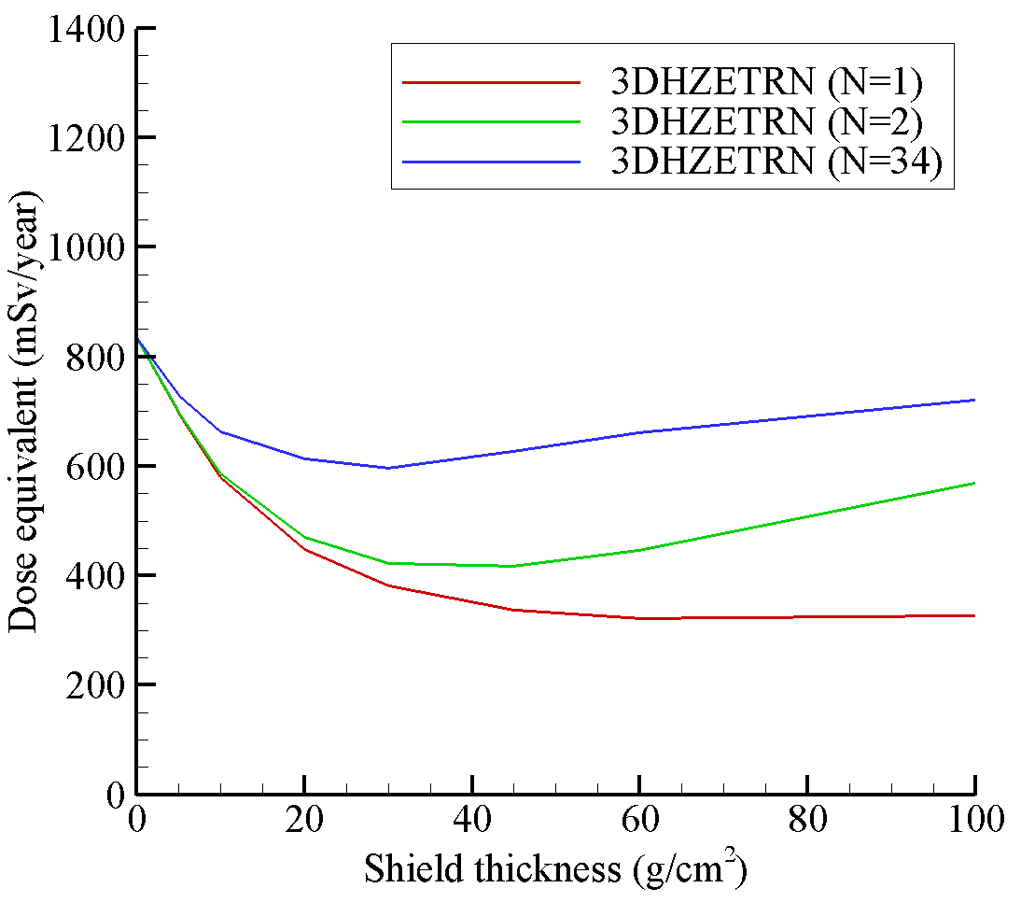
Shielding Design Strategies - GCR
The absence of water shielding greatly alters exposure versus depth results
Increased shielding (mass) can amplify exposure
Material and design optimization may be more important than previously thought for GCR environments
30 cm water
Front shield
Back shield
Front shield
Back shield
Target point
With 30 cm water absorber
No water absorber

Slide 17
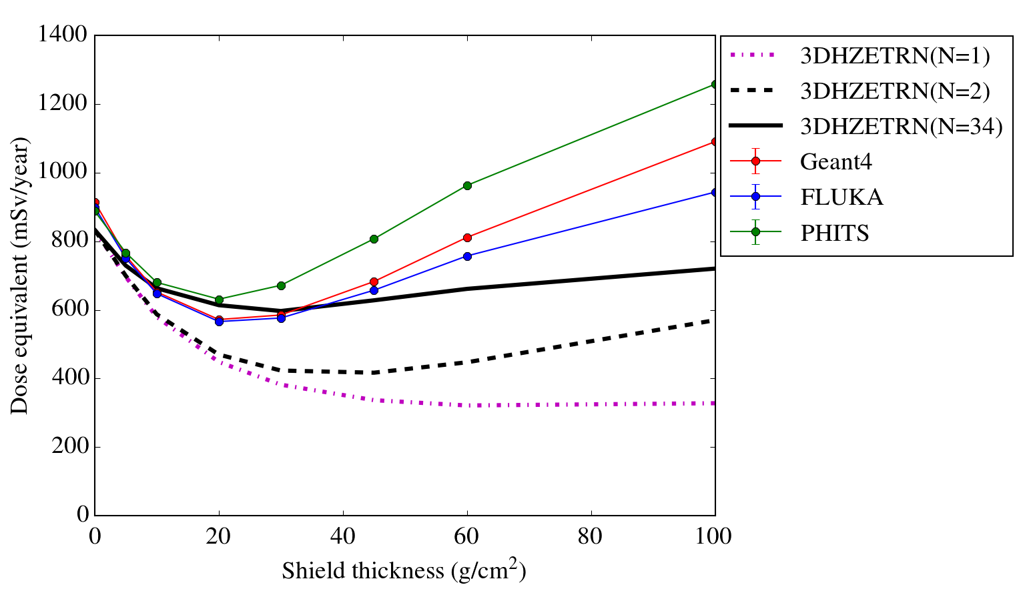
Shielding Design Strategies - GCR
Benchmarks with Monte Carlo codes are verifying a minimum in the dose equivalent versus depth curves
Utilizing idealized geometry in Monte Carlo simulations to enable computational efficiency
Geometry setup makes the local minimum appear to be more dramatic than what would be expected in a realistic vehicle (infinite lateral dimensions)
Local minimum is not as pronounced if effective dose is considered due to additional tissue shielding which effectively attenuates neutron contributions [9]
Dose equivalent versus aluminum shield thickness
Front shield
Back shield
Thin water
detector region (0.3 mm)

Slide 18
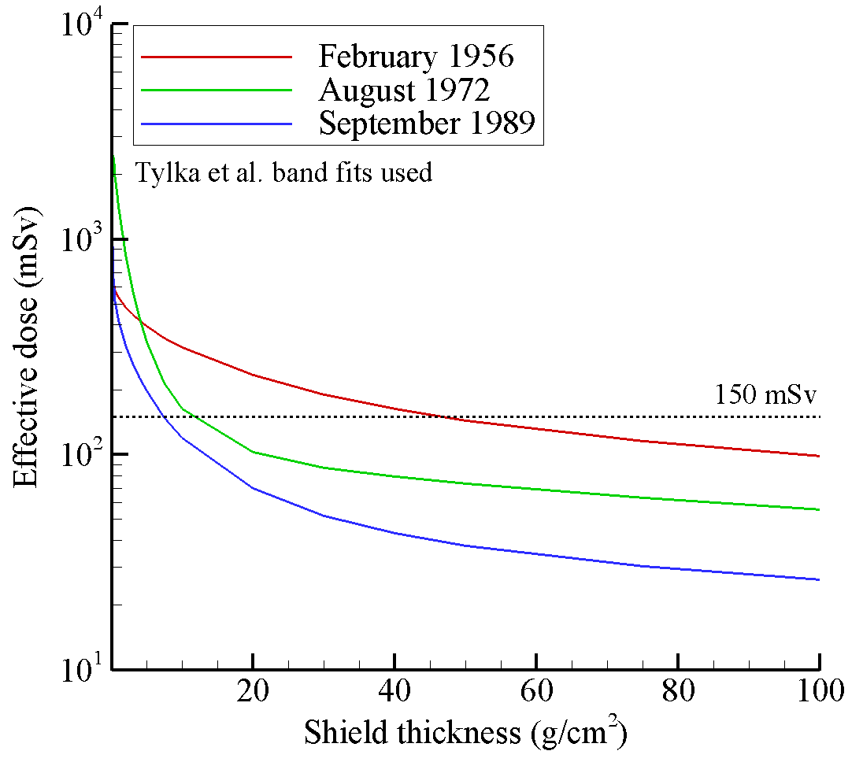
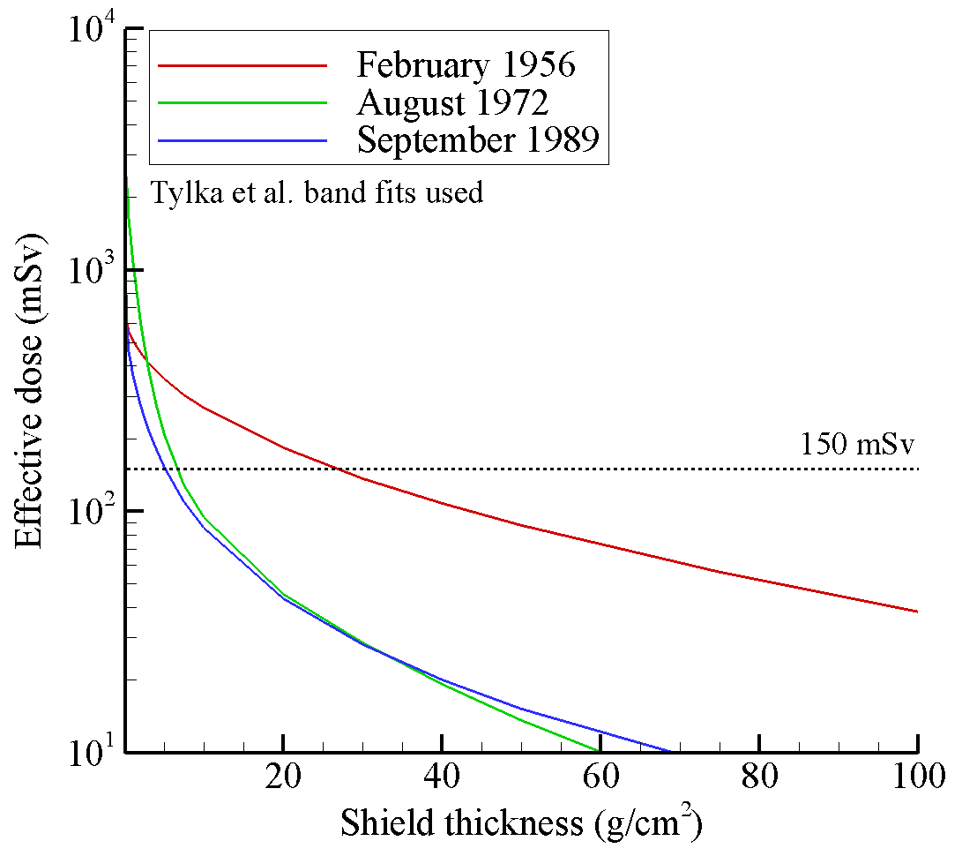
Shielding Design Strategies - SPE
For SPE environments, shield requirements are highly sensitive to the vehicle design, mission duration, destination, and other factors
There are no simple rules that define an optimal or sufficient shield design
Even if limits are met, ALARA* principle requires design efforts to further reduce exposure
The SPE used as design environment can have a significant impact on determining shield requirements
For a given SPE, location in the vehicle and onboard equipment and supplies can also have a significant impact on SPE shield design
Effective dose versus aluminum shield thickness
Effective dose versus polyethylene shield thickness
* ALARA: As Low As Reasonably Achievable

Slide 19
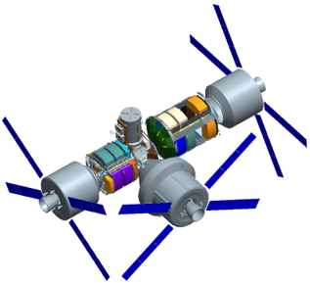
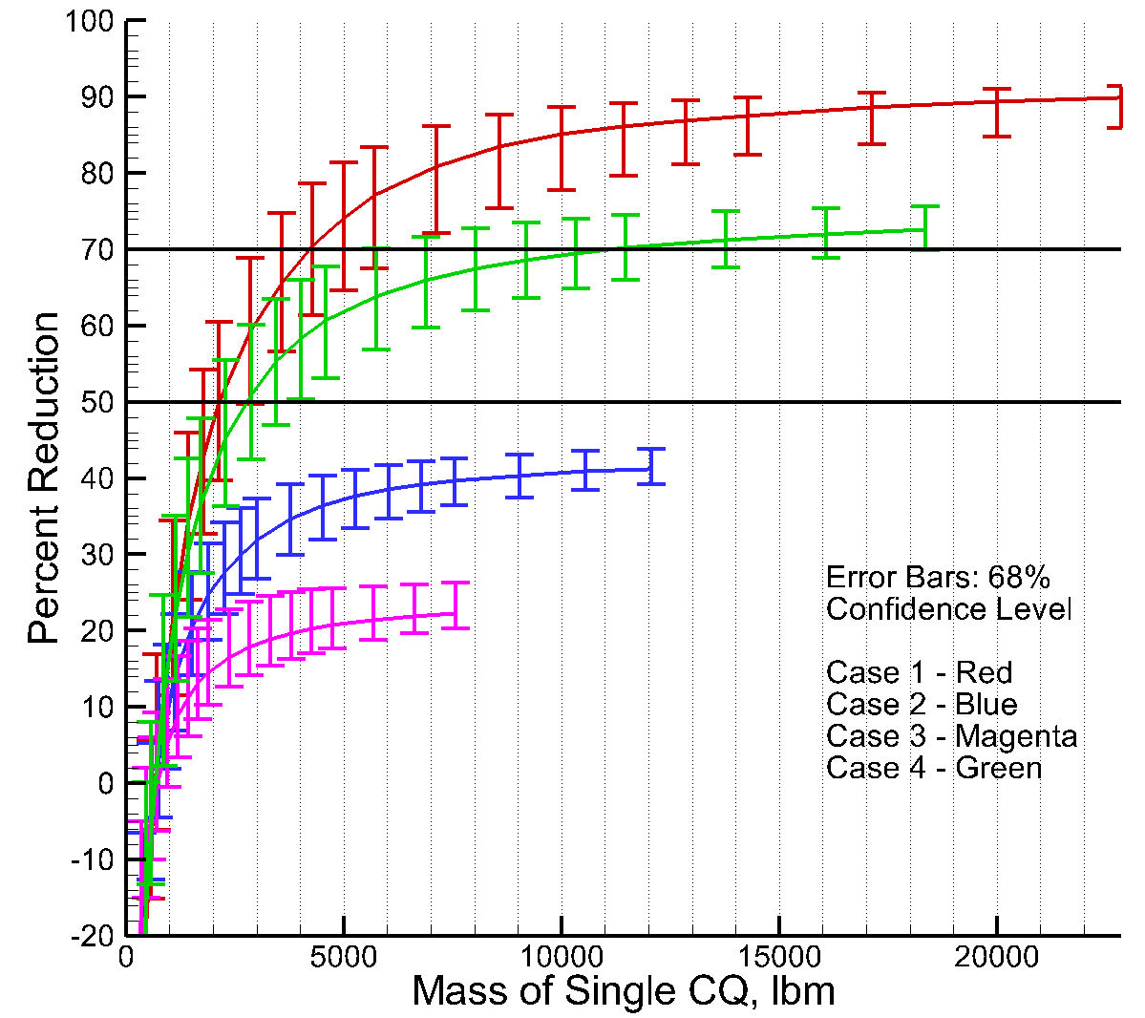
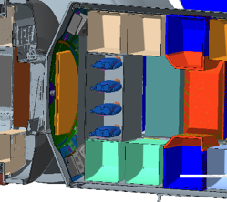
Shielding Design Strategies - SPE
Probabilistic approaches are being pursued for SPE shield design
Past efforts to design SPE protection concepts utilized either static, representative environments (e.g. King 1972 event) or a single energy spectrum representing a percentile flux based on a database of historical events (e.g. Xapsos model)
Difficult to decide which historical event or percentile flux to design against for a future mission
New approaches are being developed that leverage computational efficiency of HZETRN transport code
Astronaut exposure is evaluated for each SPE in a historical database and exposure results are analyzed probabilistically [10]
This approach makes it possible to optimize shield design no matter the spectral shape or magnitude of the SPE
Cutaway view
Reconfigurable
Shelter
Cislunar vehicle
Crew
Quarter

Slide 20
Summary
For human missions beyond low Earth orbit, exposure from SPE and GCR are a primary concern
Sensitivity studies have been performed to quantify which energies in the primary SPE and GCR environments are most import to exposure quantities behind shielding
These studies have helped identify areas where new measurements are needed to reduce environmental modeling uncertainties (AMS-02 should be helpful in both cases)
General shielding strategies for SPE and GCR environments
For SPE: passive shielding and design optimization are effective in mitigating the exposure and risk in most cases
In cases where limits are satisfied, the ALARA principle still requires designers to seek optimal shielding strategies and reduced exposures
For GCR: transport code updates and benchmarks have revealed a minimum in the dose equivalent versus depth curve for aluminum shielding near ~20 g/cm²
Material optimization may be more important than previously thought, and simply adding more mass to the vehicle design can actually make the problem worse

Slide 21
References
[1] Slaba, T.C. and Blattnig, S.R., GCR Environmental Models I: Sensitivity Analysis for GCR Environments. Space Weather, Volume 12, pp. 217-224 (2014).
[2] Tylka, A.J., Dietrich, W.F., Atwell, W., Assessing the Space Radiation Hazard in Ground Level Enhanced (GLE) Solar Particle Events. 2010 Fall AGU Meeting, San Francisco, CA (2010).
[3] Durante, M., Cucinotta, F.A., Physical Basis of Radiation Protection in Space Travel. Reviews of Modern Physics, Volume 83, pp. 1245-1281 (2011).
[4] Slaba, T.C., Blattnig, S.R., Badavi, F.F., Faster and more Accurate Transport Procedures for HZETRN. Journal of Computational Physics, Volume 229, pp. 9397-9417 (2010).
[5] Slaba, T.C., Blattnig, S.R., Aghara, S.K., Townsend, L.W., Handler, T., Gabriel, T.A., Pinsky, L.S., Reddell, B., Coupled Neutron Transport for HZETRN. Radiation Measurements, Volume 45 pp. 173-182 (2010).
[6] Norman, R.B., Slaba, T.C., Blattnig, S.R., An Extension of HZETRN for Cosmic Ray Initiated Electromagnetic Cascades. Advances in Space Research, Volume 51, pp. 2251-2260 (2013).
[7] Wilson, J.W., Slaba, T.C., Badavi, F.F., Reddell, B.D., Bahadori, A.A., Advances in NASA Radiation Transport Research: 3DHZETRN. Life Sciences in Space Research, Volume 2, pp. 6-22 (2014).
[8] Wilson, J.W., Slaba, T.C., Badavi, F.F., Reddell, B.D., Bahadori, A.A., 3DHZETRN: Shielded ICRU Spherical Phantom. Life Sciences in Space Research, Volume 4, pp. 46-61 (2015).
[9] Slaba, T.C., Mertens, C.J., Blattnig, S.R., Radiation Shielding Optimization on Mars. NASA Technical Paper 2013-217983 (2013).
[10] Kim, M.H., Hayat, M.J., Feiveson, A.H., Cucinotta, F.A., Prediction of Frequency and Exposure Level of Solar Particle Events. Health Physics, Volume 97, pp. 68-81 (2009).

