Slide 1

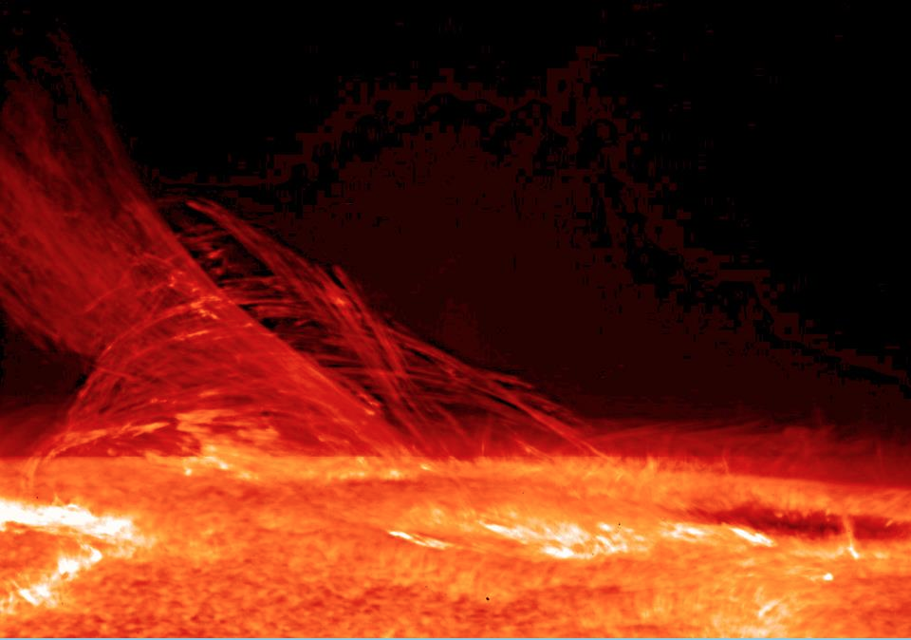
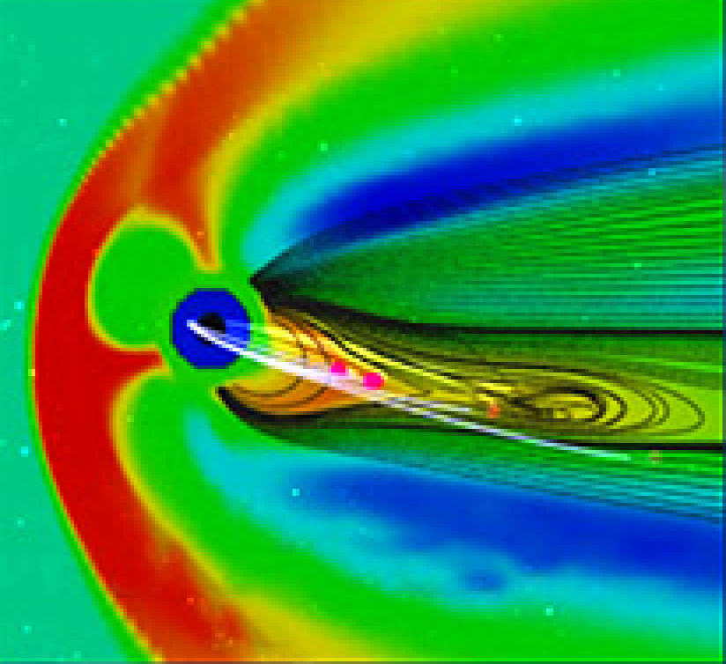
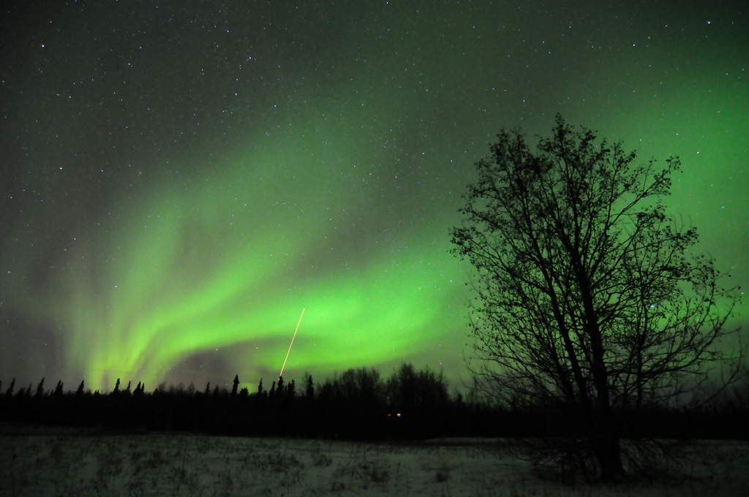
Heliophysics Science Division:
Our View of Space Weather

Slide 2
Mission
HSD conducts, for NASA, research on the Sun, the heliosphere, and interactions of Earth, other planets, small bodies, and interstellar gas with the heliosphere. Research also encompasses geospace -- Earth's uppermost atmosphere, the ionosphere, and the magnetosphere -- and the changing environmental conditions throughout the coupled heliosphere.
Research involves leading or participating in scientific flight missions, instruments, the analysis of measurements, and theory and modeling. Research also directly addresses societal needs by seeking to understand the sources of space weather effects.

Slide 3
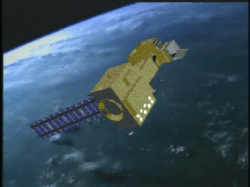
Space Weather
Substantial societal relevance
Unlike weather, many scientific underpinnings not understood
Model development immature
Driver data primarily from research missions
Space Weather is large a research field
Notes:
All components are necessary for forecast fidelity.

Slide 4
HSD Role in Space Weather
In collaboration with NASA HQ
Address key scientific problems
Provide access to space weather-relevant data streams
Develop space research models with environmental applications
Test models for space weather applications
Facilitate knowledge and technology applications to address societal needs
Provide tailored, timely, and accurate information, warnings, and forecasts for NASA’s internal space weather needs

Slide 5
HSD Commitment to
NASA’s Missions
Through the CCMC and the SWRC identify and bring to bear the latest knowledge and technology on NASA’s needs
Partner with SRAG to support, through SRAG, the human flight program
Develop continually new technologies, approaches, and capabilities to serve NASA’s robotic mission needs
We seek your input!
Notes:
All components are necessary for forecast fidelity.

Slide 6
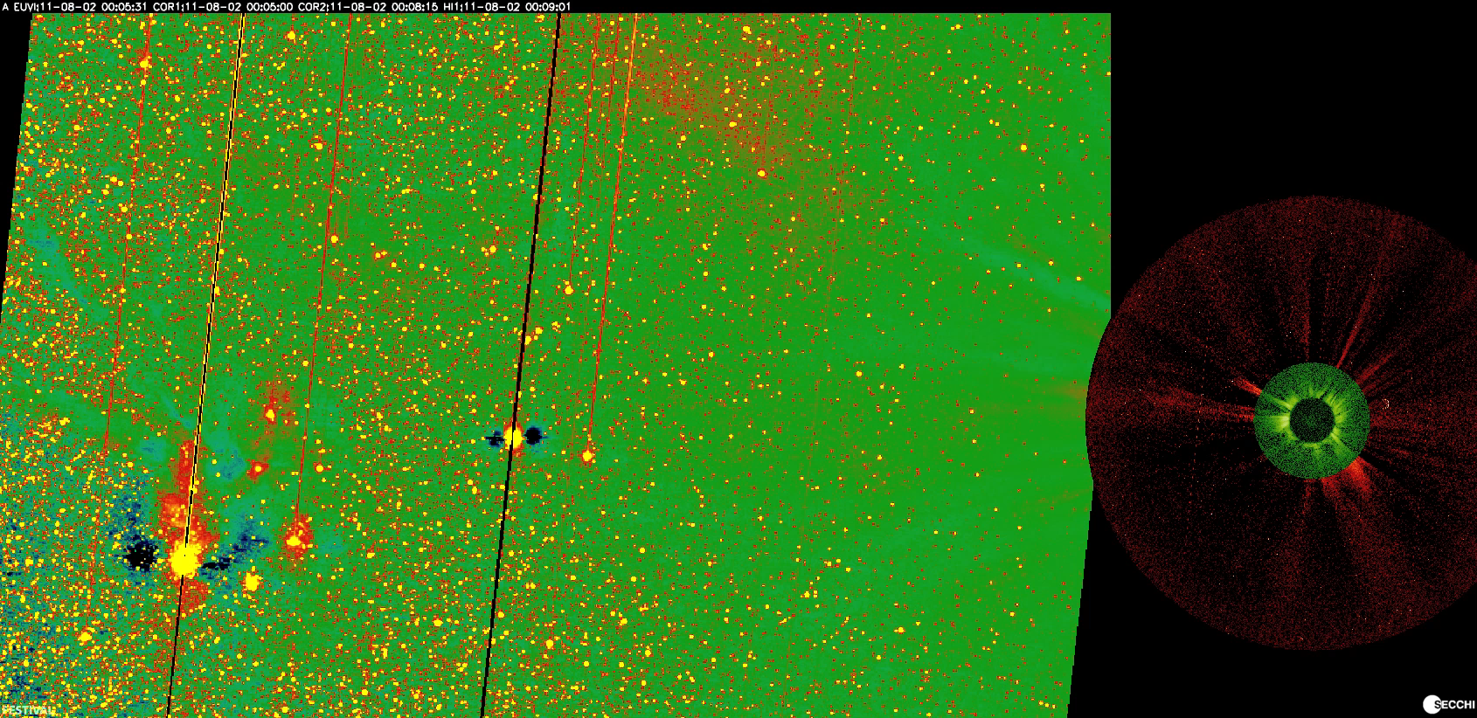
STEREO A 8/2-5/2011

