Slide 1
Predicting Space Weather Effects on Close Approach Events
2015 AMOS Conference
M.D. Hejduk
Astrorum Consulting
L.K. Newman
NASA Goddard Space Flight Center
R.L. Besser and D.A. Pachura
Omitron Inc.

Slide 2
Agenda
Pc and Pc error modeling
Atmospheric drag basics
The JBH09 atmospheric model and the Anemomilos solar storm compensation model
Determining conjunction event sensitivity to atmospheric density mismodeling
The Space Weather Trade Space (SWTS)
  Three canonical response types
SWTS response statistics
Conclusions

Slide 3
Computing Pc
The Probability of Collision (Pc) represents the probability that two satellites will come within a specified miss distance of each other
In most cases, it can be calculated by the area integral below:
  r is the nominal miss distance between the satellites
  C is the combination of the two objects’ covariance matrices
  A is the area representing the combined size of the two objects
Calculation thus considers the uncertainty in the state estimates (as represented by the covariance) in forming the probability
Notes:
This Pc approach possesses a substantial advantage over the use of simple miss-distance calculations in that it incorporates the uncertainties of the two state estimates, so that as these estimates increase substantially in uncertainty, the resultant Pc decreases and ultimately approaches zero.

Slide 4
Evaluating Pc
Is it realistic?
  Reflects errors properly and accurately (is the covariance appropriately sized?)
  JSpOC recently added improved consider parameters and other enhancements; covariance realism notably improved
Is it complete?
  Attempts to take cognizance of all of the known error sources
  Many sources with varying levels of availability
    Position estimate uncertainties (reasonably known)
    Satellite sizes (sometimes known)
    Atmospheric drag (generally not as well known/predicted)

Slide 5



Atmospheric Drag
Atmospheric drag magnitude:
  is ballistic coefficient
  ρ is atmospheric density
    Atmospheric rotation changes satellite-atmosphere relative velocity slightly
  Solar cycle and space weather have strong impact on neutral atmospheric density
    Solar storms represent particularly difficult density estimation situation
  Uncertainties in β and ρ not separable
    Effect of changes in drag can be emulated by varying β

Slide 6
Conjunction Assessment:
JSpOC Process and Products
Time of Closest
Approach (TCA)
Now
Time
SSN obs
Primary
Object
Predicted
Conjunction
Event
Batch OD
Secondary
Object
Propagation using
predicted atmospheric density
(HASDM/DCA model with
Predicted EUV indices)
Batch OD
JSpOC High Accuracy
Catalogue (ASW)
Conjunction Data Message (CDM) provided for each screening:
  Includes both objects’ state vector and position covariance at TCA
    Allows computation of probability of collision (P_{c})
Notes:
We are aware that there are other data that can vary significantly from the F10.7, but we are limited to using only what is modeled in the NOAA daily files as that is what the JSpOC delivers to us in the catalog screenings.
New HASDM includes 11 different models (F10, S10, M10, Y10 F10bar, S10bar, M10bar, Y10bar, Ap, DST, DTC)
Decision-making time vs TCA – forced to make a decision before have good data

Slide 7
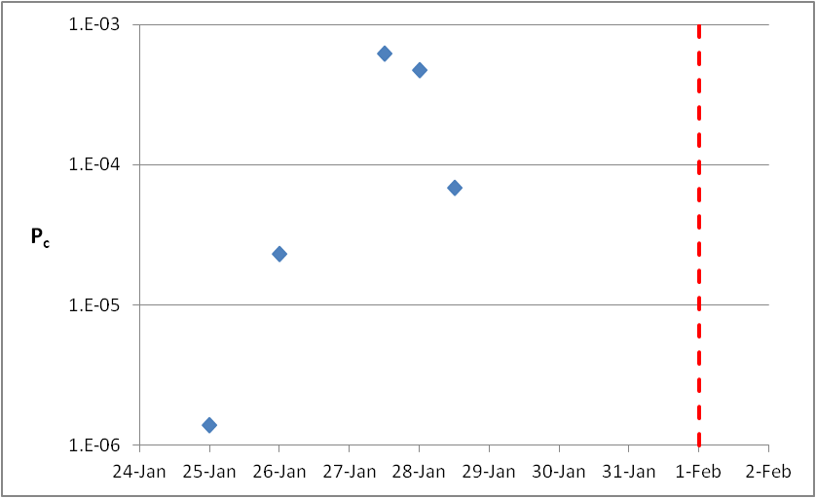
Space Weather and Conjunction Assessment: A Notional Event
TCA
25 Jan: first identification of possible conjunction on 1 Feb
27-28 Jan: P_{c} first increases to level of concern before starting to fall (looking safer)
29 Jan: Alert of a Coronal Mass Ejection (CME) heading for Earth on 31 Jan
Spacecraft O/O wants to know if (and how) CME will impact conjunction event
Does the new space weather prediction make this event safer or riskier?
Might performing a maneuver make the conjunction event worse?
?
Notes:
Same thing in different view
Think is tailing off, but have CME - is it really still not a threat?

Slide 8
Jacchia-Bowman-HASDM-2009
Atmospheric Model
Product of AFSPC/A9 and Solar Environment Technologies
Updates/enhancements to many of the internal empirical models
Employs DCA for optimized performance during fit-span
Solar storm modeling included (more on this later)
Accepts frequent updates of expanded set of solar indices (11 EUV indices)
Accepts 6-day predictions of solar indices and employs them for propagations up to 6 days
Improves accuracy of predictions up to 72 hours by 20-45%

Slide 9
JBH09 Solar Storm Predictions
Solar storms detected ~10 min after event, but can take 50 hours to reach Earth
  Want to predict effects after detection, without waiting for traditional geomagnetic indices to reflect storm presence (“chasing the action”)
JBH09 includes Anemomilos solar storm prediction model
  X-ray magnitude of the flare used to determine mass of ejecta; this gives size and severity of storm
  Flare intensity used as proxy for acceleration; integral gives storm velocity and therefore estimate of time of arrival
  Heliolocation gives storm direction and therefore likelihood of hitting the Earth
  These data can be used to predict atmosphere temperatures as function of time and therefore neutral density estimate
    However, no error analysis with model

Slide 10
Event Sensitivity to Solar Storms
Previously, in presence of solar storm, drag model error magnitude not known but “direction” known
  Models did not attempt to predict solar storm effects in advance of arrival, but solar storm bound to increase drag over quiescent case
With solar storm compensation, model error undoubtedly smaller, but direction indeterminate—could over- or under-compensate
Thus, need to determine solution’s sensitivity to density mismodeling
Can do this by systematically varying the ballistic coefficient
  Recall that density and ballistic coefficient coupled—varying one has similar effect to varying the other:
  If done systematically, can generate an entire trade-space of effects of potential density forecasting errors

Slide 11
The Space Weather Trade Space
Space Weather Trade Space (SWTS) tool developed by CARA to evaluate conjunction event’s sensitivity to solar storm drag mismodeling
Ballistic coefficient for primary and secondary satellites each varied ± half an order of magnitude about the event nominal values
Pc calculated for each pair of ballistic coefficient alterations
Trade-space plots constructed
  X-axis gives variation of primary satellite’s ballistic coefficient
  Y-axis gives variation of secondary satellite’s ballistic coefficient
  Contour color gives resultant Pc value
Pc absolute values not important but contour pattern in relation to nominal value
  Is the response contoured or flat?
  Is the nominal value at a ridge or off the peak?

Slide 12
SWTS “On-ridge” Situation
Pc on or within half an order of magnitude of highest contour
Mis-modelling in drag will only cause Pc to decrease
Operator can confidently make mitigation decision using this data because worst case already exists

Slide 13
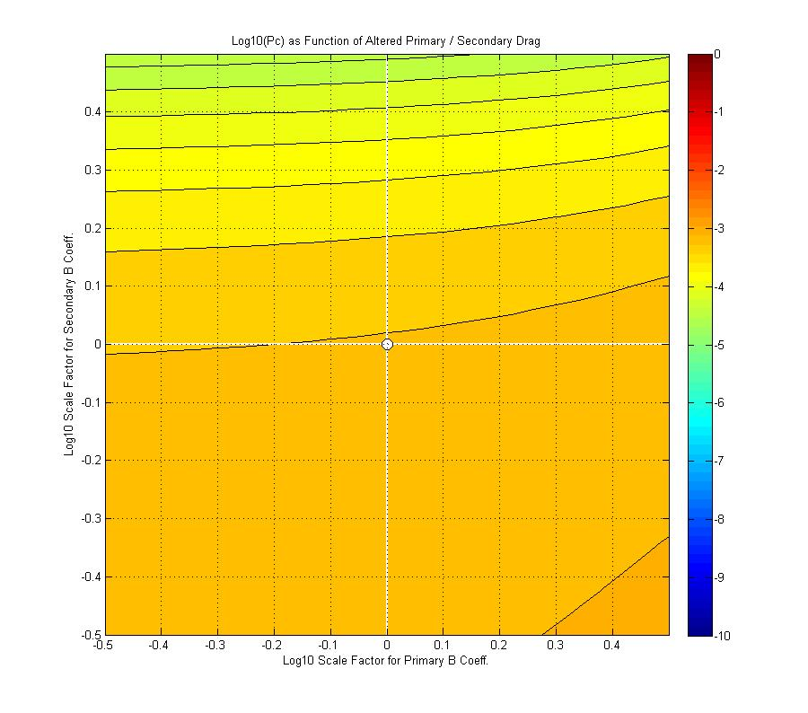
SWTS “Flat” Situation
Pc varies less than an order of magnitude across the full trade space
Drag mismodelling will thus have no effect on Pc
Operator can confidently make mitigation decision using this data because Pc is unaffected by mismodelling

Slide 14
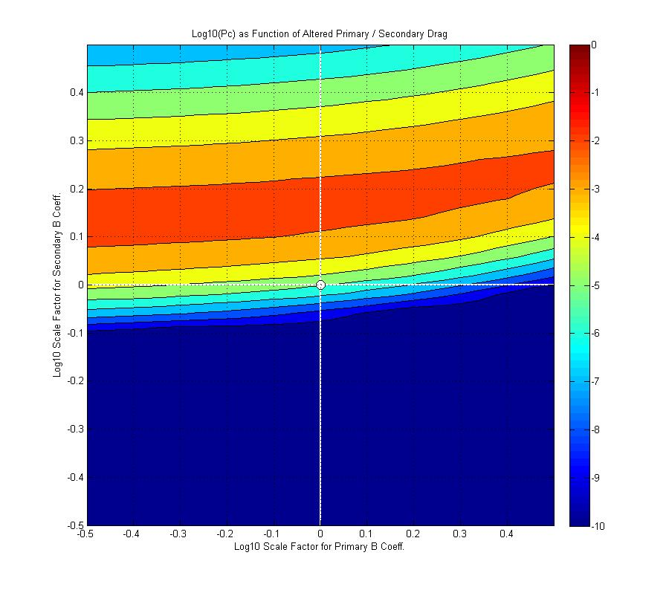
SWTS “Off-peak” Situation
Pc varies by more than an order of magnitude across the trade space
Nominal Pc is more than half an order of magnitude from the maximum
Density mismodelling could either increase or decrease the risk of the event
The tool does not provide any helpful information to the Owner/Operator in this case

Slide 15
SWTS Type Frequencies
SWTS useful only in “on peak” or “flat” situations
  How prevalent are these situations?
Developed software to analyze 16,000 SWTS plots generated since function implemented operationally 18 months ago
Categorized results by orbit regime of primary object, as defined in table below
Orbital Regime | Definition
LEO #1 | Perigee ≤ 500 km & Eccentricity < 0.25
LEO #2 | 500 km < Perigee ≤ 750 km & Eccentricity < 0.25
LEO #3 | 750 km < Perigee ≤ 1200 km & Eccentricity < 0.25
LEO #4 | 1200 km < Perigee ≤ 2000 km & Eccentricity < 0.25
HEO #1 | Perigee ≤ 2000 km & Eccentricity > 0.25

Slide 16
“Max Pc 0”
Special case of “Flat” category
If Pc exceeds 1E-05, plots are generated from that time through the time of closest event.
If Pc “rolls off” (goes to zero) during that time, the plot reflects a Pc of 0 – a flat case
Tabulated separately because these cases are discarded

Slide 17
Max Pc / Min Pc
Plot shows ratio of maximum to minimum Pc
80% have dynamic range between 4 and 7 OoM
  Thus, most cases ridged
Only a few percent have ratio smaller than one order of magnitude
  Thus, very few “flat” response situations

Slide 18
Max Pc / Nominal Pc
Plot shows ratio of maximum Pc to the event nominal Pc
60% of LEO 2 and 3 (most of CARA primaries) show less than half an OoM difference between max and nominal
  Either “on ridge” or “flat”
Thus, majority of time tool results are informative
Results somewhat worse for high-drag satellites (LEO1)

Slide 19
Combined Results
Max Pc = 0 included here for completeness
“At peak” a majority result for most orbit regimes
  If Max Pc = 0 removed, then a supermajority
Thus, most useful “at peak” category represents a considerable majority of cases (75% in LEO 2)

Slide 20
Conclusions
While actual atmospheric density estimation errors not available, possible to identify situations in which remediation decisions can be insulated from these errors
SWTS identifies such situations by contour pattern and placement of nominal solution value within the pattern
Majority of cases allow the conclusion that the nominal Pc can be used as a conservative evaluation of the situation, despite unmodeled solar storm atmospheric density errors
Improvements to situation will probably come from physics-based atmospheric models
  A problem for space physicists

