Slide 1
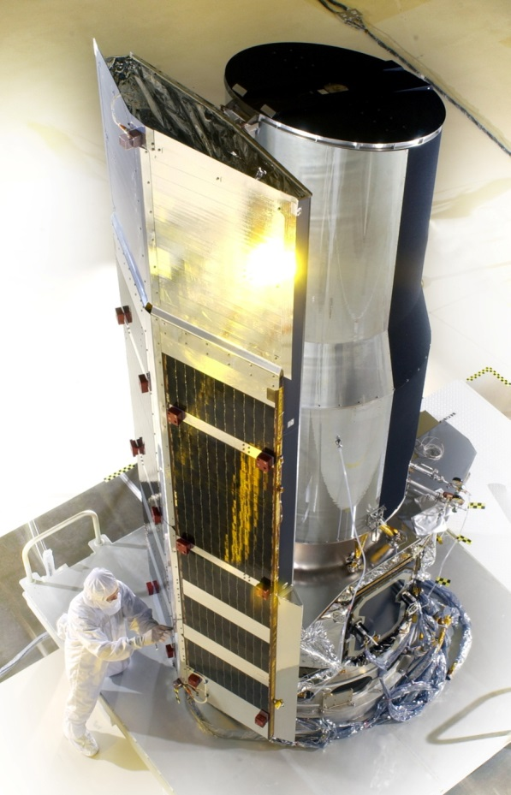
Seventh NASA Space Weather and Robotic Mission Operations Workshop
National Aeronautics and Space Administration
Jet Propulsion Laboratory
California Institute of Technology
Joseph C. Hunt Jr.
Spitzer Deputy Mission Manager / Flight Director
September 29, 2015
Jet Propulsion Laboratory
California Institute of Technology
4800 Oak Grove Drive
Pasadena, CA 91109-8099 USA

Slide 2
Agenda
Mission Overview
Subsystems Monitored for Space Weather Impacts
Operational Space Weather Process
Summary of Key Events
Summary

Slide 3
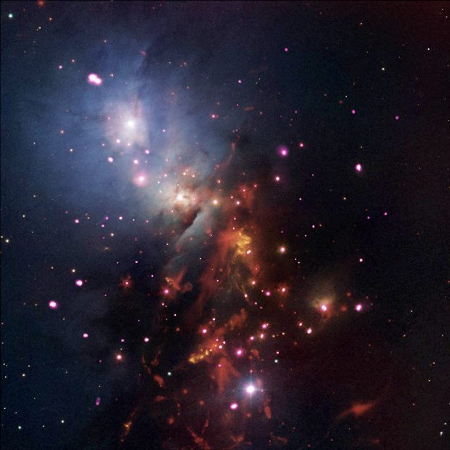
Mission Overview
Spitzer Space Telescope
Stellar Sparklers That Last
Salient Features
Heliocentric orbit trailing the Earth, (1.383 AU)
85 cm Beryllium telescope operating at 26K
2 arrays with 3-5 micron wavelength coverage
operating at ~28.7K
Launch date: August 25, 2003, Spitzer warm mission began July 27, 2009
August 2015 Spitzer completed 12 years of Science Operations.
Observing time avail. to general community: 100%
NGC 1333 is a star cluster populated with many young stars that are less than 2 million years old. Data from Chandra and Spitzer show X-ray brightness mainly depends on the size of the star. In other words, the bigger the stellar sparkler, the brighter it will glow in X-rays.
.
Science
To study the properties of extrasolar planets and search for super-earths around nearby solar-type stars
To study galaxies as they were when the Universe was less than 1 Gyr old, and to understand how galaxies and clusters of galaxies have evolved with cosmic time.
To complete the census of the Galaxy for young stars, star forming regions and dusty post-main sequence stars, and search for new classes of brown dwarfs and super-planets.
To determine the cosmic distance scale in the local Universe with unprecedented precision by the first systematic application of mid-infrared observations to this critical problem.

Slide 4
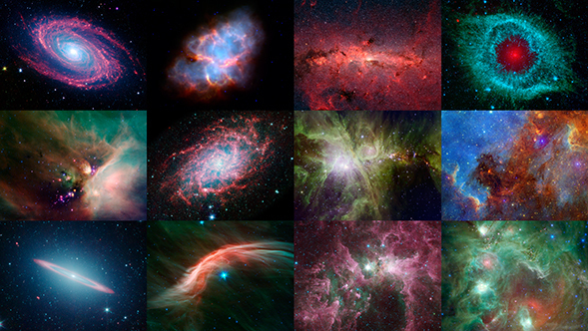
08.20.15 Colorful Calendar Celebrates 12th Anniversary of NASA's Spitzer
http://www.spitzer.caltech.edu/news/1796-feature15-10-Colorful-Calendar-Celebrates-12th-Anniversary-of-NASA-s-Spitzer

Slide 5
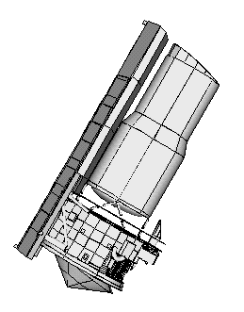
Spitzer Orbit
Geometry drives operational challenges
Oct 2018
Oct 2016
Spitzer follows the Earth around the Sun. Its orbit is slightly more elliptical than the Earth’s and it slowly recedes from Earth at about 0.1 AU/yr.
Notes:
Describe mission phases

Slide 6
Ground Segment Requirement
Warm Mission Science Phase
Monitor and annotate for S/C performance impacts and degraded science.
  No actions required from the ground
        Launch and Cryo Science Mission Phase
Space Weather event producing protons exceeding the 100 MeV energy level and particle flux greater than 100 pfu
The Ground Segment, using both local and telemetry information,
shall decide the time at which the Observatory is to resume
science operations after a solar flare
  real-time or stored sequence commands to accomplish this.
The Ground Segment shall recognize and respond to a solar flare
event within 12 hours occurrence
  powering off non-essential loads as necessary to minimize radiation effects.

Slide 7
Space Weather Monitor Sources
GSFC SWRC-Space-Weather-Research-Center
  SWRC Alerts
  SWRC Model with Spitzer’s coordinates
  SWRC Summary Reports
NOAA GOES
  After more than twelve years of drifting away from the Earth, Spitzer’s distance from Earth is ~1.38 AU, and the GOES satellites no longer serve as a predictive tool for the S/C however, may provide ground transmission possible impacts.
STEREO A/B
  During Spitzer’s prime mission phase, STEREO-B and Spitzer shared the same heliocentric Right Ascension ,no longer applicable. STEREO-A is approaching in right Ascension and could provided useful data to support alerts.
SPITZER
  Power Subsystem, Star Tracker, Mass Memory Card and IRAC instrument have proven to exhibit behavior that directly correlates to space weather events.

Slide 8
Spacecraft Right Ascension 2016

Slide 9
Subsystems Monitored for Space Weather Impacts
Mass Memory Card (MMC) Soft Scrub Errors
  The EDAC continues to correct for single bit errors due to background radiation. The corrections are summed by the ratio of corrupted bits over time.
Power/Solar Array Panel
  Continuous trending provides performance statics for the output power. All deviations are correlated and disposition.
Star Tracker
  STA component-level fault protection utilizes a series of checks to test the component health. Values are set to monitor counters for fault persistence.
Infrared Array Camera (IRAC) Radhits
  In the benign space weather environment, based on the instrument exposure time the nominal observed Radhits are 4 per second with very little scatter.

Slide 10
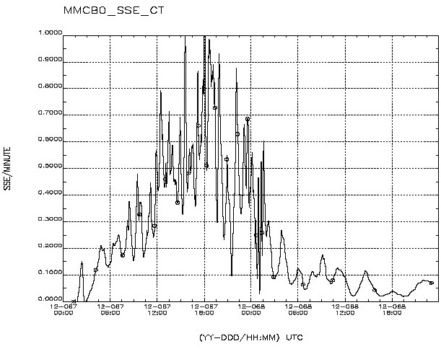
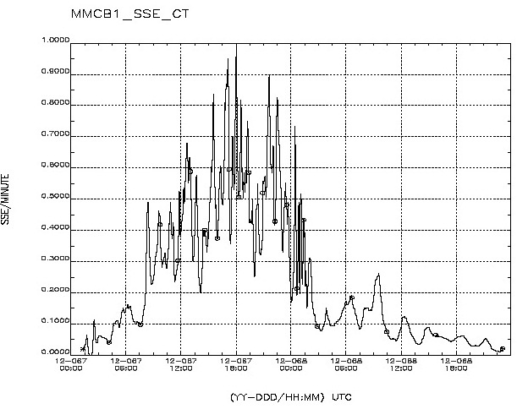
Spitzer’s Space Weather Impacts
Mass Memory Card (MMC) Soft Scrub Errors
  The EDAC continues to correct for single bit errors due to background radiation. The corrections are summed by the ratio of corrupted bits over time.
  Increased background “noise” and the rapid changes in soft scrub error rates are indicative of space weather events.
Spitzer MMC Board 0 and Board 1 Soft Scrub Error Counts during March 7-8, 2012 CME Event.

Slide 11
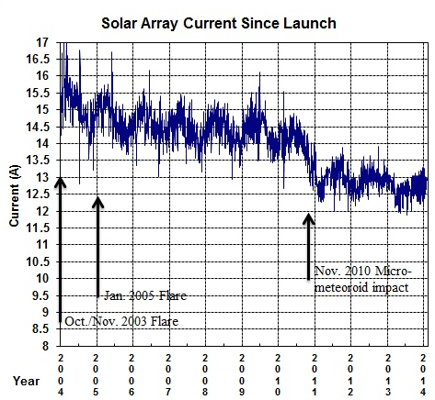
Spitzer’s Space Weather Impacts
Power/Solar Array Panel
  Continuous trending provides performance statics for the output power.
  Major solar weather events in October-November 2003 and January 2005 reduced the solar panel assembly output by 4.7% and 2.8%, respectively. In addition, in early November 2010, a micrometeoroid impact damaged one of the solar panel assembly’s strings, reducing the total power output by an additional 6.5%. The solar panel still operates well within the power output margin.

Slide 12
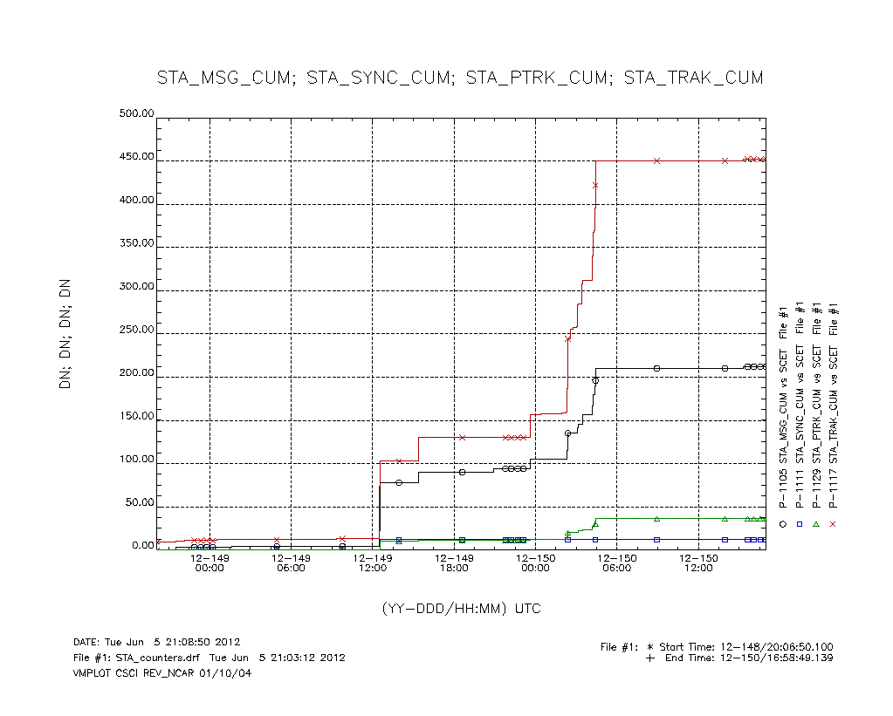
Spitzer’s Space Weather Impacts
Star Tracker
  STA component-level fault protection utilizes a series of checks to test the component health.
  The accumulated and cumulative counts increased resetting the STA. This correlated with the May 2012 space weather event.
STA Reset

Slide 13
Spitzer’s Space Weather Impacts
Infrared Array Camera (IRAC) Radhits
  Based on the instrument exposure time the nominal observed Radhits are 4 per second with very little scatter.
  (No functional impact to the Instrument, however Loss of 69.6 hours of Science data for the space weather event on DOY 067/2012).

Slide 14

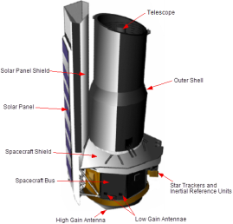
Spitzer Space Weather Process
Manual Process
No
Receive
E-mail Alert
Predicted
Spitzer
Impact
Yes
Annotate Master
Anomaly
Report & Log
Notification
Message
To Analysts
EXCEL Spreadsheet
Alert msg Info
End
Provide Updates for Anomaly
Report &
Spreadsheet
S/C & Inst.
Analysis for
Impact
Yes
Telemetry
Processes
No
End

Slide 15
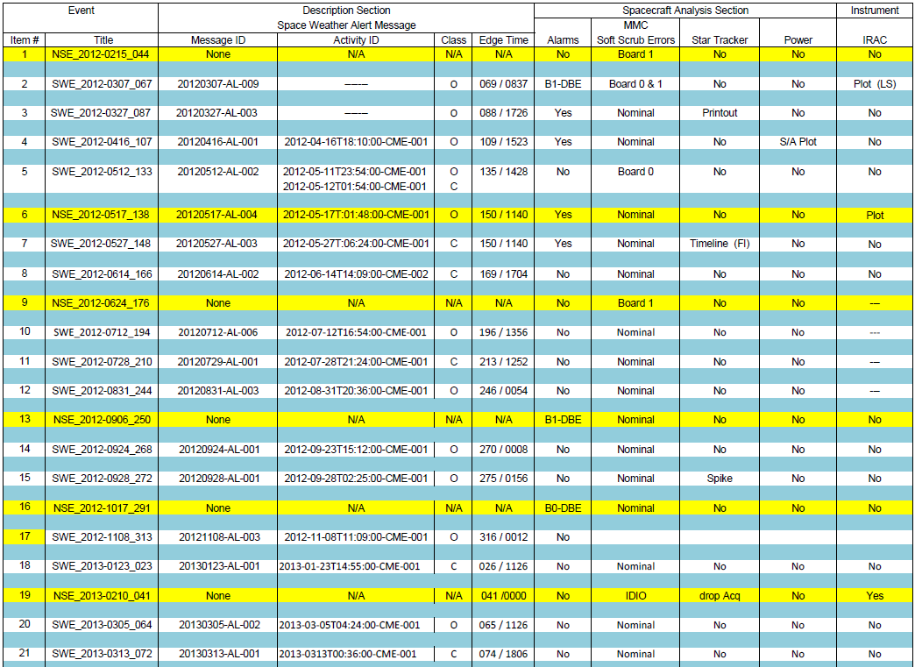
Master Space Weather Summary

Slide 16
Space Weather Process - Automated

Slide 17
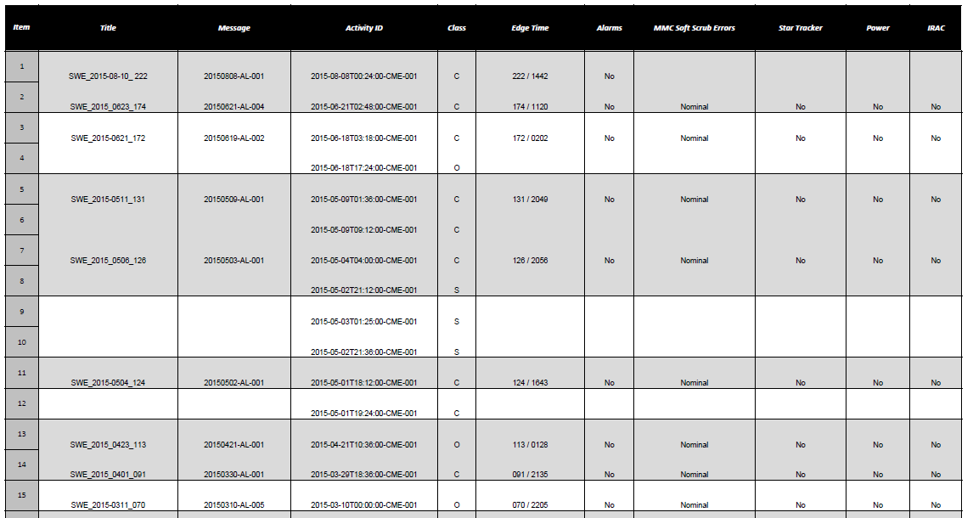
Collaborative HTML Page

Slide 18
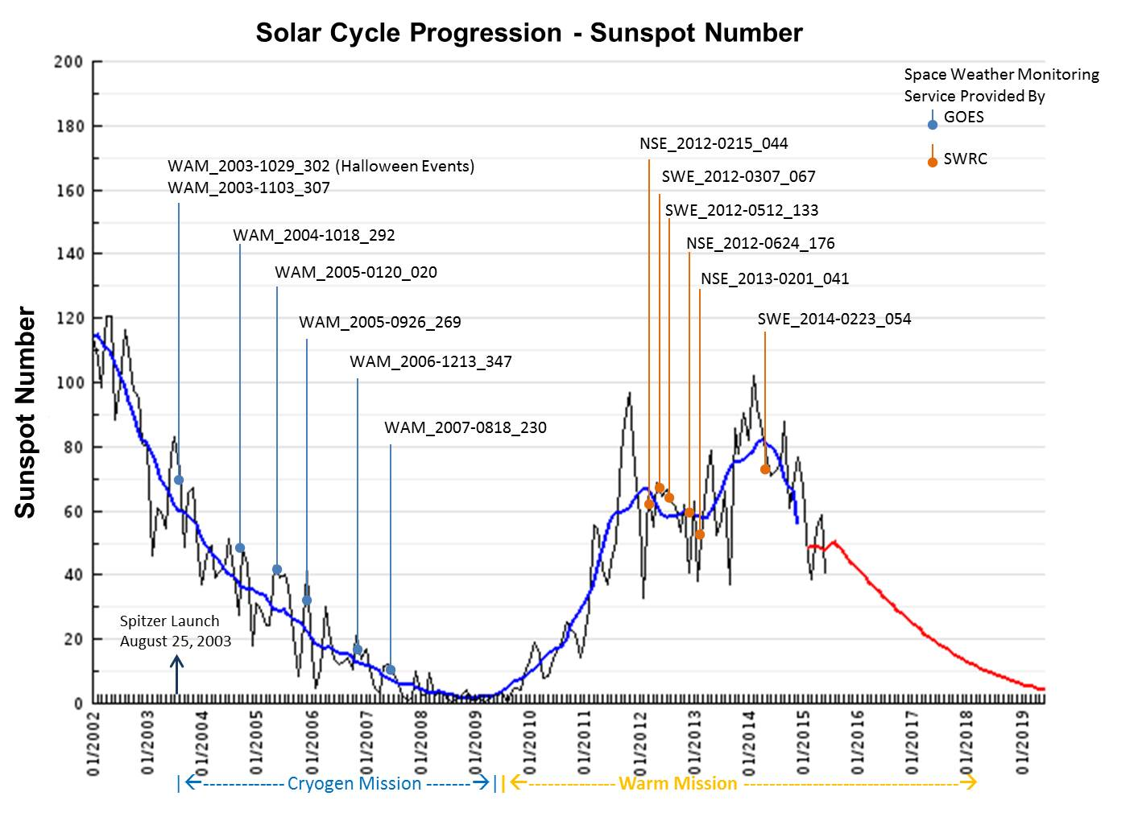
Summary of Key Events to Date

Slide 20
Summary
Can alert messages be tailored to threshold levels for customers
Online helpdesk support template
  Customer request feedback for particular event times based on orbit location
Collaboration of user community for space weather events via “DONKI”
  How do we manage NASA’s missions proprietary data

Slide 21
Acknowledgement
Thanks to Goddard’s SWRC for continued services which has provided outstanding support to the interplanetary user community.
A large number of people from the Spitzer project, support organizations at the Jet Propulsion Laboratory, Lockheed Martin Space System Company, and the Spitzer Science Center at the California Institute of Technology contributed to the operations described herein.
Special Thanks:
Kennis Stowers – JPL
Albert Jefferson – JPL
Patrick Lowrance – SSC
Sean Carey – SSC
Andrzej Stewart – LMSSC
Paul Travis – LMSSC
© 2015 California Institute of Technology. Government sponsorship acknowledged.

