Slide 1
7th Space Weather & NASA Robotic Mission Ops Workshop September 29-30, 2015 Earth Science Mission Operations EOS Aqua & Aura Space Weather View
Bill Guit
ESMO Mission Director for EOS Aqua & Aura
301-614-5188
William.J.Guit@nasa.gov

Slide 2
Satellites & Space Weather
Effects of space weather on spacecraft systems are well documented (Ref: NOAA Space Weather Prediction Center)
Surface Charging/Electrostatic Discharge (ESD)
Deep dielectric or bulk charging
Single Event Upset (SEU)/Single Event Latch-up (SEL)
Solar proton events (SPEs)
Galactic cosmic rays (GCRs)
Spacecraft drag
Total dose effects
Solar radio frequency interference and telemetry scintillation
Debris
Spacecraft orientation
Photonics noise
Materials degradation
Meteorite impact

Slide 3
Spacecraft Anomalies & Space Weather
Anomaly Investigation – How Space Events are Blamed
Many spacecraft anomalous events occur throughout a mission
Hardware Failures – EOS Aura Solar Panel Connector
Degradation – EOS Aqua and Aura Solar Array Degradation
Debris and micrometeorite impact – EOS Terra Battery and Aura Solar Panel
Single Event Upsets (SEUs) – Experienced by all 3 EOS missions
Single Event Functional Interrupt (SEFI) – EOS Aura FMU/SSR
Single Event Latch-up (SEL)
Electrostatic Discharge (ESD)
Anomaly Investigations usually start with understanding the Space Environment and geographical location of spacecraft at the time of anomaly
Contributing Factors often considered during investigation:
Solar Events
Cosmic Rays? Is this information available and presented in a way that is useful?

Slide 4
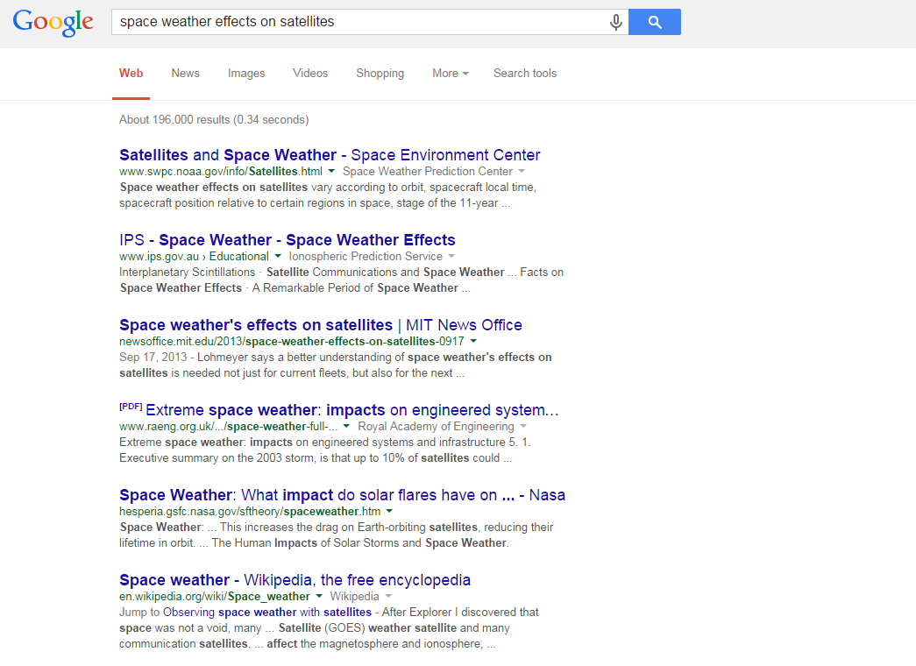

Slide 5
Conjunction Assessment & Collision Avoidance
Space Weather Events around Time of Closest Approach
Joint Space Operations Command (JSpOC) uses High Accuracy Satellite Drag Model (HASDM) which accounts for predicted space weather
Typically Debris Avoidance Maneuver (DAM) planning begins ~24 to 72 hours prior to Time of Closest Approach (TCA) using the predicted space weather
Use latest tracking data
Use latest predicted space weather and atmospheric density models
Allow sufficient time for flight support team to work the maneuver planning and screening process to ensure that the planned maneuver is safe to execute
DAM planning is a joint effort by all parties of the Flight Support Team
Flight Operations Team (FOT)
Flight Dynamics Team (FDT)
Conjunction Assessment and Risk Analysis (CARA) Team
JSpOC GSFC Orbital Safety Analyst (OSA)
Uncertainties due to space weather exist and complicate DAM planning:
Arrival, confidence and magnitude of Solar Event effects projected miss distances
Uncertainties on arrival time and magnitude of Solar Events prior to TCA complicate evaluation in determining if a DAM is warranted or could possibly make matters worse

Slide 6
Aura vs. 89477 Short-notice Debris Avoidance Maneuver High Interest Event
Identified Friday, August 28, 2015 as potential high-risk close approach
Time of Closest Approach (TCA): Saturday, Aug 29, 2015 at 07:51:15 GMT
Intensive 16-hours of DAM planning, screening and approving
Maneuver waived-off Saturday, August 29, 2015 around 0300 GMT
Event complicated by intense solar and geomagnetic activity

Slide 7
Aura vs. 89477 (TCA: 8/29 at 07:51:15 GMT)
August 29th Aura predicted close approach was particularly challenging High Interest Event (HIE).
Late notice with dramatic change to the risk highlights the need to be able to detect changes and respond faster.
Changes in predicted drag a few days prior to the conjunction resulted in a high-risk (1 in 1300) with only about 16-hours of response time.
The ESMO Flight Support Team (FST) did an amazing job and were prepared to execute a debris avoidance maneuver on short notice.
Updated tracking just hours prior to the conjunction resulted in the risk rolling off after the prime burn opportunity had been waived-off to allow more time to collect and analyze the data.
Overall the Aura HIE was very similar to the Terra HIE that occurred on June 24th and a number of other short-notice HIEs.

Slide 8
3-days until TCA (data point #11)

Slide 9
Next Screening Report (data point #12)

Slide 10
Just over 1-day until TCA (data point #16)

Slide 11
Next Screening Report (data point #17)

Slide 12
Space Weather

Slide 13
Aura vs. 89477 (data points #18 and #19)

Slide 14
Some things that worked
Flight Operations Team (FOT) Collision Avoidance Engineer notified the Aura Mission Director during their weekly Monday tag-up meeting that he was monitoring a potentially high-risk Aura conjunction that has been just below the CARA Red Threshold for a couple of days
Mission Director included the conjunction in the Weekly Top Ten Issues reviewed with the flight support team on Tuesday
Various Space Weather alerts and warnings were issues starting on Wednesday
Flight support team monitoring Space Weather (Dst, Ap, …)
Risk level dropped off and conjunction appeared to self-mitigate
Unexpectedly, with only about 16-hours to TCA the risk level became elevated to above the CARA Red Threshold
Flight support team did an amazing job on short-notice and were prepared to executed debris avoidance maneuver if necessary

Slide 15
Some Questions
Why did the Pc drop off to such a low value over 2 days prior to TCA, after being in the E-04 range for many days, even though the overall miss distance was continuing to decrease
During periods of intense solar activity what changes are being made at the JSpOC with their atmospheric density models
How long are the changes modeled for
How frequently are updates made to the models
When are the models returned to “normal”
What magnitude of changes can be expected in predicted miss distances, covariance and probability of collision

