Slide 1
CALIPSO Cloud-Aerosol Lidar Infrared Pathfinder Satellite Observations
September 27, 2012
NASA Robotic Mission Ops and Space Weather Workshop

Slide 2
CALIPSO Overview
Provides insight into the role that clouds and atmospheric aerosols play in regulating Earth's weather, climate, and air quality.
Launched on April 28, 2006
Joint French (CNES) and NASA Mission
CNES Proteus Spacecraft Bus
US Payload (Laser, Telescope, Wide Field Camera, IIR)
Member of the Afternoon Constellation (A-Train)
Altitude of 705km
Polar Orbit (Sun-Synchronous)
Ground Track repeated every 16 days
Payload Operations are conducted from NASA Langley Research Center
Spacecraft Operations are conducted by CNES in Toulouse, France

Slide 3
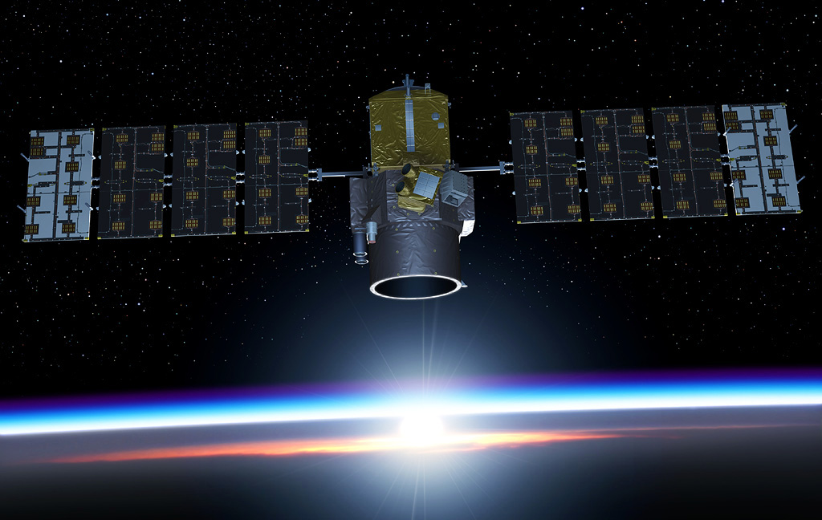
CALIPSO LIDAR
Laser Pulse Out
Backscatter Return

Slide 4
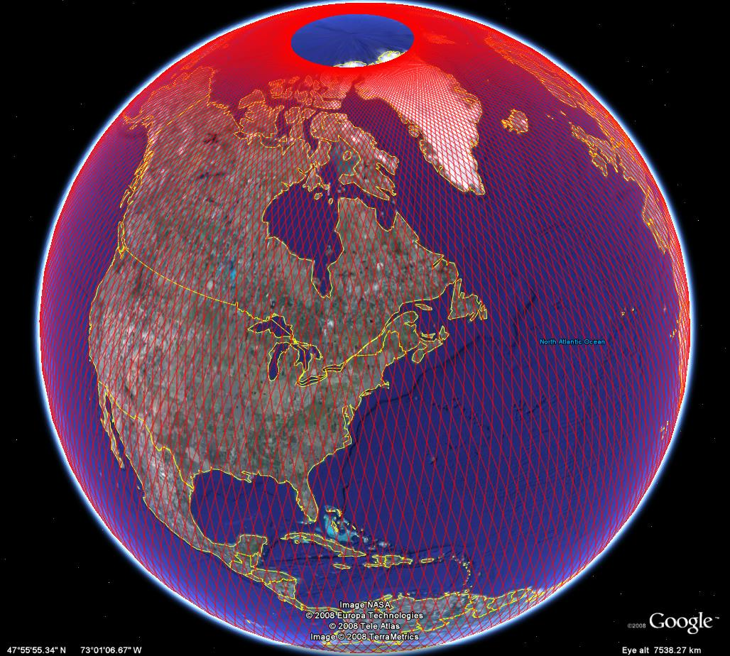
Global Coverage
16-Day repeating ground track to within 10 km

Slide 5
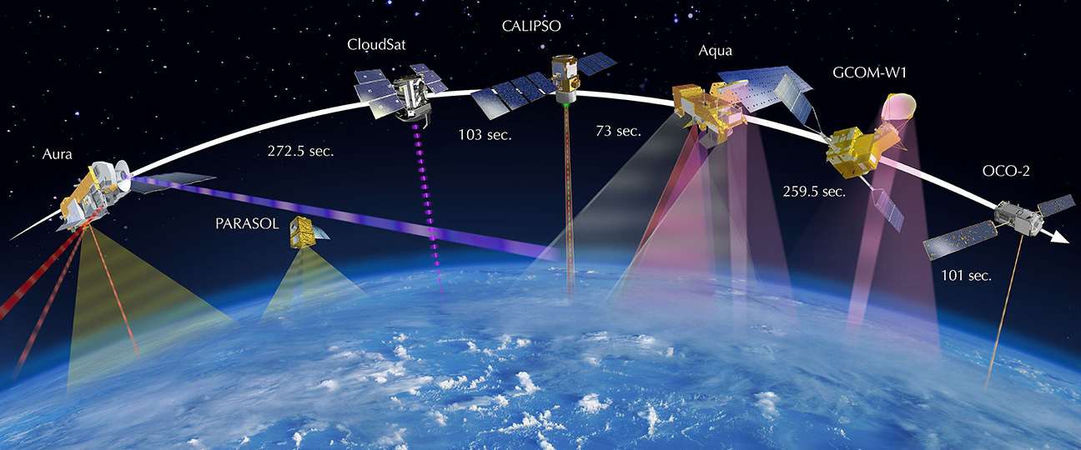
A-Train Missions

Slide 6
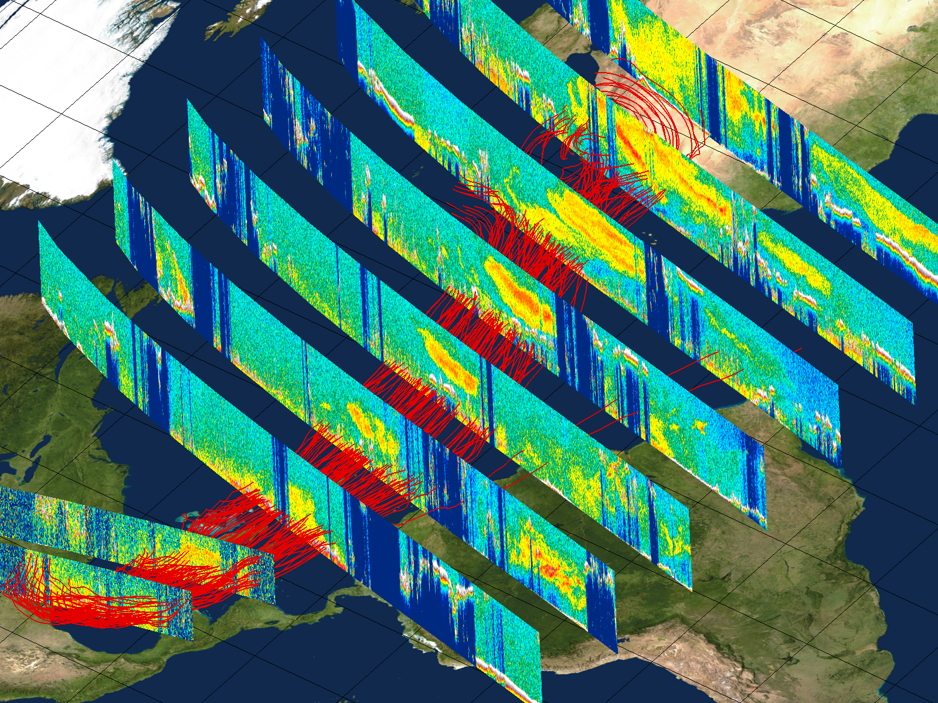
Aug 17
Aug 18
Aug 19
Aug 20
Aug 21
Aug 25
Aug 22
5 km
Aug 28
3 km
Aug 23

Slide 7
CALIPSO Payload Heavy Ion Vulnerability
Heavy Ion Vulnerability
Heavy ions are correlated with protons
CALIPSO uses NOAA GOES proton alerts
10 MeV Proton Event greater than 10 pfu
Threat of a Single Event Gate Rupture in high-voltage MOSFETs
One MOSFET loss is anticipated during the mission due to Galactic Cosmic Rays (GCR)
Payload commanded to Safe Mode, Laser Relays Opened
100 MeV Proton Event greater than 1 pfu
Single Board Computer Memory Damage
Payload is powered off

Slide 8
Flight Rules
10 MeV Proton levels greater than 10 pfu
Action to be executed during working hours (CNES)
Payload to Safe mode, laser relays opened.
100 MeV Proton levels greater than 1 pfu
Require immediate action
Payload off next available pass.
Operations Team uses a hotline to request turn off.
Return to Data Acquisition following 10 MeV SUMMARY

Slide 9
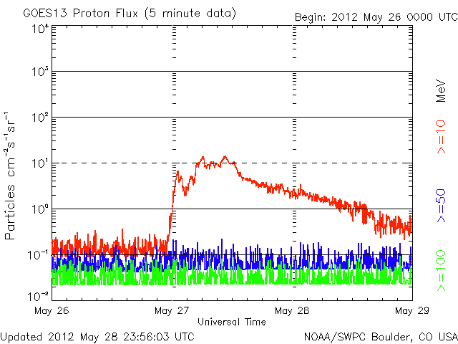
May 26, 2012 Event

Slide 10
CALIPSO 2012
Payload in SAFE mode (10 MeV > 10 pfu)
07/13/2012 – 07/18/2012 – 09/03/2012
11 days of lost science data
Payload OFF (100 MeV > 1 pfu)
01/23/2012 – 03/07/2012 – 05/17/2012
28 days of lost science data
2011 – 15 days of lost science data

Slide 11
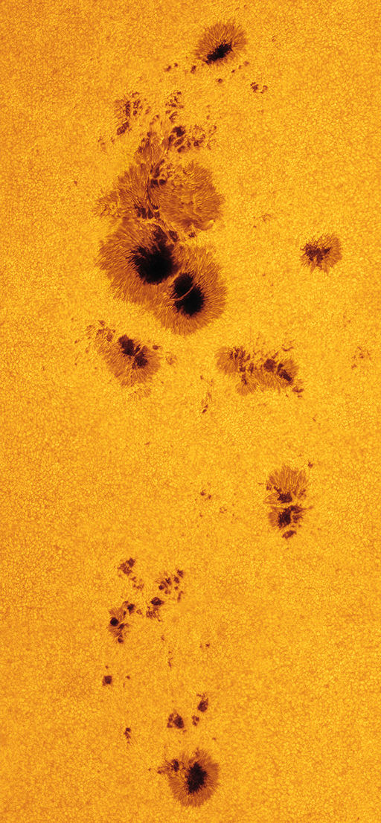
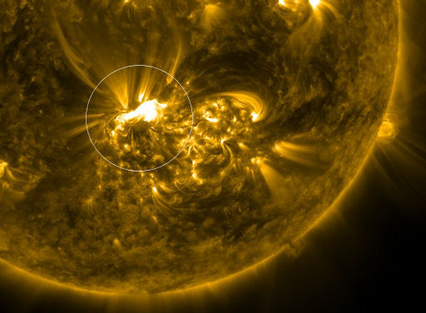
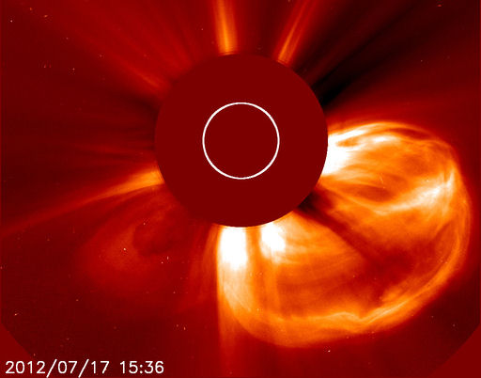
Sunspot Region 1520

Slide 12
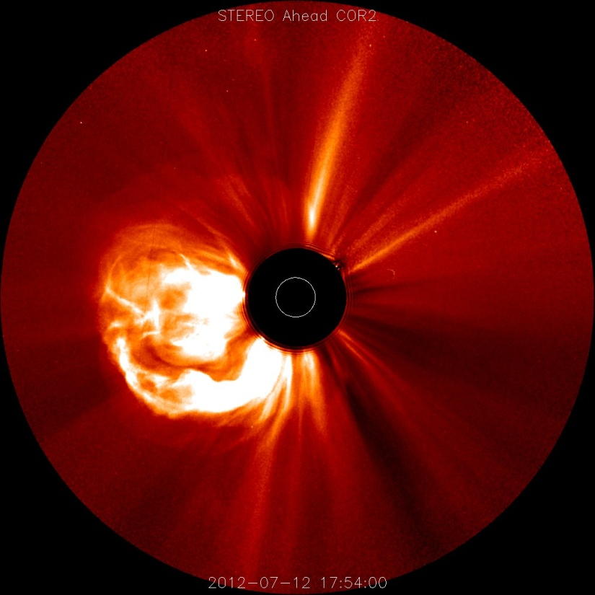
July 12th Solar Flare SOE
Long duration X1.4 class solar flare detected on July 12, 2012 at 16:49 UT originating from region 1520.
CALIPSO commanded to SAFE mode on July 13, 2012 at 16:07 UT due to observed increase in 10 MeV > 10 pfu proton flux.

Slide 13
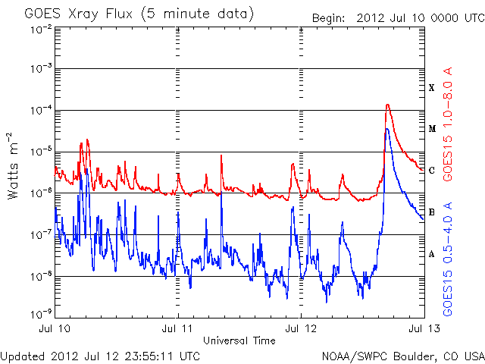
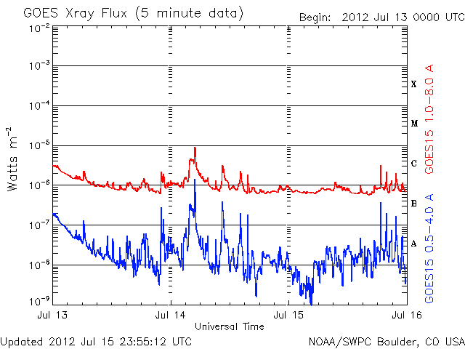
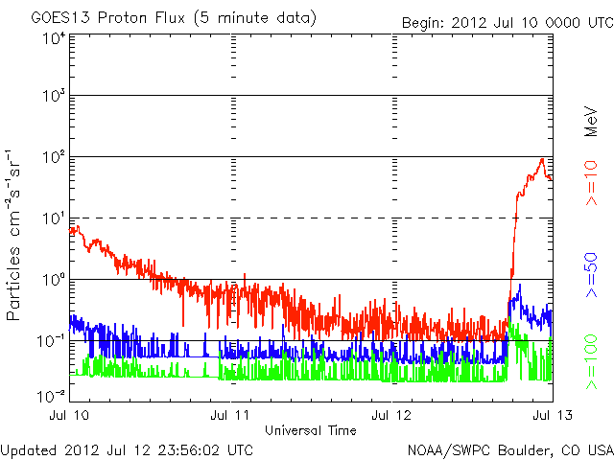
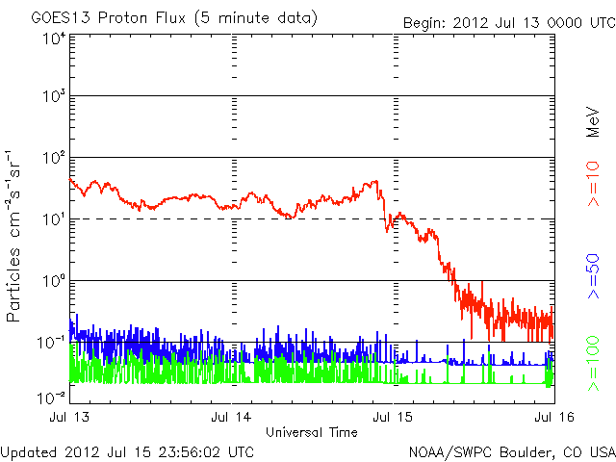
GOES X-Ray and Proton Flux

Slide 14
July 17th Return to DAQ
Return to Data Acquisition on July 17, 2012 at 13:33 UT.

Slide 15
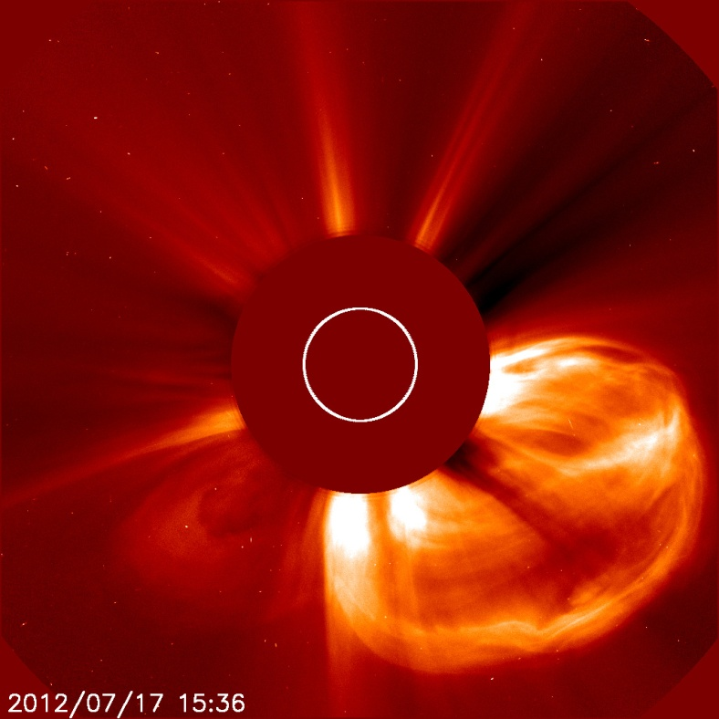
July 17th Solar Flare SOE
Long duration M1.7 class solar flare detected on July 17, 2012 at 12:03 UT originating from region 1520.
Long duration M7.7 class solar flare detected on July 19, 2012 at 05:13 UT originating from region 1520 as it rotated off the west limb of the visible disk.
CALIPSO commanded to SAFE mode on July 18, 2012 at 10:05 UT due to observed increase in 10 MeV > 10 pfu proton flux.

Slide 16
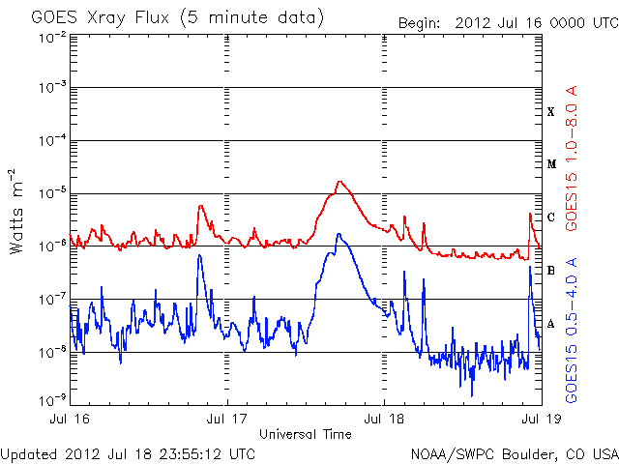
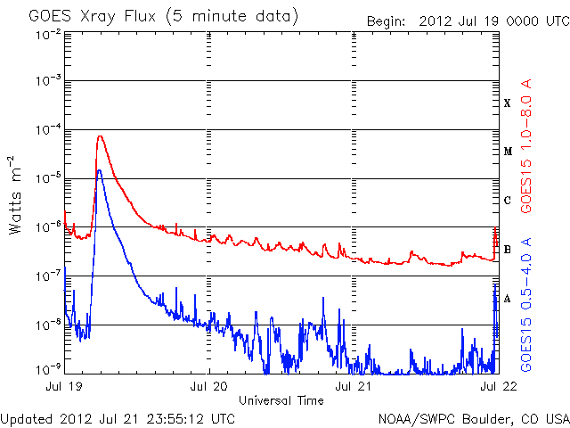
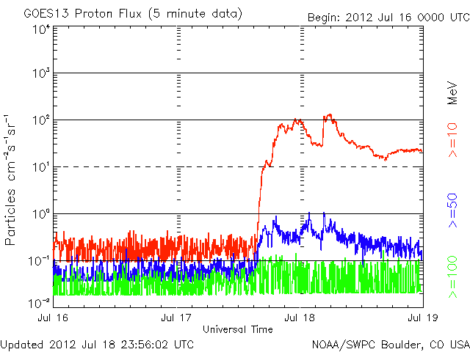
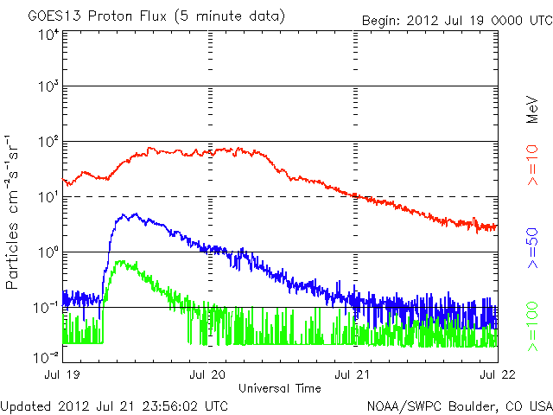
GOES X-Ray and Proton Flux

Slide 17
July 23rd Return to DAQ
Return to Data Acquisition on July 23, 2012 at 14:35 UT.

Slide 18
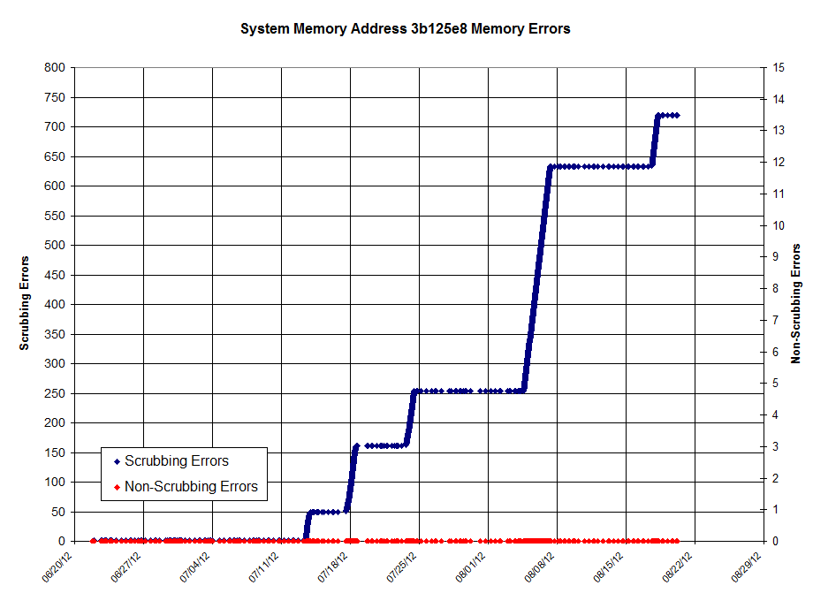
Stuck Bit (3b125e8)-07/13/2012
Payload computer power cycle is required if 1024 or more consecutive memory corrections are observed.
720 total scrubbing errors corrected, 224 consecutive
Last seen on 08/17/2012

Slide 19
CALIPSO Needs
Heavy Ion Warning/Tool
Alpha Magnetic Spectrometer on ISS
Advanced Warning for Protons
Currently the only correlation we have to Heavy Ions
Heavy Ion / Proton information near CALIPSO orbit

