Slide 1
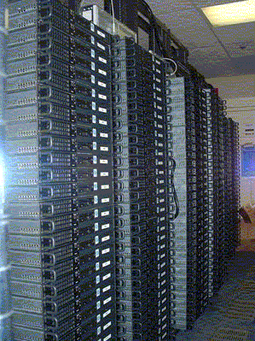
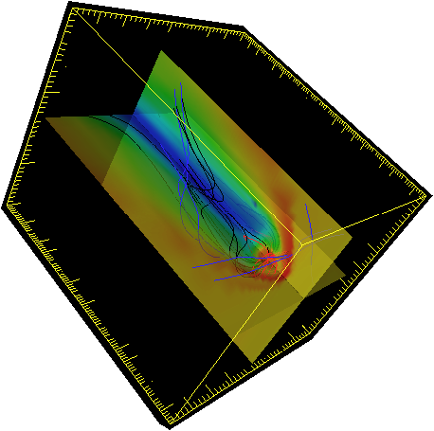
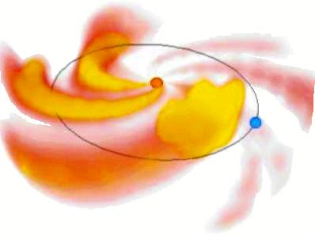
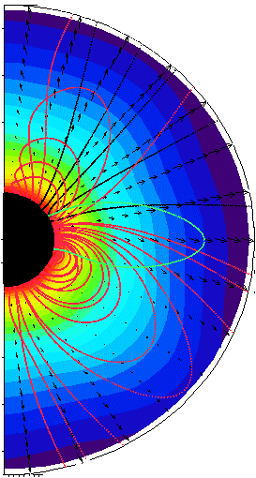
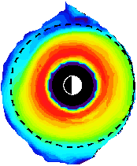
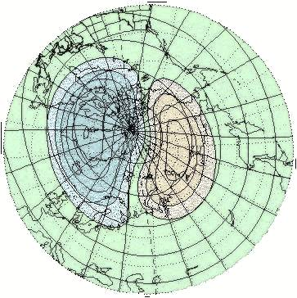
NASA GSFC Space Weather Research Center: status and future plans
Pulkkinen, A.^{1,2} and the SWx team
¹The Catholic University of America, USA
²NASA/GSFC Space Weather Laboratory, USA

Slide 2
Overview
Some historical notes.
Status of the NASA GSFC Space Weather Research Center SWx services.
Future plans.

Slide 3
Some historical notes
2007
Charged by NASA HQ/HSD to develop initial web-service.
SWx and anomaly resolution support for SSMO initiated.
2008
Successful proposal to OCE/TEI to develop innovative SWx information dissemination system (iSWA).
OCE study emphasizes SWx needs of NASA’s robotic missions.
2009
Robotic mission operator workshop, IPP/OCE supported, requirements document.
SWx alert partnering with the US Air Force Weather Agency.
2010
Formal establishment of GSFC Space Weather Desk in March 2010.
Routine SWx alerts and updates for robotic missions across NASA, broad partnering
2012
Activity renamed as NASA GSFC Space Weather Research Center (SWRC).
Substantial effort to train new forecasters for supporting sustained operations.

Slide 4
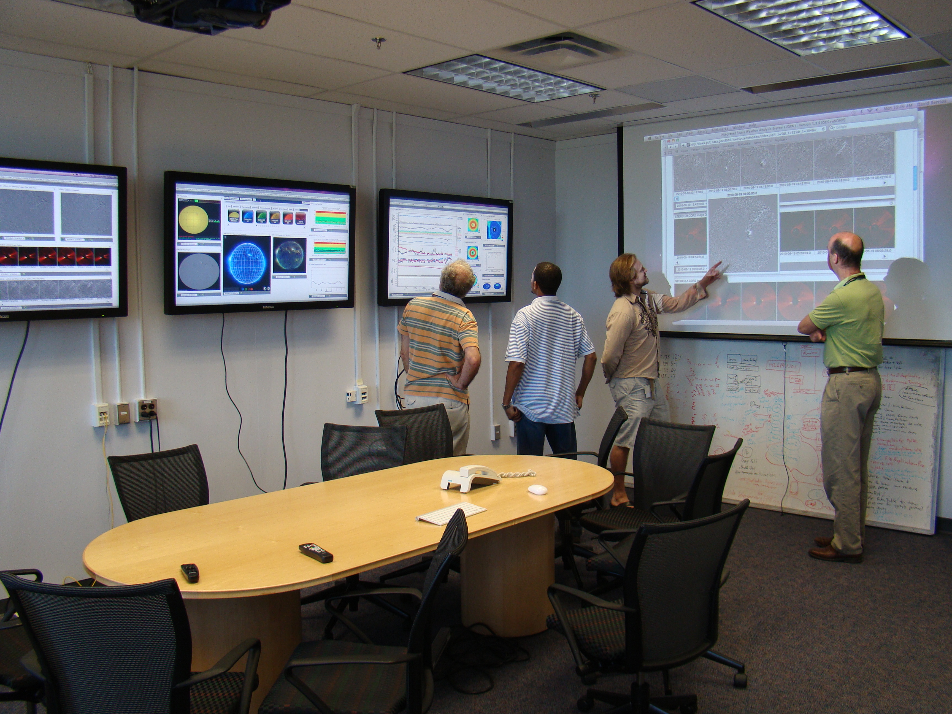
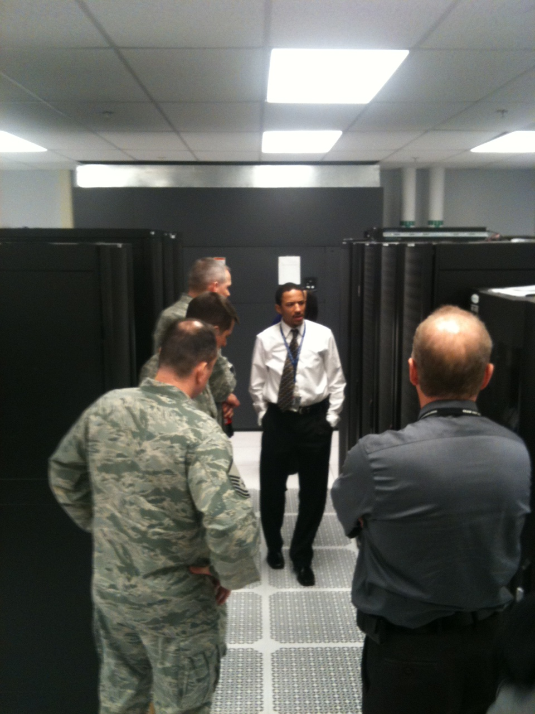
Status of the SWRC SWx services
8:00-24:00 EST, 7 days per week space weather alerts.
Weekly reports.
Spacecraft anomaly analysis support.
Real-time space weather displays and products via iSWA.
Annual SWx and NASA robotic missions operator workshop.

Slide 5
SWx service updates
As usual, we try to be very responsive to your feedback. For example:
New products from WSA-Enlil: background solution Kp index estimates, inclusion of only ecliptic cut to some of the visualizations, control of the CME simulation visualizations, movie making capability.
Tutorial about the WSA-Enlil simulations and explanation of the used projections.
Inviting NAIRAS team to the workshop to check for possible collaboration.
New rounds of training for new space weather forecasters.
The core forecasting team now includes 12 folks.

Slide 6
SWx service updates
New iSWA features and products. (presentation by D. Berrios and R. Mullinix)
Continuing extensive model validation activities. For example:
Geospace model validation to check how well state-of-the-art models reproduce ground dB/dt. Paper under preparation.
Model updates and new models. For example:
Working with JSC SRAG folks under the umbrella of OCT-supported Integrated Solar Energetic Proton Event Alert Warning System (ISEP) project.
First ensemble CME simulations carried out.

Slide 7
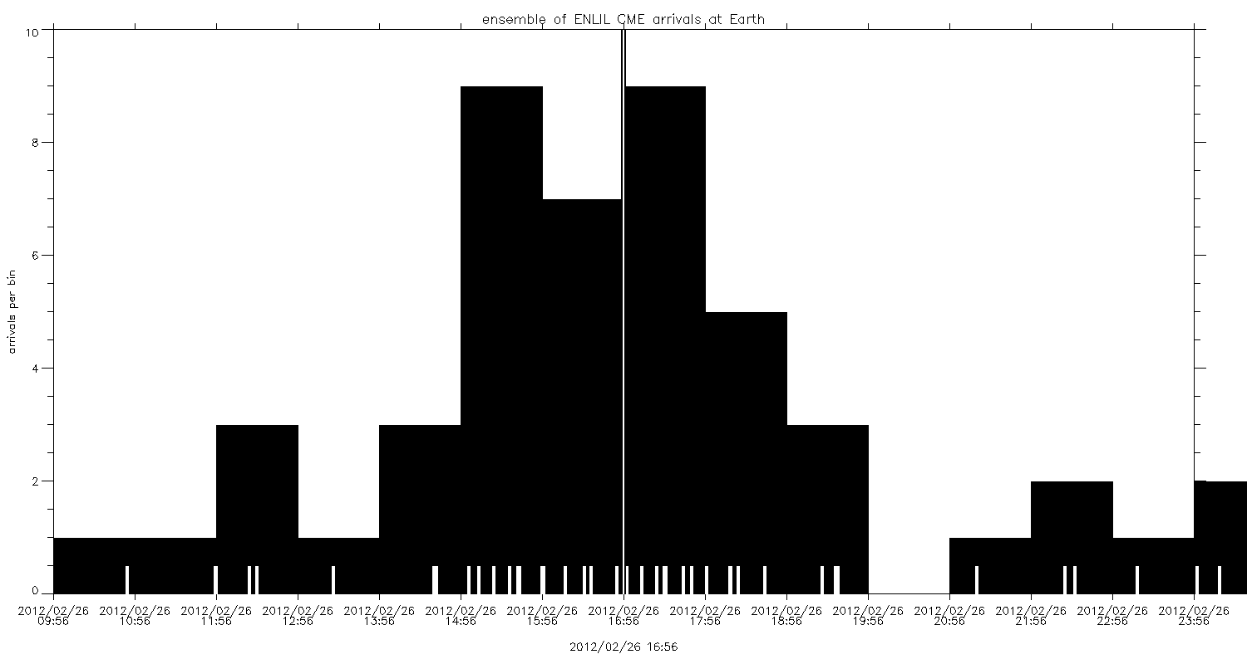
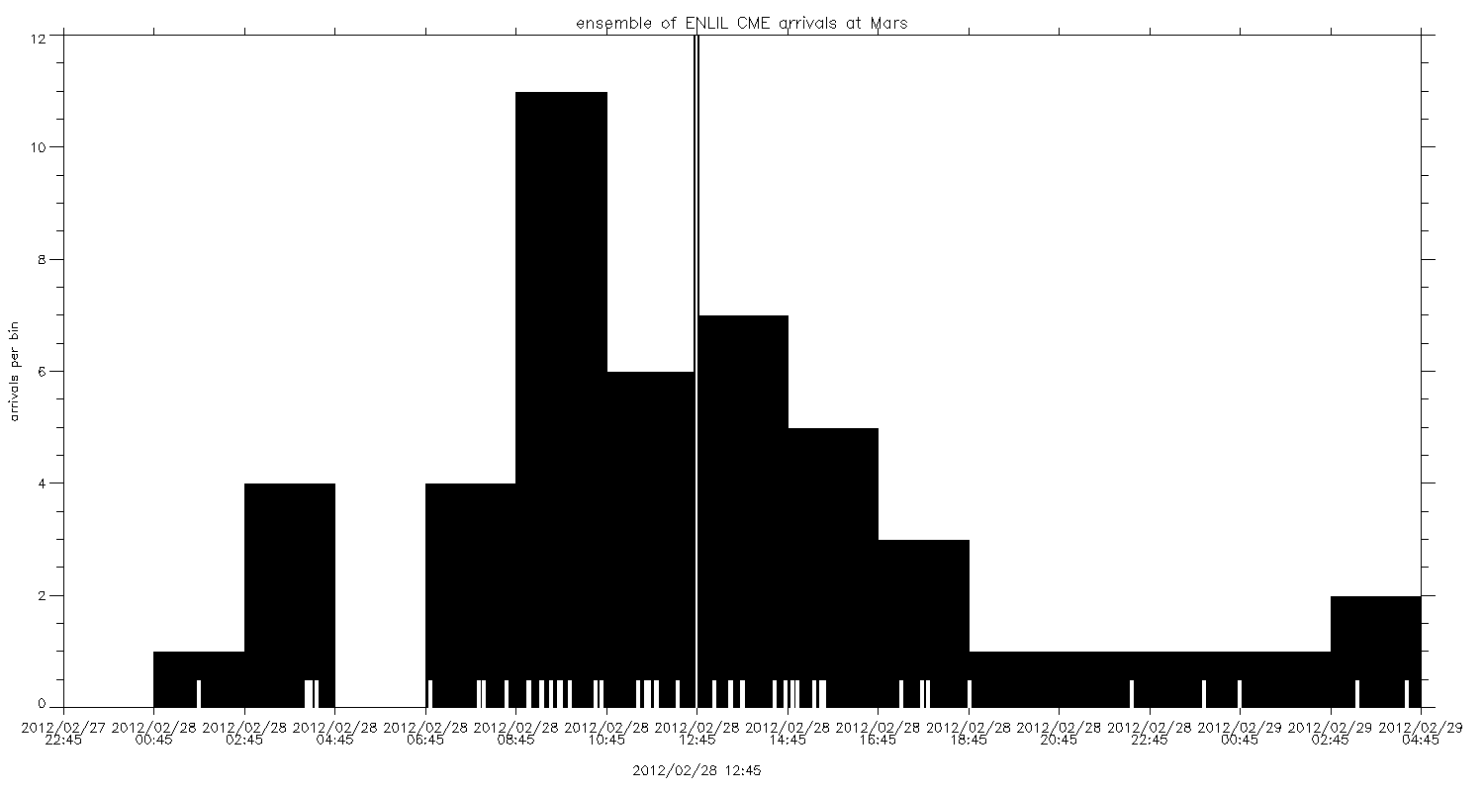
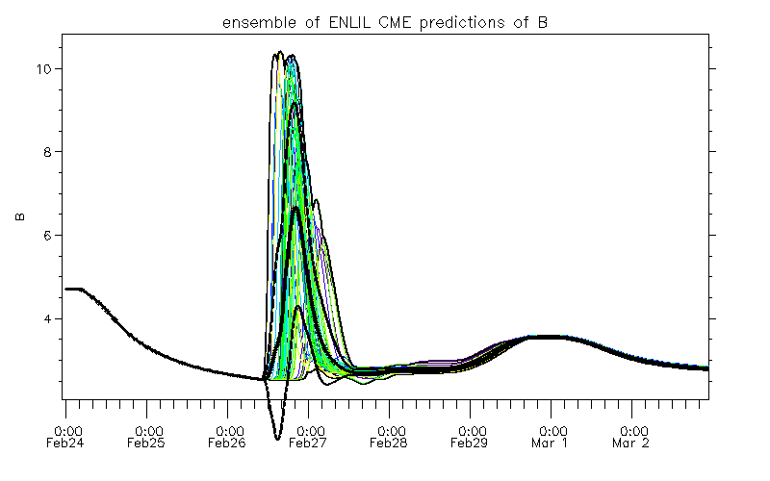
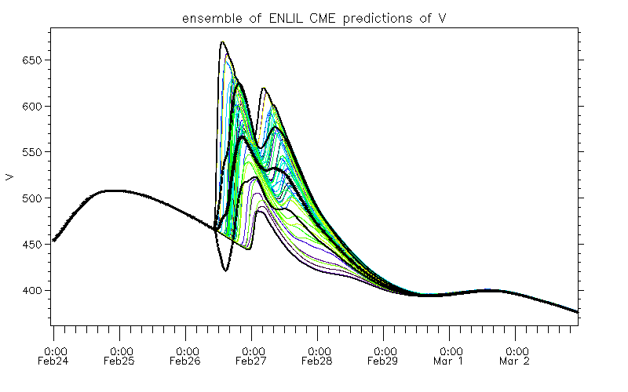
Ensemble CME predictions (example)
2012-02-24 CME event

Slide 8
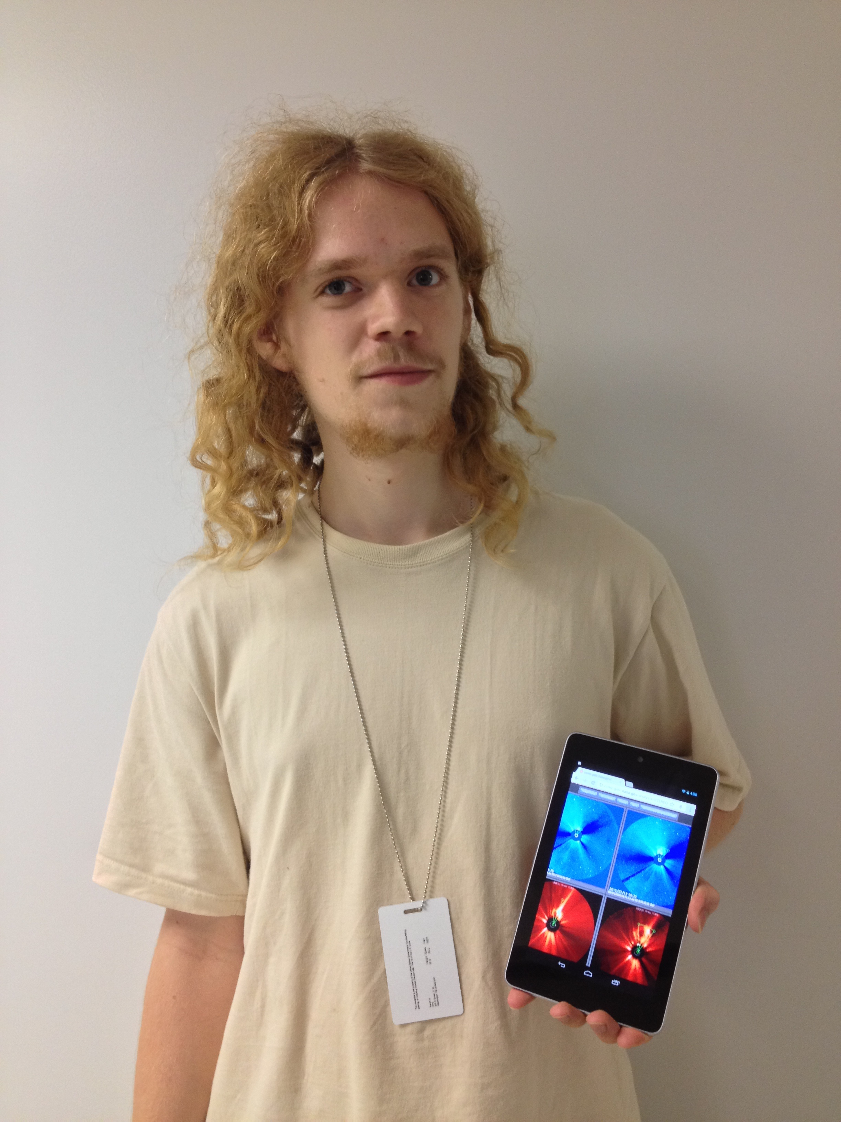
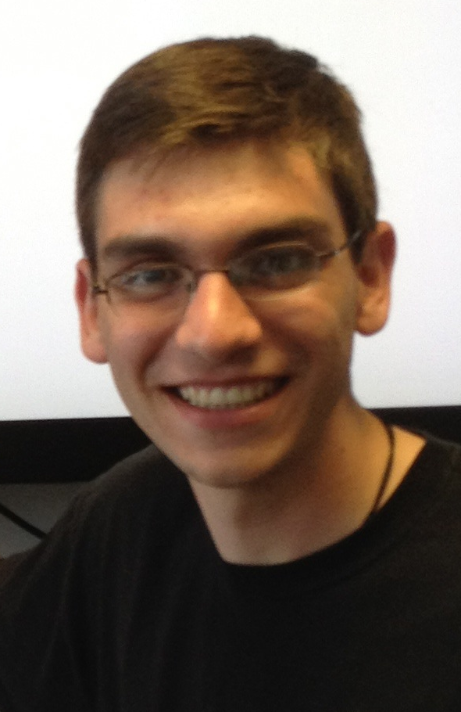
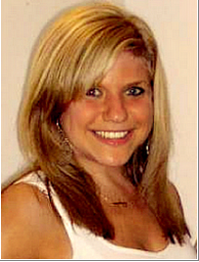
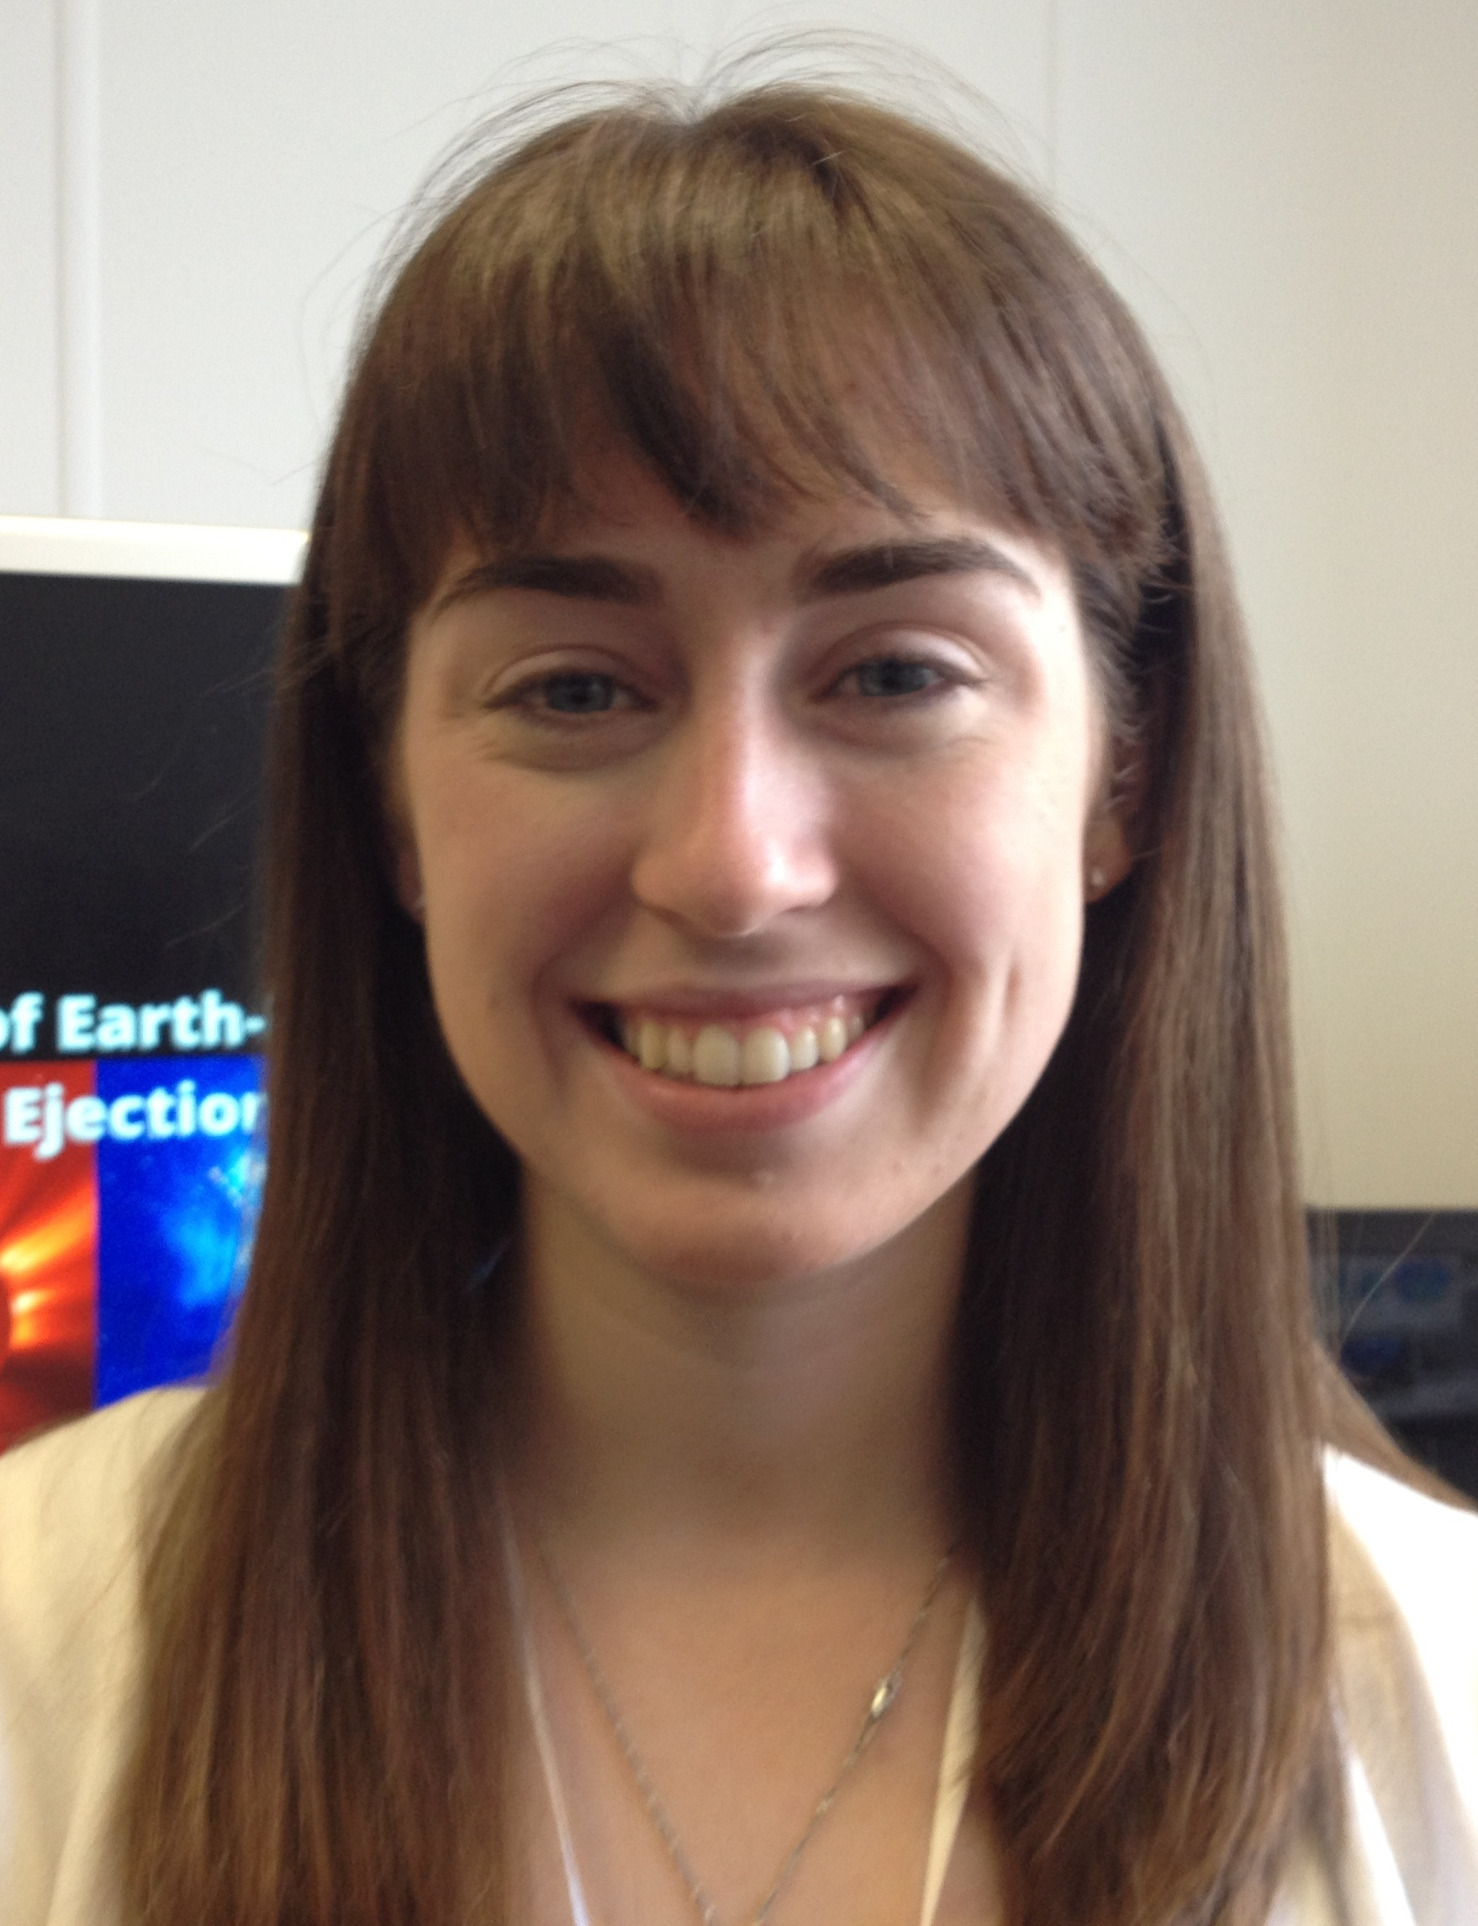
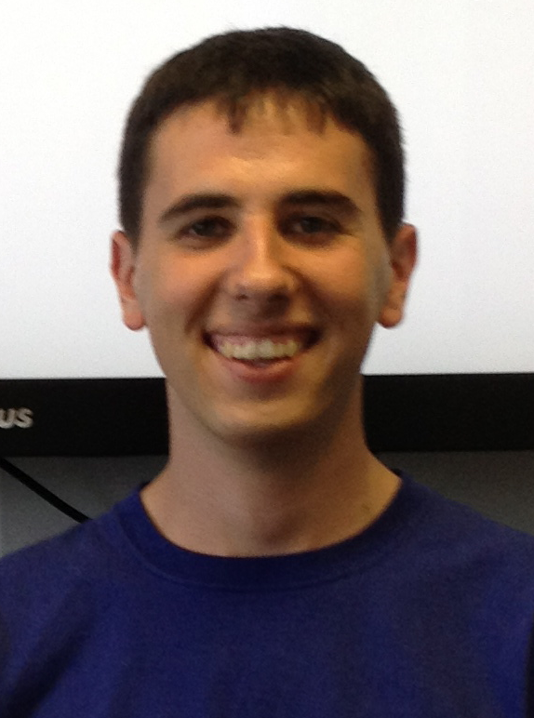
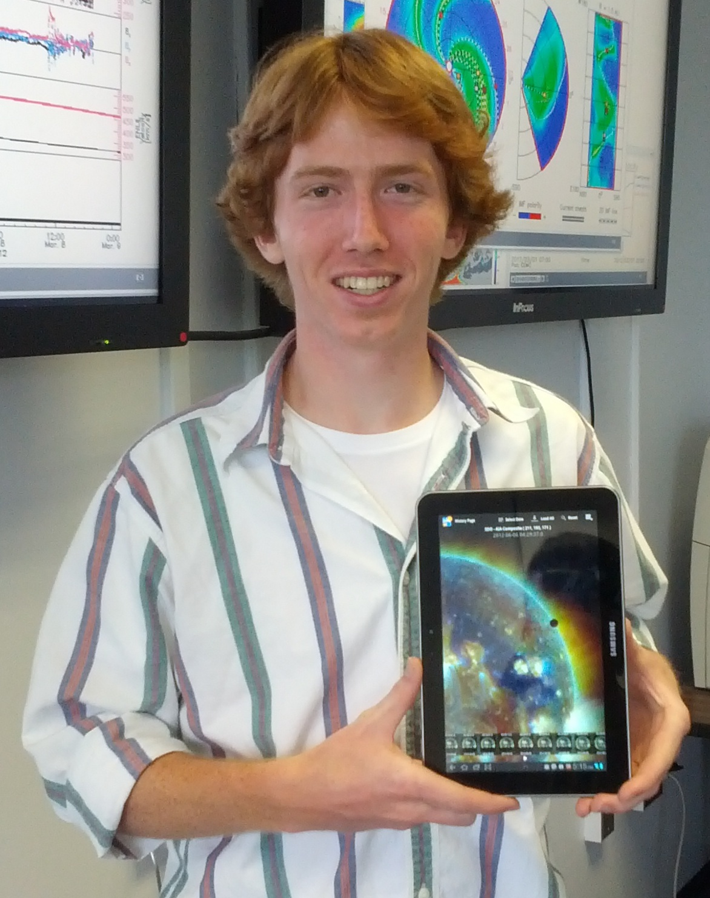
SWx service updates
We have taken increasingly active role also in the education front:
Interns working on space weather problems.
Student forecasters as a part of the team throughout the year.
University collaboration: online space weather tutorials and space weather classes (e.g. “Space Weather: Physics, Applications and Operations” taught by CUA at GSFC).

Slide 9
SWRC future plans
As usual, we invite user feedback to improve our services.
Continue the training of the new forecasters.
Continuous improvement of our forecasting capacity. For example:
Integrate RBSP data into iSWA.
Implement DREAM model to better quantify the state of the radiation belts.

