Slide 1

Linkage of Radiation Environment Variability near Earth with MSL on the Cruise to Mars
by A. Posner, C. Zeitlin, D. M. Hassler, R. F. Wimmer-Schweingruber, P. MacNeice, D. Odstrcil, L. Rastaetter, B. Heber, B. Ehresmann, F. A. Cucinotta, J. P. Andrews, R. Beaujean, E. Boehm, S. Boettcher, D. Brinza, M. Bullock, S. Burmeister, T. Cleghorn, J. Eigenbrode, M. Epperly, D. Grinspoon, J. Guo, M.-H. Kim, J. Koehler, O. Kortmann, C. Martin, R. Mueller-Mellin, K. Neal, J. Peterson, S. C. R. Rafkin, G. Reitz, L. Seimetz, K. D. Smith, Y. Tyler, and E. Weigle

Slide 2
Outline
The cosmic ray/SEP environment in the inner heliosphere
Particle propagation, the heliospheric magnetic field and the transfer orbit: HP effect
MSL/RAD observations and the comparison with 1 AU
Radial cosmic ray gradients revisited
Discussion

Slide 3
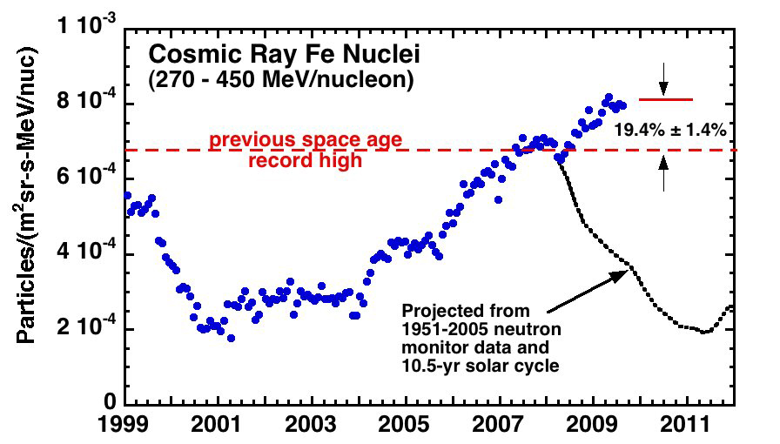
Galactic cosmic rays at 1 AU
Notes:
Historically high Cosmic Ray levels observed in recent deep solar minimum. Cosmic ray projected intensity for 2008-2012 based on 1951 – 2005 Climax neutron-monitor observations projected forward using a 10.5 year solar cycle and the projected intensity for 1996 thru late 1997 based on scaling the Fe intensity versus data from 1998 – 2005.

Slide 4
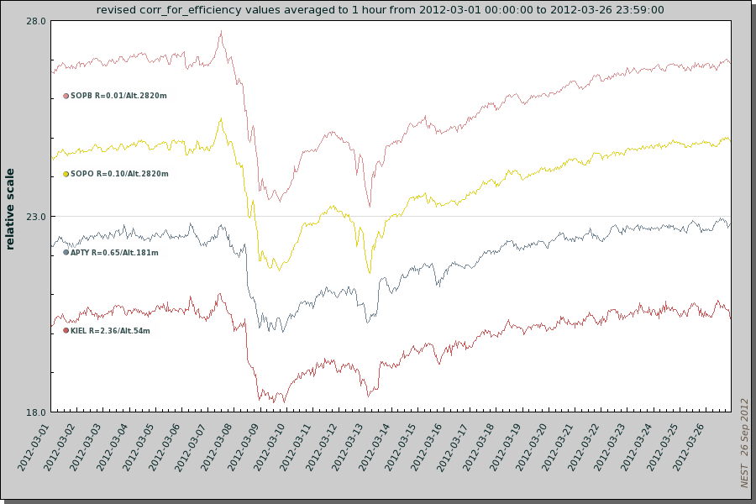
The March 2012 Forbush effect
Count rate variation of different neutron monitors in March 2012 during a period of two Forbush decreases. Courtesy: www.nmdb.eu
Notes:
Forbush decreases are caused by transient disturbances (ICMEs, magnetic clouds) that propagate out from the Sun. These disturbances cause modulation of GCRs. During the early phase of the solar maximum, “steps” to lower GCR levels are observed and maintained for some time, presumably linked to the ~1 year propagation time of these disturbances to the heliosheath. The GCR level recovers during the decline of solar activity in response to a lower frequency of transient disturbances generated by the sun.

Slide 5


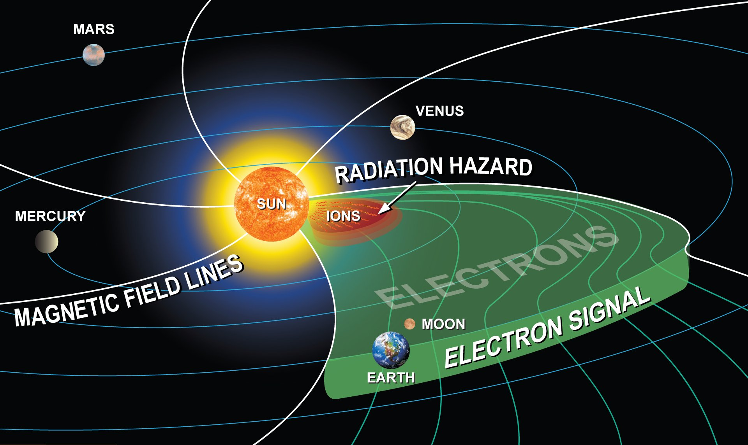
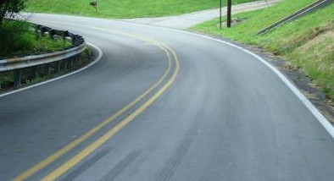

SEP
Notes:
Disregarding turbulence, charged particles travel along the large-scale heliospheric magnetic field lines. Propagation along the field happens much faster than any propagation across the large-scale field, in a similar fashion as a road allows higher car speed than off-road travel.

Slide 6
SEP
Notes:
For locations along the magnetic field lines connected with those crossing near Earth, early warning of prompt particle events from the sun with forecasting systems such as REleASE or UMASEP would be possible. The top sketch depicts an artists‘ view of the radiation field in the inner heliosphere ten minutes after release of solar energetic particles from the Sun. Relativistic electrons (and protons) have reached 1 AU at the time when hazardous high-intensity protons (~30 MeV) are still within 0.2 AU from the flare location. The fast-moving (test-) particles probe the magnetic field ahead of the protons for instantaneous magnetic connectivity, which would not otherwise be possible.
Twenty minutes to one hour later, the hazardous protons have reached the Earth-moon system, and minutes later these particles would also reach locations along this field line downstream of Earth.
Astronauts venturing beyond the protective magnetic field of Earth face the direct effects of the Sun. Within even one hour, explorers can be engulfed with particles that cause harmful long- or short-term health effects and put missions at risk.

Slide 7
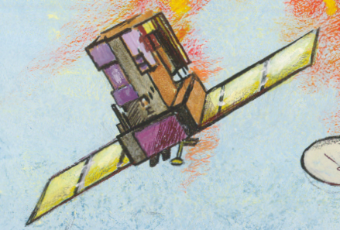

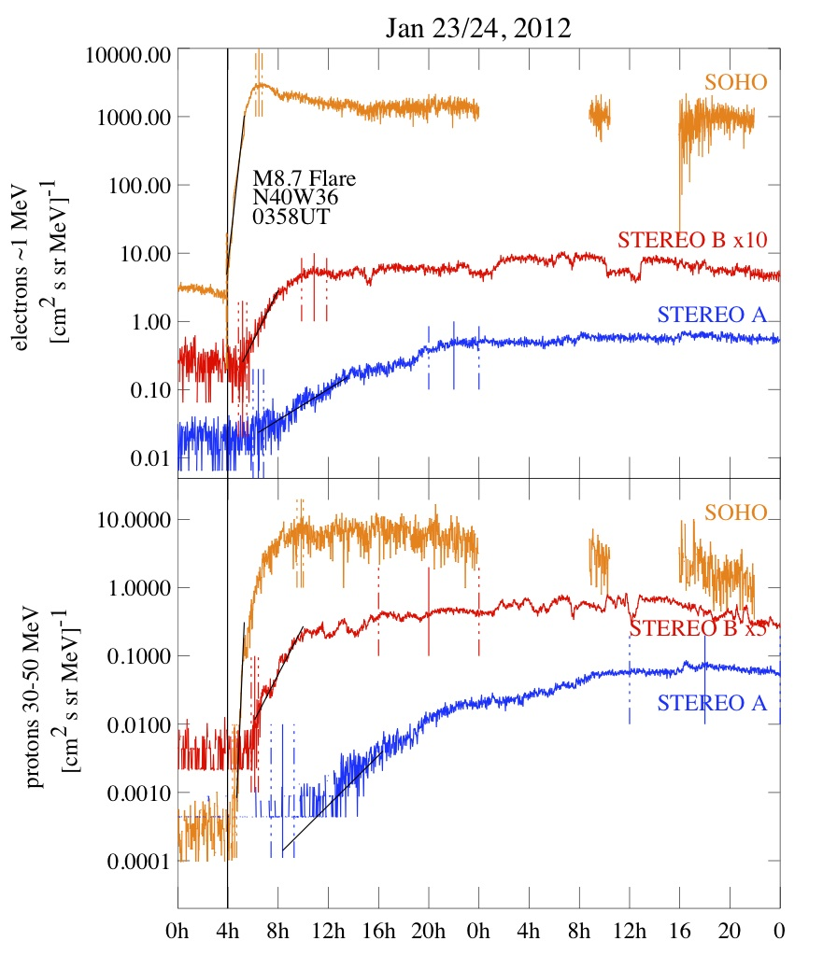
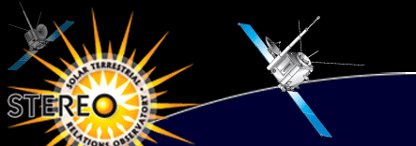
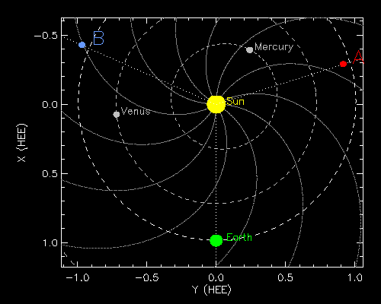
SEP event all around the sun
Notes:
However, there exists significant SEP transport across the heliospheric magnetic field, as this example from January 2012 shows. Note, the delay of the onset between the well-connected and successively worse-connected s/c (SOHO at Earth, STEREO B, STEREO A).

Slide 8
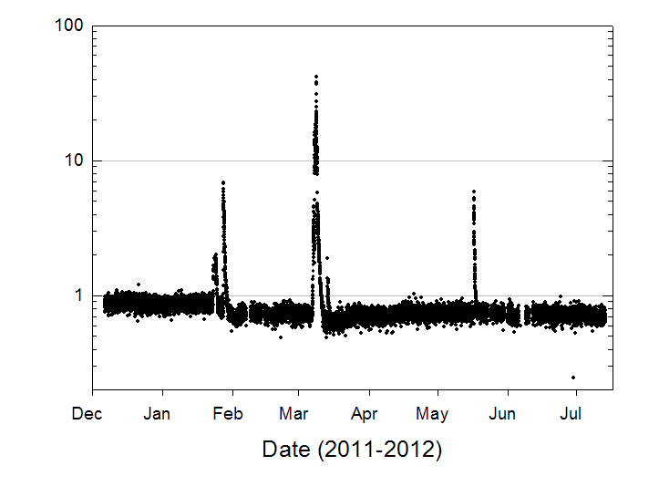
SEP
SEP
SEP
FD
FD
Hassler et al., 2012
Notes:
RAD observations:
RAD observed cosmic rays, including Forbush decreases, and SEP events during cruise.

Slide 9
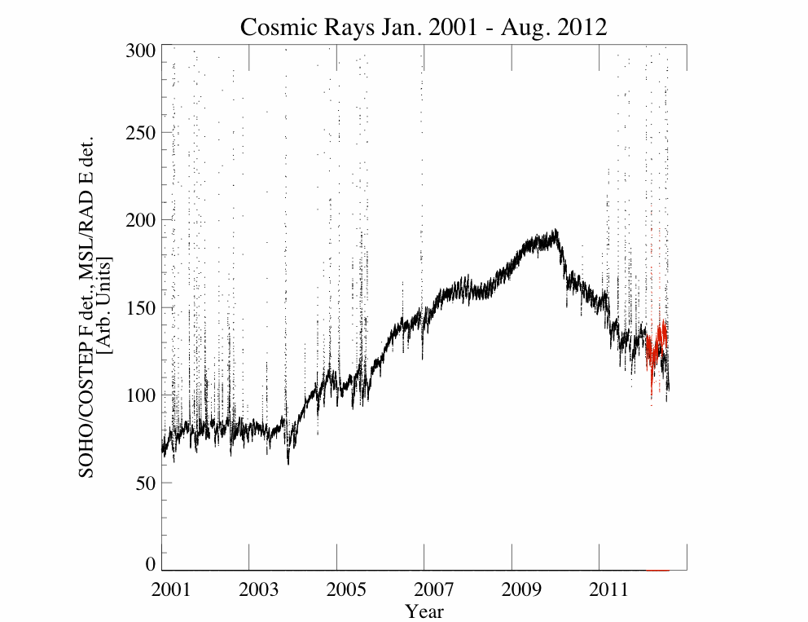
← High-E SEPs →
Solar minimum
← Galactic Cosmic Rays→
Solar maximum
SOHO/COSTEP
MSL/RAD
Notes:
For this analysis, single detector rates are being used. The commonality between the detectors is that they both are deeply embedded in the s/c and instruments, leading to rather high low-energy cut-off values for electrons and ions. Outside SEP events, the count rates are dominated by high-energy protons from GCRs. SOHO/COSTEP F detector data with proton cut-off at >50 MeV for protons tracks the observations of ACE GCRs shown earlier. The cut-off for MSL/RAD’s E detector is higher, but due to lack of information on the MSL s/c it is hard to determine accurately.
Longer-term trend of GCRs including MSL cruise phase data. MSL observations are normalized to the levels seen at 1 AU by SOHO/COSTEP.
The spikes are high-energy SEPs that reach the detectors.

Slide 10
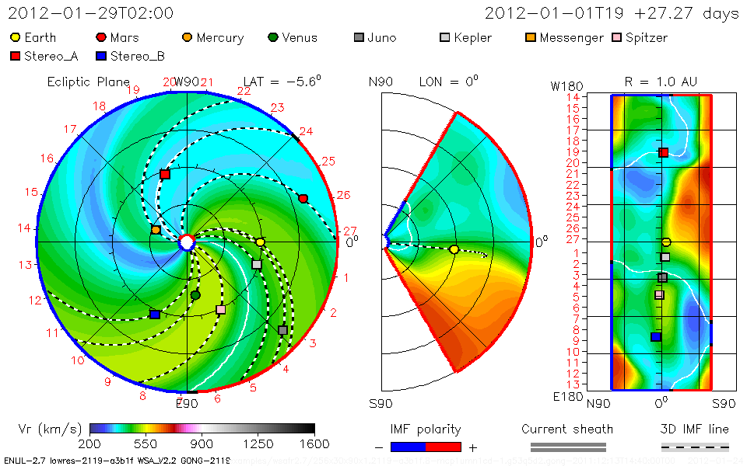

WSA-ENLIL & MSL Cruise Phase
c/o D. Odstrcil
Notes:
SOHO is located near 1 AU, and MSL is on cruise to Mars. This movie c/o D. Odstrcil, L. Rastaetter and P. MacNeice shows the trajectory of MSL to Mars in the time frame January 2012 through May 2012. The solar wind conditions in the inner heliosphere are derived from actual GONG remote-sensing solar observations during this period in connection with the WSA-ENLIL model.
Note that the MSL trajectory stays close to the (modeled) magnetic field line from the Sun that intersects with the Earth. The actual field line separation distances in longitude and latitude have been determined using an updated version of WSA-ENLIL.

Slide 11
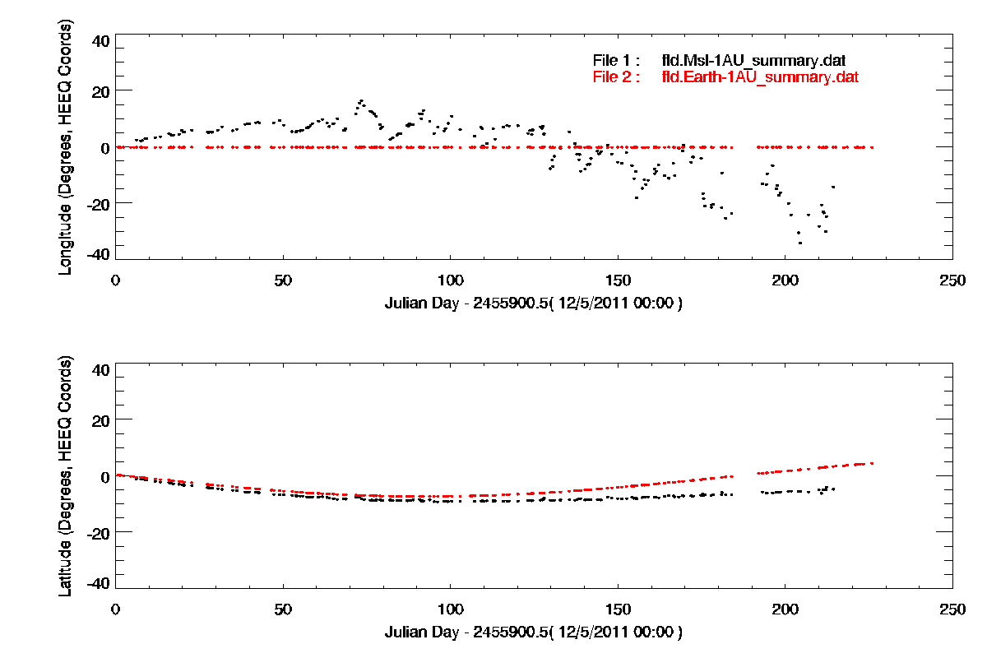
Magnetic field line separation
Hohmann-Parker Effect
Feb. 1 – May 4 Time Interval
Notes:
Modeled output using GONG data and the latest WSA-ENLIL code c/o D. Odstrcil.
The top graph shows the longitude separation of the field lines connecting Earth with the Sun and MSL with the sun, derived for 1 AU. The bottom graph displays the separation in latitude.
For the first ~185 days, MSL stayed within a 20deg fan of field line separation in heliographic longitude. Latitude separation grows slowly toward the end of the cruise phase interval. We need to be cautious. For 92 days of the cruise phase, the interval between the vertical lines, the E detector was run in a single, constant detection mode. Concentrating on this period would avoid any instrumental artifacts.
Constant RAD operations criteria and close proximity in magnetic latitude and longitude during this period, starting at Feb. 1 (here day 58, DOY32) and ending May 5 (here day 154, DOY126) ( May 21/day 170/DOY 142), warrant the most meaningful GCR comparison during cruise.

Slide 12
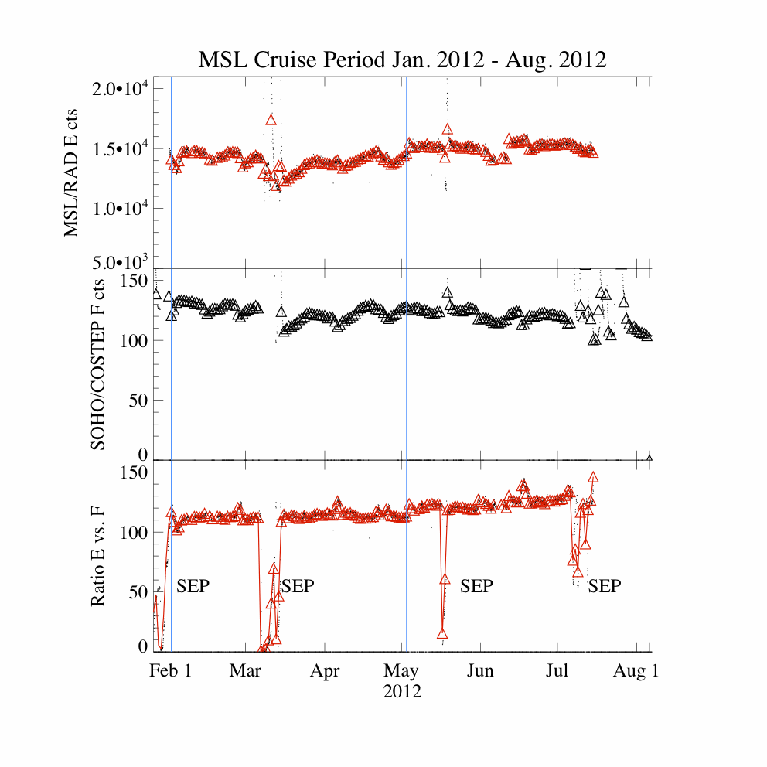
Feb. 1 – May 4 Time Interval
Notes:
Going back to the current observations. This graph shows on top the single detector count rate of the E-detector of MSL/RAD. The middle graph shows an equivalent count rate (F Detector of COSTEP) at 1 AU. The ratio of the two is shown at bottom. Clearly visible are four single excursions during the particle events of January, March, May, and July 2012. During this time, the SOHO/COSTEP F detector count rates by far exceed the top range of the viewgraph. The (slightly) lower energy cut-off for COSTEP allows more SEPs to reach the F detector than the RAD E detector. Radial SEP intensity differences might also play a role, but presumably are not significant.
We will analyze the highlighted time interval with regard to radial GCR gradients.

Slide 13
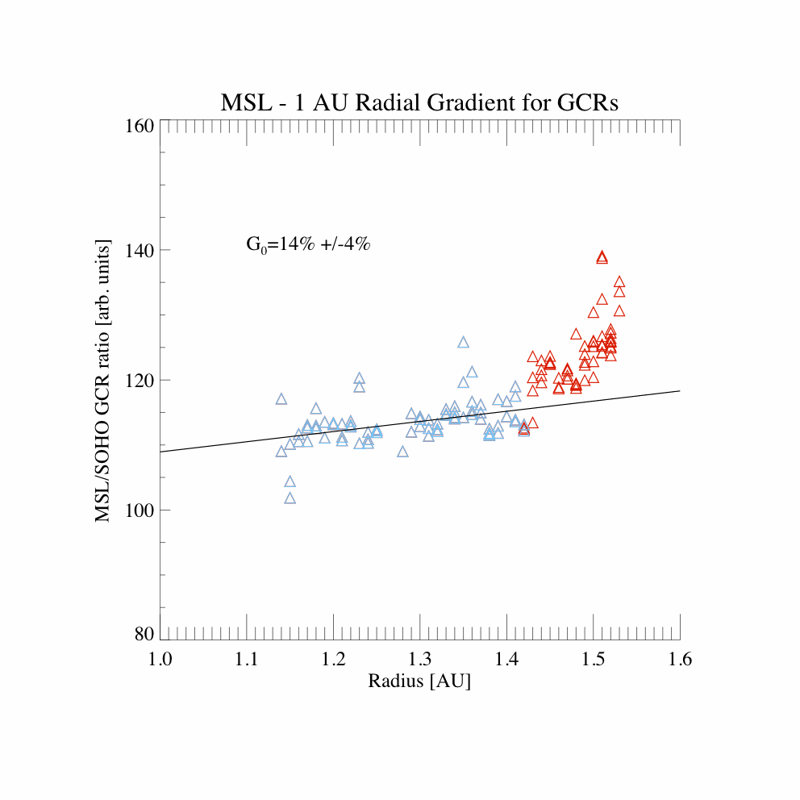
Feb. 1 – May 4 Time Interval
(blue symbols)
Notes:
The radial gradient over distance would be~14%/AU. Given the response function uncertainties, this value could be interpreted as an upper limit.
Periods of SEP fluxes are omitted and gradient determination is limited to 1.14-1.43 AU.
After this, the detection mode changes, and the latitude and longitude separations between Earth and MSL rise significantly, making the determination of GCR gradients more uncertain.

Slide 14
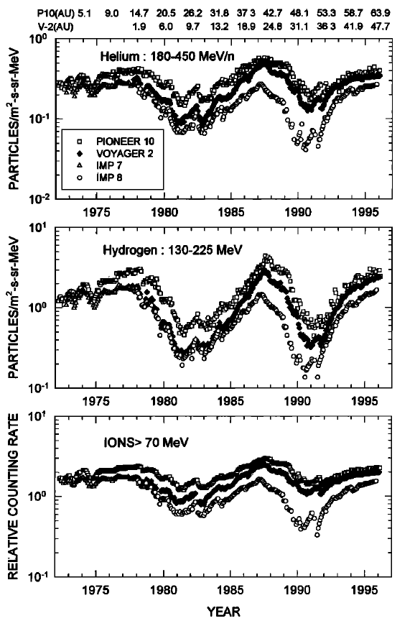
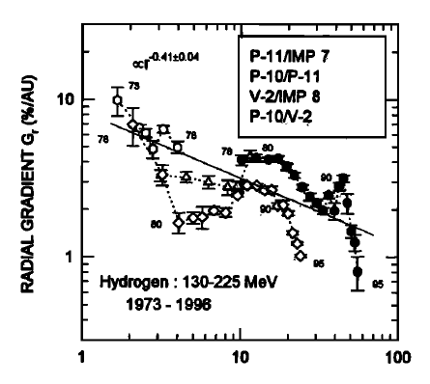
Fujii and McDonald, JGR, 1996
Notes:
To put this in context, Fujii&McDonald determined radial GCR gradients with IMP-7/8 and Pioneer/Voyager. The left graph shows various GCR components and their dependency on the solar cycle over various distances. In general, low-rigidity particles are modulated stronger than those of higher rigidity (He), and the total effect of modulation is stronger in the inner heliosphere than farther out, expressed in lower radial gradients with distance.
Radial gradients for protons of comparable energies as shown here are provided in the right panel. Intermediate distance measurements, i.e. near 1 AU, are in short supply. The value derived here appears rather high as compared to the published data. However, various factors may explain why this is:
Solar cycle phase leads to steep decrease in GCR intensity during the cruise period, explaining the observed up- and down in gradients.
The higher instrument low-energy cut-off at MSL removes lower-rigidity ions and thus contributes to less overall modulation when compared with lower instrument cut-off observations from L1.
Taking these two effects into account and extrapolating the radial gradient to smaller distances would lead to near agreement of published data with the gradient found here.

Slide 15
Discussion
Fujii & McDonald find with IMP-8, Pioneer and Voyager that GCR radial gradients are highly variable with distance and phase of the solar cycle
Limited data from comparisons between intermediate distances. RAD fills the void. Comparison shows rather high radial gradient of ~14%/AU.
Higher cut-off energy for protons expected at RAD vs. COSTEP. This may contribute to a seemingly high-end radial gradient, which is exacerbated by rise in modulation level during this period.
Additional information to be gained from solar rotation phase analysis due to unique cruise phase trajectory ~ along Earth’s Parker spiral magnetic field lines in connection with WSA-ENLIL.
Higher than expected radiation dose exposure to astronauts when relied upon 1 AU GCR observations & previous radial gradient determinations. Effect of excess dose on MSL s/c negligible.

