Slide 1
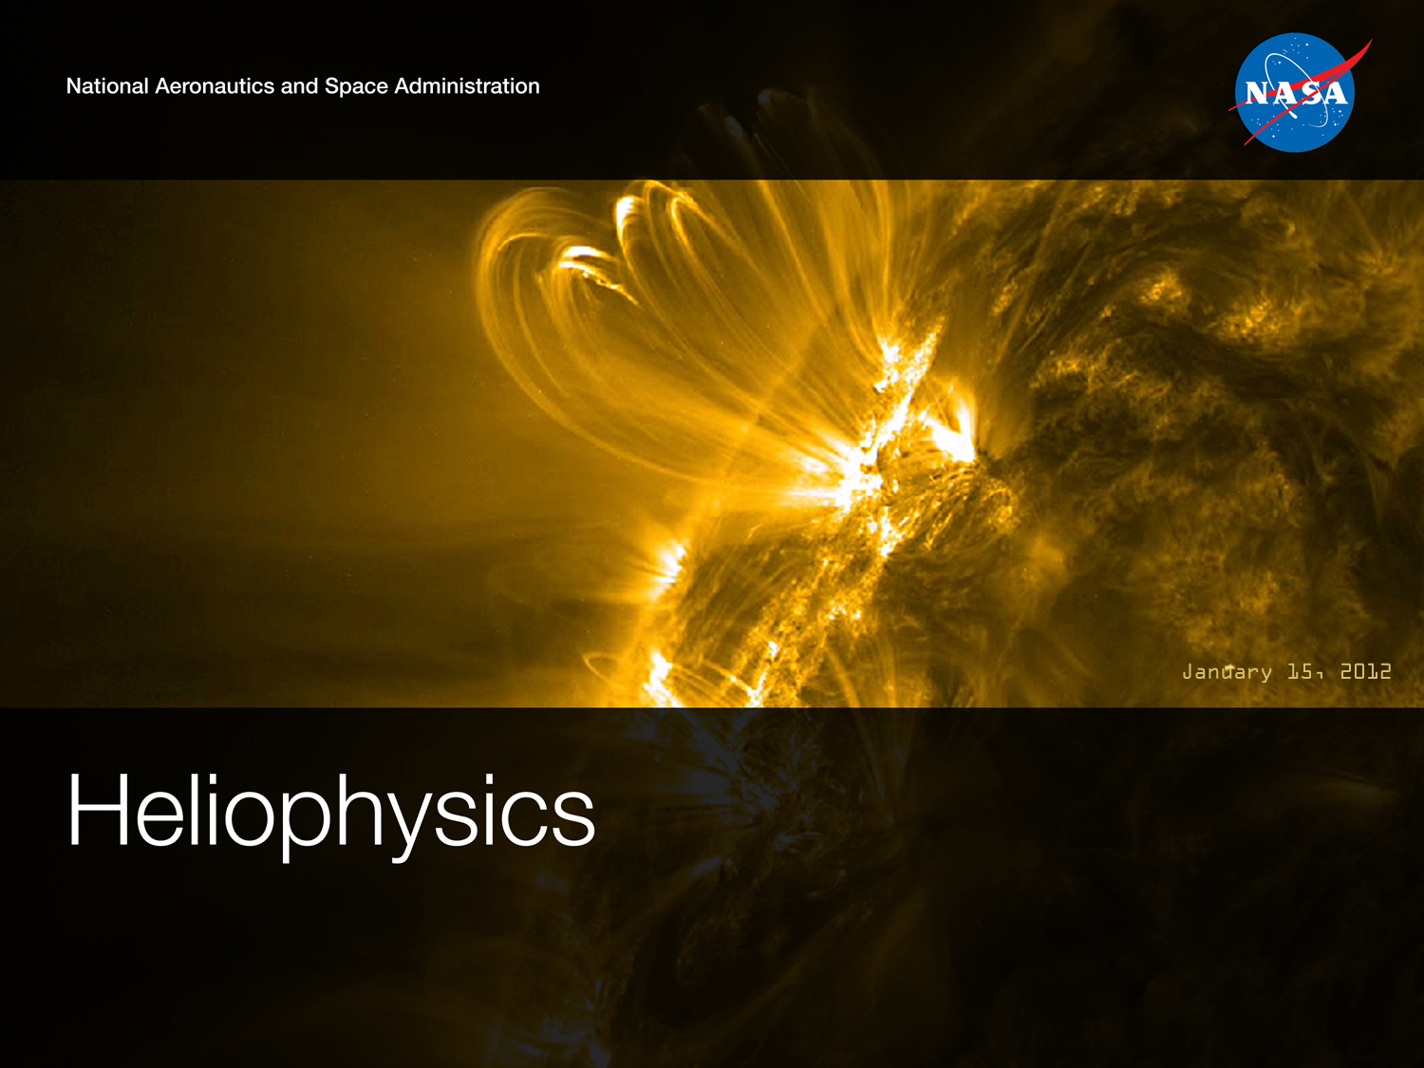
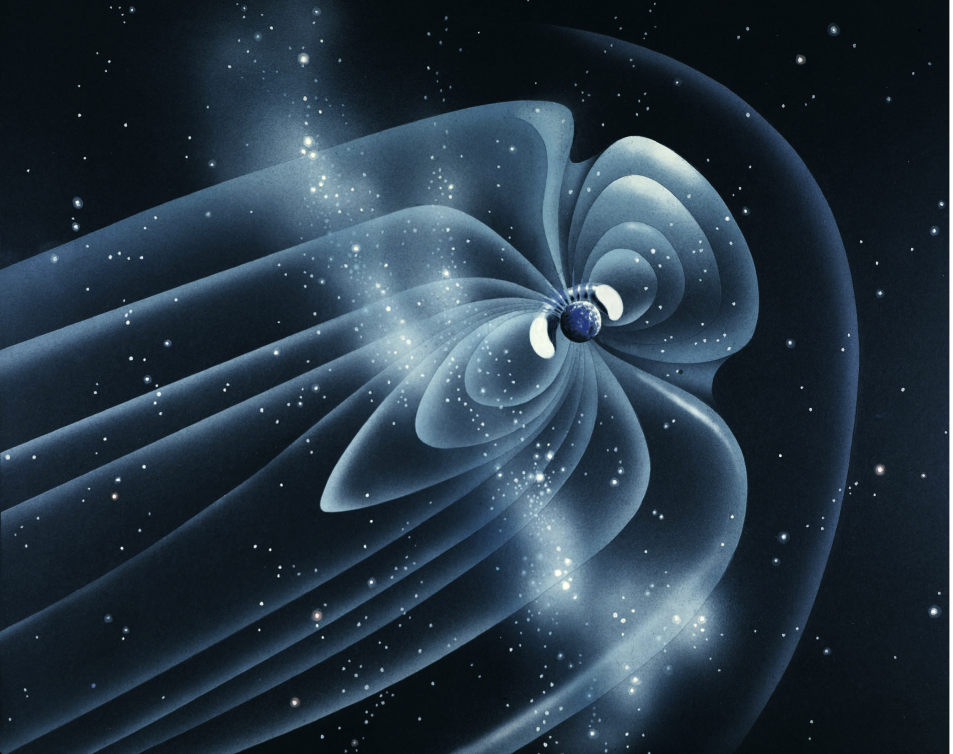
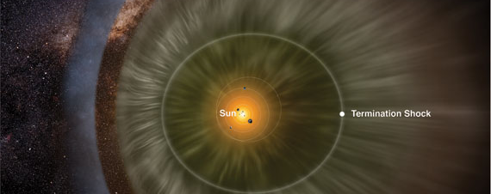
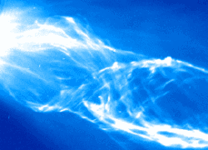
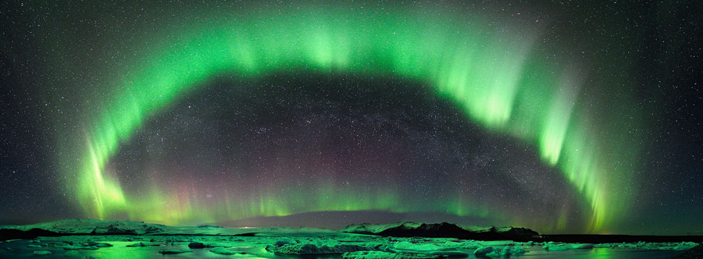
Science Mission Directorate
SMD View of Space Weather and of Space Weather Needs
September 27, 2012
Dr. Barbara Giles

Slide 2
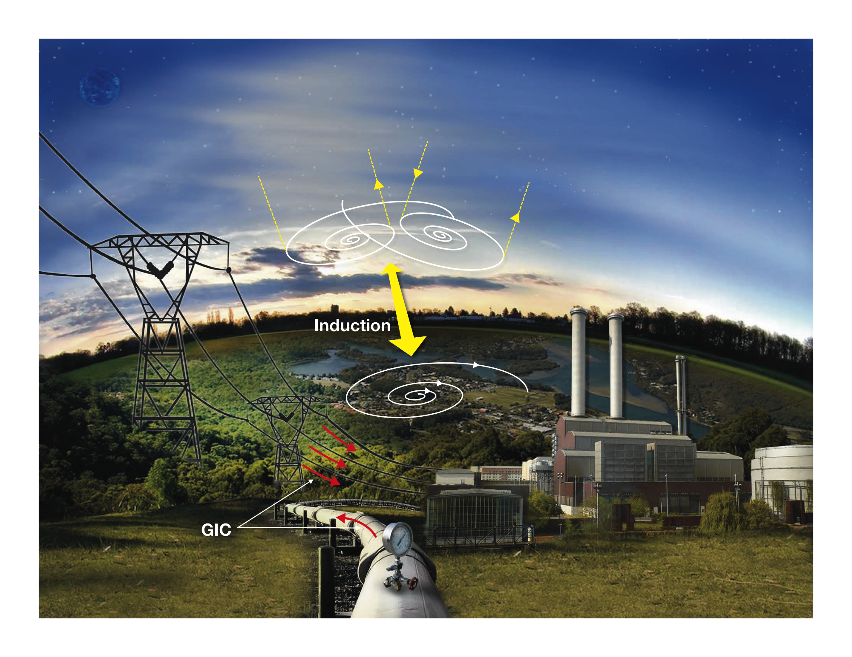
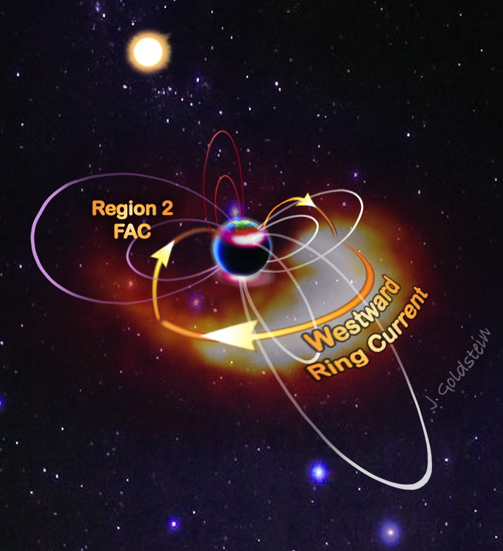
Geomagnetic Induced Currents

Slide 3
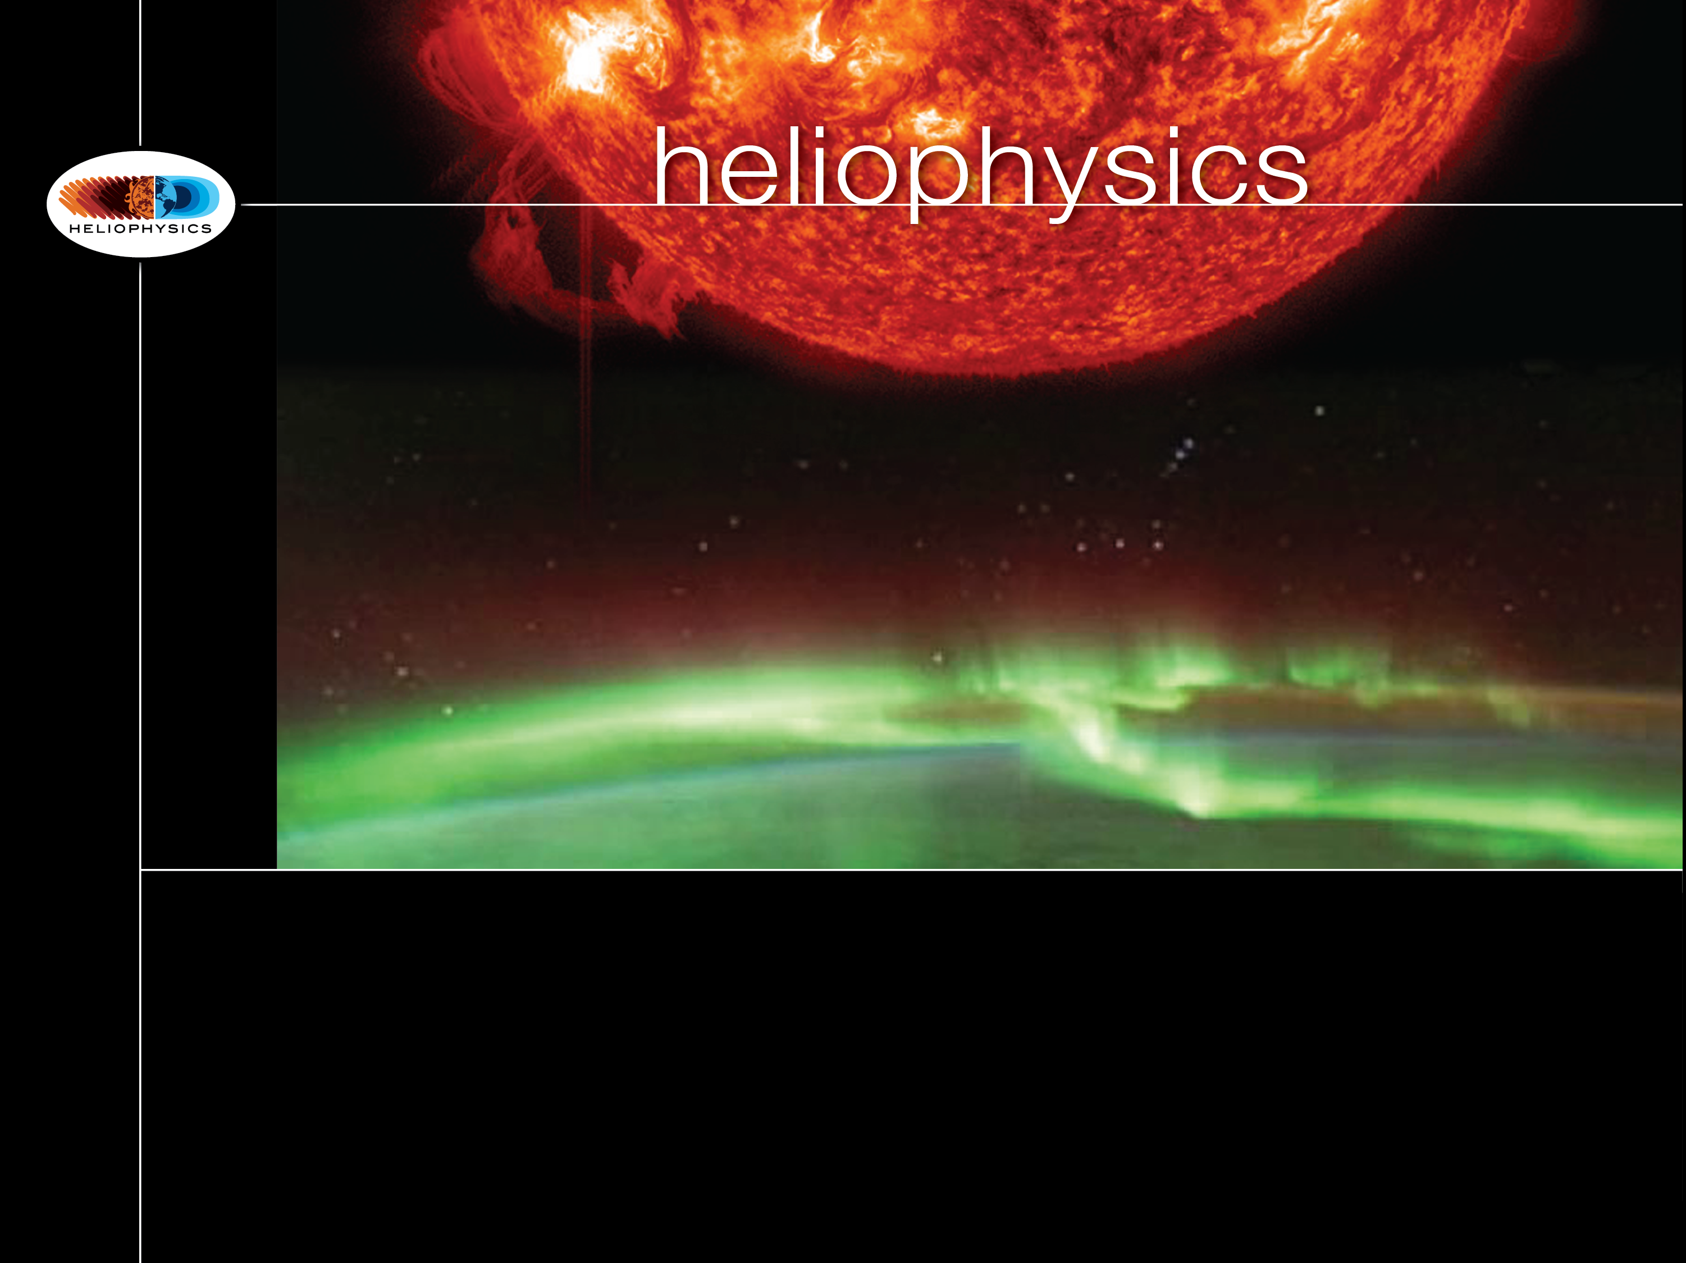

Heliophysics: and the 2012 NRC Solar and Space Physics “Decadal Survey”
and the 2012 NRC Solar and Space Physics “Decadal Survey”
NRC Report: Solar and Space Physics: A Science for a Technological Society
Released: Aug. 15, 2012

Slide 4
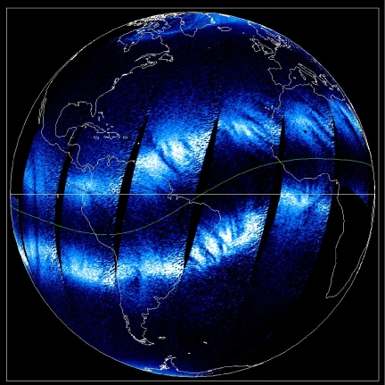
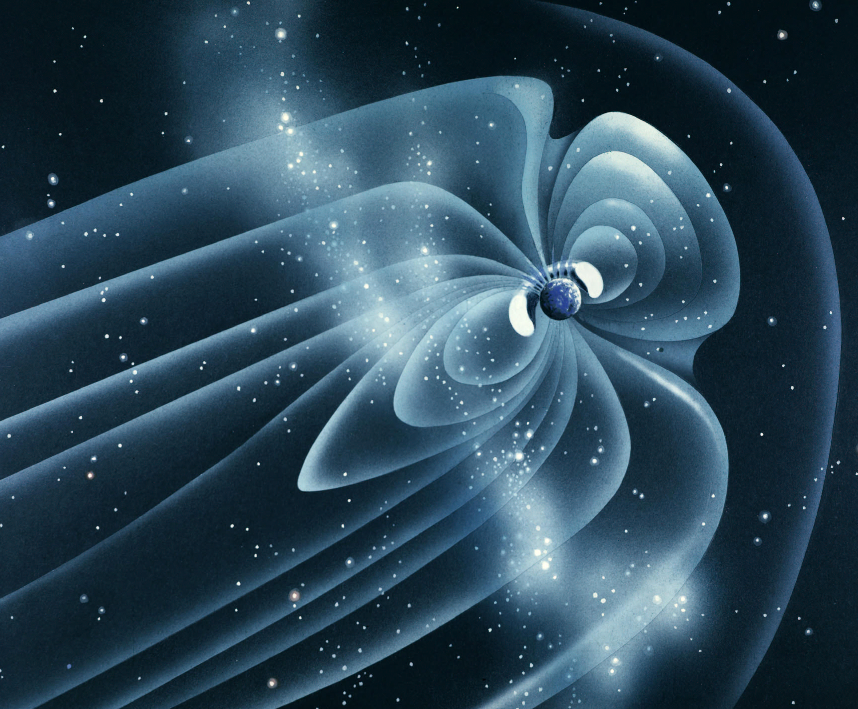
SMD Heliophysics Goals: 2010 SMD Science Plan to now
Understand the Sun and its interactions with the Earth and the solar system
Understand the fundamental physical processes of the space environment – from the Sun to Earth, to other planets, and beyond to the interstellar medium
Understand how human society, technological systems, and the habitability of planets are affected by solar variability and planetary magnetic fields
Maximize the safety and productivity of human and robotic explorers by developing the capability to predict the extreme and dynamic conditions in space

Slide 5
From the Decadal Survey …
SCIENCE GOALS FOR THE NEXT DECADE
Goal 1. Determine the origins of the Sun’s activity and predict the variations in the space environment.
Goal 2. Determine the dynamics and coupling of Earth’s magnetosphere, ionosphere, and atmosphere and their response to solar and terrestrial inputs.
Goal 3. Determine the interaction of the Sun with the solar system and the interstellar medium.
Goal 4. Discover and characterize fundamental processes that occur both within the heliosphere and throughout the universe.

Slide 6
In the area of space weather, SMD HPD intends to continue:
to support the scientific and technical developments that enable the next generation of physics-based solar and space environment models;
to support the transition of these research models into operations;
to the best of its ability, to address NASA’s robotic and future human mission need to predict the extreme and dynamic weather conditions in space; and
to provide full, appropriate access to the data, scientific knowledge, and modeling/application products to maximize the collective investment toward understanding space weather effects and the improvement of warning/mitigation strategies.

Slide 7
To that end, SMD Heliophysics has created a new program within its budget entitled:
Space Weather Research to Operations
The intent is to support the applied research and research-to-operations efforts called for by national space weather mitigation efforts.
The Headquarters Program Office is managed by:
Program Executive: William Stabnow
Program Scientist: Elsayed Talaat

Slide 8
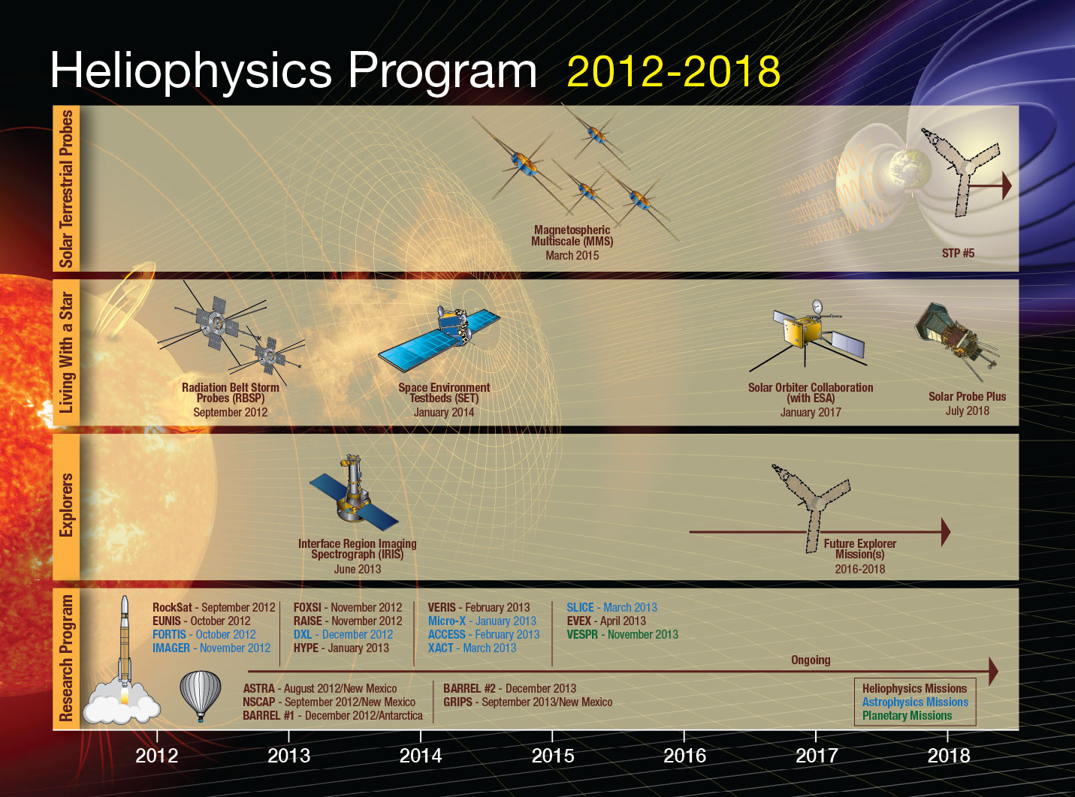
✓

Slide 9
2/13/12
Astrophysics
Earth Science
Heliophysics
Planetary Science
Total Missions / Spacecraft 86 / 98
Formulation 11 / 11
Implementation 15 / 18
Primary Ops 14 / 14
Extended Ops 46 / 55
JPL 2
GSFC 7
MSFC 1
LaRC 1
ARC 1
JPL 3
GSFC 9/13
DFRC 1/0
MSFC 1
ARC 1
JPL 7
GSFC 4
MSFC 2
LaRC 1
JPL 16/18
GSFC 27/34
MSFC 2
Fermi
SDO
LRO
NPP
CALIPSO
GALEX
Spitzer
Planck
Cloudsat
ACRIMsat
GRACE (2)
Jason-1
OSTM/Jason 2~
QuikSCAT
Voyager (2)
Mars Express
Mars Odyssey
MER (1)
Cassini
MRO
Deep Impact
HST
Suzaku
Integral
XMM
SWIFT
Aqua
Aura
SORCE
EO-1
Terra
TRMM
Landsat 7~
ARTEMIS* (2)
THEMIS (3)
STEREO (2)
AIM
Cluster-2 (4)
SMAP
GRACE FO
ICESat-2
GEMS
Solar Orbiter
Solar Probe +
OSIRIS-REx
EX-1
EX-2
Strofio
Kepler
Chandra
Hinode
Disc-12
LADEE
NuSTAR
ST-7
OCO-2
JWST
Astro H
LDCM
GPM
MAVEN
SET-1
RBSP (2)
MMS (4)
IRIS
SOFIA(1/0)
Herschel
Rosetta
DAWN
Juno
GRAIL
MSL
Aquarius
MESSENGER
New Horizons
SAGE III
SOFIA is a mission project but does not add spacecraft
Italics = US instruments on foreign mission
X / Y = # of missions / # of spacecraft
* New missions two of the THEMIS spacecraft, respectively
~ Operated by another agency
# Being reassessed per new Decadal Survey
NOAA Reimbursable:
GOES-R series, Jason-3, JPSS-1&2, DSCOVR
RHESSI SOHO TIMED IBEX WIND ACE GEOTAIL CINDI TWINS-A TWINS-B

Slide 10
Heliophysics2012 Decadal Survey Comparison
1. Complete the Current Program
Recommendation: The survey committee’s recommended program for NSF and NASA assumes continued support in the near term for the key existing program elements that constitute the Heliophysics Systems Observatory (HSO) and successful implementation of programs in advanced stages of development.
In-guide plans: Current budget supports RBSP, BARREL, IRIS, MMS, SOC, SPP, next Explorer.
2. Implement the DRIVE Initiative
Recommendation: implementation of a new, integrated, multiagency initiative that will develop more fully and employ more effectively the many experimental and theoretical assets at NASA, NSF, and other agencies. Up to $40M/yr.
Diversify observing platforms with microsatellites and mid-scale ground-based assets
Realize scientific potential by sufficiently funding mission operations and data analysis
Integrate observing platforms and strengthen ties between agency disciplines
Venture forward with science centers and instrument and technology development
Educate, empower, and inspire the next generation of space researchers
In-guide plans: Augment research program gradually; +$4M in FY16-18, rising to+40M by FY23.
Preliminary analysis is provided: NASA will study the Decadal Survey recommendations and submit revised budget plans, as appropriate

Slide 11
Heliophysics2012 Decadal Survey Comparison
3. Accelerate and Expand the Explorer Program
Recommendation: accelerate and expand the Heliophysics Explorer program. Augmenting the current program by $70 million per year, in fiscal year 2012 dollars, will restore the option of Mid-size Explorer (MIDEX) missions and allow them to be offered alternately with Small Explorer (SMEX) missions every 2 to 3 years. As part of the augmented Explorer program, NASA should support regular selections of Missions of Opportunity
In-guide plans: Augment Explorer program gradually; +$4M in FY17-18, rising to+70M by FY24
4. Restructure Solar-Terrestrial Probes as a Moderate-Scale, PI-Led Line
Recommendation: Solar-Terrestrial Probes program restructured as a moderate-scale, competed, principal-investigator-led (PI-led) mission line that is cost-capped at $520 million LCC per mission in fiscal year 2012 dollars.
STP#5 objective: Understand the interaction of the outer heliosphere with the interstellar medium; includes L1 space weather observations
STP#6 objective: Understand how space weather is driven by lower atmosphere weather.
STP#7 objective: Understand how the magnetosphere-ionosphere-thermosphere system is coupled and responds to solar forcing.
In-guide plans: Recommendation on re-structuring will be studied in FY14; start STP#5 in FY19; begin technology development studies in FY14.
Preliminary analysis is provided: NASA will study the Decadal Survey recommendations and submit revised budget plans, as appropriate

Slide 12
Heliophysics2012 Decadal Survey Comparison
5. Implement a large Living With a Star mission to study the ionosphere-thermosphere-mesosphere system in an integrated fashion
Recommendation: The survey committee recommends that, following the launch of RBSP and SPP, the next LWS science target focus on how Earth’s atmosphere absorbs solar wind energy.
In-guide plans: Start in FY20; begin technology development studies in FY14.
Recharter the National Space Weather Program
A2.1 Solar wind measurements from L1 should be continued, because they are essential for space weather operations and research. The DSCOVR and IMAP STP missions are recommended for the near term, but plans should be made to ensure that measurements from L1 continue uninterrupted into the future
A2.2 Space-based coronagraph and solar magnetic field measurements should likewise be continued.
A2.3 Evaluate new observations, platforms, and locations with potential to provide improved space weather services. In addition, the utility of employing newly emerging information dissemination system for space weather alerts should be assessed.
A2.4 NOAA should establish a space weather research program to effectively transition research to operations.
A2.5 Distinct funding lines for basic space physics research and for space weather specification and forecasting need to be developed and maintained.
In-guide plans: Start Space Weather Research to Operations project in FY14; continue to support missions with real-time data beacons
Preliminary analysis is provided: NASA will study the Decadal Survey recommendations and submit revised budget plans, as appropriate

Slide 13
Upcoming Activities of Interest
Survey of Decadal Surveys (lessons learned)
  Objective: Formulate initial lessons learned from recent decadal surveys; assess whether a formal NRC study on the subject is warranted or desirable
  Activity: reformulated as a workshop only (no consensus findings or recommendations)
  Status: cttee appointed, planning mtg held 6/21-22 in Irvine
  Planned mtgs: workshop to be held with SSB mtg on 11/12-14 in Irvine
  Product: NRC workshop report due summer 2013
Standing Committee on Solar and Space Physics (CSSP)

Slide 14
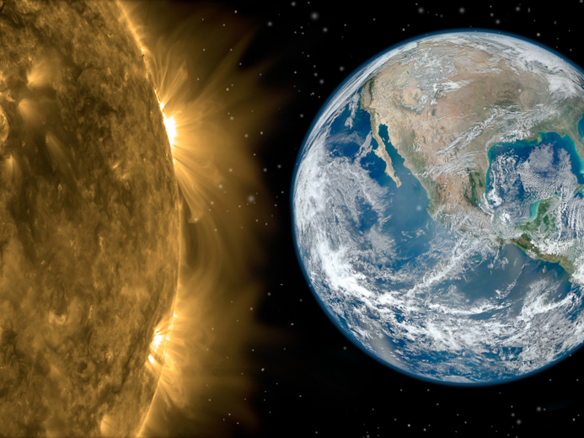
How and why does the Sun vary and affect Earth and the rest of the solar system?
Notes:
Let me wrap up this session now. There are many strategic science areas, I was not able to address in this limited time period … most everything specifically of interest to Earth Science plus huge portions of heliophysics science, most notably our important work in the outer heliosphere. That must be left to later discussions.
From the earliest observers … to the innovators that built the scientific instruments of today … you, me … each one of us have been driven to explore for a variety of reasons, be it intellectual, stewardship, economical, or just the pure joy of expanding our horizon.
Our future depends on our ability to operate from, through, and in space.
The strategies we choose cannot be viewed in isolation to our specific scientific interests.
We must, as individuals, recognize that our choices are a key component of the solutions to real 21st-century challenges.
As we have done before and regardless of the demands of the current environment, let us prepare for a space science program that will serve the nation effectively and that will achieve those national priorities we all hold near to our heart.
Thank you for your time today …

