Slide 1
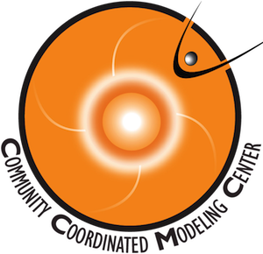
Kamodo and CCMC-Vis: CCMC Tools for Visualization and Analysis
Rebecca Ringuette^{1, 2}, Lutz Rastaetter², Darren DeZeeuw², Asher Pembroke^{3,4}, Katherine Garcia-Sage², Oliver Gerland³, Michael Contreras³, and Robert Robinson^{5, 2}.
¹ADNET Systems, Inc., ²NASA Goddard Space Flight Center, ³Ensemble Consultancy, ⁴Satoshi Energy, ⁵Catholic University of America
Kamodo-Core
CCMC-Kamodo
CCMC 2022 Workshop

Slide 2
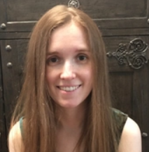
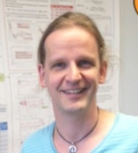
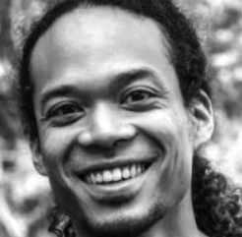
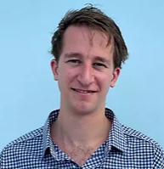
The Kamodo Team
CCMC Staff:
Rebecca Ringuette: Model interfaces, metadata, flythrough and other CCMC capabilities.
Lutz Rastaetter: Internal cross-language interfaces, specialized interpolators, CCMC-Vis, team management.
Darren de Zeeuw: GitHub management, visualization, metadata.
Katherine Garcia-Sage: Orbit propagation and satellite reconstruction studies, external affairs.
Ensemble Consultancy partners:
Asher Pembroke & Oliver Gerland: Core Kamodo capabilities, expert bug squashers.
CCMC-Kamodo
Kamodo-Core

Slide 3
Outline
Rebecca Ringuette: Overview, model interfaces, metadata.
Darren de Zeeuw: Data-model comparison using Kamodo’s flythrough, interactive visualization.
Lutz Rastaetter: Cross-language interfaces, specialized interpolators, CCMC-Vis.
Asher Pembroke: Calling Kamodo from other languages, Code-free and reduced code interfaces.

Slide 4
Kamodo: Simplifying Model Data Access at CCMC
Model Reader: Model-agnostic direct access to functionalized model data (currently ITM and Magnetosphere).
Flythrough: Fly a trajectory time-series (real, generated, or user-given) through model data.
Constellation Tool: Reconstruct what a satellite constellation would see using model data as a virtual reality.
PyHC Executable Paper: Demonstration of model-data comparison and interoperability with other packages.
Notes:
Also emphasize ALL commands are model agnostic. The flythrough output is shown at about 11 seconds. The reconstruction tool produces three plots: the reconstructed data the constellation would see, the corresponding model data, and the percent difference between the two (in that order in the video). Another possible visualization method for the flythrough is shown at the end.

Slide 5
Kamodo: New and Planned Features
Specialized Interpolators: Block-adaptive grid interpolator for SWMF/BATS-R-US and GUMICS
Code-free interfaces: Create code-free workflows with functionalized data.
Coming soon:
Link to orbit propagators and TLEs as inputs
Expand model and interpolator library
Interpolator parallelization
Online analysis container with model data
Direct interactive access from other languages (e.g. C, C++, Fortran)

Slide 6
Kamodo: Demo Notebooks
Model Reader notebook: https://drive.google.com/file/d/1oknnmk53mwmdQxmq2liQ-Aeustcpv2fR/view?usp=sharing
Model-Data notebook Part 1: https://github.com/nasa/Kamodo/blob/master/notebooks/Model_Data_Comparison-TIEGCM.ipynb
Model-Data notebook Part 2:
https://github.com/nasa/Kamodo/blob/master/notebooks/Model_Data_Comparison-ROR.ipynb

Slide 7
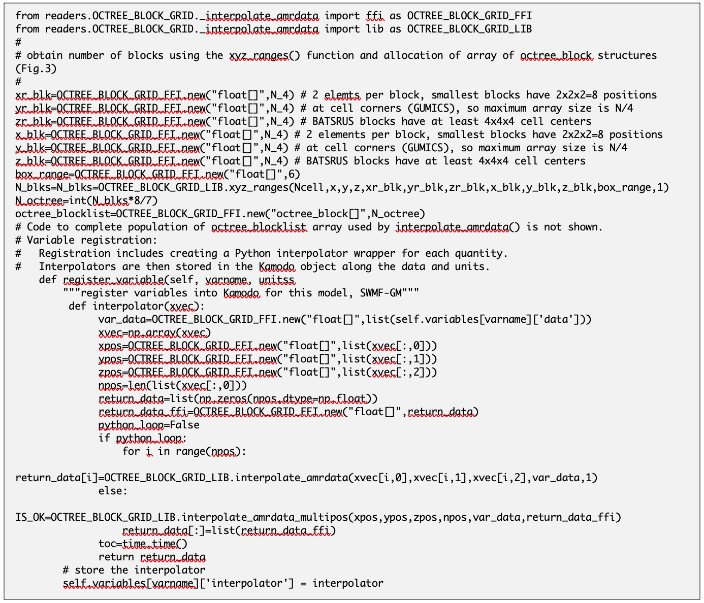
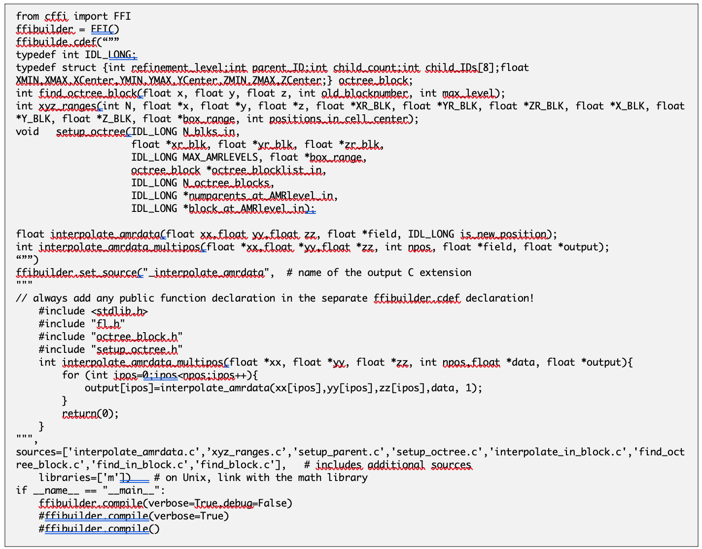
Kamodo: Specialized Interpolators and Readers
Python interpolator using C interface function and library.
CFFI compilation script with interface routine definition
SWMF/BATSRUS, GUMICS:
Interpolator for block-adaptive grids written in C is linked to Python via cffi.
Code suitable for:
BATSRUS IDL (cell centered) data,
GUMICS TecPlot (cell-corner based) or
GUMICS DC (cell-centered) data.
Plans / Collaboration Opportunities:
Extend interpolator to solar-heliosphere applications:
spherical coordinates
generalized radial coordinate
ARMS model (MHD of solar corona)
Implement parallelized interpolation in 4D (time+space)
3D interpolators arranged in time, run in parallel to assemble time series.
Function declarations
Interpolator
C source files and compilation

Slide 8
Kamodo: Specialized Interpolators and Readers
Using OpenGGCM Fortran library
OpenGGCM magnetosphere and ionosphere electrodynamics:
compressed files decoded using Fortran library via f2py.
Conversion performed on CCMC server.
Create 4D (space+time) NetCDF files for Kamodo + Flythrough
Access to large data files using Xarray.
Opportunities for Collaborations:
Implement parallelized interpolation in 4D (time+space)
Split large grids into sub-regions as needed for faster regional analyses (near-Earth, dayside, etc.).
Use 3D reader/interpolators in parallel to create 4D interpolation.
[ kamodo_ccmc/readers/OpenGGCM $] cat readmagfile3d.f
c----------------------------------------------------------------------
subroutine read_3d_field(path3d,
& threeDfield,var,nx,ny,nz,asciiTime)
c----------------------------------------------------------------------
! character(len=40) :: path3d
character(len=110) :: path3d
character*80 var
character*80 asciiTime
real threeDfield(nx,ny,nz)
integer fileNo2
integer nx
integer ny
integer nz
integer it
!f2py intent(in) :: path3d
!f2py intent(in,out) :: threeDfield
!f2py intent(in) :: var
!f2py intent(out) :: nx,ny,nz
!f2py intent(out) :: asciiTime
fileNo2=11
c write (0,*) 'opening file: |',path3d,'|'
open(unit=fileNo2,file=path3d,status='old',action='read',err=222)
call read_mhd3d(fileNo2,threeDfield,nx,ny,nz,var,asciiTime,it)
close(fileNo2)
return
222 write(0,*) "could not open file"
return
end
. . .
Signature of entry point routine.
Build readOpenGGCM library with f2py:
f2py -c -m readOpenGGCM \
read_b_grids.f \
read_ctim2d.f \
readmagfile3d.f
Specification for f2py of inputs and outputs.
Python use:
import readOpenGGCM as ropgm
. . .
# read ‘bx’ from 3D data file (*.3df.??????):
(field3d,nx,ny,nz,timestring) =
ropgm.read_3d_field(filepath, fieldbuffer, ’bx’)

Slide 9
Kamodo: Specialized Interpolators and Readers
Collaboration Opportunities:
GUMICS:
Added support for GUMICS-5 *.dc files in IDL (CCMC online vis.):
Grids as large as 15 million cells tested.
Possible to read subregions of grid.
GAMERA:
Model writes multi-timestep magnetosphere HDF-5 output files.
MPI model generates outputs for separate parts of grid:
Parallelized reader and interpolation.
Specialized Fortran interpolator to be supplied by modelers.

Slide 10
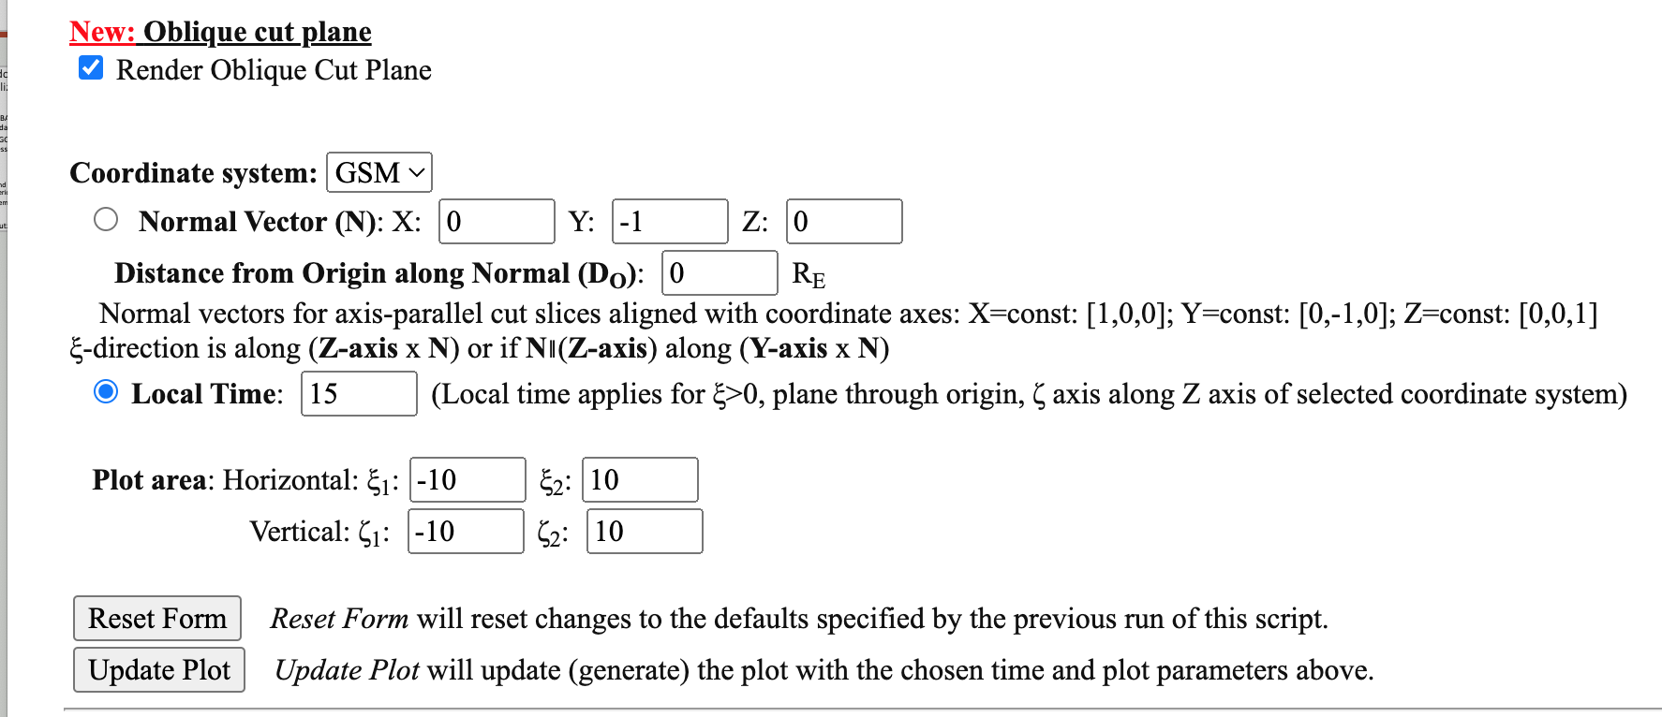
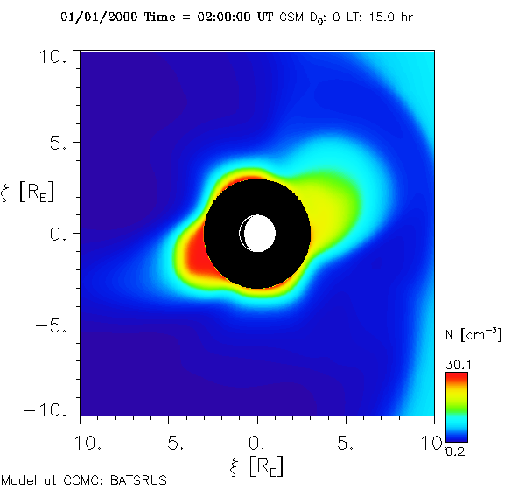
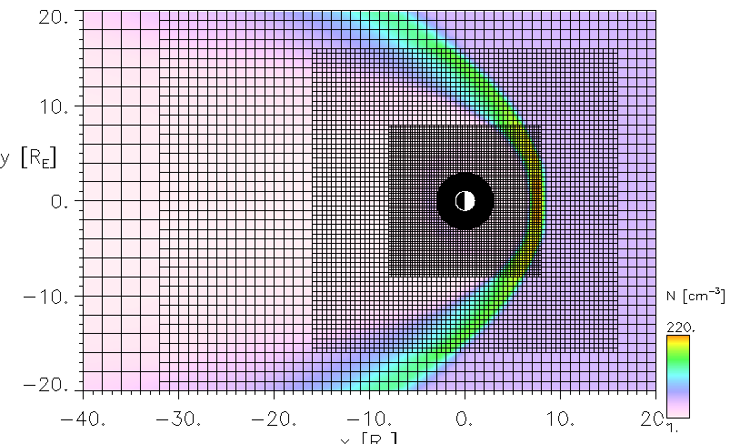
CCMC-Vis: Added Features
Oblique plot plane options
User Interface Modernized:
Only items relevant to Plot Mode selection shown.
Advanced options on demand only.
Plot features added:
Oblique slices and coordinate transformation (SM-GSM-GSE),
Side-by-side plot comparison for multiple runs.
Choice of color tables.
Models added:
SH: Euhforia
GM: HYPERS, GAMERA, GUMICS-5
IM: IMPTAM, VERB-3D
IT: PANDOCA, JB, IRI, IGRF (run-on-request runs) WACCM-X, Adelphi, AmGEO, SuperDARN

Slide 11
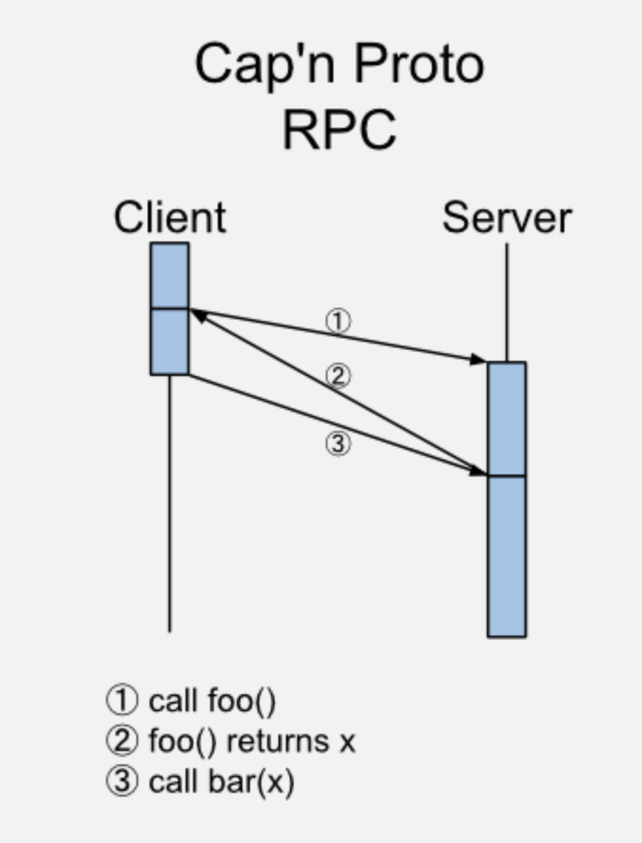
Kamodo-Core Remote Procedure Call (RPC) Update
Improved code base released by Ensemble team via Kamodo-Core Version 22.5.0.
Adds RPC-based cloud & API Configurability,
Cross-language usage enabled (Fortran, C++ etc)
This RPC specification, built on Cap'n Proto serialization protocol, provides a flexible and generic means for Kamodo end users to call containerized Kamodo functions
The KamodoClient, which subclasses Kamodo, behaves just like Kamodo core's base class, except that all interpolations and function evaluations will occur within the remote containers that implement them.
Binary Data Streaming: In addition to the basic python data types, functions can send and receive binary data.
This allows NumPy arrays and accompanying metadata to be communicated as quickly as possible without the need for JSON serialization on either end.

Slide 12
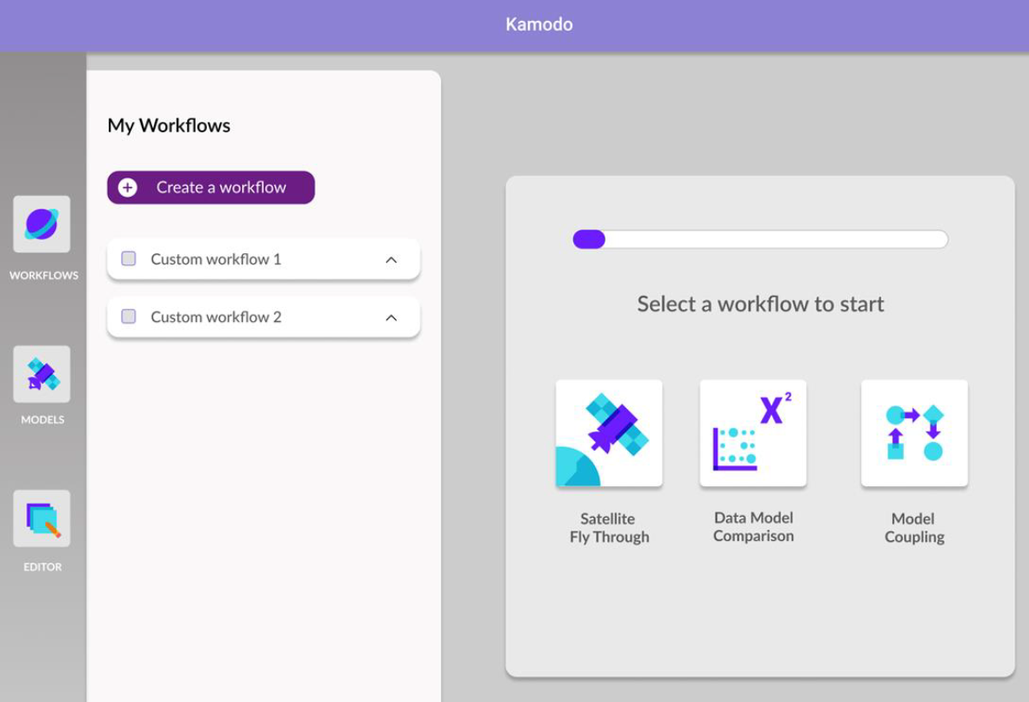
Kamodo-Core Code Free Interface
Containerized custom workflows
Interactive access to model data
Great for commercial and education applications
https://youtu.be/vpJgtAMCVvc
Embed youtube video here

Slide 13
Kamodo: Future Plans
Open Science: Improve documentation, build open access to compute capabilities next to model data, include miniature executable papers as tutorials.
New features: Orbit propagators through pysat, heliospheric coordinate systems through SpacePy, image analysis through SunPy.
CCMC core improvements: Expanded model library through collaborations, parallelized interpolators, HAPI layer on top of flythrough function, line-of-sight calculation tool.
Science research: Constellation studies, expanded model-data comparisons, model-model interfaces for model coupling

