Slide 1
New CCMC Website
Tyler Schiewe

Slide 2
Goals
Focus on static content
Make content:
Easier to find
Easier to read
Easier to edit
Laptop phone psd created by riandra - www.freepik.com

Slide 3
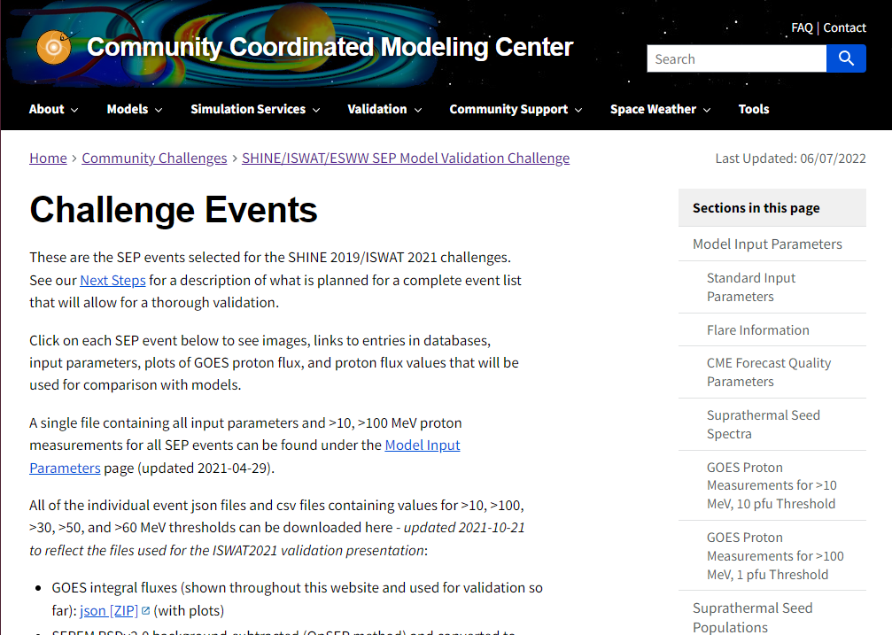
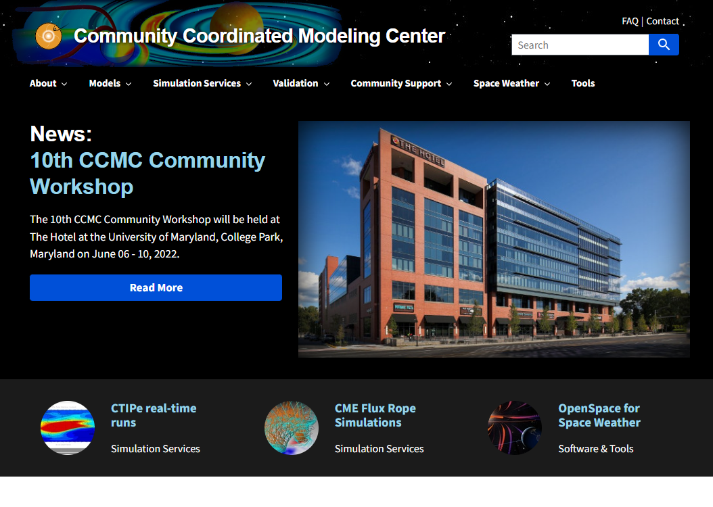
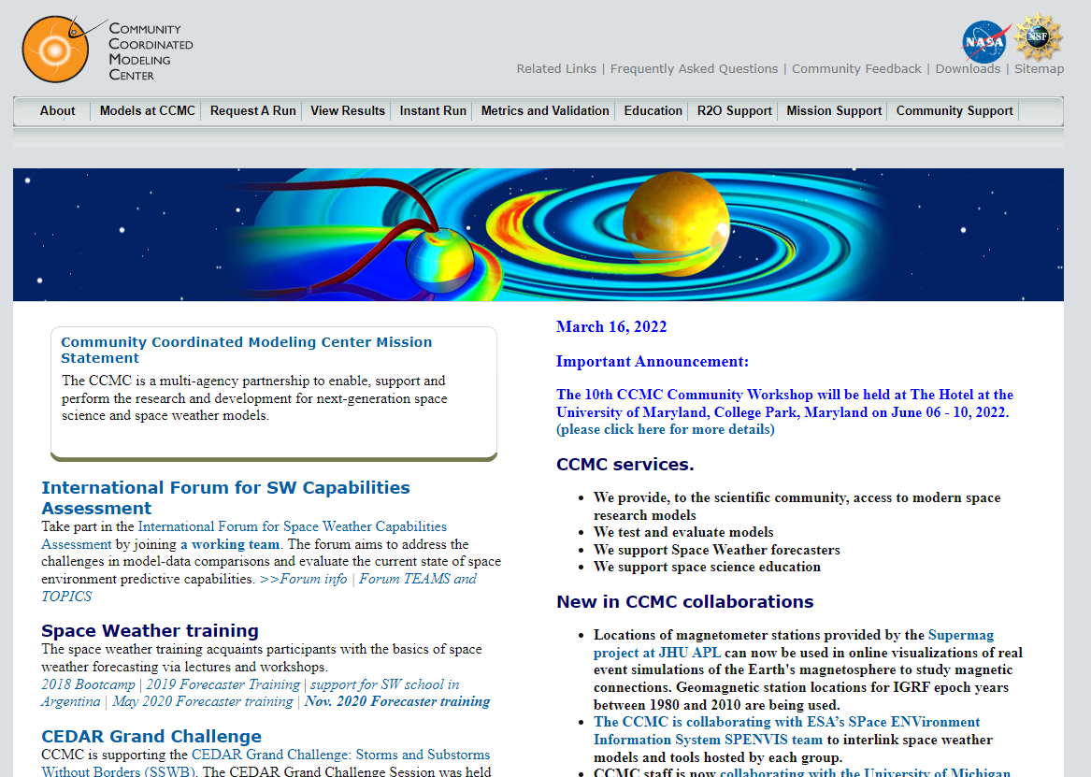
Easier to Find
Full-site search
Reorganized menu
Restructured pages
Merged small pages
Removed duplicate content
Archived legacy pages
Breadcrumb navigation
Auto-generated table of contents with jump links
Last-updated timestamp

Slide 4
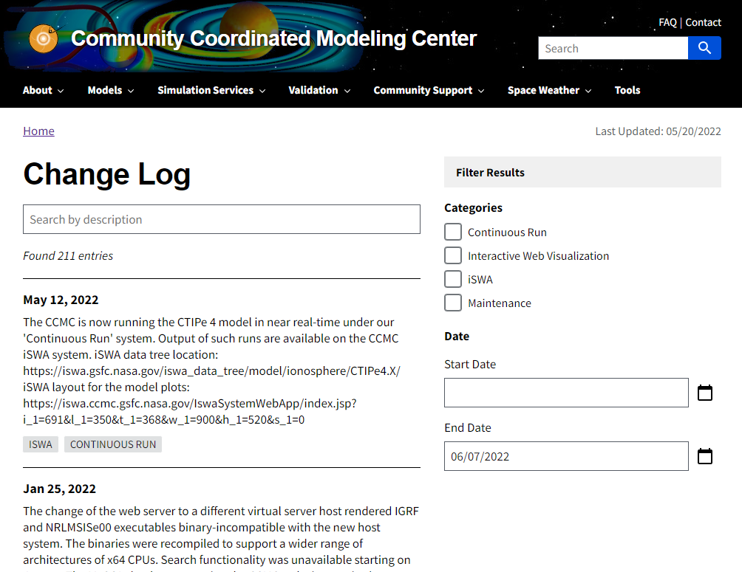
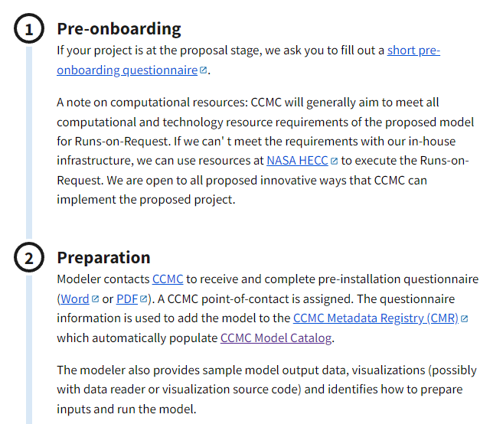
Easier to Read
Cohesive design using USWDS
Mobile-friendly and responsive layout
Consistent font size and content width
Pre-designed, accessible components
Interactive filters for list pages

Slide 5
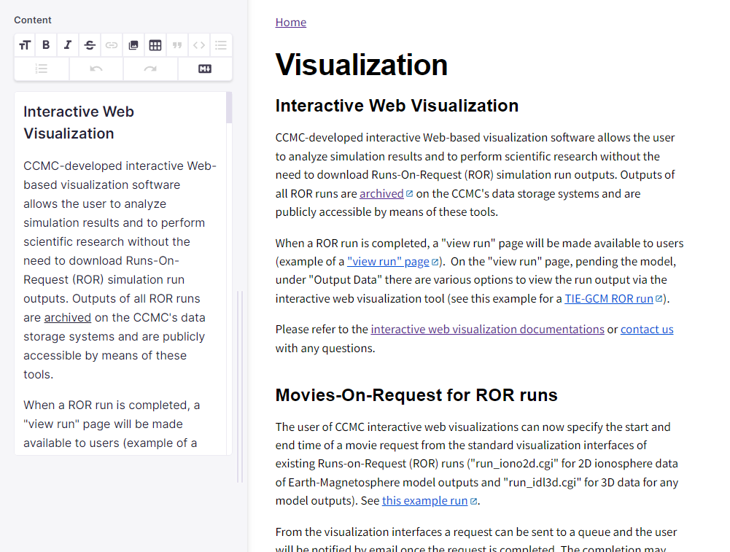
Easier to Edit
In-browser, WYSIWYG, no-code editing
Version-controlled in Gitlab
Allows edits from external contributors
Full commit history
Branching enables experimentation and collaboration
Automated build pipeline
Optimizations at build stage
Quality checks at test stage
Easy deployment to cloud

Slide 6
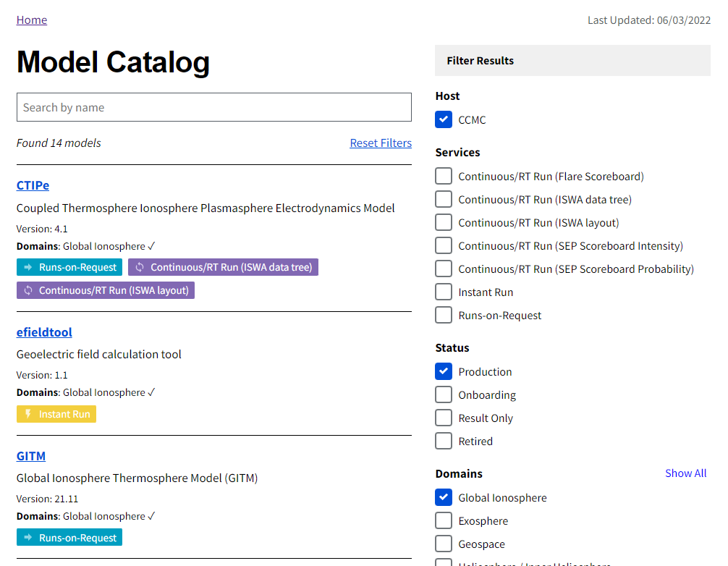
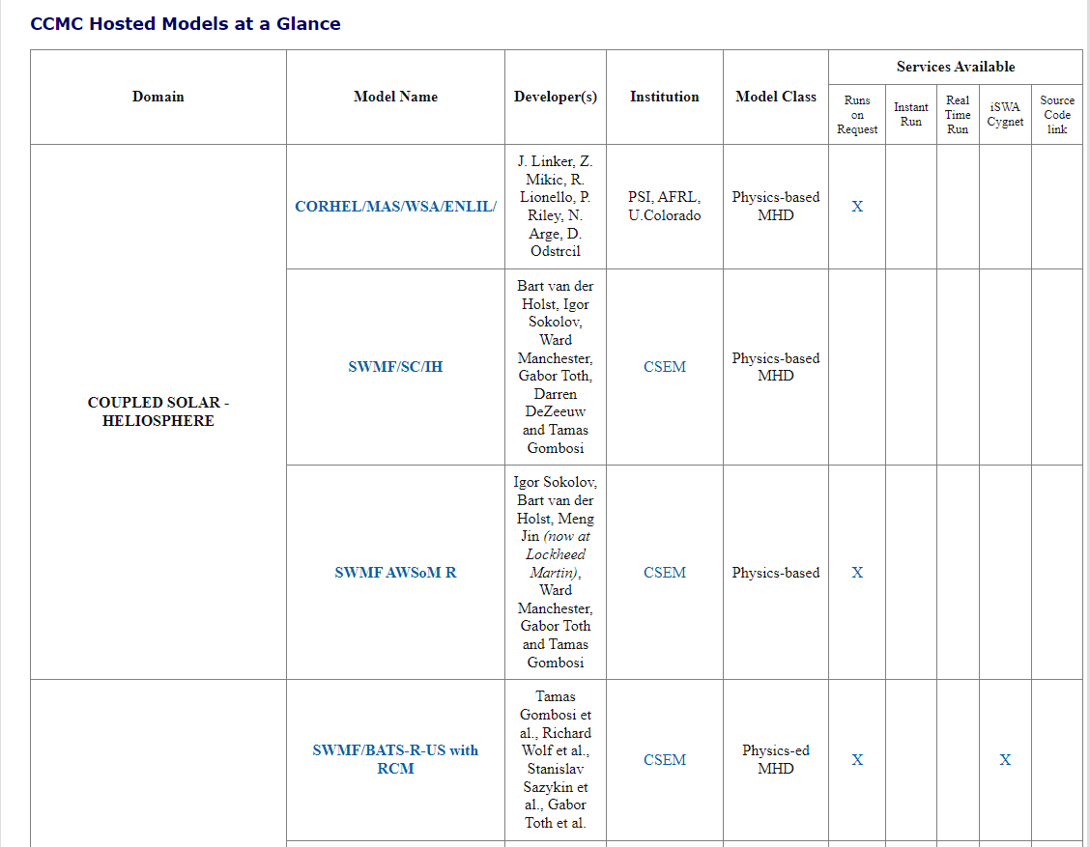
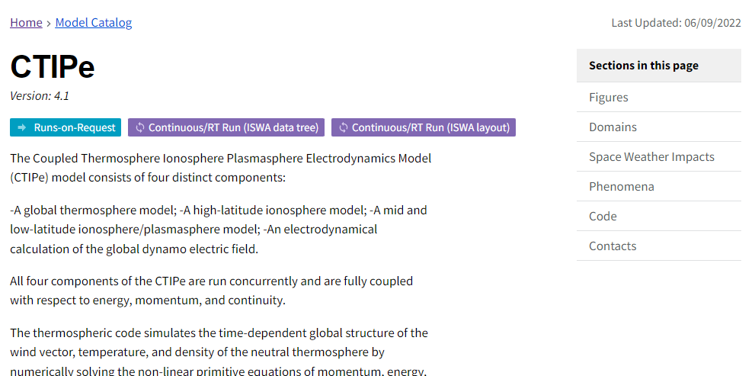
Model Catalog
https://ccmc.gsfc.nasa.gov/models/
Generated from CCMC Metadata Registry (CMR)
Find all models according to services
Filter by domain, phenomena, etc.
Shareable: https://ccmc.gsfc.nasa.gov/models/?services=Runs-on-Request&domains=Geospace

Slide 7
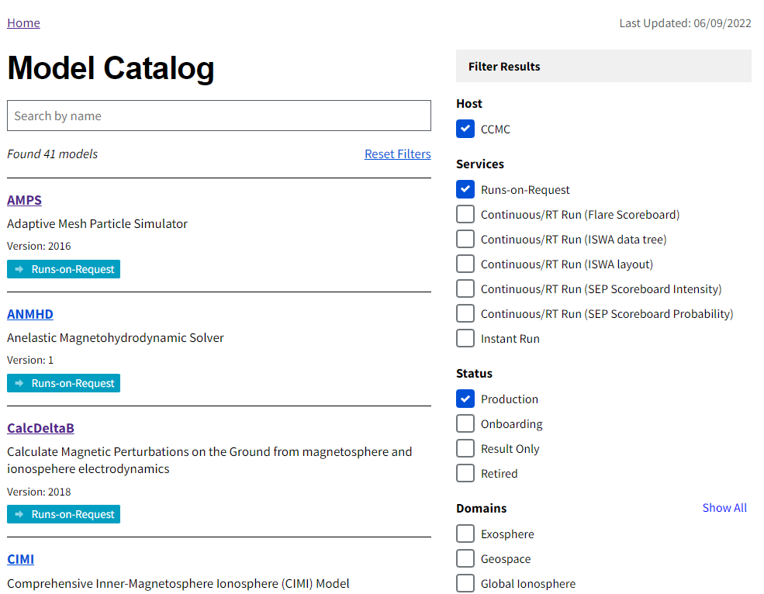
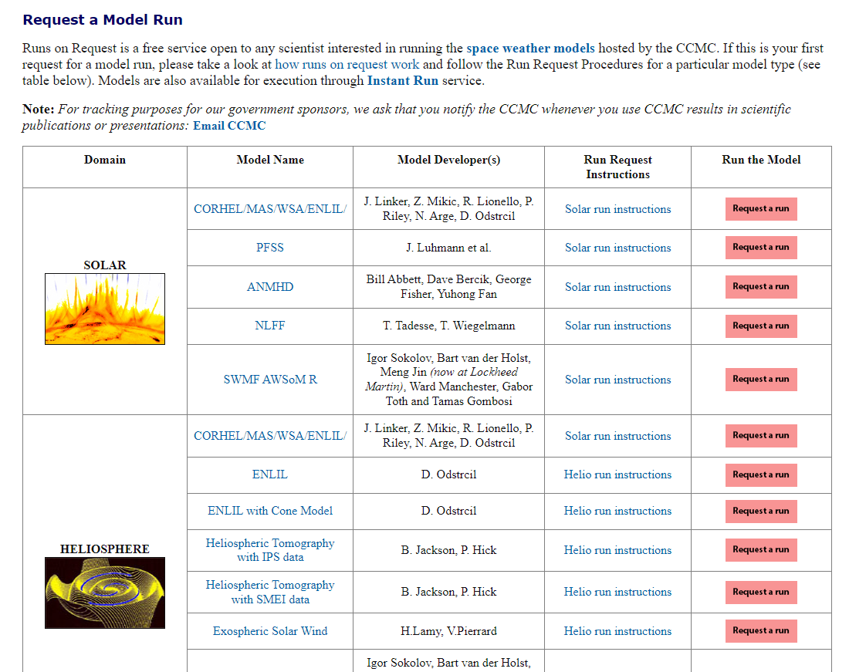
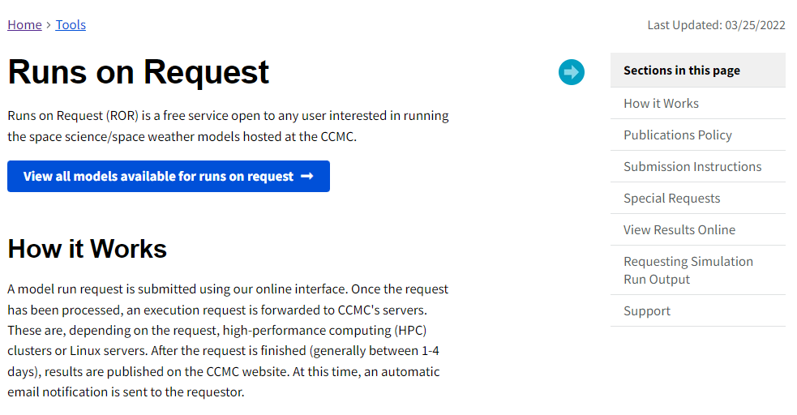
Request a Run Page
https://ccmc.gsfc.nasa.gov/tools/runs-on-request/
Replace duplicate and manually updated pages with model catalog
https://ccmc.gsfc.nasa.gov/models/?services=Runs-on-Request

Slide 8
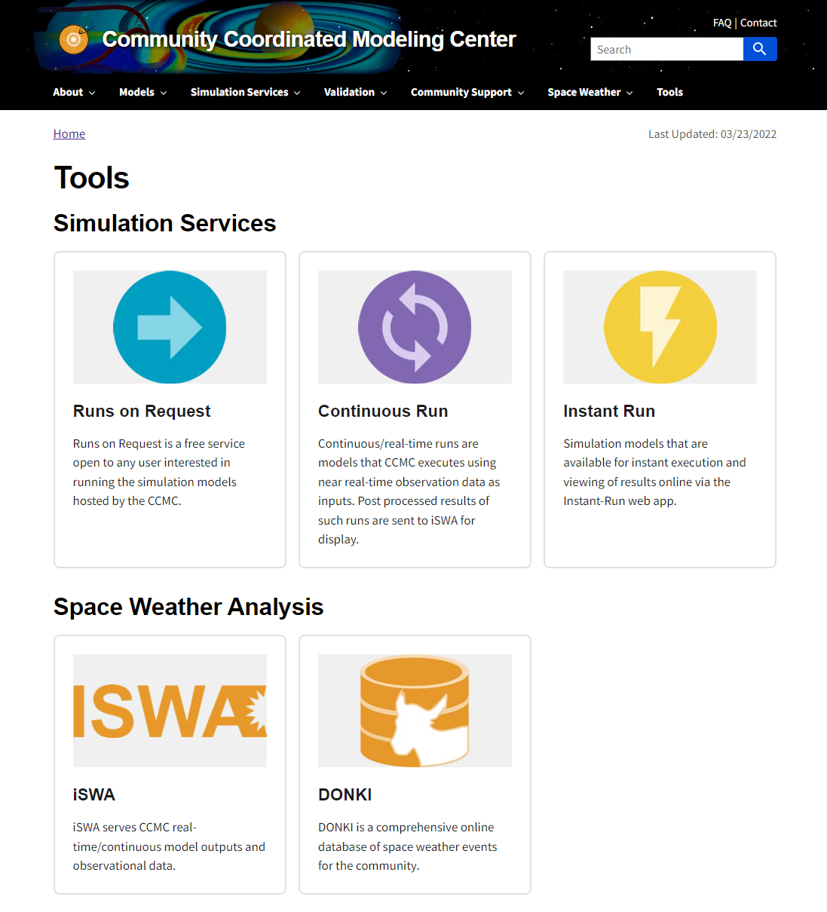
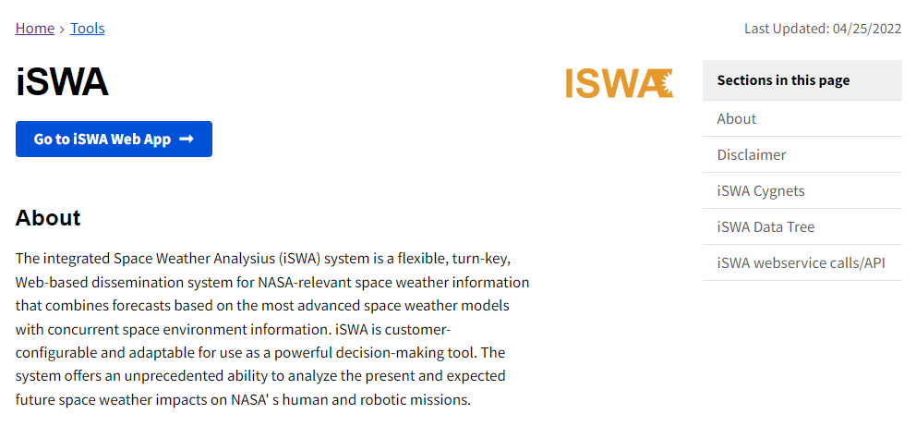
Tools Page
https://ccmc.gsfc.nasa.gov/tools/
All tools in one place
Landing pages for all tools with info and link to app

Slide 9
Questions?

