Slide 1
Instant Run System (IR)
Mark Moussa, Rita Owens and CCMC Team

Slide 2
Next Generation Instant Run Overview
Replacing legacy technologies with modern technologies allows for:
Faster and easier onboarding of new models
More optimal run time
Integrated system
Improved user interface and user experience

Slide 3
Technologies used
NodeJS
ReactJS
Docker
Used to develop the server
Used to develop the web interface
Used to host the models in a controlled and secure setting
Notes:
Quick overview, I’ll be explaining the reasoning for each one more in depth in the following slides

Slide 4
New in Model Onboarding
Model developer contacts and sends information about model
Inputs/outputs, source code, etc.
Model is containerized using Docker, and web interface is created based on information given
Feedback is given from the model developer and necessary changes are made
Models and interface are backed up and verified using source control

Slide 5
New in Web Interface
Interactive plots
Error validation
Uniform and updated theme/styling
Multiple data output options
Modularity of website allows for ease of reuse of standardized building blocks, for faster model interface generation

Slide 6
Containerized Models
Containerizing models has made maintenance and onboarding significantly easier and faster
Models and their prerequisites are encapsulated and frozen, allowing them to be hosted on any platform, OS, etc., without causing versioning issues.
Docker containers have restart policies, health checks, and significant logging features to help prevent downtime

Slide 7
Coming Soon
List of Models that have been added/transitioned to the new IR system:
HWM14, IRI 2016, NRLMSIS, and SuperDARN Convection Models
Add new IR model as they are being onboarded
UI/UX improvements
Transition all remaining IR models to the new IR system no later than end of 2022
Models execution: Application Programming Interface (API) under development
CI/CD Integration

Slide 9
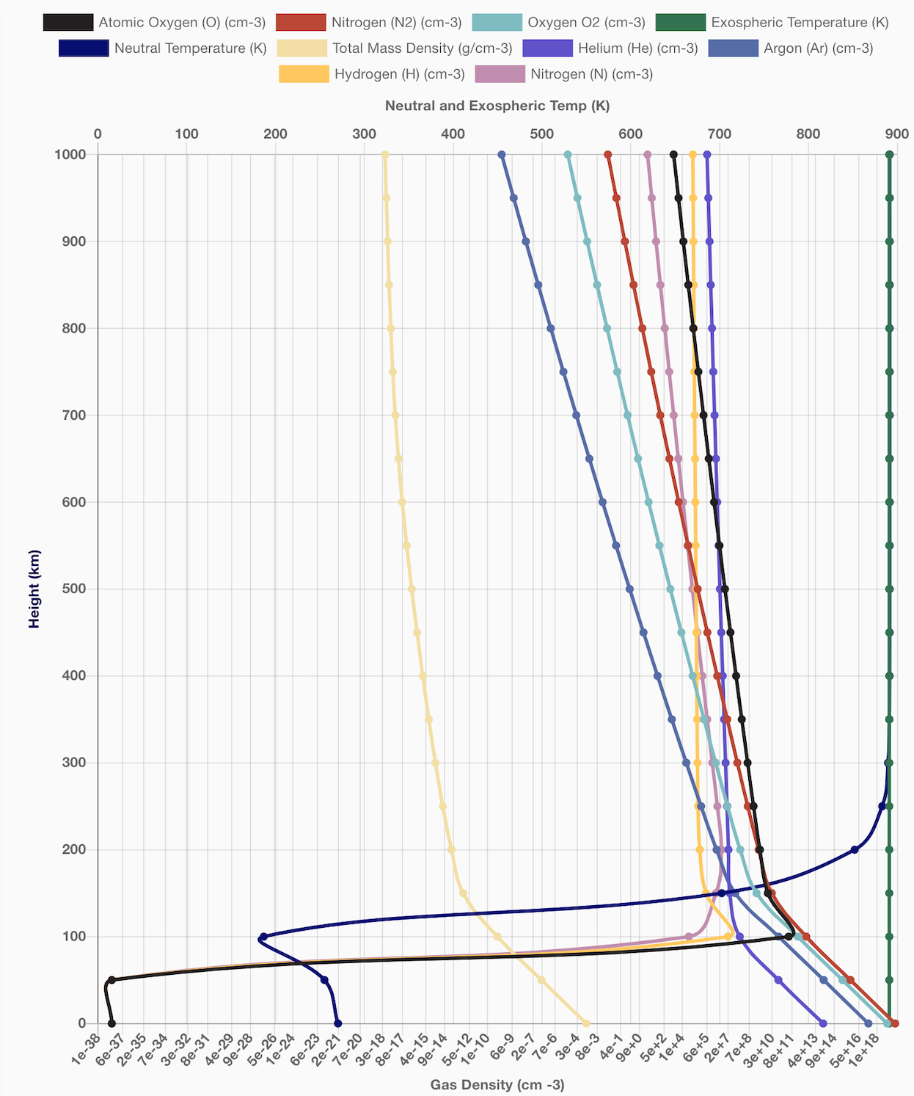
Notes:
Graphs are more interactive, appealing to look at, and easier to extract information

Slide 10
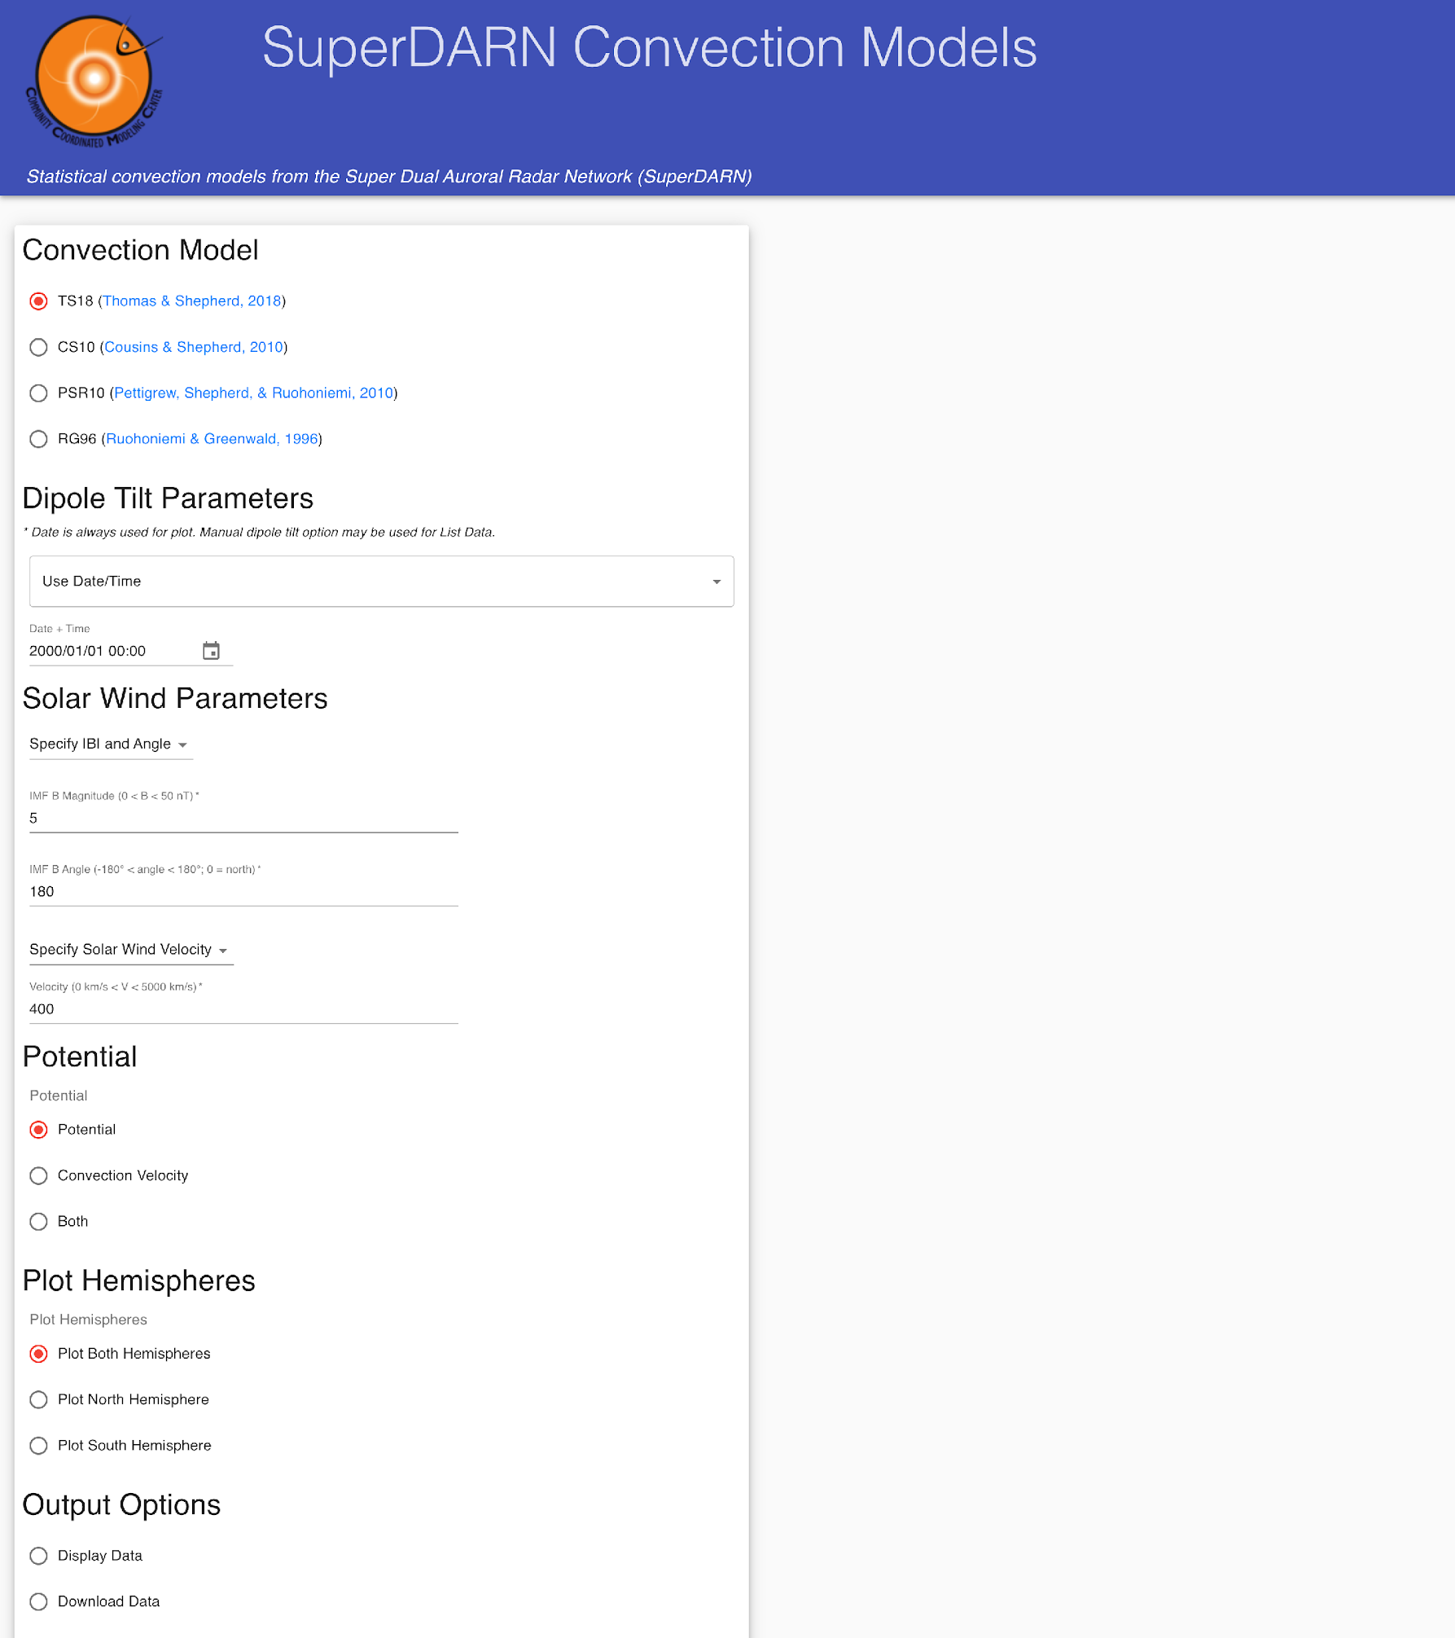
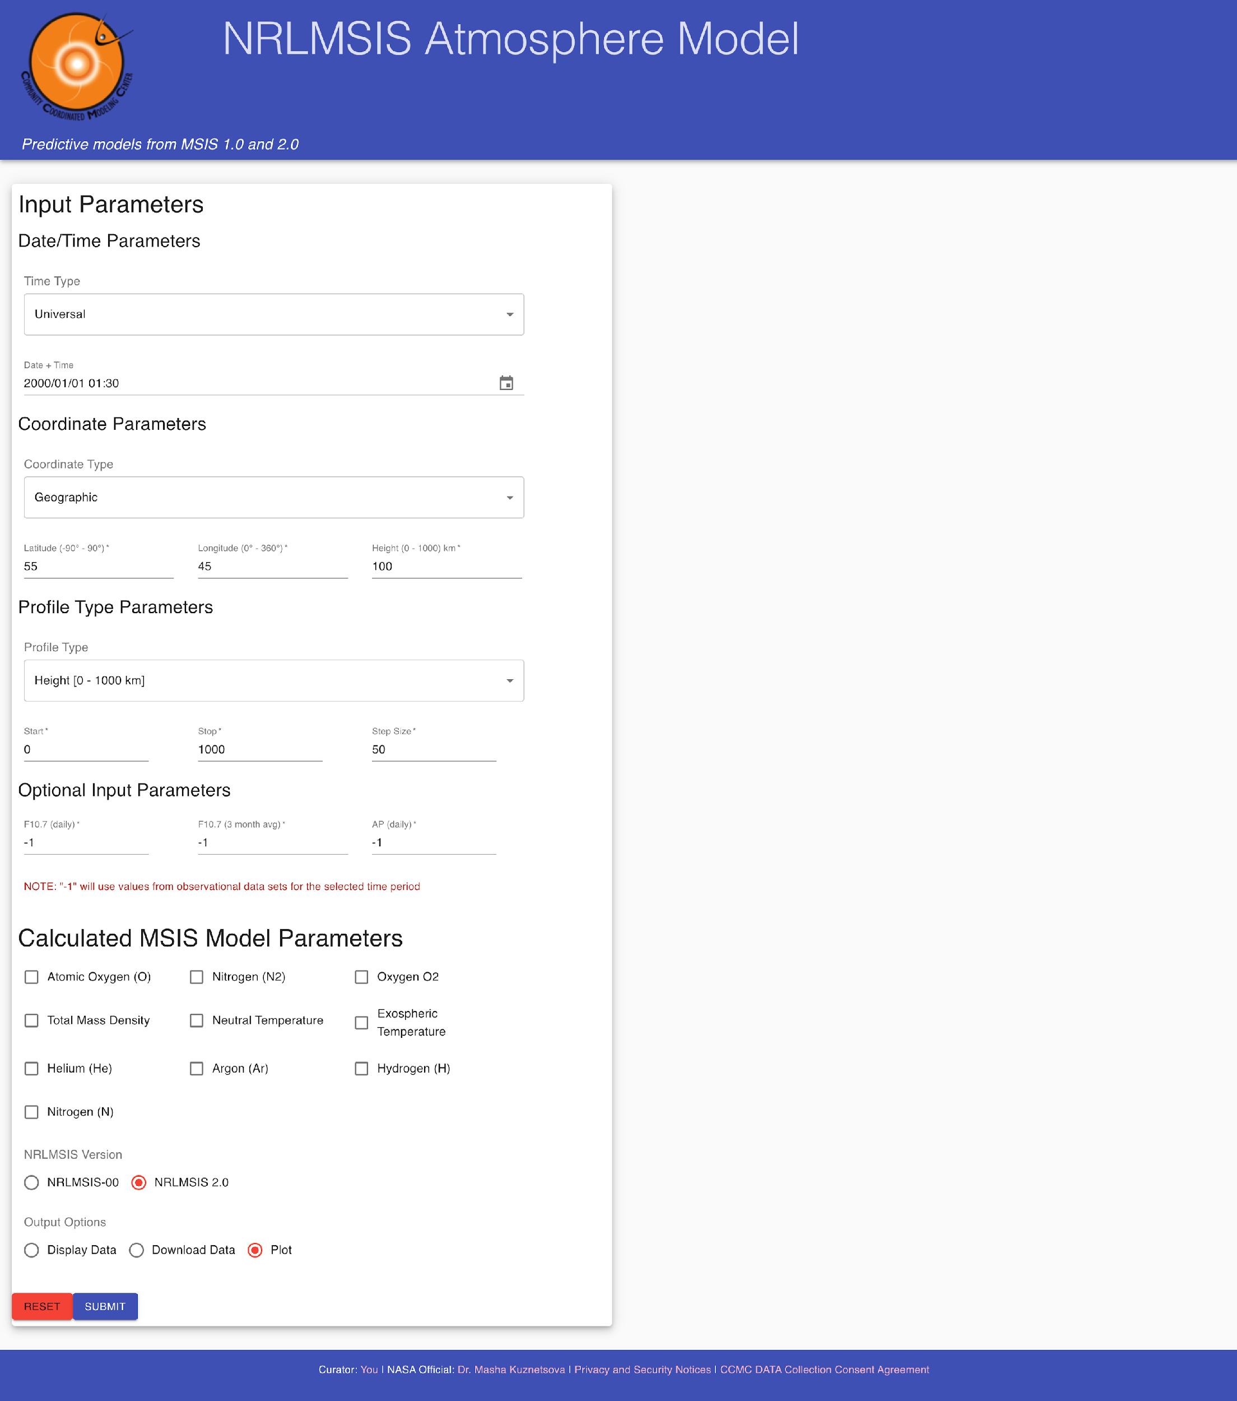
Notes:
Cohesiveness between different models
All part of Instant Run system
Change one aspect, change them all at once

Slide 12
Questions?

