Slide 1
Next-Generation Continuous/Real-time Runs Framework
Chinwe C. Didigu
NASA Community Coordinated Modeling Center
CCMC Workshop 2022
10 June 2022
Update and Feedback on CCMC Services

Slide 2
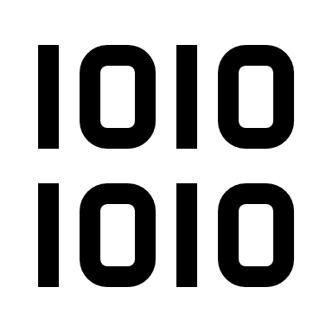
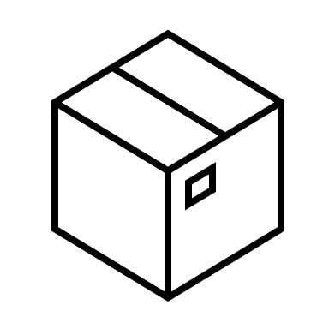
Next Generation Continuous Runs Framework: The Vision
Containerize models and software
Kubernetes Control Plane
Robust real-time monitoring
Follow best practices
Implement CI/CD pipeline
Node
Node
Node
Build
Test
Release
Deploy
Replication & Automatic Fail-over
Kubernetes container orchestration

Slide 3
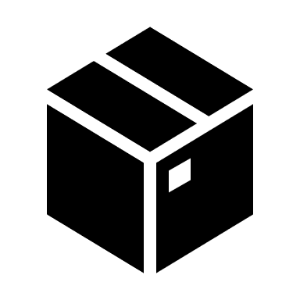
Model Onboarding: What’s New?
MODEL DEVELOPER FILLS MODEL QUESTIONNAIRE
MODEL DEVELOPER INSTALLS AND TESTS ON AWS
MODEL DEVELOPER GIVES SOURCE AND DOCUMENTATION TO CCMC
CCMC TRACKS MODEL IN VERSION CONTROL AND CONTARINERIZES
Feeds CCMC Metadata Registry (CMR) entry, CMR feeds new website, provides model links from SEP Scoreboard and other CCMC apps
Model is installed on CCMC’s AWS development instance
Any sample model outputs should also be given to CCMC for comparison
Model is tracked in CCMC’s internal GitLab

Slide 4
Model Containerization: Benefits and Challenges
Benefits:
Easy to transfer and install.
Saves time and resources.
Self documenting (prerequisites, dependencies, environment).
Supports automation.
Container platform integrations – health checks, restart policies, log rotation.
Challenges:
Permissions – need to be tailored to diverse systems/users, existing containerized models.
Models not keeping source code and inputs/outputs separate.

Slide 5
Continuous Integration and Deployment (CI/CD): What is it?
CI/CD is a software development practice that enforces the automation of building, testing, and deployment of software.
Deploy
Test
Build
Track
Models can now be moved around (on-prem or cloud) with just a push of a button.
Model updates are seamlessly integrated, built, deployed, and re-deployed to target servers.
Codifies model installation steps and configuration.
No longer spend hours on model installs, no mistakes.

Slide 6
R2O Success Story: Transitioning models to M2M
Transitioned 5 containerized models to M2M through the CCMC-SRAG-M2M shared collaborative cloud – UMASEP, RELeASE, SEPSTER, SEPSTER2D, MAG4.
Model code repositories transferred to shared GitLab.
Detailed build and install documentation, as well as build/install scripts, and CI/CD configuration included in repository.
Model is deployed to shared cloud by CCMC and accessible by M2M.
M2M team uses supplied documentation to install model in test environment and eventually to operations.
Future model updates deployed to CCMC, shared cloud, and pushed to shared repository.

Slide 7
Coming Soon: Automatic Failover with Kubernetes
Kubernetes is a container orchestration software that manages containerized applications.
It also provides many useful features such as:
Replication
Load balancing
Automatic failover
Several useful tool integrations
CCMC will leverage these capabilities to provide improved resilience to the CR system.
Provide almost zero down-time.
Increased reliability.
Main Kubernetes cluster in-house, backup cluster in the AWS cloud.

Slide 8
Coming Soon: Real-time Monitoring
Current system is like a black box, not trivial to determine system state.
Troubleshooting and resolution not as timely.
Real-time monitoring in the new system will:
Perform real-time log collection and analysis.
Determine and store run status.
Gather and store metrics.
Issue email alerts covering a wider range of issues.
Display real-time run status and all monitoring artifacts in quick look-up web dashboard.

Slide 9
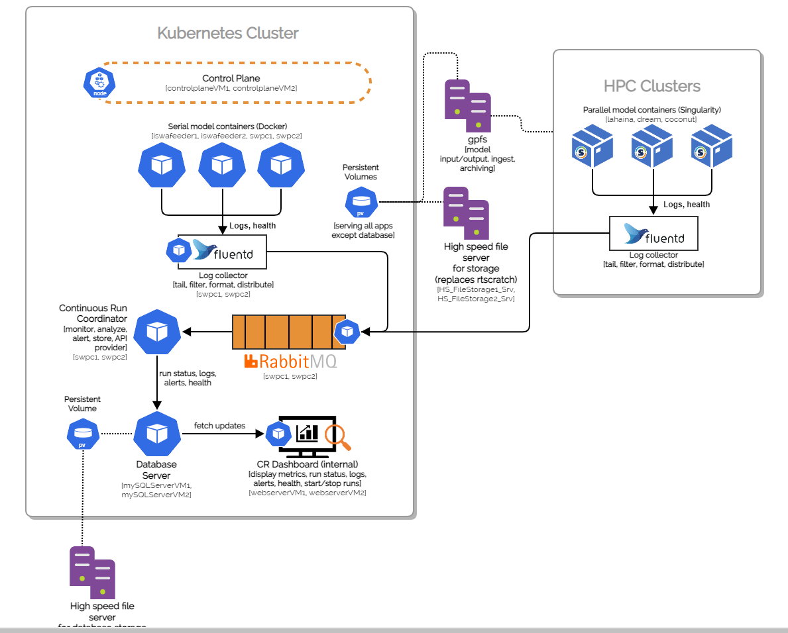
Next Gen Architecture

Slide 10
Questions?

