Slide 1
Real-time space weather predictions
by IRAP-STORMS
A.P. Rouillard, I. Plotnikov, V. Réville, A. Kouloumvakos, N. Poirier, K. Dalmasse, M. Indurain, M. Alexandre

Slide 2
http://storms-service.irap.omp.eu/

Slide 3
MEDOC
CDPP
APIS
HELIO-F
SIIG
BASS2000
IN-SITU DATA CENTERS
SOLAR IMAGERY DATA CENTERS
STORMS
SOLAR
ORBITER
OFRAME
(spaceweather.fr)
VSWMC
PARKER
SOLAR
PROBE
SUPPORT SPACECRAFT OPERATIONS + SYNERGIES
ESA
SPACE WEATHER

Slide 4
STORMS
SOLAR
ORBITER
OFRAME
(spaceweather.fr)
VSWMC
PARKER
SOLAR
PROBE
SUPPORT SPACECRAFT OPERATIONS + SYNERGIES
ESA
SPACE WEATHER

Slide 8
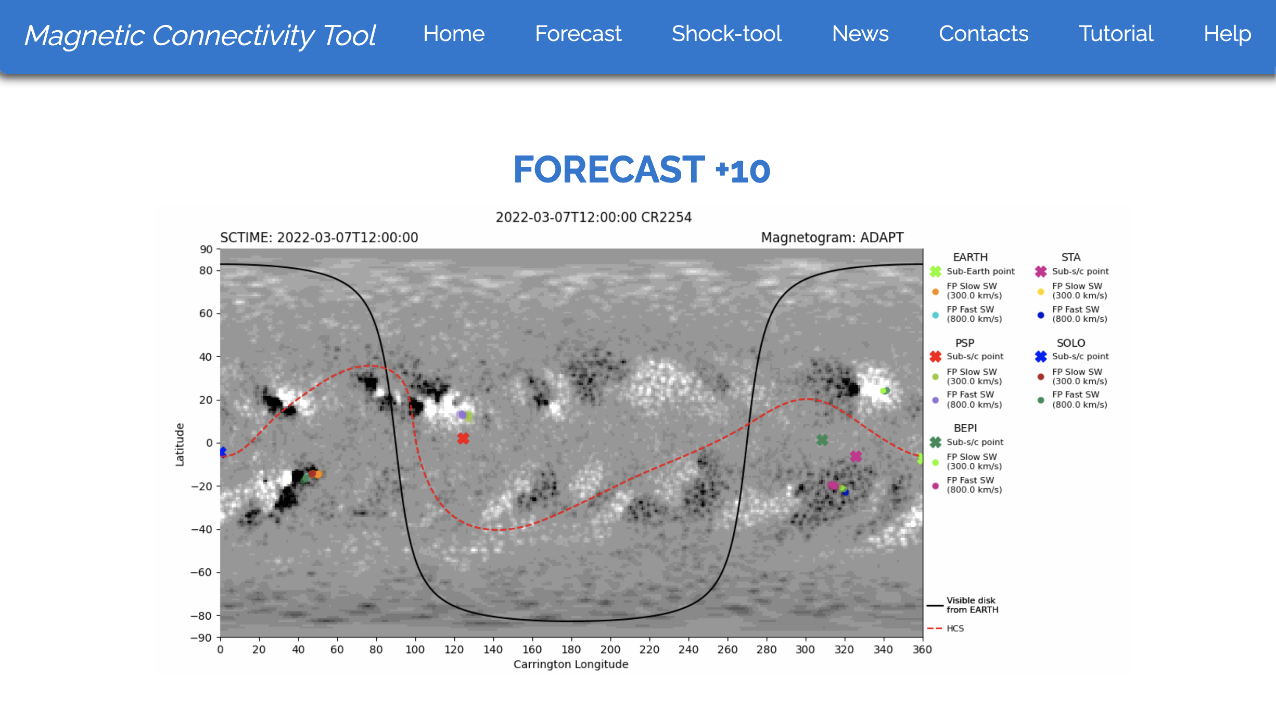
Dev 2020-2021: data assimilation to constrain models

Slide 10
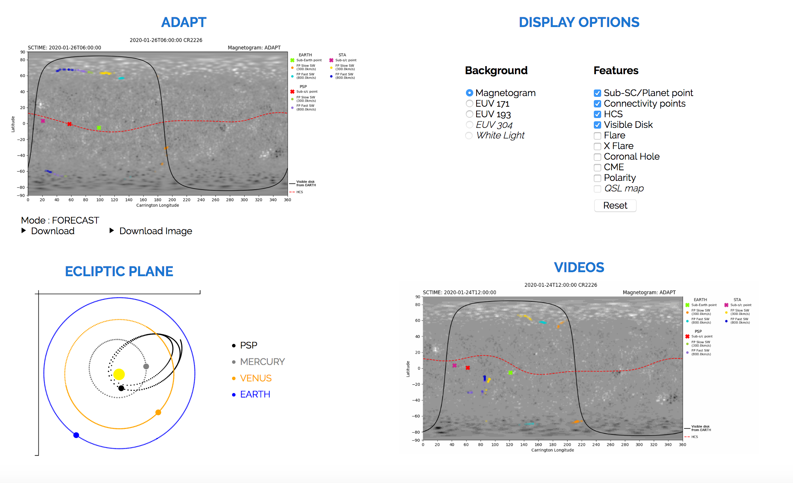

Slide 11
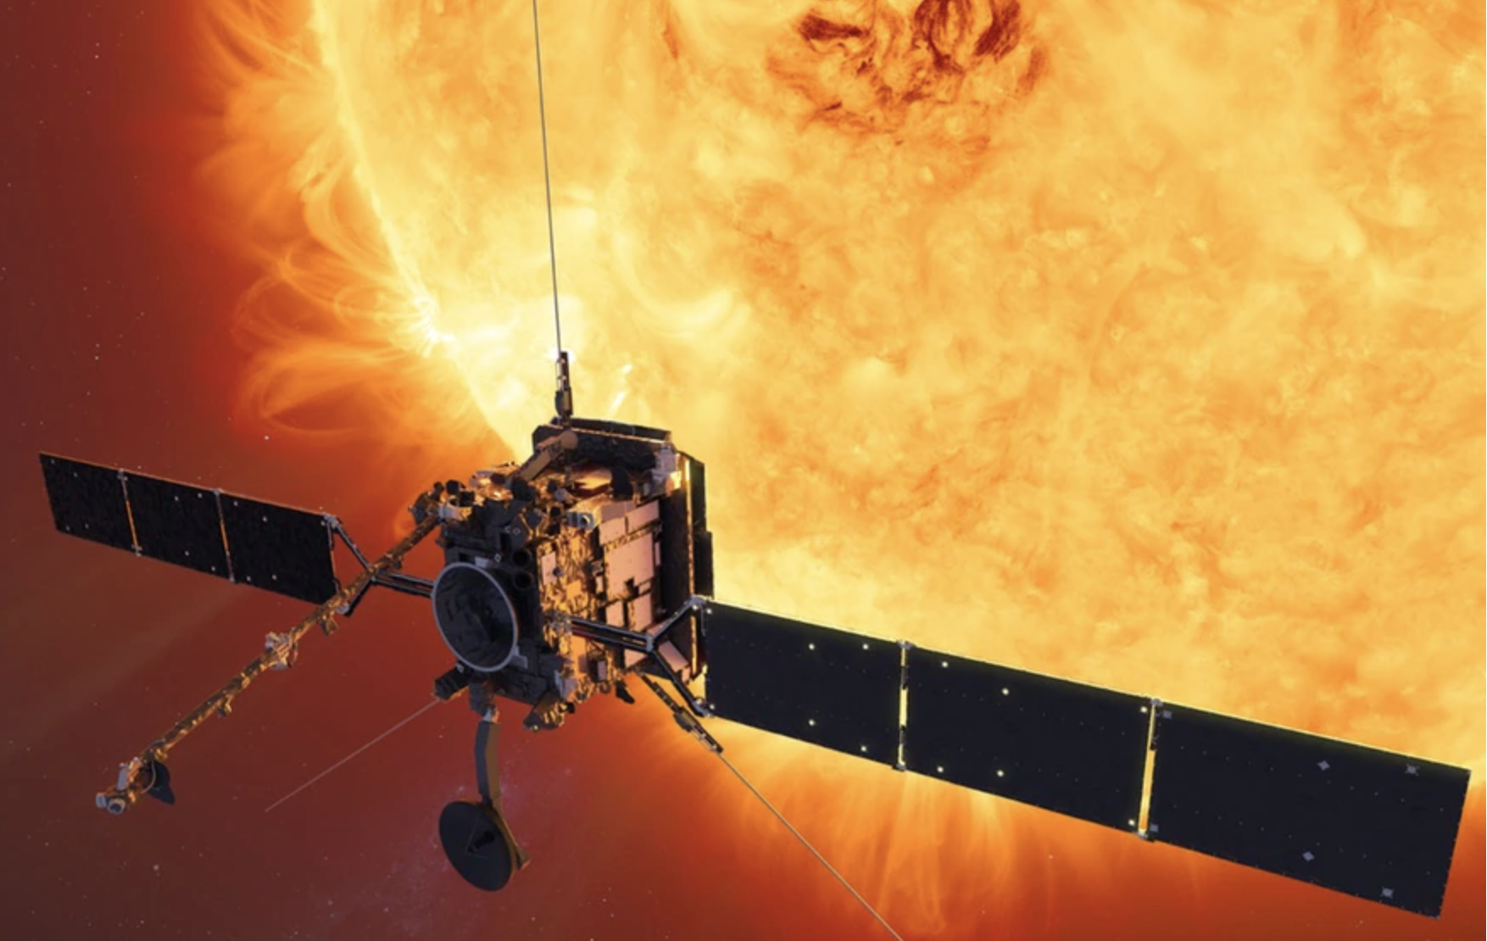
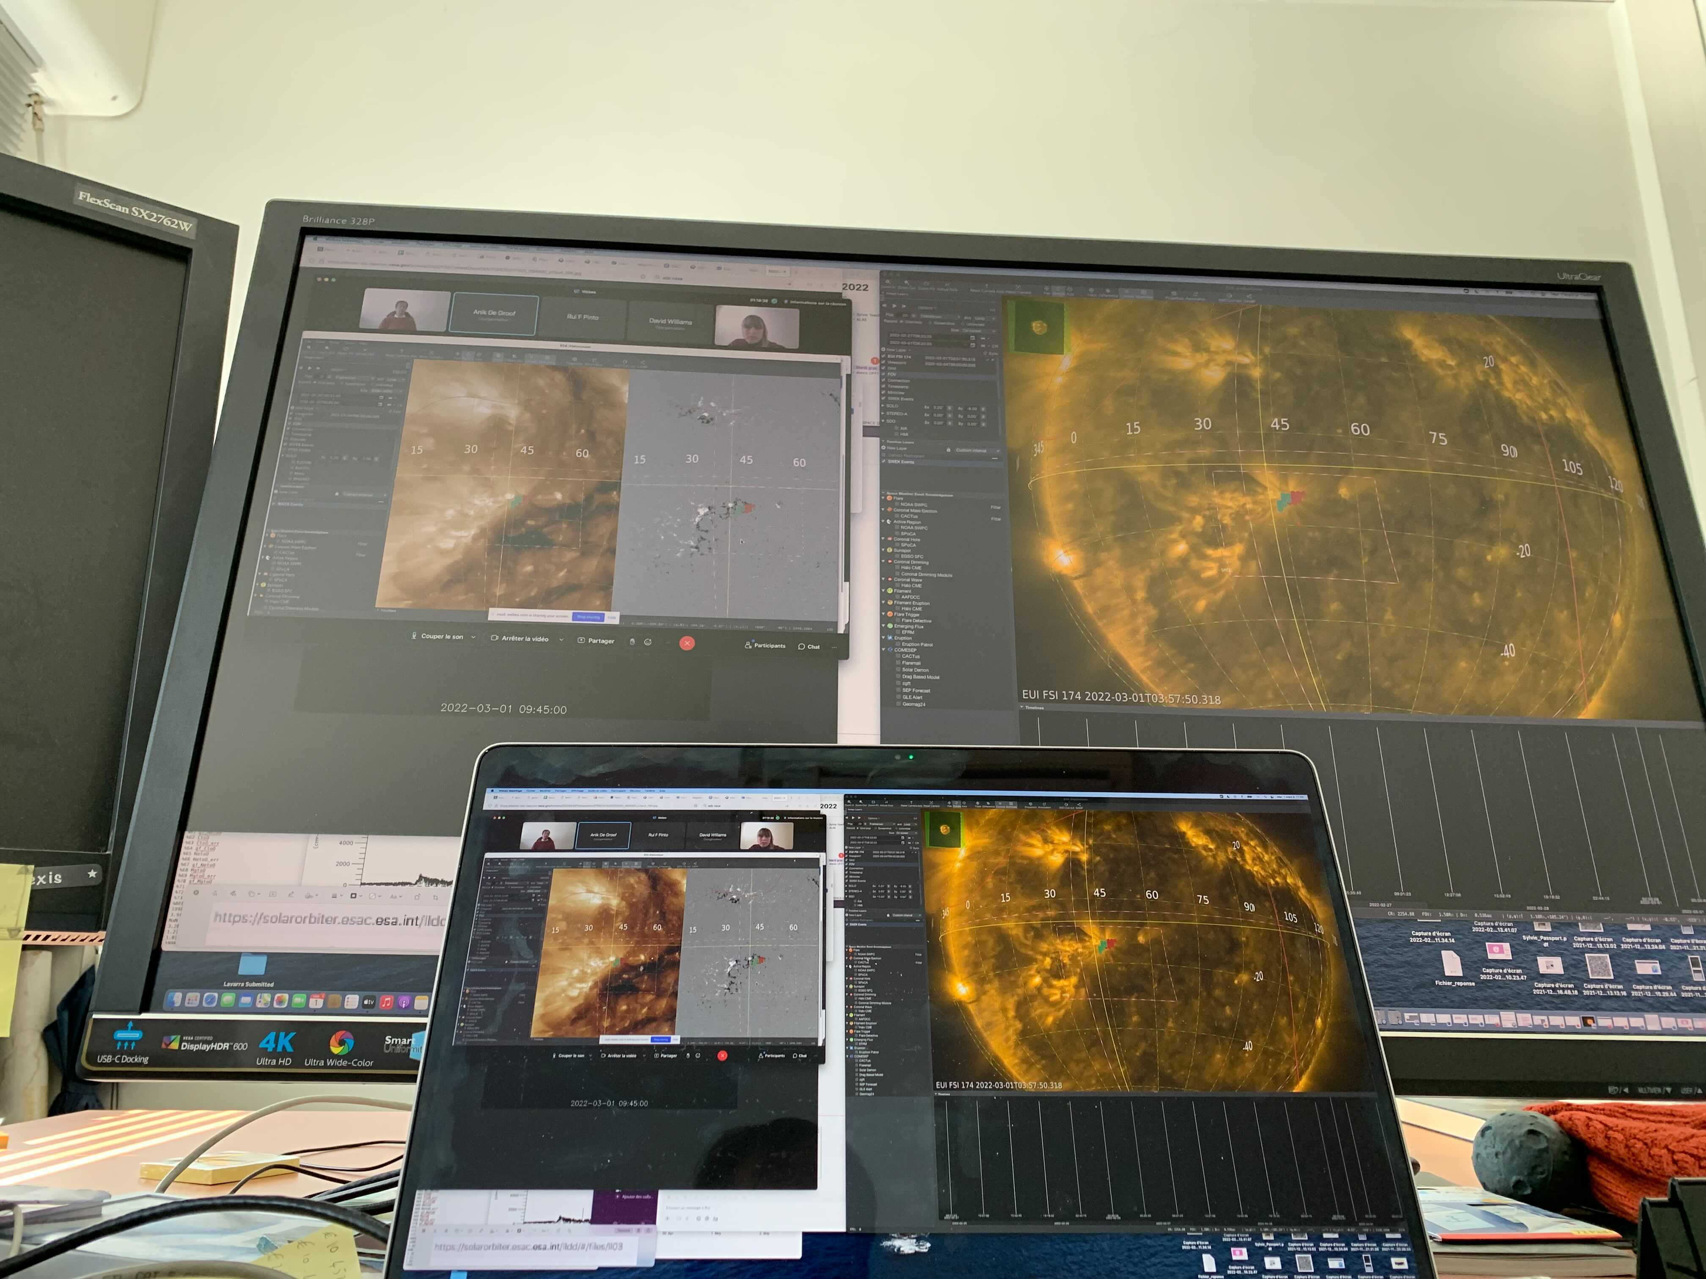
Upload Command
Coordination
(other space missions
+ ground observatory)
Real-time low-res data
(LLD)
STORMS

Slide 12
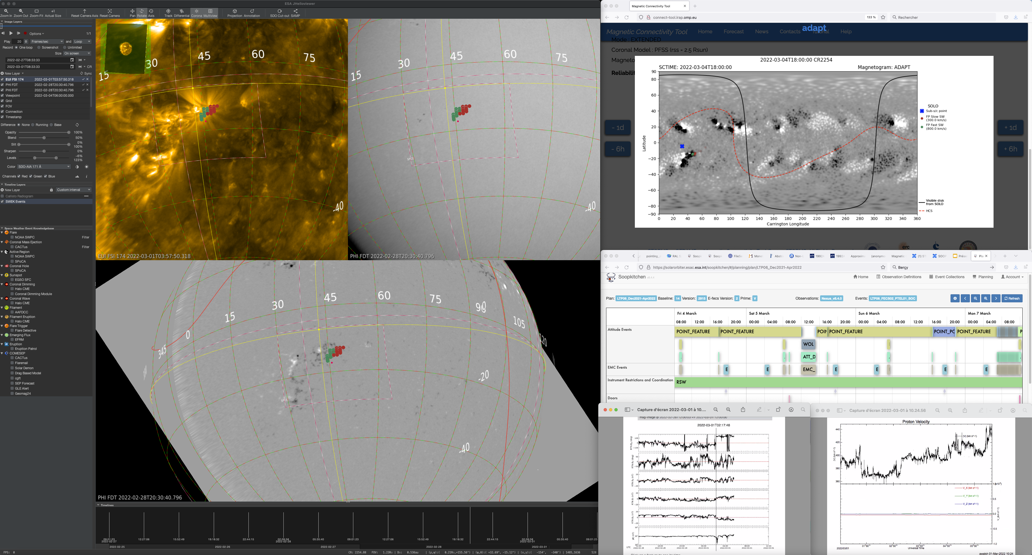

Slide 13
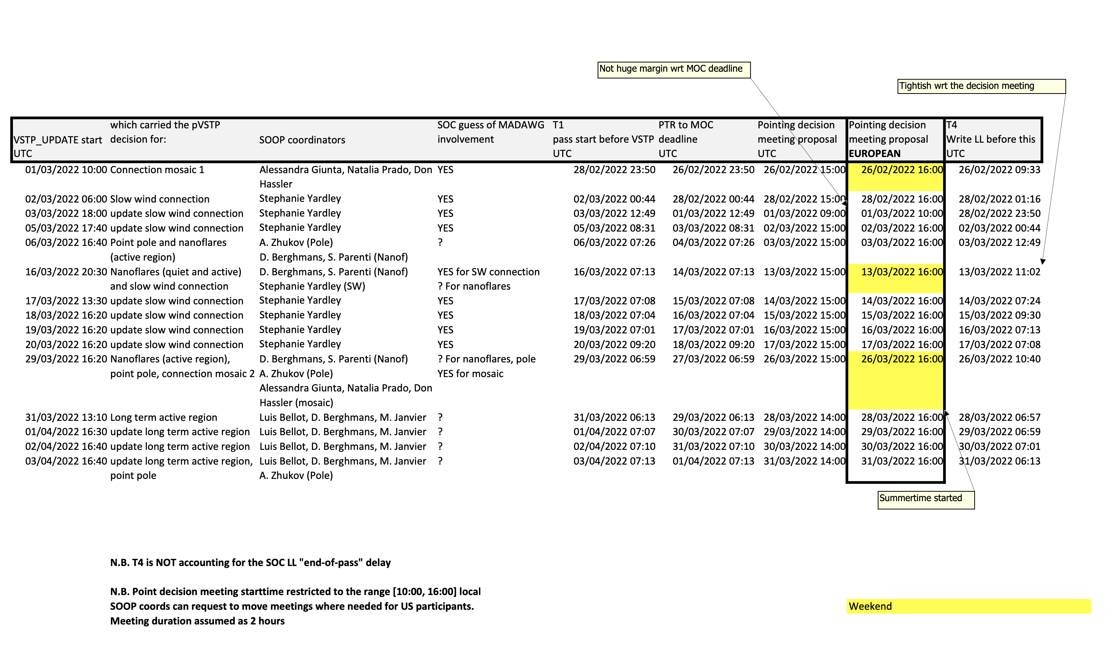

Slide 15
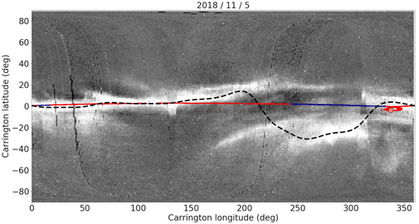
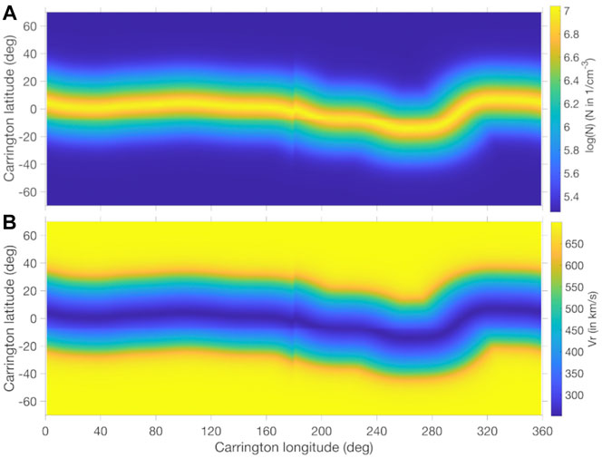
Assimilation of remote-sensing
Observations:
HELIOCAST 3-D MHD

Slide 16
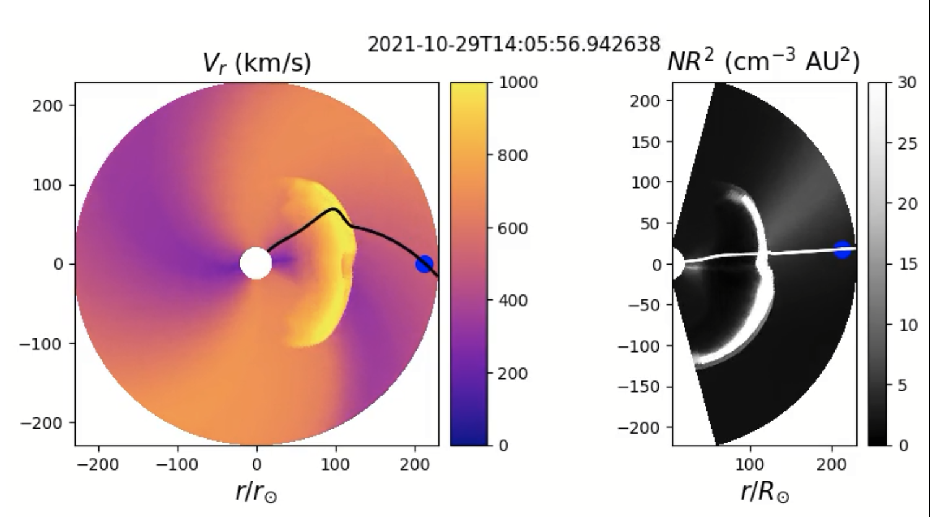
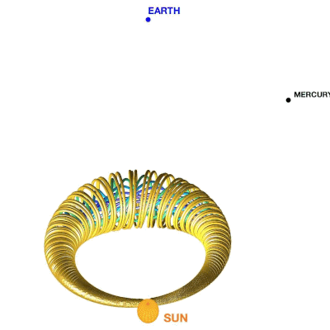

Slide 17
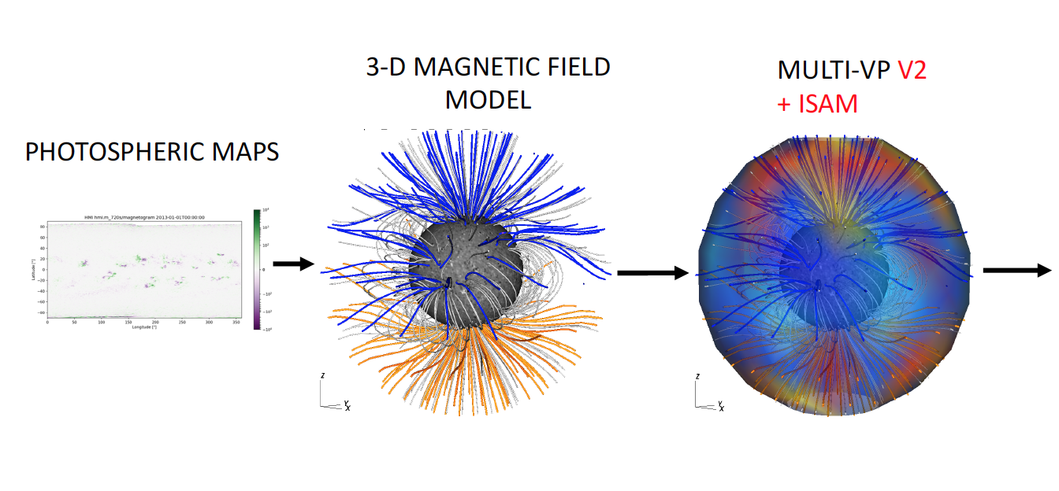
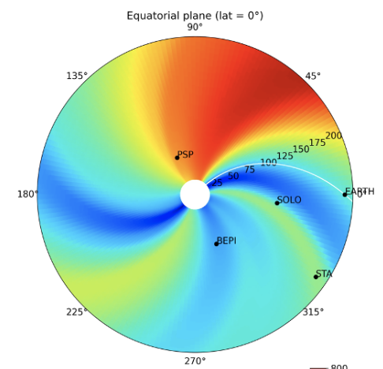
Solar wind forecasts: SWIFT-MULTI-VP

Slide 18
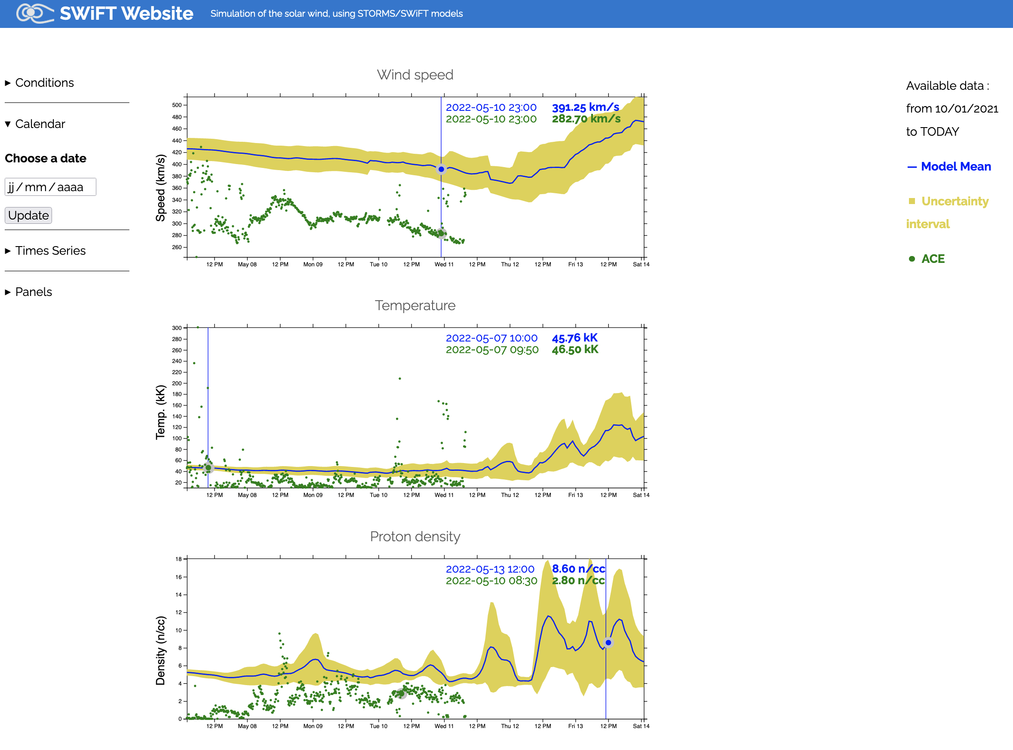
SWIFT: Solar Wind forecasts run twice a day

Slide 19
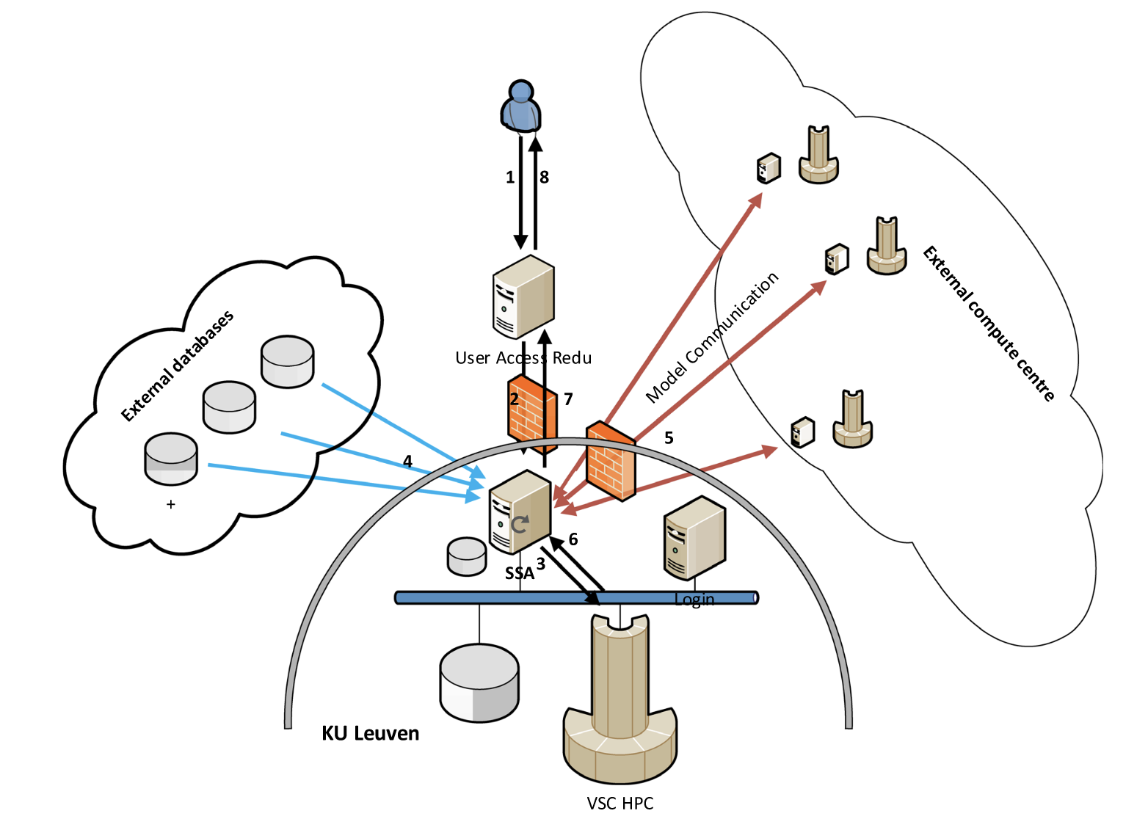

Slide 21
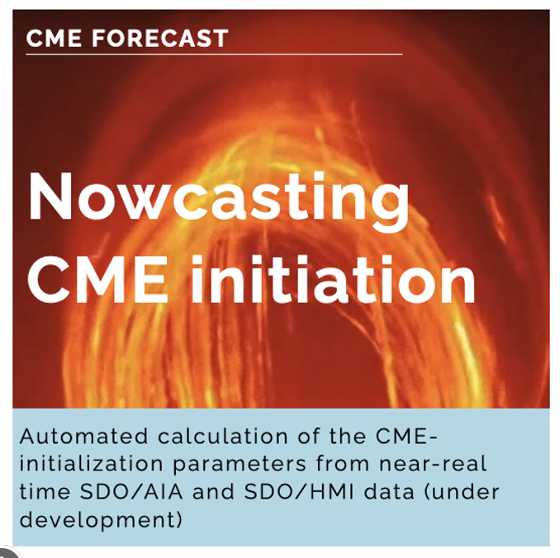
Nowcasting flare-associated CMEs
Developer: Kévin Dalmasse (kevin.dalmasse@irap.omp.eu)
Exploits near-real time SDO/AIA 1600 A + pre-CME SDO/HMI magnetogram. The 2-minute cadence AIA1600 data is used for the automated extraction of the flare-ribbons timeseries.
Derives the photospheric footpoints and the tilt of the CME magnetic flux rope
CME poloidal magnetic flux injection is approximated as the time-derivative of the flare-ribbons magnetic flux.
CME magnetic flux rope tilt can also be computed from the photospheric footpoints of the CME as identified by the user from one of AIA1600, AIA304, AIA171, or AIA34 pre-CME data.
Dalmasse et al. 2022

Slide 23
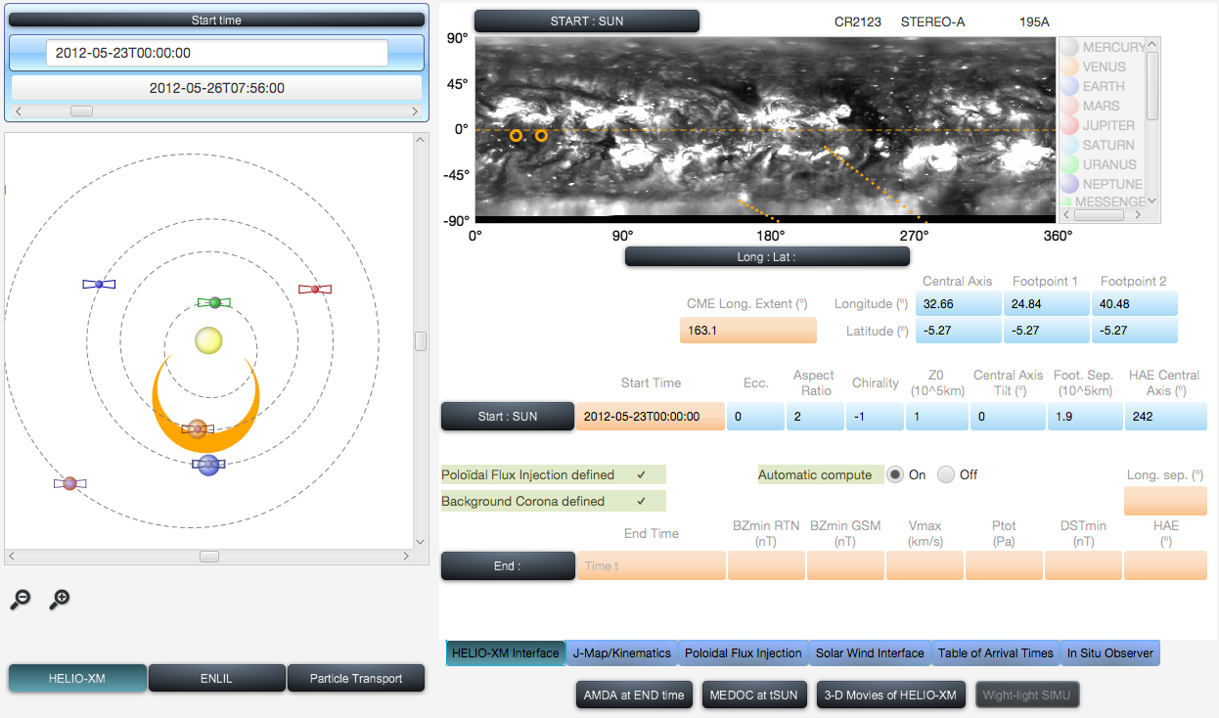
CME Flux Rope Propagation Tool
specify a set of parameters to initialise the structure near the Sun (3-D orientation, poloidal magnetic flux, strength of confinement field),
the tool generates z magnetic flux rope in 3-D and propagate the structure from the Sun to any point in the inner heliosphere (takes 4 minutes at most), it will compute the elongation-variation of the flux rope on a J-map,

Slide 25
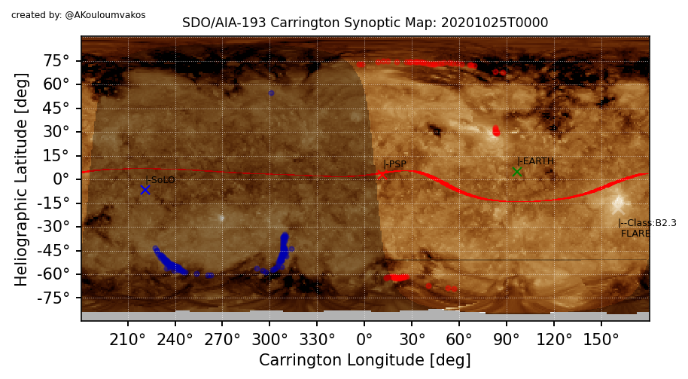
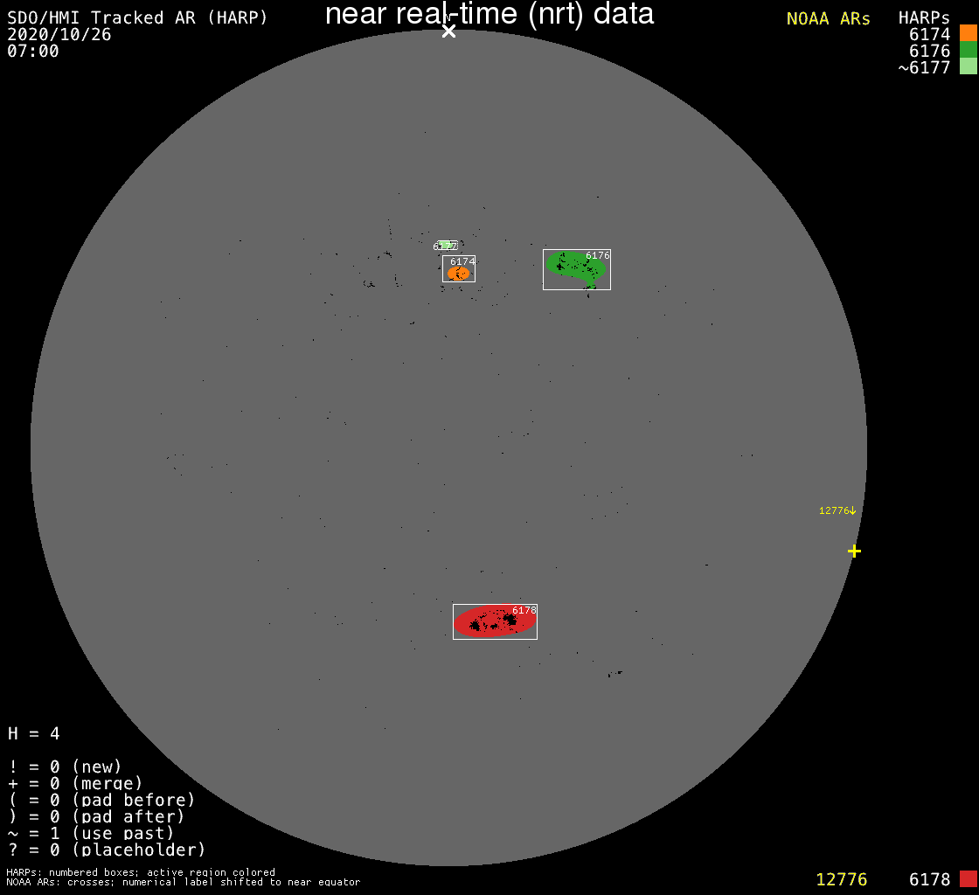
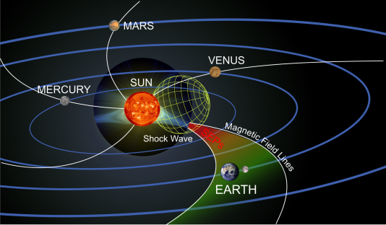
Constructing the Pipeline
Flare & CMEs Forecasting
IAASARS, National
Observatory of Athens
Related projects:
FLARECAST, ASPECS
Active Regions Flare Propability CME Likelihood and Speed
Shock wave modelling L'Institut de Recherche en Astrophysique et Planétologie Related projects: COROSHOCK, EUHFORIA 2.0
AR: HARP-06176
Lat: 30.13 - Long: 19.20
Beff: 8.18
CME speed: 194 km/s
Mean Flare: 3.0E-06 (e.g. C3 class)
Shock Model Corronal Model
Mag. Connectivity
Forecasting
http://phobos-srv.space.noa.gr
Predicted Shock Properties

