Slide 1
UK Met Office space weather research, operations & verification
Suzy Bingham, David Jackson, Edmund Henley, Siegfried Gonzi, Mike Marsh, Richard Mace, Michael Sharpe, Sophie Murray*
* Trinity College Dublin
10th CCMC Workshop
10th June 2022
@MetOfficeSpace

Slide 2
Outline
Operations & research
SWIMMR models & verification ambition
NRT verification of MOSWOC forecasts
Collaboration ideas with CCMC
Summary

Slide 3
Operations & research

Slide 4
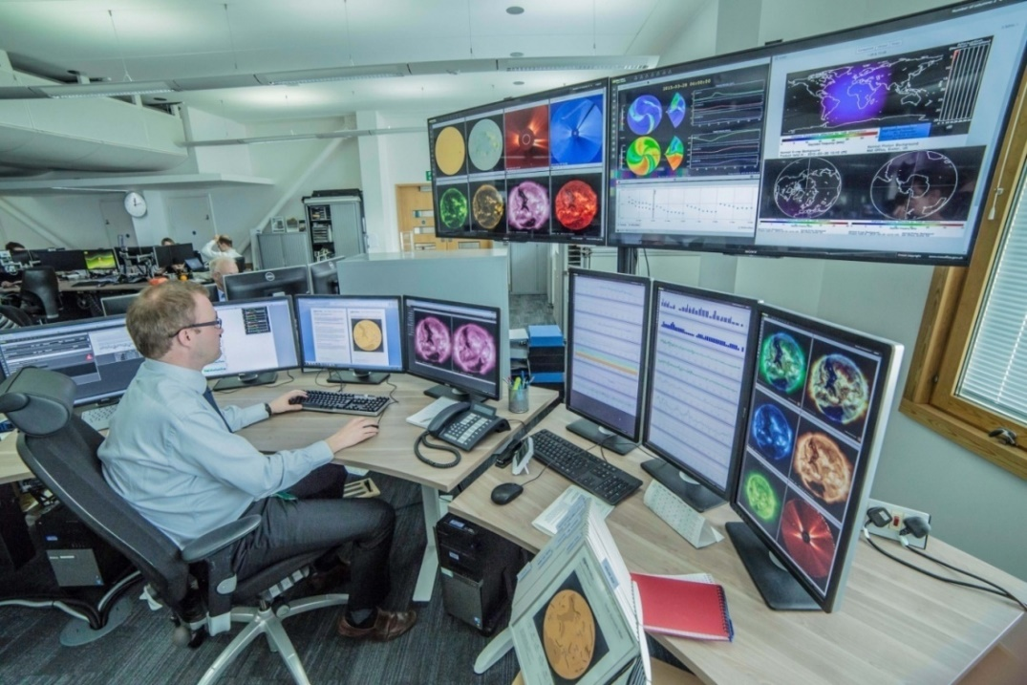
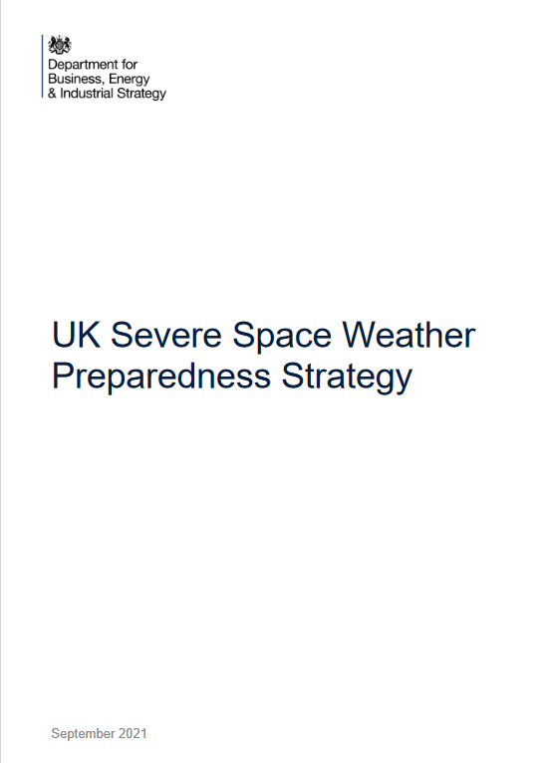
Met Office Space Weather Operations Centre (MOSWOC)
24/7 since 2014
14 Forecasters, 6 Scientists, Programme managers, IT managers & developers
Twice daily forecasts, alerts, warnings, ICAO advisories (PECASUS consortium)
UK strategies, 2021
Public webpages: https://www.metoffice.gov.uk/public/weather/space-weather/

Slide 5
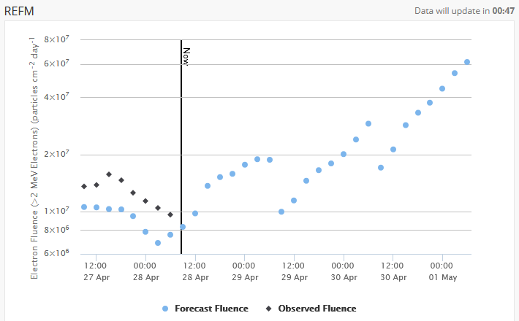
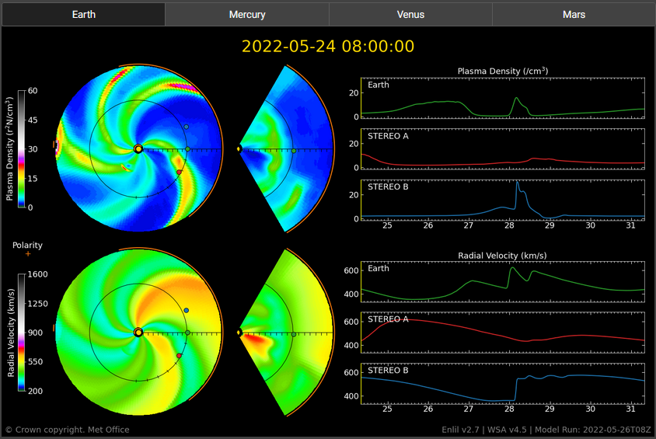
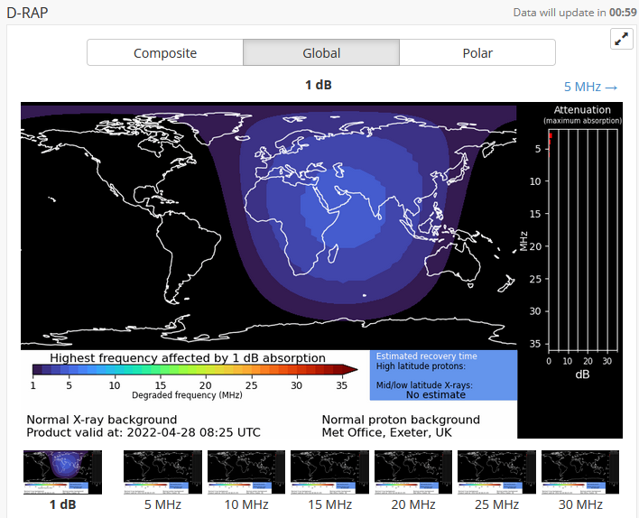
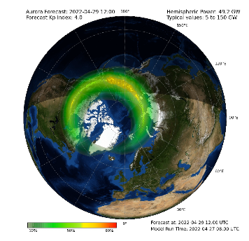
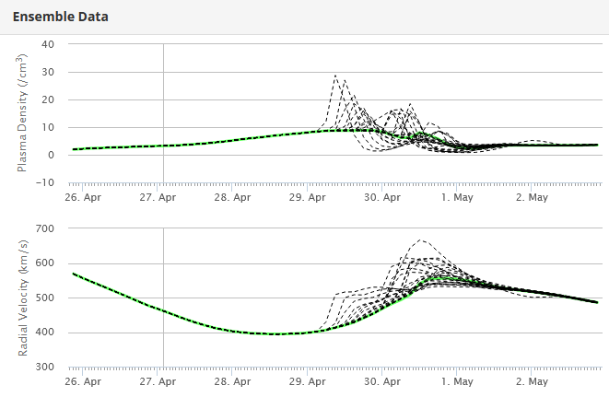
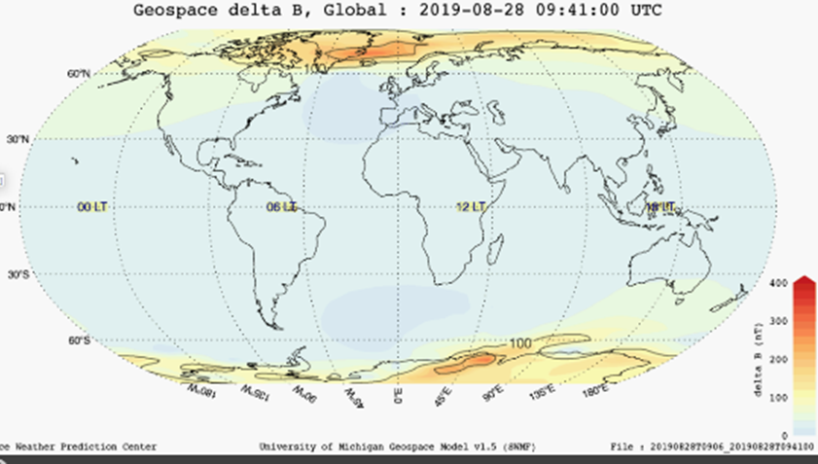
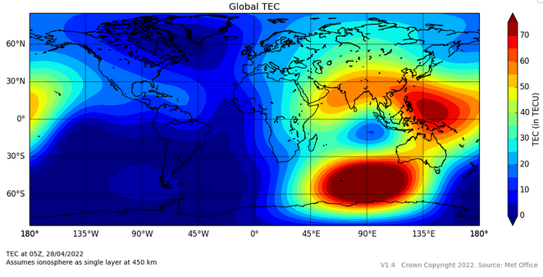
Models & tools
WSA-Enlil
24 member ensemble to capture uncertainty in CME arrival
Solar wind recurrence model
REFM
SWMF Geospace
D-RAP
Bernese: TEC
OVATION aurora nowcasts / forecasts
SWPC CAT, SMART

Slide 6
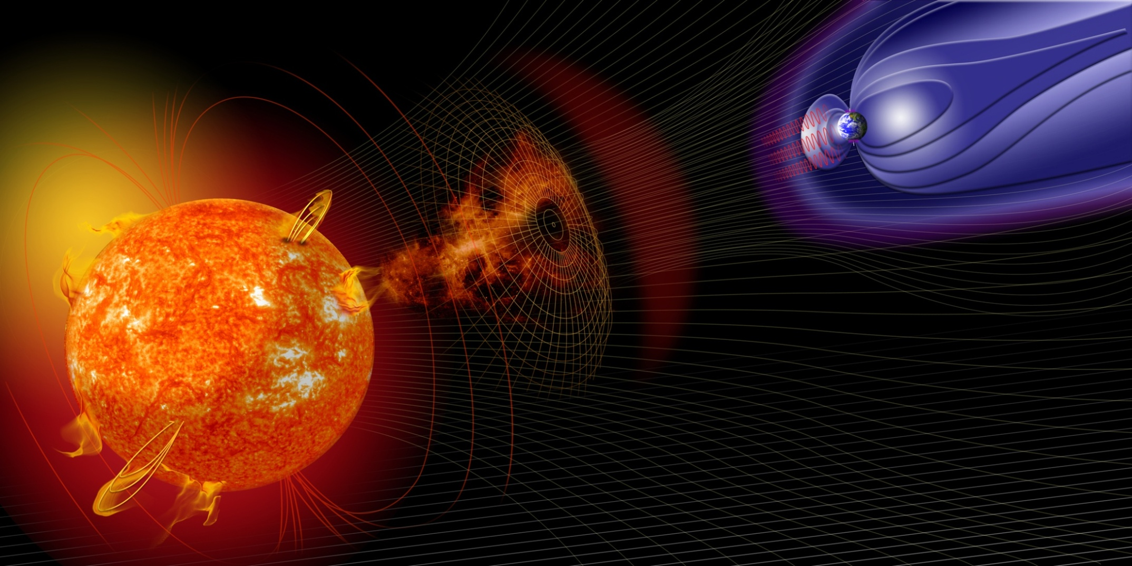
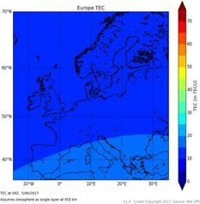
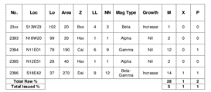
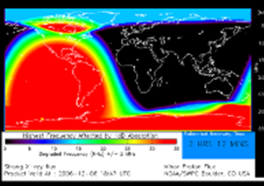
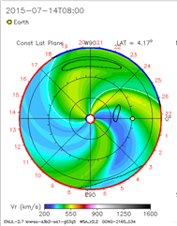
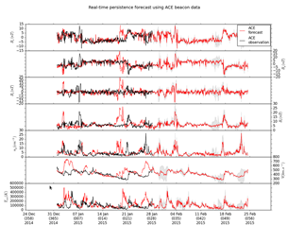
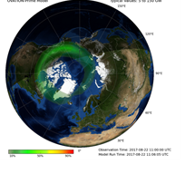
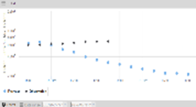
Toward Sun-Earth coupled modelling
Solar wind (interplanetary space)
Magnetosphere
Radiation belts
Photosphere (solar surface)
Corona (solar atmosphere)
Ionosphere
Thermosphere
Middle and Lower atmosphere
Ground
GOAL: Coupled Sun-to-Earth models with DA for much-enhanced forecast capacity

Slide 7
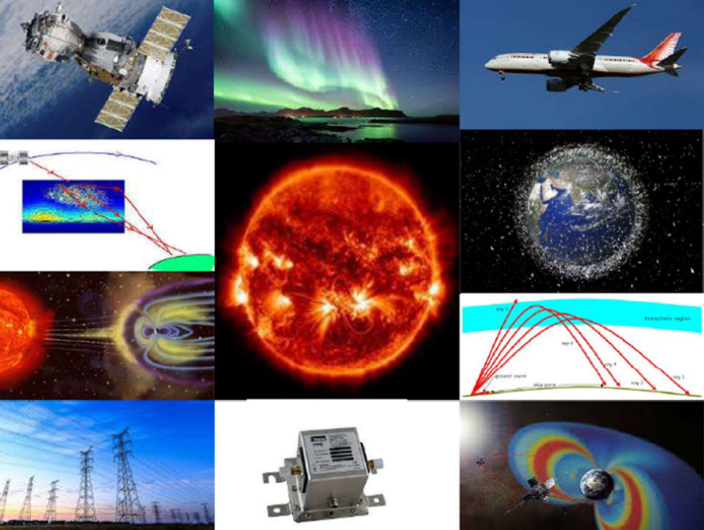
SWIMMR programme
Space Weather Instrumentation, Measurement, Modelling & Risk
(see previous talk, Ian McCrea)
£20 million, 4-year UK programme – develop & deploy new instruments, models & services to further improve MOSWOC forecasting – towards Sun-to-Earth modelling system
Strengthen links between Met Office operations & UK research – provide platform for more efficient R2O transition (address valley-of-death)
Partners across UK developing models, instrumentation, etc – Met Office developing R2O AWS platform – partners run models on platform – towards operational use by MOSWOC
SWIMMR programme overview
Notes:
‹#›

Slide 8
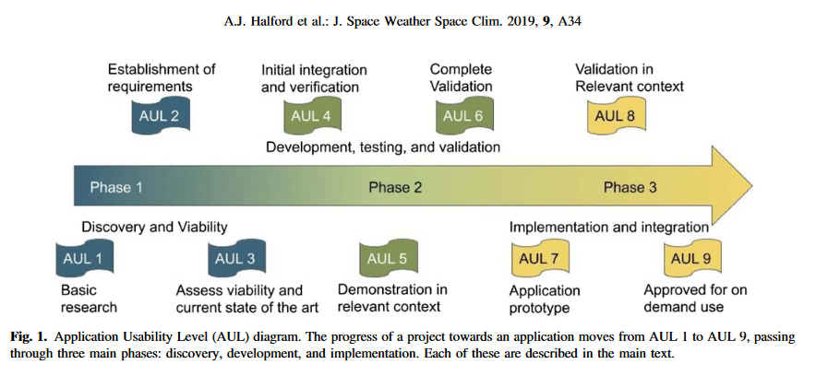
SWIMMR AULs Application Usability Levels
R2O tracking framework
Similar to Technology Readiness Levels (TRLS)
Encouraging modellers to talk to users about requirements from early stage & to verify model along the R2O path
Halford et al., 2019, AUL paper

Slide 9
Proposed AWS-based verification environment - dependent on Tech Team resource & partner needs – under discussion with individual partners - separate environment to the AWS model execution environment
Partners (subject matter experts)
- Develop verification code
- Specify environment needed to run code (python packages, etc)
- Provide list of truth data
Met Office Tech
Provide AWS verification environment
Provide data feed APIs for verification data for each partner model
Route output to Dashboard
Partners
Run verification code on AWS environment
Use model output endpoints & truth source endpoints
View metrics on Dashboard
Benefits of approach:
Visible long-term verification
Reproducible results (journals require)
Quantifies improvements if any model changes
Ensures ‘operational setup’ is being verified (may not be the case if at partner institute)
Helps to potentially compare with other models at later stage
More easily share results between modellers & users
Gives clear view of whether to implement models operationally.

Slide 10
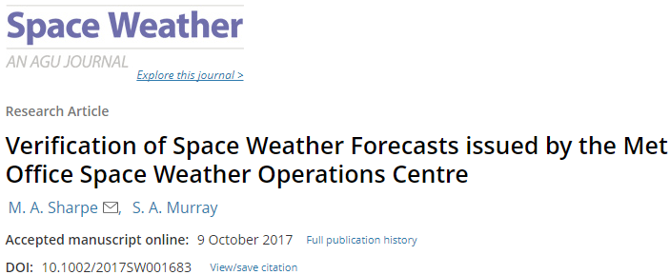
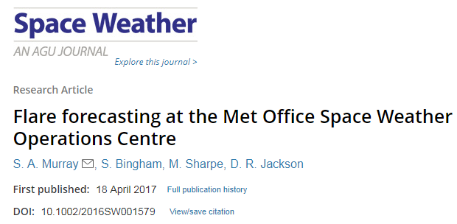
Near real-time verification of MOSWOC forecasts
V&V definitions are community-dependent - we use the meteorological-community definitions

Slide 11
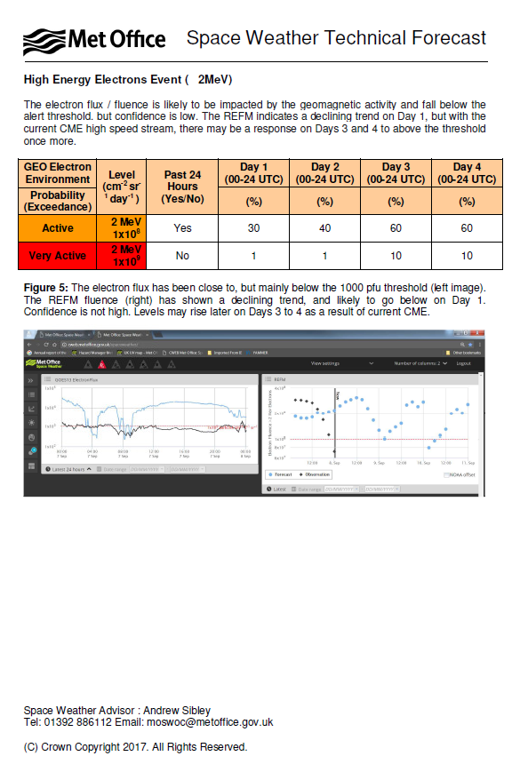
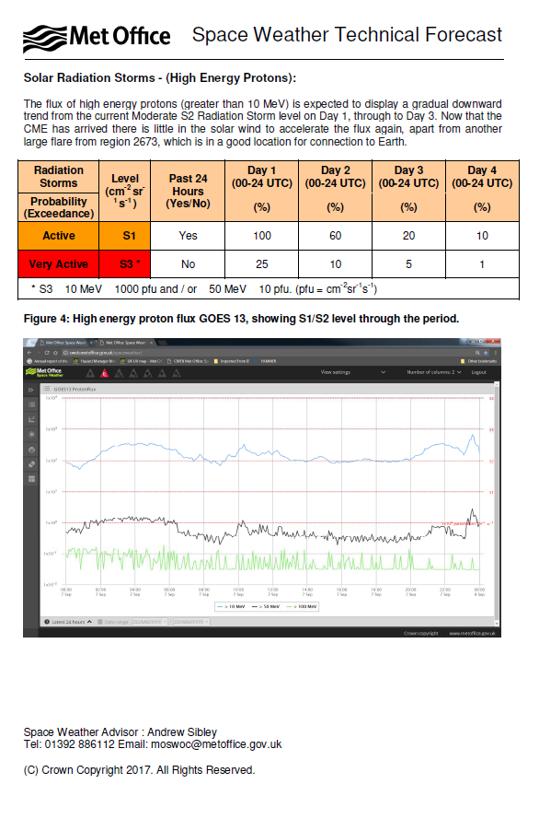
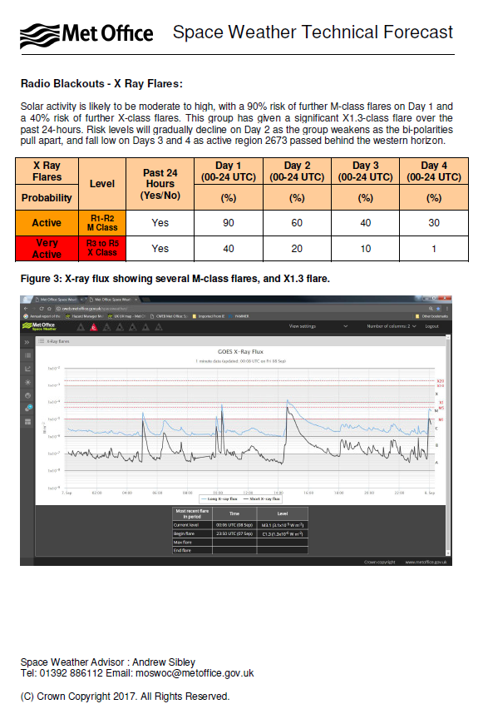
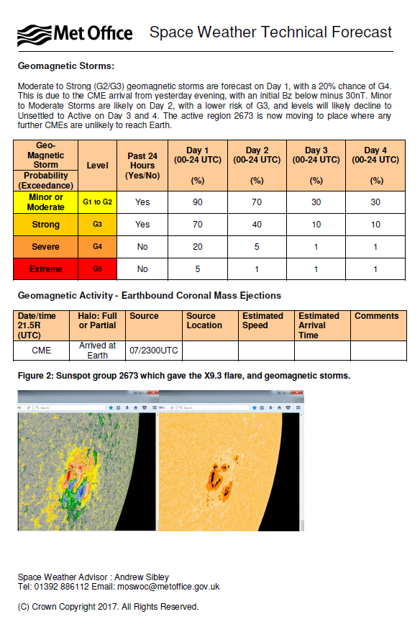
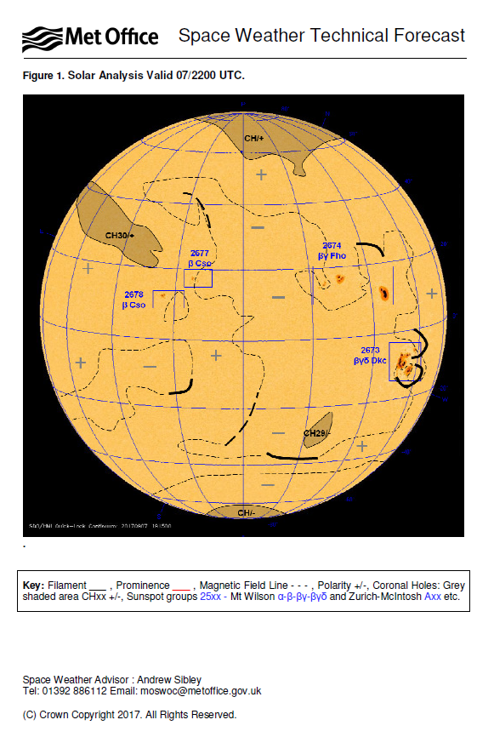
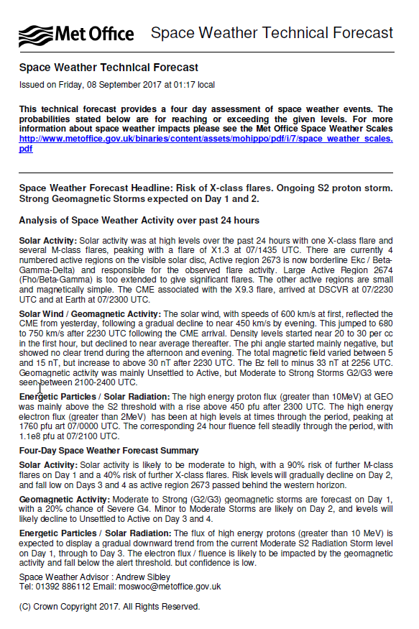
Met Office Space Weather Operations Centre (MOSWOC)
4 day probability forecasts:
geomagnetic storms,
X-ray flares,
high energy protons &
high energy electron events
CME arrival time
at Earth predictions
Solar
analysis
Summary for next 4 days

Slide 12
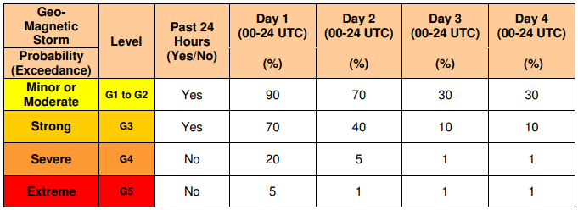
NRT verification of 4-day probabilistic forecasts
Example MOSWOC 4-day probabilistic geomagnetic storm forecast
Geomag category
Probability that geomag level will occur for each of the next 4 days
Treat each category/level separately
Treat as multi-category
Assess forecast resolution:
Relative Operating
Characteristic (ROC) plots
Assess forecast reliability:
Reliability diagrams
RPSS: relative improvement of probability forecast over reference forecast in predicting category which observation fell into in that 24h period

Slide 13
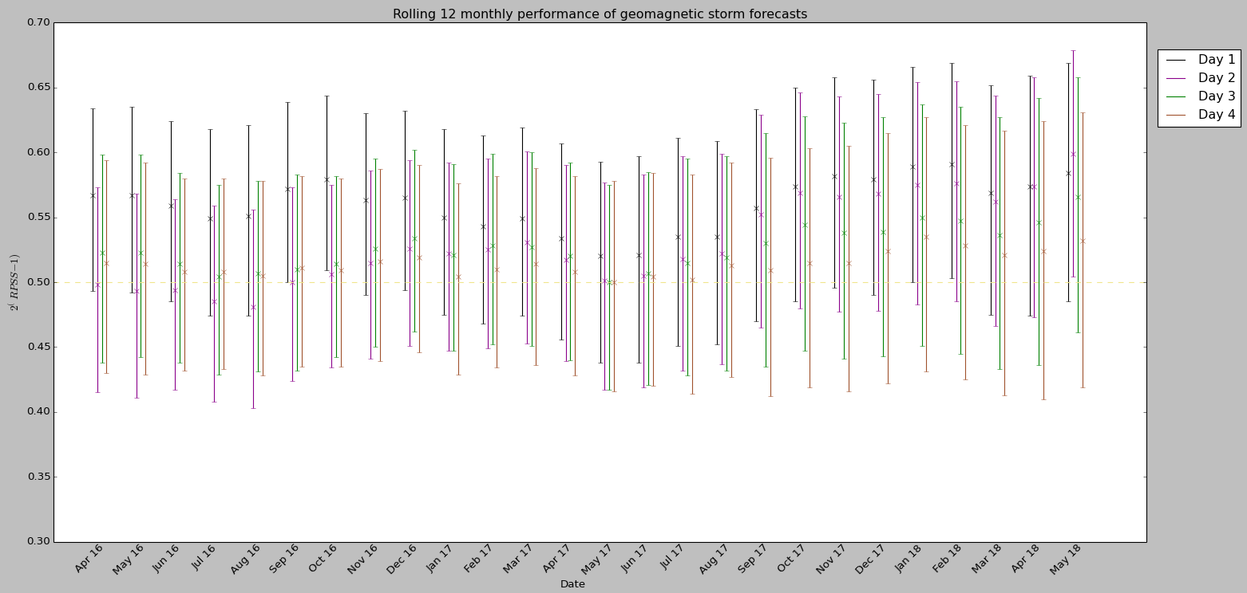
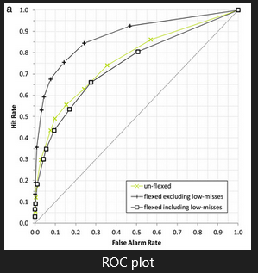
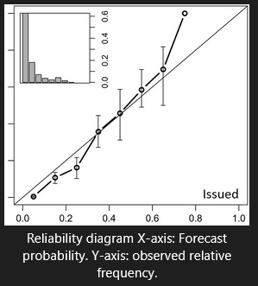
NRT verification results
Rolling 12-month analysis using RPSS indicates:
Day-1 geomagnetic storm activity forecasts typically perform better than a ‘climatology’ benchmark
No consistent evidence for flare forecasts (flares are more difficult to predict)
Shown forecaster added value to statistical flare forecasts
ROC & Reliability plots suggest: forecasts are skilful at identifying M-class flares & geomag storms, but both over-forecast
Next steps - RAG traffic light indication (adapted from shipping forecasts) – forecasters can quickly see top level verification

Slide 14
CCMC collaboration ideas

Slide 15
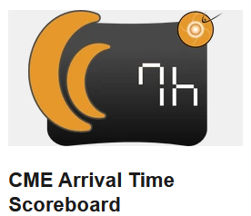
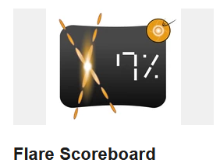
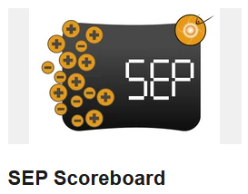
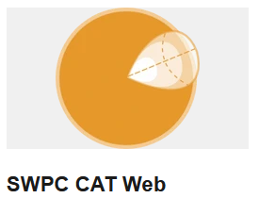
CCMC collaboration ideas
Scoreboards
Currently sending to CME Scoreboard
Ideally, after AWS migration, plan to push json file/make endpoints available to CCMC to poll forecasts, including Background Solar Wind Scoreboard
SWPC CAT
Currently use IDL SWPC CAT - require Python version before 2025
Internal assessment of Python version – further improvement for speed & useability for our operational use
Ideally – design a user-driven python CAT replacement (to share) – hope to collaborate with SWPC & CCMC on this

Slide 16
CCMC collaboration ideas
3D Enlil visualisation
LASP/TREC, SWPC, CCMC, Met Office
Project takes advantage of full Enlil 3D data volume by interactively visualising CME expansion – view CME properties outside of 2D plane intersecting
Work needed on operational implementation
LASP/TREC project
Interoperable AWS environments
Architecture for Collaborative Evaluation (ACE) – CCMC/SWPC proving ground – uses AWS
SWIMMR shared AWS environment – as similar to Met Office operational environment as possible - for pre-op testing & R2O
Currently strongly focused on SWIMMR projects – post-SWIMMR plan to open out to broader research collaboration to UK & internationally
Sharing one AWS platform or making SWIMMR & ACE interoperable – towards UK/US/ broader international coordinated R2O2R activities

Slide 17
Summary

Slide 18
Summary
Operations & research
Goal: Sun-to-Mud coupled model system
SWIMMR programme – R2O Valley-of-Opportunity
Encouraging use of AULs & ISWAT Action Teams’ recommendations on event lists & metrics
NRT verification
NRT verification systems - useful for operational environment
Ambition: AWS verification environment
CCMC collaboration
Scoreboards
SWPC CAT
3D Enlil visualisation
Interoperable AWS environments for international R2O2R coordination

Slide 19
Any questions please? Thank you

Slide 20
Extra slides

Slide 21
Geomagnetic storm forecast verification results: Ranked Probability Skill Score (RPSS)
Plot updated daily on Met Office system to monitor rolling skill of forecasts compared to reference
X-axis: Apr ‘16 – May ’18, Y-axis: RPSS
Crosses: mean RPSS/month for days 1-4
Vertical lines: 90% bootstrapped with replacement confidence intervals (CIs)
Point averages suggest day 1 forecasts are more accurate than days 2-4
Point averages for day 1 lie above no-skill line, & most of days 2-4, suggesting forecasts perform better than reference
But CIs cross no-skill line so no statistically significant evidence that forecasts outperform reference in predicting max daily geomag category
Rolling 12 monthly performance of MOSWOC geomagnetic storm forecasts compared to reference forecast (frequency of occurrence over preceding 180 days)
(RPSS: relative improvement of probability forecast over reference forecast in predicting category which observation fell into)

Slide 22
Enlil BCs - performance comparison Typically do case studies before operational model implementation
Comparing performance of different methods for producing Enlil BCs – for operational suite change – check that newer version of WSA & use of CGONG was at least as good as operational version
Using different WSA versions, & synoptic maps – comparing different Enil configurations (deterministic / ensemble)
Observations: OMNI database (hourly averaged WIND data at L1)
Assess: background solar wind speed, plasma density & magnetic field magnitude, CME arrival times
Configurations:
Operational version, input from SWPC (WSA v2.2 with UGONG) – det & 24-member ensemble
UGONG WSA v4.5 – det & 24-member ens [SWU, SWUX]
CGONG WSA v4.5 – det & 24-member ens [SWC, SWCX] . [Corrected GONG uses better representation of observed photospheric magnetic field]
ADAPT synoptic maps, WSA v4.5 - 12-member ensemble [SWA]. [ADAPT incorporates DA method – has ensembles built-in]

Slide 23
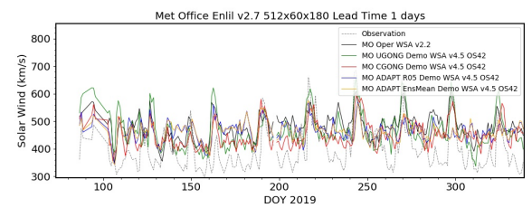
Model performance comparison
March-Dec 2019.
Hourly averaged solar wind speed predicted by different model configurations, with 1 day lead time. (00UTC model run).
Observations from OMNI database.
Calculated various statistical parameters: gradient, interception, correlation coefficient, etc. Calculated biases using hourly values of obs & forecast pairs. Models generally over-predict for solar wind speed <500km/s – underpredict for >500km/s.
New models in demonstrator suite are not worse than current operational model - & model with CGONG input data performs best (for this study) for background solar wind speed & plasma density
Outcome:
Replace operational suite with CGONG (SWC & SWCX)
Use ADAPT config (SWA) as demonstrator suite - anticipate replacing SWC with SWA in future once fine tuning Enlil to work with ADAPT.

Slide 24
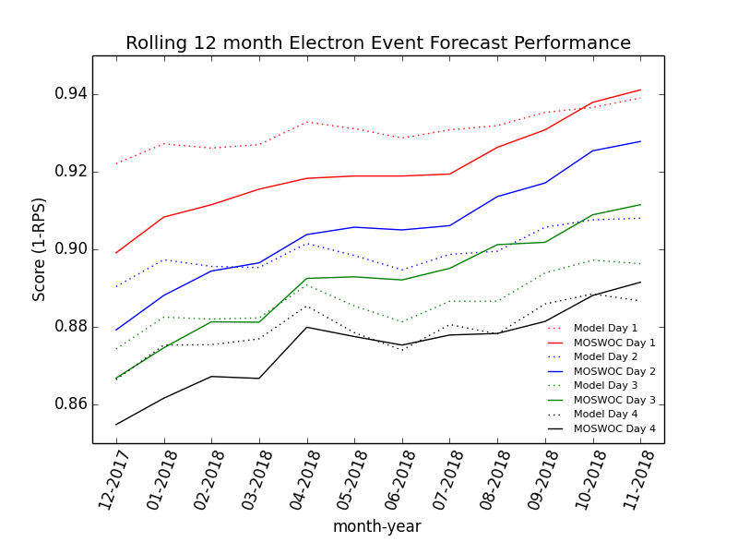
Electron forecast verification
Probability that an Active or Very Active electron event will occur based on today’s electron fluence & that 27 days ago – M. Sharpe
MOSWOC forecast
Rolling 12-month performance (measured by RPS) for each day of the MOSWOC electron event forecast & RPEFM (also done for REFM)
Each point is performance over a 12-month period of assessment – 1-RPS is displayed to make positively orientated score on y-axis (range 1-0, 1 perfect)
RPEFM appears to out-perform MOSWOC issued forecasts but by Nov 2018 this is reversed
Rolling 12 monthly performance (RPS) of RPEFM & MOSWOC forecasts, for days1-4

Slide 25
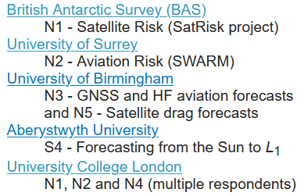
SWIMMR projects
Notes:
‹#›

