Slide 1
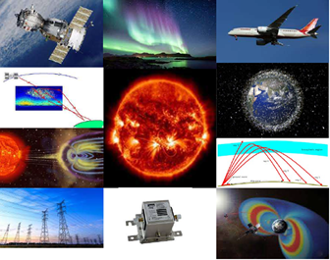
SWIMMR Space Weather Innovation, Measurement, Modelling and Risk A “Wave 2” programme of the UKRI Strategic Priorities Fund
Ian McCrea
STFC Rutherford Appleton Laboratory

Slide 2
Severe Space Weather and the UK National Risk Register
Space weather first added to UK National Risk Register of Civil Emergencies in 2011
Led to the designation of BEIS as the risk-owning UK ministry and creation of Met Office Space Weather Operations Centre
Long-standing discussion of how to translate UK space weather research into operational capabilities led to first proposal in July 2018
Submitted to “STFC Priority Projects” call – essentially a call for bright ideas for future programmes, with no obvious source of funding
STFC Strategy Director liked the idea and pushed us toward the UK Strategic Priorities Fund, managed by UKRI

Slide 4
What is SWIMMR?
A £19.9M five-year (originally four) programme in SPF Wave 2, delivered via NERC and STFC
To develop and deploy new instruments, models and test facilities to support the UK space weather community and national capabilities in MOSWOC
Directly addresses priorities identified by UK ministries (BEIS, MoD and DfT) – based on input from MOSWOC and senior members of the academic community
Aimed at improving predictions and establishing a legacy of enhanced operational capabilities, which aligns with National Space Weather Preparedness Strategy and UK National Space Strategy (both issued September 2021)
SWIMMR ends in March 2024 (one-year extension to original proposal) – currently working on ways to fund a follow-on programme

Slide 5
The SWIMMR Programme
Eleven projects, divided almost equally between STFC and NERC
Delivered through NERC (total budget £9.8M)
N1: Improvement of satellite risk forecasts (budget £1.9M)
N2: Improvement of aviation risk forecasts (budget £1.6M)
N3: Improved forecasting for GNSS and HF communications (budget £2M)
N4: Improved forecasting of ground level current effects (budget £2M)
N5: Improved forecasts of satellite drag (budget £1.1M)
Funding for all five NERC topics started on June 1st 2020

Slide 6
The SWIMMR Programme
Delivered through STFC (total budget £10.2M):
S1: In-situ radiation measurements for space and aviation (budget £5.7M)
S2: Support for technology testing and modelling (budget £655k)
S3: Support for the transition from research to operations (budget £920k)
S4: Forecasting from the Sun to L1 (budget £450k)
S5: Support for a ground radiation monitoring network (budget £1.4M)
S6: Production of an updated space weather impact study (budget £300K)
S6 project not yet awarded – currently under tender

Slide 7
Meeting User Needs
Nowcasts, forecasts, reconstructions to retrospectively attribute effects
N1: Spacecraft and electronic technologies
N2: Aircraft and high-altitude aviation
N3: Position, Navigation, Timing and Communications
N5: Re-entry, orbit determination and collision risk
N4: Power grids, gas pipelines and rail network
S4: Multiple sectors benefit from improved solar wind and CME forecasts
S1, S5 provide new sources of radiation data
S2 provides new testing facilities and capabilities for radiation resilience
S3 provides a framework for migrating and operationalising research models

Slide 8
SWIMMR Models
SWIMMR will add the following new models to MOSWOC:
BAS Radiation Belt Model
With electron and proton forecasts and extension to LEO
University of Surrey MAIRE+ model (aviation radiation)
Incorporates SPARX energetic electron model (Univ of Central Lancashire)
BGS Near Real Time models of Ground Electric Field and Geomagnetic Field
With UK grid/pipeline models
Underpinned by improved UK ground conductivity model
New modules for improved solar wind modelling
Coronal models, corona to solar wind coupling, coronagraph tools and solar wind model
Near Real Time Assimilative Ionosphere/Thermosphere Model
Based on University of Birmingham AEGIS system (with Bath, Lancaster, Leeds, Leicester)
Products for HF, absorption, scintillations and gradients
Orbit propagator for thermospheric effects on satellite orbits

Slide 9
SWIMMR Instruments
SWIMMR will add the following new instrument/data capabilities
Radiation monitors
Radiation monitor in 1200km high-inclination orbit (cf Oneweb)
~15 radiation monitors for aviation (mix of aircraft and balloon-borne)
New design for key technologies of a UK monitor for high altitude/highly elliptical orbits
Ground-based neutron monitors
Two new systems for UK operation with novel compact design
Upgrades to UK neutron testing facility (ChipIr)
New collimator system for main facility
New “small source” system (NILE) for stand-alone, lower energy operations
New “R2O” environment for migrating models from academic to operational use
Built on Amazon Web Services, running at UK Met Office
Multiple new data sources provided to models via Met Office APIs
Will include data from some of the above sensors

Slide 10
Where is SWIMMR now?
Effectively three years into a five-year programme
Ten out of eleven projects up and running
Modelling projects developing well
Handover of six new models to Met Office has now started
Computing framework to enable model transfer progressing well
Signed contract to fly trusted radiation monitors in space (@1200 km)
Tenders out for aviation radiation monitors and new impact studies
Begun development of novel neutron monitors for GLE detection

Slide 11
Where is SWIMMR leading?
SWIMMR is not an end in itself. It is an enabler to get the UK to the next level in space weather monitoring and prediction capability.
Promises a step change in UK modelling capability and the provision of data to support those models
Exemplifies a “research to operations” capability to move models easily from academic to forecasting use – similar to CCMC
Upgrades UK capabilities to produce instruments and provide facilities tuned to user requirements
Helps drive the thinking needed on future research and observational priorities and facilitates discussion with policy makers

Slide 12
What happens next?
Space weather is seen as an area of UK strength
UK Space Strategy (2021) contains strong support for future international collaborations
Bilateral activities with US are seen as especially strategic
If SWIMMR funding uplift is approved, we will add a new activity on future bilateral partnerships
This could cover joint use/benchmarking of models and services
Also joint research/operations (e.g. radiation monitoring for aviation)
SWIMMR follow-on programme might have more international flavour

Slide 14
What SWIMMR is not!
Not intended as a vehicle for pure blue-skies research
This is strategic science, directed to government and Met Office priorities
Government and ministerial Chief Scientist support was crucial to the bid
SWIMMR should deliver on time and in budget
Funding is conditional on us delivering against the scope of the proposal
There is significant Monitoring and Evaluation, compared to normal grants
Projects need to stick closely to budget and schedule
Financial re-profiling of the programme is possible, but bureaucratic
Next re-profiling opportunity is coming in Autumn 2022
Possible uplift to SWIMMR budget in next two financial years (tbd)
SWIMMR now ends on 31/03/2024
An extension to March 2024 was requested due to Covid, and approved in April 2021
There will be no SPF Wave 3, so any follow-on will be a different kind of programme

Slide 15
SWIMMR Finances @ April 2021
Project | FY19/20 | FY20/21 | FY21/22 | FY22/23 | FY23/24 | TOTAL
NERC Management | 0.030 | 0.090 | 0.080 | 0.080 | - | 0.280
SWIMMR N1 |  | 0.530 | 0.700 | 0.800 | 0.140 | 2.170
SWIMMR N2 |  | 0.530 | 0.700 | 0.800 | 0.140 | 2.170
SWIMMR N3 |  | 0.530 | 0.700 | 0.800 | 0.140 | 2.170
SWIMMR N4 |  | 0.430 | 0.550 | 0.640 | 0.120 | 1.740
SWIMMR N5 |  | 0.270 | 0.340 | 0.340 | 0.070 | 1.030
NERC OpEx | 0.060 | 0.070 | 0.070 | 0.070 | - | 0.280
TOTALS | 0.090 | 2.460 | 3.120 | 3.530 | 0.610 | 9.830

Slide 16
SWIMMR Finances @ April 2021
Project | FY19/20 | FY20/21 | FY21/22 | FY22/23 | FY23/24 | TOTAL
SWIMMR Management | 0.200 | 0.150 | 0.140 | 0.165 | 0.025 | 0.680
SWIMMR S1 | 0.050 | 0.264 | 1.960 | 2.000 | 1.230 | 5.504
SWIMMR S2 | 0.210 | 0.085 | 0.100 | 0.210 | 0.050 | 0.655
SWIMMR S3 |  | 0.211 | 0.300 | 0.260 | 0.150 | 0.921
SWIMMR S4 |  | 0.075 | 0.150 | 0.150 | 0.075 | 0.450
SWIMMR S5 |  |  | 0.150 | 0.700 | 0.550 | 1.400
SWIMMR S6 |  |  | 0.050 | 0.150 | 0.100 | 0.300
STFC OpEx | 0.060 | 0.036 | 0.080 | 0.070 | 0.044 | 0.290
TOTALS | 0.520 | 0.821 | 2.930 | 3.705 | 2.224 | 10.200

Slide 17
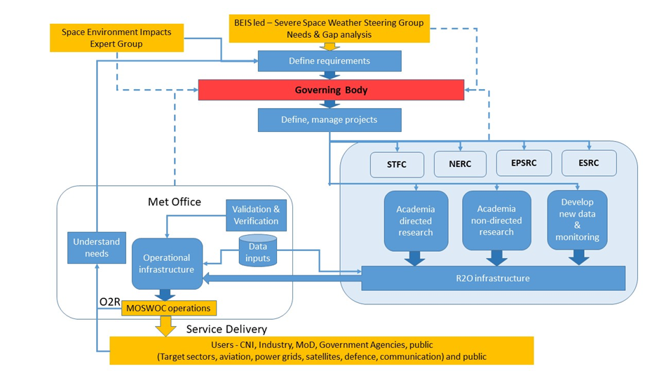
UK Space Weather Relationships
SWIMMR Governance

