Slide 1
PITHIA-NRF Plasmasphere Ionosphere Thermosphere Integrated Research Environment and Access services: a Network of Research Facilities
European Union’s Horizon 2020 Research and Innovation Programme Grant Agreement No 101007599
Anna Belehaki, PITHIA-NRF coordinator
Research Director, National Observatory of Athens
CCMC workshop, 10 June 2022

Slide 2
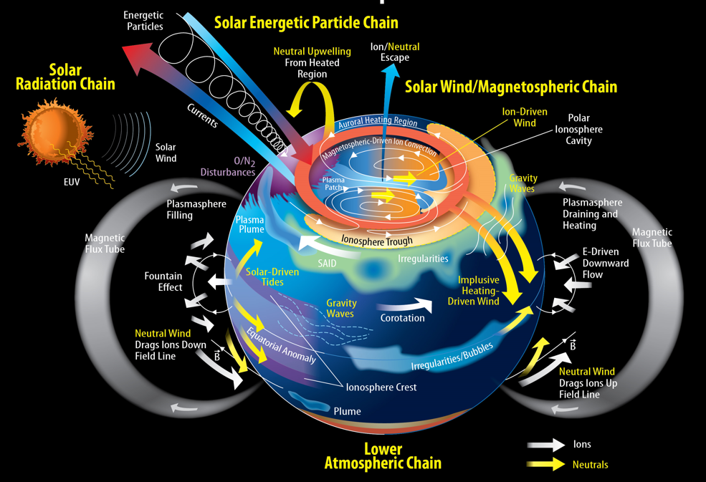
The rational
The Earth’s Ionosphere, Thermosphere, and Plasmasphere is governed by the complex electrodynamic and photochemical system of the upper atmosphere coupled with variable electromagnetic fields and thermospheric winds.
These physical processes are the source of many scientific, operational, societal, and environmental challenges that affect the smooth operation of critical technologies and research infrastructures.

Slide 3
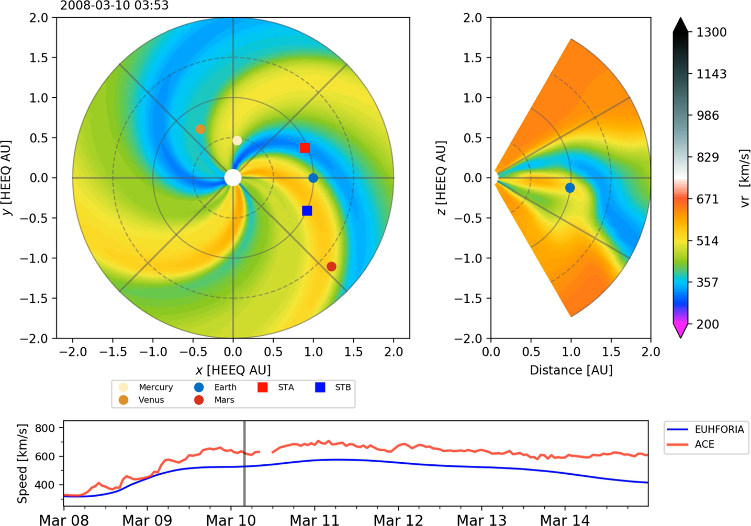
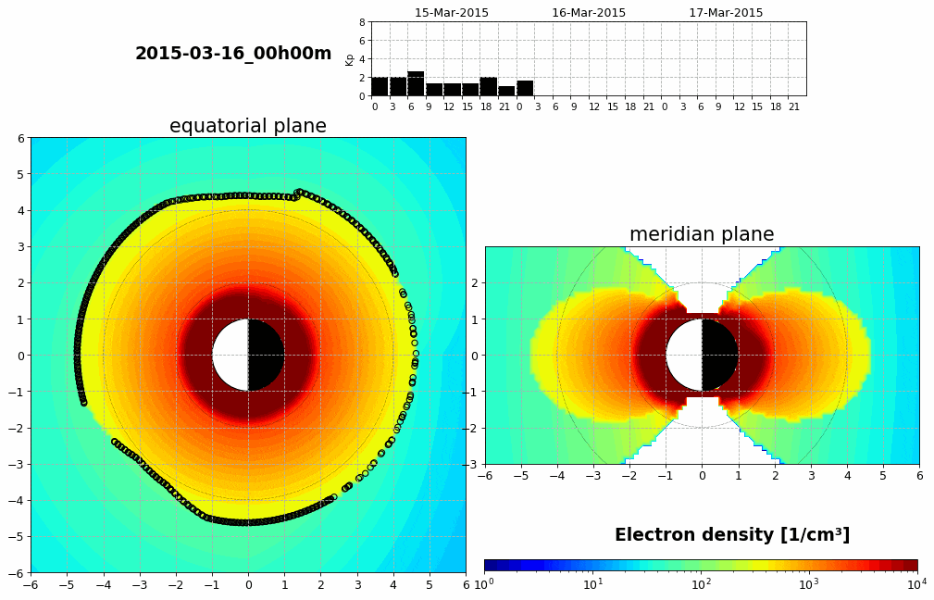
Scientific challenges
While we understand the broad features of the coupled ionosphere thermosphere plasmasphere system response, we still need to improve the depth of understanding of its variability in long- and short-time scales that would allow us to build models with real predictive power.
Jürgen Hinterreiter et al., 2019
Courtesy: BIRA-IASB

Slide 4
PITHIA-NRF consortium
22 Beneficiaries
2 Third Parties
5 External Advisors

Slide 5
PITHIA-NRF is funded with 5.2M euro for 4 years (2021 – 2025)

Slide 6
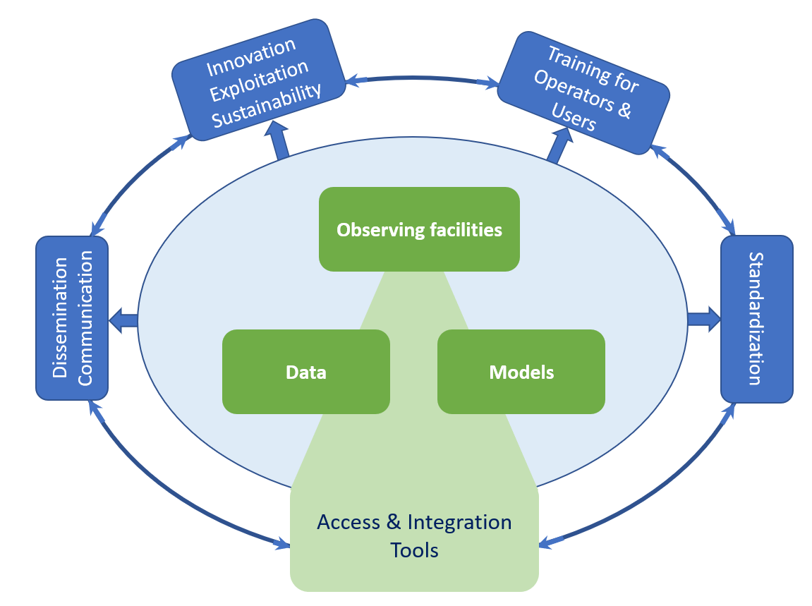
Overview & Ambition
Europe operates excellent observing facilities and is extremely well-placed in developing ionospheric, thermospheric and plasmaspheric models.
However, more is needed to:
Support the interoperable use of observing facilities;
Develop standardized processes that lead to FAIR data and data-products;
Facilitate the use of scientific models’ concepts for experimentation purposes;
Support space applications developers to implement innovative projects.
… and all these need to be more reliable.
To achieve this challenge, the scientific research community requires support from a structured research infrastructure organized to provide transnational research services, including access and standardization.

Slide 7
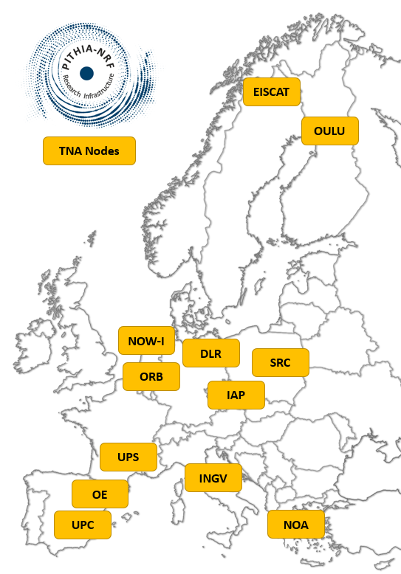
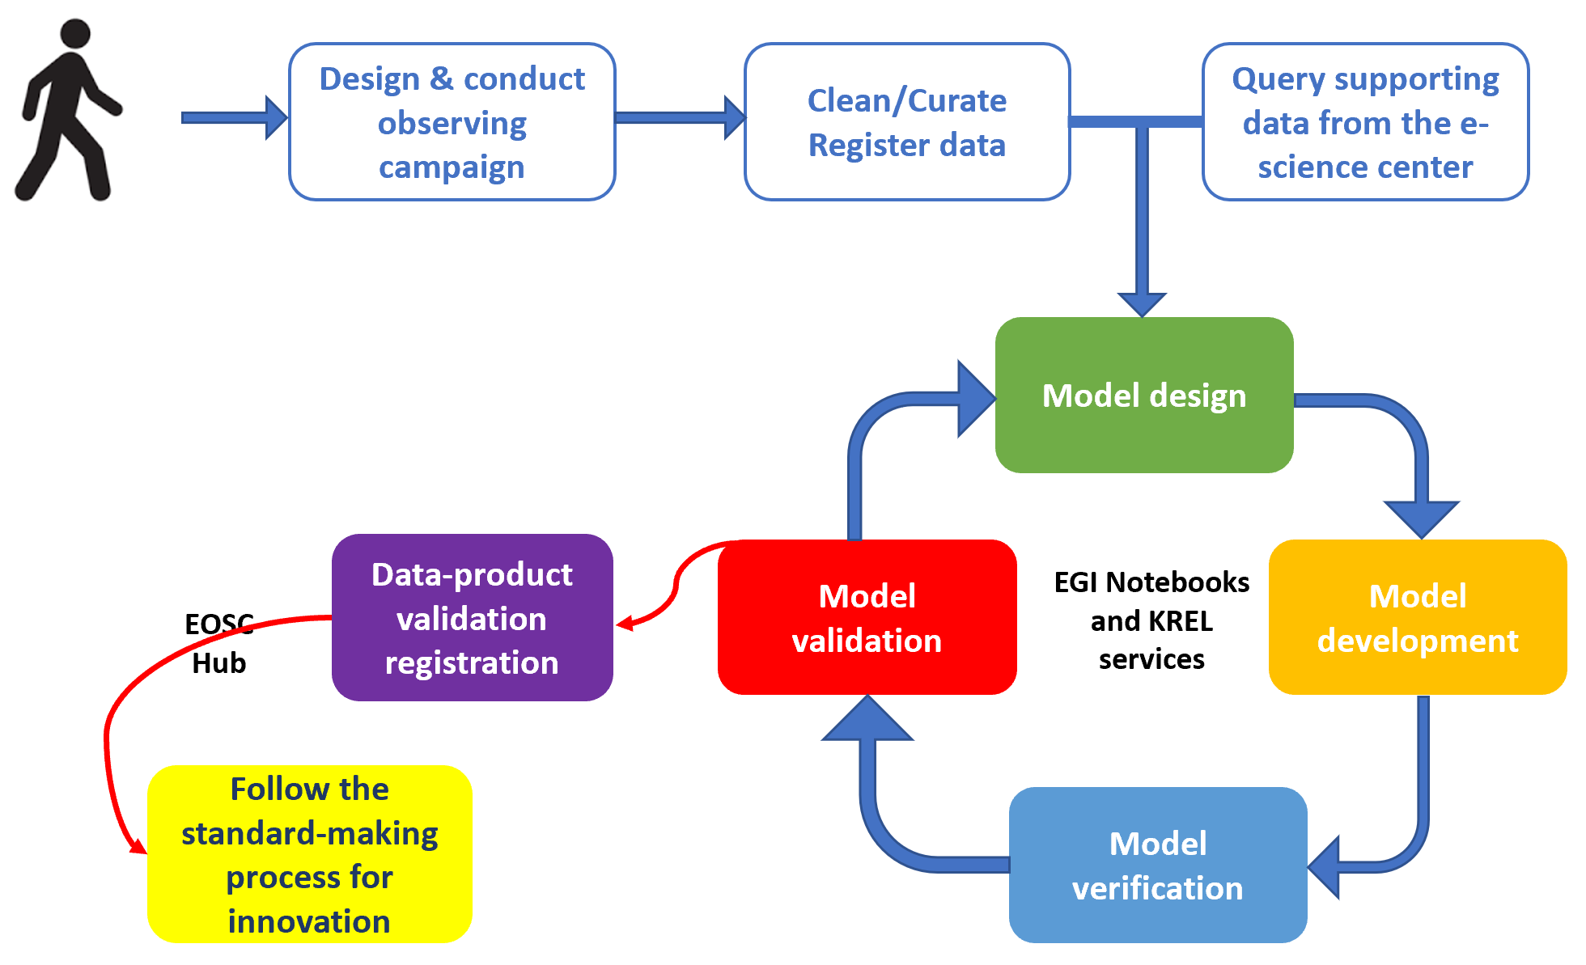
Specific Objective 1
PITHIA-NRF provides effective and convenient access to the best European research facilities (nodes) for the upper atmosphere. Access is provided to scientific users, from academia, Small and Medium Enterprises (SMEs), large companies and public organizations. Access is subsidized through the Transnational Access (TNA) programme, and gives the possibility for external research teams to perform their own projects working in one of the PITHIA-NRF nodes, learning how to operate the observing facilities end-to-end, i.e. from setting up a special campaign, to the collection, analysis and exploitation of data using the project tools and services.

Slide 8
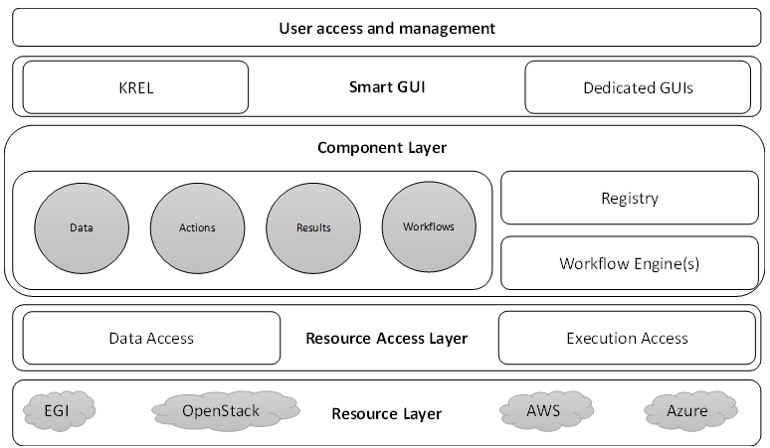
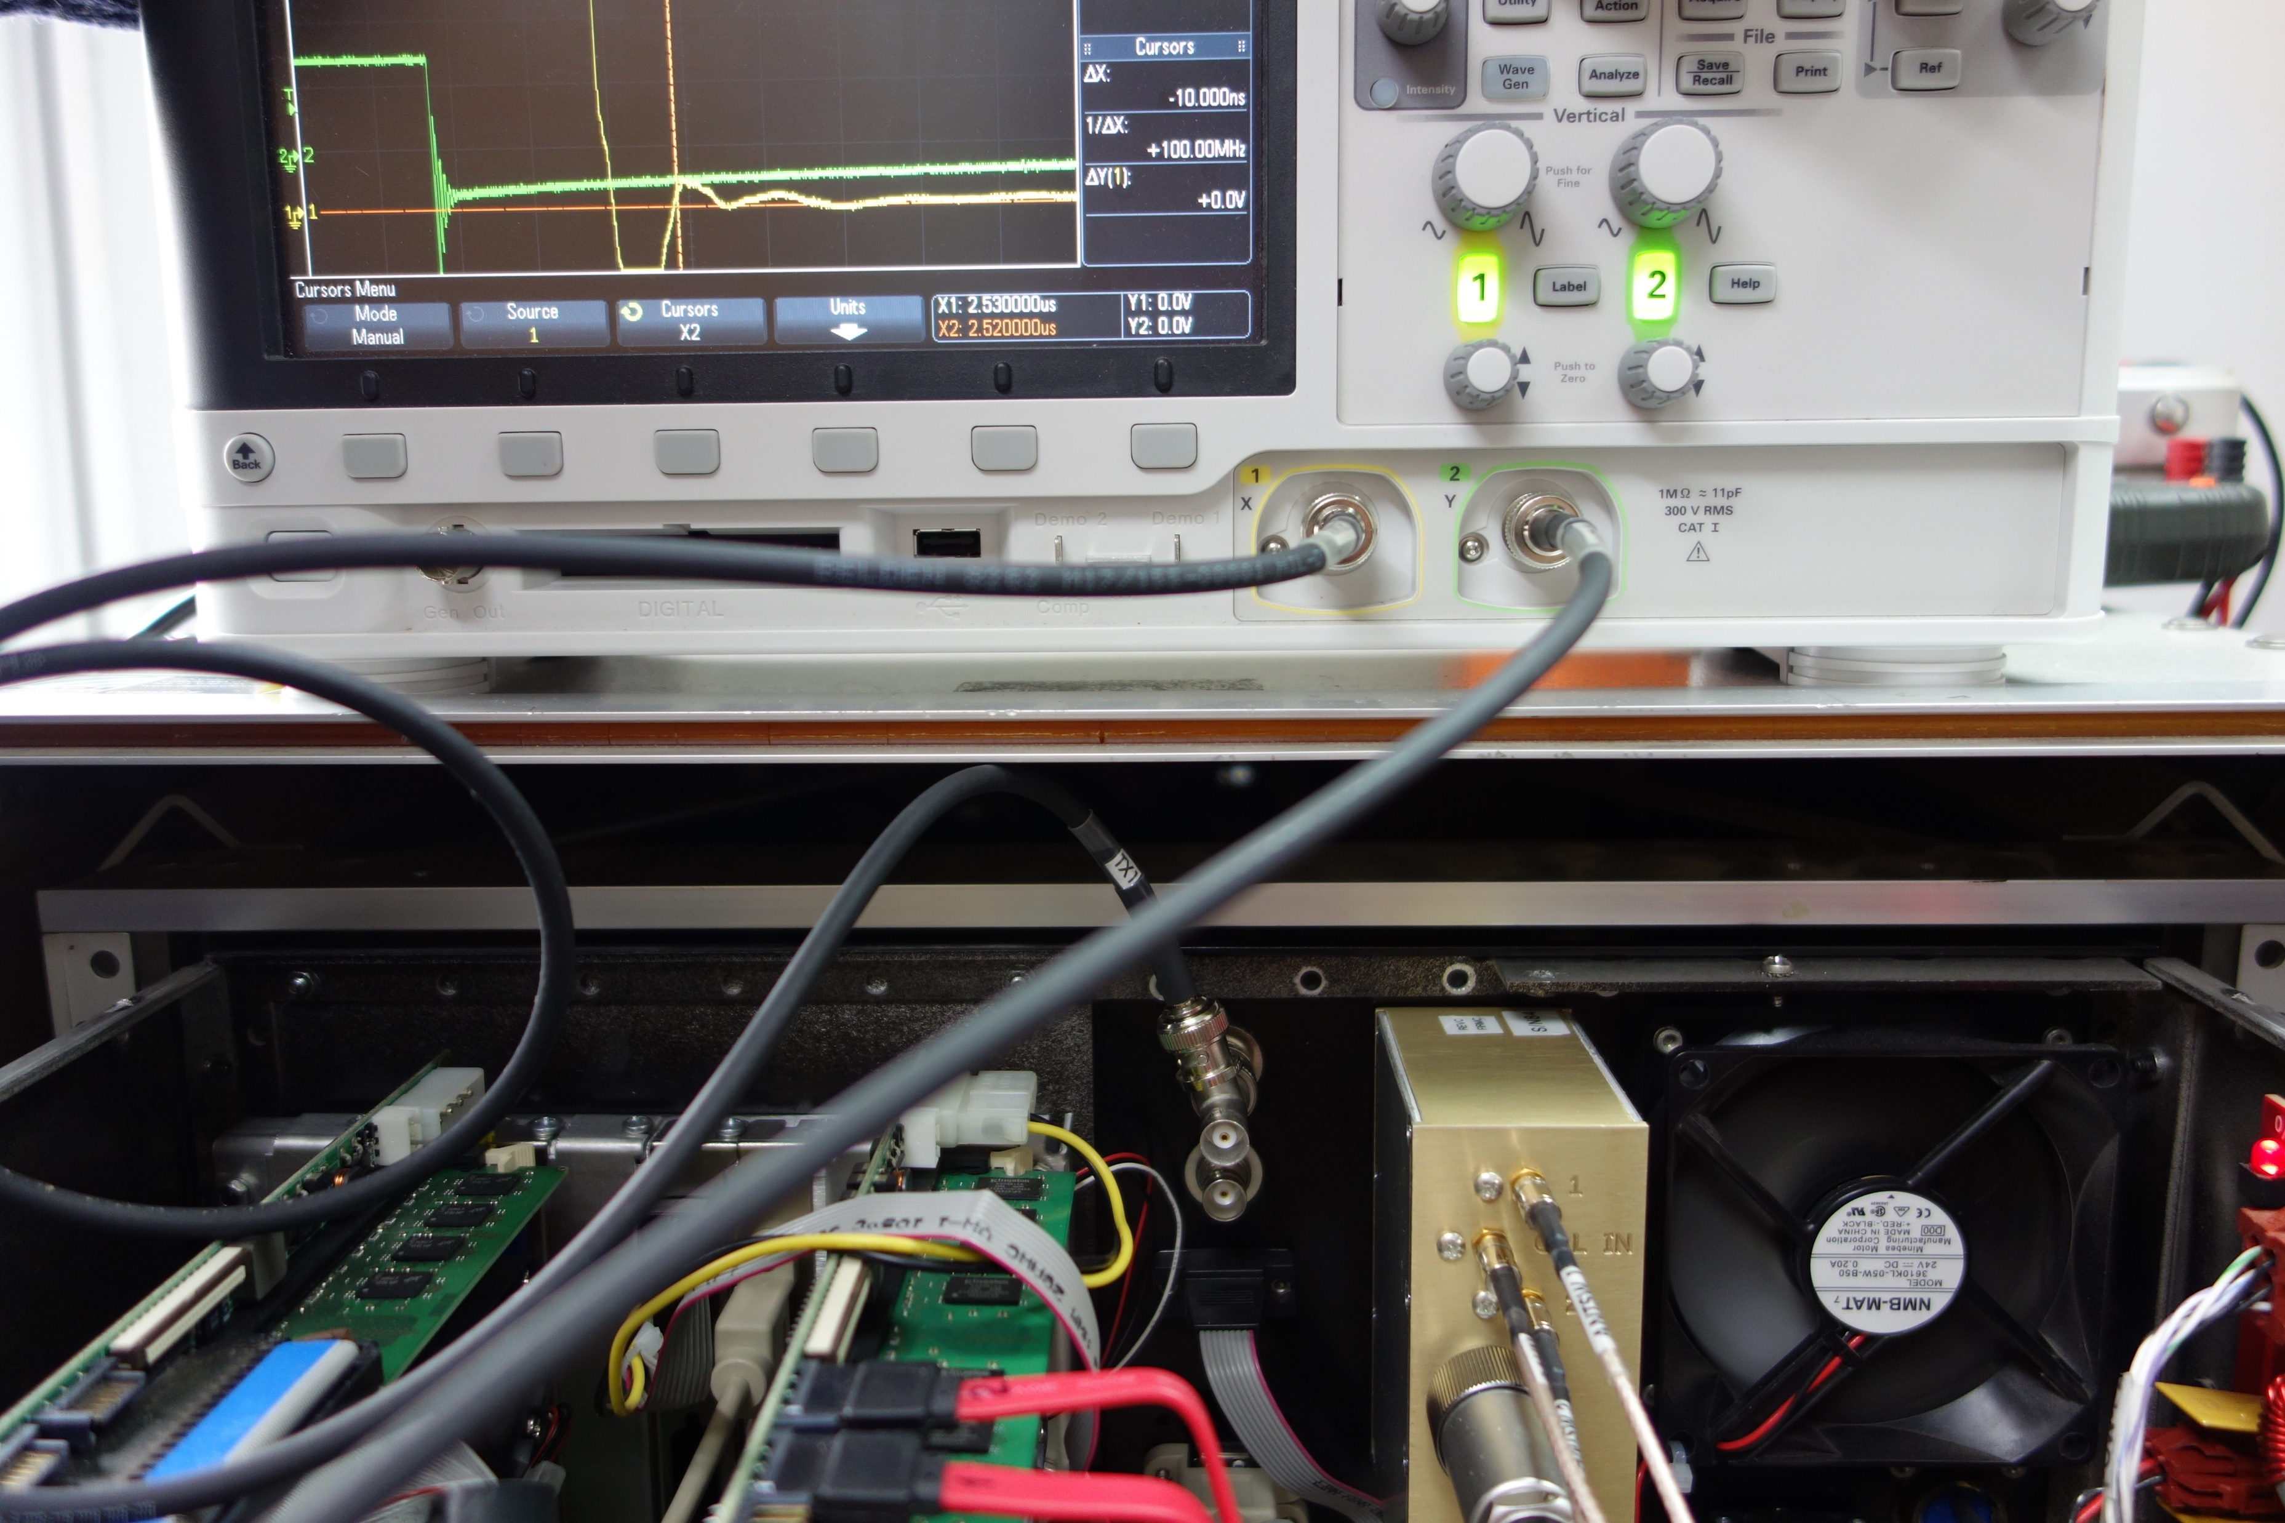
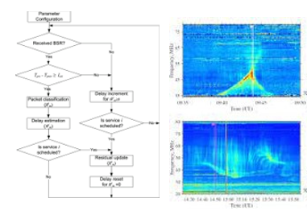
Specific Objective 2
PITHIA-NRF develops integration tools that enable the establishment of a comprehensive Research Infrastructure. This set of tools is provided through the PITHIA-NRF e-science center, a dedicated knowledge hub that provides open access to FAIR data and higher-level data-products. These tools cover data discovery, data standardization, data quality control, publicly-accessible workflow applications to automate the calculation of data-products, and tools to enable the registration of new datasets and new models. An additional set of integration tools targets to the optimization of observing strategies through the release of standardized operation protocols, management tools, and training procedures for operators. These integration tools are expected to lead to the optimal use and joint development of the PITHIA-NRF observing facilities.
PITHIA-NRF Nodes Scientific Instrumentation
PITHIA-NRF Scientific data & Models

Slide 9
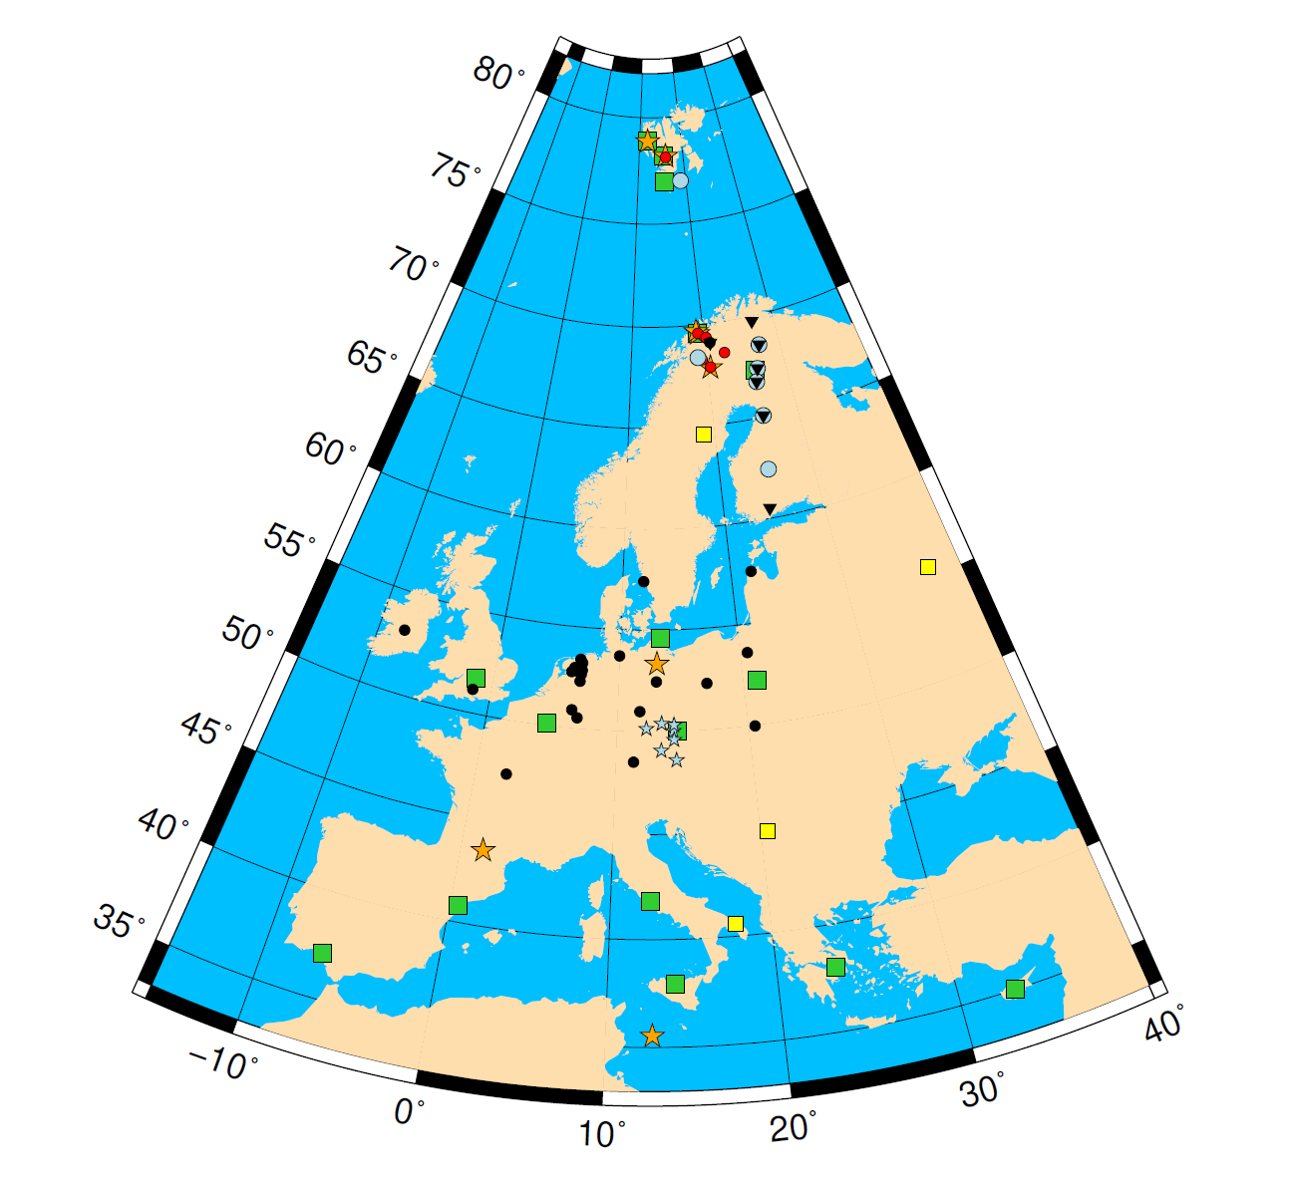
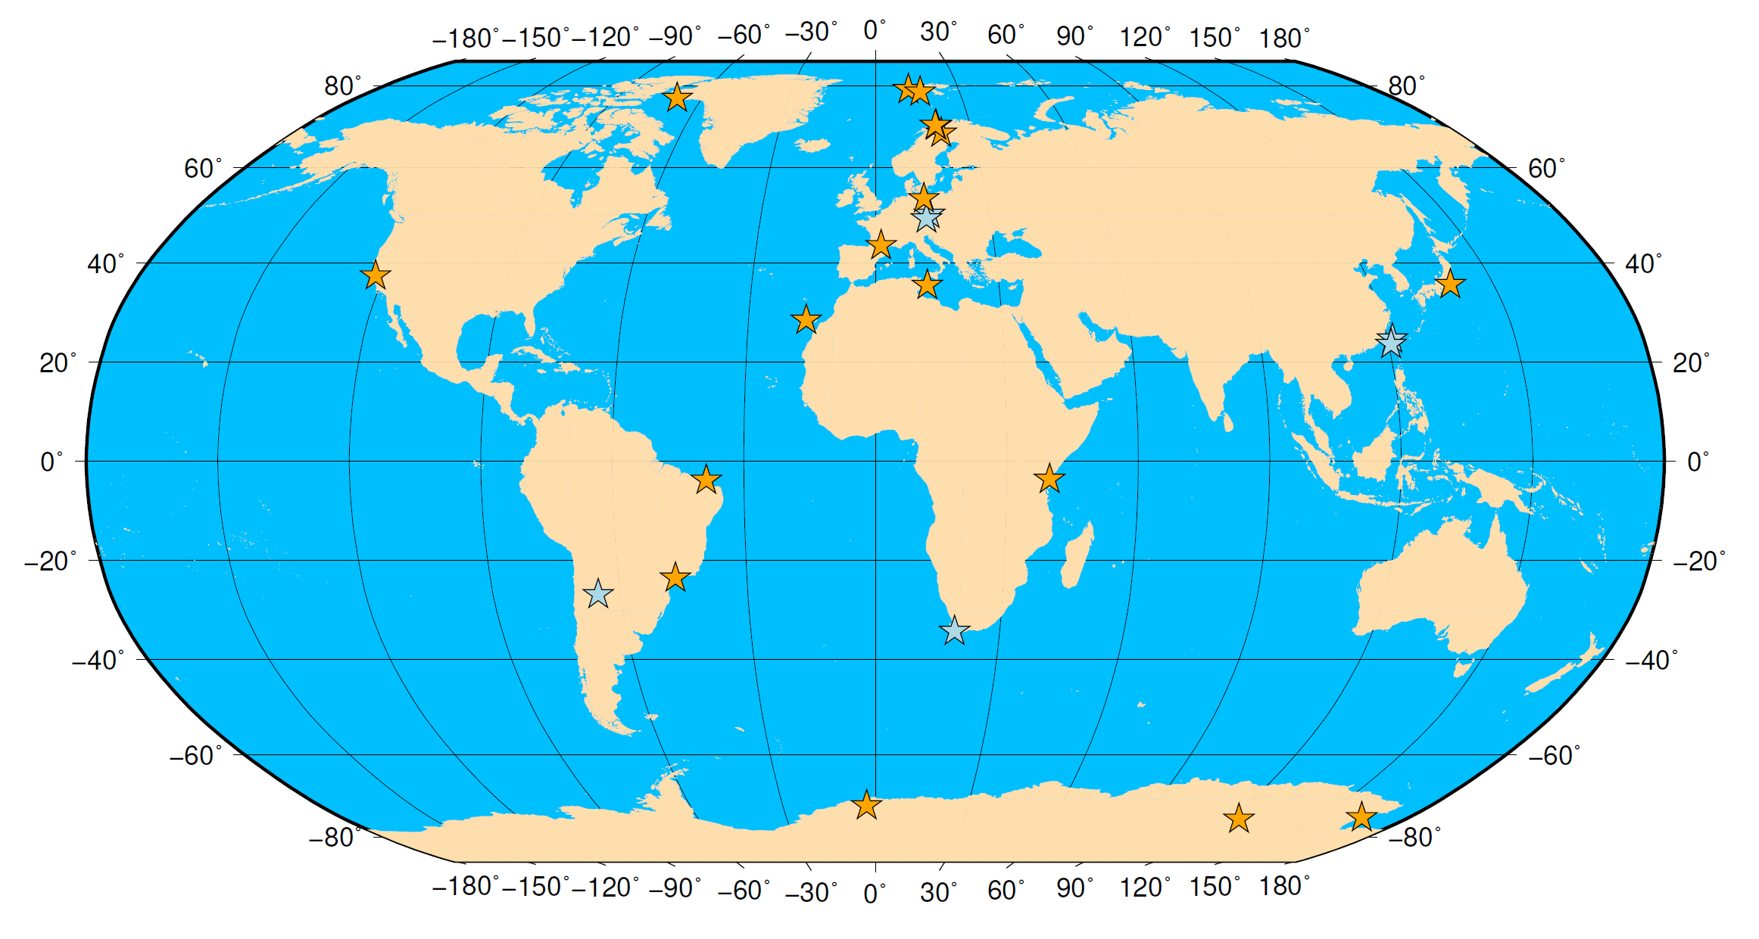
Specific Objective 3
Through connection with the European Open Science Cloud, the e-science center of PITHIA-NRF provides long-term observational data, required for advancing our knowledge in the Ionospheric, Thermospheric and Plasmaspheric research domain. PITHIA-NRF provides access to data from ground-based instruments such as GNSS ground based receivers, Ionosondes, Digisondes, Dynasondes, Doppler Sounders, Incoherent Scatter Radars, Riometers, All Sky Imagers, and the LOFAR radio telescope. It also provides access to data from satellite experiments, including in situ, Radio Occultation and Topside Sounding observations.
ionosondes with real-time data delivery
ionosondes without real-time data delivery
IAP CDSS transmitters and receivers (on both maps)
INGV + DLR GNSS scintillation receivers (on both maps)
EISCAT transmitters and receivers light blue circles: SGO riometer chain
SGO pulsation magnetometer chain
LOFAR sites and sites associated with LOFAR
GNSS sites of standard networks (such as EUREF and IGS) are too numerous to be shown.
The ionosondes (mostly Digisondes) with near real-time data provision are owned or operated by consortium partners or outside the consortium but offer free data access.
The World map shows GNSS high sampling rate and CDSS sites only.

Slide 10
Specific Objective 4
PITHIA-NRF provides organized and systematic training on the use of observing facilities and of the integration tools.
Training towards project partners in the use of integration tools
Training towards external users, in particular students, scientists from countries with no tradition in space research, engineers from the R&D departments of private companies and large organizations.
Training is provided through workshops, schools and webinars.
To get access to PITHIA-NRF nodes, successful participation to on-site sessions is required.

Slide 11
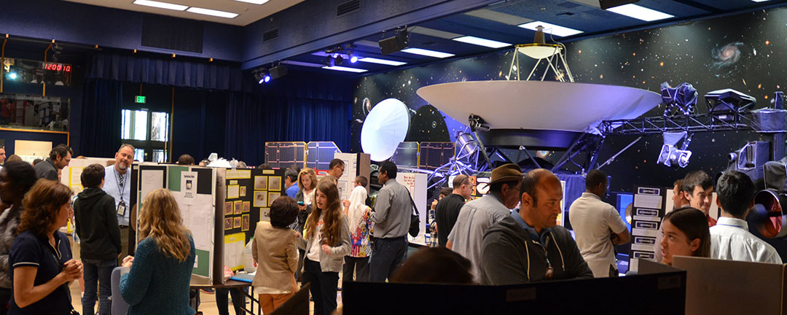
Specific Objective 5
PITHIA-NRF builds the innovation platform to promote cooperation between stakeholders and sets the standards for future collaboration (i.e. the IPR policies for the exploitation of the services). It also provides the tools for continuous interaction with users, promotion of the PITHIA-NRF activities and services to the public and to the stakeholders, and promotes joint public-private collaboration for high-risk innovation and close-to-market activities.
This activity supports the overarching aim of the PITHIA-NRF project for the establishment of a European distributed research infrastructure that will provide a range of services to the upper atmosphere community for R&D projects.

Slide 12
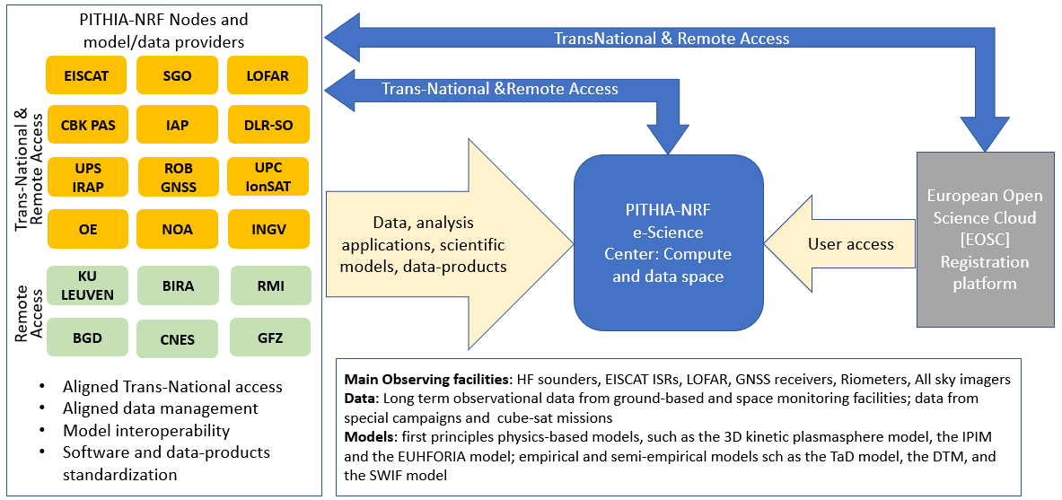
Integrating facilities, data and models

Slide 13
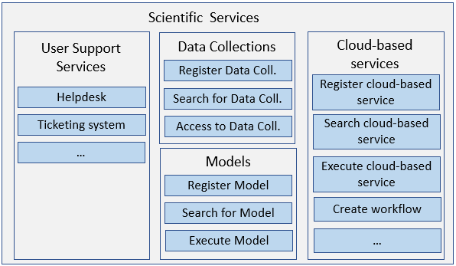
10 STEPS of Registration based on the ESPAS ISO 19156 data model
PITHIA-NRF e-Science center
10. Collection
9. Process
8. Computation
7. Acquisition
6. Instrument
5. Operation
4. Platform
3. Project
First e-science center release for open access is expected in September 2022
2. Individual
1. Organisation

Slide 14
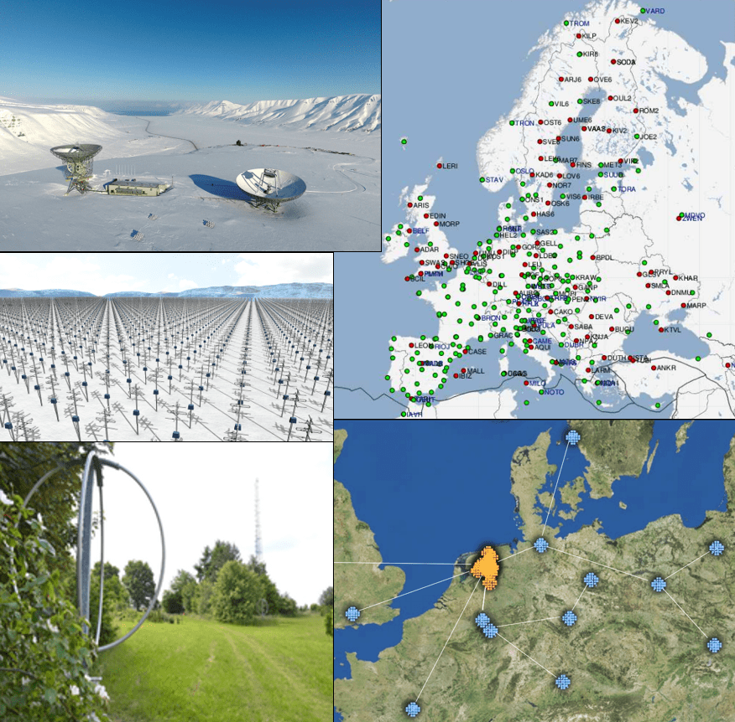
PITHIA-NRF TNA projects
Indicative projects accepted in the 1st and 2nd TNA Call
Longitudinal differences in traveling ionospheric disturbance characteristics at midlatitudes
Wave-like structures in the ionosphere with D2D operations
Ionospheric reconstruction profilers ingesting GNSS, Digisonde and in situ electron density data from LEO satellites
Retrieving the ionospheric currents and magnetic field variations from the upper atmosphere emissions polarisation.
Ionospheric Disturbance due to Space Weather in LOFAR data
Thermospheric O/N2 variability and Its effects on Ionosphere during disturbed and quiet days, for solar cycles 23 and 24
The F2-layer peak height response at mid-latitudes to Space Hurricane
Storm-related Study of Ionospheric irregularities over southern Europe using digisondes and GNSS Data
Can PolaRISation Measurements of Auroral emissions Trace the Ionospheric Currents?
Contribution to feasibility study of data-driven Autonomous Service for Prediction of Ionospheric Scintillations
Next TNA Call will open in July 2022

Slide 15
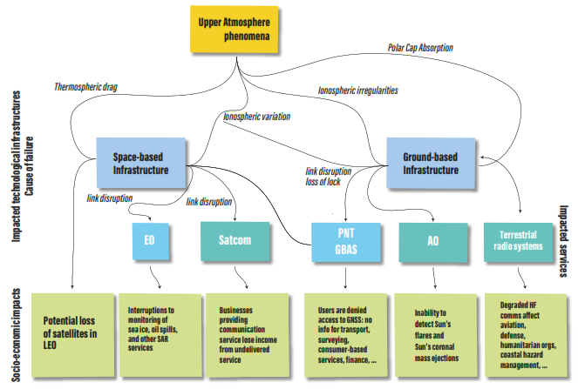
PITHIA-NRF Innovation Framework
You are welcome to join in person or virtually!
An event to promote cooperation between stakeholders and set the standards for systematic collaboration.
Users from SMEs and the aerospace sectors will be informed about the PITHIA-NRF concept, the expected results, and the possibility to use the nodes for developing projects on validation and calibration of new instrumentation.

Slide 16
Thank you for your attention!
https://www.pithia-nrf.eu
Join PITHIA-NRF network
to stay informed about our activities and collaboration opportunities
The PITHIA-NRF project has received funding from the European Union’s Horizon 2020 research and innovation programme under grant agreement No 101007599

