Slide 1


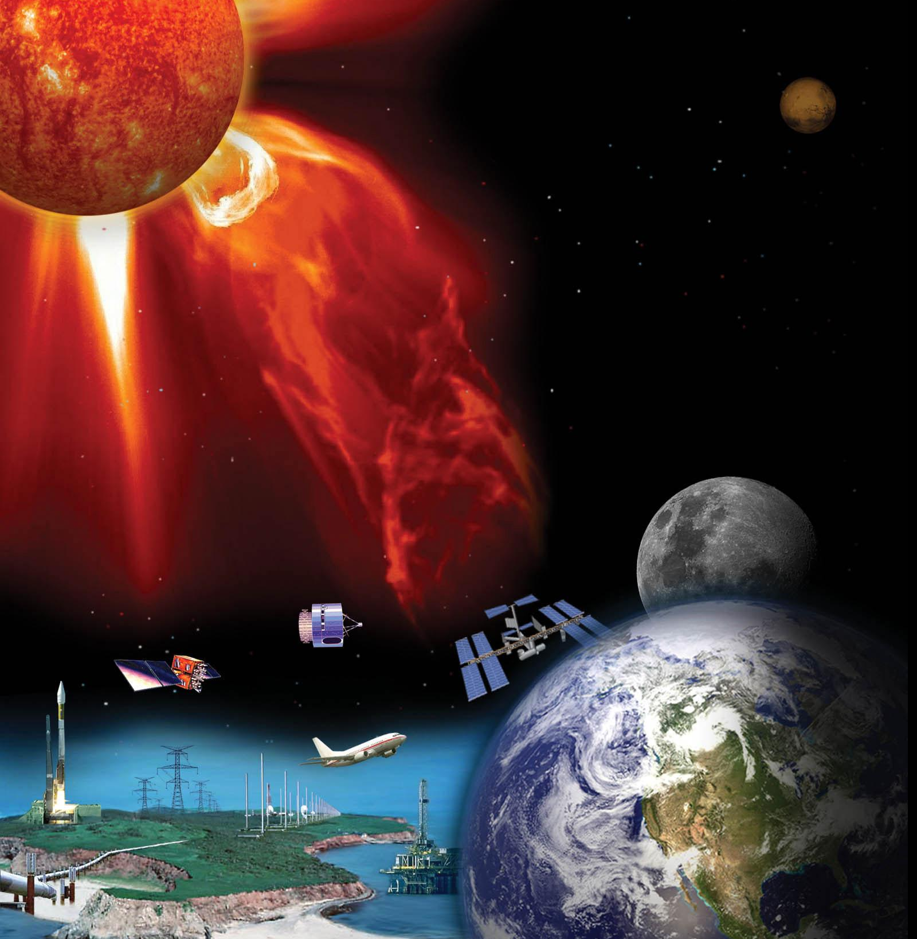
Running VSWMC models remotely via API and opportunities for partnership with CCMC
Stefaan Poedts
CmPA / KU Leuven, Leuven (Belgium)
UMCS, Lublin (Poland)
and the VSWMC-P3 team
Credit: NASA
CCMC Workshop, 10/06/2022

Slide 2
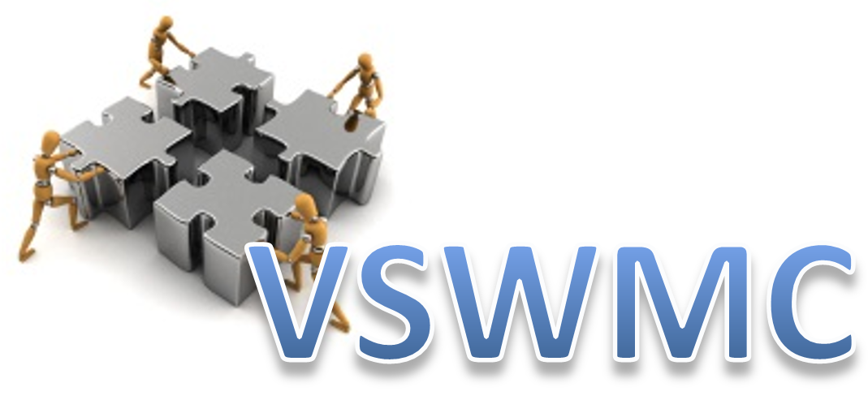












Virtual SWE Modelling Centre
An open end-to-end (Sun to Earth) space weather modeling system,
enabling to interactively run & "couple" various space weather models in an integrated tool,
with the models located either locally or geographically
distributed (≠ CCMC)
Basic set-up of federated service with geographically distributed system elements

Slide 3
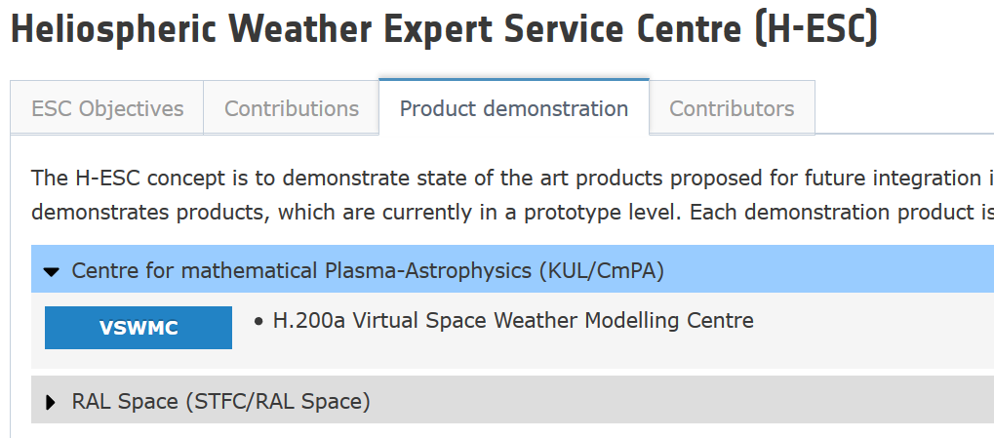
First operational VSWMC (May 2019)
Framework node communication
AppServer
EUHFORIA
Gumics-4
Corona
Heliosphere
BAS-RBM
ODI
Visualization 1
Kp index
Dst index
Visualization 2
Bow shock stand-
off distance
DEMO

Slide 4
New VSWMC-P3 models
Wind-Predict @KU Leuven = alternative global corona model
CTIP @KU Leuven = Coupled Thermosphere Ionosphere Plasma sphere
MULTI-VP @Toulouse = alternative global corona model
BIRA Plasma sphere Model (BPiM) @BIRA = 3D dynamic model of the plasma sphere
SNRB @ KU Leuven = electron fluxes at geostationary orbit
SNGI @ KU Leuven = geomagnetic indices Kp and Dst
SPARX @ University of Central Lancashire = SEP time-flux profiles
Spenvis DICTAT @ BIRA (output displayed on the R-ESC webpages) = s/c internal charging analysis
Gorgon @ Imperial College London = alternative magnetosphere model
MCM @ Leuven = MOWA Climatological Model (temp., wind, density up to
120 km, temp., total and partial densities above 120 km)
DTM @ Leuven = Drag Temperature Model (thermosphere 120-1500 km)

Slide 5
Coupling of models via the VSWMC
  New ‘trend’ in space weather modelling
  Enables better predictions
      Example: MULTI-VP + EUHFORIA Heliosphere
        Better capturing of HSSs due to improved coronal model (Multi-VP vs WSA)
      Example: EUHFORIA + PARADISE (SEP model)
        Using (EUHFORIA) simulated IMF instead of Parker spiral
  Enables earlier predictions/warnings
      Example: EUHFORIA + OpenGGCM/Gorgon/GUMICS
        replacing L1 data by synthetic/simulated data three days ahead
        Enables forecasts 2-3 days ahead instead of nowcasts!
5

Slide 6
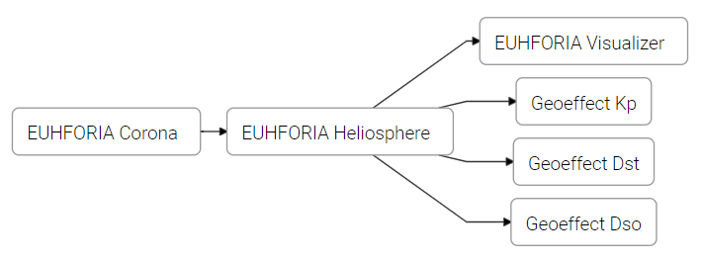
Most used model chain (via CLI)

Slide 7
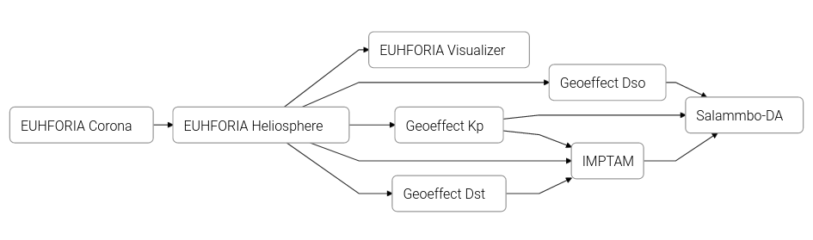
New RB-Fan models
Simulation of Euhforia + Indices + IMPTAM (+ Salammbo)
  Euhforia + Indices run on HPC cluster in KU Leuven
  then IMPTAM runs in FMI, we monitor the run and receive the IMPTAM results
  Then we send Kp, Dso, and IMPTAM results to ONERA where Salammbo is ran
  (outside the VSWMC)

Slide 8
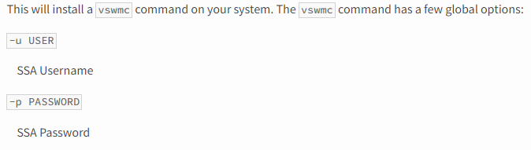
VSWMC Command-Line Interface (1) https://pypi.org/project/vswmc-cli/
Install with pip: > pip install --upgrade vswmc-cli
Notes:
pip is a standard package manager used to install and maintain packages for Python.

Slide 9
VSWMC Command-Line Interface (2)
List available simulations:
> vswmc –u username –p password simulations list
e.g. (from D. Barnes)
Notes:
pip is a standard package manager used to install and maintain packages for Python.

Slide 10
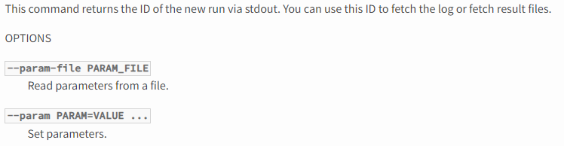
VSWMC Command-Line Interface (3)
Start a run:
> vswmc run [--param-file PARAM_FILE] [--param PARAM=VALUE ...] -- SIMULATION
Notes:
pip is a standard package manager used to install and maintain packages for Python.

Slide 11
VSWMC Command-Line Interface (4)
Input parameters:
> vswmc –u username –p password simulations describe euhforia
Notes:
pip is a standard package manager used to install and maintain packages for Python.

Slide 12
VSWMC Command-Line Interface (5)
Filter on simulation
List all runs (default shows only ongoing)
List runs:
> vswmc ps [--simulation SIMULATION] [-a, --all]
e.g. (from D. Barnes, with ps -a)
Notes:
pip is a standard package manager used to install and maintain packages for Python.

Slide 13
Fetching results
checking the status of a run:
> vswmc -u USERNAME -p PASSWORD ps -a | grep “5f83ff24b16a671f66c842fc”
Printing the logs of a run:
> vswmc -u USERNAME -p PASSWORD logs 5f83ff24b16a671f66c842fc
List all results files from a run:
> vswmc -u USERNAME -p PASSWORD ls -l 5f83ff24b16a671f66c842fc
Copy results files of a run:
> vswmc -u USERNAME -p PASSWORD cp 5f83ff24b16a671f66c842fc:euhforia_Earth.dsv $resdir
Notes:
pip is a standard package manager used to install and maintain packages for Python.

Slide 14
Using the VSWMC API with scripts cfr. David Barnes
Notes:
pip is a standard package manager used to install and maintain packages for Python.

Slide 15
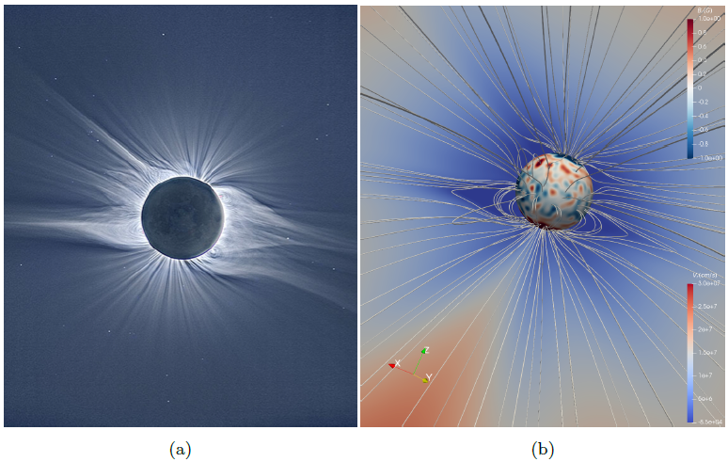
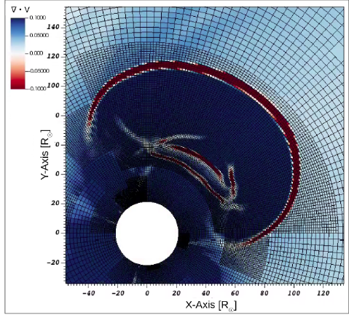
New ESA HMT/EUHFORIA 2.0 models (TBD)
COCONUT (global MHD EUHFORIA-corona)
+ FR CME models (TDm, Miller-Turner)
ICARUS (efficient EUHFORIA-heliosphere)
+ advanced FR CME models
(FRi3D, Gibson & Low, torus)
PARADISE (SEP acceleration and transport)

Slide 16
Summary (thx to D. Barnes)
The VSWMC is extending (20+ models & many model chains)
The VSWMC GUI functionality is accessible via a CLI
Simulations can be requested via scripting
David Barnes (RAL) has been using the API for more than 3 years to submit daily EUHFORIA runs using the same inputs as MetOffice WSA/Enlil
(and results are archived and have been compared statistically, the paper is submitted)
CCMC is welcome to use VSWMC models via the CLI (cf. RAL)
CCMC models could be shared (and coupled) with VSWMC
Collaboration on model validation and comparison?
Notes:
pip is a standard package manager used to install and maintain packages for Python.

Slide 17
THANK YOU!
Credit: NASA Goddard
References:
S. Poedts: "Forecasting space weather with EUHFORIA in the Virtual Space Weather Modeling Centre", Plasma Physics and Controlled Fusion, 61, 014011 (6pp) (2018). DOI: 10.1088/1361-6587/aae048
S. Poedts, A. Kochanov, A. Lani, C. Scolini, C. Verbeke, S. Hosteaux, E. Chané, H. Deconinck, N. Mihalache, F. Diet, D. Heynderickx, J. De Keyser, E. De Donder, N.B. Crosby, M. Echim, L. Rodriguez, R. Vansintjan, F. Verstringe, B. Mampaey, R. Horne, S. Glauert, P. Jiggens, R. Keil, A. Glover, G. Deprez, J.-P. Luntama: "The Virtual Space Weather Modelling Centre", J. of Space Weather and Space Climate, 10, Art. 14 (2020). Open Access DOI: 10.1051/swsc/2020012

