Slide 1
Improvement of CIMI Model for Uncertainty Quantification at CCMC Piyush M. Mehta, Alfredo Cruz, Smriti Nandan Paul, and Richard J. Licata West Virginia University CCMC/CIMI Collaborators: Yihua Zheng, Mei-Ching Fok, and Christian Ferradas Alva LANL/RAM-SCB Collaborators: Steve Morley and Humberto Godinez

Slide 2
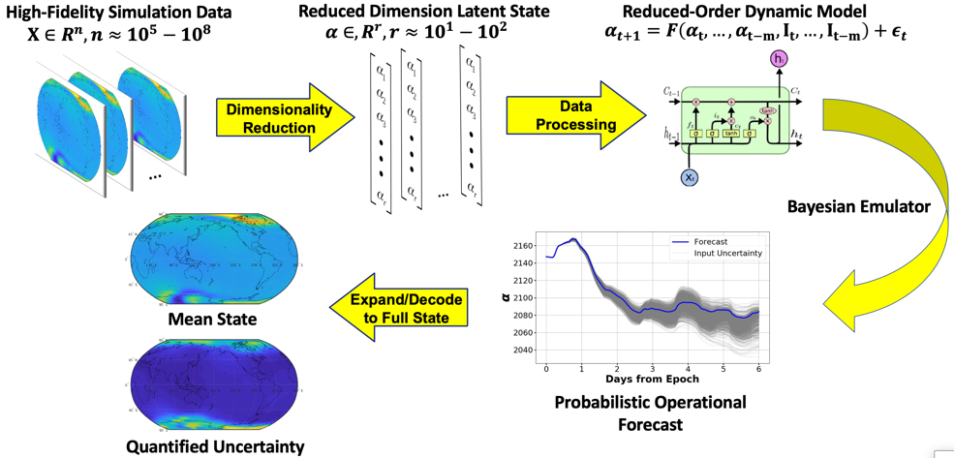
Motivation
Physics-based high-dimensional models are ubiquitous across sciences including space physics and space weather
Computational cost limits contributions to science and operations
Goal: Accelerate physics-based, high-dimensional simulation models
Comprehensive and systematic investigation of the system
Model-data comparison with input uncertainty
Ensemble/Probabilistic forecasts
Support model-data fusion or data assimilation
Large simulated data sets (e.g. for problems with class imbalance)
Approach: exploit simulation data sets
Develop fast emulators
Forecasting model with uncertainty Quantification

Slide 3
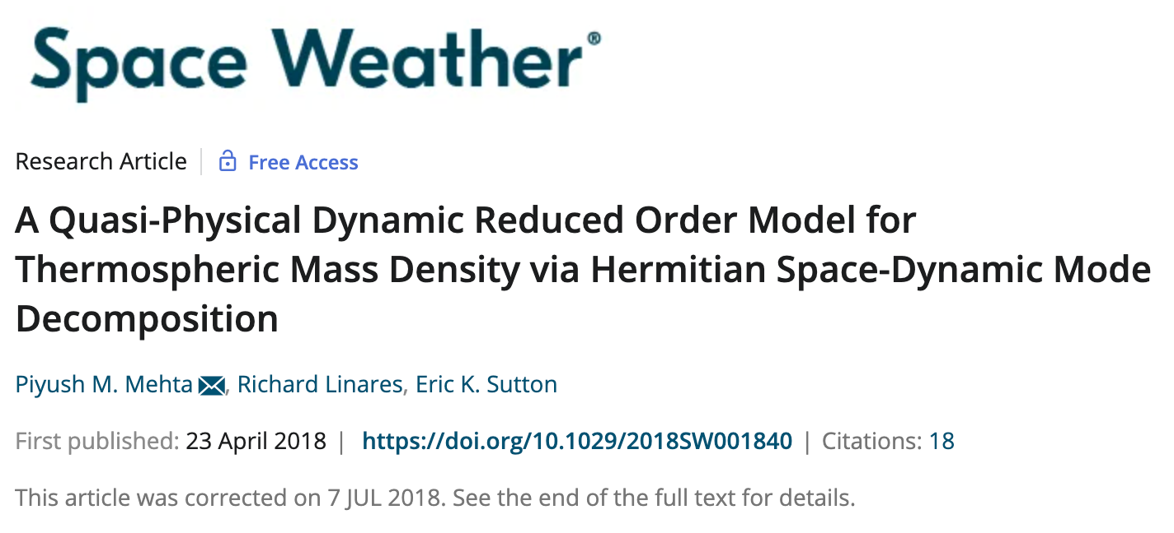
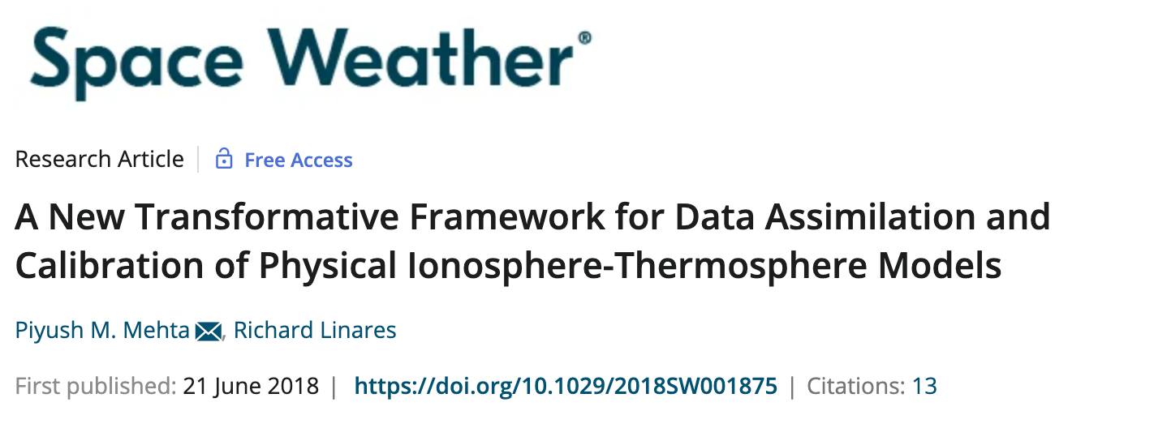
Demonstration: Thermosphere Density
Dimensionality Reduction
Dynamic Model
Principal Component Analysis | Linear state-space model
Autoencoders | LSTM
Linear
$α_{t+1}=Aα_{t}+BI_{t}+ε_{t}$
Nonlinear
$α_{t+1}=F\left(\begin{aligned}α_{t},…,α_{t−m}, \\ I_{t},…,I_{t−m}\end{aligned}\right)+ε_{t}$

Slide 4
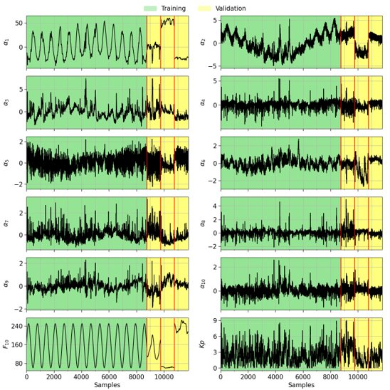
Thermosphere: PCA+LSTM
Global density outputs from TIE-GCM
Simulated input data used for training
Performed PCA to reduce dimensionality
from 7,680 to 10
Train LSTM on simulated data (figure)
Use three 1,000 sample segments for
validation
Storm period (2003)
Low solar activity (2008)
High solar activity (2002)
Use remainder of 1996-2009 as test data

Slide 5
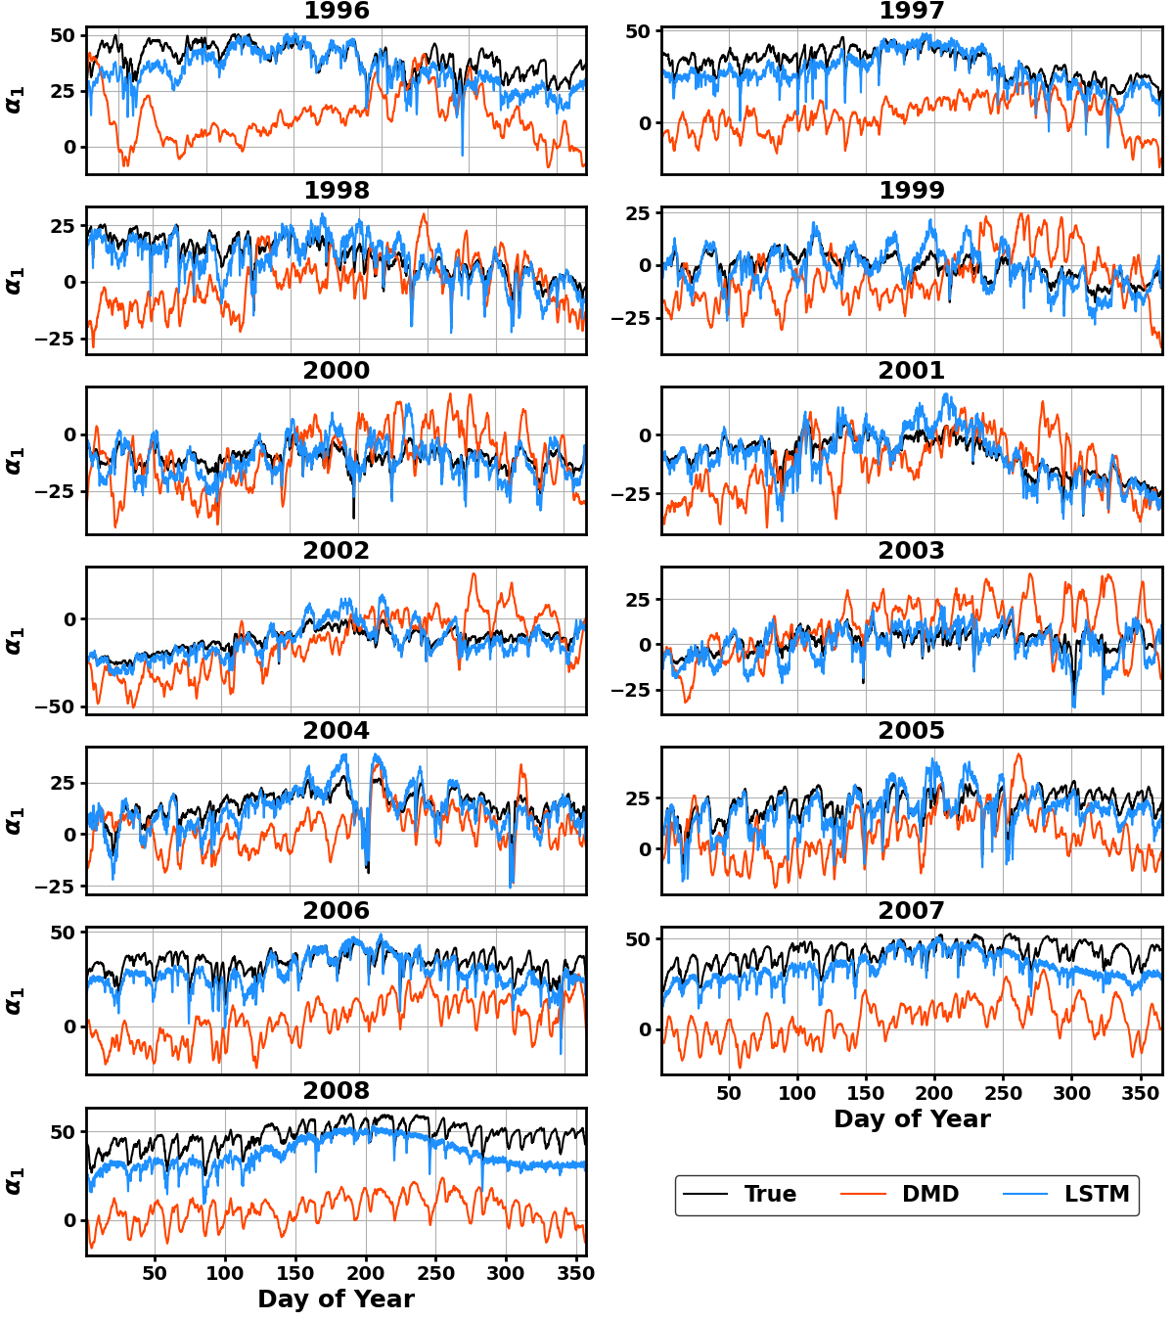
Emulation
LSTM can make dynamic prediction from 1996 to 2009 (111,000+ time steps) with low error
DMD struggles with α₁ during long-term dynamic prediction
DMD: 75.90%
LSTM: 15.59%
LSTM calibration: 5.46%
Can be improved further with hyperparameter tuning

Slide 6
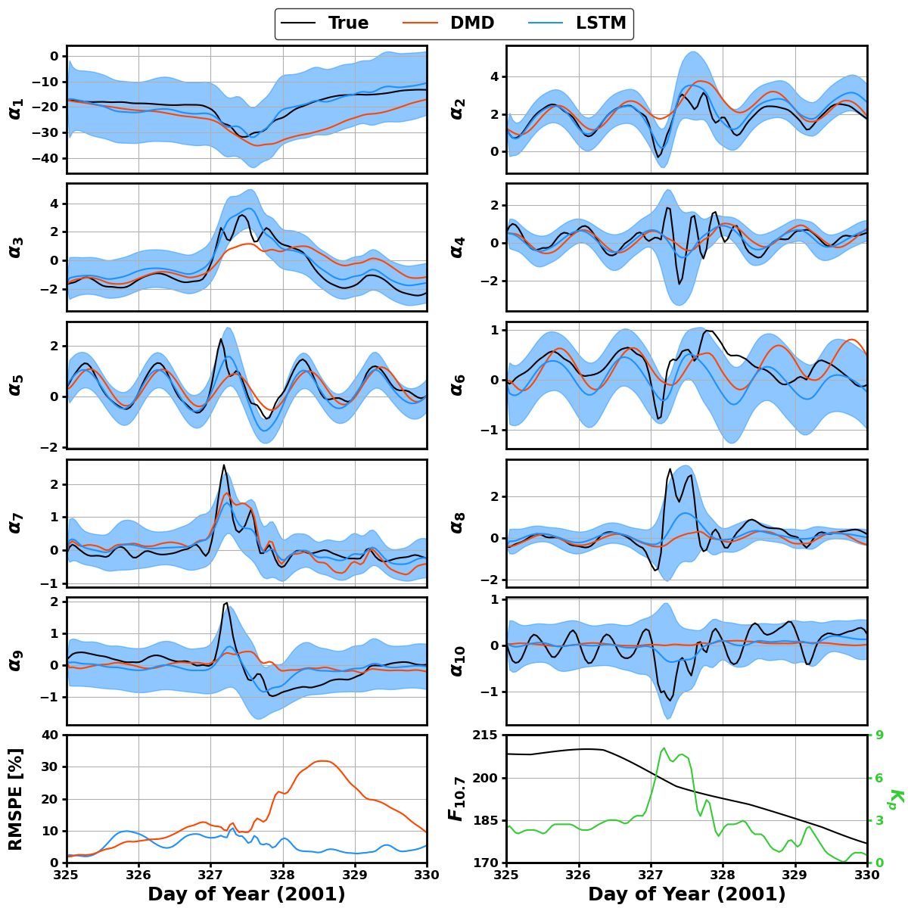
Forecasting
LSTM uses custom loss function to enable robust uncertainty estimation
For storm periods, nonlinear ML model far outperforms linear DMD approach
DMD: 14.23%
LSTM: 5.58%
LSTM calibration: 10.37%
Can be improved further with hyperparameter tuning

Slide 7
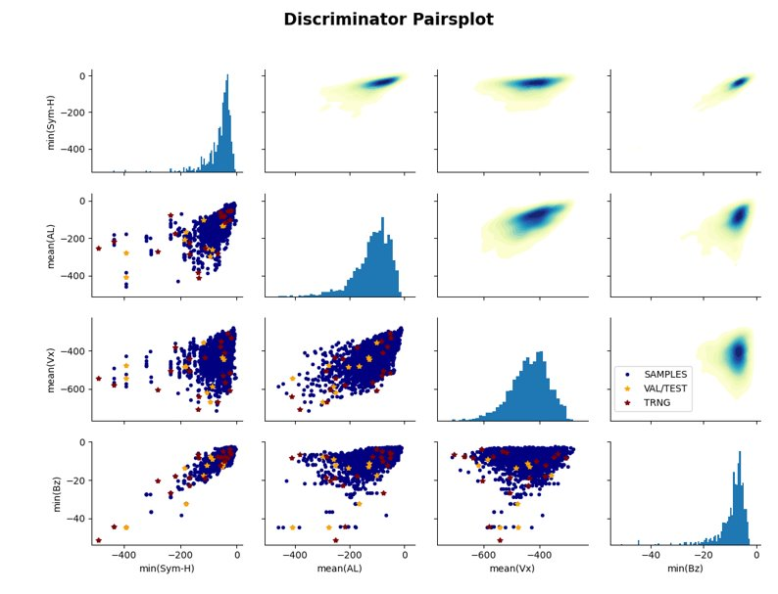
CIMI and RAM-SCB: Data Sampling
OMNIWeb Data
20+ Years (2000-2020)
1-Minute Cadence
Weekly Intervals
Daily Sliding Window
7,664 Intervals Identified
Interval Filters
SW Radial Velocity < 500 km/s
36 hrs of Missing Data
2,839 Candidate Intervals
Sample Statistics
Minimum Sym-H, Mean AL, Mean Vx, Minimum Bz
Linear Discriminator
Stochastic Approach to Sample the Event Space
10 Linear-Spaced Bins per Statistic
Event is Randomly Selected for Each Statistic
Final Selection Made from Pool of 4

Slide 8
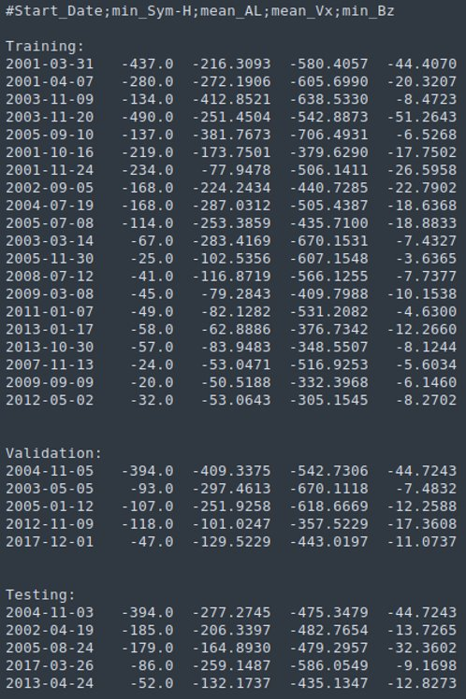
Event Simulations
30 Resulting Events
20 Training (66.67 %)
5 Validation (16.67 %)
5 Testing (16.67 %)
Categorization
Training Data Has Largest Spread in Each Parameter
Each Dataset Contains Varying Conditions
Quiescent Time/Small Storm
Moderate Storm
Large Storm
The simulation database will be made available to community (CIMI simulations currently running)

Slide 9
Omni-Directional Flux
Directional-Differential Flux
(72,35,25,15)
Pitch Angle Distribution (72)
Omni-Directional-Differential Flux
Integration
Trapezoid Rule
RAM-SCB: 0-90 Deg
Computations
Spatial (MLT,R): 25*15 = 375
Epochs: 20*1,008 = 20,160
Energy (E): 35
Total: 20,160*375*35 = 265 M
Increase Speed
Simplified Integration
Vectorized Multiplication
Parallelized Each Epoch
$$j_{omni}=\frac{\int_{0}^{π}{j\left(E,α\right)∗\sin\left(α\right)dα}}{\int_{0}^{π}{\sin\left(α\right)dα}}$$
$$\int_{0}^{π}{\sin\left(α\right)dα}=2 ⟹ j_{omni}=\frac{2 \int_{0}^{π/2}{j\left(E,α\right)∗\sin\left(α\right)dα}}{2}$$
$$≈\sum_{i=2}^{72}{\left[\left(j\left[i\right]∗\sin\left(PA\left[i\right]\right)+j\left[i\text{−}\text{1}\right]∗\sin\left(PA\left[i\text{−}\text{1}\right]\right)\right)∗\left(PA\left[i\right]−PA[i\text{−}\text{1}]\right)\right]}$$

Slide 10
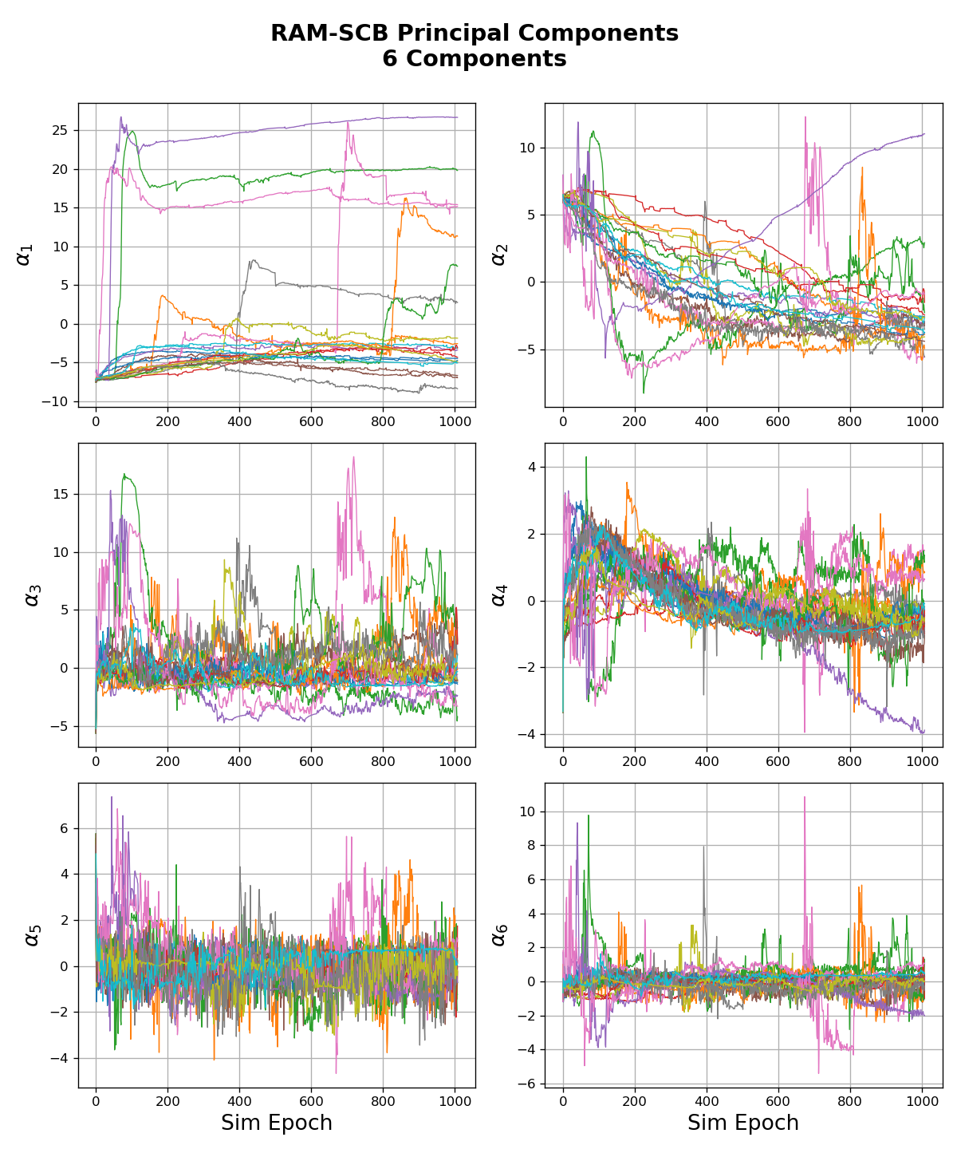
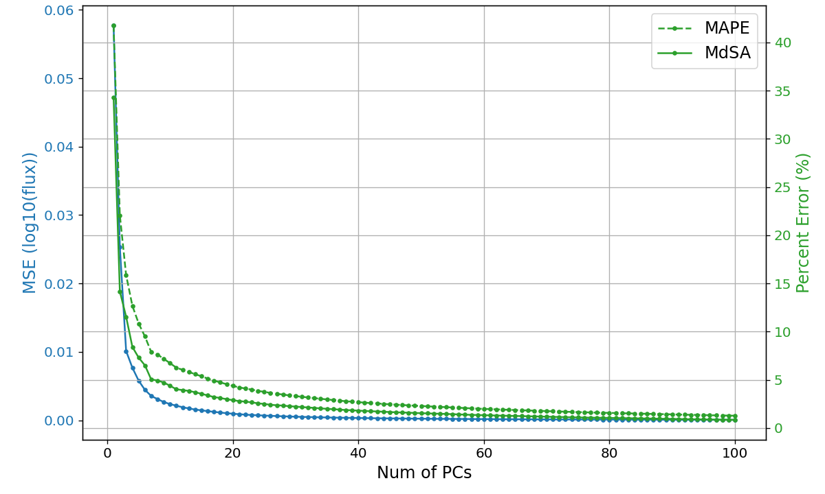
PCA
Dataset
Single Energy: 208 keV
Omni-Dir-Diff Flux
PCA
SVD Formulation
100 PCs

Slide 11
Conclusions
We are seeing promising results towards achieving the goals of fast emulators and dynamic forecasting models with robust and reliable uncertainty quantification.
Want acknowledge NSF and NASA CCMC for supporting these efforts.

