Slide 1









2022 Community Coordinated Modeling Center Meeting
College Park, MD, June 6-10, 2022
Improving Space Weather Predictions with Data-Driven Models of the Solar Atmosphere and Inner Heliosphere
Team members: Nikolai Pogorelov, Tae Kim, Talwinder Singh, Mehmet Yalim
The University of Alabama in Huntsville
Charles N. Arge, Shaela Jones-Mecholsky, Goddard Space Flight Center
Jon Linker, Ronald Caplan, Cooper Downs, Predictive Science Inc.
Phillip Colella, Brian Van Straalen, Lawrence Berkeley National Laboratory
Lisa Upton, Southwest Research Institute
Carl Henney, Air Force Research Laboratory
Students: Dinesh Hegde, Syed Raza

Slide 2
Science Objective Overview
Our science goal is to develop a new software to support data-driven, time-dependent models of the solar atmosphere and heliosphere suitable for near real-time predictions of the SW properties at Earth’s orbit and further in the interplanetary space.
Software components
A new solar magnetic field flux transport model (OFT), which evolves information to the back side of the Sun and its poles and updates the model flux with new observations using data assimilation methods.
A new potential field solver (POT3D) combined with the output from the traditional WSA model, and with remote coronal and in situ solar wind observations. WSA and the new potential field solver (PFSS and PFCS) are being validated using the maps from the new flux transport model. [NOW PUBLICLY AVAILABLE.]
A highly parallel, adaptive mesh refinement (AMR) solver for the Reynolds-averaged, ideal MHD equations describing the solar wind flow in the region between R = 10−20×R⊙ and 1–3 au. These equations are accompanied by the equations describing the transport of turbulence. We are building on the Multi-Scale Fluid-Kinetic Simulation Suite (MS-FLUKSS) collaboratively developed at UAH using the Chombo AMR framework (Colella et al., 2007). The new version of our software (HelioCubed) is being built on a newly developed Chombo 4 framework and allow us to perform simulations with the fourth order of accuracy in time and space, and use cubed spheres to generate meshes around the Sun.
New algorithms to track exactly the surfaces that passively propagate with the SW (heliospheric current sheet, CME driving surface, etc.) once their initial position at the inner boundary is known.

Slide 3
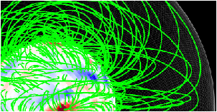
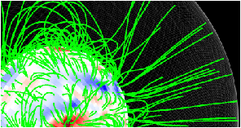
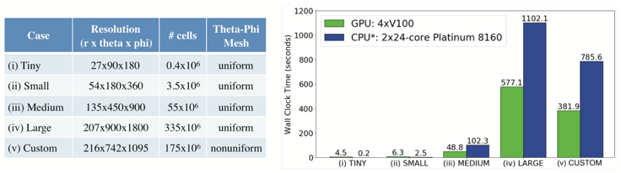
POT3D – Open Source Potential Field Solver
POT3D is a high performance Fortran-90 MPI code that solves Laplace's equation using finite differences on a non-uniform spherical grid. IT has been ported to GPUs using OpenACC.
A paper describing POT3D (Caplan et al. 2021) is published in ApJ.
The code is open source (https://github.com/predsci/POT3D) and is also part of the SPEC beta version of the SPEChpc™2021 benchmark suites (https://www.spec.org/hpc2021).
Potential Field
(Closed Wall)
Potential Field
(Source Surface)

Slide 4
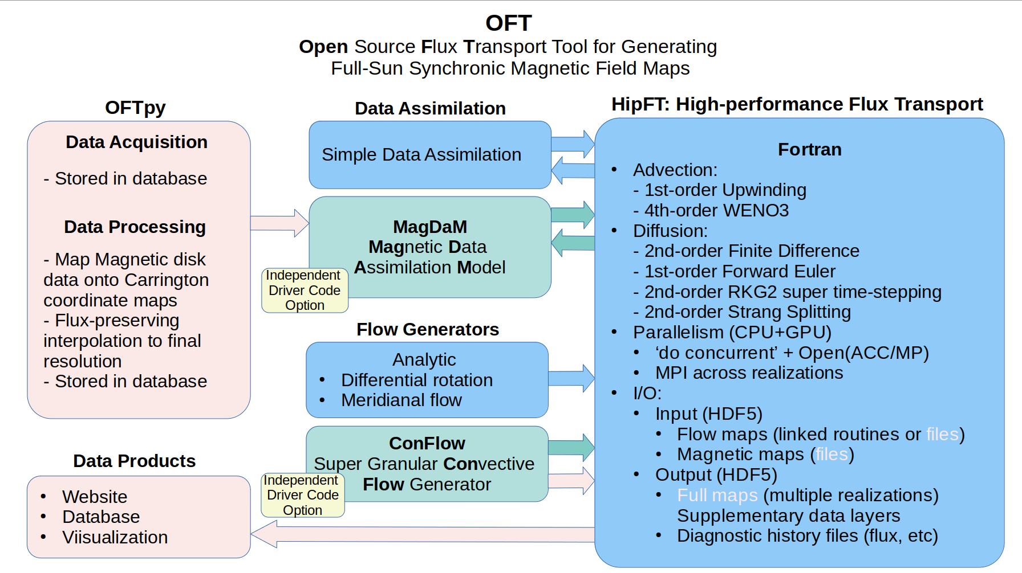
OFT is being built upon AFT (Upton & Hathaway, 2014+) and ConFlow (Hathaway, 2010).

Slide 5
Components of OFT
Data Acquisition and Processing: OFTpy
Assimilation of magnetograms from solar observatories is the key input to flux transport models. We have developed OFTpy, a python codebase that facilitates acquisition and processing of data products to a computation-ready format for HipFT. The current code supports full processing of JSOC HMI M720s line-of-sight (LOS) magnetograms to a radial-ux Carrington Rotation (CR) Map. This extensible software will also serve as a prototype/example for future users to incorporate magnetograms from alternative observatories. In future iterations, we plan to expand capabilities to include NSO GONG LOS magnetograms, and HMI vector magnetograms.
On the left: An HMI 720s magnetogram, observed on 2012/01/15 00:59:52, converted to radial flux and projected into Carrington Coordinates with OFTpy. We are presently comparing this mapping to a map-ping product developed by the Stanford team for use by ADAPT.

Slide 6
2. High-performance Flux Transport: HipFT
The PSI team performed several validation tests for HipFT, both quantitative and qualitative. It has implemented the Strang splitting, which made it possible to obtain the second order of accuracy in time for both advection and diffusion operators. The order of accuracy is 2 for the diffusion and 1 for advection operators now. However, by introducing a WENO3 scheme the order of accuracy in space will also reach 2.
As a qualitative test, we compared running HipFT on a magnetic map derived from observations with differential rotation and meridianal flow profiles, as well as a 500 km²/s diffusion coefficient for 28 physical simulation days. We then compared this result with the same simulation performed with the established AFT model, and the two results were qualitatively very similar as shown below.

Slide 7
The snapshots are shown of a 2.5 year run of HipFT (with differential rotation and meridional flows) that starts with a zero-valued blank map, and assimilates HMI data every 2 hours. We show the results on 9.5, 349.5, 694.5, and 874.5 days with and without diffusion of 200 km²/s. The runs were preformed using a single NVIDIA RTX 2080 Ti GPU and took ∼ 33 minutes and ∼ 12 minutes with and without diffusion respectively.

Slide 8
3. SuperGranular Convective Flow: ConFlow
Typically, SFT models use a diffusion coefficient to account for the mixing that occurs from the turbulent convective motions. This diffusion coefficient causes the magnetic flux in active regions to weaken and spread out uniformly. The AFT model is unique in that it explicitly models the turbulent surface flows produced by convection (Hathaway et al., 2010).
Thanks to David Hathaway and building on the experience of using ConFlow by Lisa Upton, the team is building an open-source version of this code. While not initially included in our proposal, the addition of the ConFlow simulation will add tremendous value and realism to our final OFT product.

Slide 9
Merging POT3D with the WSA model.
We performed comparison between the original WSA & POT3D coronal solutions for the magnetic field and solar wind speed. WSA predicts SW speed and interplanetary magnetic field (IMF) polarity anywhere in the inner heliosphere. It also provides inner boundary conditions for several advanced MHD solar wind models such the UAH MS-FLUKSS.
Advantageous of POT3D are the following: (1) it is designed to run on the latest high-performance platforms (e.g., GPUs), (2) flexible grid; and (3) rapid generation of ultra-high resolution coronal magnetic field solutions.
It has been shown that the SH coronal magnetic field solution and POT3D’s are virtually identical
There is only a 3% difference in the field polarity assignment between the two models over the entire
360◦ × 180◦ grid, as well as an RMS of the signed magnetic field values of only 5.49 nT. The field
strength over the surface of the map is relatively uniform with an average magnitude of roughly
122 nT.

Slide 10
How MS-FLUKSS Works
Boundary conditions from different sources can be loaded, MS-FLUKSS (and the code being developed) interpolates them in space and time to fit its own grid
Adaptive mesh refinement and dynamic load balancing
Reynolds-averaged MHD equations with collisional source terms and turbulence models
Saving solution on the fly along existing spacecraft trajectories, at Earth and other planets.
Parallel HDF5 for efficient saving of AMR data.
The new codes will be released under Apache-2.0 license

Slide 11
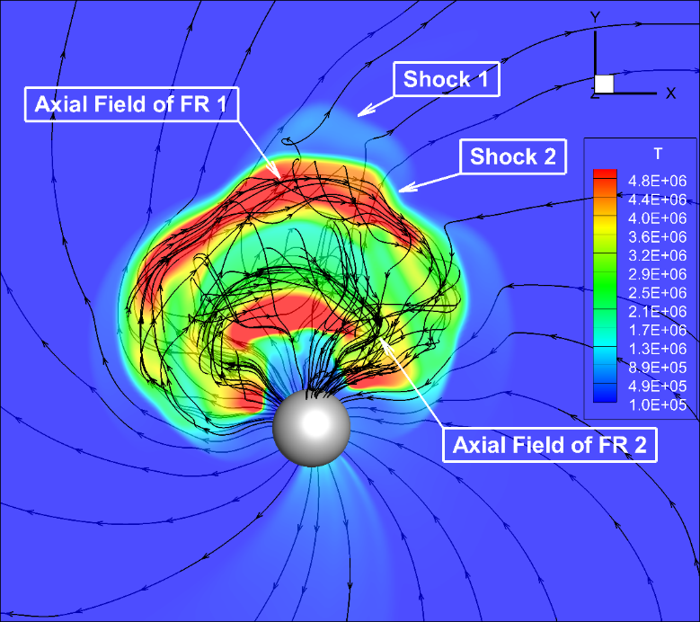
MS-FLUKSS applications
Clockwise: (i) comparison of turbulence models with Voyager data; (ii) interaction of two CMEs; (iii) CME shock surface colored by the fast magnetosonic Mach number

Slide 12
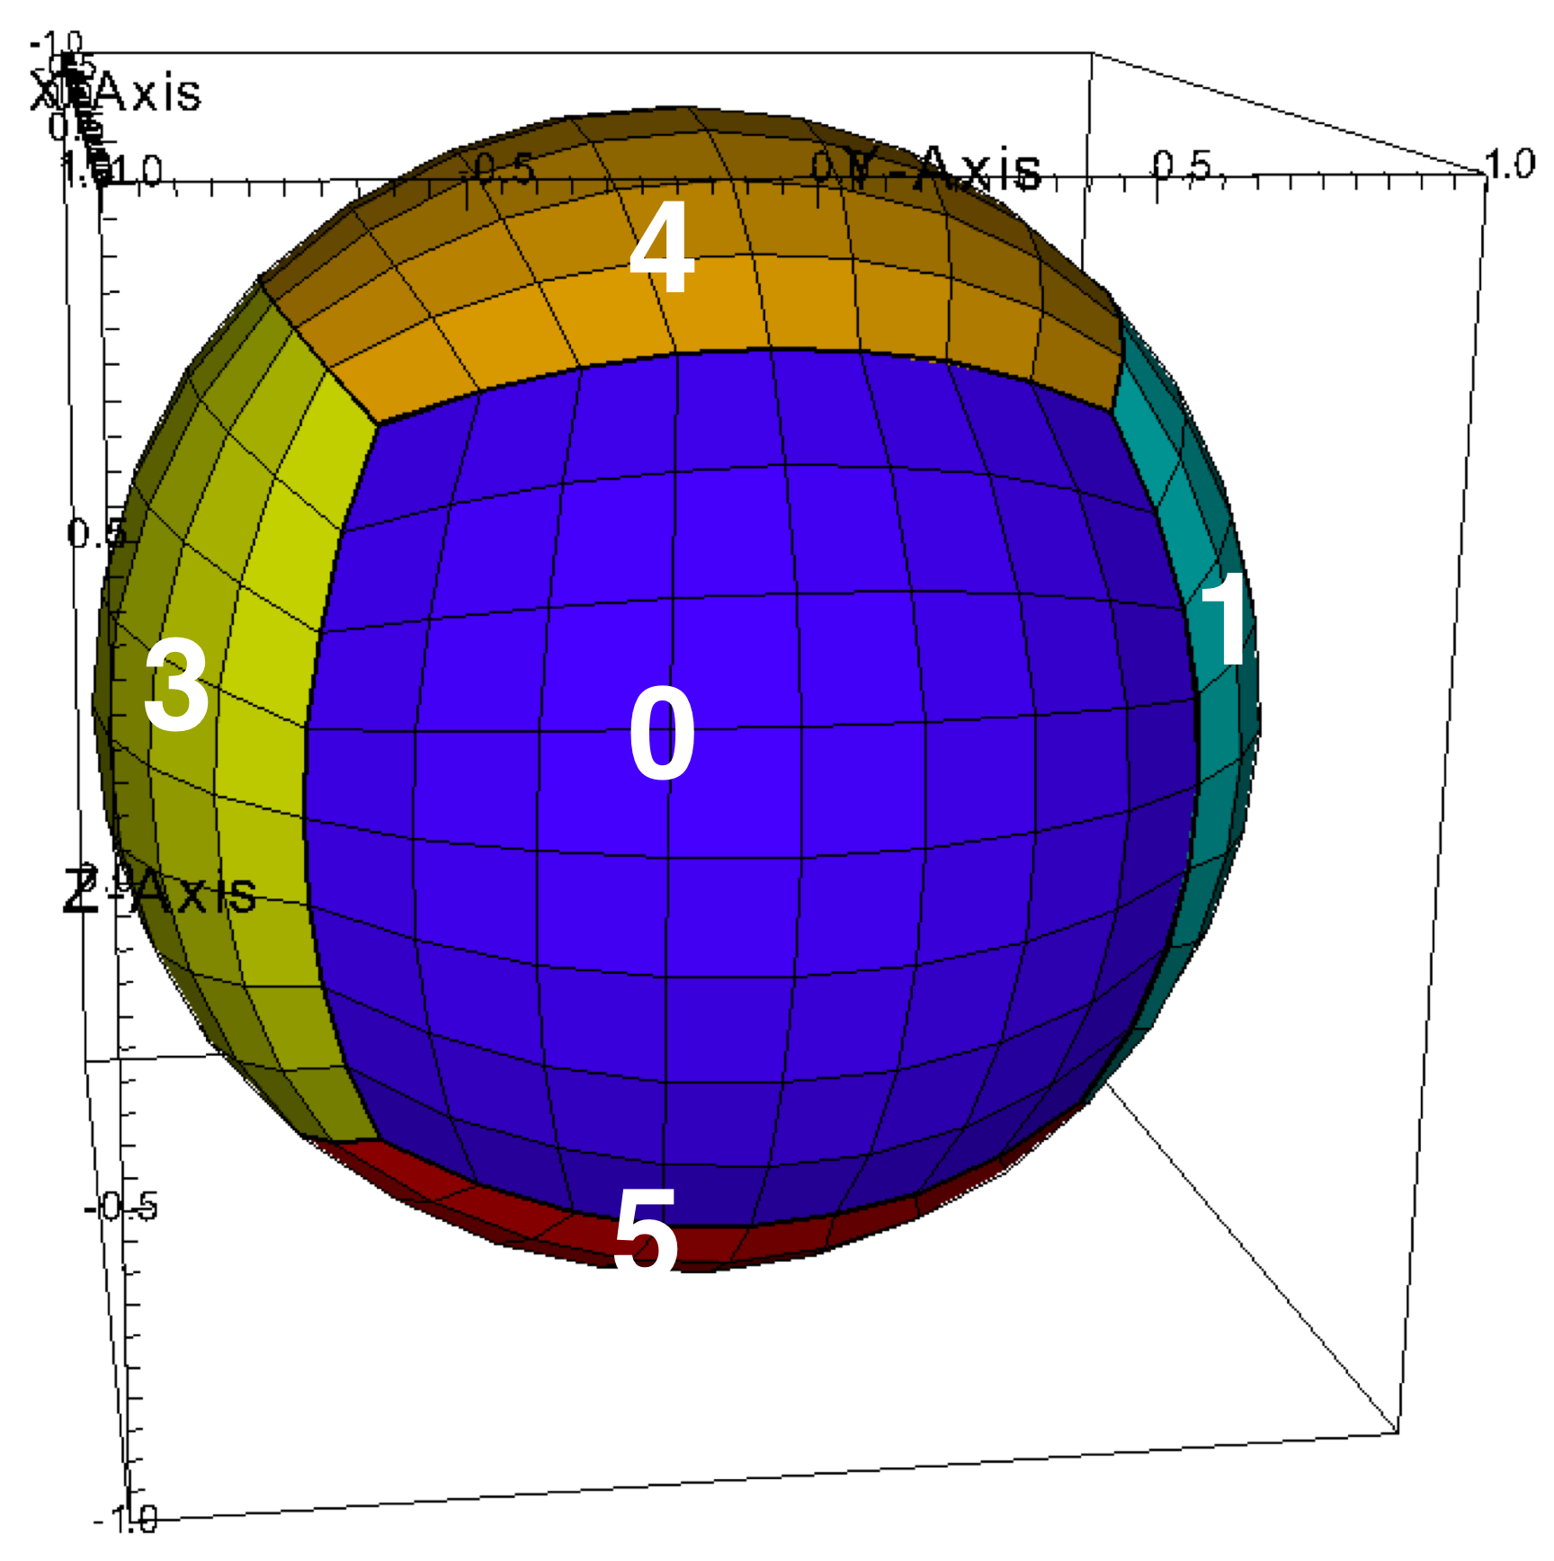
HelioCubed: A Next-Generation Model Using Mapped-Multiblock Grids
and Heterogeneous Processors
Mapped Multiblock Grids
Representation of spherical geometry using a conforming cubed-sphere mapping of spherical shells eliminates pole singularity.
Fourth-order accurate finite-volume method for MHD.
Basis for structured-grid AMR.
Performance Portable C++ Abstraction Library
Structured-grid algorithms for PDE expressed as a composition of high-level abstractions: stencils, pointwise operations applied to data on a rectangle.
Proto library developed under DOE Exascale Computing Project support provides a highly productive programming environment for implementing such algorithms.
Retargeted implementations of Proto provides performance portability across different architectures, including multicore and heterogeneous (e.g. GPU) systems, without any changes to user-level code.
Software Engineering Methodology
Code verification: unit testing, convergence studies on benchmark problems, integrated into a regression testing framework.
Workflow management for code validation, parameter sweeps for uncertainty quantification.
Notes:
Motivated by the White House National Space Weather Strategy and Action Plan and the National Strategic Computing Initiative, NSF and NASA created the Space Weather with Quantified Uncertainties program. The program brings together teams from across scientific disciplines to advance the latest statistical analysis and high-performance computing methods within the field of space weather modeling. The products of these awards will enable the operational organizations to improve operational models and space weather predictions.
All software developed as a result of this award will be made available by the awardee free of charge for non-commercial use; codes widely available to be used and further improved upon by the global space weather modeling community as physics/data assimilation improve

Slide 13
4th order finite volume method For MHD
We use finite volume method to solve hyperbolic MHD equations in conservative form with 4th order of accuracy in space and time (for non-linear problems).
The average values of primitive variables are calculated on R and L side of the faces with 4th order accuracy and a Reimann problem solver is used to find the 4th order accurate fluxes through these faces.
The 4th order accurate RK4 method is used to integrate the equations with time.
Limiters specially designed for the 4th order accurate methods are used.
We have deployed both CPU and GPU execution of Proto using CUDA on NVIDIA GPU architectures and using HIP on AMD GPU architectures. The CUDA version has been optimized for the NVIDIA Tesla processor (v100) and has also been deployed on the newer Ampere graphics processor (A100).
We have also implemented linear and non-linear dissipation methods to suppress oscillations and retain smooth solutions with fourth-order accuracy in space. HDF5 support has been added to Proto. The radial flow will be exactly preserved on mapped grids.
We use the WSA predictive metric to objectively rank HelioCubedmodel predictions when using an ensemble of photospheric magnetic field input maps.

Slide 14
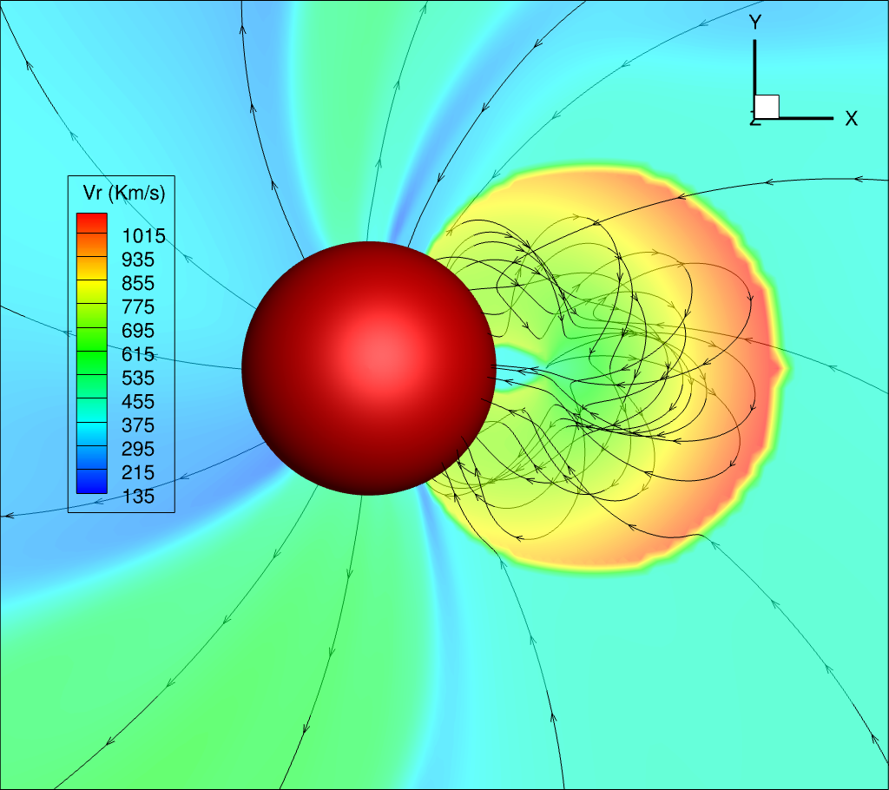
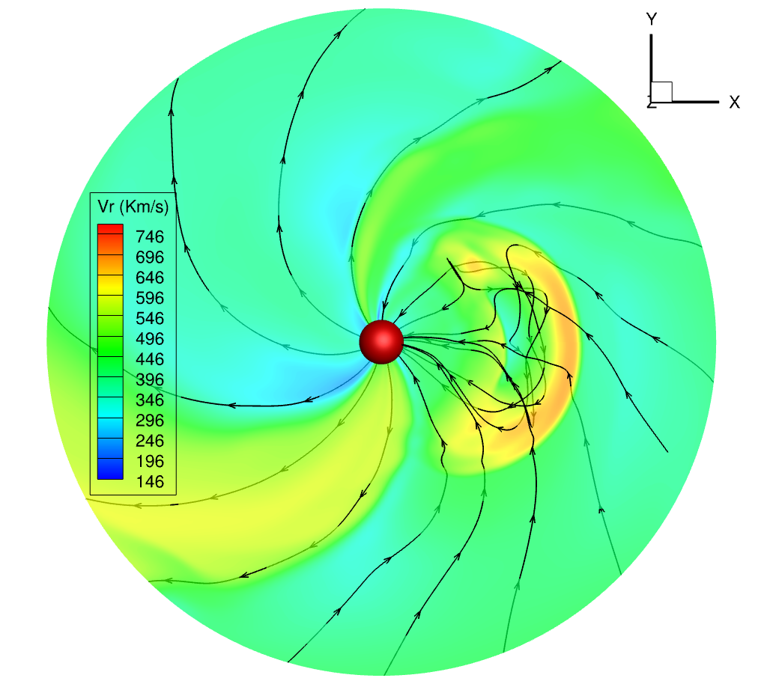
CME simulations with a constant turn model
This flux rope-based model (Isavnin, 2017; Vandas & Romashts, 2017) can be used to simulate CMEs in the inner heliosphere.
A croissant-shaped flux rope can be initialized with the desired direction, tilt, half angle, aspect ratio, and speed. All these parameters can be estimated using a graduated cylindrical shell model.
This model also allows us to initialize the poloidal and toroidal magnetic fluxes as well as the direction of their twist can be initialized in this model. These values can be estimated from the source active regions at the Sun using various observations.
The initial structure of the constant turn flux rope model
The flux rope 30 hours after the initial insertion
Singh et al 2022, in press

Slide 15
Using quantified uncertainties for ensemble modeling of CMEs
Flux-rope-based magnetohydrodynamic modeling of
coronal mass ejections (CMEs) is a promising tool for prediction of the CME arrival time and magnetic field at Earth. In Singh et al. (2022), we introduced a constant-turn flux rope model and used it to simulate the 12-July-2012 16:48 CME in the inner heliosphere. We constrained the initial parameters of this CME using the graduated cylindrical shell (GCS) model and the reconnected flux in post-eruption arcades. We correctly reproduced all the magnetic field components of the CME at Earth, with an arrival time error of approximately 1 hour.
We further estimated the average subjective uncertainties in the GCS fittings, by comparing the GCS parameters of 56 CMEs reported in multiple studies and catalogs. Using these, we have created 77 ensemble members for the 12-July-2012 CME. We found that 55% of our ensemble members correctly reproduce the sign of the magnetic field components at Earth. We also determined that the uncertainties in GCS fitting can widen the CME arrival time prediction window to about 12 hours for the 12-July-2012 CME.
By comparing ensemble members with only one parameter different, we found that the uncertainties in longitude and tilt affect the magnetic field values at Earth much more than uncertainties in half angle and aspect ratio.

Slide 16
Conclusion
By introducing a highly-parallelized, CPU-GPU based sequence of OFT-POT3D-WSA-HelioCubed codes, we will able to perform efficient ensemble modeling of the SW flow and improve SWx predictions of CME arrivals and the z-component of B..

