Slide 1
Validating Thermospheric Neutral Density Models using GEODYN’s Precision Orbit Determination
Z.C. Waldron¹, K. Garcia-Sage², E.K. Sutton¹, J.P. Thayer¹, V. Ray¹,
CCMC, and the GEODYN Teams
¹ CU Boulder Space Weather Technology, Research, and Education Center
² NASA Goddard, Space Weather Laboratory, Community Coordinated Modeling Center

Slide 2
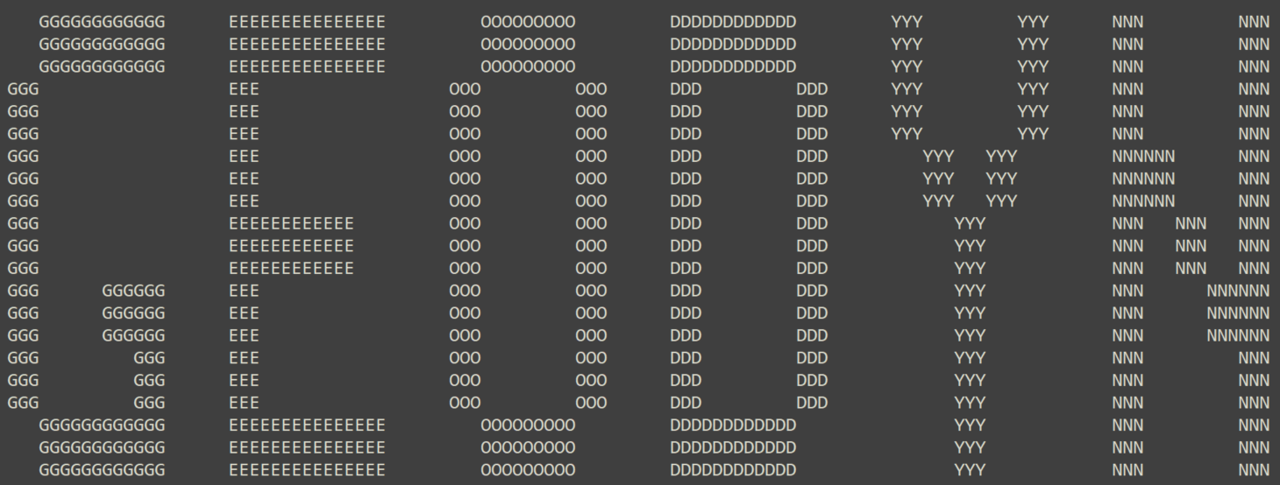
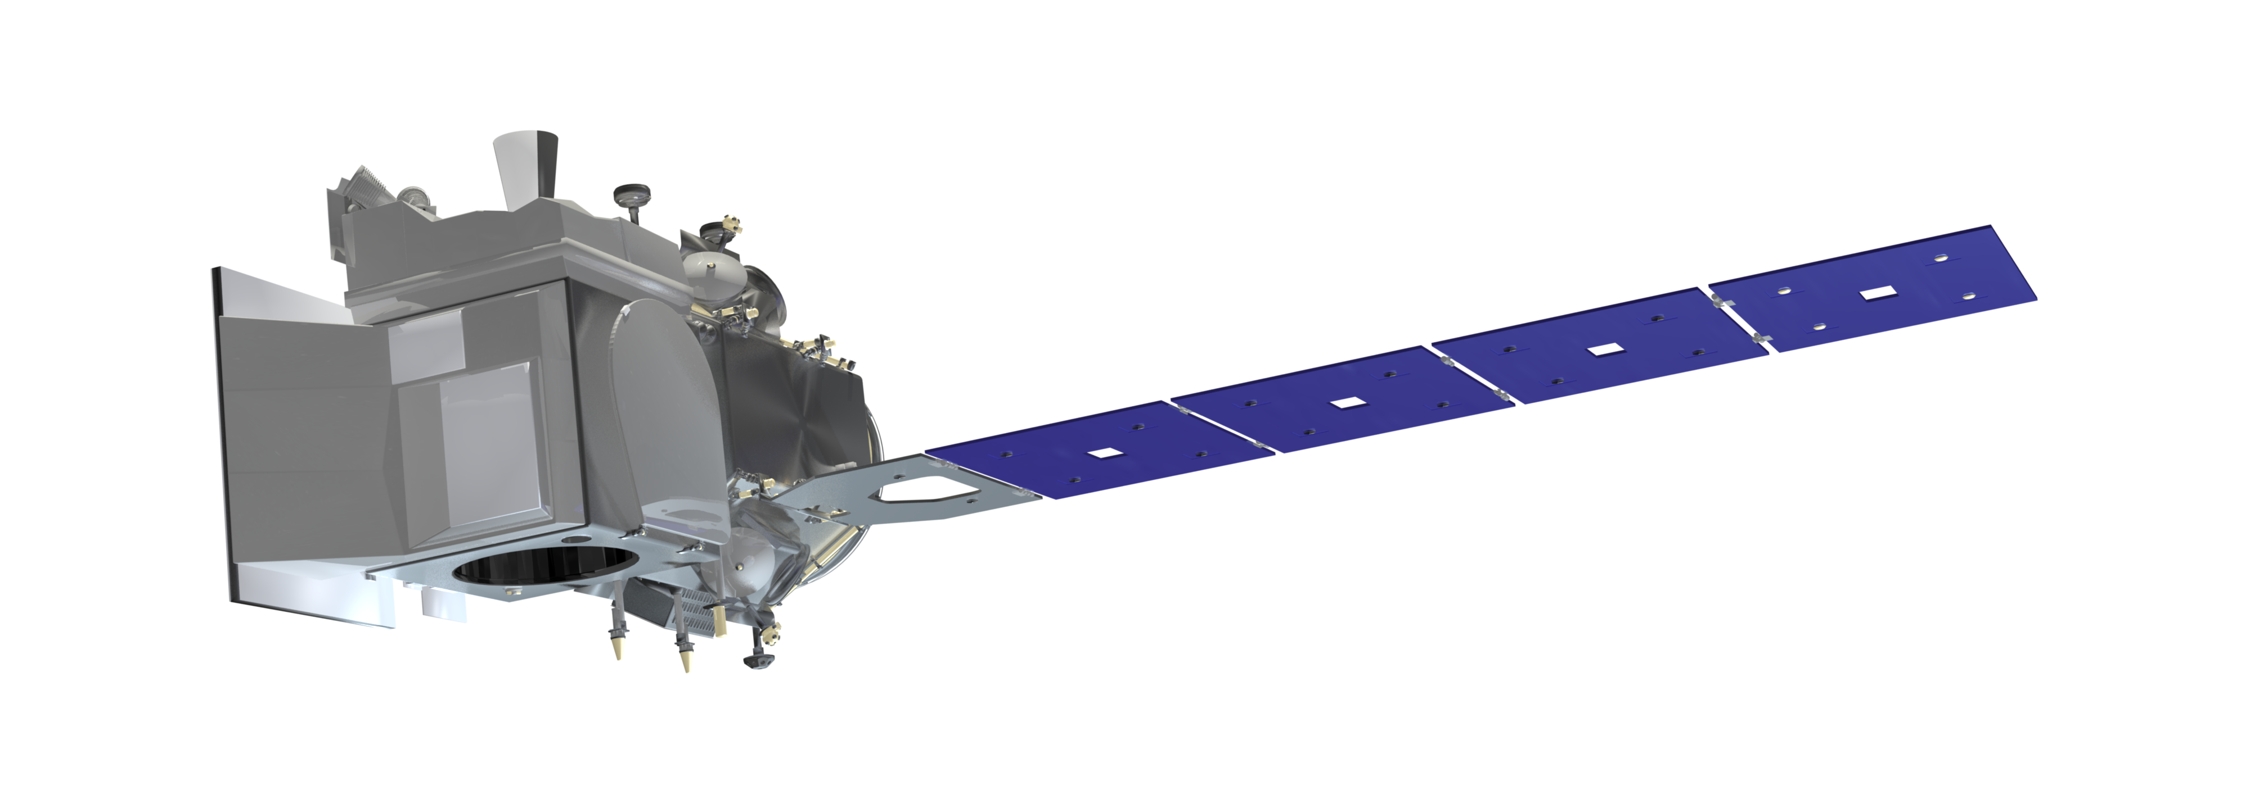
Overview/Goals
Results
Methodology
Ongoing/Future Efforts
Concluding Summary
Project Goals
Develop a methodology and tool that can use GEODYN’s POD to validate upper atmospheric density models
Allow POD program to access many density models while remaining user-friendly
Perform a case-study validation using ICESat-2
Contributors
Space Weather Technology, Research, Education Center (SWx TREC) Gas-Vehicles Interaction Team
CCMC and the Kamodo Team
GSFC Geodesy and Geophysics Laboratory
GEODYN ASCII art from an output file
Image and logo from the ICESat-2 Visualization Gallery

Slide 3
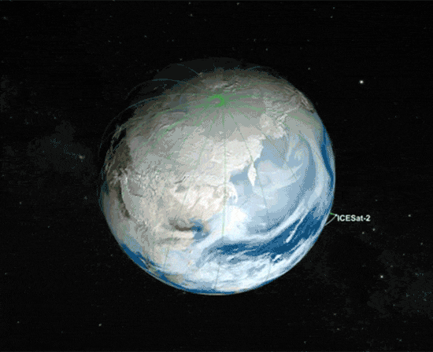
Validation as Motivation
Overview/Goals
Results
Methodology
Ongoing/Future Efforts
Concluding Summary
Leverages the high-precision nature of space geodetic POD, but refashioned to focus on satellite drag and density model validation.
Takes advantage of the global coverage becoming available through other GNSS-enabled satellites
Almost any high-quality POD solution can theoretically be used for density model validation through this new tool
Animated GIF of the ICESat-2’s Polar Orbit from
the ICESat-2 Visualization Gallery

Slide 4
Overview/Goals
Results
Methodology
Ongoing/Future Efforts
Concluding Summary
Step 1: Prepare GEODYN II for drag study using ICESAT-2 input parameters
Step 2: Use different density models to
re-determine the ICESat-2 orbit using GEODYN
Step 3: Perform the Validation
ICESat-2 Mission POD:
Re-determined orbits:
MSIS2
DTM2020
JB2008
HASDM
TIEGCM
CTIPe

Slide 5
Overview/Goals
Results
Methodology
Ongoing/Future Efforts
Concluding Summary
Step 1: Prepare GEODYN II for drag study using ICESat-2 input parameters
Step 2: Use different density models to
re-determine the ICESat-2 orbit using GEODYN
Input
Tracking Data
GEODYN
Output
POD orbit
Input
Setup and Control Files
Key
Select Density Model
Inputs
PCE Tracking Data
Pygeodyn
Python wrapper
Pygeodyn Wrapper
Select density model
GEODYN Program
Outputs
Notes:
POD usually refers specifically to orbit fits whose residuals are below a certain threshold (that’s variable but usually cm level). It could be dynamic POD (based on precise force models) or reduced-order (using empirical accelerations like they do for IceSat2). Since you are not trying to minimize the residuals here, I would just call them orbit fits.

Slide 6
Overview/Goals
Results
Methodology
Ongoing/Future Efforts
Concluding Summary
Step 1: Prepare GEODYN II for drag study using ICESat-2 input parameters
Step 2: Use different density models to
re-determine the ICESat-2 orbit using GEODYN
The GEODYN II Software
Precision orbit determination and geodetic parameter estimation tool
Made by the GSFC Geodesy and Geophysics Laboratory
Used on every NASA geodetic Earth and planetary altimeter mission since 1985.
Provides very high-fidelity conservative and non-conservative force modelling
Input
Tracking Data
GEODYN
Output
POD orbit
Input
Setup and Control Files
Key
Select Density Model
Inputs
PCE Tracking Data
Pygeodyn
Python wrapper
Pygeodyn Wrapper
Select density model
GEODYN Program
Outputs

Slide 7
Overview/Goals
Results
Methodology
Ongoing/Future Efforts
Concluding Summary
Step 1: Prepare GEODYN II for drag study using ICESat-2 input parameters
Step 2: Use different density models to
re-determine the ICESat-2 orbit using GEODYN
The Pygeodyn Wrapper
Makes it easier to use GEODYN for satellite drag studies
Makes it easier to add and run multiple density models
Input
Tracking Data
GEODYN
Output
POD orbit
Input
Setup and Control Files
Key
Select Density Model
Inputs
PCE Tracking Data
Pygeodyn
Python wrapper
Pygeodyn Wrapper
Select density model
GEODYN Program
Outputs

Slide 8
Overview/Goals
Results
Methodology
Ongoing/Future Efforts
Concluding Summary
Step 1: Prepare GEODYN II for drag study using ICESat-2 input parameters
Input
GNSS Tracking Data
Constructed by GEODYN team
Step 2: Use different density models to
re-determine the ICESat-2 orbit using GEODYN
Input
Setup and Control Files
GEODYN
(Empirical accelerations)
Use ICESat-2 POD as PCE Tracking data
Use ICESat-2 POD as PCE Tracking data
ICESat-2 POD Solutions as PCE tracking data
Constructed by GEODYN team
Empirical accelerations are used to fit GNSS tracking data
Very low orbit error at ~1.5cm radial precision
“PCE” = precisely converted elements
orbit trajectory is used as tracking data
GEODYN
Output
POD orbit
Input
Setup and Control Files
Key
Select Density Model
Inputs
PCE Tracking Data
Pygeodyn
Python wrapper
Pygeodyn Wrapper
Select density model
GEODYN Program
Outputs
Notes:
We use the precisely determined orbit trajectories of the Ice, Cloud, and Land Elevation Satellite-2 (ICESat-2) as tracking measurement input to a data-reduction run of GEODYN--- the goal being to assess the ability of different density models to re-determine the orbit of ICESat-2.
We adopt the term precise conversion of elements (PCE) when using known spacecraft trajectories as the tracking measurement type in GEODYN. Therefore, in future sections we sometimes refer to the ICESat-2 POD solutions as the PCE dataset, and refer to the model assessment GEODYN runs in which PCE is the tracking data type and the density models are compared, as model validation runs.

Slide 9
Overview/Goals
Results
Methodology
Ongoing/Future Efforts
Concluding Summary
Step 1: Prepare GEODYN II for drag study using ICESAT-2 input parameters
Key
Inputs
PCE Tracking Data
Step 2: Use different density models to
re-determine the ICESat-2 orbit using GEODYN
Pygeodyn Wrapper
Construct an ICESat-2
POD-based orbit fit using each density model
Semi-empirical models are written directly into the GEODYN source code.
More complex physics-based model outputs are interfaced via Kamodo
Select density model
GEODYN Program
Outputs
Use ICESat-2 POD as PCE Tracking data
GEODYN
Outputs
ICESat-2 POD-based orbit fits for a given density model
Input
Setup and Control Files
Pygeodyn
Python wrapper
Select Density Model
Pygeodyn
Python wrapper
MSIS2
DTM2020
JB2008
HASDM
TIEGCM
CTIPe

Slide 10
Overview/Goals
Results
Methodology
Ongoing/Future Efforts
Concluding Summary
Step 1: Prepare GEODYN II for drag study using ICESAT-2 input parameters
Step 3: Perform the Validation
Step 2: Use different density models to
re-determine the ICESat-2 orbit using GEODYN
Key Assumptions
All parameters other than atmospheric density are held constant
Drag coefficient is fixed at $C_{D}=2.2$
Empirical Accelerations are turned off
Use ICESat-2 POD as PCE Tracking data
GEODYN
Outputs
ICESat-2 POD-based orbit fits for a given density model
Input
Setup and Control Files
Pygeodyn
Python wrapper
Select Density Model
Pygeodyn
Python wrapper
MSIS2
DTM2020
JB2008
HASDM
TIEGCM
CTIPe

Slide 11
Overview/Goals
Results
Methodology
Ongoing/Future Efforts
Concluding Summary
Step 1: Prepare GEODYN II for drag study using ICESAT-2 input parameters
Step 3: Perform the Validation
Step 2: Use different density models to
re-determine the ICESat-2 orbit using GEODYN
Key Assumptions
All parameters other than atmospheric density are held constant
Drag coefficient is fixed at $C_{D}=2.2$
Empirical Accelerations are turned off
Use ICESat-2 POD as PCE Tracking data
For each density model:
$PCE$
“True” Orbit Trajectory
Model’s Orbit Trajectory
Orbital
Residuals
GEODYN
Outputs
ICESat-2 POD-based orbit fits for a given density model
Input
Setup and Control Files
Pygeodyn
Python wrapper
Select Density Model
Pygeodyn
Python wrapper
MSIS2
DTM2020
JB2008
HASDM
TIEGCM
CTIPe

Slide 12
Validation Metrics for Model Densities are the In-track Residuals and the In-Track RMS errors
Overview/Goals
Results
Methodology
Ongoing/Future Efforts
Concluding Summary
In-track Residuals
Drag effects are seen most clearly in the in-track direction
Relative deviations from PCE orbit are treated as a proxy for model densities differing from a true density (unknown)
In-track RMSe
Indicates how well the output orbit matches the PCE orbit over a given arc. The RMSe is the square root of the variance of the residuals.
$$\hat{Z}$$
In-track $\hat{\text{T}}$
tangential to the orbit and always points to the velocity vector $\vec{\text{v}}$
$$\hat{Y}$$
$$\hat{X}$$
$$\hat{T}$$
$$\vec{v},$$
$$\vec{r}$$
$$\hat{W}$$
$$\hat{N}$$
Notes:
for a perfect force model (including perfect densities), residuals are minimized. The PCE dataset does that by using empirical accelerations.
*assumed-true density refers to a POD-based model density whose errors have been compensated for by GEODYN’s dynamically reduced empirical accelerations and dense tracking measurements and is assumed to represent the realistic density along the satellite’s orbit.

Slide 13
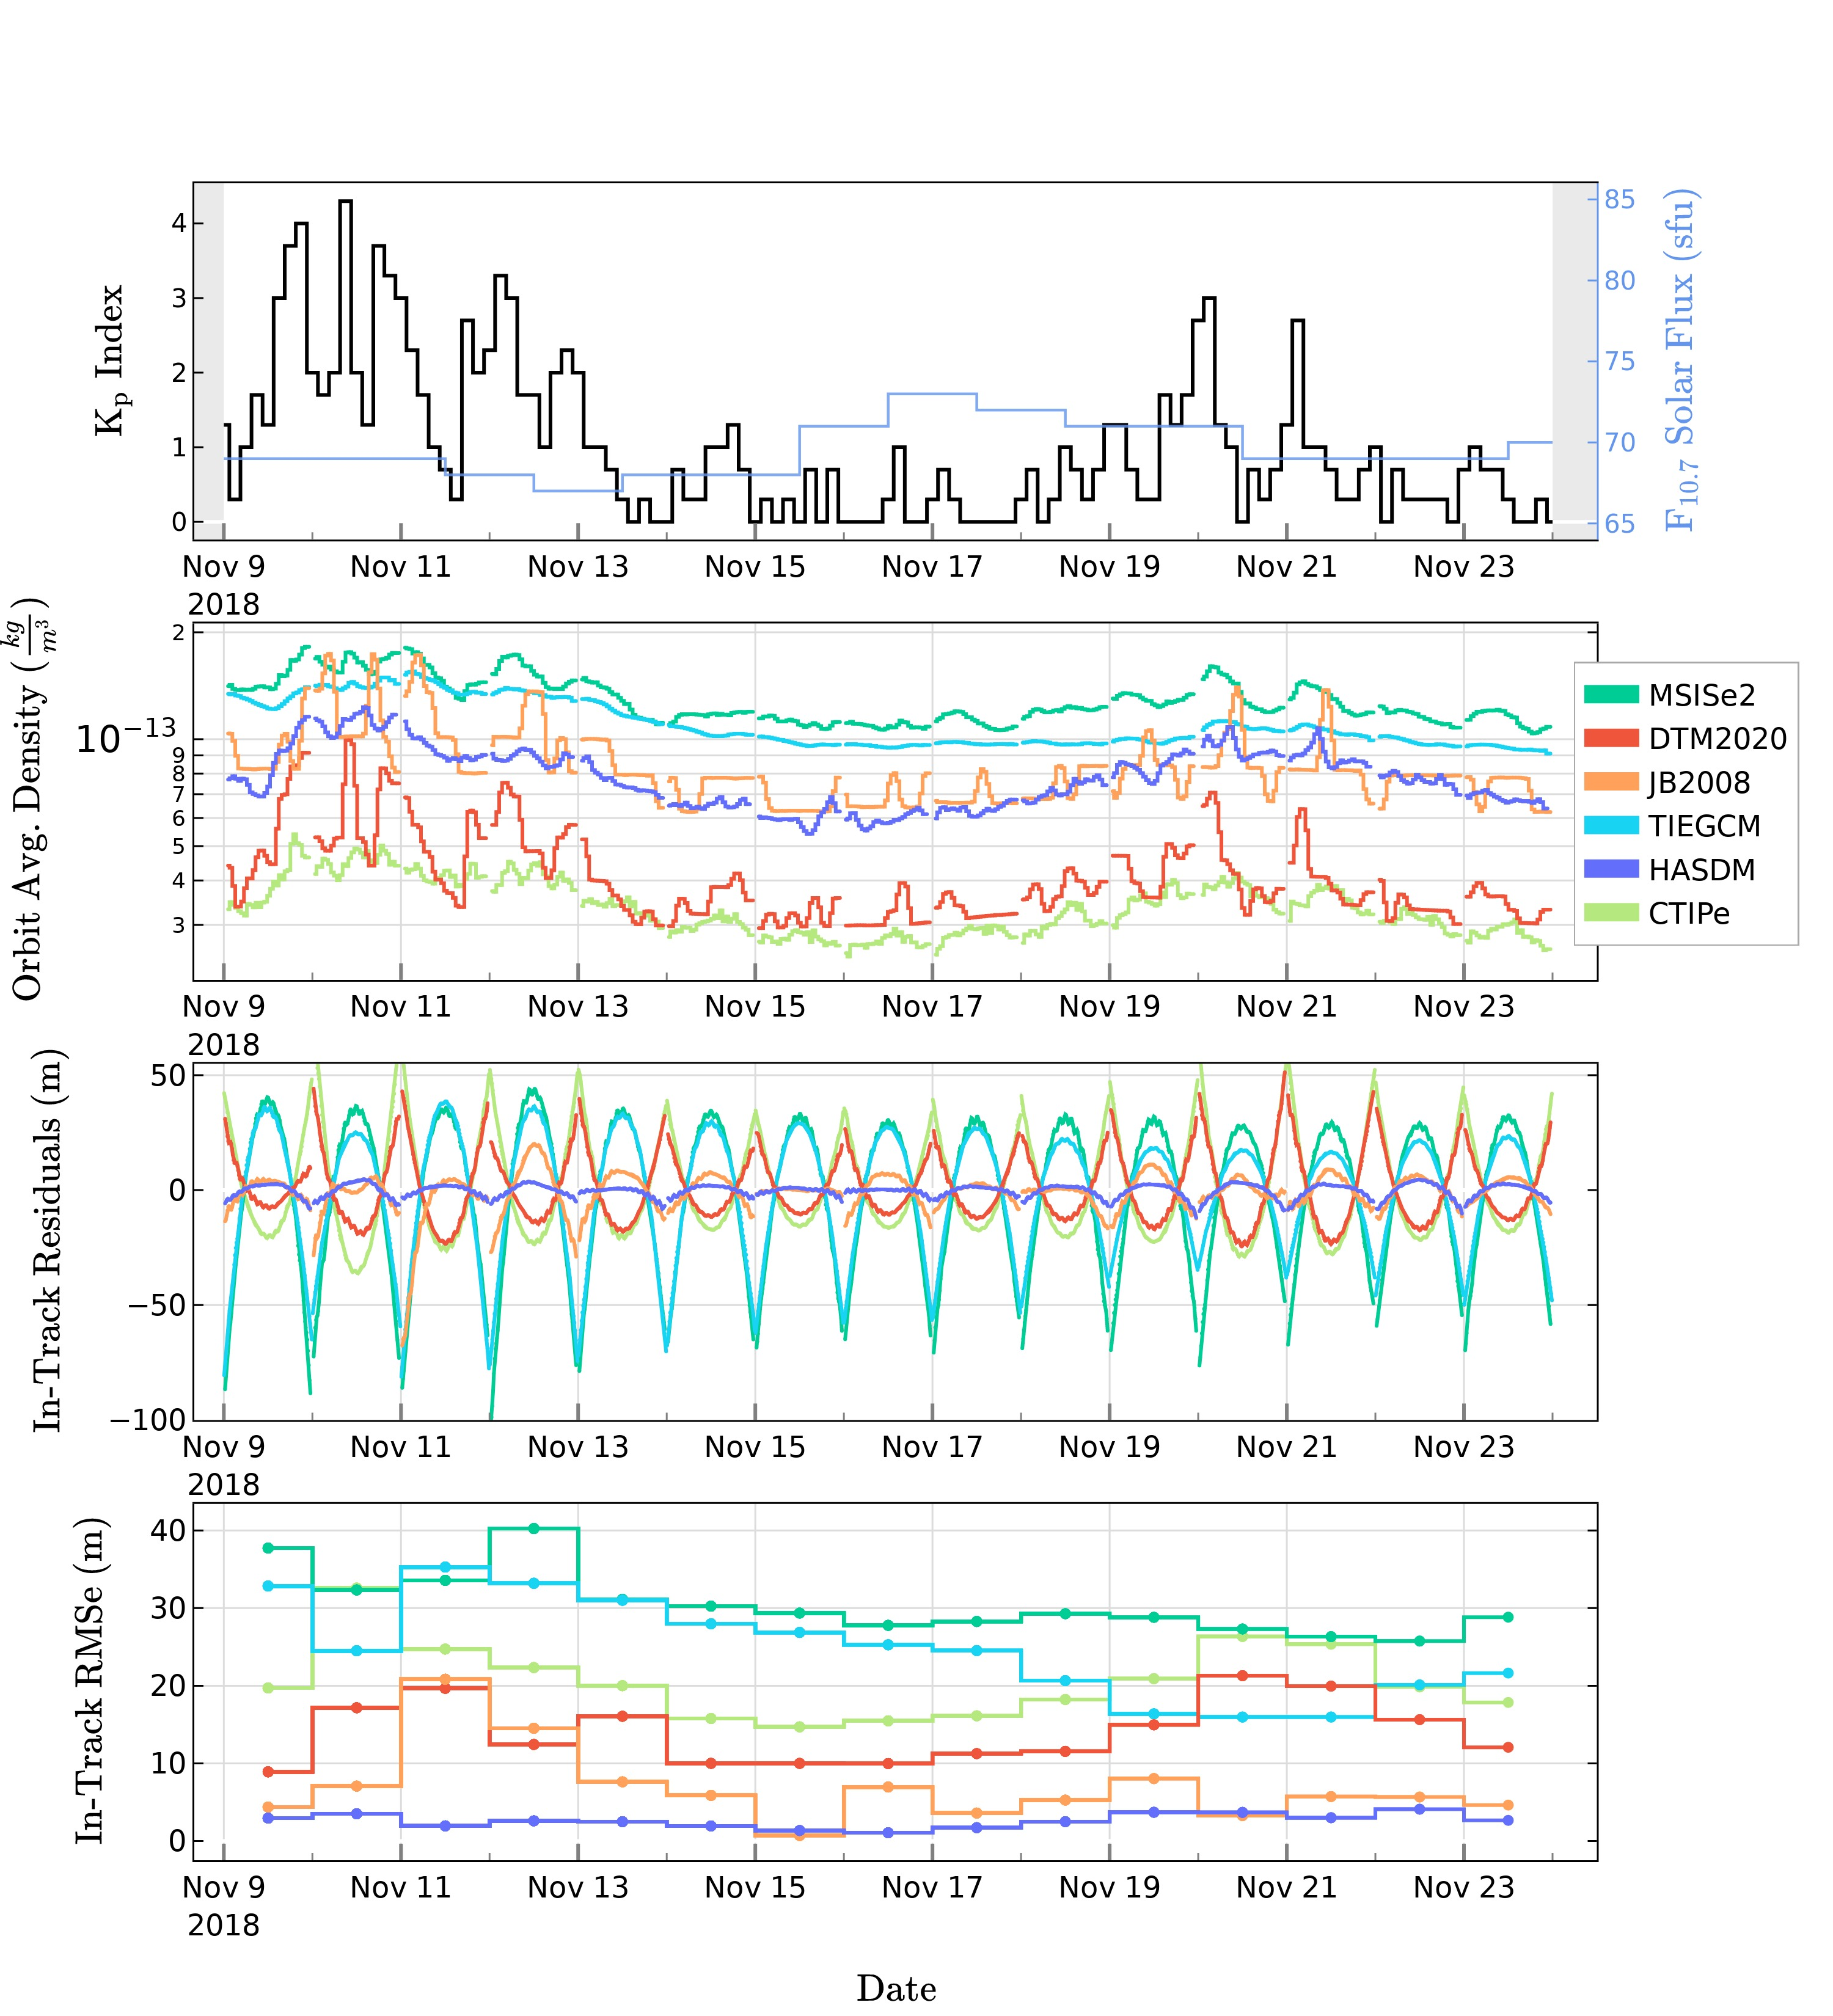
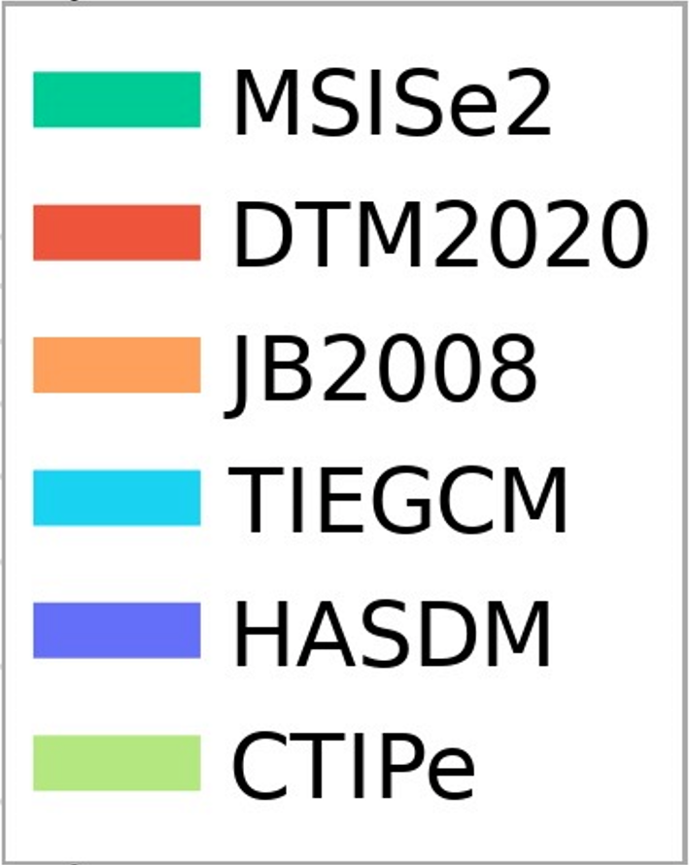
Results and Discussion
Overview/Goals
Results
Methodology
Ongoing/Future Efforts
Concluding Summary
Kp Index
${\text{F}}_{\text{10.7}}$Solar Flux (sfu)
Represents a validation of atmospheric models under the following conditions/assumptions:
Low-to-minor geomagnetic activity, deep solar minimum
ICESat-2 orbit altitude of ~496 km
$C_{D}=2.2$
Method captures large/global scale density variations, of which, drag is most sensitive
Orbit Averaged Density $\text{(}\text{kg}\text{/}{\text{m}}^{\text{3}}\text{)}$
In-Track
Residuals $\text{(}\text{m}\text{)}$
In-Track
RMSe $\text{(}\text{m}\text{)}$
Date

Slide 14
Results and Discussion
Overview/Goals
Results
Methodology
Ongoing/Future Efforts
Concluding Summary
Orbit Averaged Density $\text{(}\text{kg}\text{/}{\text{m}}^{\text{3}}\text{)}$
Represents a validation of atmospheric models under the following conditions/assumptions:
Low-to-minor geomagnetic activity, deep solar minimum
ICESat-2 orbit altitude of ~496 km
$C_{D}=2.2$
Method captures large/global scale density variations, of which, drag is most sensitive
In-Track
Residuals $\text{(}\text{m}\text{)}$
In-Track
RMSe $\text{(}\text{m}\text{)}$
Date

Slide 15
Results and Discussion
Overview/Goals
Results
Methodology
Ongoing/Future Efforts
Concluding Summary
Orbit Averaged Density $\text{(}\text{kg}\text{/}{\text{m}}^{\text{3}}\text{)}$
Represents a validation of atmospheric models under the following conditions/assumptions:
Low-to-minor geomagnetic activity, deep solar minimum
ICESat-2 orbit altitude of ~496 km
$C_{D}=2.2$
Method captures large/global scale density variations, of which, drag is most sensitive
In-Track
Residuals $\text{(}\text{m}\text{)}$
$$PCE−Model Orbit$$
Majority of the error and variations should be due to drag
In-Track
RMSe $\text{(}\text{m}\text{)}$
Date
Notes:
Re-iterate the overall steps and why this works given that the Empirical accelerations were used to account for CD/Force model errors in the original POD

Slide 16
Results and Discussion
Overview/Goals
Results
Methodology
Ongoing/Future Efforts
Concluding Summary
Orbit Averaged Density $\text{(}\text{kg}\text{/}{\text{m}}^{\text{3}}\text{)}$
Represents a validation of atmospheric models under the following conditions/assumptions:
Low-to-minor geomagnetic activity, deep solar minimum
ICESat-2 orbit altitude of ~496 km
$C_{D}=2.2$
Method captures large/global scale density variations, of which, drag is most sensitive
In-Track
Residuals $\text{(}\text{m}\text{)}$
$$PCE−Model Orbit$$
Majority of the error and variations should be due to drag
In-Track
RMSe $\text{(}\text{m}\text{)}$
Relative deviations from PCE orbit are treated as a proxy for model densities differing from a true density (unknown)
Date

Slide 17
Results and Discussion
Overview/Goals
Results
Methodology
Ongoing/Future Efforts
Concluding Summary
Orbit Averaged Density $\text{(}\text{kg}\text{/}{\text{m}}^{\text{3}}\text{)}$
Represents a validation of atmospheric models under the following conditions/assumptions:
Low-to-minor geomagnetic activity, deep solar minimum
ICESat-2 orbit altitude of ~496 km
$C_{D}=2.2$
Method captures large/global scale density variations, of which, drag is most sensitive
In-Track
Residuals $\text{(}\text{m}\text{)}$
Not all deviations in the residuals are due to density, so this is a relative metric rather than absolute
$$PCE−Model Orbit$$
Majority of the error and variations should be due to drag
In-Track
RMSe $\text{(}\text{m}\text{)}$
Relative deviations from PCE orbit are treated as a proxy for model densities differing from a true density (unknown)
Date
Notes:
Relative metric rather than absolute
Non-drag errors from mismodeled physics are present, but these are minimized and controlled for in inter-comparison runs.

Slide 18
Results and Discussion
Overview/Goals
Results
Methodology
Ongoing/Future Efforts
Concluding Summary
Orbit Averaged Density $\text{(}\text{kg}\text{/}{\text{m}}^{\text{3}}\text{)}$
Represents a validation of atmospheric models under the following conditions/assumptions:
Low-to-minor geomagnetic activity, deep solar minimum
ICESat-2 orbit altitude of ~496 km
$C_{D}=2.2$
Method captures large/global scale density variations, of which, drag is most sensitive
In-Track
Residuals $\text{(}\text{m}\text{)}$
In-Track
RMSe $\text{(}\text{m}\text{)}$
HASDM outputs densities that are close to the unknown truth, and JB2008 performs the best of the semi-empirical and physics-models
Date

Slide 19
Results and Discussion
Overview/Goals
Results
Methodology
Ongoing/Future Efforts
Concluding Summary
Orbit Averaged Density $\text{(}\text{kg}\text{/}{\text{m}}^{\text{3}}\text{)}$
Represents a validation of atmospheric models under the following conditions/assumptions:
Low-to-minor geomagnetic activity, deep solar minimum
ICESat-2 orbit altitude of ~496 km
$C_{D}=2.2$
Method captures large/global scale density variations, of which, drag is most sensitive
In-Track
Residuals $\text{(}\text{m}\text{)}$
In-Track
RMSe $\text{(}\text{m}\text{)}$
The HASDM densities are closest to the true density (unknown)
Date

Slide 20
Results and Discussion
Overview/Goals
Results
Methodology
Ongoing/Future Efforts
Concluding Summary
Orbit Averaged Density $\text{(}\text{kg}\text{/}{\text{m}}^{\text{3}}\text{)}$
Represents a validation of atmospheric models under the following conditions/assumptions:
Low-to-minor geomagnetic activity, deep solar minimum
ICESat-2 orbit altitude of ~496 km
$C_{D}=2.2$
Method captures large/global scale density variations, of which, drag is most sensitive
In-Track
Residuals $\text{(}\text{m}\text{)}$
The strongly negative in-track residuals of
MSIS2 and TIEGCM
Modeled density to be too high
Causes more drag acceleration
Density model orbit is behind the PCE orbit.
In-Track
RMSe $\text{(}\text{m}\text{)}$
Date

Slide 21
Results and Discussion
Overview/Goals
Results
Methodology
Ongoing/Future Efforts
Concluding Summary
Orbit Averaged Density $\text{(}\text{kg}\text{/}{\text{m}}^{\text{3}}\text{)}$
Represents a validation of atmospheric models under the following conditions/assumptions:
Low-to-minor geomagnetic activity, deep solar minimum
ICESat-2 orbit altitude of ~496 km
$C_{D}=2.2$
Method captures large/global scale density variations, of which, drag is most sensitive
In-Track
Residuals $\text{(}\text{m}\text{)}$
The strongly positive in-track residuals of DTM2020 and CTIPe
Modeled density to be too low
Causes less drag acceleration
Density model orbit is ahead of the PCE orbit
In-Track
RMSe $\text{(}\text{m}\text{)}$
Date

Slide 22
Overview/Goals
Results
Methodology
Ongoing/Future Efforts
Concluding Summary
Ongoing Efforts and Future Work
Implementing a physical CD model into GEODYN such that a density scaling factor can be extracted
Add more models: GITM and WAM-IPE
Expand ICESat-2 time period
Expanding to new satellites and their POD solutions
Concluding Remarks and Questions
We show our tool that can use GEODYN’s POD to validate upper atmospheric density models
Allow POD program to access many density models while remaining user-friendly
Perform a case-study validation using ICESat-2
HASDM performs best under these conditions, JB2008 performed 2nd best

Slide 23
Overview/Goals
Results
Methodology
Ongoing/Future Efforts
Concluding Summary
Ongoing Efforts and Future Work
Implementing a physical CD model into GEODYN such that a density scaling factor can be extracted
Add more models: GITM and WAM-IPE
Expand ICESat-2 time period
Expanding to new satellites and their POD solutions
Concluding Remarks and Questions
We show our tool can use GEODYN’s POD to validate upper atmospheric density models
Allow POD program to access many density models while remaining user-friendly
Perform a case-study validation using ICESat-2
HASDM performs best under these conditions, JB2008 performed 2nd best

Slide 24
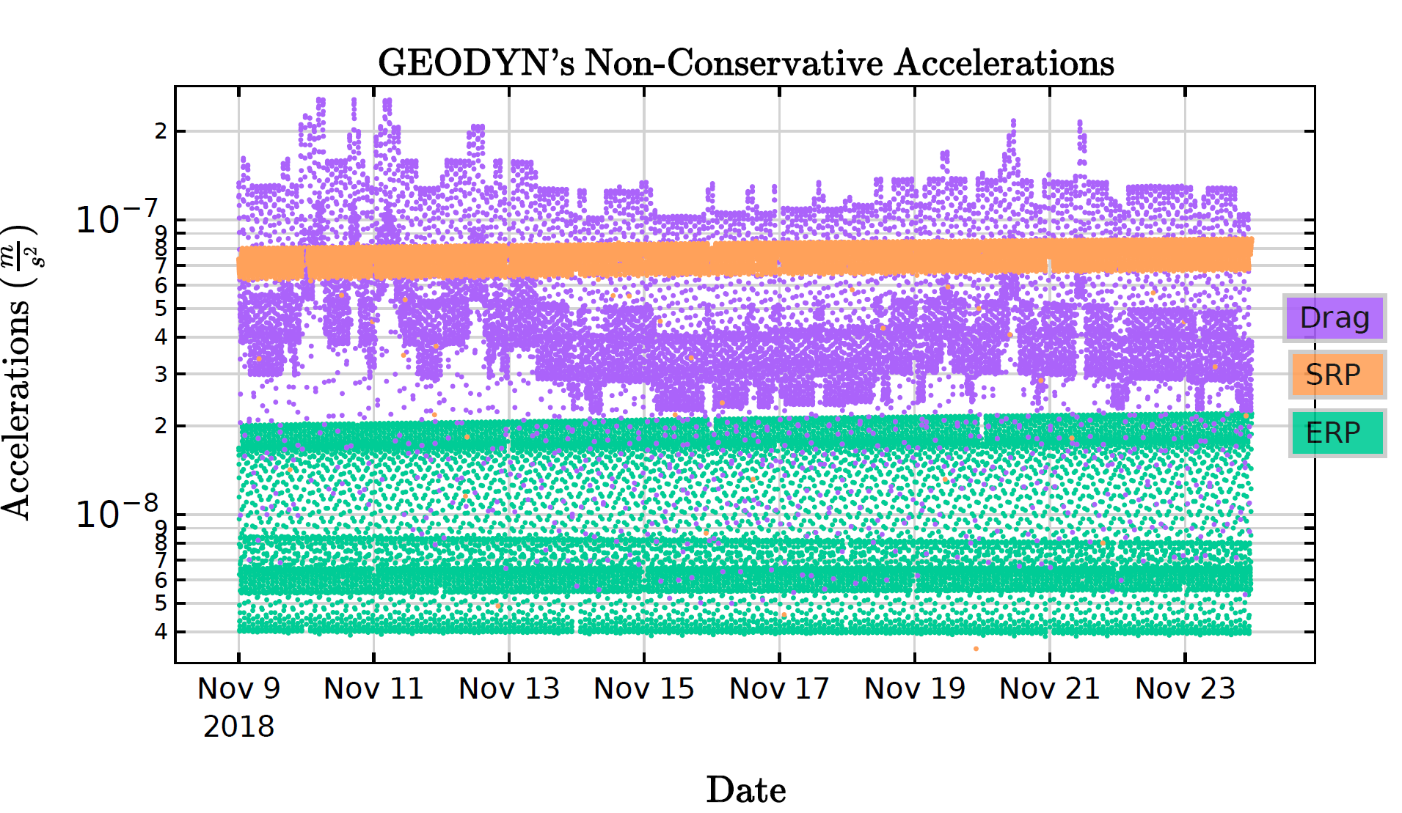

Slide 25
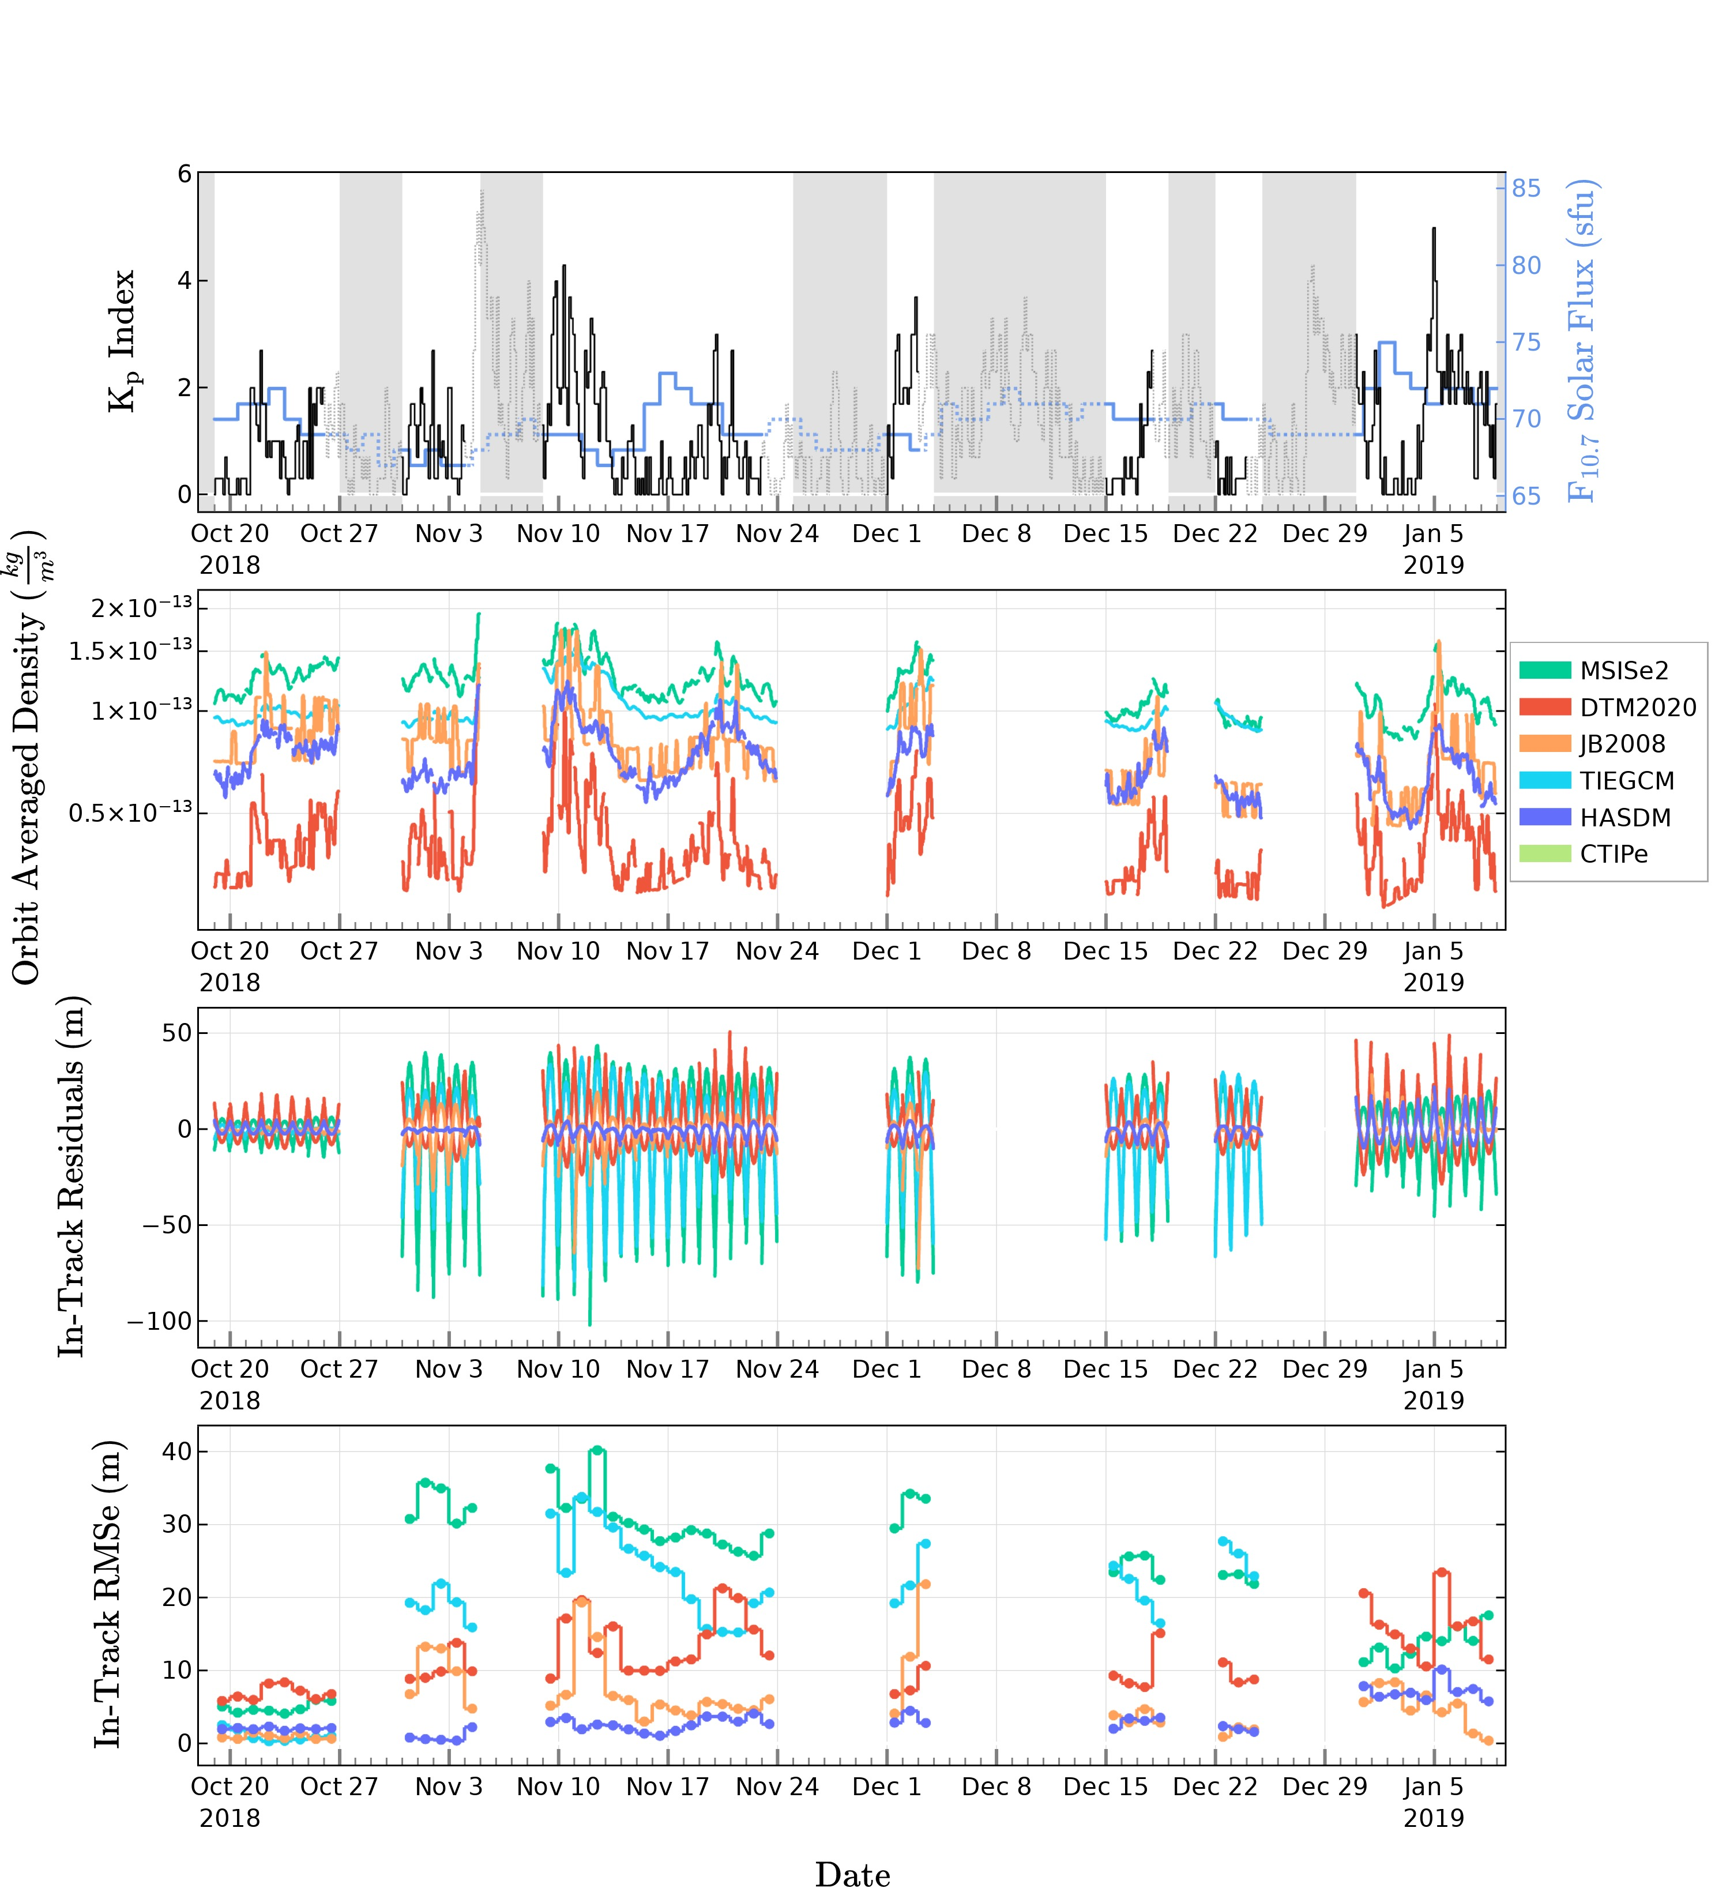
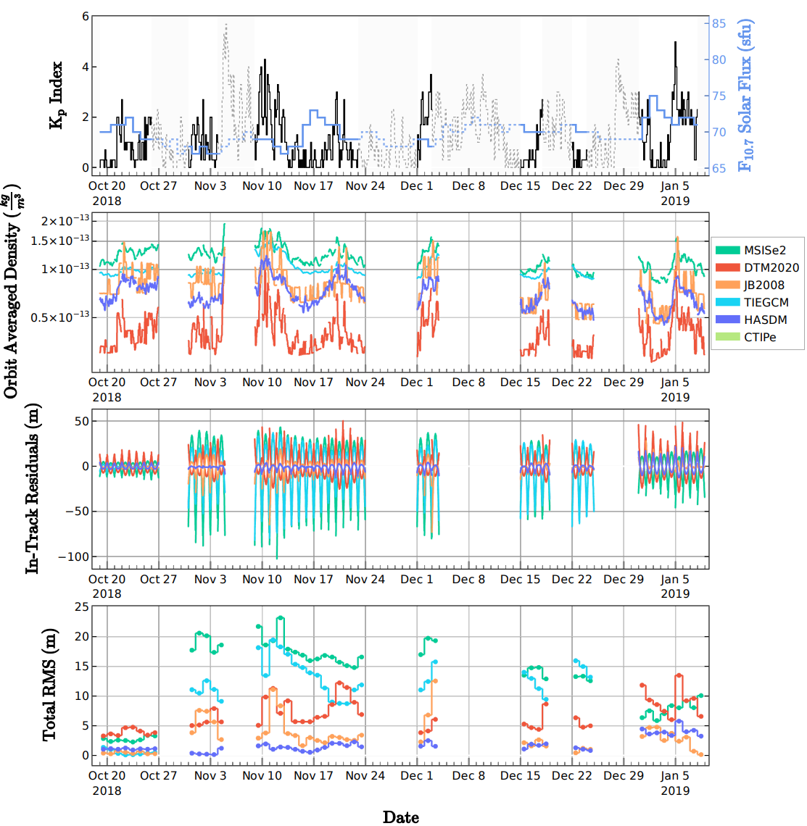
3-month result

