Slide 1
Thermosphere model assessment
Sean Bruinsma
CNES, Toulouse, France
&
Jia Yue, Jack Wang
CCMC

Slide 2
Summary of what was done
Thermosphere model assessment under storm conditions
Density data of 13 storms and updated metrics (as follow-up metrics study and paper of Bruinsma et al., 2018) for comprehensive and standardized thermosphere model assessment under storm conditions have been published
The assessments were done for the semi-empirical models NRLMSISE-00, JB2008 and DTM2013, as well as the first-principles models TIE-GCM and CTIPe
International Space Weather Action Team G2A
https://www.iswat-cospar.org
Notes:
Save propellant

Slide 3
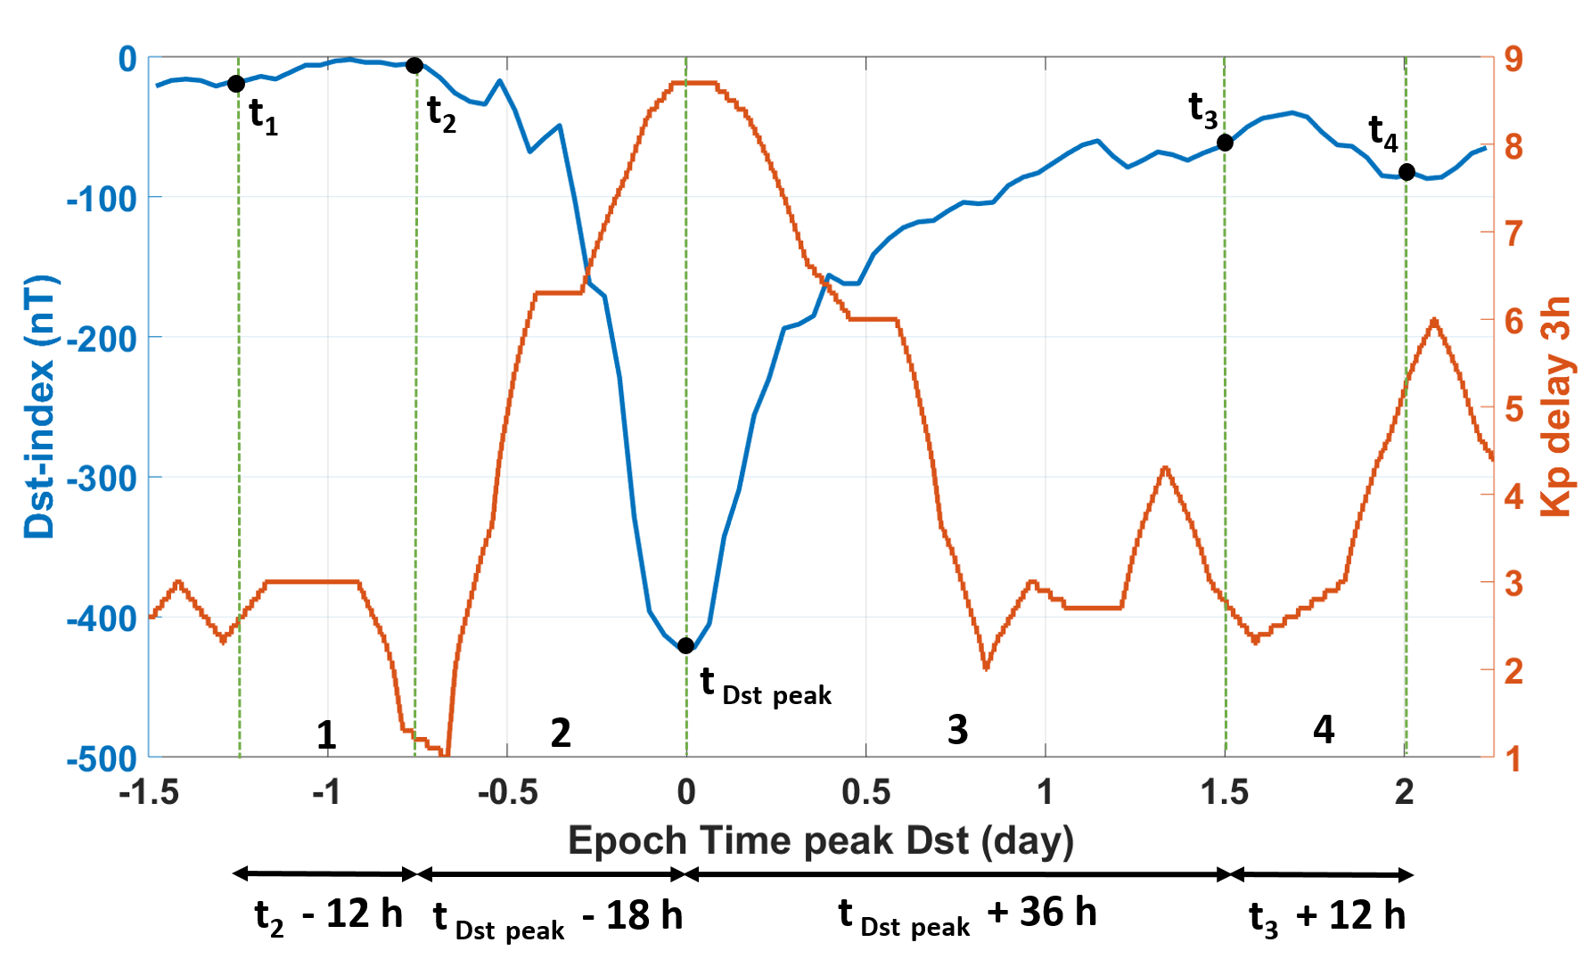
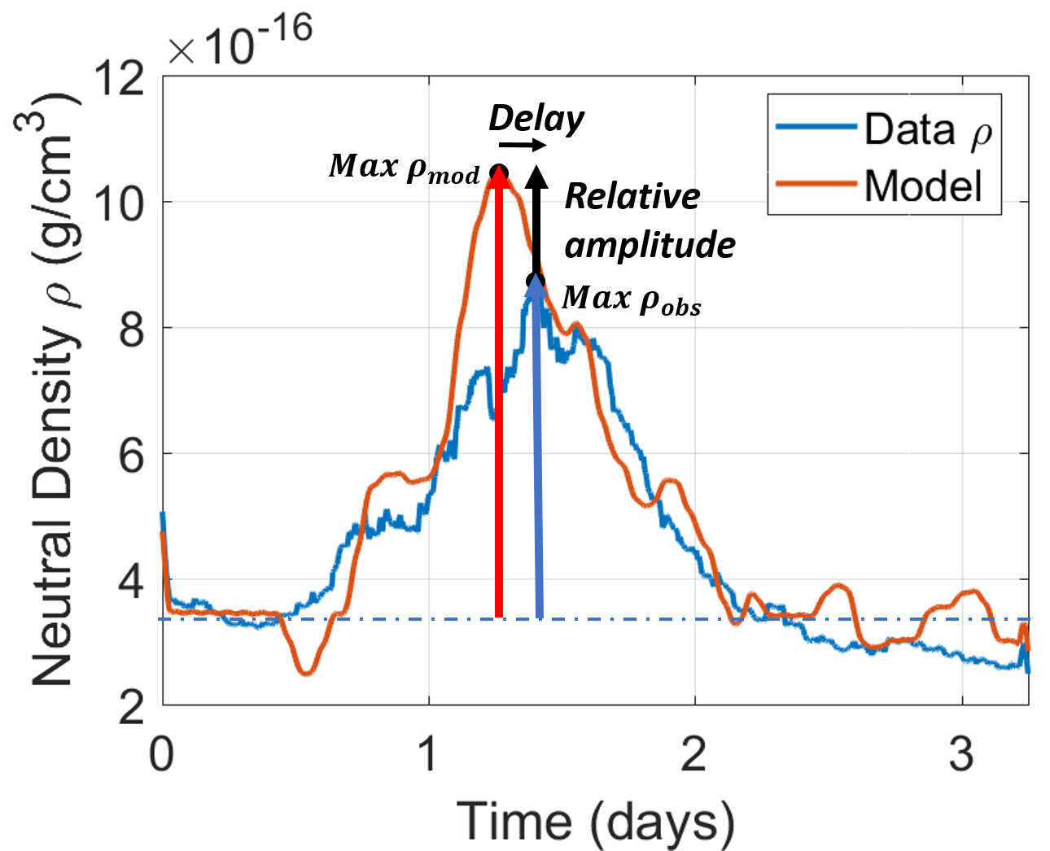
Storm metrics: definition of the storm event and peak
1) Density ratio (mean and standard deviation), correlation calculated:
Per phase
Entire event
2) Amplitude/phase of the peak
de-bias
Phase: Pre Onset Recovery Post
“t₀”

Slide 4
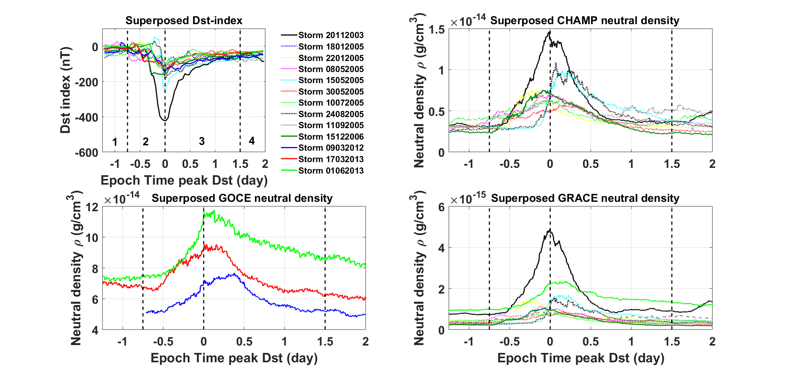
STORMS USED IN THE ASSESSMENT (13)
Notes:
Aeropass < 10mn

Slide 5
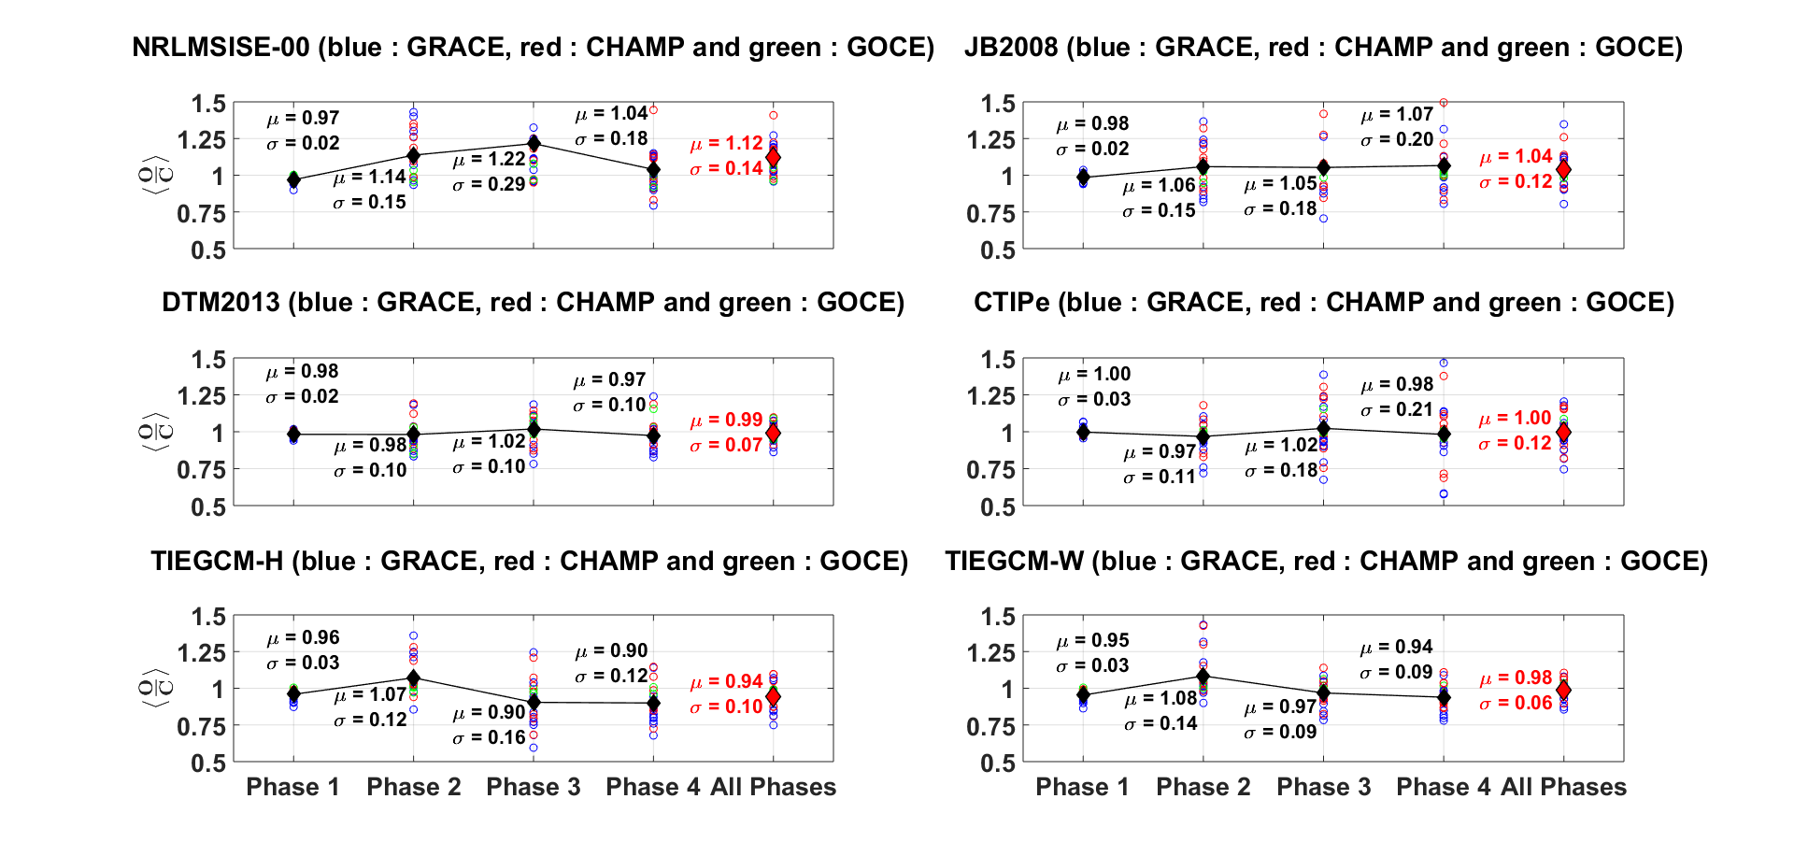
Mean of the density ratios
Under estimation
Notes:
Aeropass < 10mn

Slide 6
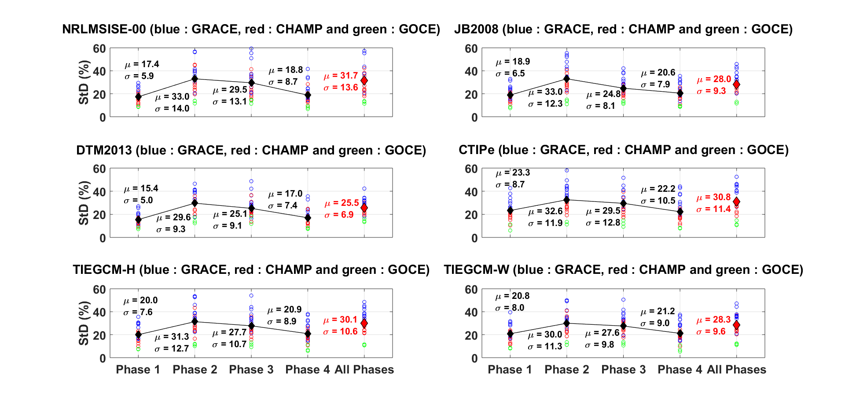
Standard deviation of the density ratios
Notes:
Aeropass < 10mn

Slide 7
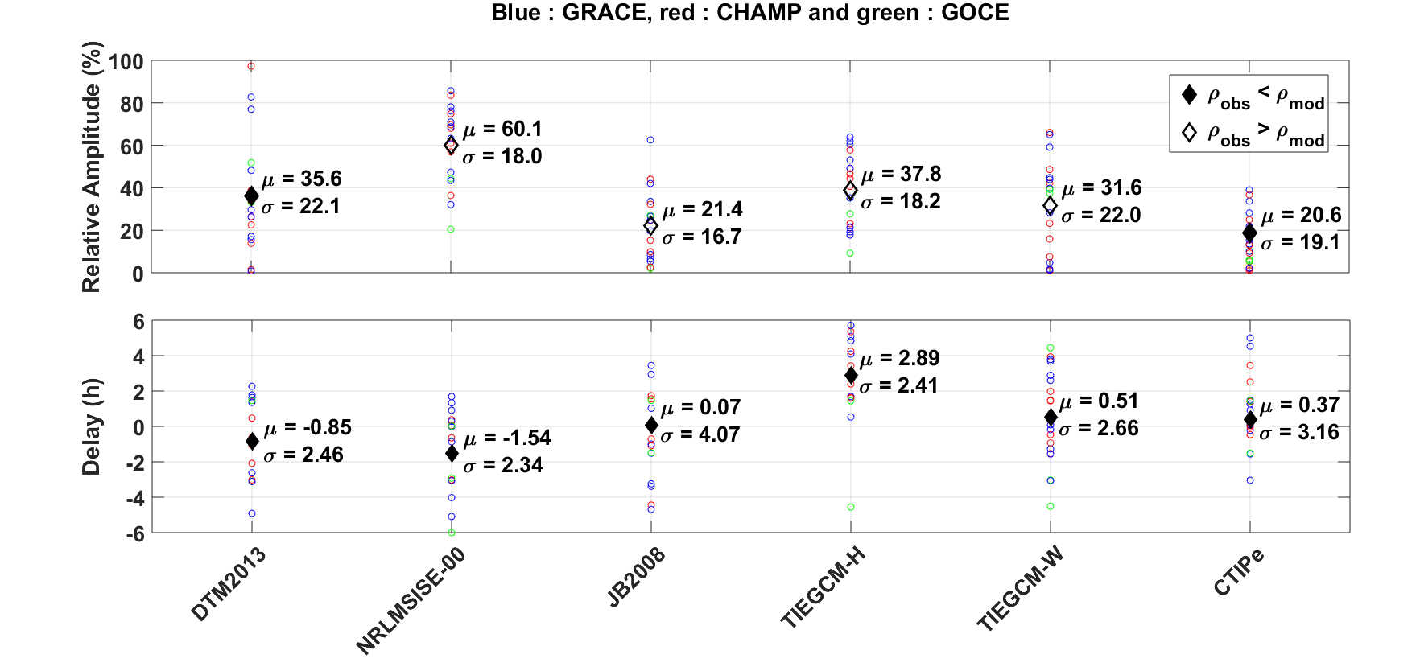
Mean and standard deviation of the peak amplitude and phase
Notes:
Aeropass < 10mn

Slide 8
To do
Thermosphere model assessment under storm conditions was done for 13 selected storms (mostly isolated events) according to a tailored and unambiguous procedure (a compromise) and applying new metrics; this new procedure must now be implemented at CCMC.
Assessment of NRLMSISE-00, JB2008, DTM2013, DTM2020 (not shown) as well as TIE-GCM and CTIPe was done
Re-do the assessment for above models, and with new GRACE data (TU Delft)
Set up the thermosphere model score board
Assess MSIS 2.0, GITM, WACCM-X etc
Add data (e.g. GRACE-FO) and recent storms to the procedure (on a regular basis), update model assessment
Model assessment for long periods (years, solar min/med/max conditions).
Notes:
Aeropass < 10mn

