Slide 1
CCMC-SWPC R2O2R Partnership Using Shared Architecture for Collaborative Evaluation
Dr. Steven Hill &
SWPC and CCMC ACE Teams
Thu 9 Jun, 2022
Notes:
Good afternoon. Today I’ll be talking about a collaboration between SWPC and CCMC. This effort is to create a shared architecture for evaluating new capabilities for advancement in readiness for operations.

Slide 2
Contributors and Participants
Michele Cash
Mihail Codrescu
Ratina Dodani
Mike Husler
Tamara Bledsoe
Kelvin Fedrick
Dominic Fuller-Rowell
Brent Gordon
Terry Onsager
Eric Adamson
Hazel Bain
Tzu-Wei Fang
Min-Yang Chou
Chinwe Didigu
Maria Kuznetsova
Tina Tsui
Jia Yue
ACE
not
ACE
Notes:
I want to acknowledge all the contributors and participants in this effort. They are the ones who have made this happen.
In particular, I’d like to acknowledge the support of Masha Kuznetsova who spearheaded the effort to actually get us a footprint in the cloud as well as her team that outfitted that environment.
For the SWPC folks, this effort was one of passion, and frequently fell in the ‘other duties as assigned’ category.
And of course, just a reminder that this effort is not to be confused with the spacecraft, which at some point will reach end of life, maybe.

Slide 3
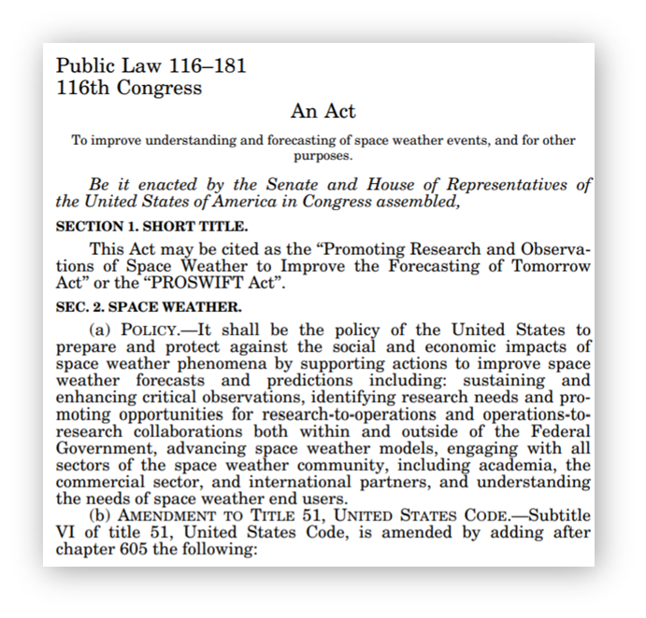
Motivation
PROSWIFT Act directs federal agencies to develop formal mechanisms to transition space weather research models and capabilities to NOAA.
Architecture for Collaborative Evaluation (ACE)
Space Weather Prediction Testbed (SWPT)
Promoting Research and Observations of Space Weather to Improve the Forecasting of Tomorrow
Notes:
Momentum has been building in policy and advocacy for improving and accelerating the transition of space weather capabilities (models, observations, and applications) from research to operations. Most notably the PROSWIFT act passed by Congress and signed by the President last year. These efforts provide the necessary authorization and framework for collaboration between agencies, academia, and industry.

Slide 4
Some Nomenclature and Definitions
Proving Ground – A general term that the R2O2R Framework describes as: “Entities comprising the Space Weather Proving Grounds conduct validation and demonstration of advanced operations, services, and science and technology capabilities that address user needs”
Testbed – A singular proving ground, operated by SWPC to cover transition to operations from RL7 through RL9 on NOAA systems
ACE – one of potentially many proving grounds operating in the RL5-6 range
Capability – A model, observational product, or forecast application
Notes:
It’s important to set up some common definitions so we’re on the same page with terms that can be interpreted differently in different contexts

Slide 5
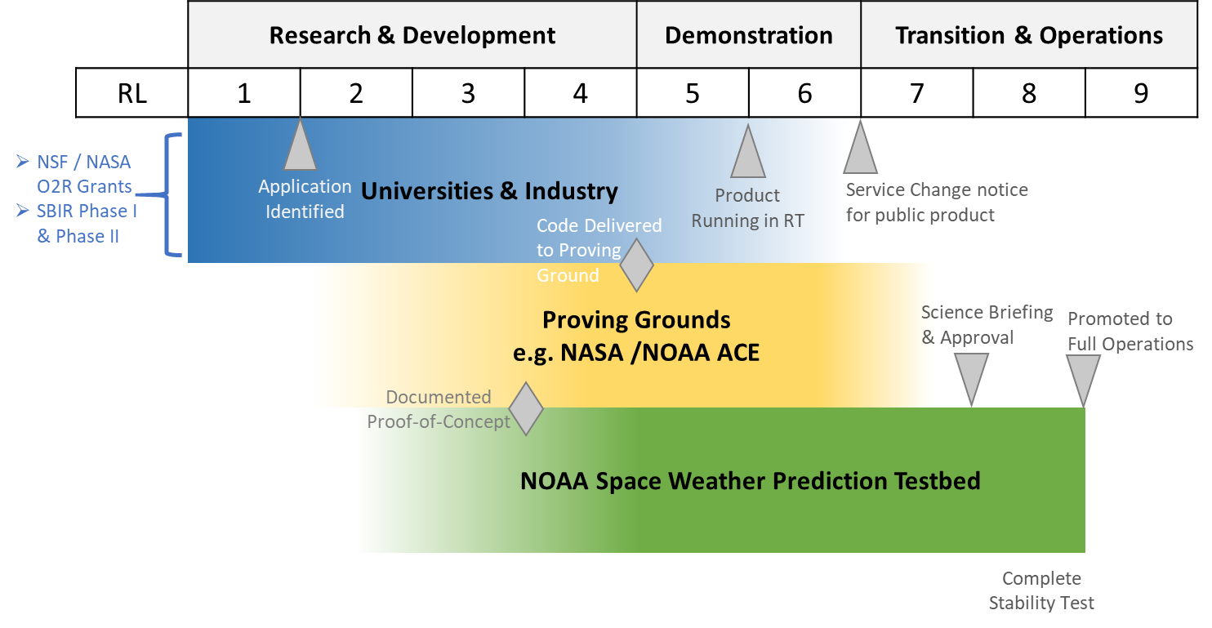
Space Weather R2O Progression
RL Activities
1 | Basic Research
2 | Applied Research
3 | Proof-of-Concept Developed
4 | Initial Validation Complete
5 | Proving Ground Validation Complete
6 | Product Running RT in Test Environment
7 | Product Running in Staging Environment
8 | Stability Tested in Ops Environment
9 | Full Operations
Notes:
The shadings are intended to show that there is involvement from multiple groups at most of the steps of the transition process

Slide 6
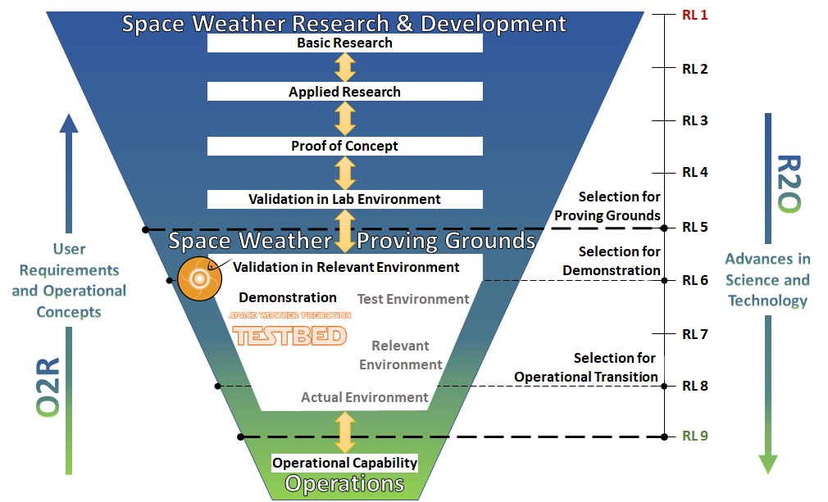
ACE and SWPT Support Progressively Higher RLs
The ‘transition funnel’ shows the locations of the ACE and SWPT along the RL ‘scale’
Fewer capabilities advance to higher RLs than exist at lower RLs
ACE & SWPT
R2O2R Framework Process
Notes:
The cl
SWPT
Capitalize on the $100s millions in research investments
A Physical Facility
Researchers, developers, forecasters, and customers collaborate and build relationships
Conduct collaborative exercises and experiments under quasi-operational conditions
Co-located with SWPC in Boulder, Colorado
Focused on solving operational problems and enhancing operations
Demonstration of capabilities
Conducted in either an on-going, real-time and/or an event-based, retrospective manner
Test, Operational Development, and Operational Environments
ACE
Located in Greenbelt and the cloud
Will provide an ‘onramp’ for new capabilities
Will support development of the new CCMC Continuous Runs System

Slide 7
Bridging the “technical” R2O2R Divide
SWPC’s environment is a secure, high availability system, making it challenging to directly share computational resources with researchers.
Research
ACE
SWPT
Operations
Notes:
SWPC – David Skaggs Research Center in Boulder, CO
Forecast Center, Research scientists, Software developers , Systems support, Administration
APS – Enterprise Data Center in Ashburn, VA
Unstaffed, Data center equipment only, Warm failover capability (ingest is ‘hot’)
FISMA High
Sharing SWPC’s environment is challenging, so SWPC is working with CCMC to create the ACE and creating the Space Weather Prediction Testbed as the final step before operations

Slide 8
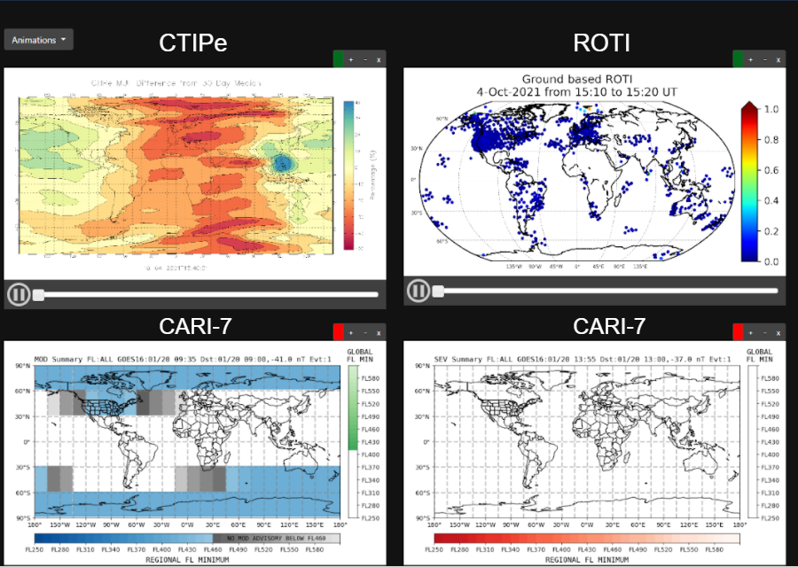
ACE Provides a Complete Package of “Hardware”
Configured to be as similar to the NOAA operational systems as is reasonably possible.
Allows researchers and developers to modify codes for models, observational products, and applications to run quasi-operationally.
Cloud and on-prem compute
Dataflow and User Interfaces
Notes:
Encompasses the information technology (IT) infrastructure, such as a cloud computing environment, local computing environments, data flow, and user interfaces, used to jointly evaluate forecast capabilities.
Elastic Compute Cloud (EC2)...Virtual Private Cloud (VPC)...Simple Storage Service (S3).
This Proving Ground creates an environment that is as ‘operations-like’ as possible outside SWPC.
This will allow new capabilities to be evaluated and validated prior to a demonstration in SWPC’s Space Weather Prediction Testbed (SWPT).
Because the environment is operations-like, the transition to the Testbed environment should not require major code changes and re-validation.

Slide 9
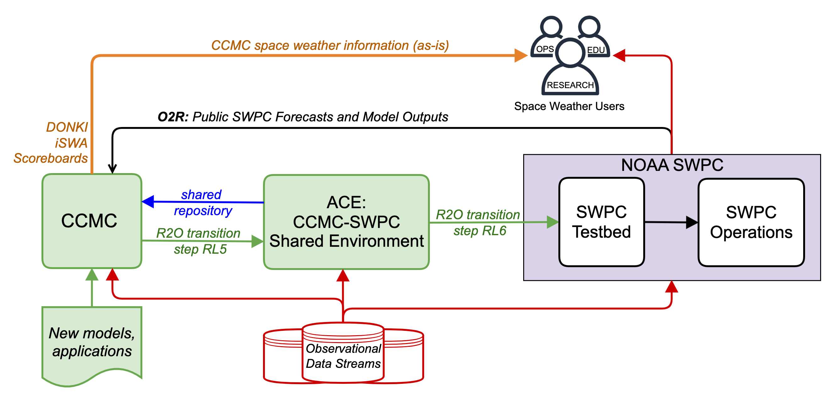
People, Process, and Technology
CCMC and SWPC staff facilitate transition of capabilities to the ACE and support validation studies.
Notes:
The architecture is cloud-based and shared between NASA and NOAA, and eventually other organizations participating in R2O2R activities could be added
The cloud component makes access much easier by researchers and other Proving Grounds centers compared to a fixed hardware environment.
The SWPT can interface directly with the Architecture to support operational evaluation once initial performance and validation have been completed.

Slide 10
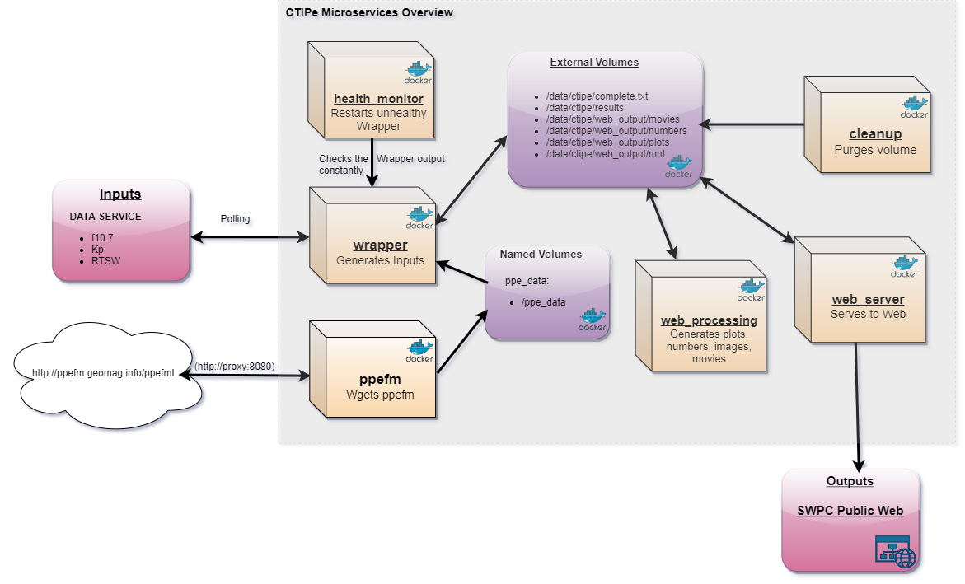
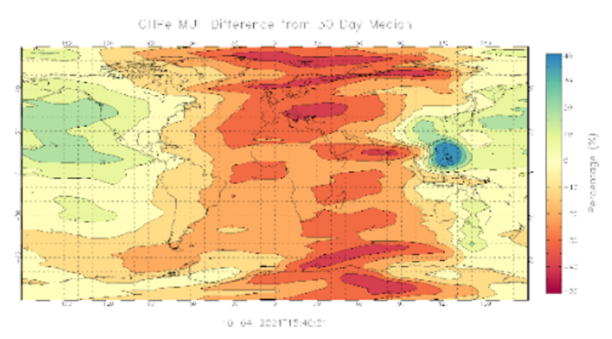
Pilot a Simple Model First…
Coupled Thermosphere Ionosphere Plasmasphere Electrodynamics (CTIPe).
A SWPC containerized version of this serial model was installed and tested.

Slide 11
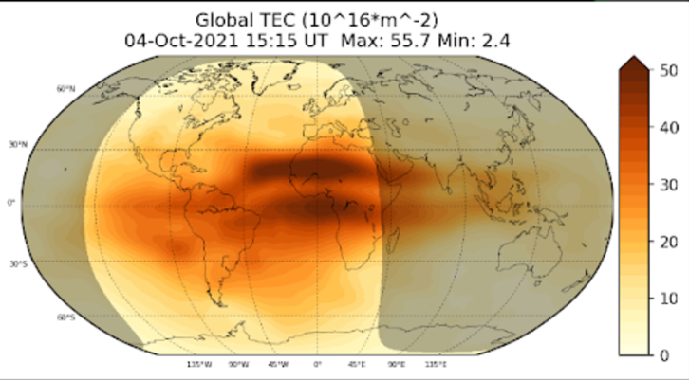
…then Pilot more Complexity and More Data
Bigger footprint and higher system complexity than CTIPe.
GPS data are obtained via NTRIP casters.
Investigating adding COSMIC2 data for GLOTEC.

Slide 12
Ongoing Work
Refining a detailed Readiness Level Checklist and definitions
Defining and creating an access controlled web presence to support collaboration with partners and capability developers
Identify new capability to begin R2O at ACE
Providing model developers access to ACE to demonstrate ACE as a usable resource validation and collaboration
Notes:
Model improvements will demonstrate the ability to actively develop in ACE

Slide 13
Summary and Conclusion
Environment and staff exist and are gaining proficiency.
Initial testing and building of the ACE is nearing completion.
Anticipate using ACE and SWPT in FY23 to improve existing capabilities and evaluate new capabilities.

Slide 14
BACKUP
BACKUP SLIDES

