Slide 1
Uncertainty Quantification for Data-Driven Space Weather Modeling
Piyush M. Mehta
Assistant Professor
J. Wayne and Kathy Richards Faculty Fellow
Director: ASSIST (Astrodynamics, Space ScIence, and Space Technology) Lab
CCMC Workshop, Lunch Discussion Panel

Slide 2
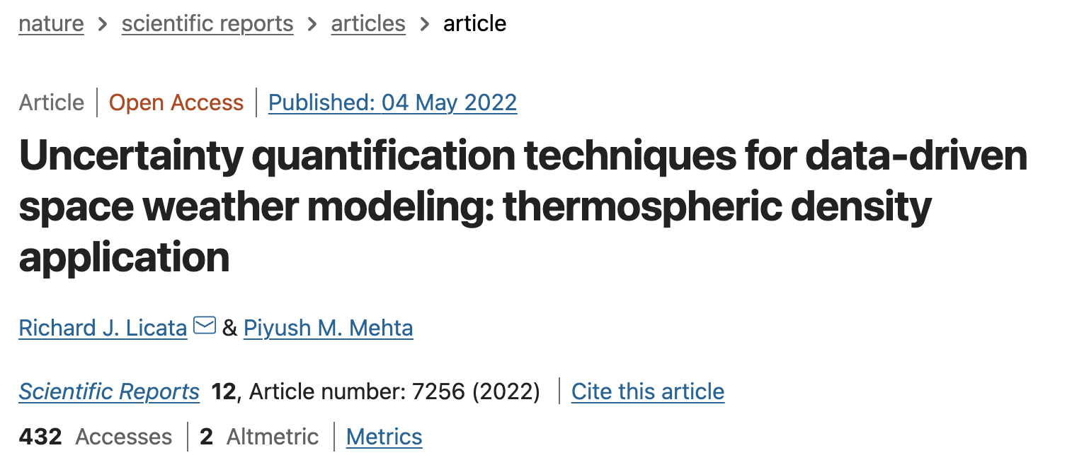
Uncertainty Quantification
All models are inherently limited
Physics-based: Incomplete physics, parameterization, high-dimensional
Empirical: data with limited spatio-temporal resolution, data quality and fidelity, parameterization
Data-Driven modeling received a new boost with contemporary ML developments
Sources of uncertainty
Aleatoric – inherent data randomness
Epistemic – model uncertainty
Uncertainty quantification is crucial for decision-making
Demonstrated uncertainty quantification techniques for various approaches to data-driven modeling

Slide 3
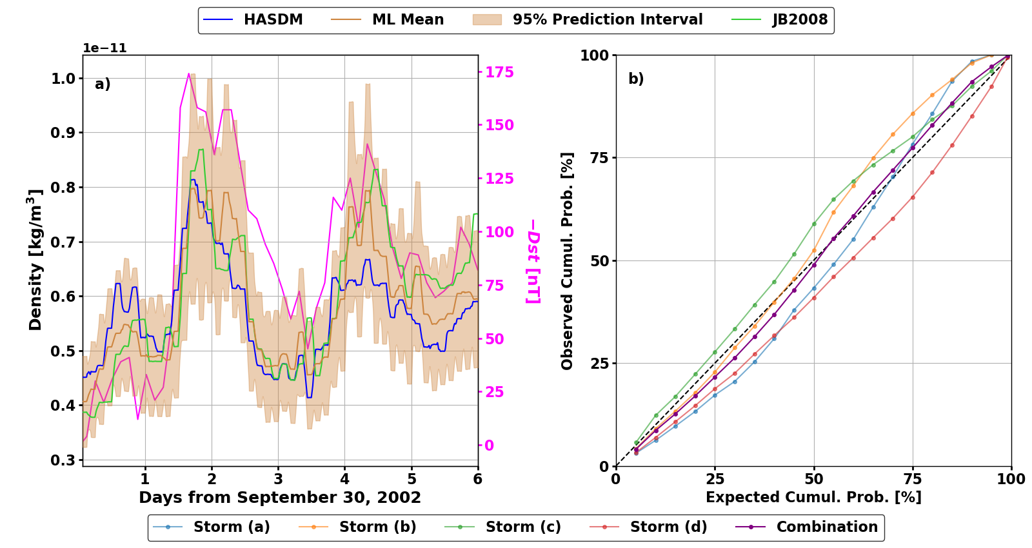
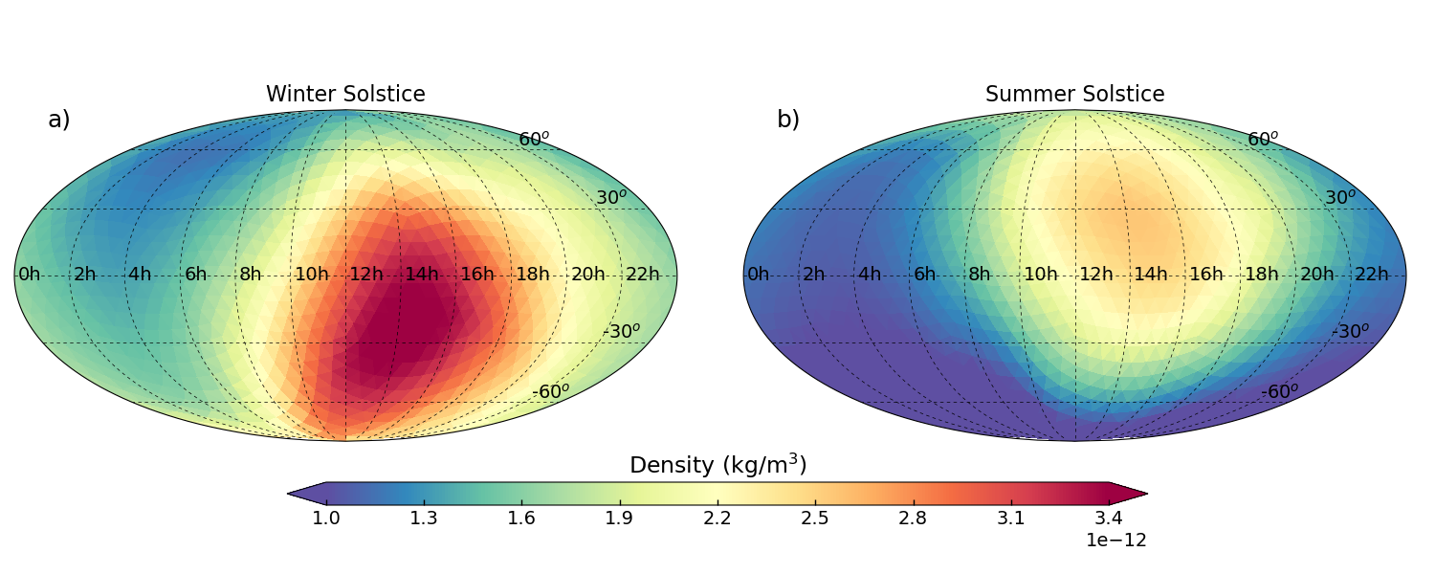
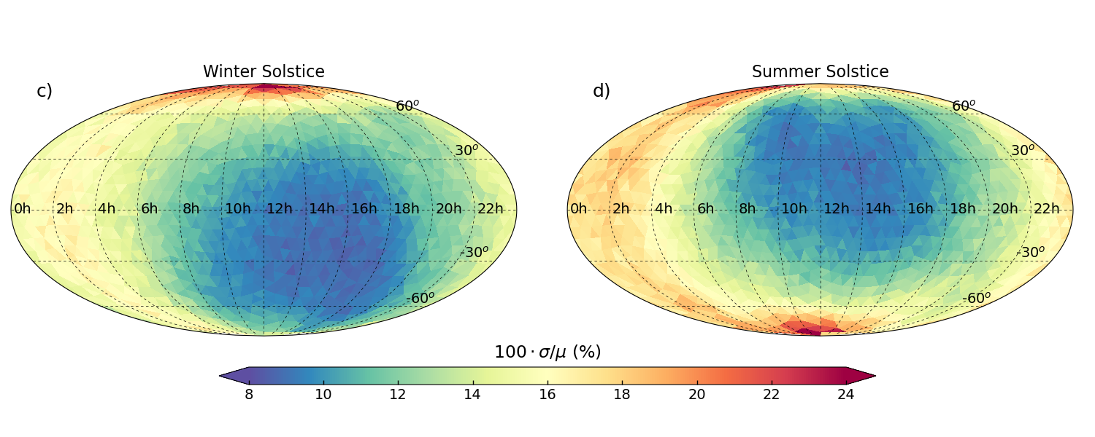
Data-Driven Thermosphere Modeling with Uncertainty Quantification
Original Dataset
HASDM-ML (Licata et. al., Space Weather 2022)
Based on 20-years of 3D HASDM data cubes (SET HASDM Database – SwX, 2021)
Nonlinear model and provides Robust & Reliable (R&R) uncertainty estimates
CHAMP-ML (Licata and Mehta, Nature Scientific Reports, 2021)
Demonstration of global model development with localized in-situ CHAMP densities
Nonlinear model with R&R uncertainty estimates
Ideal for global investigation of small-scale variations
MSIS-UQ (EGU 2022)
Based on the methodology of EXTEMPLAR (Weimer et. al., 2016, 2020): Estimation of MSIS 2.0 exospheric temperatures using CHAMP/GRACE/Swarm densities
Does not use EXTEMPLAR grid, nonlinear global model for exospheric temperature using localized measurements improves model resolution, and provides R&R uncertainty
How do we measure Robustness and Reliability
HASDM-ML
CHAMP-ML

Slide 4
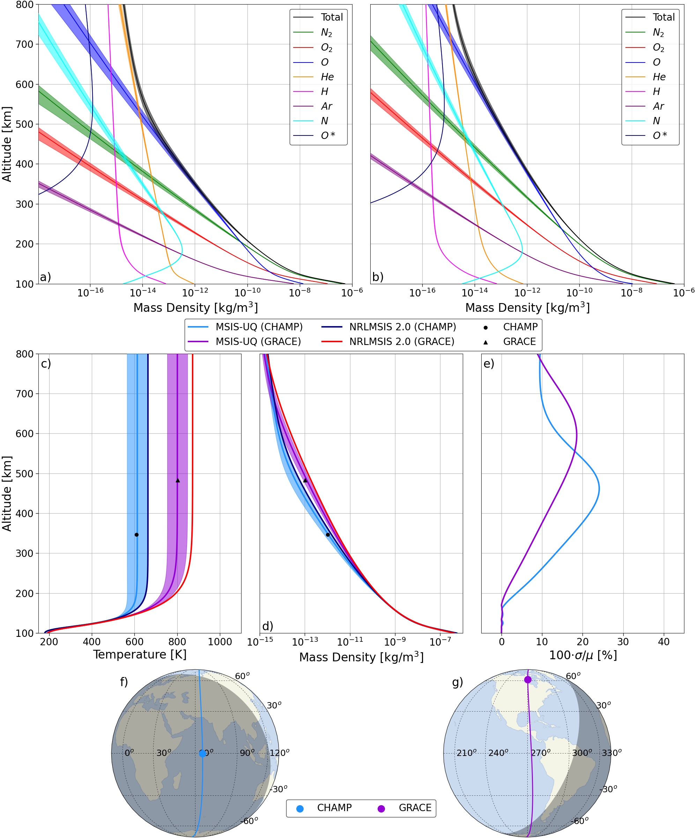
Model Performance
Test set performance (for respective datasets)
HASDM-ML
Mean absolute error: 10.69%
Calibration error: 1.76%
CHAML-ML
Mean absolute error: 11.66%
Calibration error: 1.22%
MSIS-UQ: Relative difference between models and satellite estimates on independent test set
NRLMSIS 2.0: 45.86%
HASDM: 31.79%
MSIS-UQ: 20.50% (4.22% calibration error)
MSIS-UQ

