Slide 1
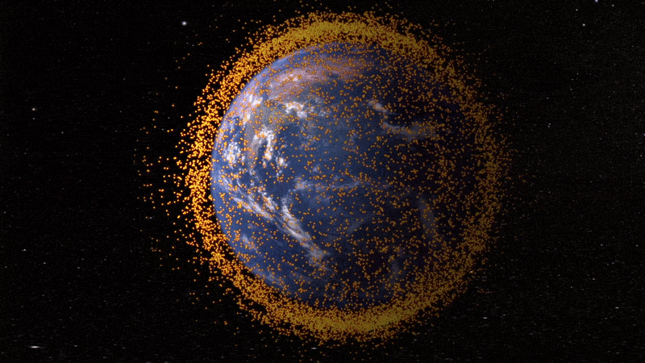
SPAM: A New Tool for Monitoring Solar Energetic Particle Impacts to Satellite Operations
J.C. Green
Space Hazards Applications, LLC
jgreen@spacehaz.com
AMS 2022
T.P. O’Brien, R. Quinn
Image Credit: NASA
Notes:
I was asked to talk about modeling Solar Energetic Particles in the near earth environment so this talk is not focused on predicting when an SEP will occur like was discussed earlier in the week. Now were more interested in what is actually observed at Earth and what impact has on satellite operations.

Slide 2
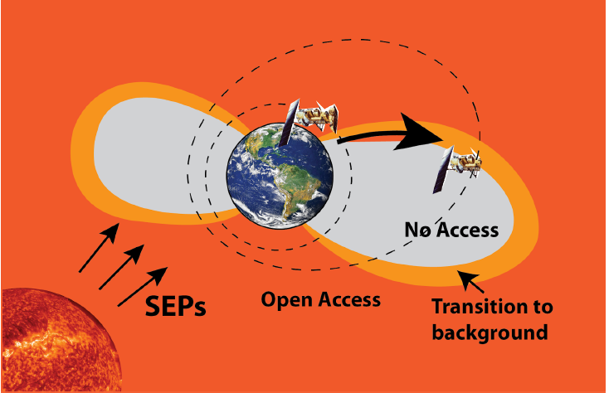
SPAM
Solar Particle Access Model
An empirically derived data driven model for mapping solar particle flux throughout the magnetosphere for satellite anomaly monitoring and attribution
X
X
Notes:
For describing SEPs at earth we’ve been working on a new model called the solar particle access model. Its an empirically derived data driven model for mapping solar particle flux throughout the magnetosphere and we’ve specifically developed this for satellite anomaly monitoring and attribution.

Slide 3
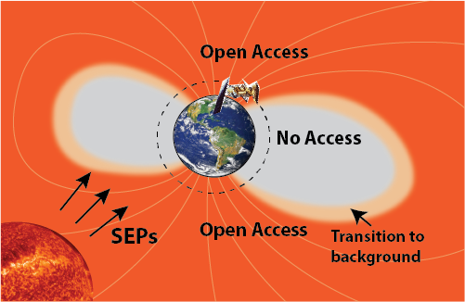
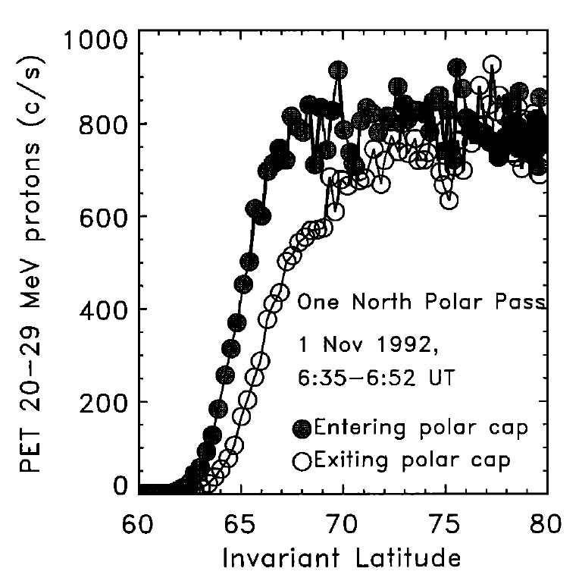
Solar Particle Access
Some regions are shielded as ions are deflected by Earth’s magnetic field.
Polar orbiting MEO/LEO satellites will pass in and out of high flux regions.
Monitoring the threat from these ions requires knowledge of where they have access or are deflected.
Access regions change as the magnetic field is distorted by the oncoming solar wind.
Particle Flux
Polar Cap
Shielded region
Leske et al., 2001
Notes:
For satellite operations, we don’t just need to know when an SEP event occurs but also where and what is the impact. Out at geosynchronous orbit, satellites will be completely engulfed by the SEP. But at lower altitudes its very different. Over the polar cap region ions funnel straight down as shown in this top schematic. But at low latitudes the ions will be deflected. That means that polar orbiting satellites in low or medium Earth orbit will go in and out of the high flux region as they go around the Earth. So if you want to monitor the the threat during one of these SEP events, you need to know where your satellite is relative to these access regions. That’s not a simple because we don’t have global measurements of ions everywhere. And those access regions move as the magnetic field is distorted by the solar wind.

Slide 4
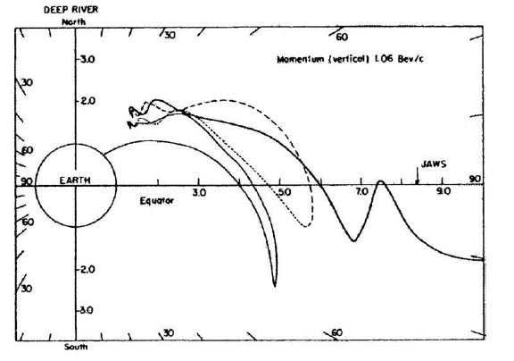
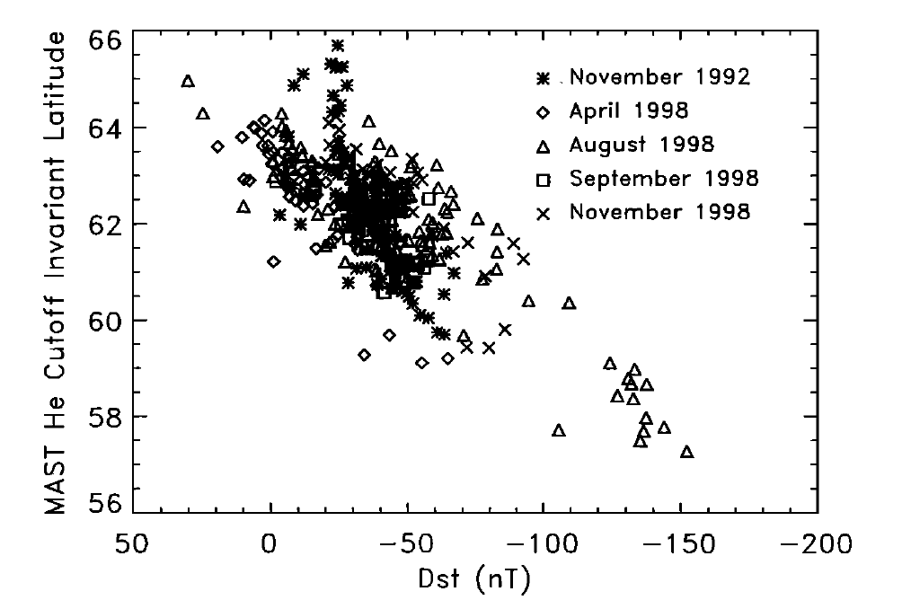
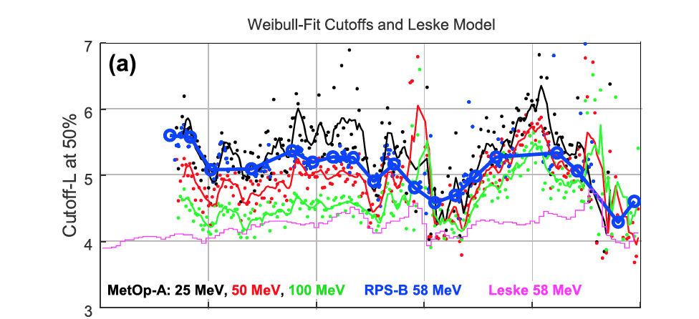
Why SPAM?
Current models:
Physics based: trace particle trajectories
Statistical: Define average locations based on past event
Issues:
Don’t capture the observed dynamic variations
Don’t apply to all latitudes and altitudes.
Give single cutoff locations and don’t describe how the flux increases across that boundary which is important for satellite impacts.
Are not easily accessible to satellite operators.
Smart and Shea, 2009
Leske et al., 2001
O’Brien et al., 2018
Notes:
There are some models already developed but they have some issues that limit their utility for understanding impacts to satellites. We heard about the physics based models, like NAIRAS earlier where you actually trace particle orbits to find access regions. There’s also some simple statistical models where you look at a large number of events and define where the boundary is and how it varies with indices such as Dst. The issue with many of these is that they capture the average behavior but don’t to capture the high variability observed during individual events. One practical problem, is that they just aren’t accessible in real time to satellite operators which is why weve developed SPAM

Slide 5
SPAM
SPAM definess SEP access regions using real time observations of ions in Low Earth Orbit (POES/MetOP)
Maps each POES/MetOp pass through the access regions to:
All Magnetic Local times
All altitudes
All ion species
Notes:
SPAM is different because we use real time measurements of ion flux to tell us exactly where these boundaries are. So there’s no guess work. We use measurements from the POES/MetOp satellites that are all in low altitude polar orbits so every time a POES satellite goes through this region we know exactly where the boundary is and what the flux is. The challenge is, to figure out how to map from a single pass from one POES satellites through this cutoff region, first out to all magnetic local times and then out to all altitudes and then to the full range of ion species. To do that weve looked at 25 years of SEP events and come up with functional forms to describe that mapping.

Slide 6
STEP 1: Weibull Fits
Fit each pass of POES/MetOp (low altitude) particle fluxes to Weibull functions for 20 years of SEP events (7/01/1998-01/01/2018).
Example Fit
J0
L0
Proton flux
γ
J₀ – Flux at large L
L₀ – location where flux drops to 63%
γ –steepness of the increase
L
Notes:
The first thing we do is to simplify what’s observed at POES by fitting it to a function like in this example here on the right. The blue trace is proton flux observed at POES with high fluxes at large L or high latitudes that decreases as the satellite moves equatorward. And we fit it to a Weibull function that has 3 parameters. Then we just have to figure out how those parameters change as you move around in local time, altitude, and out to othe ion species.

Slide 7
STEP 2: Mapping MLT, altitude, ion species
Normalized L0
MLT mapping: Compare Weibull fit parameters for POES satellites at same time but different MLT
At high dynamic pressure the boundary moves out on the dayside and inward on the nightside.
Altitude mapping: Compare Weibull fit parameters for satellites at same time but different altitudes
Can map flux along field lines
Species mapping: Compare fit parameters for different ion species
L₀ values for different ion rigidities follow the dipole expectation with a linear offset:
Dynamic Pressure (nP)
MLT
L_{0_high} =1.1 L_{0_low}+.32 r²=.69
L0_{R2}= sqrt(R1/R2) L0_{R1} - 2.31(R1/R2) + 2.37
Notes:
I don’t have time to go into all the details

Slide 8
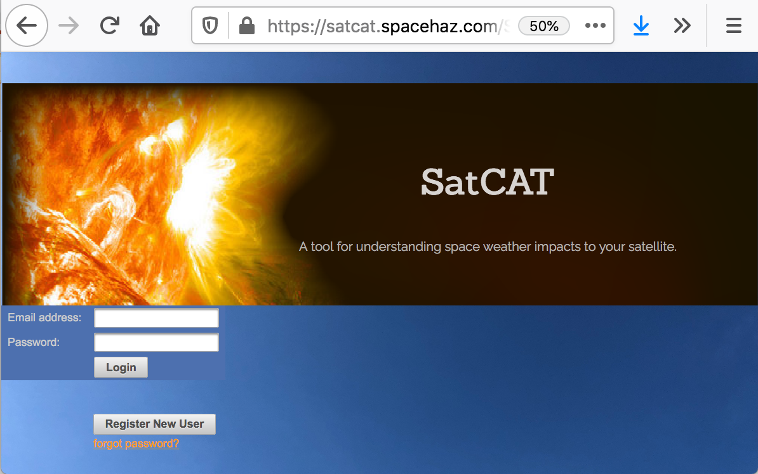
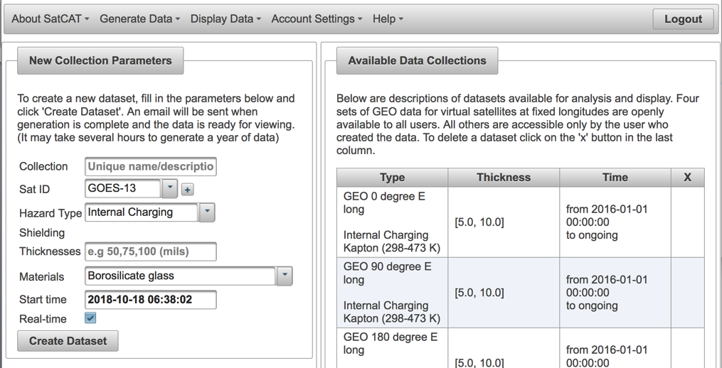
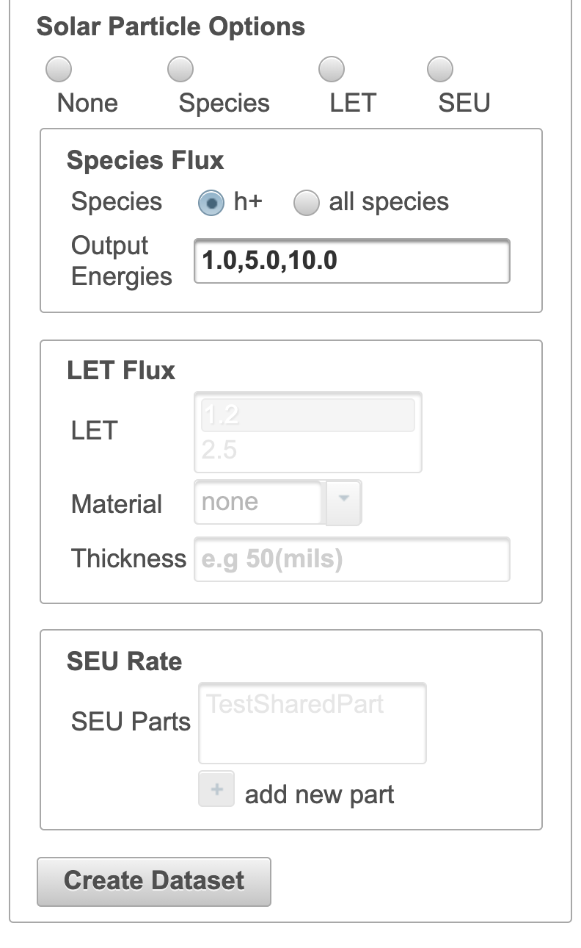
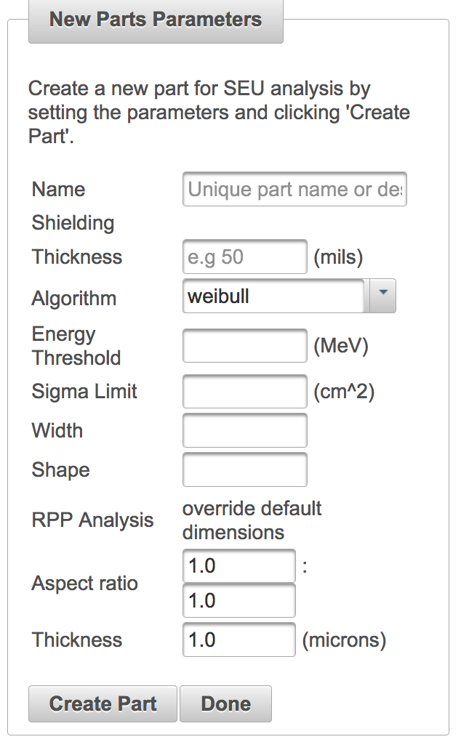
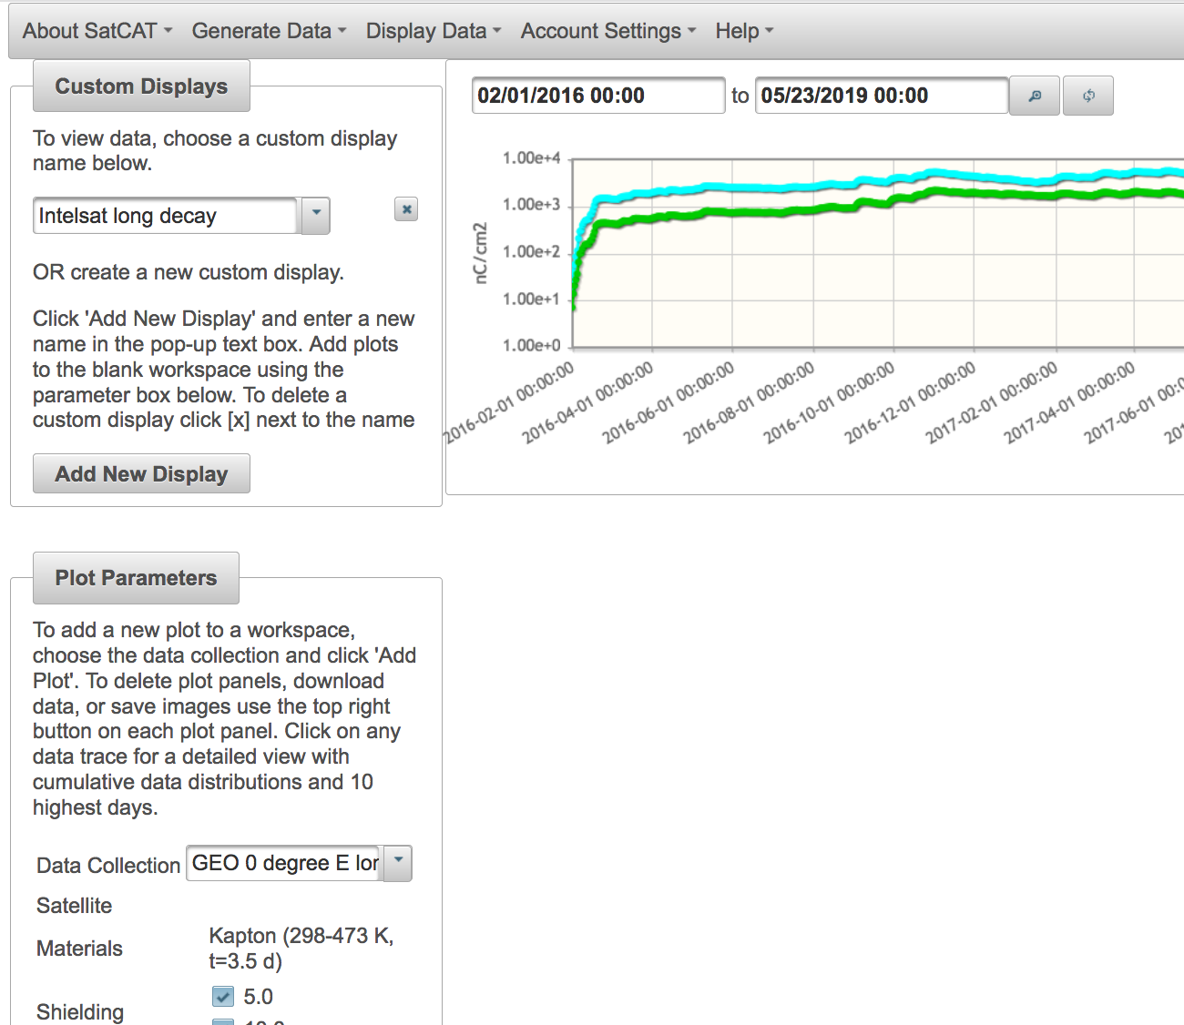
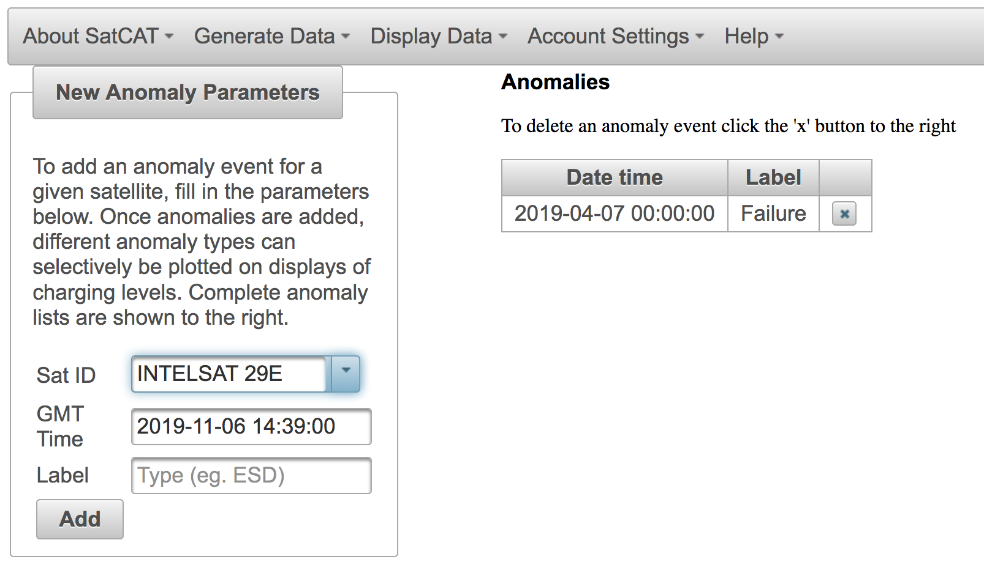
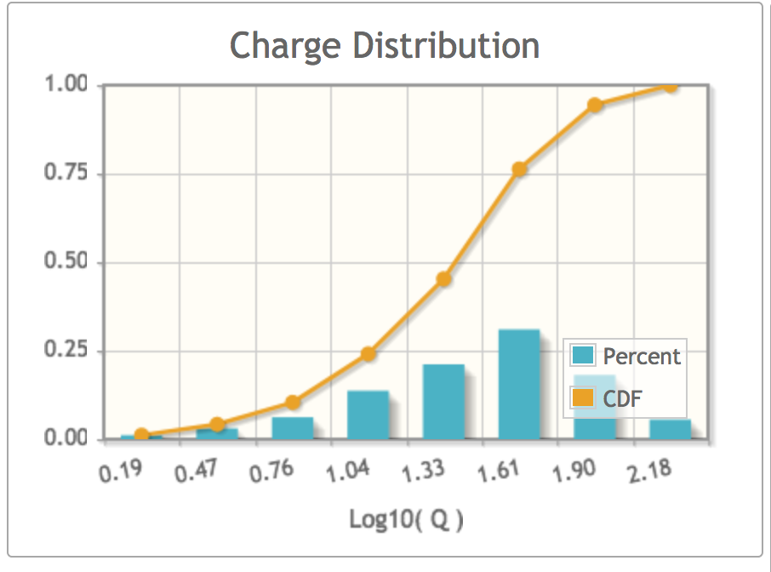
SPAM/SatCAT
Login
Generate internal charging history
Anomaly Investigation
SPAM is being integrated into the Satellite Charging Assessment Tool framework that currently gives expected internal charging hazards https://satcat.spacehaz.com/
The application allows users to choose a satellite from the NORAD catalogue and generate a time history of ion fluxes and upset rates for different components that is stored in a database and updated in real time
Add lists of anomaly times
Display and analyze
Generate SEU rates
Display data and anomalies
Add anomaly times
Analyze
Notes:
Finally, were making this whole thing available through an online application. The application allows users to choose there satellite from the NORAD catalog. It generates a trajectory, calculates the ion flux, the LET flux, and the single event upset rate along the orbit and then stores that for plotting and analysis. And it can be set to update in real time.

Slide 9
Summary
What’s needed?
Comparison between SPAM empirical method and theoretical methods
Method for combining measured data with theoretical methods
Better access tools to simplify information for operators and particularly for understanding impacts to mega constellations
More software development funding

