Slide 1
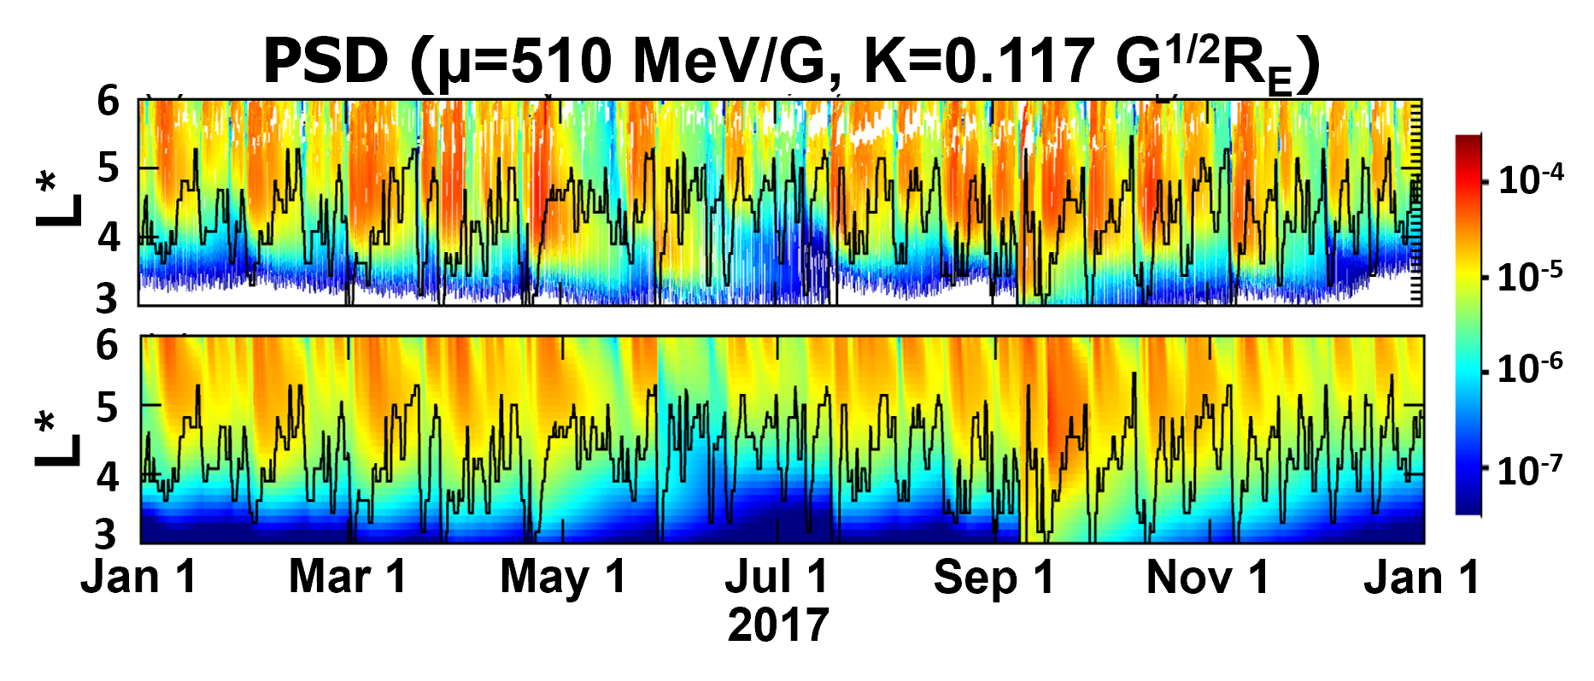
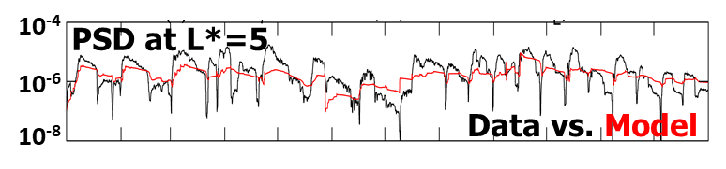
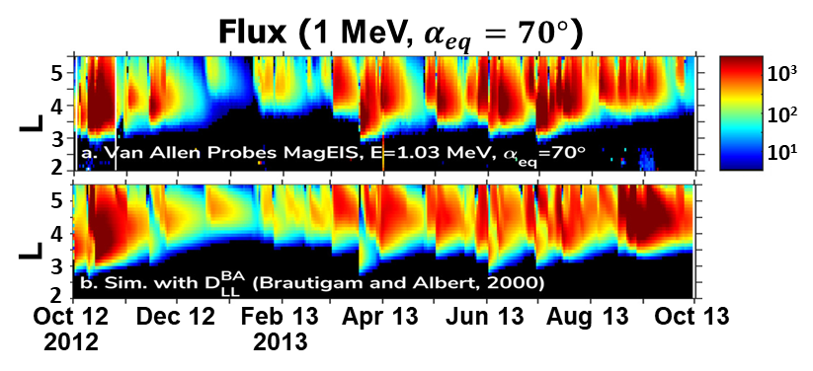

RB Modeling: Hits and Misses
Hits: long-term dynamics inside GEO generally well reproduced by 3D diffusion models, with:
  Data-driven outer boundary
  Empirical inputs of RD, Hiss, Chorus, EMIC waves
Misses:
  Some fast enhancements under-reproduced
  Many fast dropouts not captured
  Better inputs or missing physics?
PSD data
DREAM3D
[Lee, Tu+, CCMC 2022]
Jan 1
Mar 1
May 1
Jul 1
Sep 1
Nov 1
Jan 1
2017
Flux data
VERB3D
[Drozdov+, JGR 2021]
Weichao Tu, CCMC Workshop, 06/09/2022

Slide 2
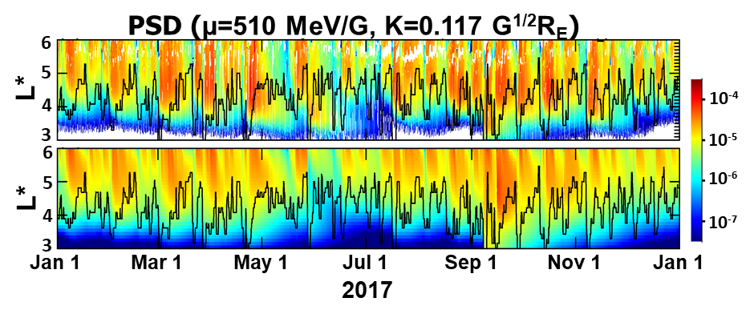
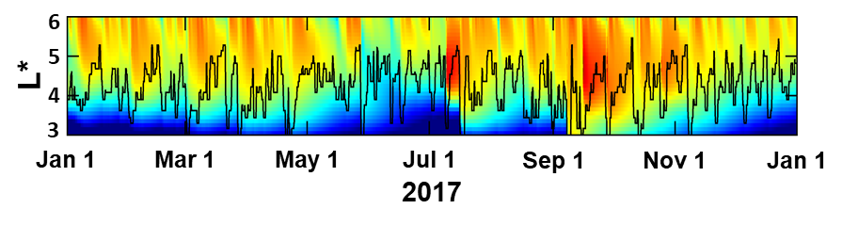
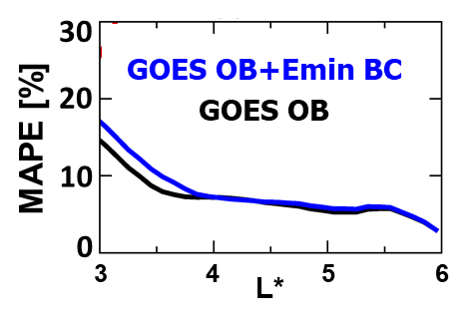
RB Modeling: Better Inputs
Magic of data-driven outer boundary condition
  Right answer for a wrong reason?
More realistic inputs
  O.B., seed electrons, D_{LL}, waves, LCDS, etc.
  Challenging!
  Contributions from machine learning and data assimilation
PSD data
GOES OB
GOES OB
+ Emin BC
Weichao Tu, CCMC Workshop, 06/09/2022

Slide 3
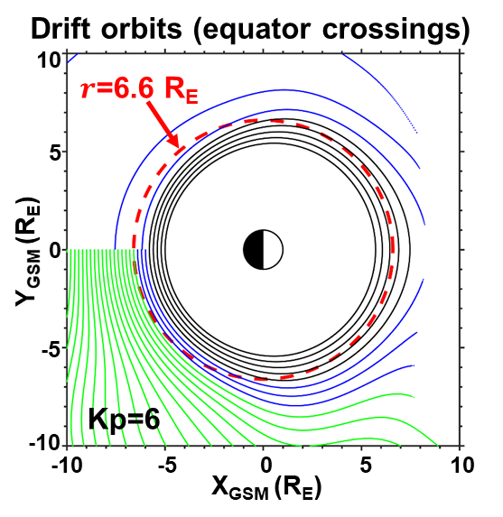
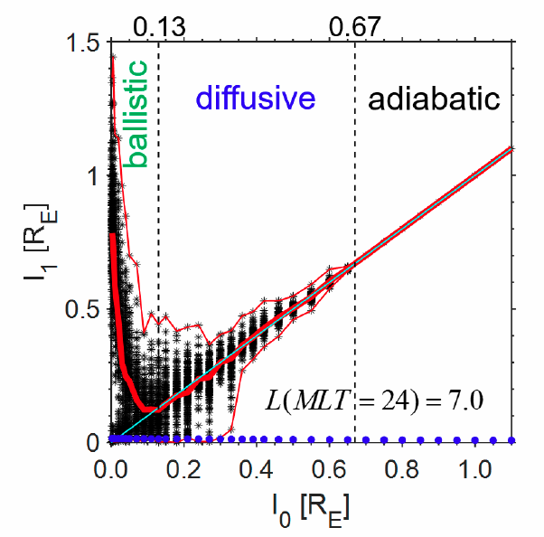
RB Modeling: Missing Physics
Midnight
Noon
What is the relative importance of non-traditional mechanisms to RB dynamics? E.g.,
  Nonlinear wave-particle interactions
  Drift Orbit Bifurcation (DOB)
  Field line curvature (FLC) scattering
Quantify the electron transport rates
  Diffusion? Advection? Mix of both?
  Phase dependent?
Incorporate into global RB models
(Modified from Ukhorskiy+ [JGR, 2011])
[Huang, Tu+, AGU 2020]
Weichao Tu, CCMC Workshop, 06/09/2022

