Slide 1
Community Coordinate Modeling Center Workshop
Lunchtime discussion panel:
June 9, 2022 12:30pm -- 2:00pm: Innovative Solutions to Improve Near-Earth Environment Modeling Chairs: Jacob Bortnik and Weichao Tu

Slide 2
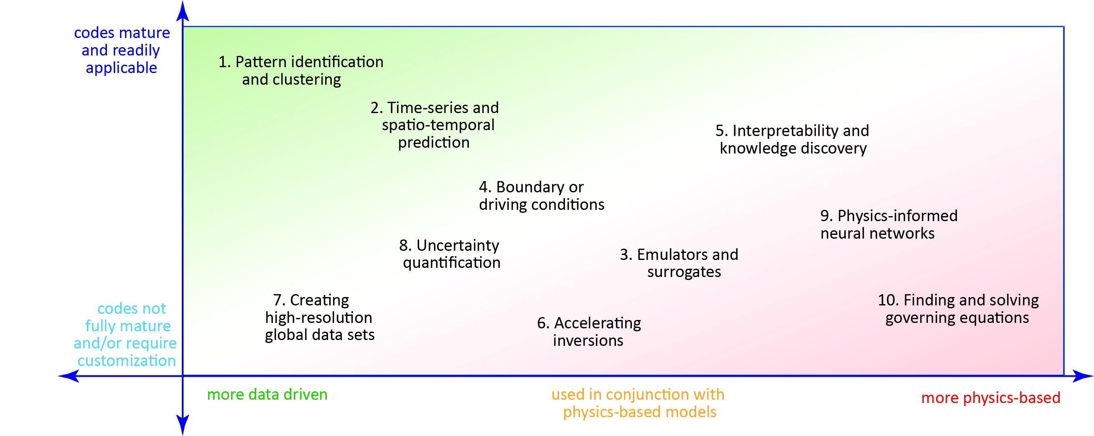
Extracting knowledge from data: ML in the physical sciences
Machine Learning (ML) in general:
Obtain data -> build a model
Test on “unseen” data (test/validation)
Make forecasts/predictions
Adjust model as needed.
Model generally “black box”, hard to know what its doing
Machine Learning for physical sciences (e.g., space weather)
Build a model that predicts well (as above)
Extract physical insight/understanding, what is needed (application+algorithm development)
Physical laws are obeyed (“Physics informed”): ensure symmetries, invariants, conserved quantities
Models are more physically realistic, perform better and require less data to train
Interpretability: which inputs controlled the output? Globally & Locally
Causality flow: how did information propagate in the system? What controls what?
Extract governing equations: what are we missing in our understanding.
Bortnik, J., and E. Camporeale (2021), Ten ways to apply machine learning in Earth and space sciences, Eos, 102, https://doi.org/10.1029/2021EO160257.
Notes:
Hi, I’m Jacob Bortnik, a professor at UCLA focusing on space physics, space weather, and machine learning applications in the physical sciences
I would like to begin by highlighting the important contrast of the application of ML in industry, or general applications vs the physical sciences:
Im general applications, we collect data from a certain system, built a ML model, make predictions that we test for its goodness and generality, and deply in a specific situation. Typically the models are black box and we don’t know or really care about how the model makes its predictions.
But in the physical sciences, an accurate prediction is only the starting point! Even if we build a very accurate model of our space environment, do we really understand it any better? Probably not. And in that context, a ML model is only our starting point and the various system dynamics are encoded into the ML model. So we want to use ML models to extract any kind of physics insight or understanding, this includes
<READ MY LIST>

