Slide 1
RAM-SCB-E: Self-consistent Inner Magnetosphere Modeling
Steven K. Morley
(Space Science & Applications, LANL)
With thanks to Vania Jordanova, Miles Engel, and many others
LA-UR-22-25240
10th CCMC Community Workshop
College Park, MD

Slide 2
RAM-SCB-E Ring current - Atmosphere interactions Model
Ring current-atmosphere interactions model (RAM) [Jordanova et al., 1994, 2006; 2012]
Solves bounce-averaged Boltzmann equation for distribution functions of ions and electrons
Includes all major loss processes
Convection and corotation E field
Flexible B field options
Ring current-atmosphere interactions model (RAM) [Jordanova et al., 1994, 2006; 2012]
Support for e⁻, H⁺, O⁺, and He⁺ with optional N⁺
Multiple plasmasphere model options
Parameterized wave-particle interaction effects
Notes:
J is the electric current density; the pressure tensor P is assumed gyrotropic, with the 3 diagonal components
Pperp, Pperp and Ppara (relative to direction of magnetic field B)

Slide 3
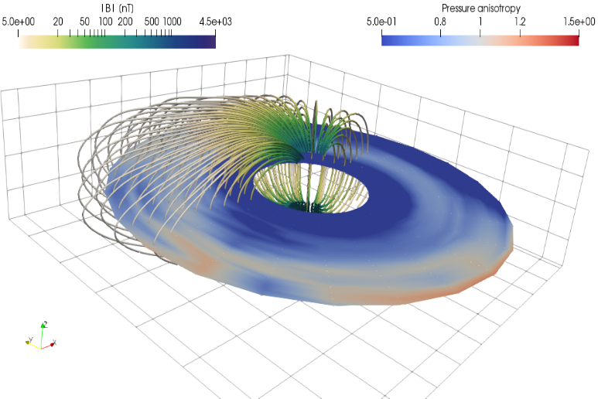
RAM-SCB-E With Self-Consistent magnetic (B) field
Proton Pressure
Pressure Anisotropy (Engel et al., 2019)
3D equilibrium (SCB) code [Cheng, 1995; Zaharia et al., 2004; 2010; Engel et al., 2019]
Solves force balance equation across full domain
Euler potentials (flux coordinates)
Recent Improvements [Engel et al., 2019]
SCB grid decoupled from RAM grid
Improved convergence of SCB solution, especially during very active periods
Adaptive SCB coupling frequency
Improved numerics throughout
Notes:
J is the electric current density; the pressure tensor P is assumed gyrotropic, with the 3 diagonal components
Pperp, Pperp and Ppara (relative to direction of magnetic field B)

Slide 4
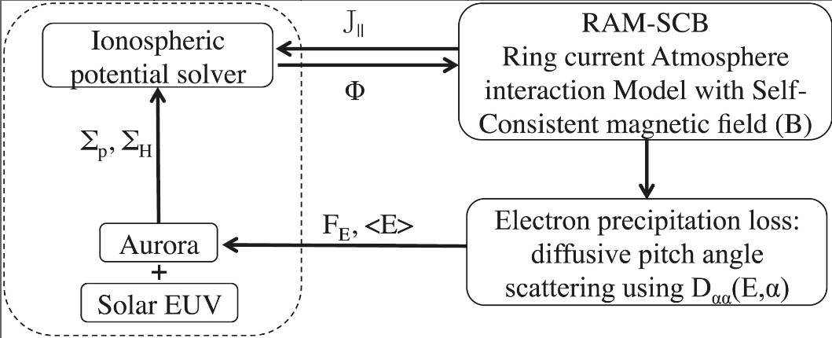
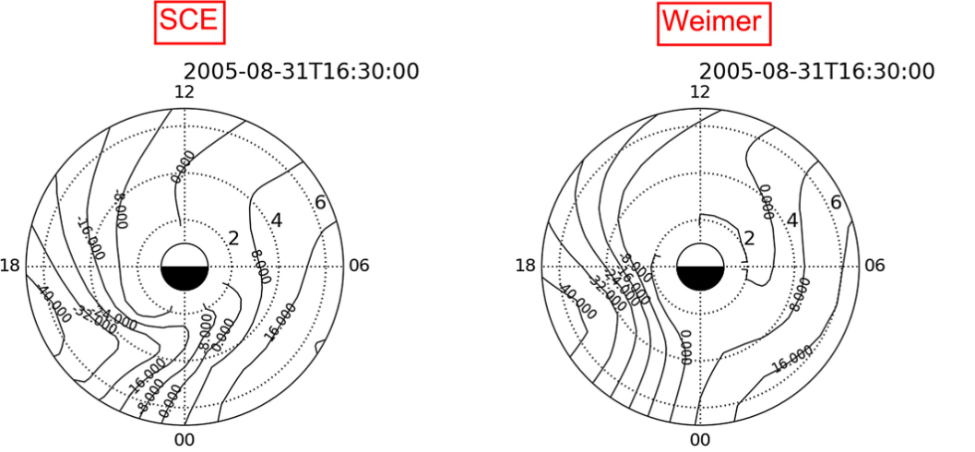
RAM-SCB-E And self-consistent Electric field
Electric Potential
Self-consistent Electric Field [Yu et al., 2017]
RAM provides FAC and precipitation
Precipitation drives conductance changes, solve for ionospheric potential
SCE shown to capture occurrence of SAPS
9.3keV Proton Flux
Comparing SCE to Weimer E-field model (Yu et al., 2017)
Notes:
J is the electric current density; the pressure tensor P is assumed gyrotropic, with the 3 diagonal components
Pperp, Pperp and Ppara (relative to direction of magnetic field B)

Slide 5
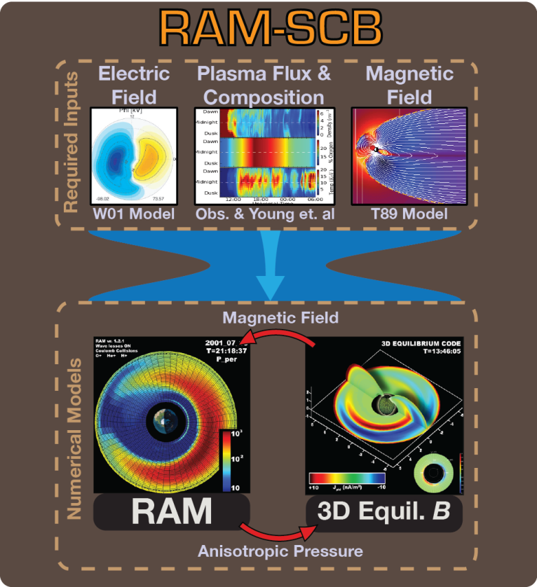
RAM-SCBE Self-consistent Inner Magnetosphere Modeling
Coupled physics models
RAM to evolve distribution functions
SCB to find pressure-balanced magnetic field
SCE for self-consistent electric field (not on the graphic yet!)
Magnetic field options
Centered dipole
Empirical field models, e.g., Tsyganenko ‘89, ‘96, ’05
SCB, where outer boundary must be set using one of the above
SCB, with outer boundary from BATSRUS
RAM outer flux boundary
Omnidirectional flux at 6.5 Re from observations
Typically use MPA & SOPA from LANL geosynchronous platforms
Omnidirectional flux from statistical models
Kp and VBz-parameterized models by Denton et al.
Calculated from coupled MHD
Notes:
J is the electric current density; the pressure tensor P is assumed gyrotropic, with the 3 diagonal components
Pperp, Pperp and Ppara (relative to direction of magnetic field B)

Slide 6
RAM-SCBE Self-consistent Inner Magnetosphere Modeling
Electric Field Models
Volland-Stern (Kp parameterized)
Weimer 2000 & 2005
Self-consistent Electric Field
Coupled with SWMF
Composition Models
Fixed composition ratios
Young et al. (time-varying)
Testing user-specified, time-varying composition
Notes:
J is the electric current density; the pressure tensor P is assumed gyrotropic, with the 3 diagonal components
Pperp, Pperp and Ppara (relative to direction of magnetic field B)

Slide 7
Visualization and Analysis Post-processing to VTK format
Visualization and Analysis tools for most products provided in SpacePy
See spacepy.pybats.ram
Postprocessing tools generate VTK products from RAM-SCB restart files
VTK is open-source and compatible with tools such as ParaView, VisIt, PyVista, MayaVi, and more…
Ecosystem includes interactive tools and underlying visualization libraries
Allows scripted generation of high-quality 3D visualizations
VTK includes analysis tools, including field line tracing, extracting cut-throughs
ParaView includes additional tools/plugins. For example, TTK plugin enables direct topological analysis.
Dipole Field
SCB (T89 Boundary)
Notes:
J is the electric current density; the pressure tensor P is assumed gyrotropic, with the 3 diagonal components
Pperp, Pperp and Ppara (relative to direction of magnetic field B)

Slide 8
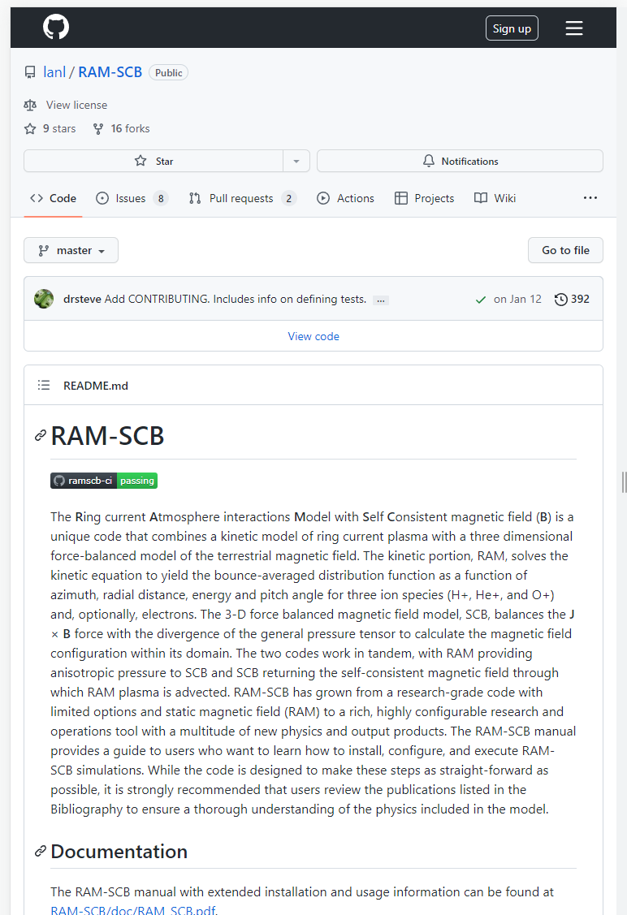
Open-Source Software
RAM-SCB-E is provided as open-source software
Repository at https://github.com/lanl/RAM-SCB
3-clause BSD license
Portable
Fortran 2008 (with some legacy F77 models included)
Leverages SWMF build system
Reduced dependencies from previous versions
Shared-memory Parallel
RAM species run in parallel
Field traces, integration, etc. in SCB run in parallel
Modern development workflow
Version control using git
Contributions via pull requests from feature branches
Continuous integration using Github Actions
Docker builds since 2017

Slide 9
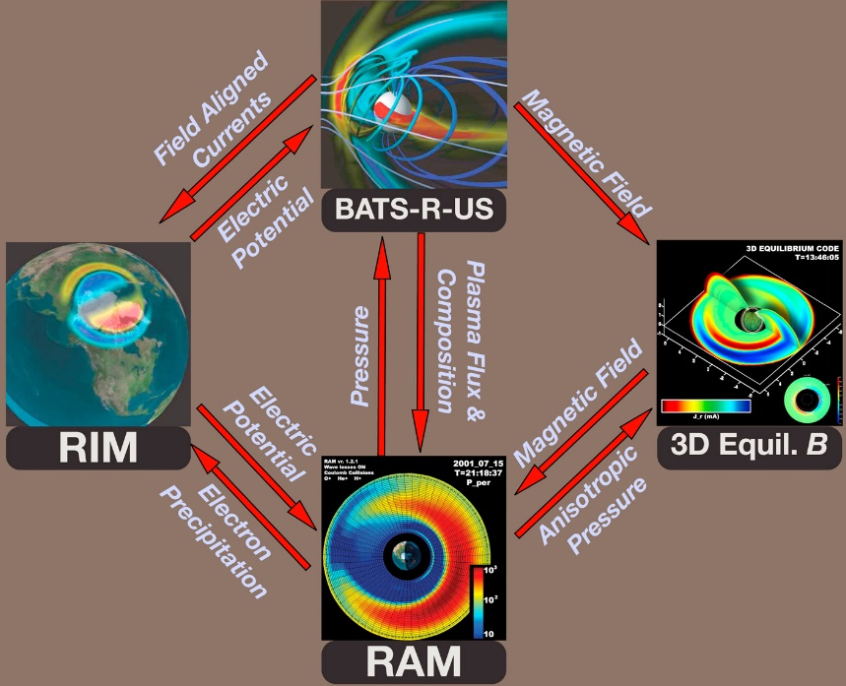
Coupling with SHIELDS/SWMF RAM-SCBE as a drop-in IM component in SWMF
Coupled physics models
Global MHD: BATSRUS
Ionospheric electrodynamics: RIM
Inner magnetosphere: RAM-SCB
Driven by solar wind state at upstream boundary
Geospace model boundary at 32R_{E} upstream
Provides required boundary conditions for RAM-SCB
For details see Welling et al., 2018
Figure: Welling et al., 2018

Slide 10
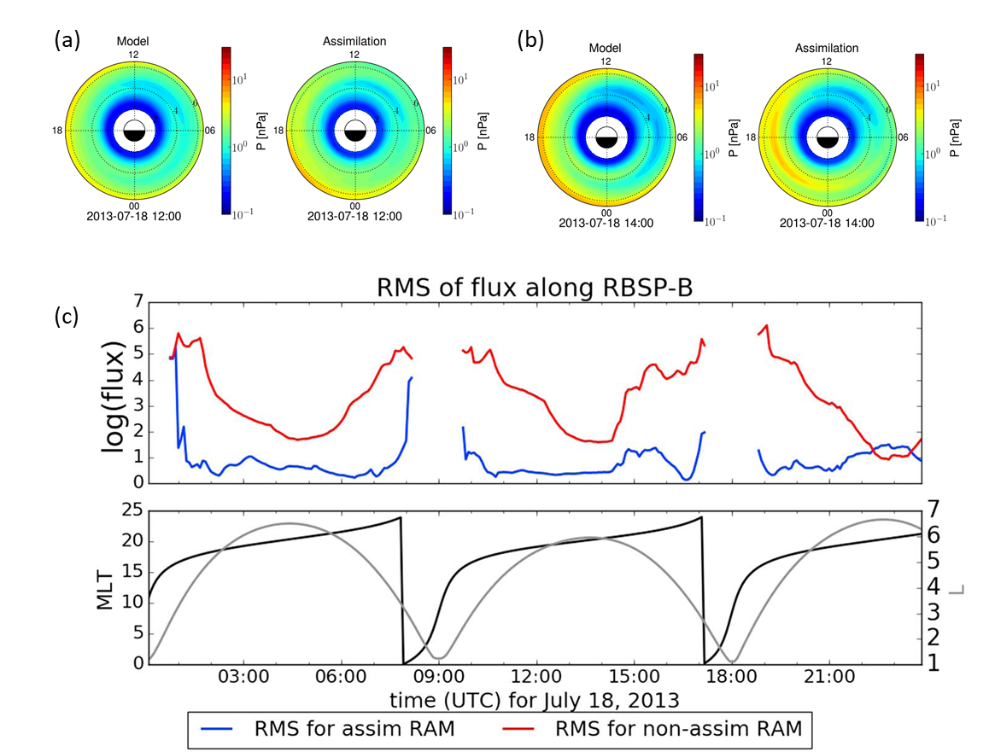
Data Assimilation Using data to improve nowcast/hindcast states
Ensemble Kalman Filter
EnKF is computationally cheaper than some other DA schemes
Orthonormal projection used to capture dominant correlations in ring current
Data assimilation is performed in orthonormal subspace and then transformed back into RAM frame
Uses covariance inflation to avoid ensemble collapse and localization to reduce spurious long range correlation
Data assimilation needs data!
Low-latency data improves nowcasts
High-latency data improves hindcasts
Improved initial condition also improves forecasts
For details see Godinez et al., 2016
RMSE(flux) for RBSP-B
Modified from Godinez et al., 2016
RMSE for assim RAM
RMSE for non-assim RAM

Slide 11
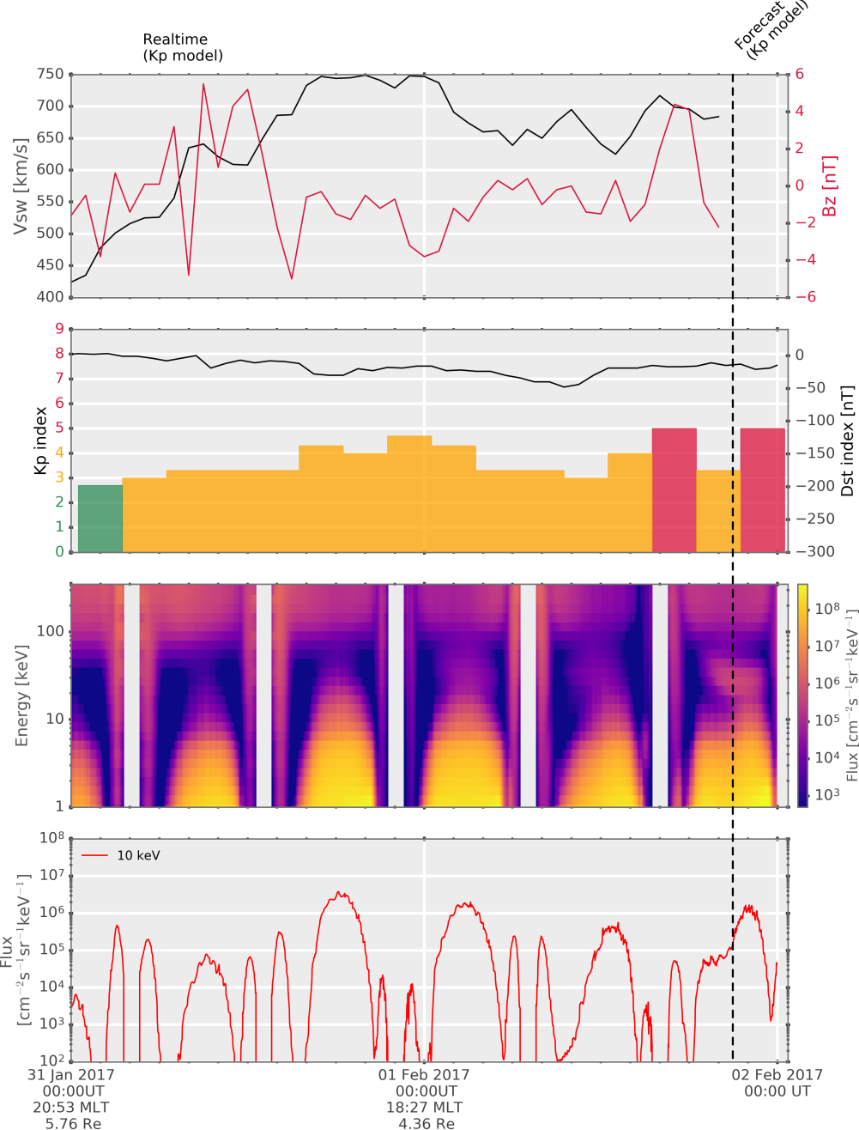
Real Time Prediction and Forecasting SHIELDS-RC provides nowcasts and short-range forecasts
Simplified configuration
All boundary conditions must be specified into the future to enable prediction
Generally this means models parameterized by geomagnetic indices
Can use dipole field or Kp-parameterized T89
SHIELDS-RC typically turns SCB off for robustness and speed
Recent SCB updates have improved robustness
Outer flux boundary specified by statistical model
Kp or VBz models can be used for “near-realtime”
Predicted Kp lets us use Kp-based models into the future, giving >3 hours of forecast window
Runs many times faster than real-time on a standard desktop computer
Predicts flux along arbitrary orbits, other products can be derived
Figure: Jordanova et al., 2018

Slide 12
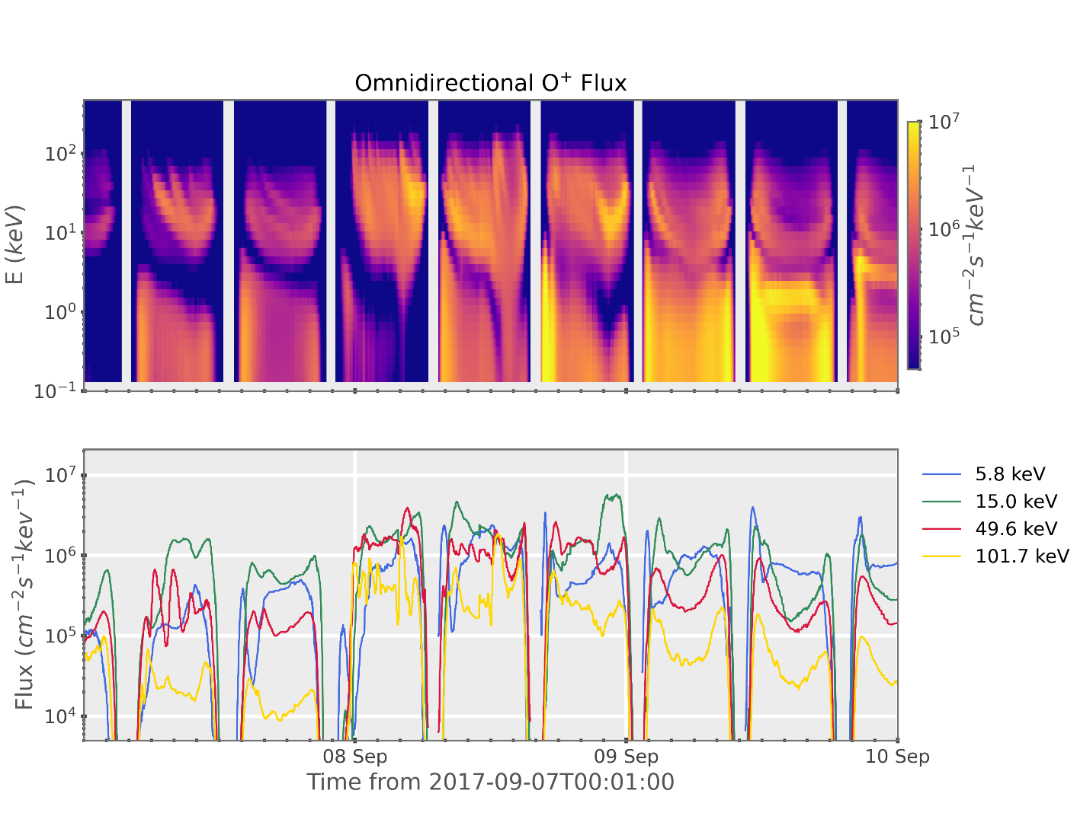
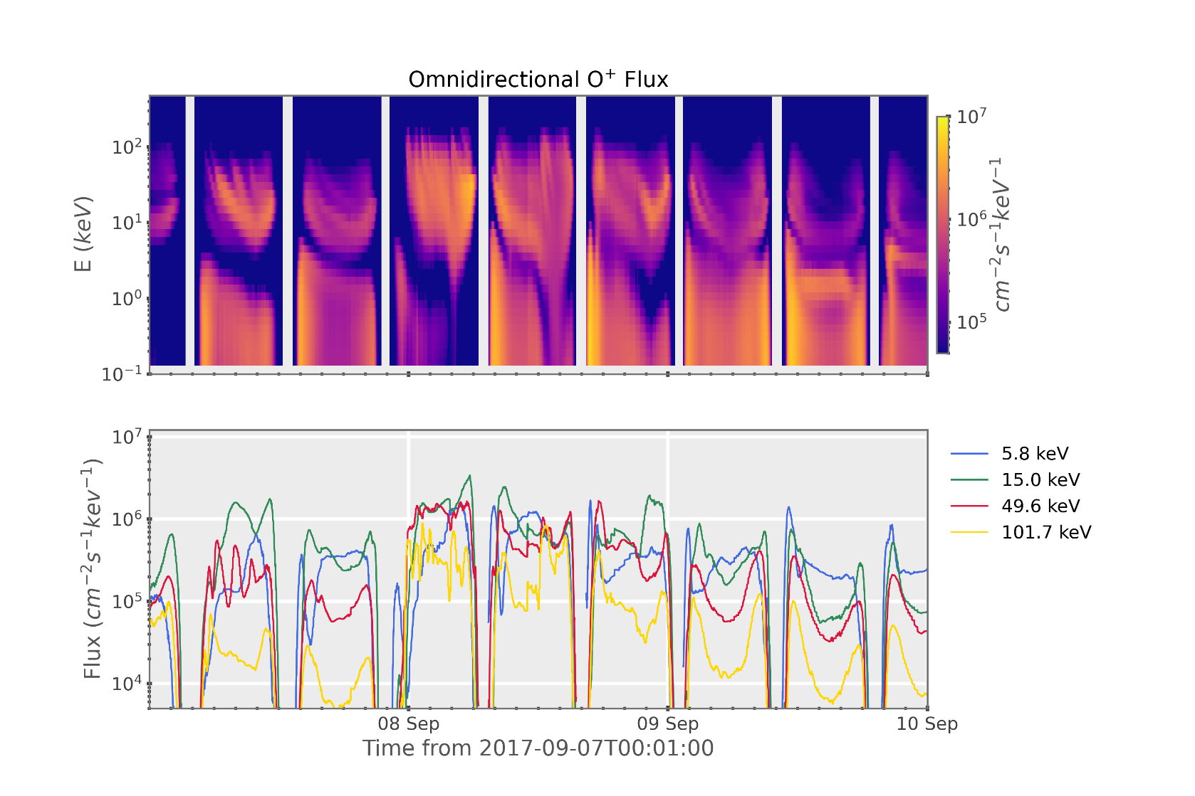
Inner magnetosphere science investigation Example: Sept. 2017 storm composition study
Using event-specific composition gives higher O+ flux and more LT structure
VAP A&B measured ratios
Young et al., 1982

Slide 13
Model on-boarding at CCMC
Deliverables
Guidelines for the CCMC users on the RAM-SCB options, including updated documentation
Tools to calculate and visualize derived products from the RAM-SCB model
Transition RAM-SCB to CCMC for runs-on-request
Initial model configurations for runs-on-request are TBD
Subject to both validation and robustness testing
Progress
Project just started
Work underway on improved documentation and out-of-the-box visualization tools
Installation tested on CCMC AWS instances

Slide 14
RAM-SCB-E is an open-source scientific model
Self-consistent electric and magnetic fields
Anisotropic pressure
Two-way coupling with SWMF
Modernized code with active development
Shared-memory parallel
Version control using git; issues and pull requests on github
Ongoing work
Integration of data assimilation capability
Surrogate modeling of RAM & SCB using ML
Improvements to plasmasphere and WPI modeling
iSWAT surface charging benchmarking challenge
Onboarding with CCMC, …

