Slide 1
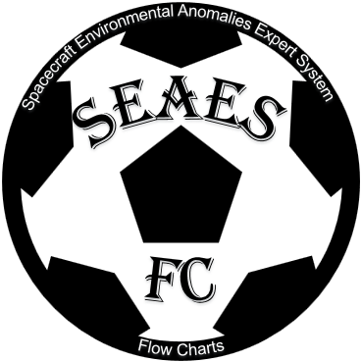
SEAES-FC (Space Environmental Anomalies Expert System Flow Charts)
Paul O’Brien¹, Alex Boyd¹, Jeff Cox² and Tim Guild¹
9 June 2022
CCMC Workshop 2022
1 Space Sciences Department—Chantilly 2 Space Domain Awareness Sensors & Analytics

Slide 2
Overview
SEAESFC – Spacecraft Environmental Anomalies Expert System
Tailoring a DoD satellite anomaly resolution tool for NASA/CCMC
The tool is built around four flow charts addressing: surface charging, internal charging, event total dose, and single event effects
User supplies vehicle of interest and date/time of anomaly and answers a couple of yes/no questions
The tool then automatically obtains needed data from iSWA and performs the analysis by executing each of the four flow charts
The tool conclusions are “Investigate X” or “X Unlikely”, where X is each of the four hazards
The tool also provides some context graphics showing the South Atlantic Anomaly for low altitude anomalies, and the magnetotail for ex-GEO/cislunar anomalies
Expect to deliver tailored prototype to CCMC in August

Slide 3
Tailoring for Civilian Applications
This tool was initially developed for the DoD
Removed REACH LEO data dependence – unclear whether/when it will be available outside DoD channels in near-real time
Removed AE dependence:
No real-time source of AE
DoD tool can pull years-old AE from Unified Data Library (UDL)
Added support for Ex-GEO (e.g., cislunar, peri-geospace)
Changed environmental data feeds from UDL to iSWA
Added SSCWeb as ephemeris source

Slide 4
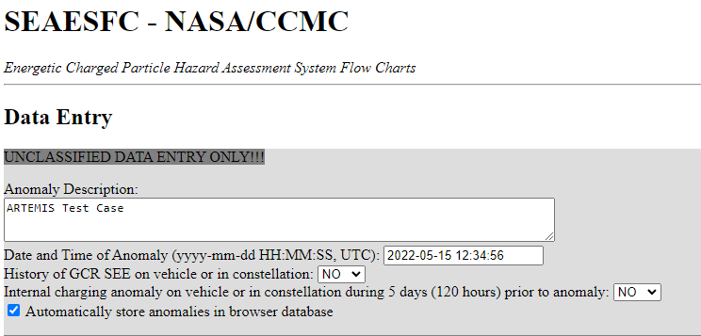
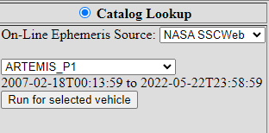
Example I – ARTEMIS in the Tail Plasma Sheet
User enters basic anomaly info
Provides orbit/ephemeris info or looks up in SSCWeb, UDL

Slide 7
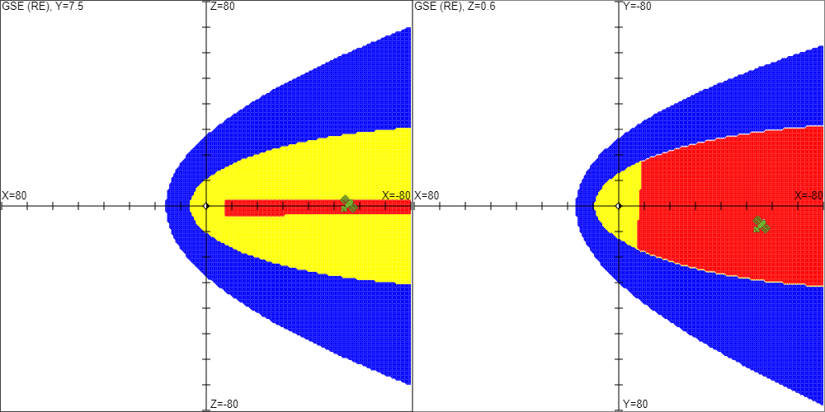
Deep Tail Surface Charging Visualization
This new visualization depicts the bow shock, magnetopause, and tail plasma sheet in GSE coordinates using the same region definitions as SSCWeb

Slide 8
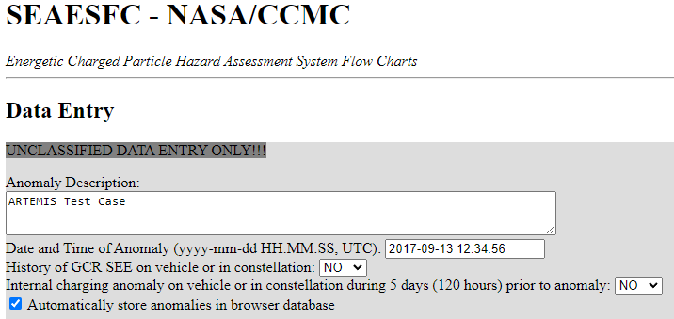
Example II – ARTEMIS during an SEP
User enters basic anomaly info
Provides orbit/ephemeris info or looks up in SSCWeb, UDL

Slide 10
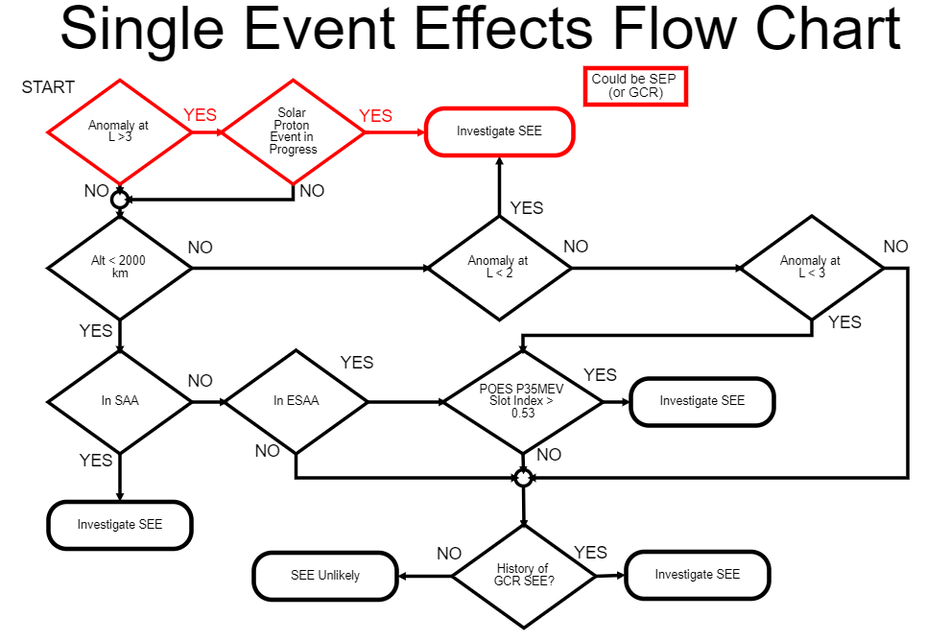

Slide 11
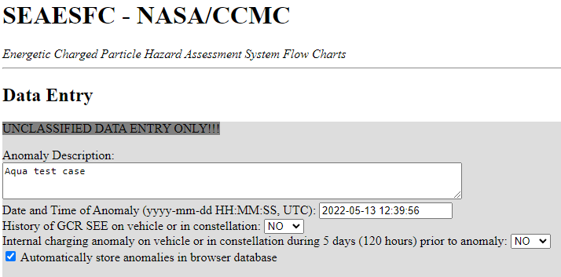
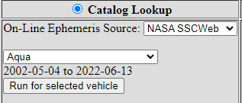
Example III – Aqua in LEO
User enters basic anomaly info
Provides orbit/ephemeris info or looks up in SSCWeb, UDL

Slide 12
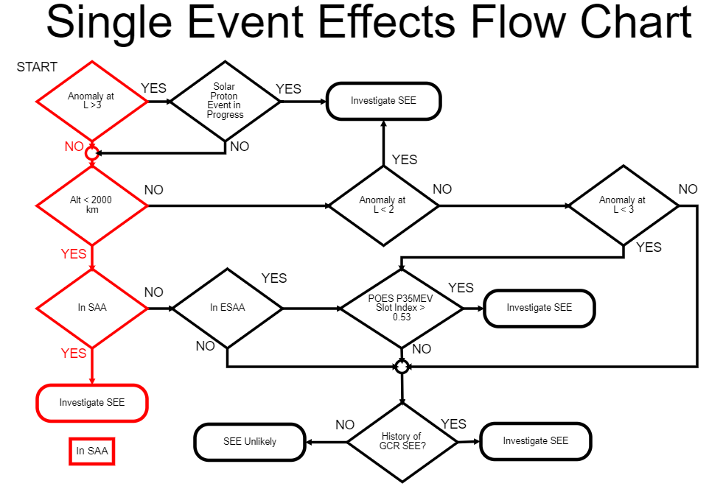

Slide 13
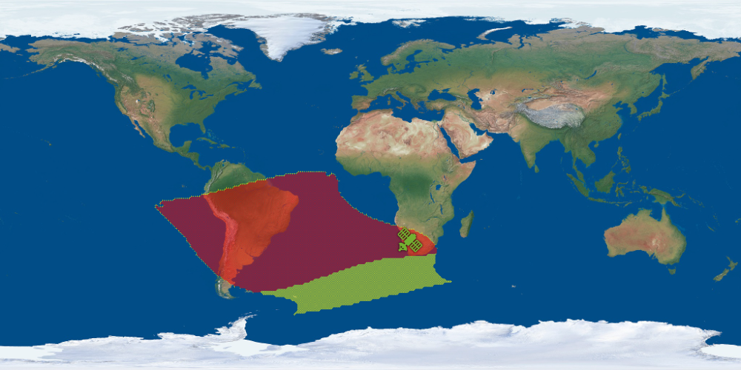
South Atlantic Anomaly Visualization
This improved visualization depicts the satellite’s location relative to the (Extended) South Atlantic Anomaly at its altitude

Slide 14
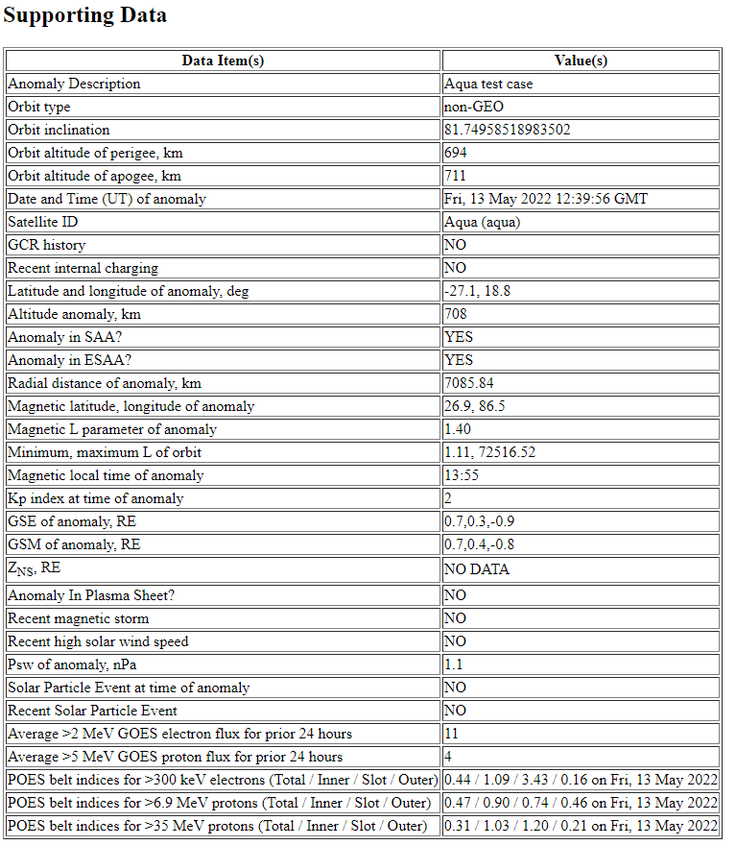
Additional Information
Each run also provides a table of supporting data in case a subject matter expert needs to dig deeper into the conclusions
The tool also saves each run in an in-browser database for retrieval into CSV format for statistical analysis

Slide 15
Summary
We are adapting a satellite anomaly assessment tool from the DoD for use at CCMC
It addresses surface charging, internal charging, single event effects, and event total dose
It extends the DoD tool from Earth orbit to all of peri-geospace
Prototype code delivery to CCMC expected in August
Coming Soon!

