Slide 1
Current and Future Real-Time Ionosphere Situational Awareness Products from SWPC
Dominic Fuller-Rowell
NOAA, Space Weather Prediction Center
University of Colorado Boulder, CIRES
CCMC Workshop 2022

Slide 2
Summary
SWPCs role (real-time situational awareness, inform forecast office, & disseminate ICAO advisories)
Legacy regional data assimilation (USTEC & NATEC)
New global ionosphere products (GloTEC, ROTI, and soon scintillation)
Ingesting COSMIC-2 and commercial Radio Occultation (RO) sTEC measurements into GloTEC
Using GloTEC to validate commercial RO data (CWDP)
Tuning parameters in physical models like WAM-IPE using results from GloTEC
TEC anomaly as for situational awareness
ROTI to detect irregularities
Algorithm for ROTI => S4 and sigma-phi
Space-based scintillation measurements -- geolocated S4, all-clear, and bubble maps

Slide 3
SWPC
Provide low latency situational awareness products
Forecast office issue alerts and advisories (e.g. ICAO)
Develop new products in collaboration with the larger research community (R2O)
Validate new observations (e.g. CWDP)
Forecast space weather phenomenon and impacts
Facilitate O2R - share models and data with the scientific community (e.g. CCMC)

Slide 4
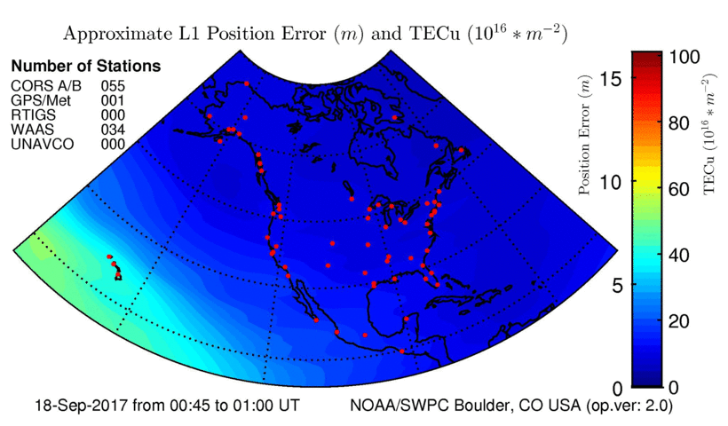
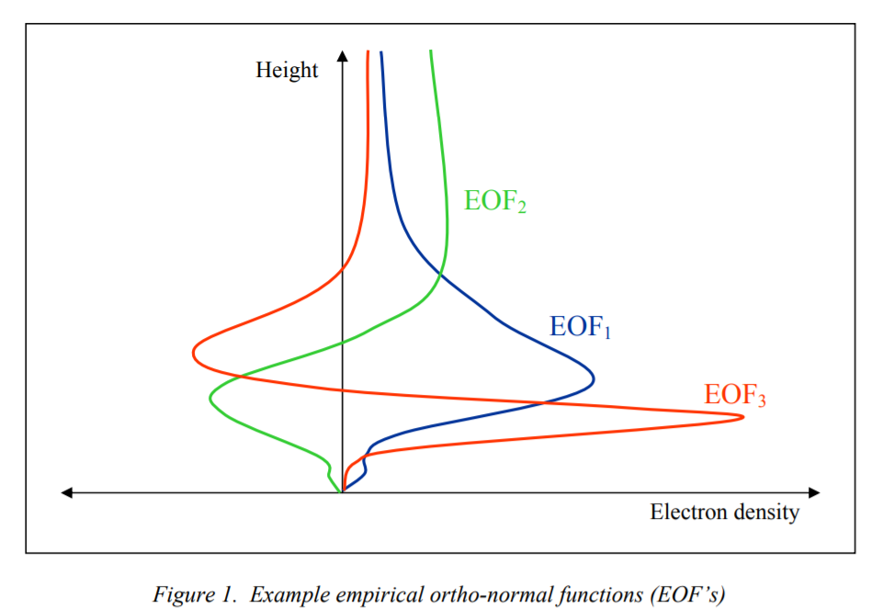
NATEC – Regional TEC Legacy product (~2005)
Gauss-Markov Kalman Filter
IRI as background model
Tuned for vTEC
Ne is weighted sum of three EOFs
EOFs reduce computational cost
Solve for 3 coefficients rather than Ne at each altitude
Solution is constrained to the climatological empirical IRI profile
Effective approach for ingesting ground-based, upward looking observations
Distributes the observations vertically
Struggles ingesting orthogonal look direction radio occultation (RO) observations (e.g. COSMIC-2)

Slide 5
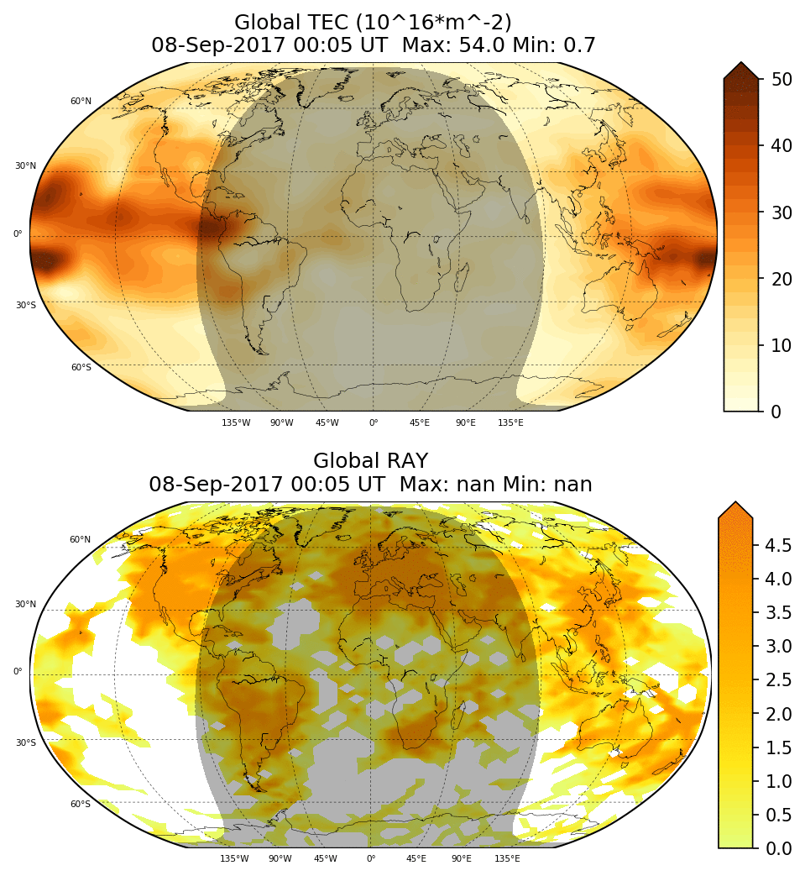
Real-Time Global Ionosphere Specification
Called GloTEC
Global 3D electron density data assimilation
Gauss-Markov Kalman filter - GMRES solver
IRI-16 background model
Data coverage
# of observations per F-region voxel
Real-time ground-based GNSS observations
IGS, UNAVCO, INPE, NRCan, RAMSAC, CDDIS, and more
Space-based GNSS observations (RO)
Orthogonal look direction
COSMIC 1 & 2
ICAO thresholds of 125 & 175 TECu
Used to tune physics models like WAM-IPE
Used for validating new observations
Deploying GloTEC at CCMC

Slide 6
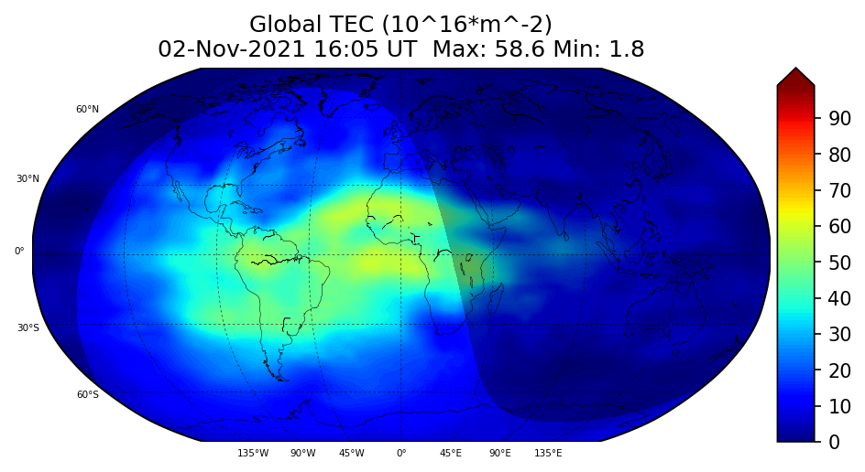
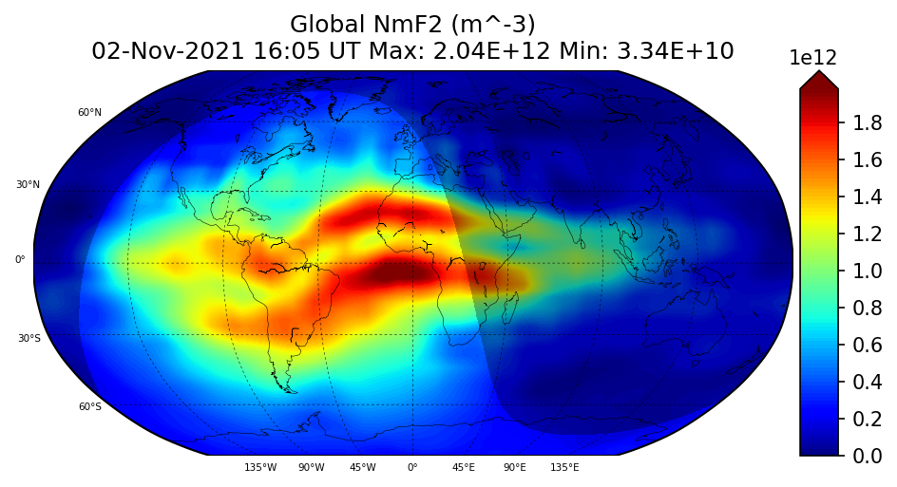
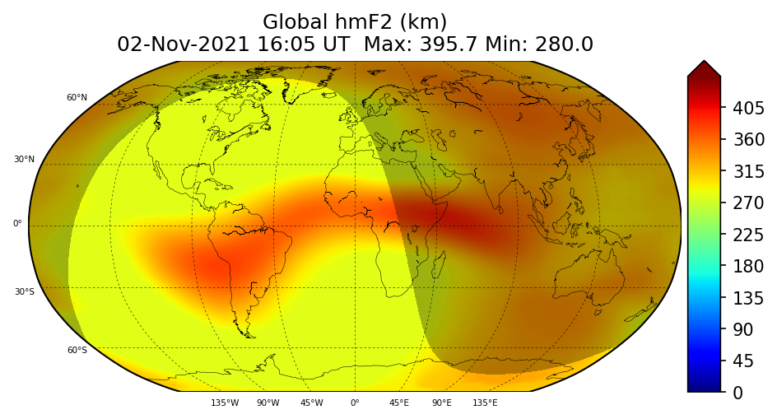
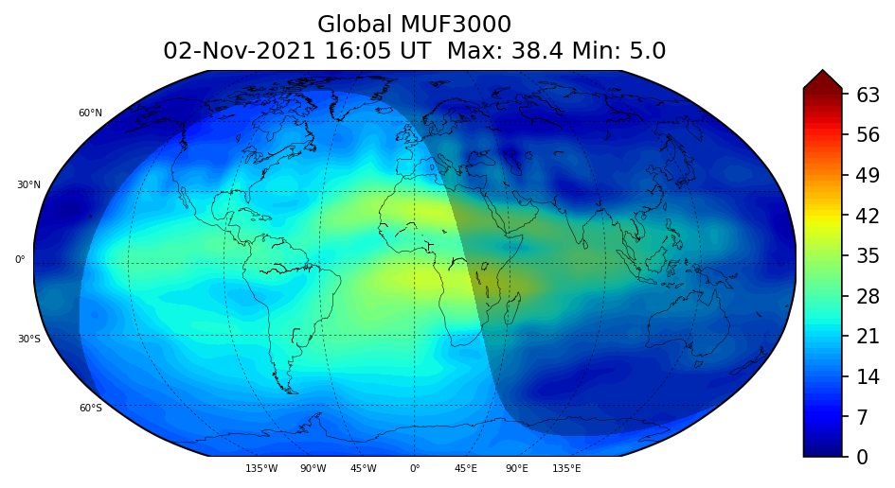
GloTEC Products

Slide 7
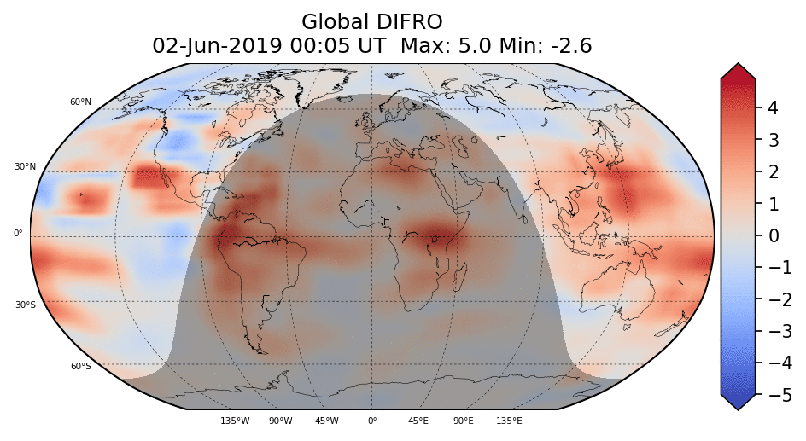
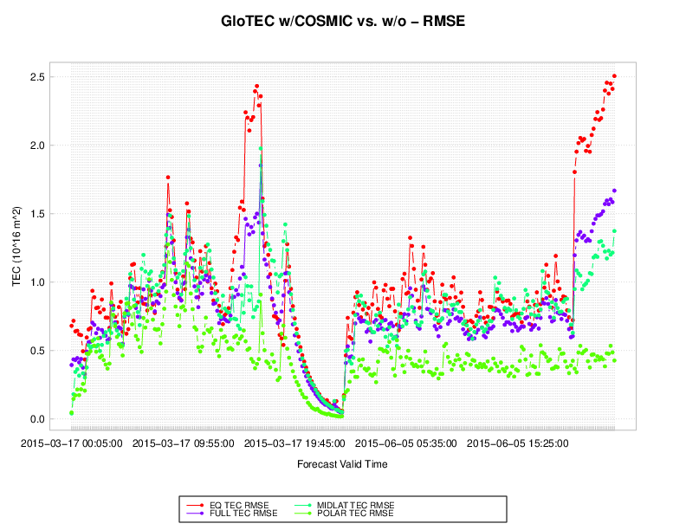
Ingesting Radio Occultation Observations
GloTEC TEC product - quiet time
Difference in TEC w/ & w/o commercial RO
Realistic, significant, and reasonable impact
Provides data where coverage is lacking
Approximately +- 5 TEC units
Believable impact where there aren’t ground-based observations
NCAR METplus and METviewer tools
Regional RMSE with and w/o RO
Expect small difference in vertical TEC
Expect large difference in vertical distribution of Ne
Commercial validation report delivered, and findings submitted to congress
Ingesting commercial data in real-time…ops?
Sounds like more commercial data is coming

Slide 8
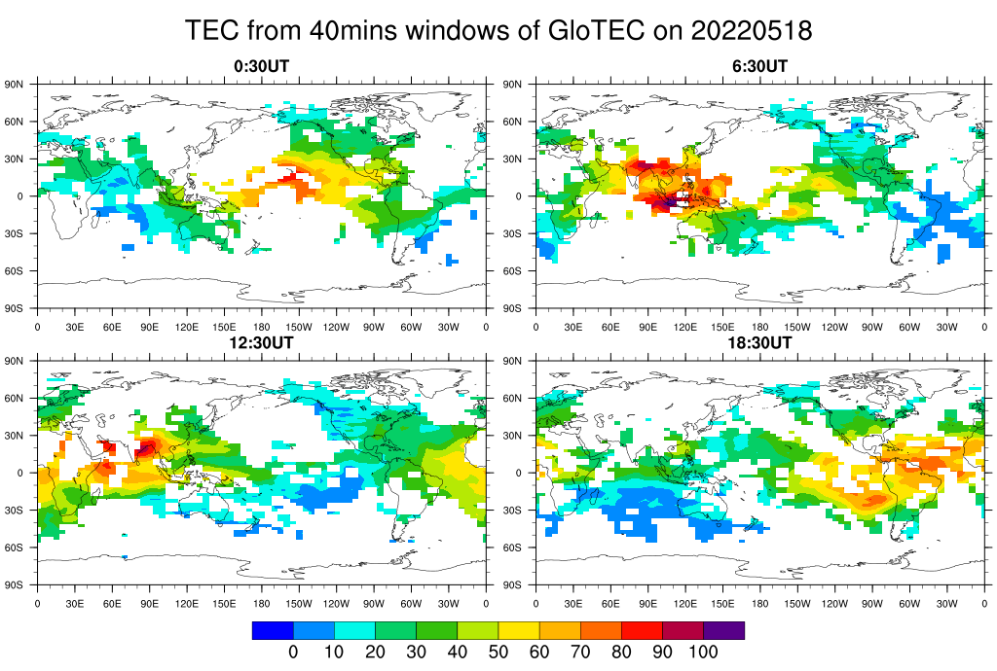
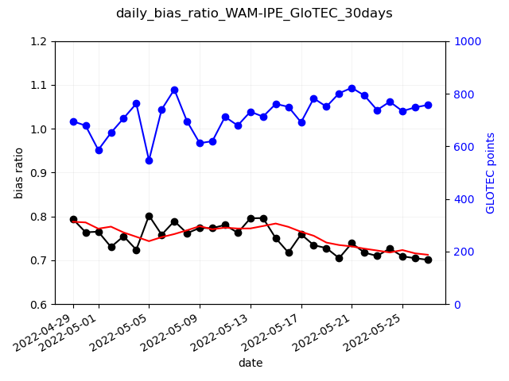
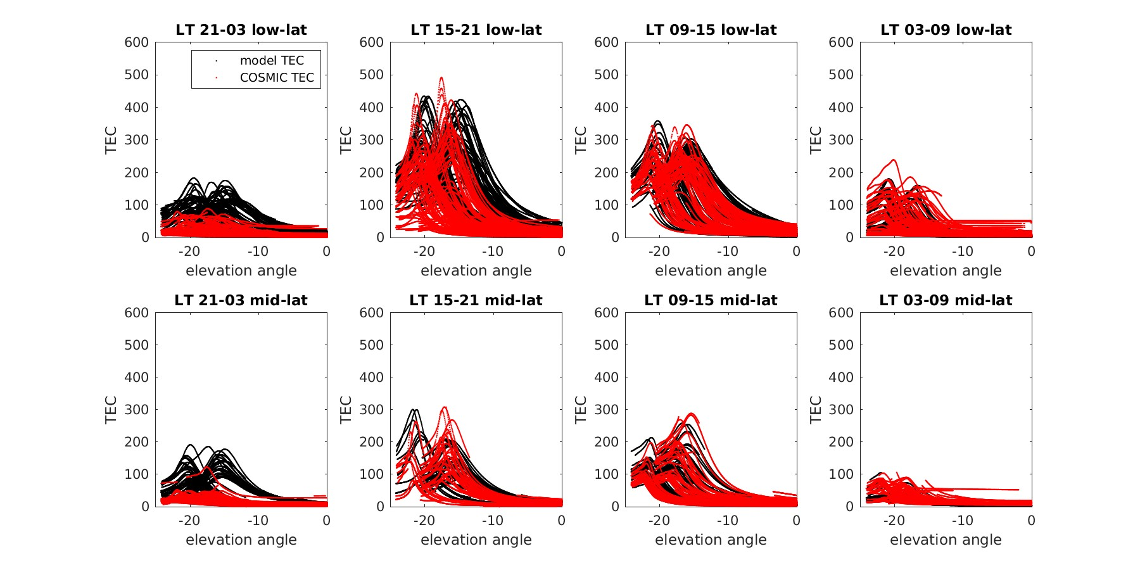
Bias correction: WAM-IPE Parameter Tuning
Example of coverage in 40-minute window using COSMIC-2 data, with real-time ground-based GNSS in Glo-TEC
40-min
window
WAM-IPE exceeds COSMIC-2 plasma density particularly at dusk through to midnight
A reduction in the vertical plasma drift (Vi, scaled by E_factor) at low latitude can bring the WAM-IPE plasma density into better agreement with COSMIC
A reduction in plasma density can also be achieved by increasing the plasma loss rates - increasing eddy mixing (keddy) decrease the O/N2 ratio
Reducing the WAM-IPE bias can improve the value of the ensemble data assimilation
Keddy = 180, E_factor = 0.5 (reduce V_{i})

Slide 9
vTEC Anomaly - Departure from 10-day running mean
Anomalous vertical TEC informs systems operators
SED features can cause scintillation
Enhancements impact positioning
Depressions impact HF comms (MUF)

Slide 10
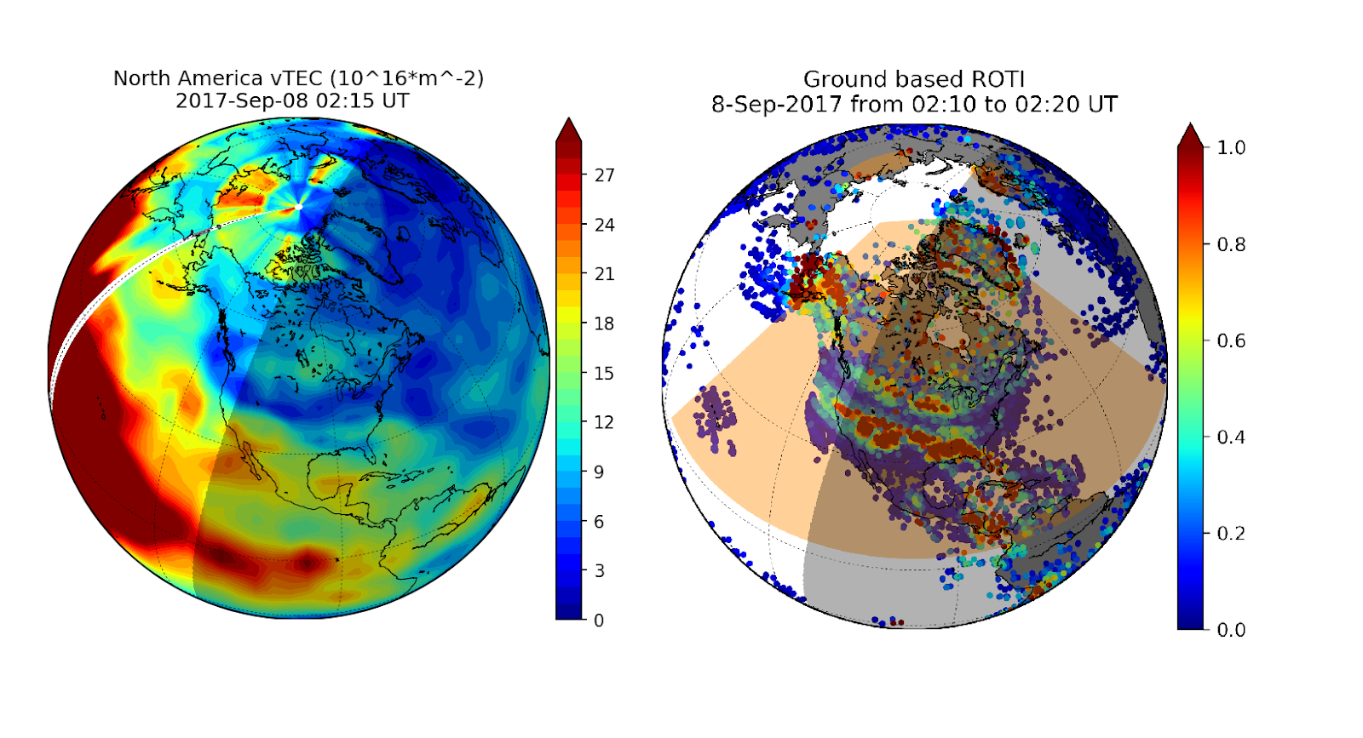

Slide 11
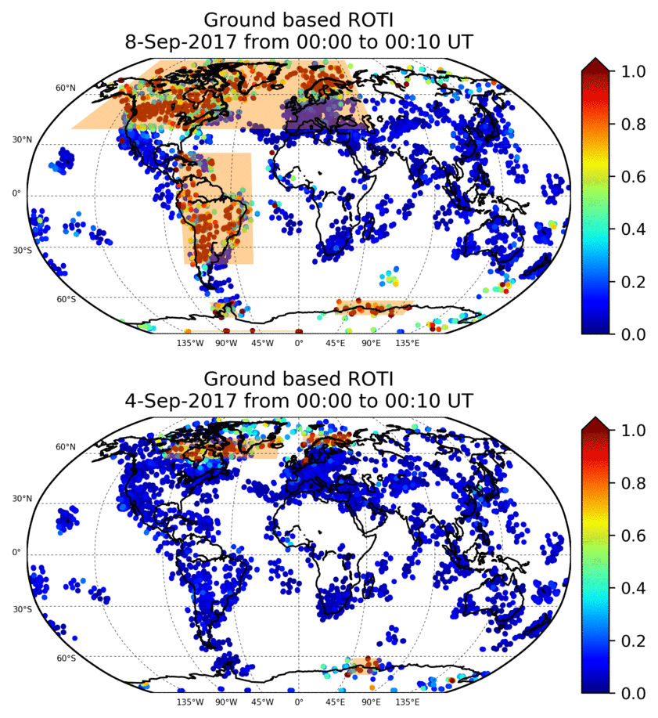
Same ground based GNSS observation data as GloTEC
ROTI - Rate of TEC Index
STD of detrended TEC
Elevation angle dependence sTEC-> vTEC
Proxy for amplitude and phase scintillation (S4 and Sigma Phi)
Automatically draw advisory boxes
DBSCAN machine learning algorithm
Tuned to ignore “noise” (anomalous ROTI observations)
ROTI and GloTEC to be used by forecast office to issue ICAO scint. advisories
Space based S4
Geolocating irregularities (with Keith Groves and Charlie Carrano)

Slide 12
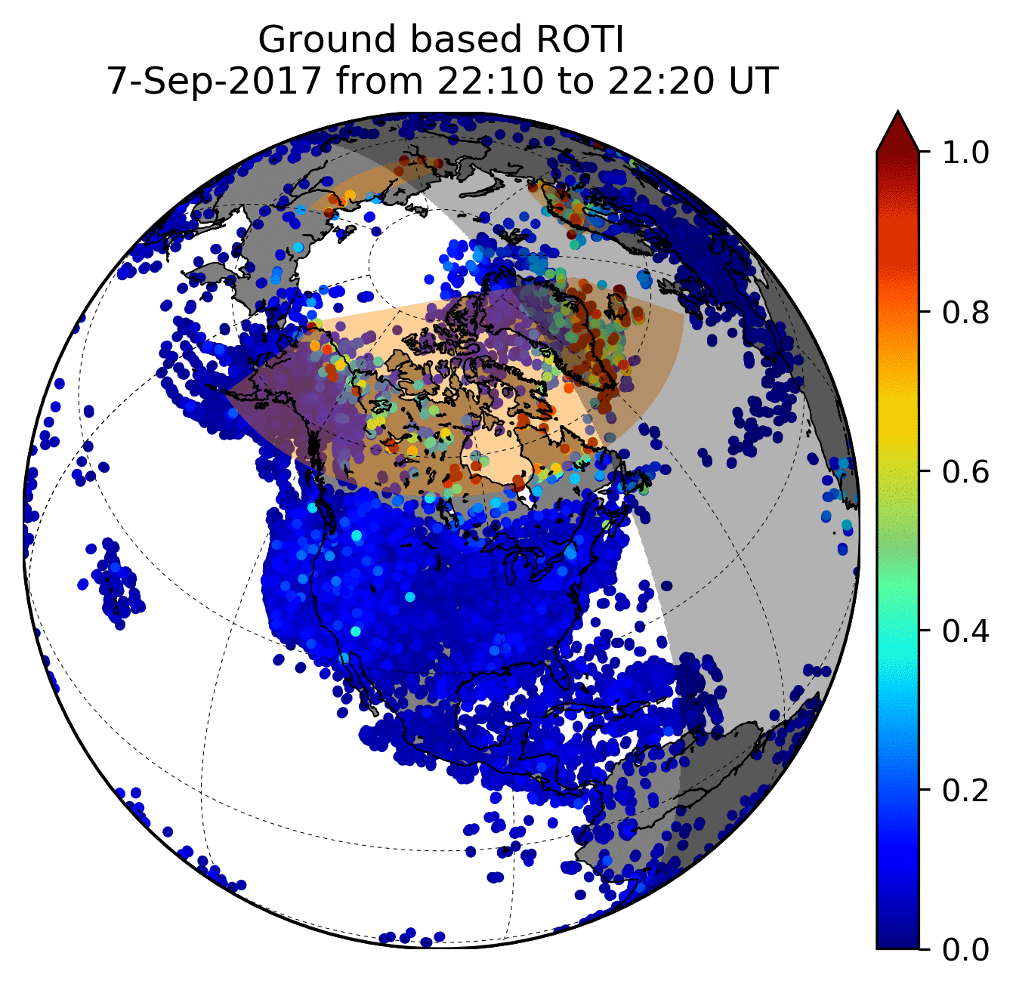
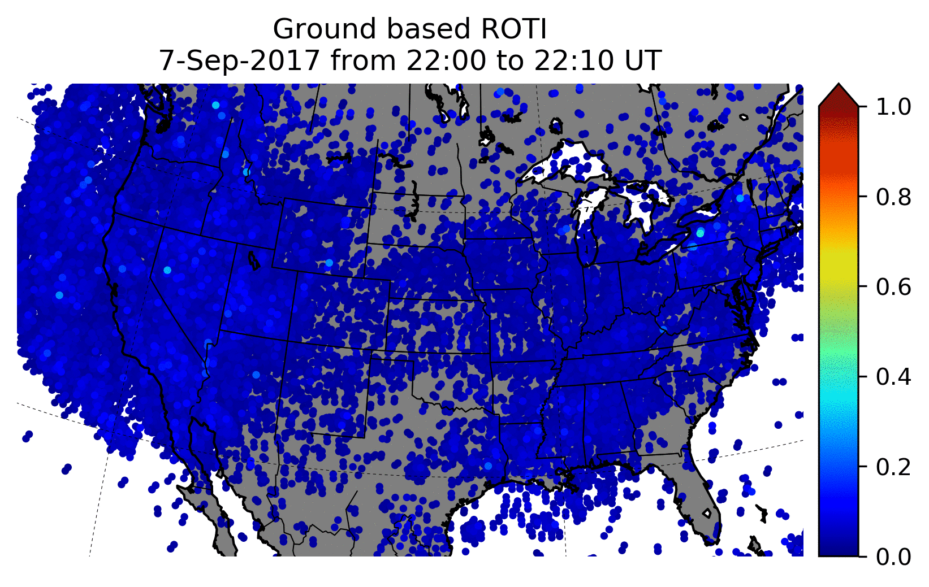
Real-world Impact on GNSS systems
Fewer observations (slip or loss of lock?)

Slide 13
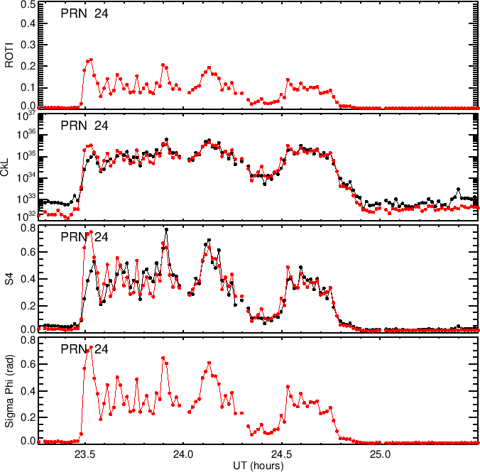
Choosing an irregularity index
We want to estimate irregularity strength
Need to remove observation geometry and relative velocities (scan velocity + drift velocity)
We would like to provide irregularity strength measured from ground and space
Proxy for impacts on operational systems by using 1Hz observations
Collaboration with BC and Aerospace on scintillation products
COSMIC-2 bubble map and all-clear coming
Coverage provided by RO observing platform is potentially game changing – Coverage!
Many challenges to developing spacecraft that can accurately measure S4
attitude must be accurately controlled and measured
Receiver occulator must be of sufficient quality
(Carrano et al., 2019)

