Slide 1
Space Weather Forecast with the Operational WAM-IPE
2022 NASA CCMC Workshop
Tzu-Wei Fang
NOAA Space Weather Prediction Center (SWPC)
Acknowledgement: T. Fuller-Rowell, G. Millward, A. Kubaryk, R. Montuoro, Z. Li, N. Maruyama, P. Richards, R. Akmaev, A. Richmond, H. Juang, S. Kar

Slide 2
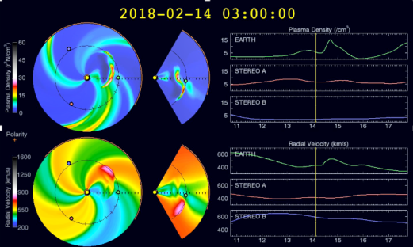
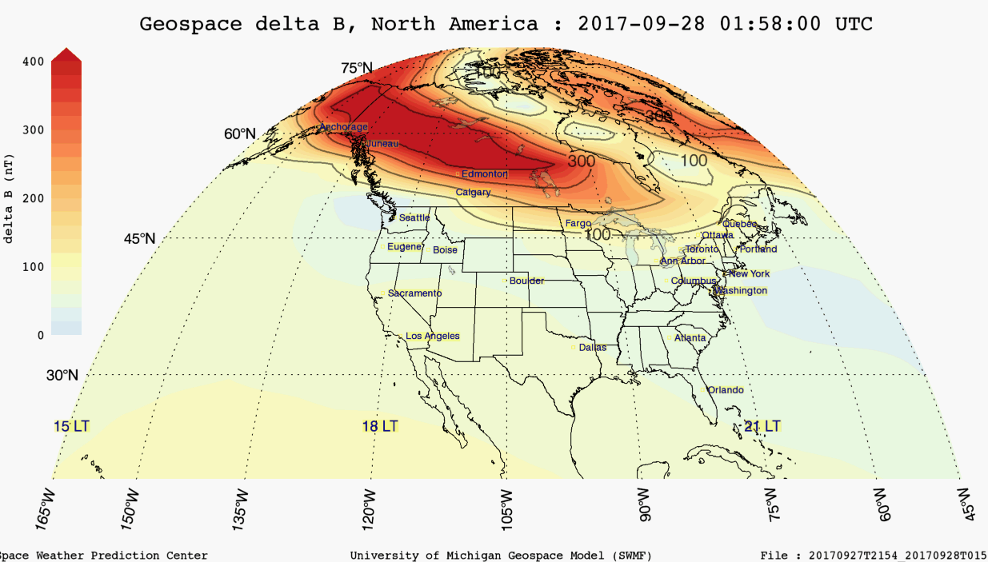
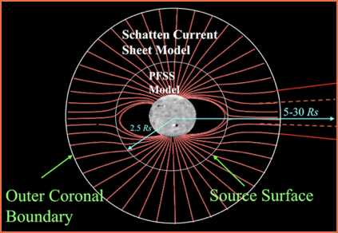
Operational Space Weather Models at NOAA NWS
WSA-ENLIL and the SWMF Geospace models have been transitioned to NOAA operations and are now providing real-time space weather products
WSA-ENLIL follows the propagation of plasma from Sun to Earth through interplanetary space for arrival time of coronal mass ejection (CME)
The SWMF Geospace model simulates the response of near-Earth magnetic fields (Earth’s magnetosphere) for impacts of induced currents on power grids and impacts of energetic particle on satellite systems
Transitioning WAM-IPE to operations added an important link in the Sun to Earth modeling framework.
Enlil
J. Grebowsky
WSA
Geospace
Notes:
Add a slide for other swpc models

Slide 3
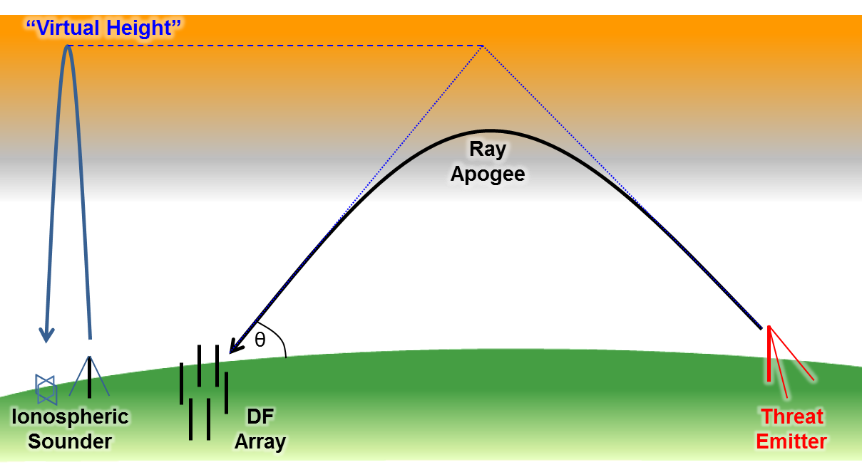
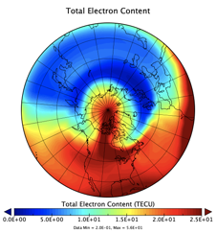
What operators care about
what WAM-IPE contributes marked in red
For HF communication:
Changes in the Minimum Usable Frequency (LUF) due to D-region absorption (DRAP)
Changes in the Maximum Usable Frequency (MUF) due to the peak plasma density (NmF2) and height of peak (hmF2)
Undulations in bottom-side F-region
For satellite positioning, navigation, timing, and communication:
Mesoscale structure and gradients in plasma density (diffract radio signals and cause amplitude or phase fluctuation in GNSS signals)
Delay in navigation signal due to line of sight electron content (position error)
Small-scale ionospheric irregularities causing scintillations/fluctuation or complete loss of signal
For satellite drag
Neutral density and its uncertainty (for decision making, maneuver planning)

Slide 4
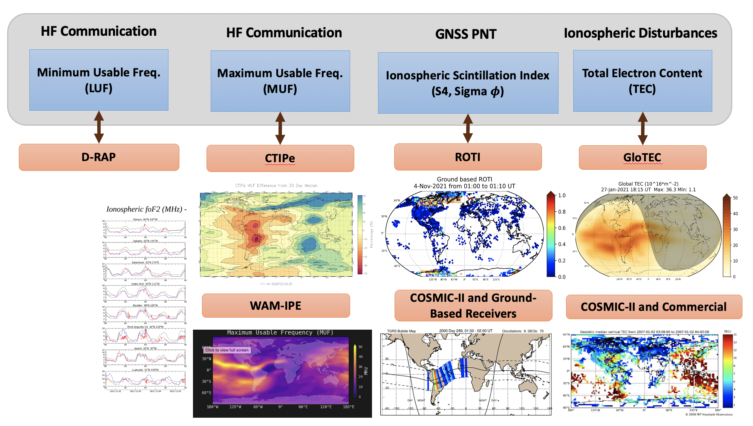
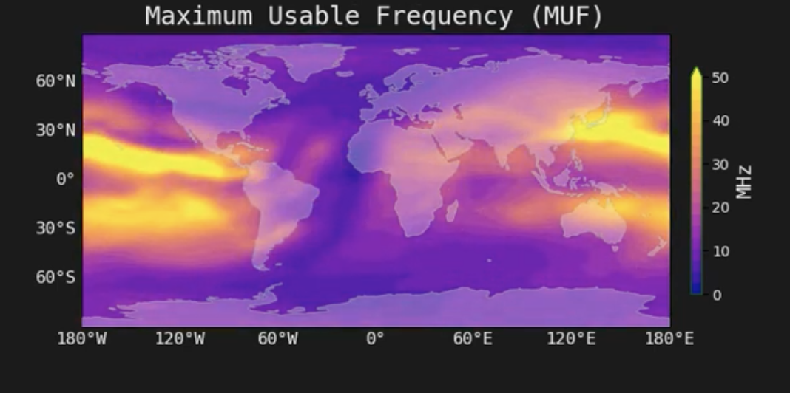
Shortwave Fadeout

Slide 5
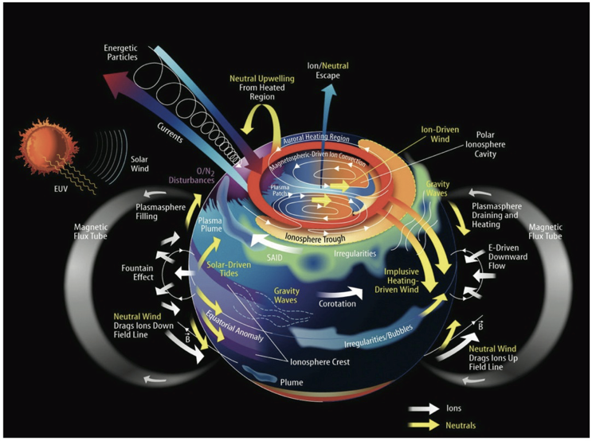
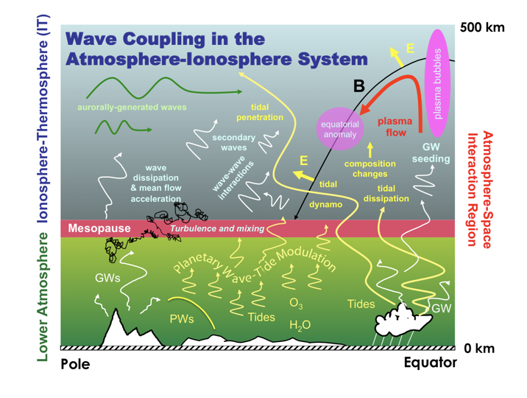
The Ionosphere and Thermosphere
The upper atmosphere exhibits significant variability just like the troposphere weather system.
The system is driven by conditions in the incoming solar wind (velocity, density, and magnetic field), solar UV and EUV radiation, as well as the waves/tides from the lower part of the atmosphere.
Courtesy of J. Grobowsky
Lower Atmosphere Forcing
Longitude structure in tropical convection drives non-migrating tides
Sudden stratospheric warmings modulate the migrating tides
TW3 migrating tide drives nightside density, temperature and winds
Background variability
J. Grebowsky
Courtesy of J. Forbes
Notes:
Add a slide for other swpc models

Slide 6
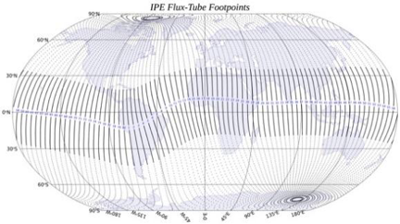
Solar and Geomagnetic Activities
(solar radiation, high-latitude E, aurora, joule heating)
Whole Atmosphere Model (WAM)
0-600 km, 0.25 scale height, 2°x 2° lat/long, T62, hydrostatic, 150 levels, 10-fold extension of Global Forecasting System (GFS) US weather model.
O3 chemistry and transport, cloud physics and hydrology
Radiative heating and cooling
Sea surface temperature field and surface exchange processes
Orographic and non orographic gravity waves parameterization
WAM Data Assimilation Scheme (WDAS)
Diffusive separation, ion drag, Joule heating, etc.
Ionosphere Plasmasphere Electrodynamics (IPE)
Time-dependent, global 3D model from 90 km to several Earth radii
IGRF coordinate system, accurately represents Earth’s magnetic field
Includes Field Line Interhemispheric Plasma (FLIP) model
ExB transport across magnetic field
Seamless perpendicular plasma transport pole-to-pole
Weimer/Heelis empirical ion convection model driven by solar wind data, TIROS auroral empirical model
Provides plasma densities (9 ion species), thermal electron and ion temperatures, and ionosphere and plasmasphere velocities
ESMF 3D-regridding WAM→IPE information
Lower Atmospheric Perturbations
(thermospheric tides, planetary waves, gravity waves)

Slide 7
What does it take to get the model into operation?
Validation and verification on model physics
Clean and robust code that runs faster than the real-time
Well documented code with proper version control applying modern software practice
Tunable parameters for model physics adjustments in operation
Manageable workflow for Concept of Operations (CONOPS)
Real-time solar and geomagnetic drivers, and a method to mitigate the data gaps and flagging of poor quality data
Computer architecture to support 24/7 operations
Usable products that forecasters and customers can easily work with

Slide 8
Forecast Workflow
Space Weather Drivers
Model ICs
Real-time/Forecast
Model grids, fix files
ESMF/
NUOPC coupling interface
COMIO
Lower Atmosphere
DA Data
WAM Data Assimilation System (WDAS)
WAM
IPE
SWIO
SWIO
Neutral parameters on pressure grid
Plasma parameters on fixed height grid

Slide 9
WAM-IPE Workflows
CONOPS I ― Include tropospheric weather into upper atmosphere forecast
Low-frequency (atmospheric data driven, hours)
Based on NWS global workflow (6-hour cycles) with WAM data assimilation
WAM Data Assimilation Scheme (WDAS): modified Gridpoint Statistical Interpolation (GSI) 3D-VAR with Incremental Analysis Update (IAU)
Observed and predicted space weather drivers for external forcing
CONOPS II ― Capture the impact of near real-time solar wind conditions
High-frequency (solar data driven, minutes)
Extension of global workflow (CONOPS I) with online solar data polling
Initialize at end of IAU “corrector” segment from CONOPS I with available solar wind drivers
Advance as soon as observed solar wind data are available
Notes:
The need for 2 CONOPS

Slide 10
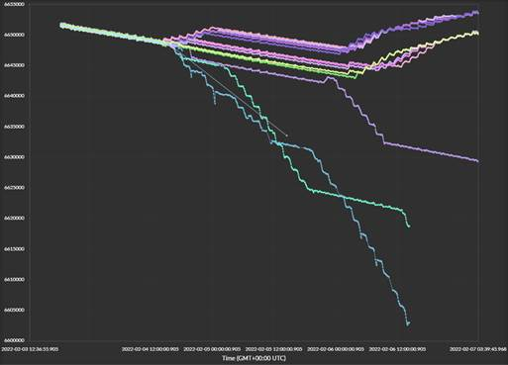
The Starlink Incident on Feb 4th, 2022
On 3rd February at 1:13 pm EST (18:13 UTC), a SpaceX Falcon 9 launched 49 Starlink satellites to low Earth orbit (350 x 210 km, 53$°$) from the Kennedy Space Center in Florida. SpaceX reported the loss of up to 38 of the 49 satellites when they encountered increased atmospheric drag due to a geomagnetic storm while they were in orbit-raising maneuvers. https://www.spacex.com/updates/ (8th Feb 2022).

Slide 11
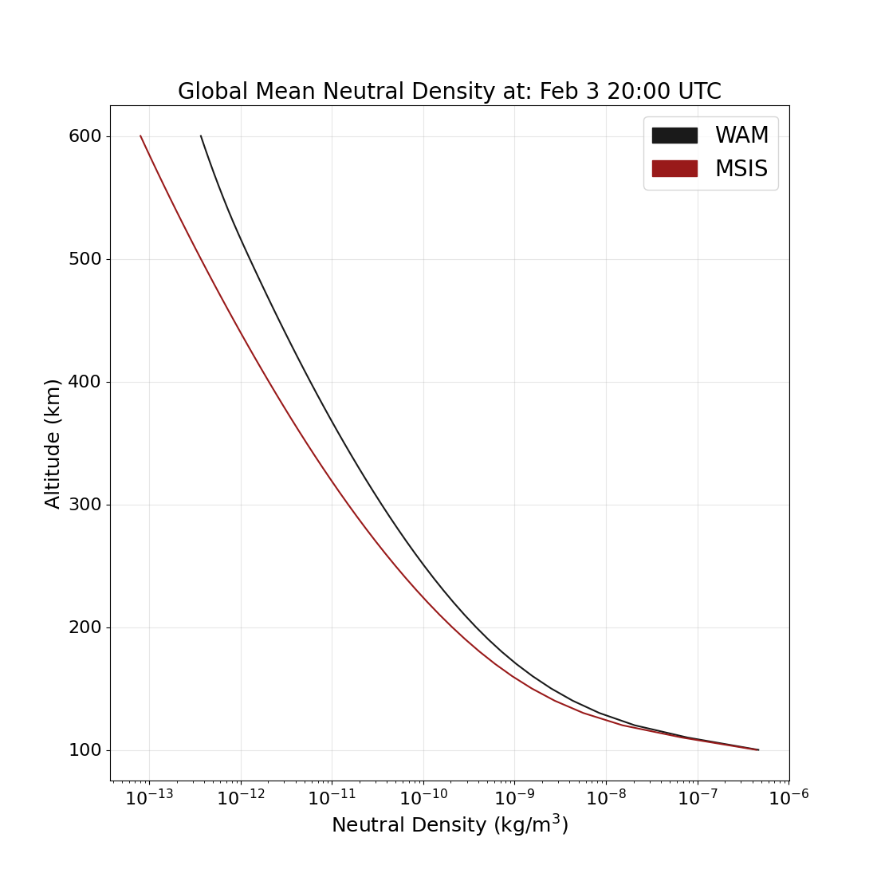
Neutral Density for the Starlink Satellite Loss
WAM and MSIS neutral density at 210 km

Slide 12
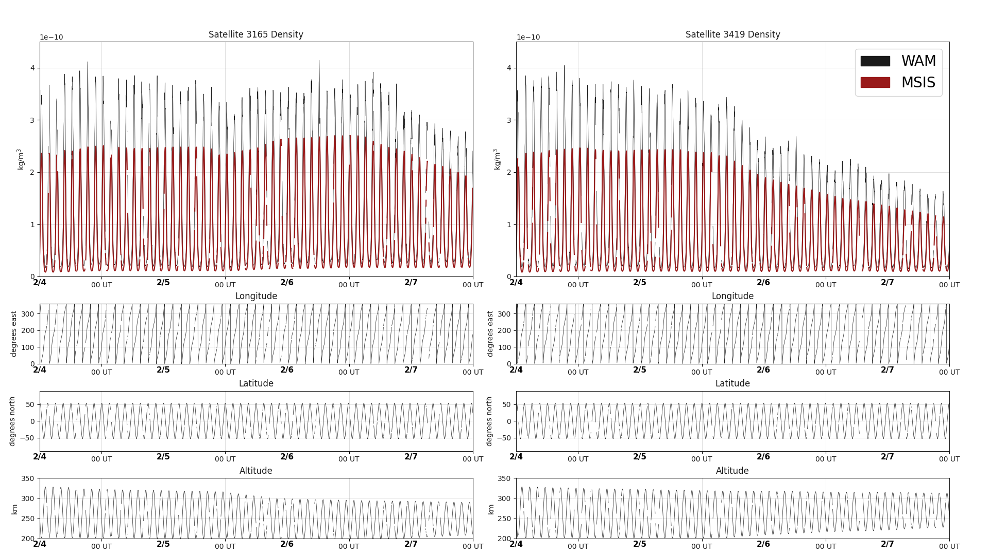
Neutral density sampled along orbits of survived Starlink satellites based on WAM-IPE (black) and MSIS (brown) global densities. It is clear that WAM have shown a much higher density environment compared to MSIS.

Slide 13
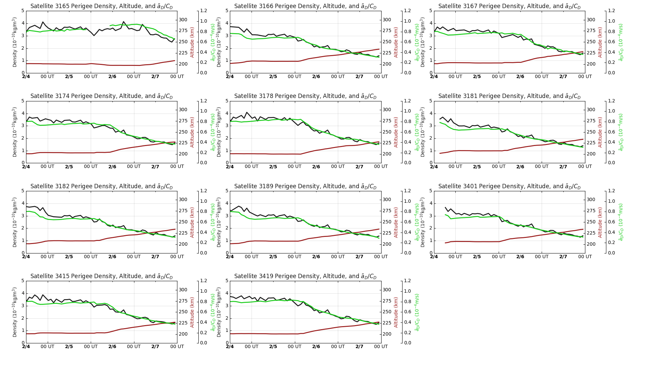
Neutral Density at Perigees
Satellite altitudes (brown)
WAM-IPE (black)
Neutral density proxy by Starlink onboard Kalman filter calculations (green)

Slide 14
Summary and Conclusion
The WAM-IPE has been in operation and provide products continuously since last July (https://www.swpc.noaa.gov/products/wam-ipe).
New products include ionosphere TEC, MUF, and thermosphere neutral density that will be used at the NOAA Space Weather Forecast Office for issuing alerts and warnings.
Future development of the WAM-IPE
Engaging the user community to improve product designs.
Provide the gridded neutral density outputs from WAM.
Implement the DA systems for WAM-IPE operation.
High-resolution model for capturing small-scale plasma irregularities (funded by NSF SWQU).
New WAM based on the Finite-Volume Cubed-Sphere Dynamical Core FV3 model for the US global forecast system.

