Slide 1
Update on PWOM and PLANET-ITTR
Alex Glocer
Many collaborators (acknowledged in sections)

Slide 2
Outline
PWOM Model overview
Major features since last workshop
  Improved coupling to SWMF allowing for studies of hemispheric asymmetry in ion outflow
  Lagrangian remap/regridding
  Adding N+ to outflow solution
PLANETARY Ionosphere Thermosphere Tool for Research (PLANET-ITTR) Model overview
Example applications:
  Planetary conductance estimates
  Hydrodynamic Escape of primary atmospheres

Slide 3
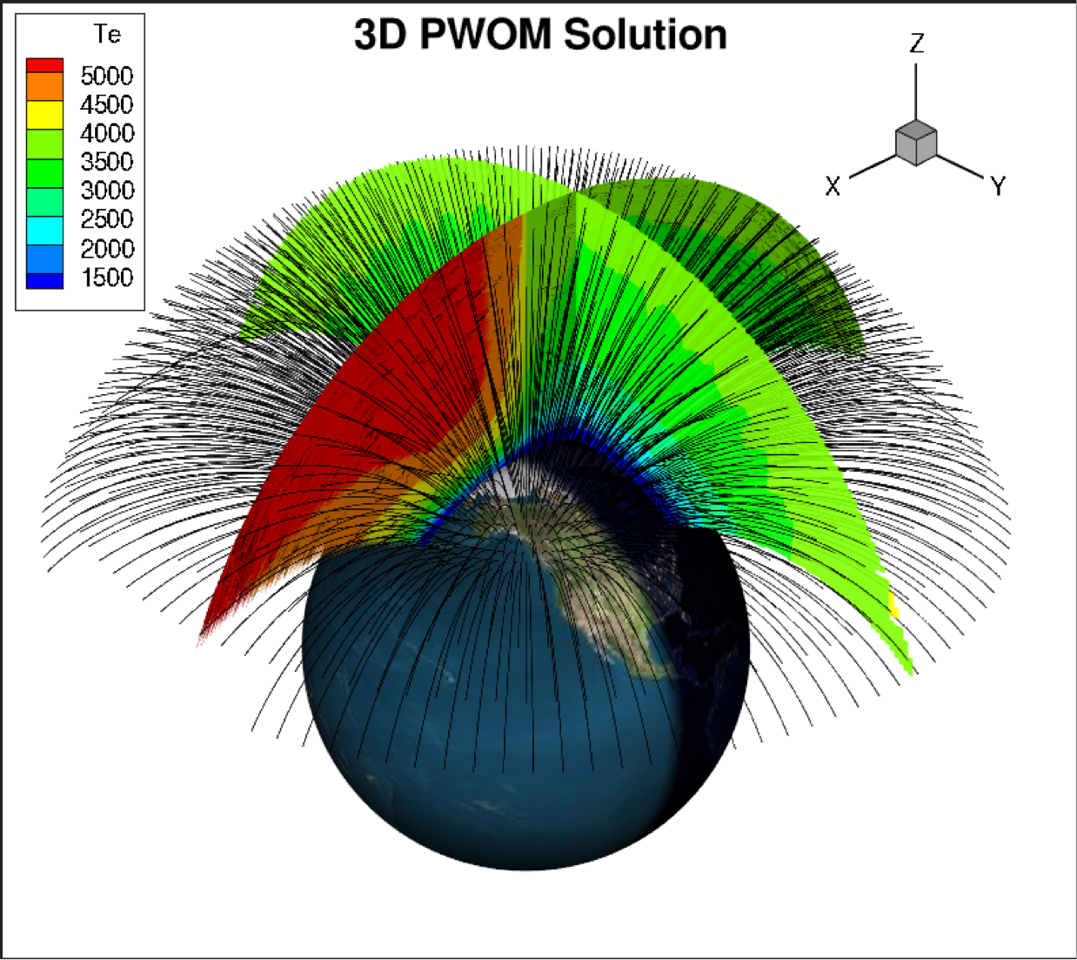
Polar Wind Outflow Model
(PWOM)
Determines transport of plasma from ionosphere to magnetosphere
Multiple convecting field-lines solutions are obtained
Key references:
  Expansion from 1D to 3D: Glocer et al., 2009a
  Coupling to multi-fluid BATSRUS: Glocer., et al 2009b
  Inclusion of kinetic Electrons: Glocer et al., 2012,2017
  Inclusion of kinetic Ions and WPI: Glocer et al., 2018
  Asymmetric outflow: Glocer et al., 2020

Slide 4
A combined fluid-kinetic approach
Glocer et al, 2018
New model capability to enable global kinetic studies of ion outflow.
Similar in concept to DyFK & GPW models but with some advantages

Slide 5
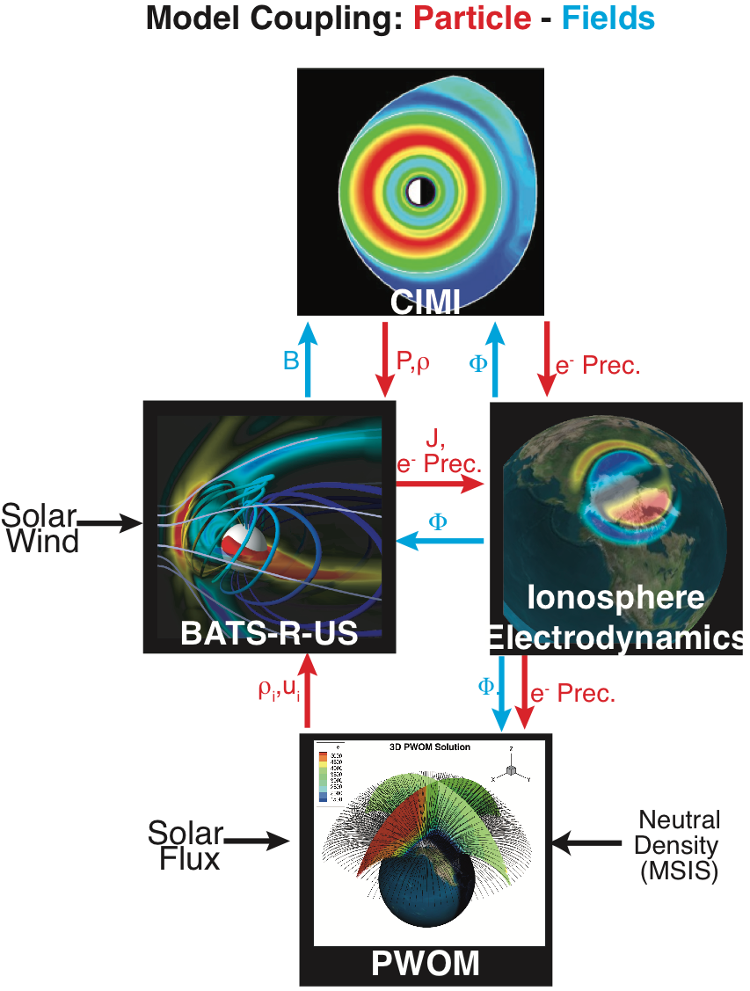
Update 1: Asymmetric Outflow Solution
PWOM is fully coupled to SWMF enabling studies of magnetospheric composition.
Previous coupling of PWOM ”mirrored” northern hemisphere outflow to southern hemisphere
Improved coupling allows for separate N and S hemisphere solutions.
Glocer et al., [2013]
Glocer et al., [2009,2018]
Ridley et al.,
[2004]
Glocer, A., Welling, D., Chappell, C. R., Toth, G., Fok, M.‐C., Komar, C., et al. (2020).
A case study on the origin of near‐Earth plasma. Journal of Geophysical Research: Space Physics, 125, e2020JA028205. https://doi.org/10.1029/2020JA028205

Slide 6
Asymmetric Outflow Impact – Asymmetric Comp.
Seasonal asymmetries of illumination lead to different outflow solutions in N and S Hemisphere.
These are different intensities and composition of outflow in each hemisphere.
The result of asymmetric outflow is asymmetric filling of the northern and southern lobes.
Glocer et al., [2020]

Slide 7
Update 2: Lagrangian Regrid
Low Resolution Cusp Model
High Resolution Cusp Model
Note: Similar but
not identical case
Low Resolution = few lines (125), High Resolution = lots of lines (900)
Course resolution can poorly resolve outflow structures
Even high resolution can under resolve regions due to bunching
Possible solutions: (1) Switch to Eulerian grid, or (2) Include Lagrangian regrid

Slide 8
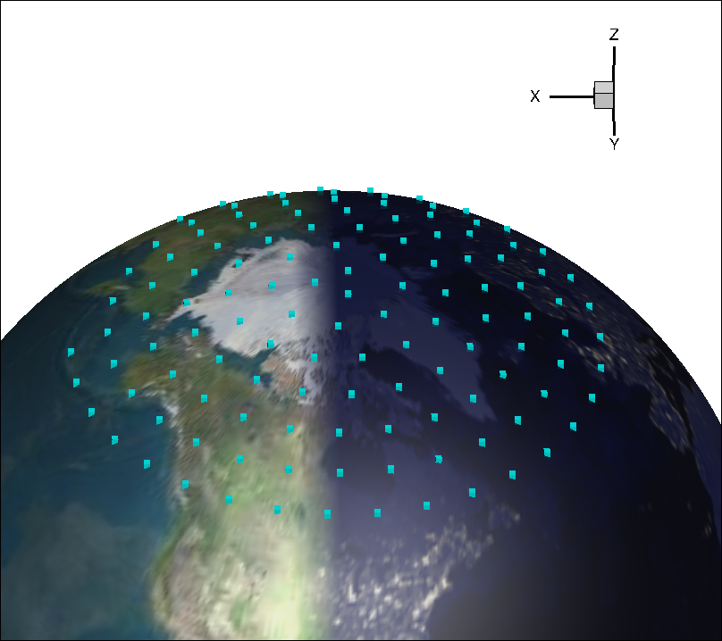
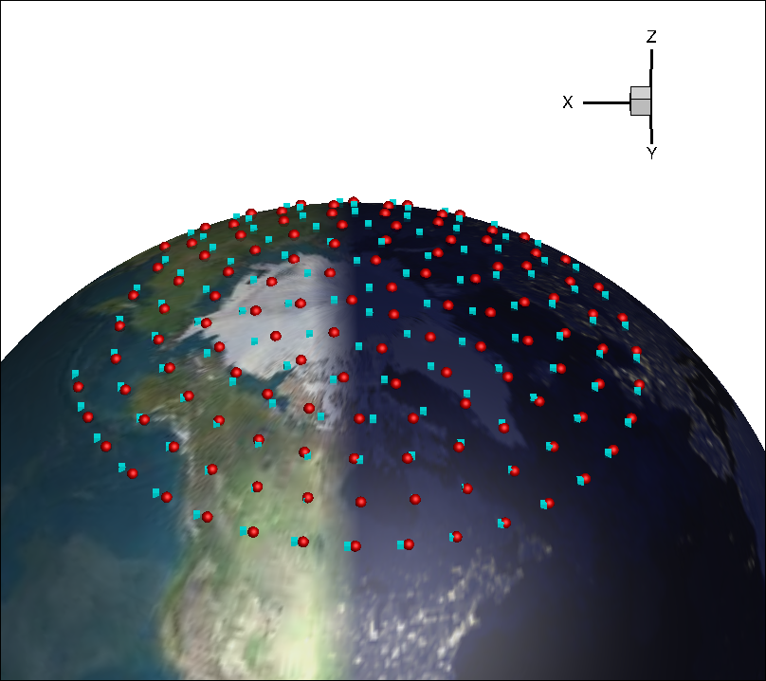
Regrid Approach
Step 1: Lines are uniformly
distributed at t= t₀ Green points are
start foot point positions
Step 2: Lines are moved under convection
and corotation. t=t₀+Δt. Red points are new
foot point positions.

Slide 9
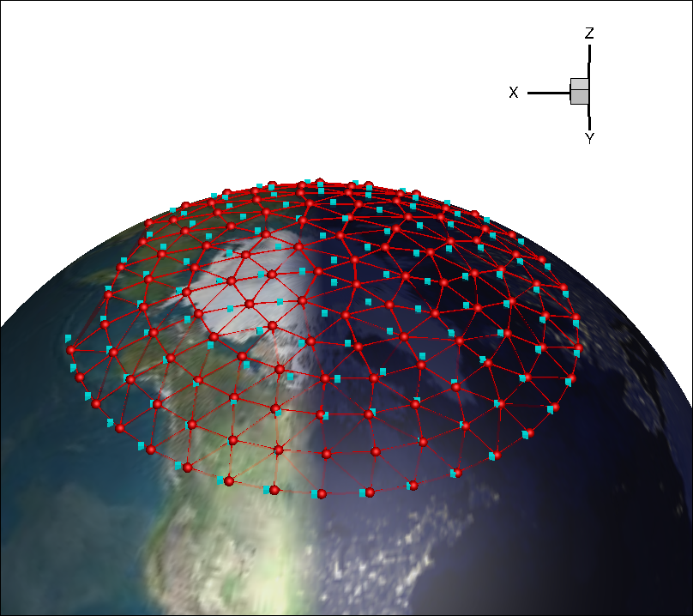
Regrid Approach
Step 3: Triangulation is developed on new
footpoint positions, and remap plan is made
(remember lines may be on
different procs)
Step 4: Get interpolation weights for each remap point
c
Area_{b}
Area_{a}
Remap
point
Area_{c}
a
b
W_{a} = Area_{a}/(Area_{a}+ Area_{b}+ Area_{c})
W_{b} = Area_{b}/(Area_{a}+ Area_{b}+ Area_{c})
W_{c} = Area_{c}/(Area_{a}+ Area_{b}+ Area_{c})

Slide 10
Regrid Approach
Step 5: Interpolate to get regridded line
All particle lists are combined with
statistical weights adjusted by
interpolation weights
Hybrid-PIC
Region
Hybrid-PIC
Region
Hybrid-PIC
Region
Hybrid-PIC
Region
Hybrid-PIC
Region
Particle Join
Operation
W_{a}*
+ W_{b}*
+ W_{b}*
=
Fluid Region
Fluid Region
Fluid Region
Fluid Region
Fluid Region
State Vars
⍴_{r}=∑w_{i}⍴_{i}
u_{r}=∑w_{i}u_{i}
P_{c}= ∑w_{i}p_{i}
State Vars
(⍴_{a},u_{a},p_{a})
State Vars
(⍴_{b},u_{b},p_{b})
State Vars
(⍴_{c},u_{c},p_{c})
State Vars
(⍴_{r},u_{r},p_{r})
Line a
Line b
Line c
Regrid Line
Final Regrid Line

Slide 11
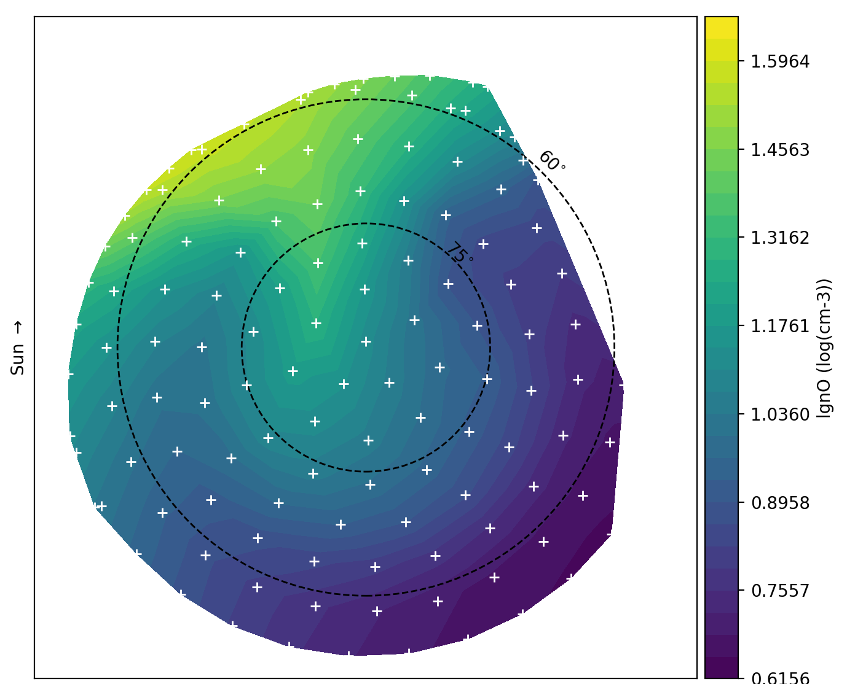
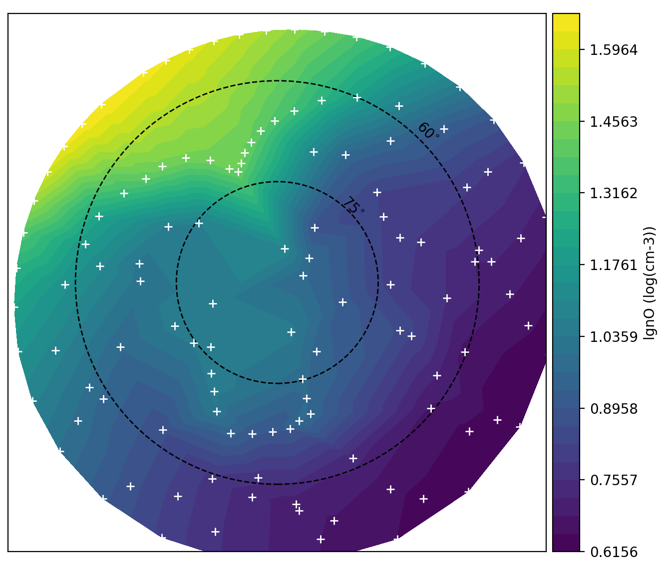
Regrid Example – fluid only (preliminary)
With Regrid
Without Regrid

Slide 12
Update 3: Adding N+ to PWOM
Comparison with observations shows that the presence of N⁺ improves the outflow solution for all species.
He⁺ solution shows the biggest improvement, as 7iPWOM predicts a density one order of magnitude higher than 3iPWOM, aligned with observations.
Solar Maximum
OGO-6 Data
n(N⁺) ≅ 10% of n(O⁺)
7iPWOM
3iPWOM
Lin, M.‐Y., Ilie, R., & Glocer, A. (2020). The contribution of N⁺ ions to Earth's polar wind. Geophysical Research Letters, 47, e2020GL089321. https://doi.org/10.1029/2020GL089321

Slide 13
What is PLANET-ITTR?
Ionosphere-Thermosphere tool funded by the SEEC initiative.
Huge variety of exoplanets that may or may not be like Earth or any solar system planet
GOAL: Develop a flexible tool to look at the upper atmospheres of these planets in response to extreme space weather and energy inputs.
Team:
  Model developers: A. Glocer and S.B Kang
  Other collaborators: V. Airapetian, J. Bell, B. Danchi

Slide 14
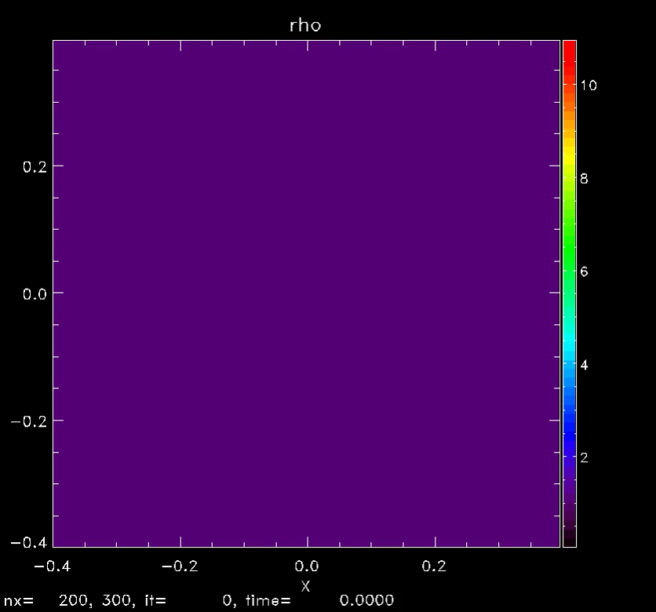
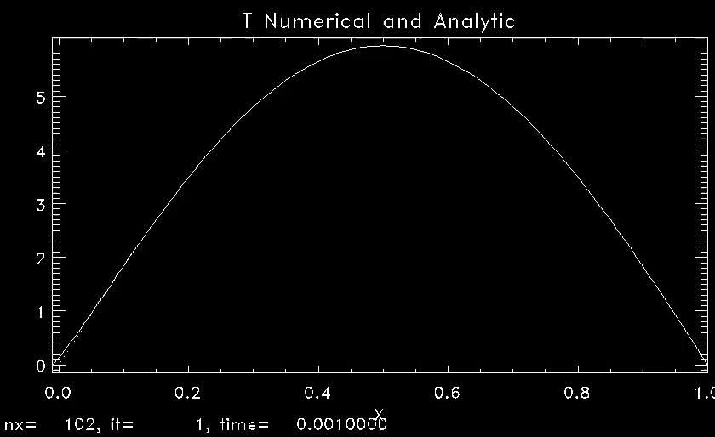
PLANET-ITTR Model Description
Main PLANET-ITTR
Advection Module
(fluid solver)
Reaction Module
(chemical solver)
Ion Production
Heat Conduction
(thermal diffusion)
Radiative Cooling
photon
A
+
))
A
+
B
H
A
B
))
External: shared libraries / utilities

Slide 15
Example Application 1: Ionospheric Conductance
Close-in Exoplanets can have very intense energy inputs including possibly Joule heating.
Ionospheric conductance mediates this energy input.
Most magnetosphere models assume Earth-like conductance models, but this may not be true.
PLANET-ITTR configured with electron transport and chemical solver can calculate conductance for different atmospheres.

Slide 16
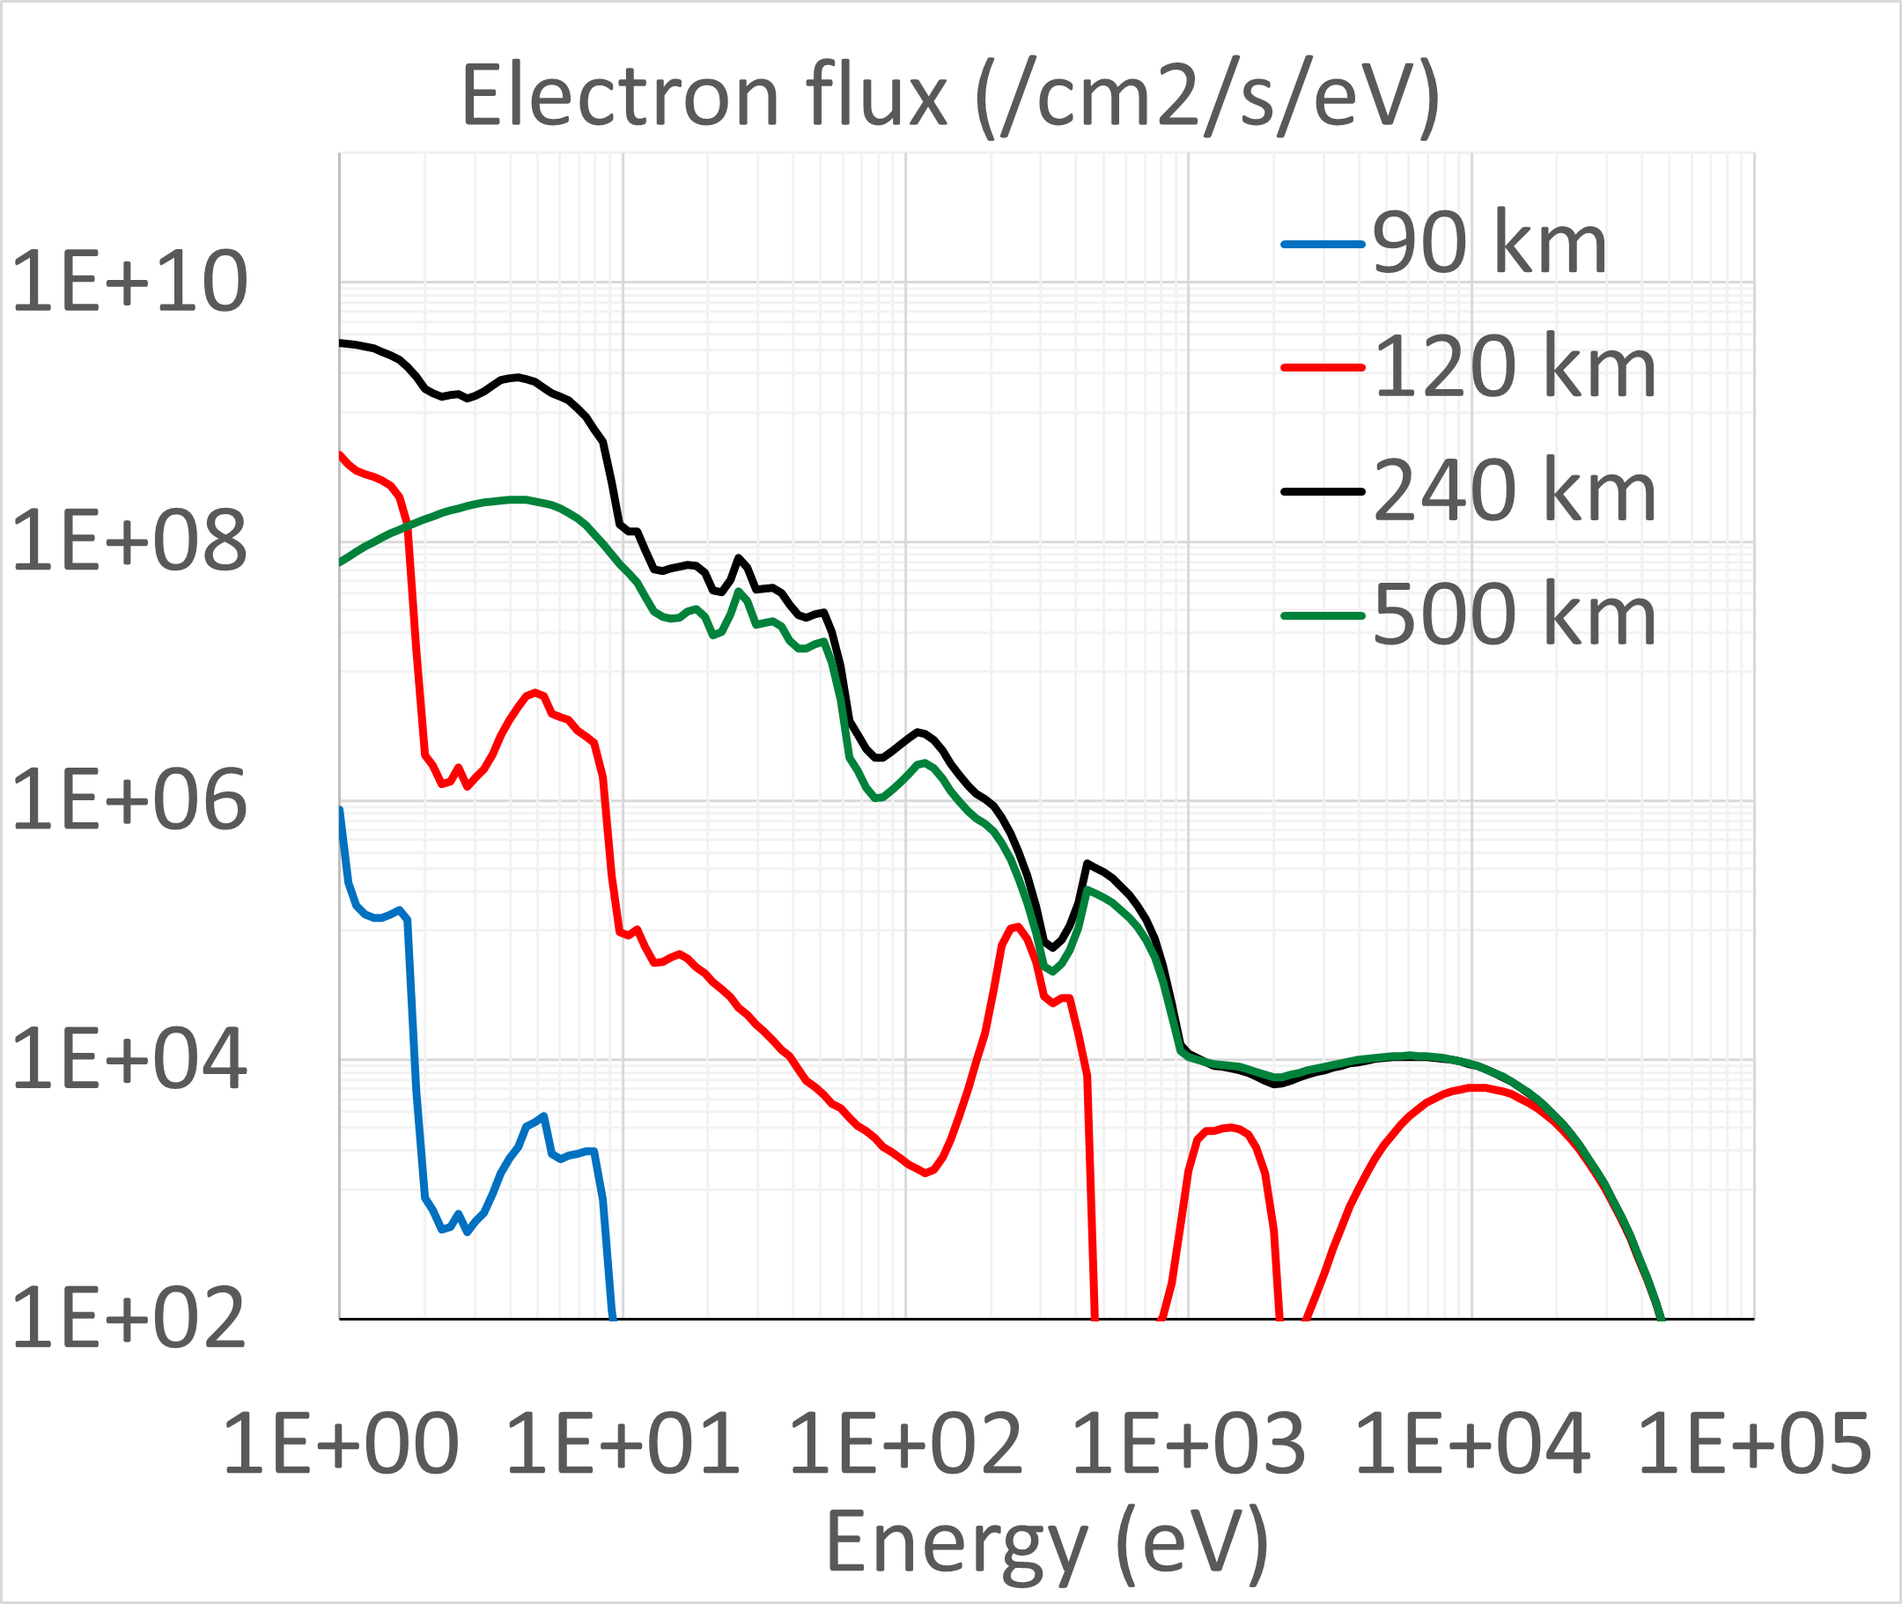
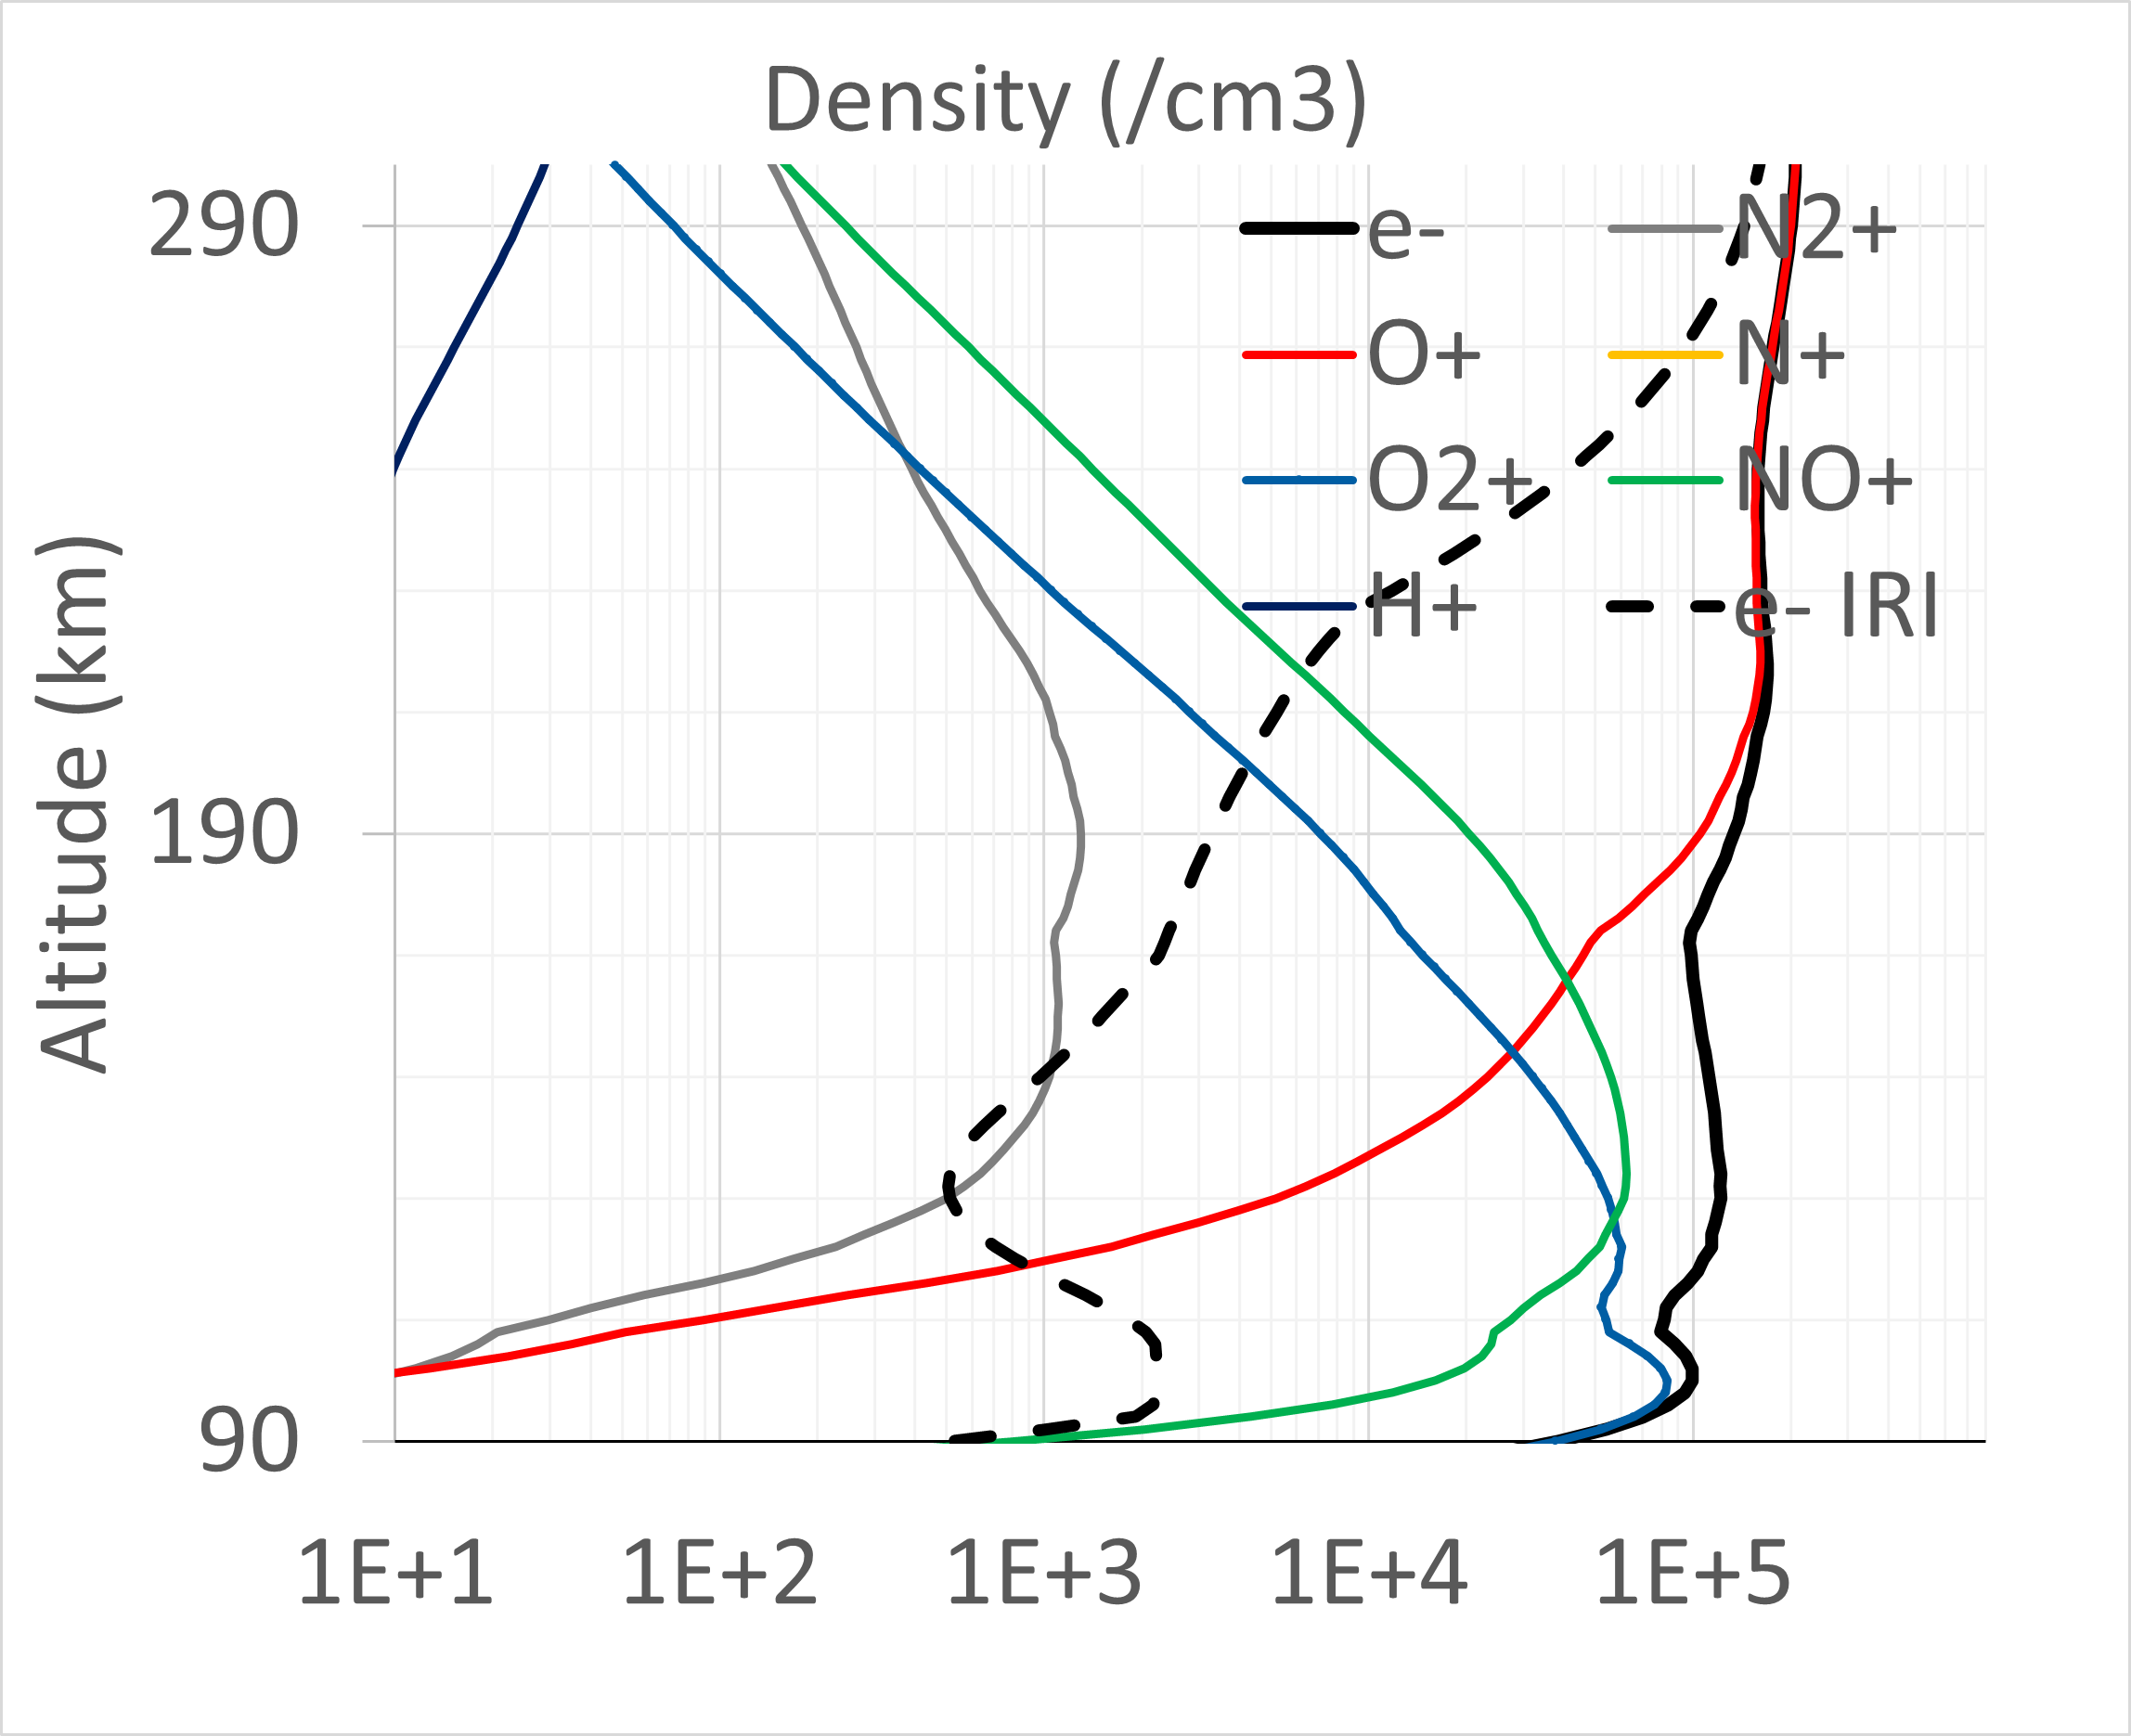
SPEAH-RIT: A built in 2-stream e- transport model (S.B. Kang)
Combine w/
Chem Solver
For Density
Input e- Beam
Similar to other 2-stream models but works for many species
When coupled to PLANET-ITTR chemical solver it can get density profiles and conductance

Slide 17
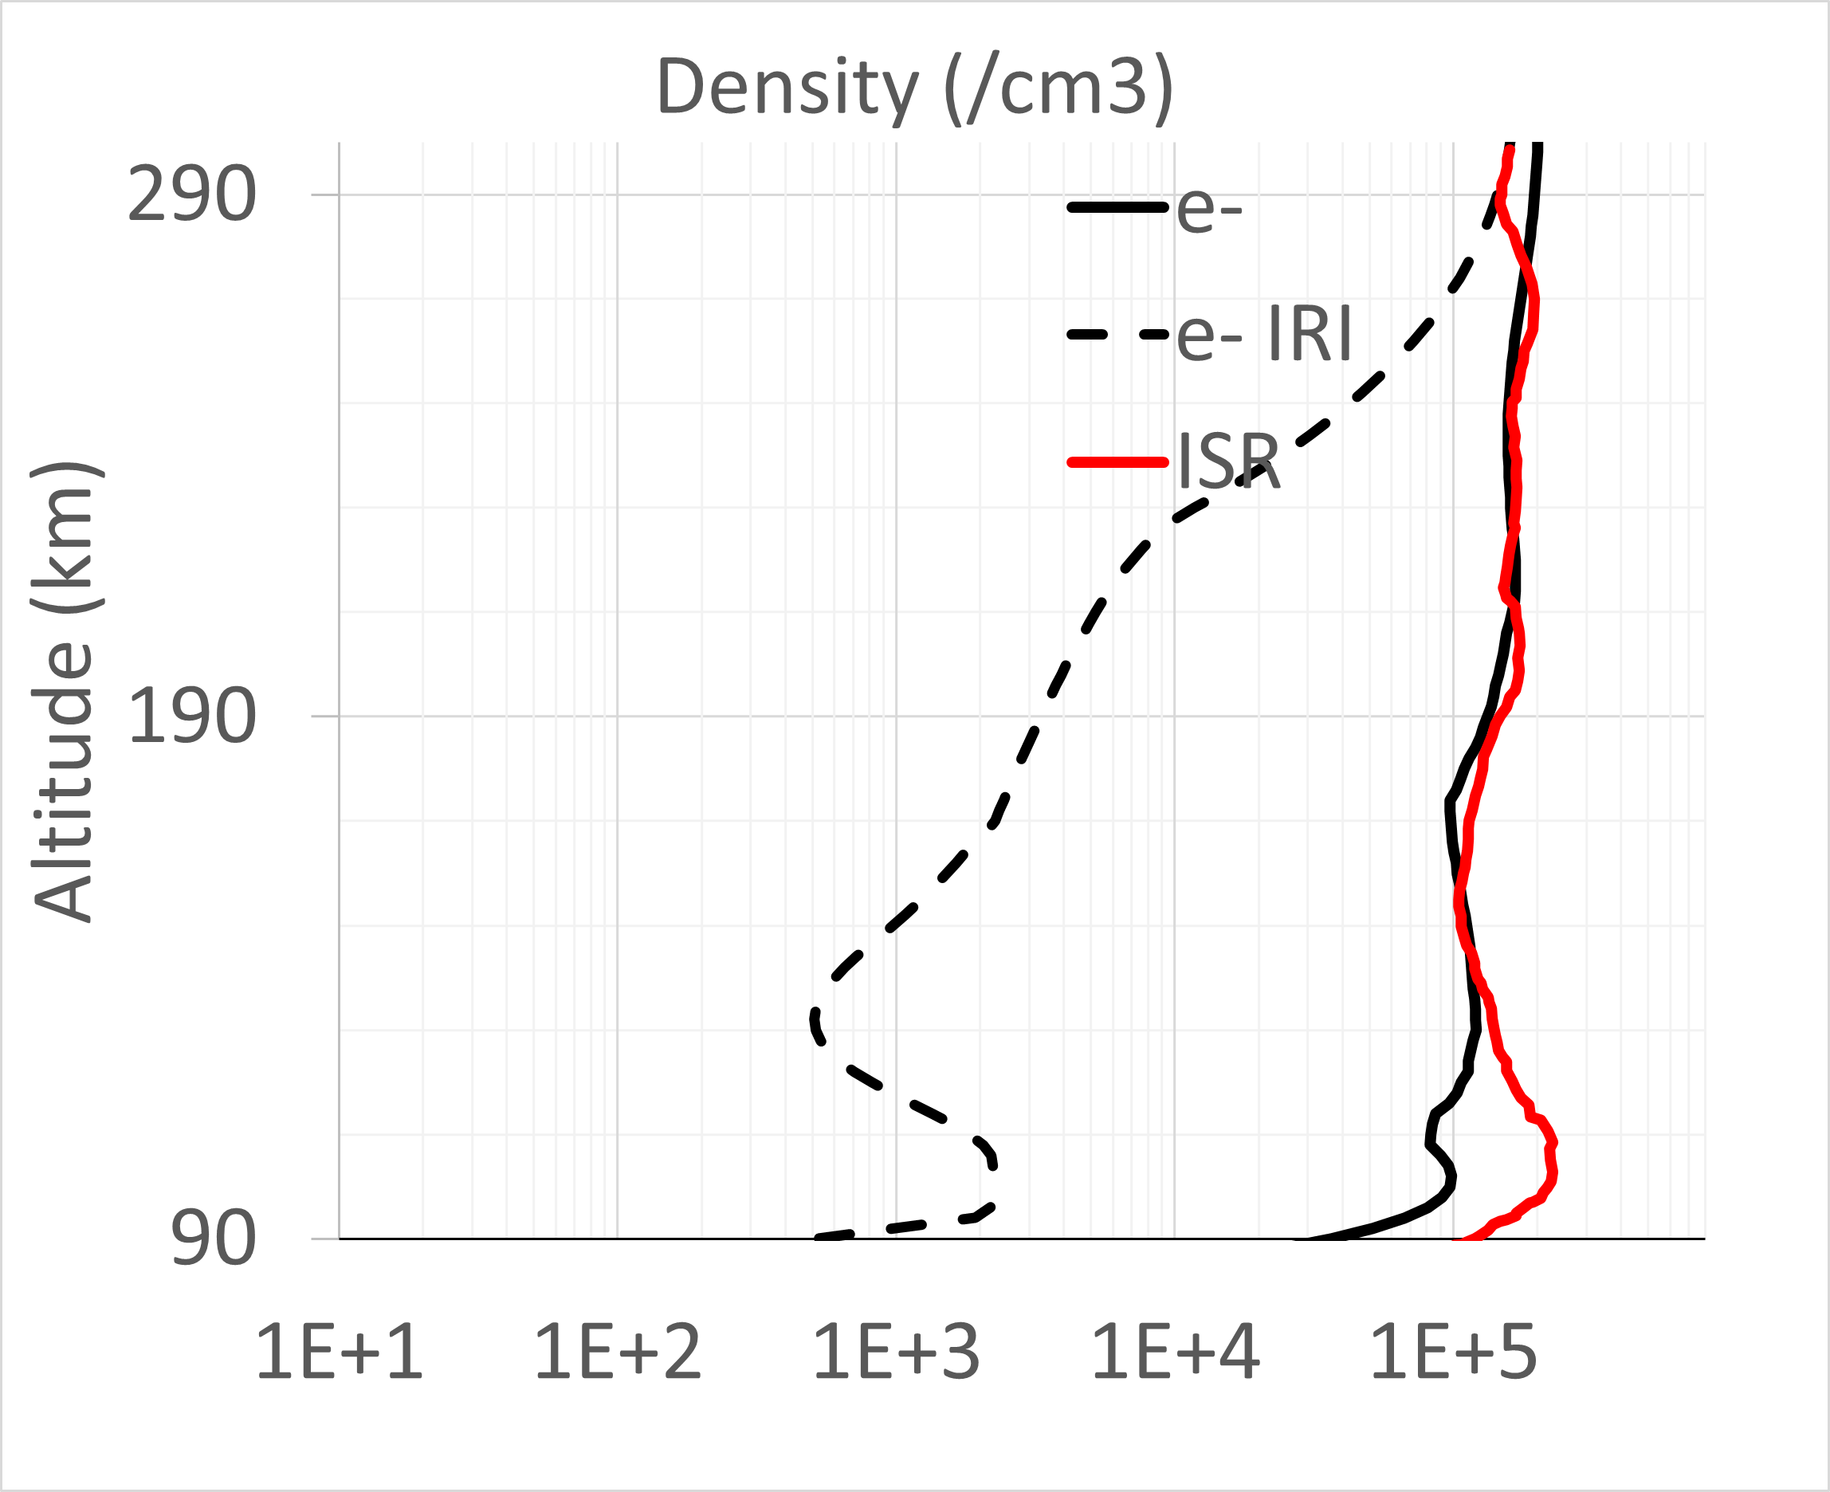
SPEAH-RIT: A built in 2-stream e- transport model (S.B. Kang)
Validate e-
Profile against
ISR data
Input e- Beam
Watson et al.,
2021
Model
Result
Similar to other 2-stream models but works for many species
When coupled to PLANET-ITTR chemical solver it can get density profiles and conductance

Slide 18
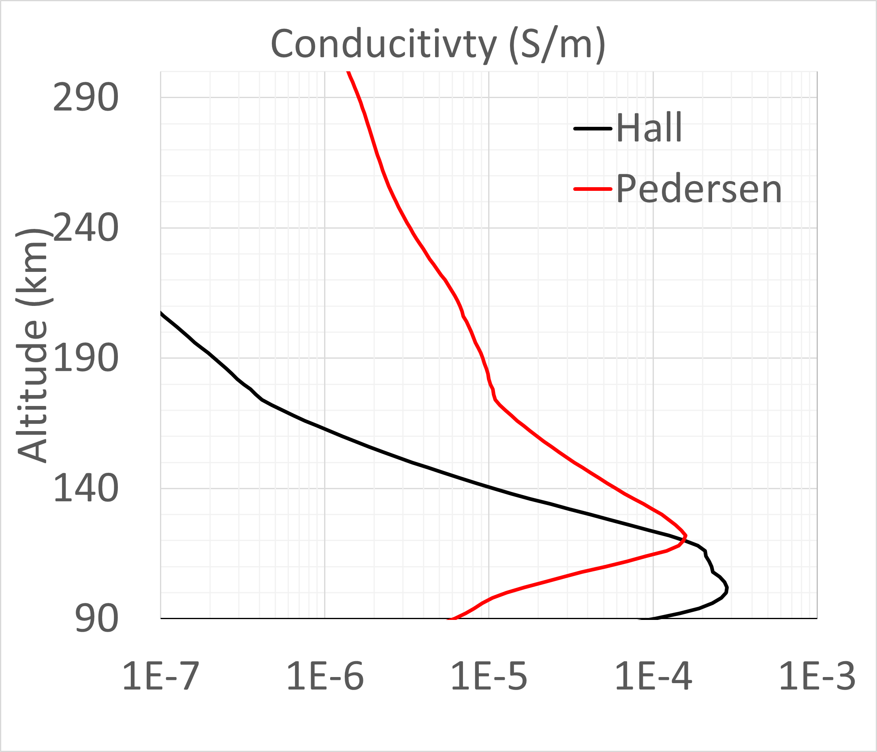
SPEAH-RIT: A built in 2-stream e- transport model (S.B. Kang)
Calculate
Conductance
Input e- Beam
Watson et al.,
2021
Model
Result
Similar to other 2-stream models but works for many species
When coupled to PLANET-ITTR chemical solver it can get density profiles and conductance

Slide 19

Hydrodynamic Loss of Proto-atmospheres of Earths and Super Earths
Planets accrete nebular gas from the protoplanetary disc during the first 1- 10 Myr of planet formation.
Solid planetary embryos acquire H–He rich atmospheres from the ambient nebular disk gas via the in situ accretion (Ikoma & Hori, 2012)
Super Earths, the abundant type of exoplanets, with M ~ 4 $M_{⊕}$ can accrete up to a few percent of the planetary mass
How long rocky planets can retain H rich dense atmospheres?
Approach: Go from simple model to complex
Credit: F. Fressin

Slide 20
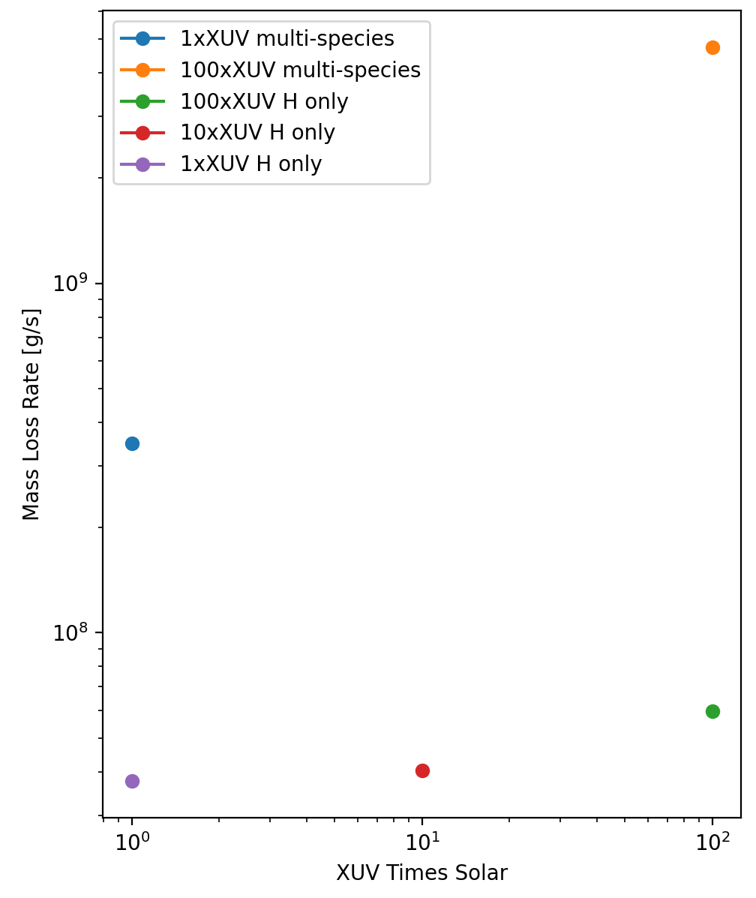
Total Mass Loss Rate of Atmosphere
More XUV/EUV input = More Mass Loss
Denser atmosphere escapes more slowly.
Energy absorption profile can change as species change
Peak escape rates could evacuate primary atmosphere in a few 100M years
More data points coming - Parameter study still ongoing
Multispecies cases
(lower density cases)
H only cases
(higher density cases)

Slide 21
Thank you!
credit: Eleanor Glocer, age 6

Slide 22
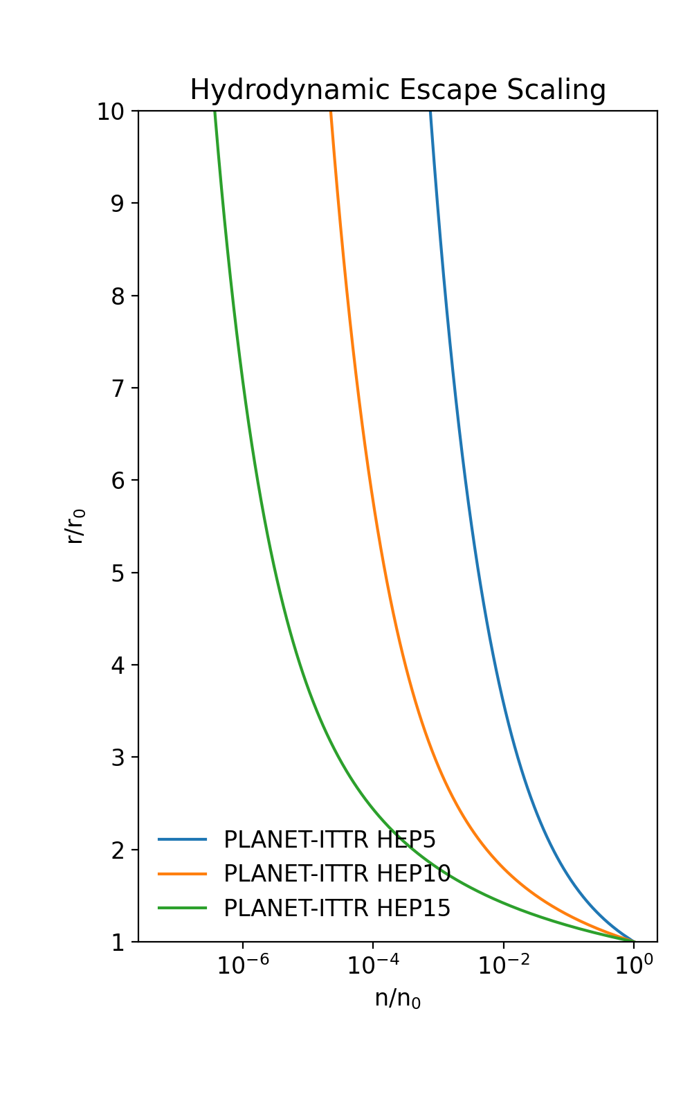
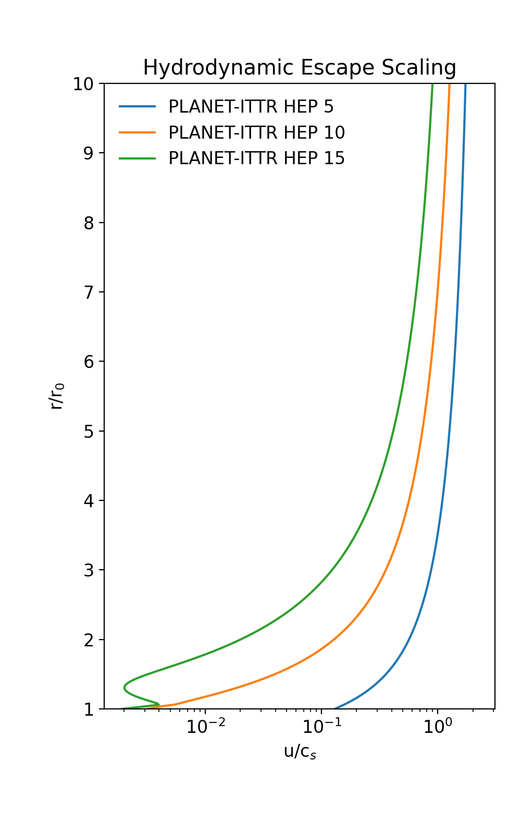
Level of Complexity: Simple
H only, Isothermal
Hydrodynamic Escape Parameter
HEP = GMm/r₀kT₀
Grav. Pot/Thermal Energy
(e.g., Tian et al 2005)﻿
Strong Escape
(T=1500k)
Increasing T decreases HEP which:
More density escapes
More Velocity
Higher Mass Loss
Weak Escape
(T=500k)

Slide 23
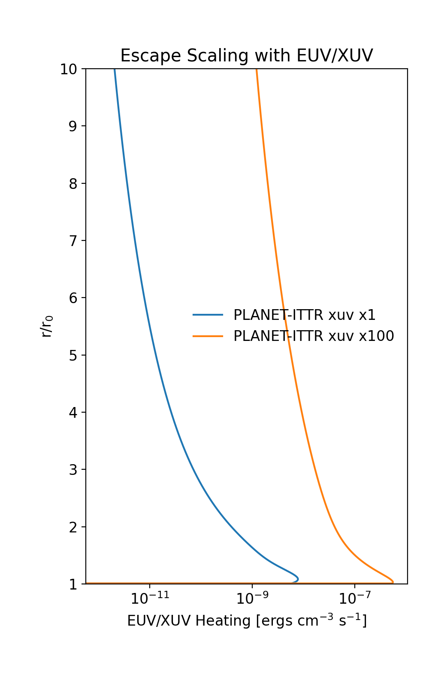
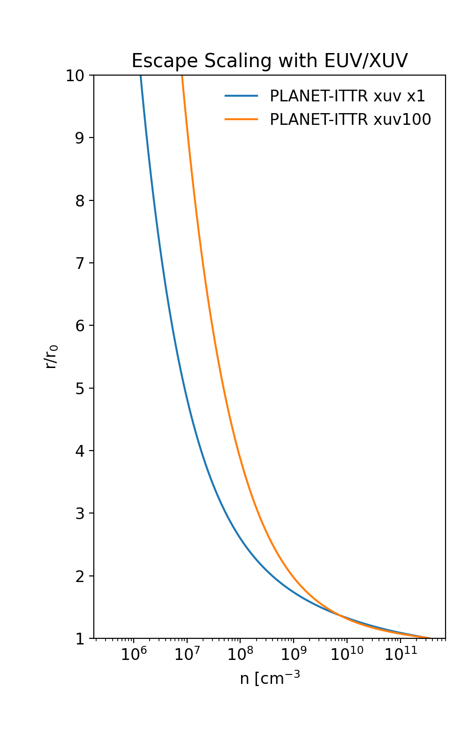
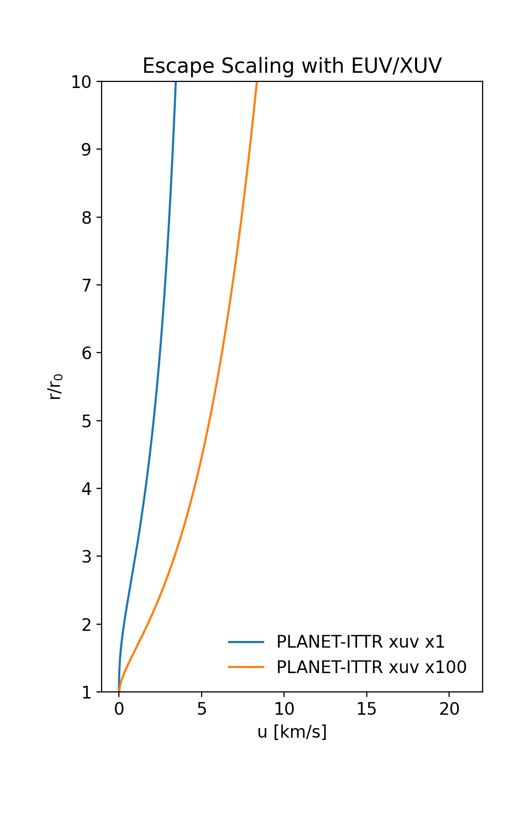
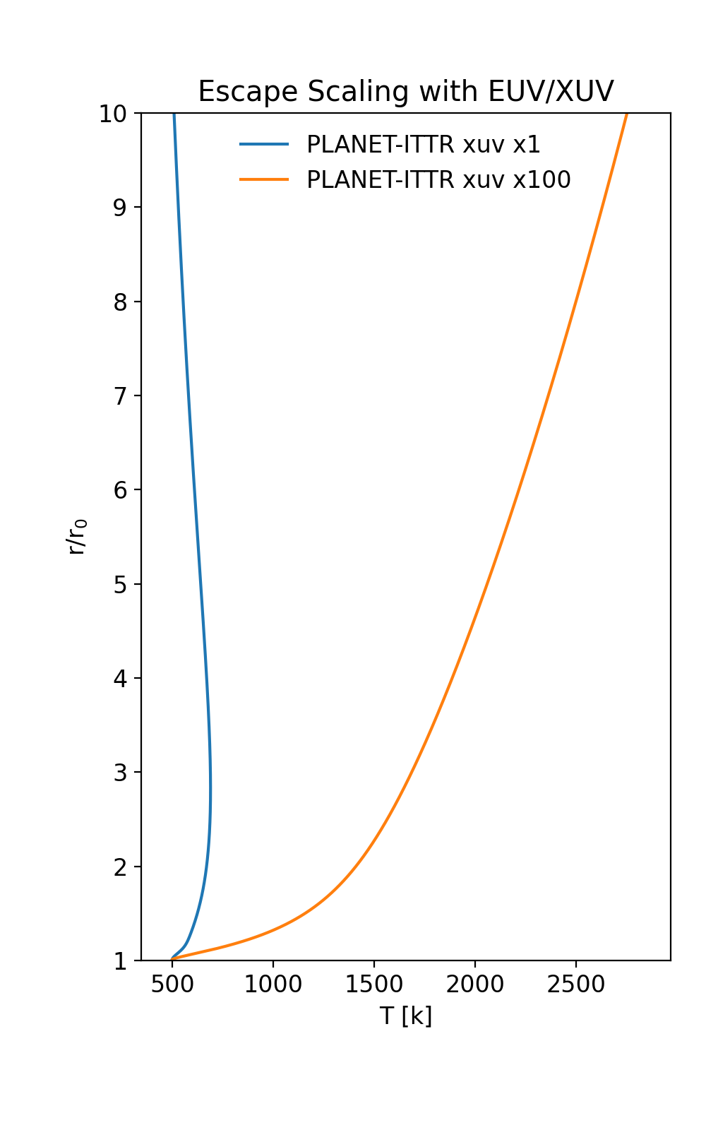
Level of Complexity: Moderate
Multiple H Species, Hydrodynamic, Radiative Cooling
Increased Energy
Absorption
Increased Density
Changes
Increased Velocity
Increased Temperature

Slide 24
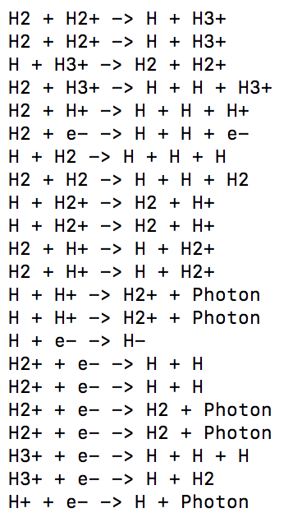

Selecting the Chemical Scheme
Species In PLANET-ITTR Simulation
Universe of Possible Reactions
Final Reaction List
Q
A
+
Q
A
B
A
C
D
D
A
+
D
A
E
F
+
E
+
h𝜈
E
+
e-

Slide 25
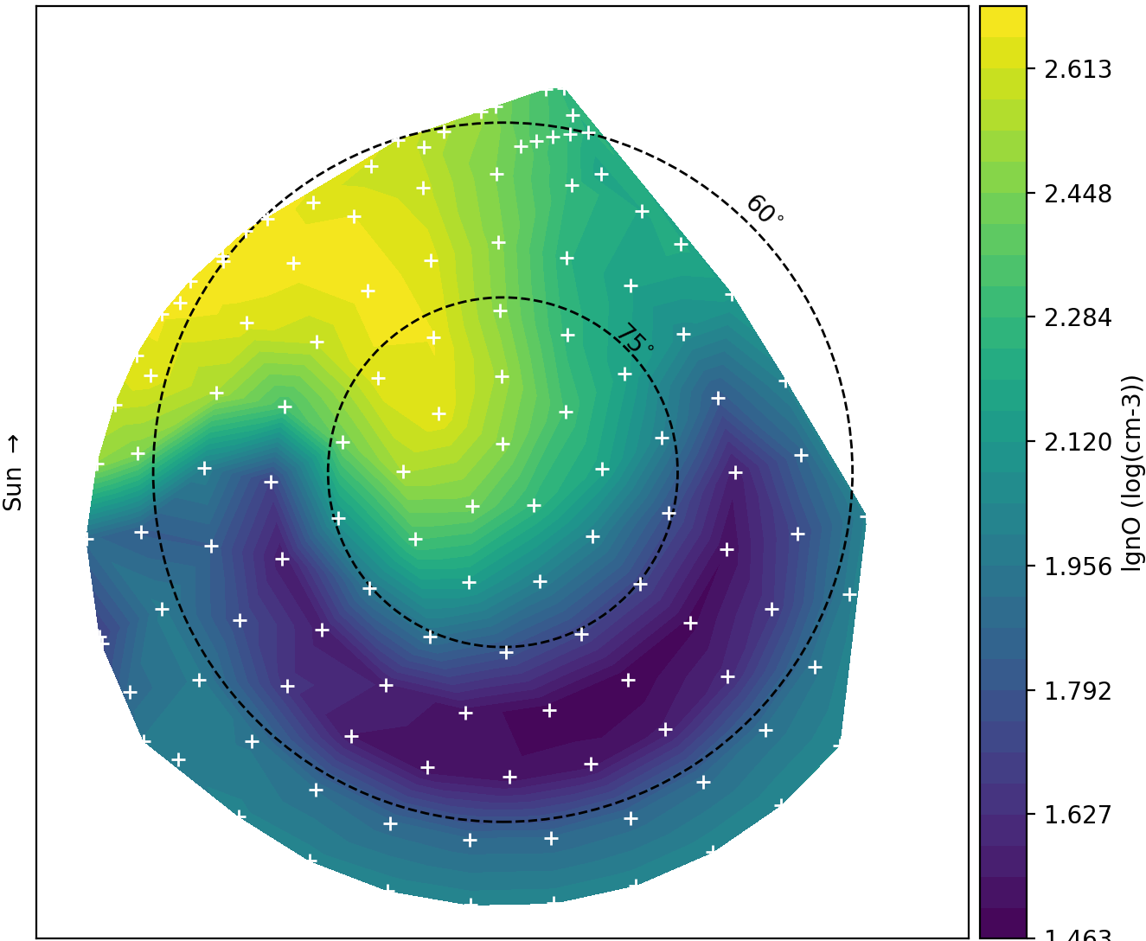
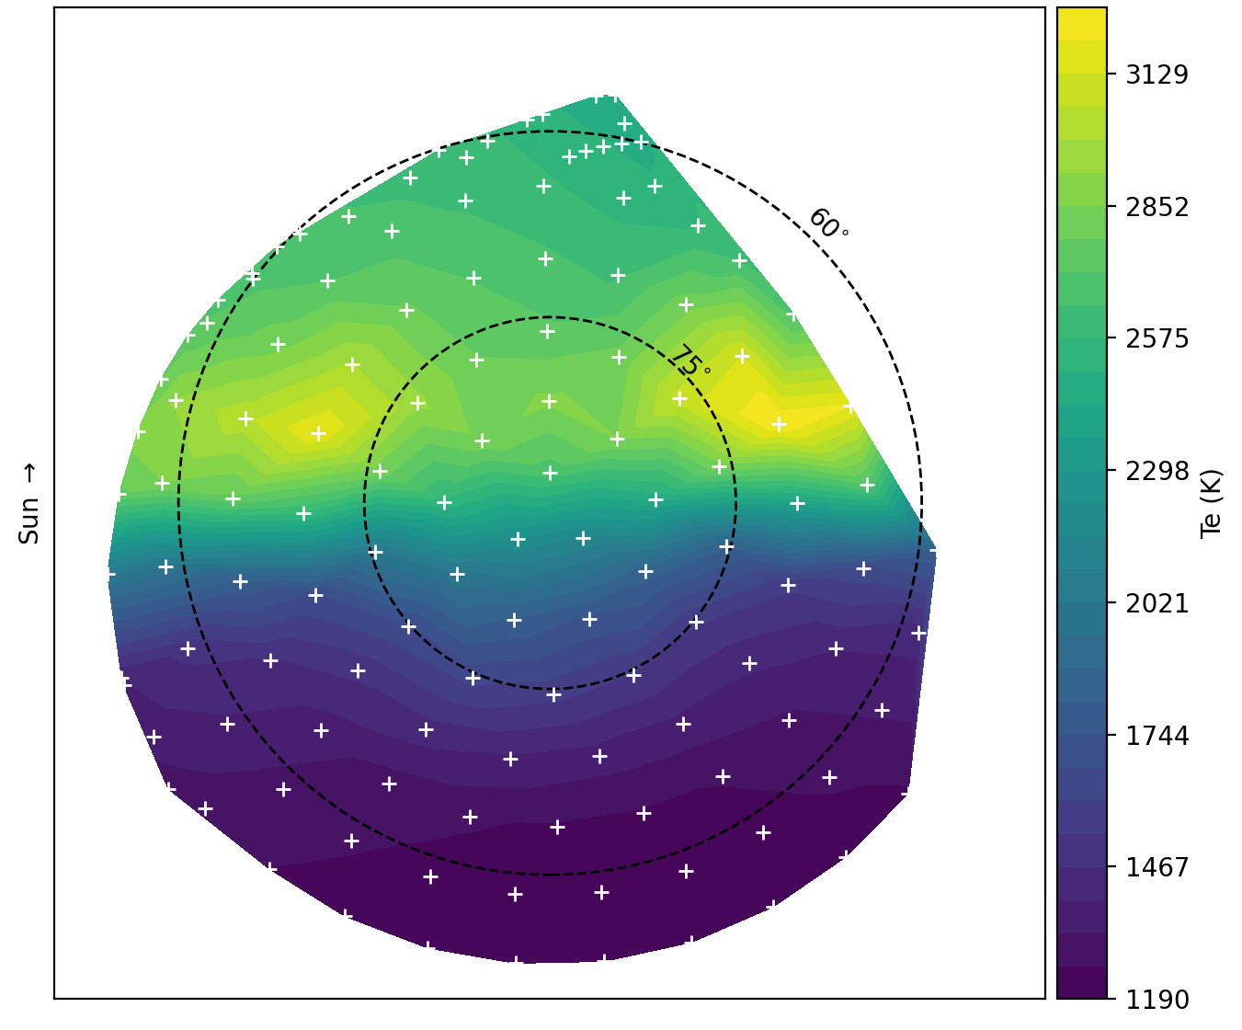
Regrid Example – fluid + particles + SE (preliminary)
Log(nO+)
Te

