Slide 1
Ionospheric Conductance in the SWMF: Code Refactoring and Physics Improvements
Daniel Welling
University of Texas at Arlington
Agnit Mukhopadhyay
NASA GSFC

Slide 2
Modeling Conductance
Solar EUV
Auroral Precip.
Miscellaneous
Starlight Conductance (e.g. Ridley et al. 2004)
Ionization of the dayside atmosphere by the Sun’s EUV spectrum increases conductance (e.g. Green et al. 1964; Torr et al. 1979).
Function of the solar zenith angle and time of year (e.g. Moen and Brekke, 1992).
Precipitation of particles into the upper atmosphere enhances conductance in the polar regions (e.g. Robinson et al. 1987).
Strength is heavily dependent on magnetospheric/space weather activity (e.g. Khazanov et al. 2017).
Polar Rain (e.g. Newell and Meng, 1992)

Slide 3
Modeling Conductance
Modeling Goal
Capture as many sources of conductance as possible.
Understand role of each source by comparing magnetosphere-ionosphere system when only a subset of sources are used.
Multiple sources of auroral conductance:
Electron & ion diffuse precipitation
Monoenergetic/discrete precipitation
Broadband precipitation
Anomalous electron heating
Many considerations for each!
Wave scattering in magnetosphere, loss cone angle, distribution of precipitating populations
Auroral Precip.
Precipitation of particles into the upper atmosphere enhances conductance in the polar regions (e.g. Robinson et al. 1987).
Strength is heavily dependent on magnetospheric/space weather activity (e.g. Khazanov et al. 2017).

Slide 4
RIM: Legacy and the Future
Solar EUV
Auroral Conductance
Parameterized via F10.7 (Moen & Brekke, 1992; Rasmussen & Schunk, 1987).
Miscellaneous
$$Σ=Σ_{0}e^{−AJ_{∥}}$$
See Ridley et al., 2004 and Mukhopadhyay et al., 2020
Starlight conductance & polar rain set as constant backgrounds.

Slide 5
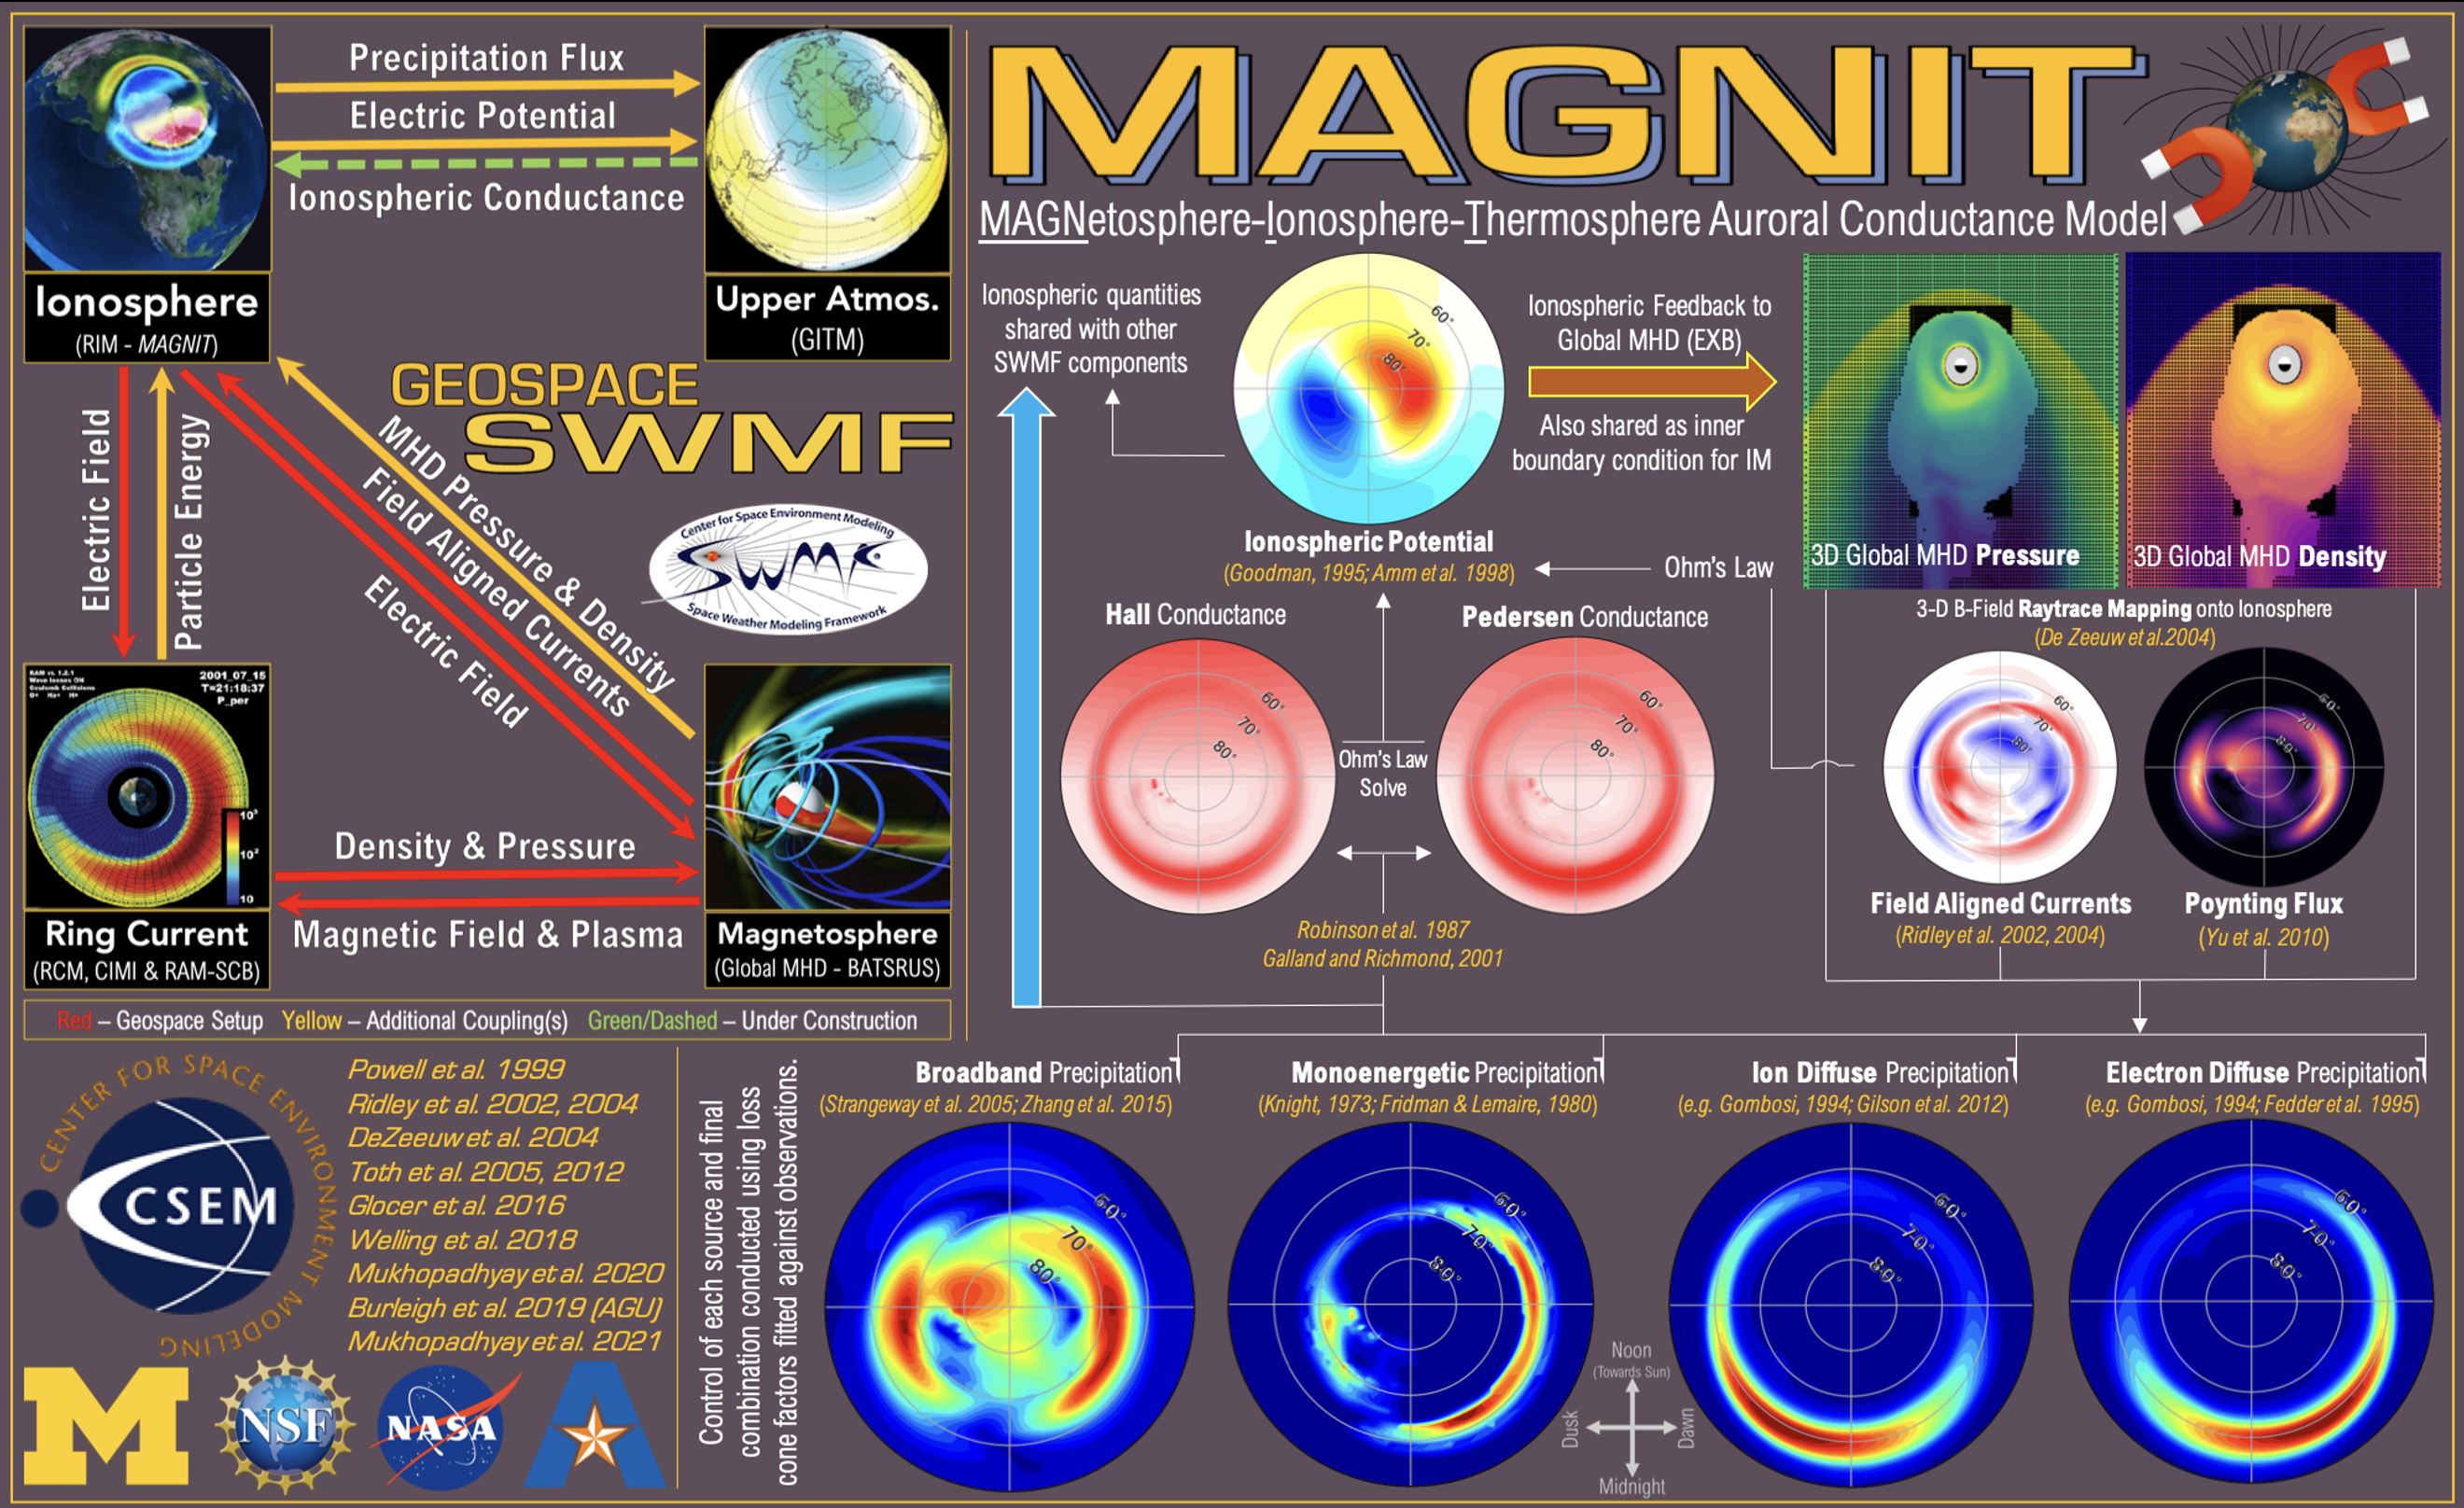
RIM: Legacy and the Future
Solar EUV
Auroral Conductance
Parameterized via F10.7 (Moen & Brekke, 1992; Rasmussen & Schunk, 1987).
Miscellaneous
Starlight conductance & polar rain set as constant backgrounds.
See Mukhopadhyay et al., 2022, in press!

Slide 6
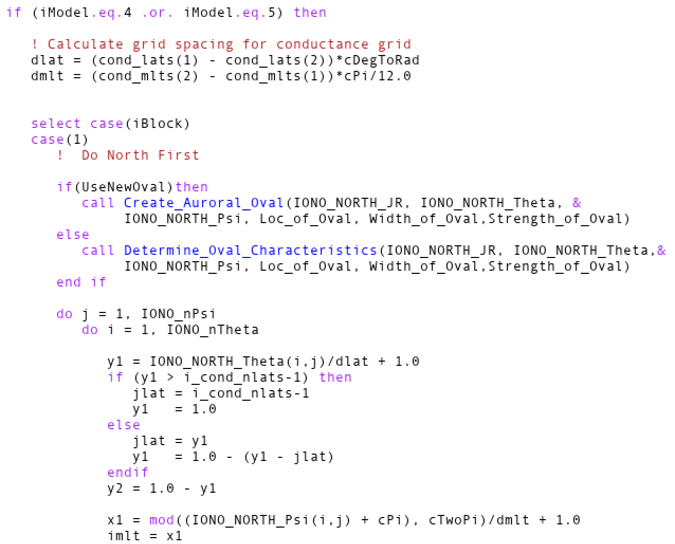
A Technical Debt Crisis
Each iModel is a single combination of sources of conductance/auroral models.
Each new iModel is created via copypasta, edited to get desired result.
There are currently 11 iModels and 2700 lines of code dedicated to conductance.
iModel sets some combination of uniform conductance or EUV and auroral conductance.
These two were for testing, have no purpose now, were never removed.
F107Flux sets F10.7 flux.
These two are overloaded and serve different roles depending on iModel.
#IONOSPHERE
5 iModel
F UseFullCurrent
F UseFakeRegion
150 F107Flux
1.0 StarLightPedConductance
0.25 PolarCapPedConductance
PARAM.in Control of Conductance

Slide 7
Conductance Code Refactoring
Completely modular approach.
Each source is applied independently and in turn.
How sources are applied can be changed by just adding a new module (no more iModel, no more copypasta).
Code complexity greatly reduced
2700 lines of code down to <1000.
Detangled all sources – no repeated code!
Diagnosed and removed some hidden bugs features.
Completely new PARAM syntax.

Slide 8
Example: Uniform Conductance
Old Commands
New Commands
#IONOSPHERE
1 iModel
F UseFullCurrent
F UseFakeRegion2
10 F107Flux
5 StarLightPedConductance
5 PolarCapPedConductance
#UNIFORMCONDUCTANCE
5 SigmaPedConst
5 SigmaHalConst
#BACKGROUNDCOND
0.0 StarLightPedCond
0.0 PolarCapPedCond

Slide 9
Example: Standard Conductance
Old Commands
New Commands
#IONOSPHERE
5 iModel
F UseFullCurrent
F UseFakeRegion2
100.0 F107Flux
0.25 StarLightPedConductance
0.25 PolarCapPedConductance
#BACKGROUNDCOND
0.25 StarLightPedCond
0.25 PolarCapPedCond
#SOLAREUV
T DoUseSolarEUV
100.0 F10.7
#AURORA
T DoUseAurora
RLM5 NameAurMod
Pssst... It’s backwards-compatible with #IONOSPHERE

Slide 10
Status and Moving Forward
Goal: Re-factor the conductance code in the SWMF.
Current capabilities are simplified; clear input command set.
Allow new physics capabilities to be implemented by anyone
Extensive care taken to ensure continuity of previous results & legacy PARAM files.
New implementation will be public pending conflict resolution & push to main branch.
Adding new conductance algorithm? Let us help!
We will help you navigate the new source code!

