Slide 1

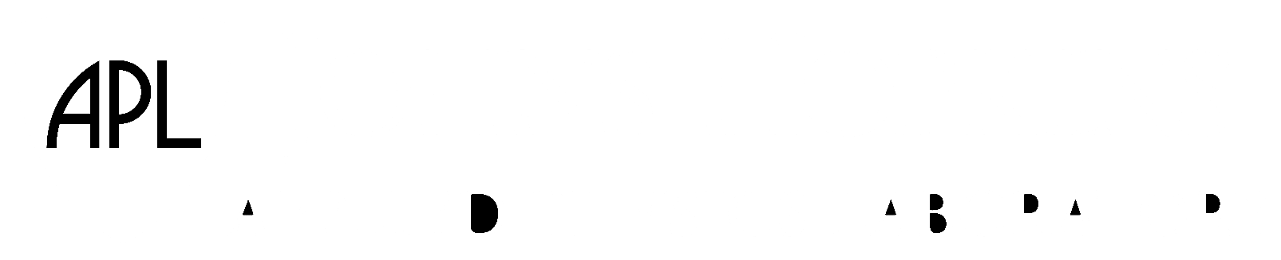


Advancing critical data-model comparisons and assimilation with AMPERE: New data release, access tools, and products
Brian J Anderson¹, Sarah K Vines¹, Robin J Barnes¹, Colin L Waters², Giuseppe Romeo¹, Matt Potter¹
1. JHU/APL; 2. Univ. of Newcastle, NSW, Australia.
CCMC 2022 Workshop, 8 June 2022

Slide 2
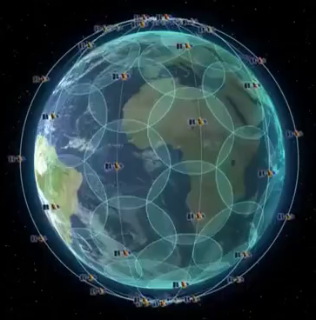
Active Magnetosphere and Planetary Electrodynamics Response Experiment (AMPERE)
NSF Geospace Facility
Magnetometer on every satellite
  Part of avionics
  30 nT resolution: S/N ~ 10
75 satellites (66 + on orbit spares), 6 orbit planes, ~11 satellites/plane
Six orbit planes provide 12 cuts in local time
9 minute spacing: re-sampling cadence
780 km altitude, circular, polar orbits
Polar orbits: guaranteed coverage in North and South: auroral zone never expands equatorward of Iridium!
24/7, global coverage. (new animation of satellites)
NEXT: Attitude from star cameras – 0.02°. More than 10x more precise than original (Block 1) Iridium.
Iridium NEXT constellation

Slide 3
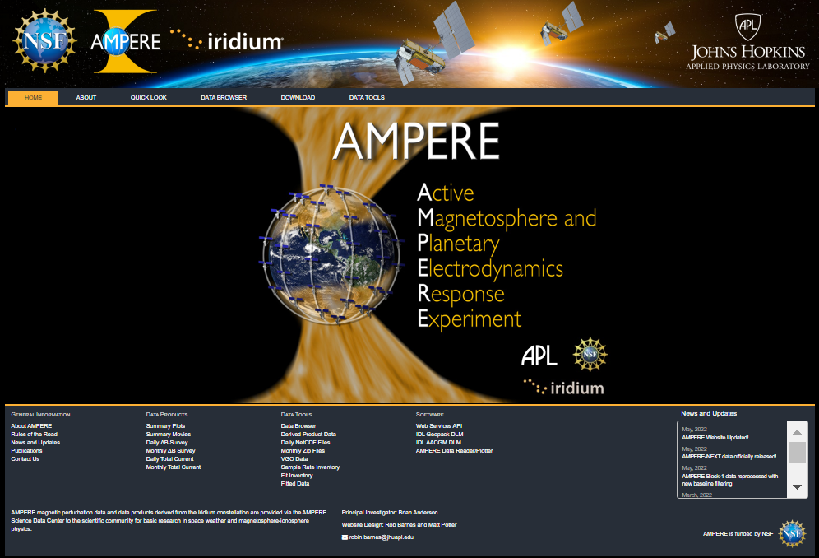
New data access portal
Improved navigation and data browser tools.
Revised: netCDF and summary products downloads.
NEW webAPI service: input data, derived fits, derived current densities.

Slide 4
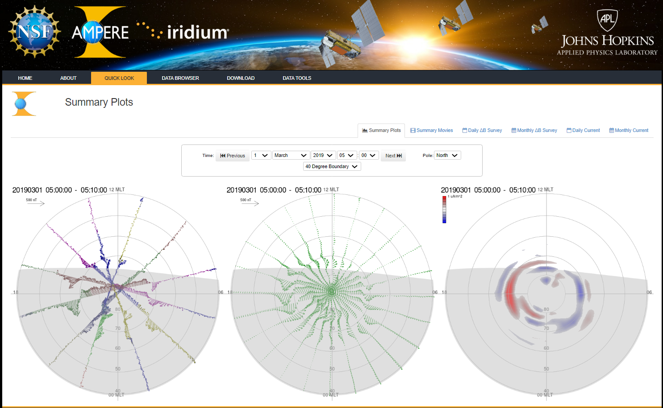
Summary plots and movies

Slide 5
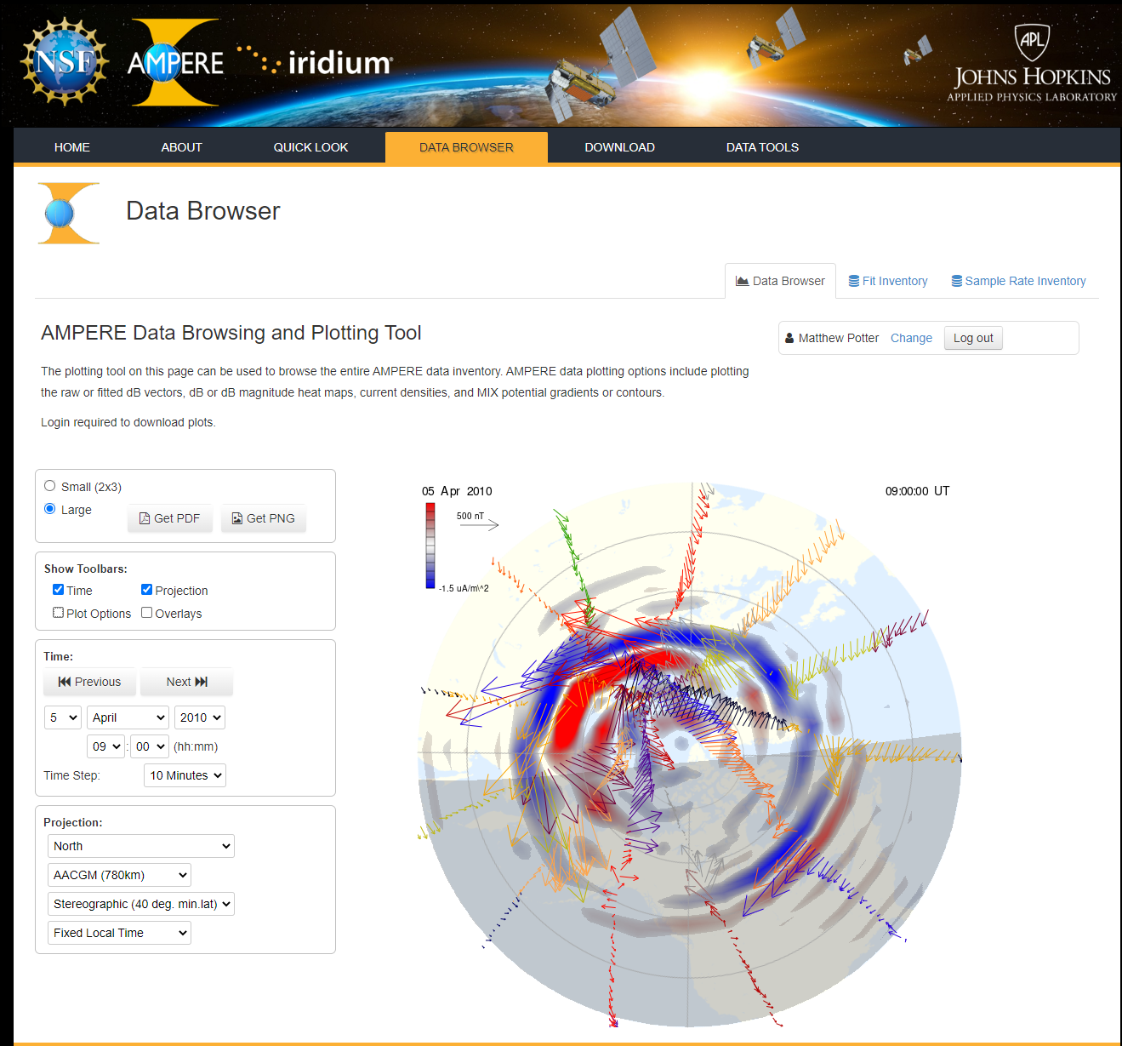
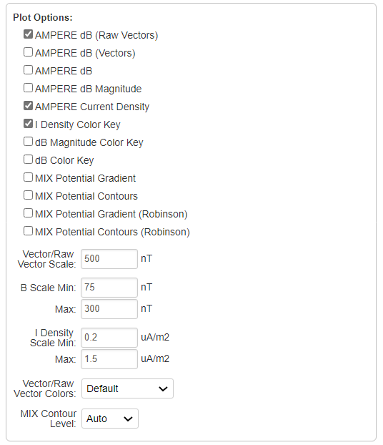
New look custom data browser and plot creation

Slide 6
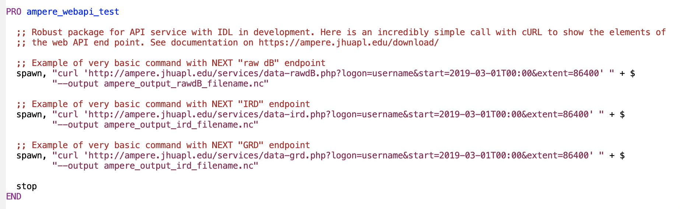
WebAPI: Example IDL snippet

Slide 7
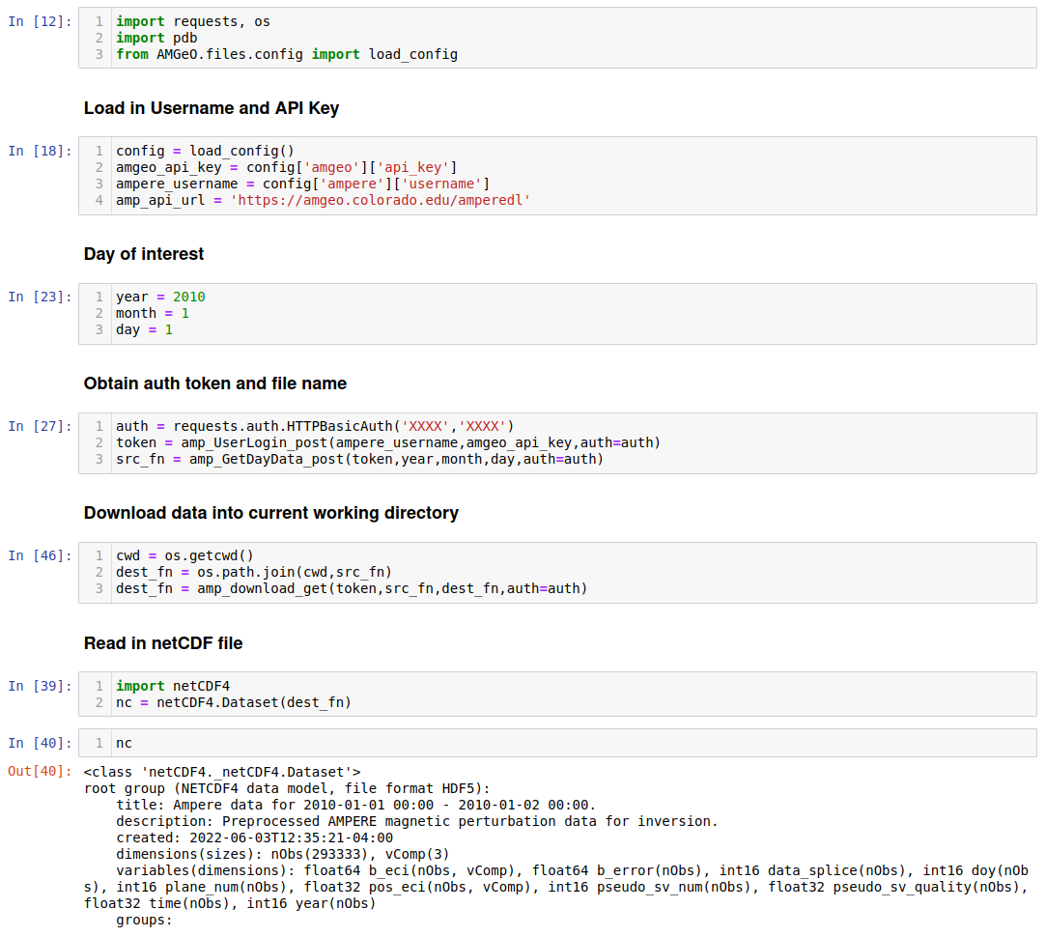
WebAPI: example AMGeO python script

Slide 8
Block 1 re-release and new data
Reprocessed and new data from Block 1: 1 Jan 2010 – 17 Sep 2017.
  Gaps in data eliminated - 8 missing months filled in.
  Baselines improved using refined attitude processing and superior main field model (now uses CHAOS 6).

Slide 9
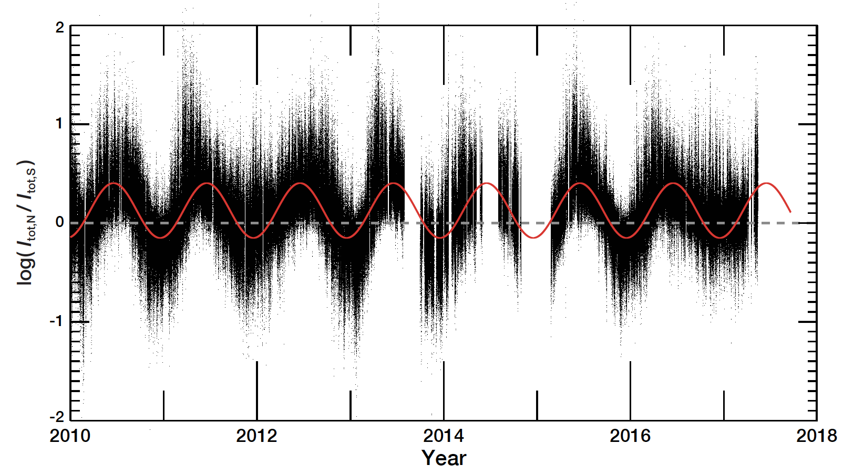
Example time series: N-S total current ratio
Back Fill Data
2013 | Aug. 01 – Sep. 30
2014 | Jul. 01 – Aug. 31 Nov. 01 – Dec. 31
2015 | Jan. 01 – Feb. 22

Slide 10
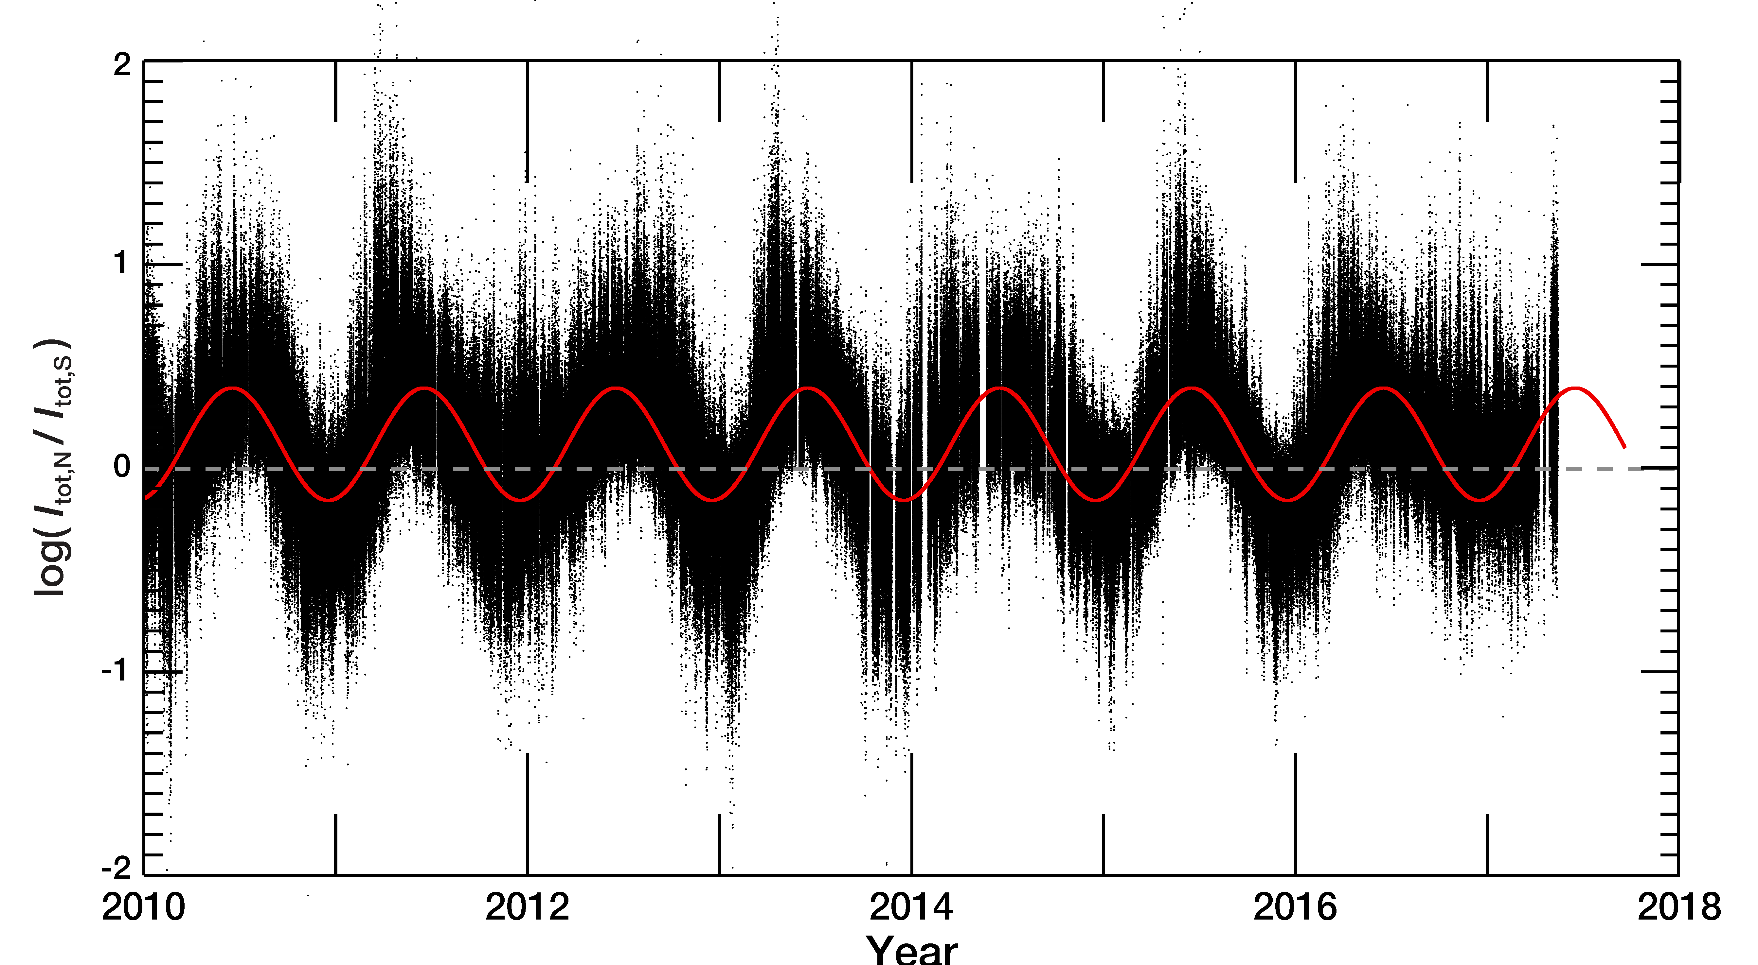
Example time series: N-S total current ratio
Back Fill Data
2013 | Aug. 01 – Sep. 30
2014 | Jul. 01 – Aug. 31 Nov. 01 – Dec. 31
2015 | Jan. 01 – Feb. 22

Slide 11
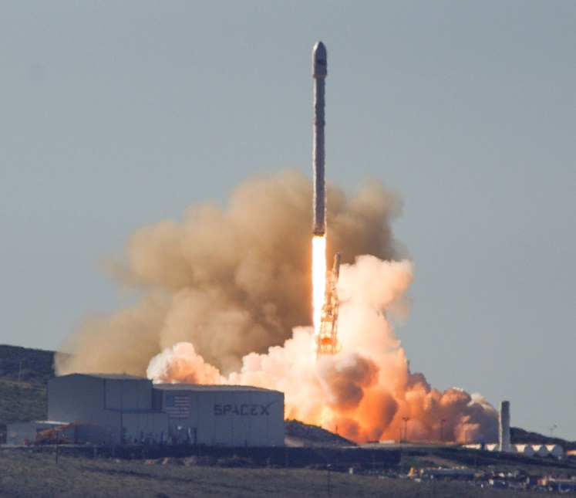
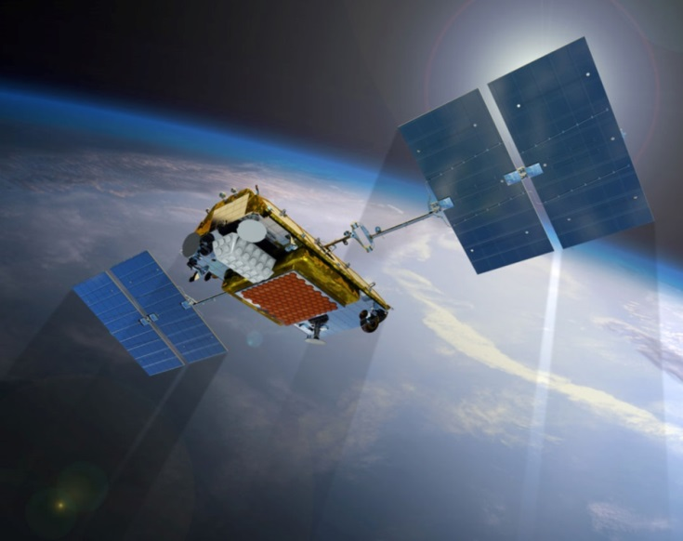
Block 1 to NEXT transition
Credit: Space.com
Commissioning: Jan 2017 – Jan 2019
14 Jan 2017, First Space X Flacon 9 launch
11 Jan 2019, 66th – 75th NEXT Satellites launched!
All 75 Iridium NEXT satellites successfully deployed! 75 for 75!!!
Launch Date No. Total launched
satellites and fully functional
Launch 1: 14 January 2017 10 10
Launch 2: 14 June 2017 10 20
Launch 3: 9 October 2017 10 30
Launch 4: 23 December 2017 10 40
Launch 5: 30 March 2018 10 50
Launch 6: 22 May 2018 5 55
Launch 7: 25 July 2018 10 65
Launch 8: 11 January 2019 10 75

Slide 12
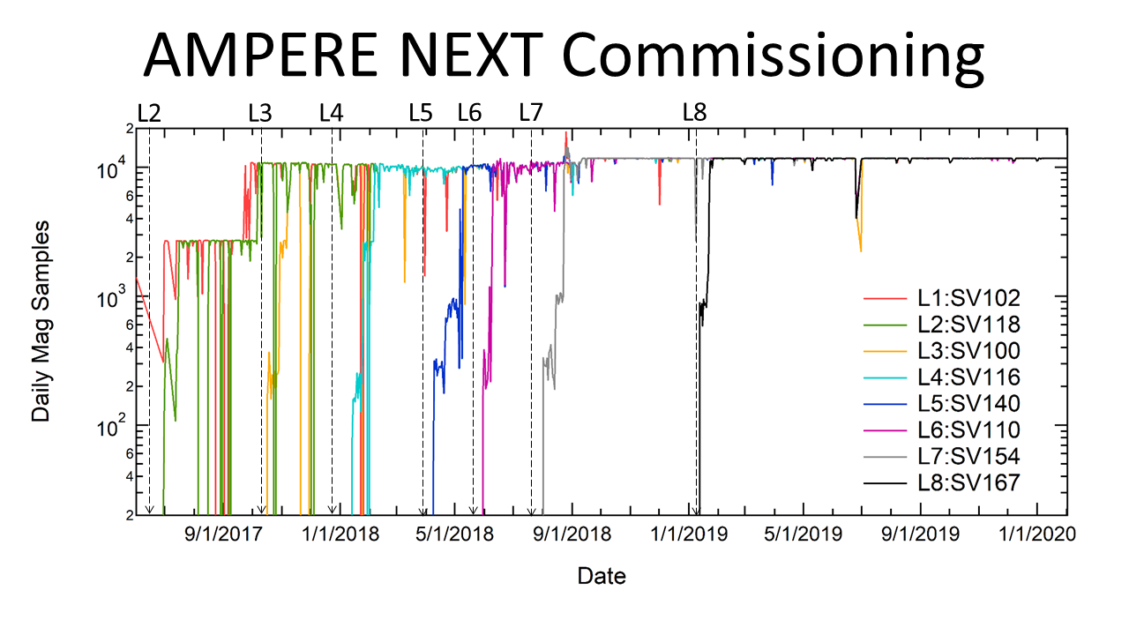
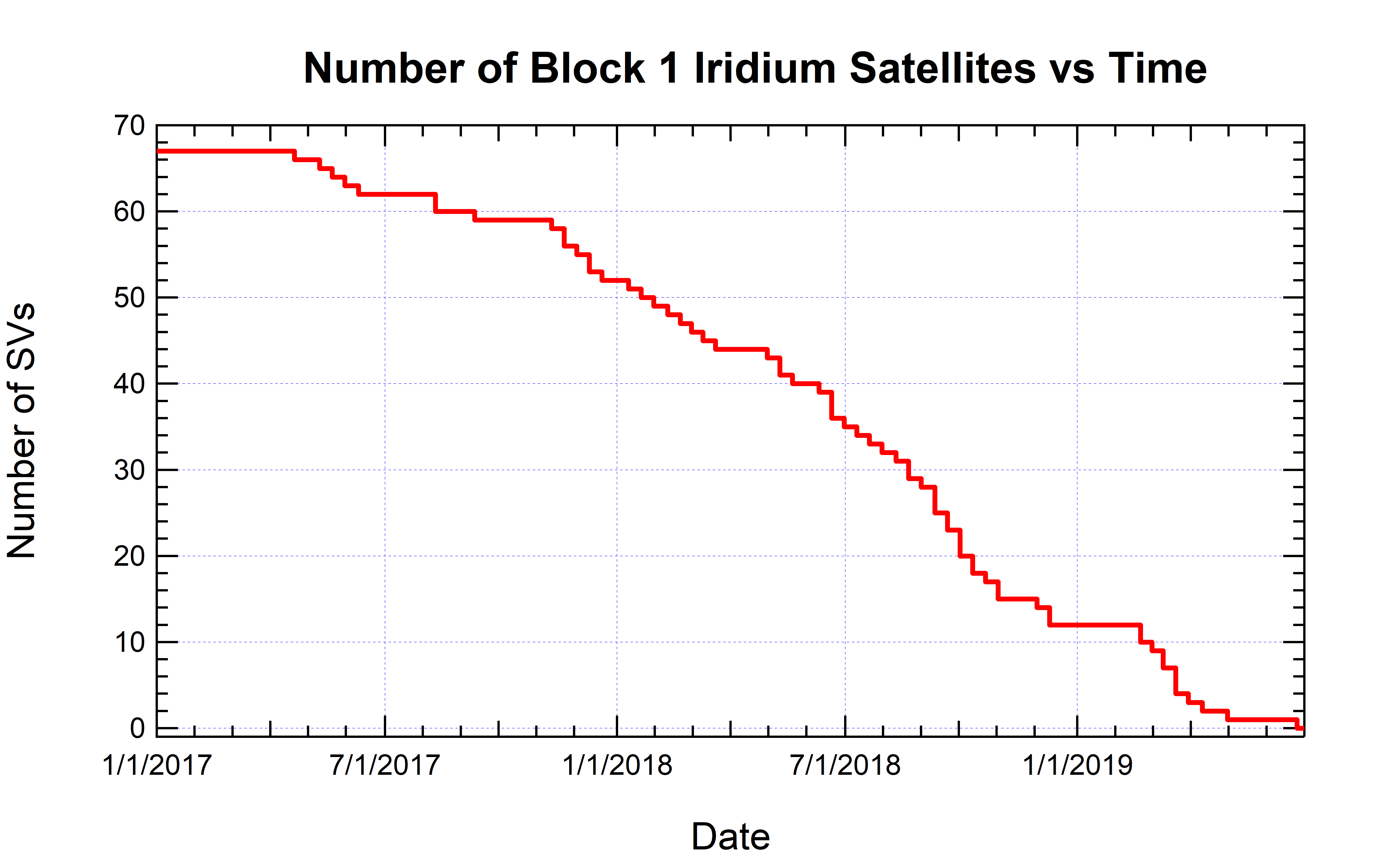
NEXT Commissioning Epoch: Jan 2017 – Jan 2019
NEXT satellites were launched and commissioned over a 1 to 2 month interval after each launch.
Block 1 satellites continued to operate during NEXT commissioning.
NEXT data contribution to AMPERE occurred late in the commissioning of each NEXT satellite.
Once each NEXT satellite was brought ‘on-line’ the process to remove each Block 1 satellite started.
The mix of Block 1 and NEXT satellites evolved throughout the transition.
Processing and inversions using this evolving mix of different data is the focus of the next release. Stay tuned!

Slide 13
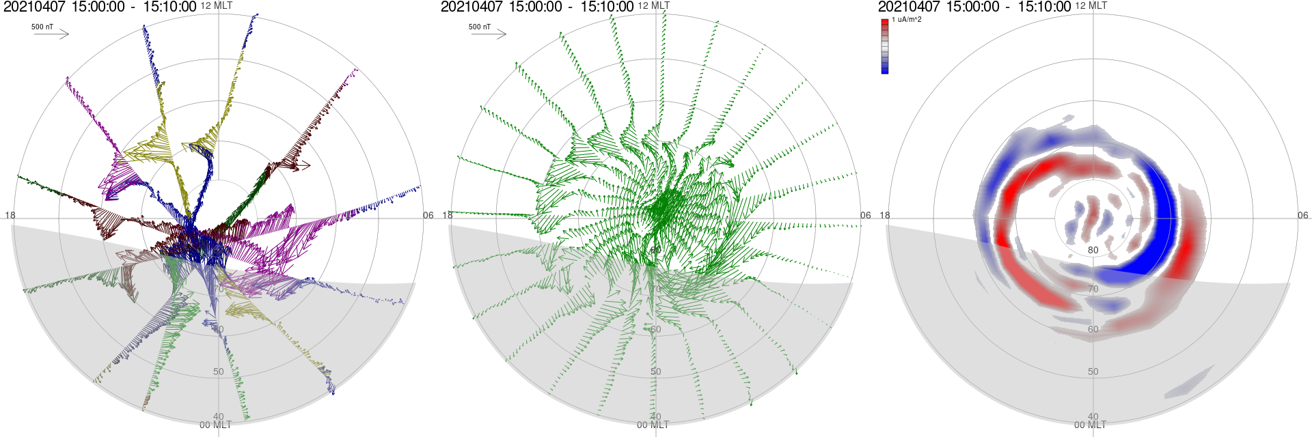
AMPERE Data Products (https://ampere.jhuapl.edu)
Derive magnetic perturbations, 𝛿B (0.1% to 1% of background field), for all spacecraft.
Global 𝛿B from 66 spacecraft merged over 10-minute time window and fit with spherical harmonics for continuous function → 𝛿B_{fit}
Ampere’s law applied to 𝛿B_{fit} gives radial (Birkeland) currents, J_{r}
10-minute resampling cadence, nearly continuous coverage since Jan. 1, 2010
Downward J||
Upward J||
δB
δB_{fit}
J_{r}

Slide 14
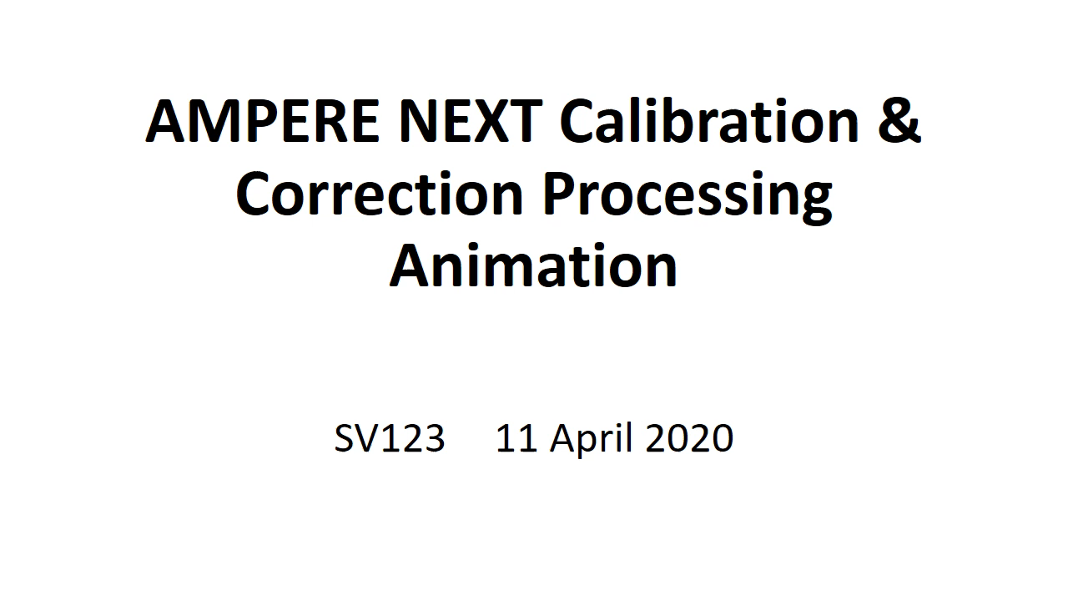

Slide 15
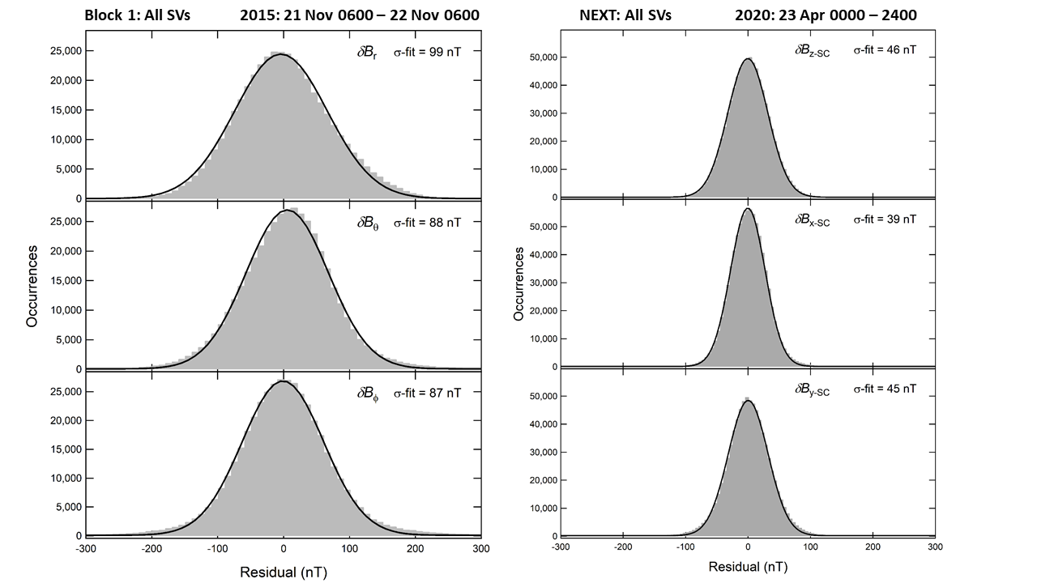
AMPERE-NEXT data is ready
2019 March 1 through the latest data processed (April 2022).
First generation contamination corrections.
Uncertainties ~ 2 x lower than from original Iridium satellites.
Higher sampling cadence than baseline original – 8 s sampling.
Original:
Block 1
NEXT

Slide 16
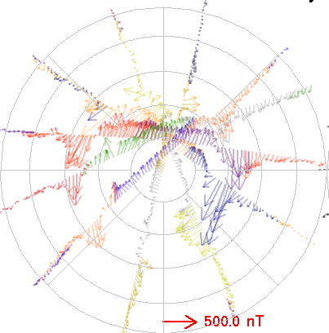
Block 1 & NEXT δB
17 July 2012 06:30-06:40 (North)
7 April 2021 15:00-15:10 (North)
Block 1: 19.44 s sampling (1.5 deg)
NEXT: 8.0 s sampling (0.5 deg)
12 MLT
18
06
80
70
60
50
40
00 MLT

Slide 17
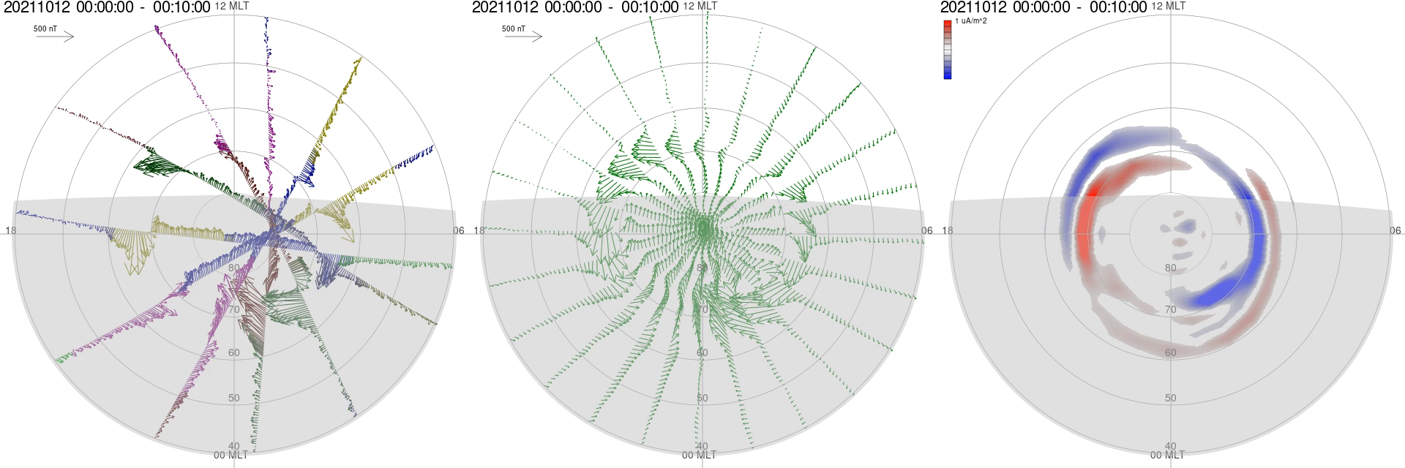
12 Oct 2021 with NEXT
New Release (coming in SPA news): Mar ’19 – Apr ‘22

Slide 18
Notes:
Want to end with another example of scientifically valuable cross-disciplinary collaboration.
We have a mission concept that most suitably fits within the planetary division, but could utilized by other divisions to enhance the science return if the mechanism is in place to bring in researchers from other disciplines
What if we built this mechanism into the mission design from the start?
What would such a mechanism look like?
How can we utilize the recommendations in the upcoming decadal surveys to provide for real cross-disciplinary science efforts? For example, do we try to push Participating Scientist/Guest Investigator programs, or do we create a separate, overarching group that has as its own line of multi-disciplinary efforts?

