Slide 1
AMPERE-Derived ELectrodynamic Properties of the High Latitude Ionosphere (ADELPHI)
Robert Robinson
Catholic University
NASA Goddard Space Flight Center

Slide 2
Outline
Determination of energy fluxes and conductivities from field-aligned currents
Derivation of high latitude auroral electrodynamic parameters, two-D maps and one-D global products
Validation of derived global products
    Hemispheric Power Index
    Cross Polar Cap Potential
    Magnetic Indices
Validation through use
Conclusions

Slide 3
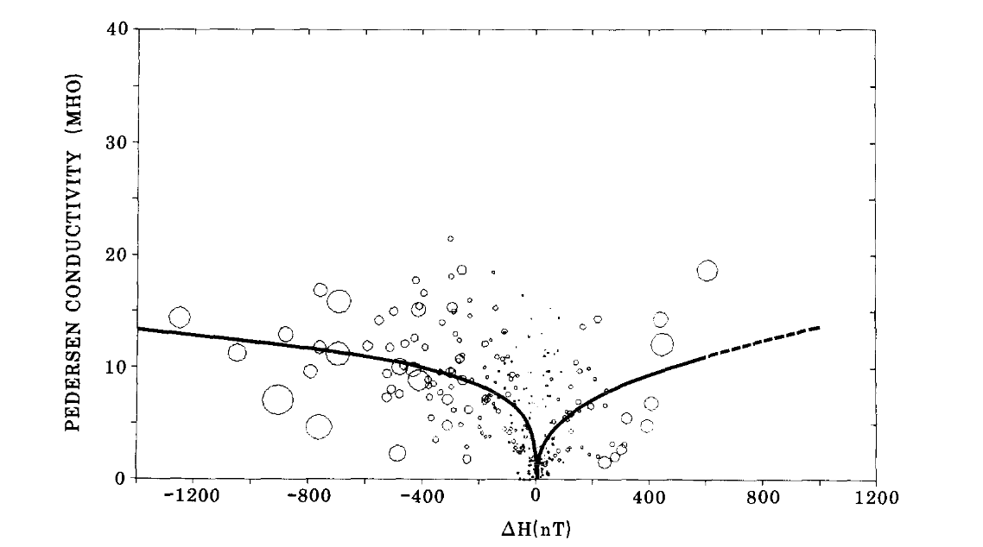
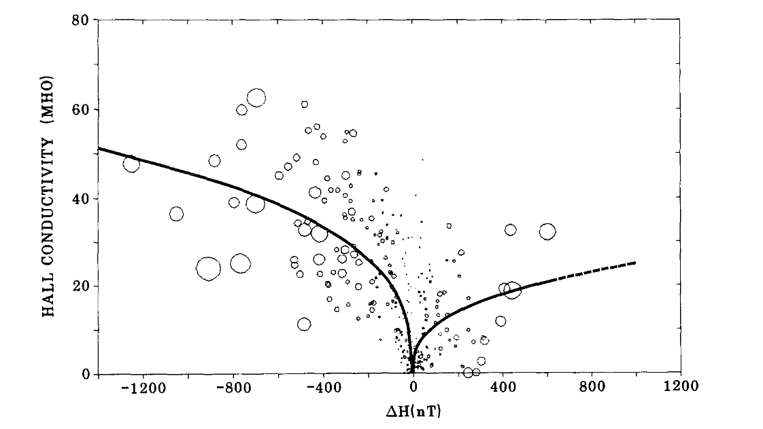
Relationship between height-integrated conductivities measured by the Chatanika Radar and north-south component (𝚫H) of the magnetic field disturbance observed at College, Alaska.
From ‘Electric Conductivities, Electric Fields and Auroral Particle Energy Injection Rate in the Auroral Ionosphere and their Empirical Relations to the Horizontal Magnetic Disturbances’, Ahn et al., 1983.

Slide 4
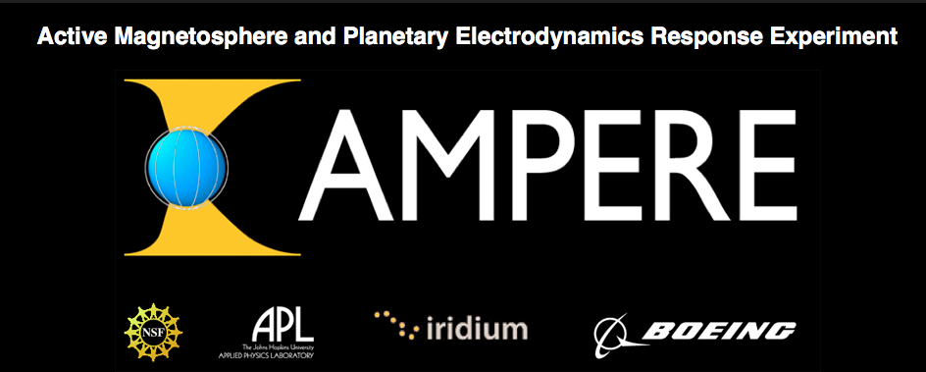
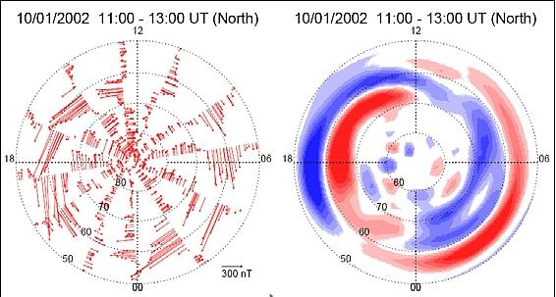
AMPERE uses magnetometer data from the Iridium constellation
of 66 satellites to measure field-aligned currents globally and continuously.

Slide 5
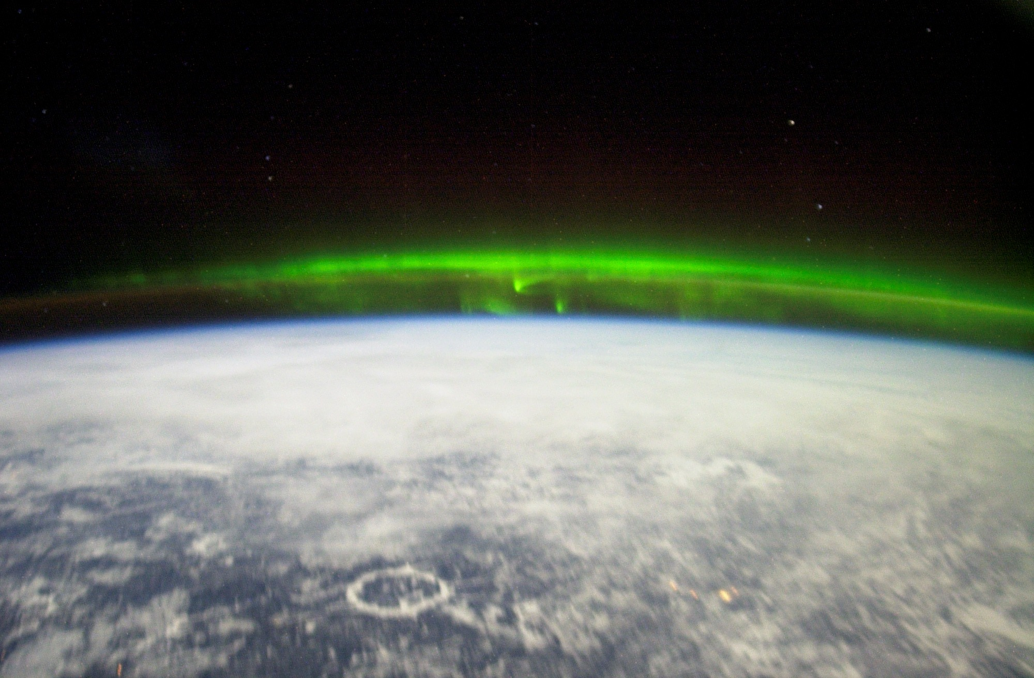
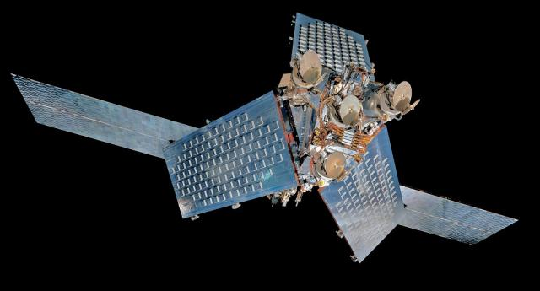
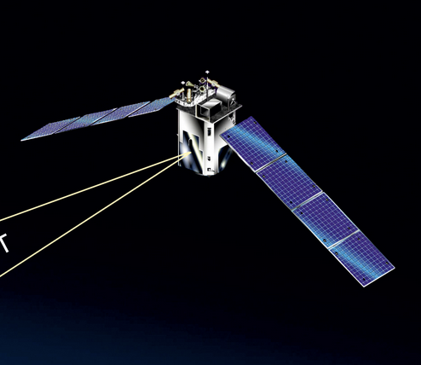
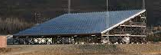
Iridium
(AMPERE)
Field-aligned Currents
TIMED (400,000 FUV measurements from GUVI)
Auroral conductances determined from electron density profiles measured by PFISR
Precipitating particle energy flux from FUV luminosities measured by TIMED/GUVI
5880 measurements from the Poker Flat Incoherent Scatter Radar (PFISR)
Measurements of auroral energy flux and conductances in conjunction with AMPERE measurements of field-aligned currents

Slide 6
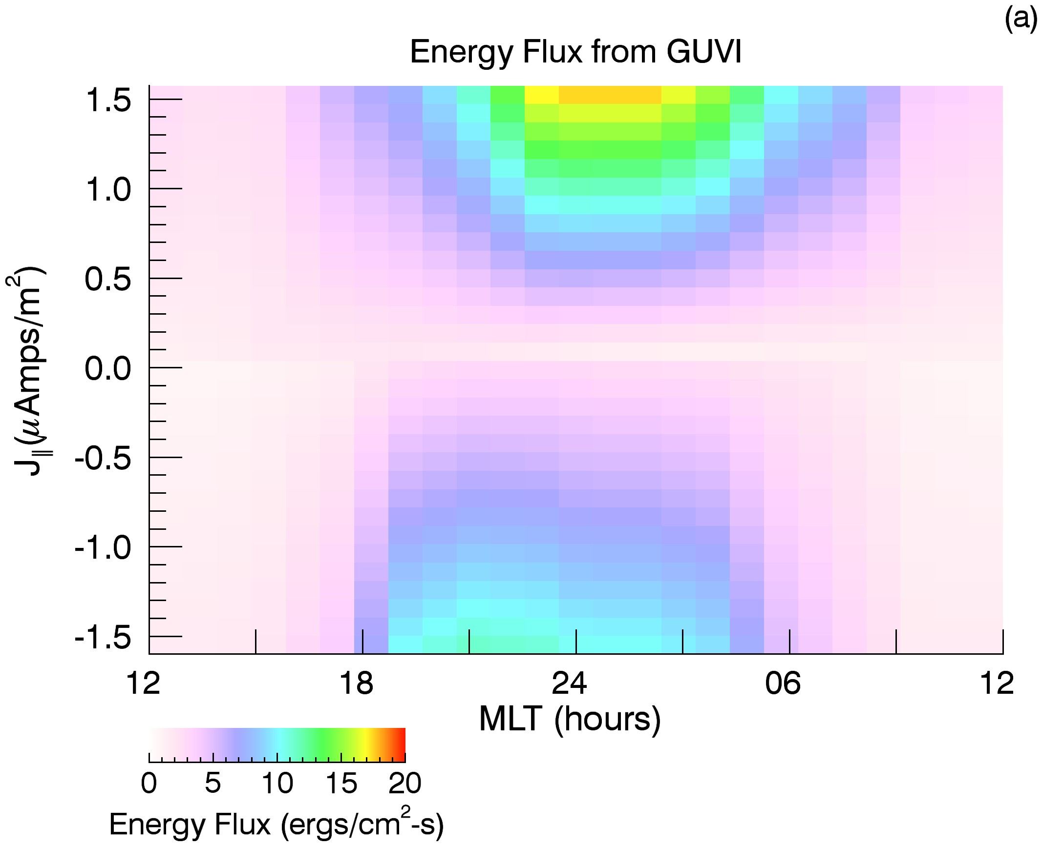
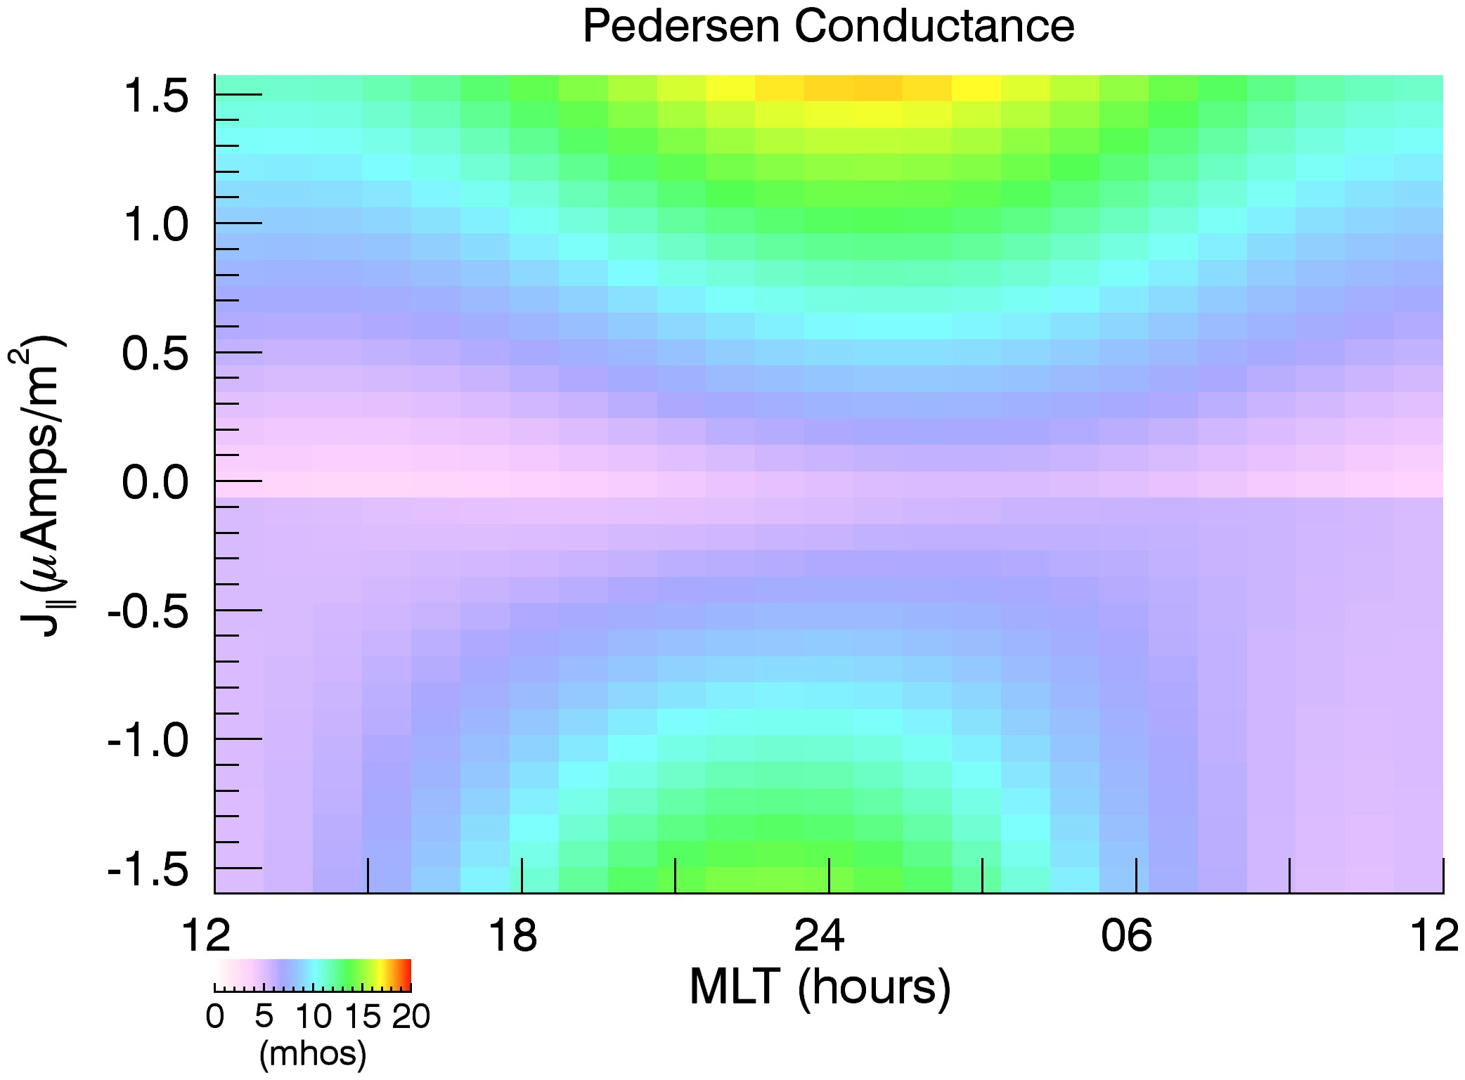
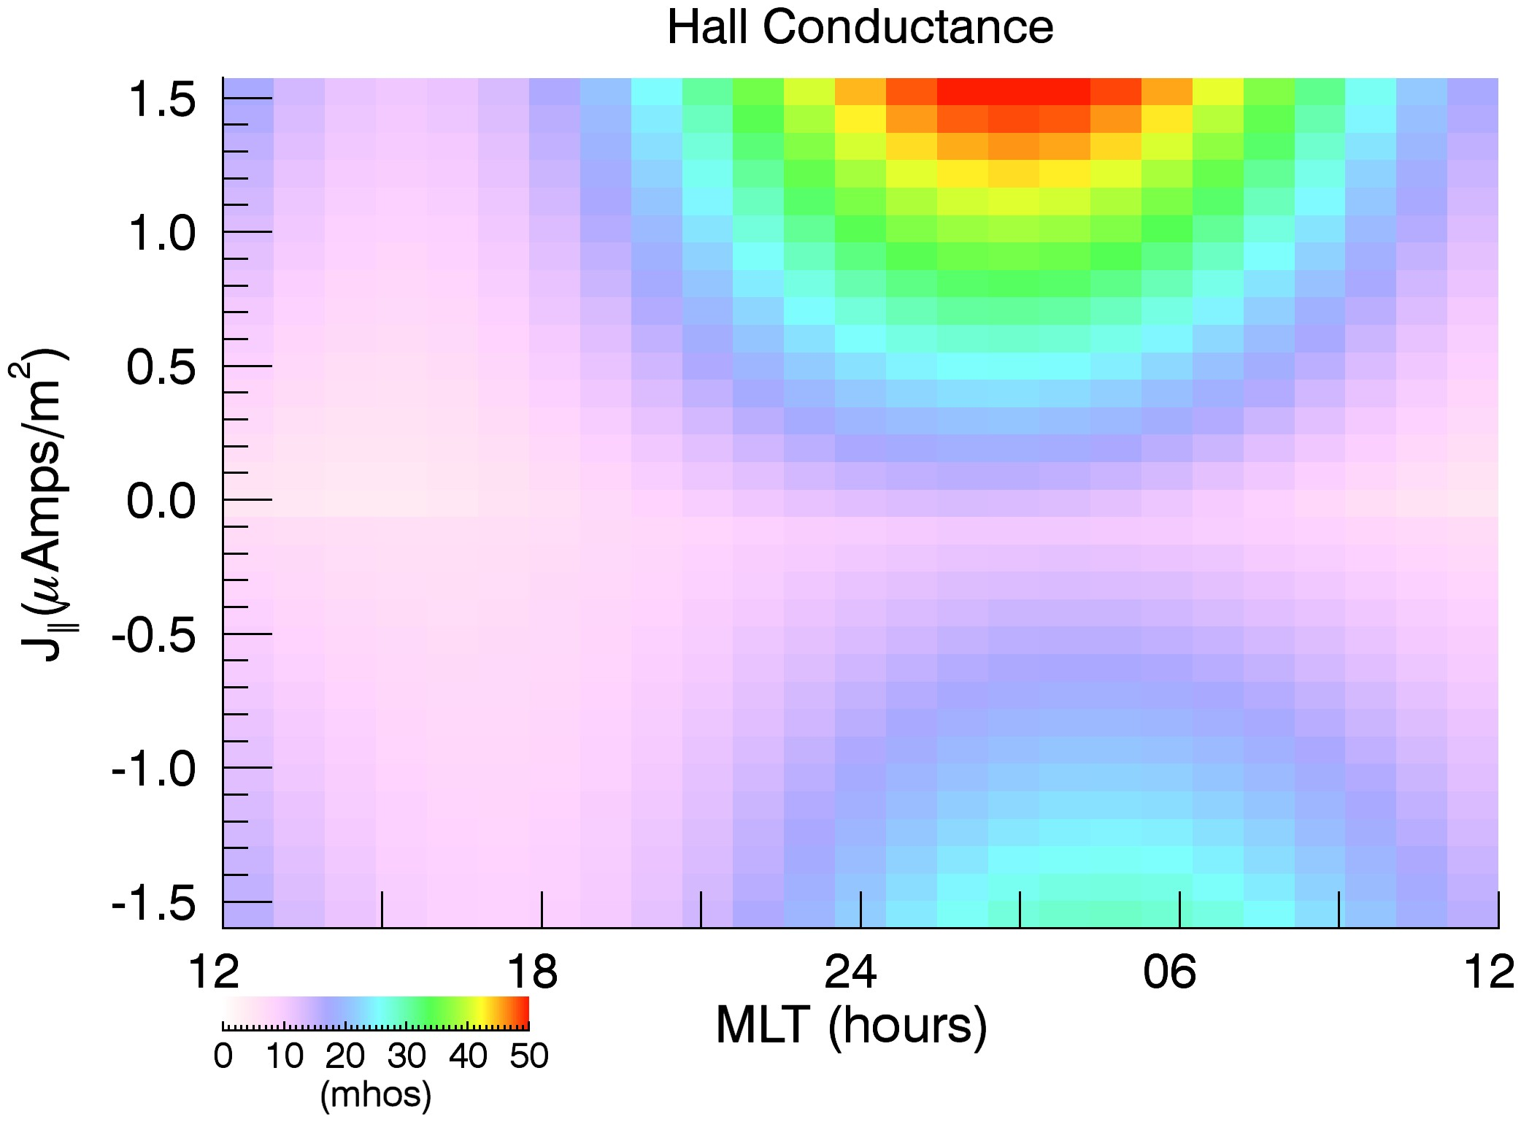
Relation between field-aligned currents and auroral energy flux and conductances as a function of magnetic local time
From GUVI study
From PFISR study
Energy Flux

Slide 7
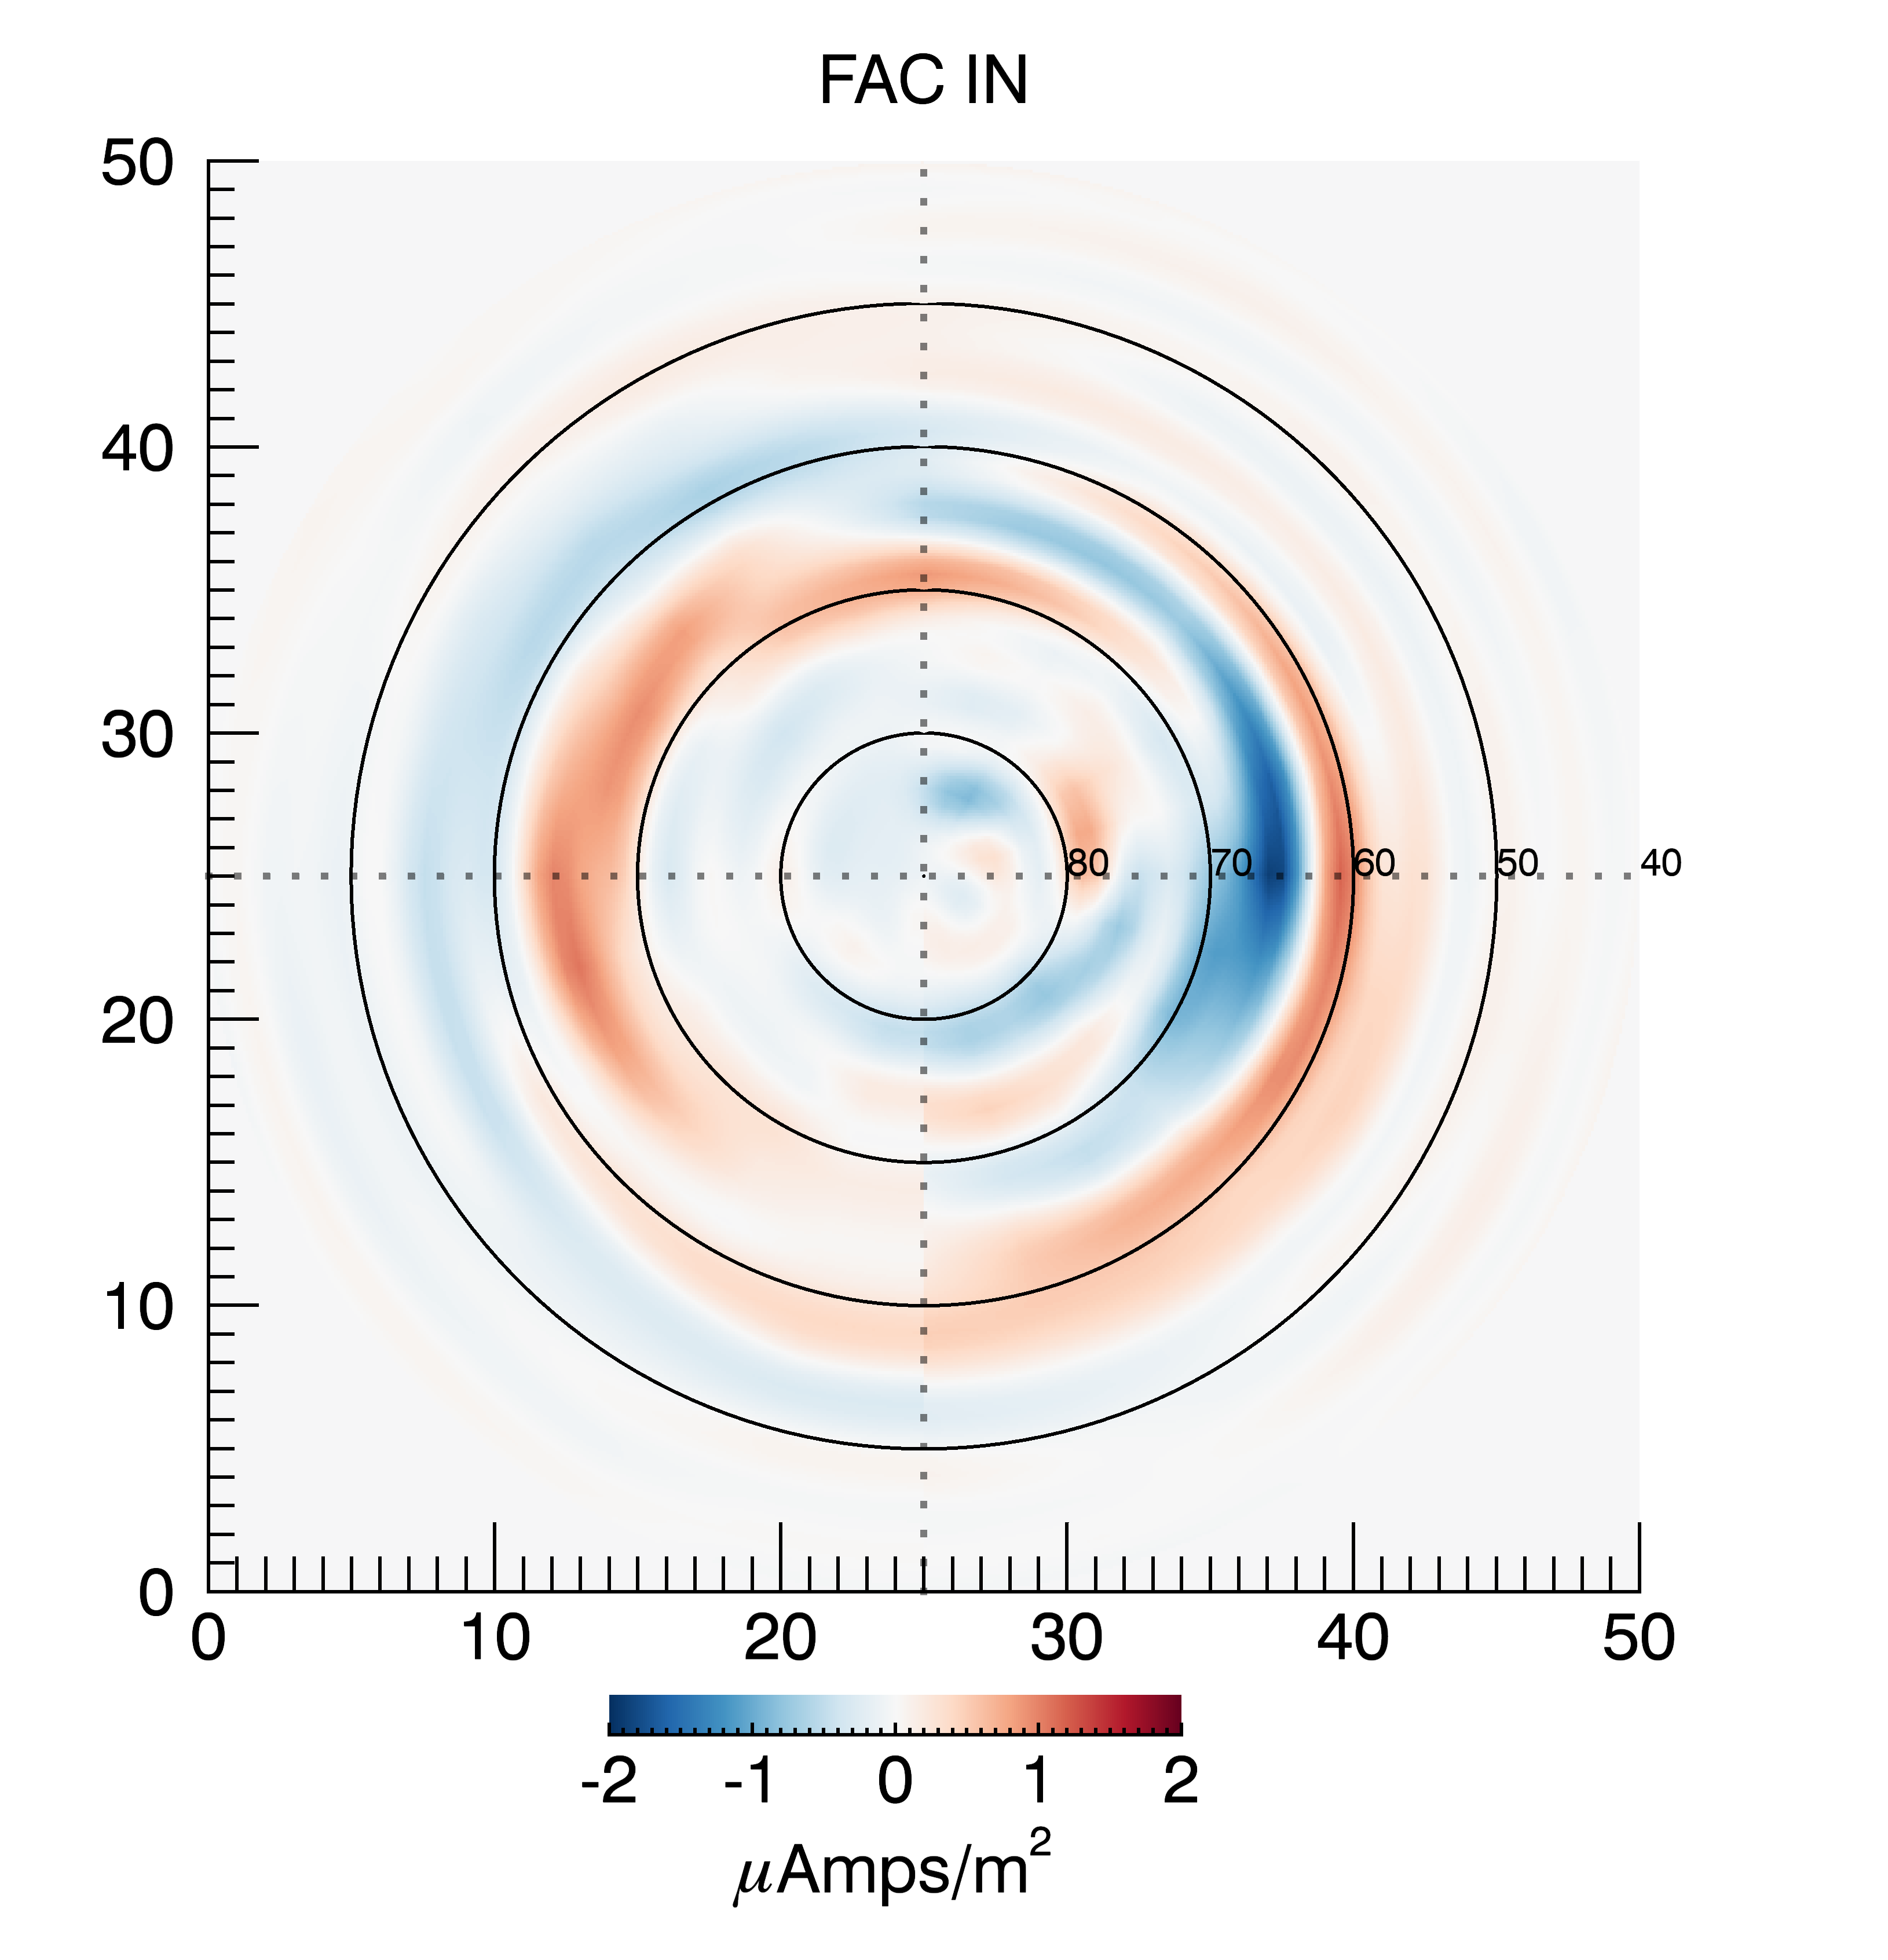
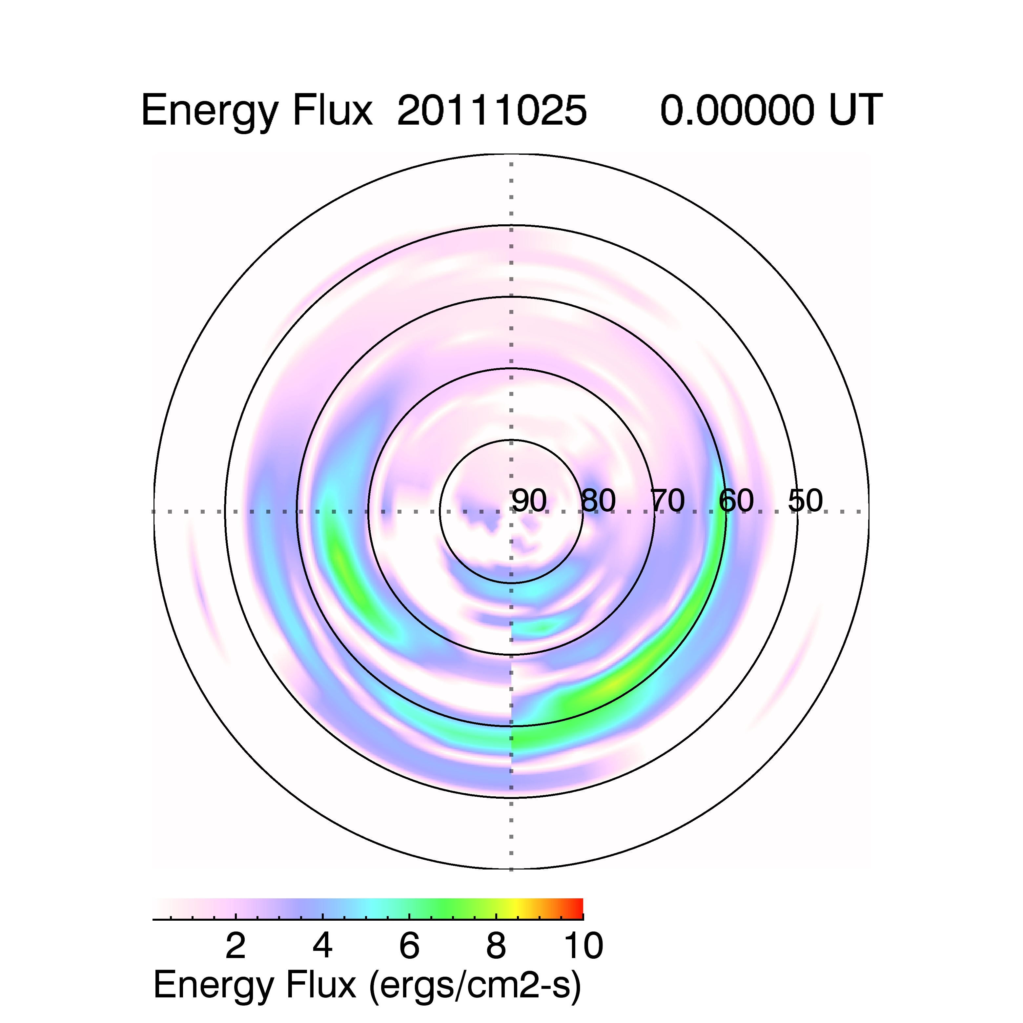
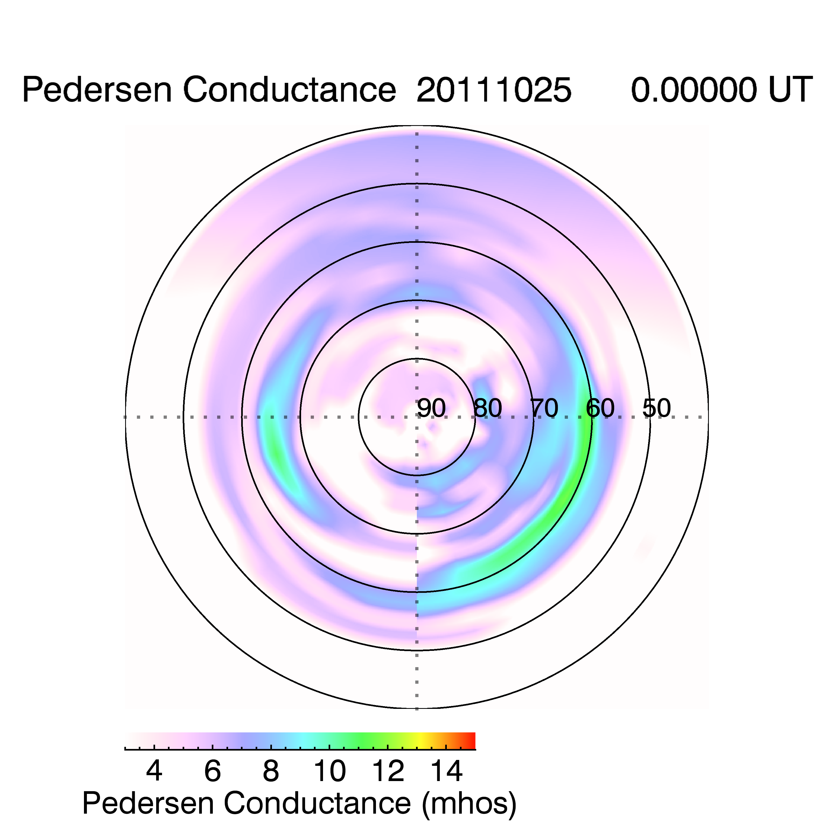
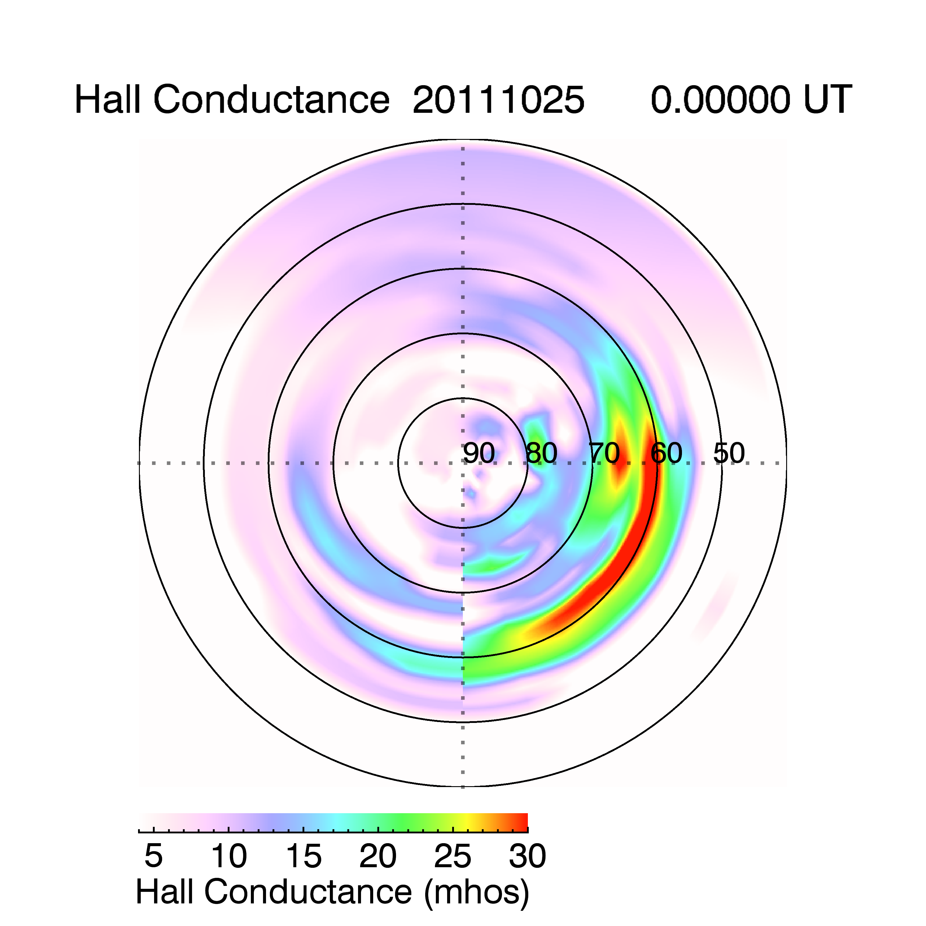
Auroral Conductances and Energy Flux from AMPERE—Updated Every 2 Minutes

Slide 8
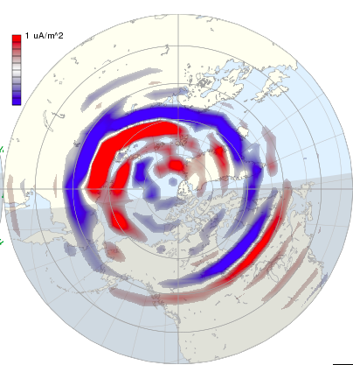

Auroral Precipitation and Electrodynamic Parameters
Derived From Field-aligned Currents
Field-aligned Currents
Global Parameters
Energy Flux
Conductivities
ΔBe, ΔBn
$$J_{∥}=∇∙(\overset{̿}{Σ}\overline{E})$$
HPI Precipitation
Poynting Flux
Electric Fields
Horizontal Currents
Cross
Polar Cap Potential
HPI
Joule Heating
Magnetic Indices
Joule heating

Slide 9
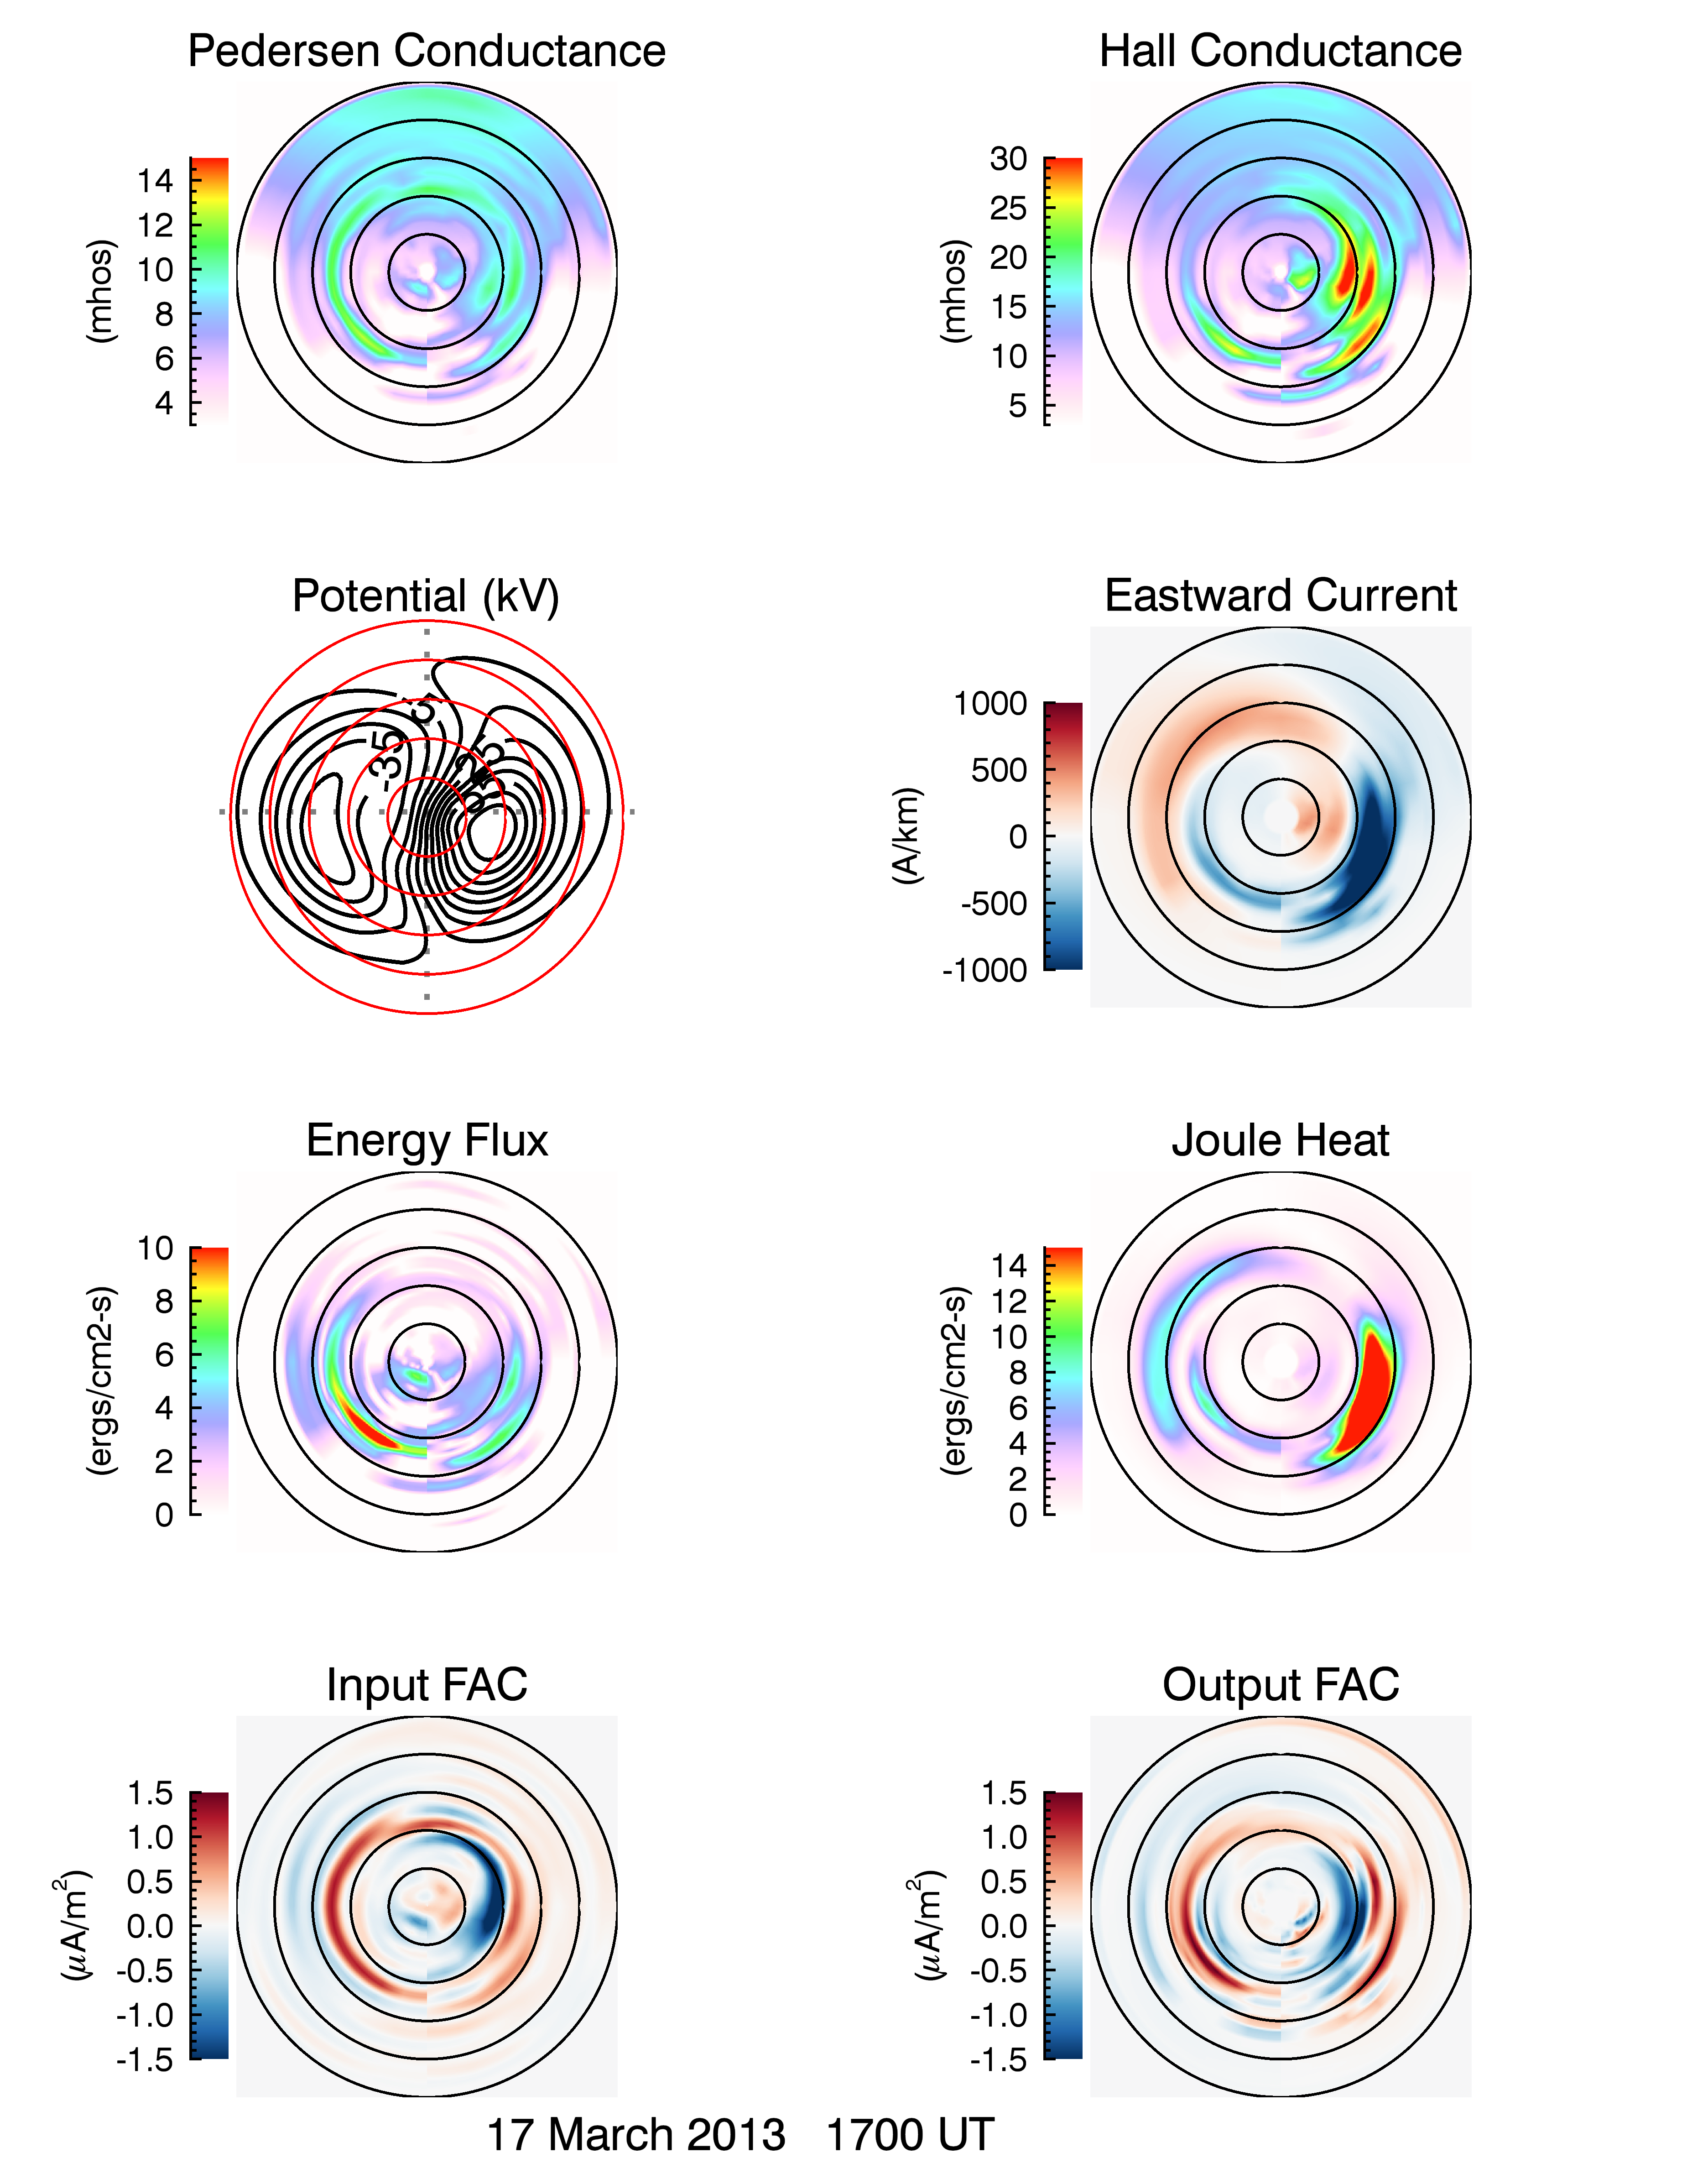
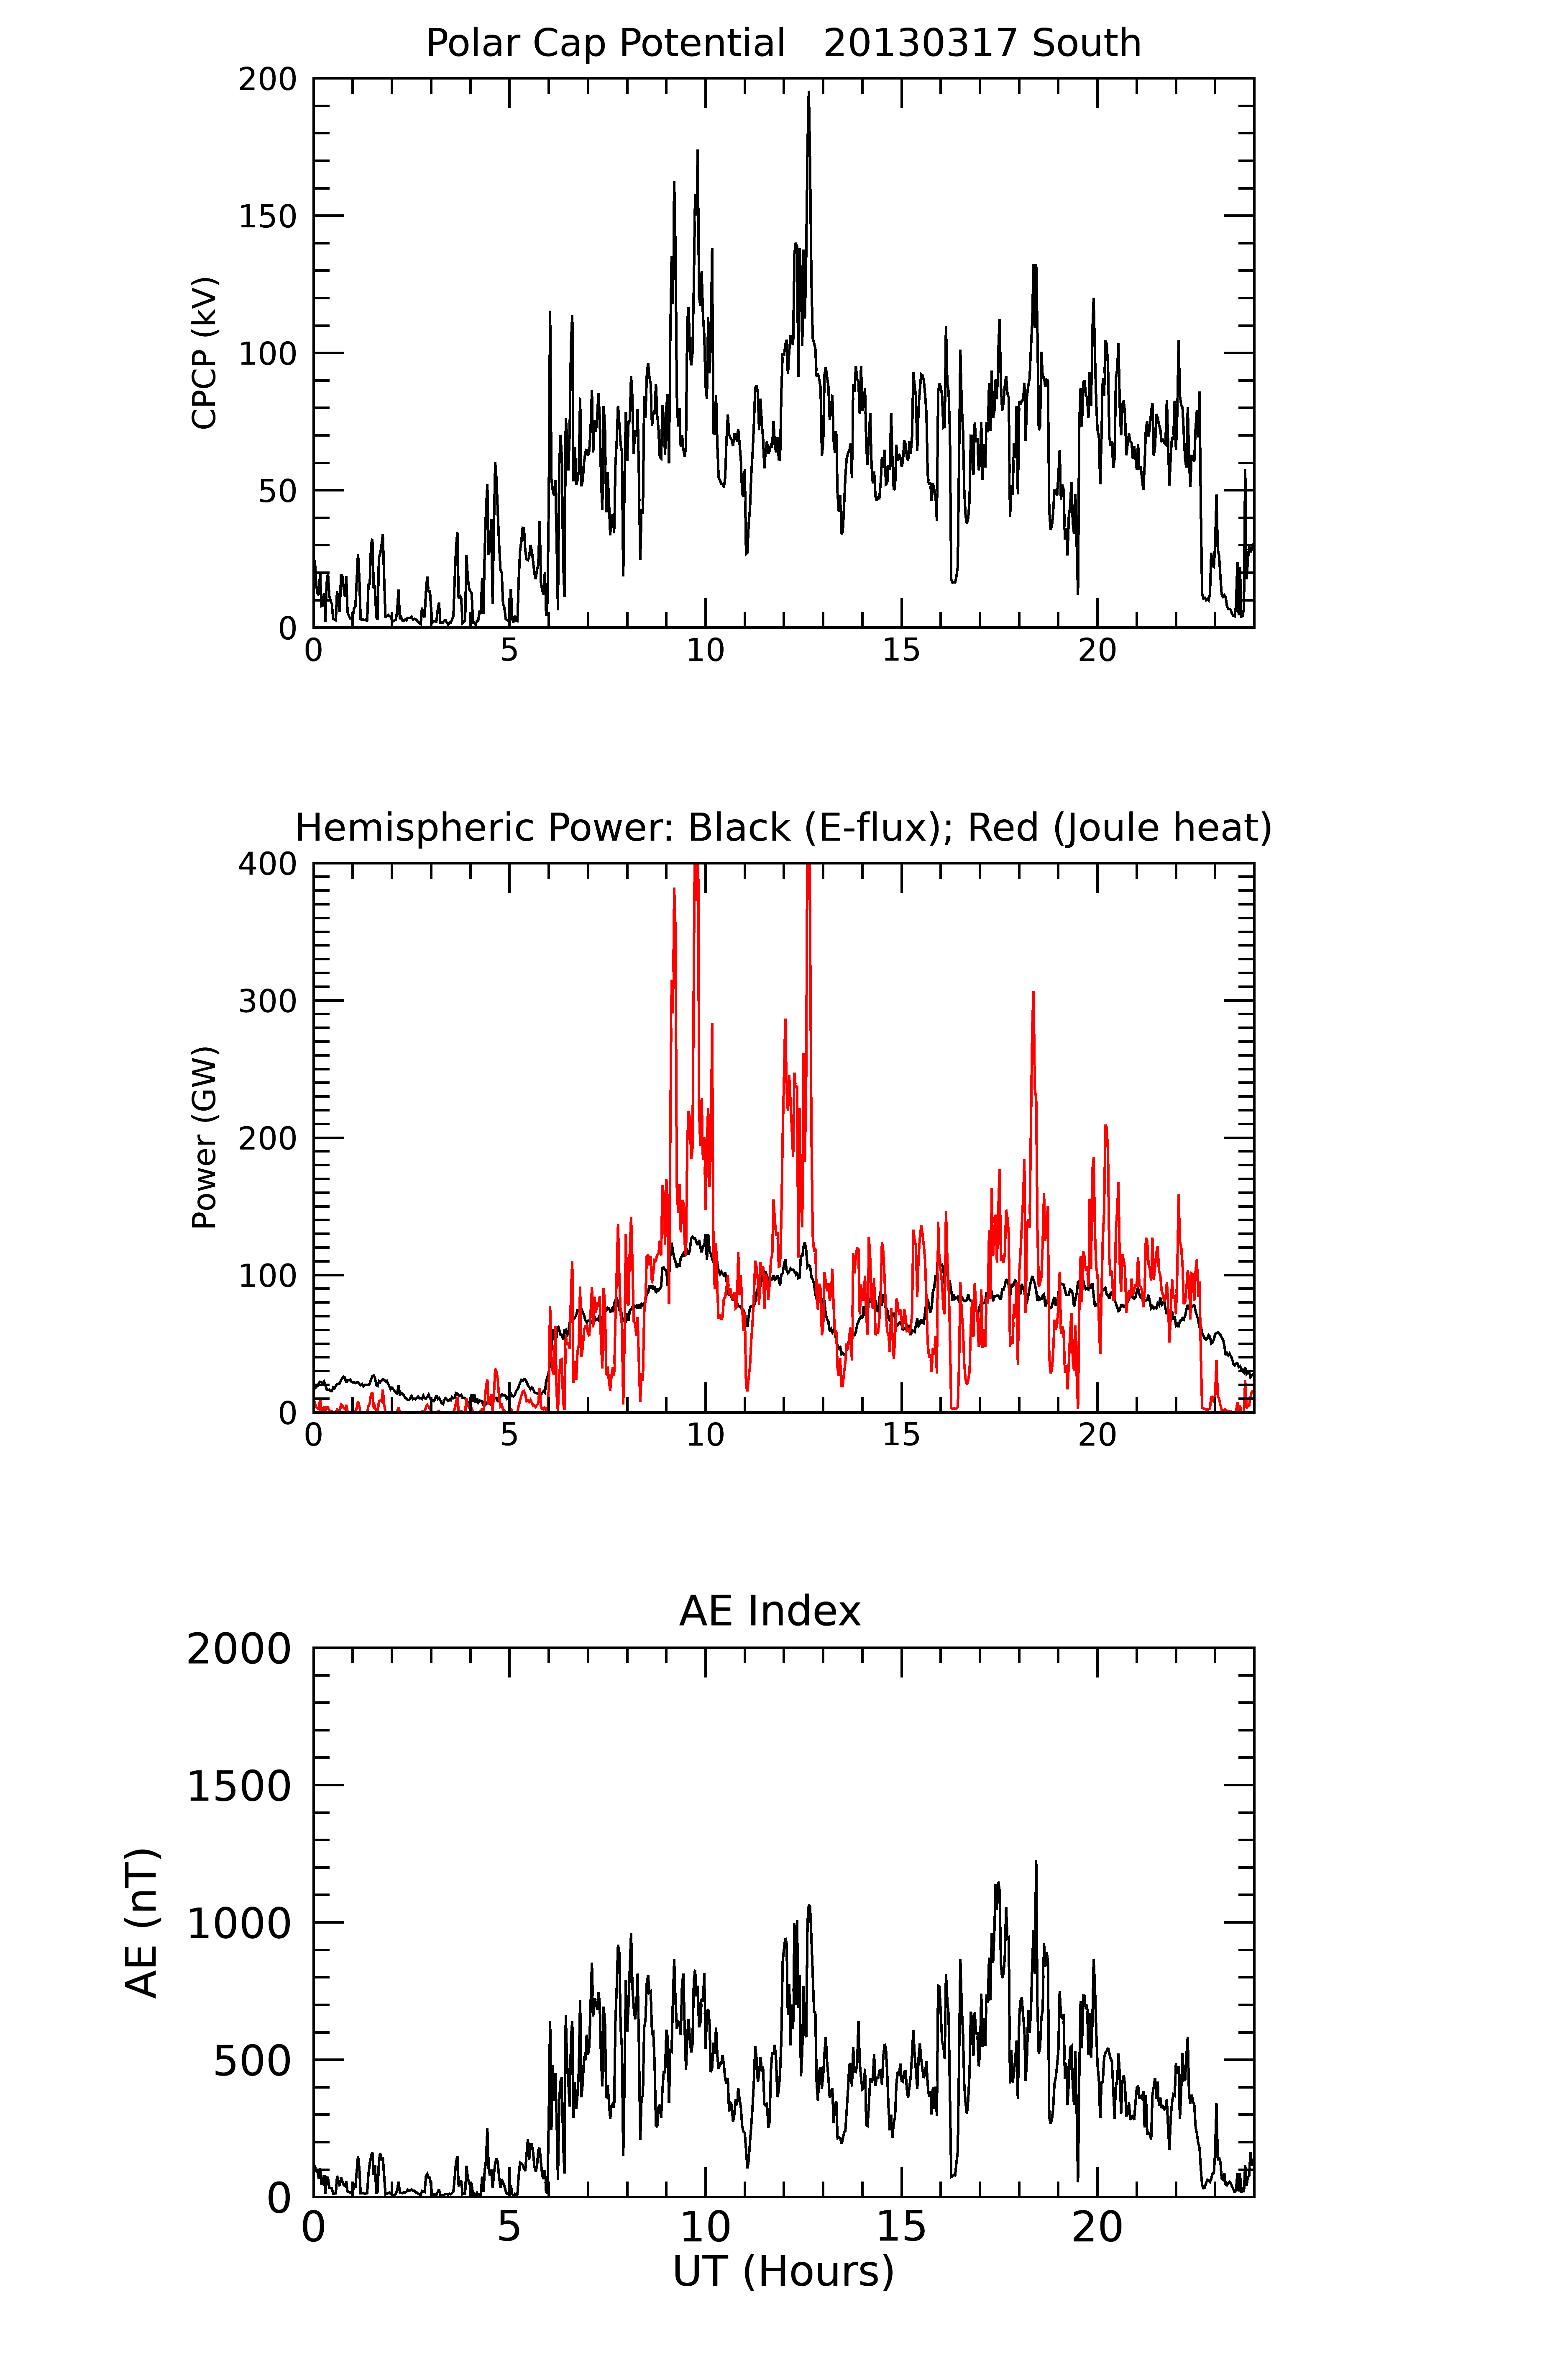
Global Parameters
Cross Polar Cap Potential (kV)
Hemispheric Power (GW)
AE (nT)

Slide 10
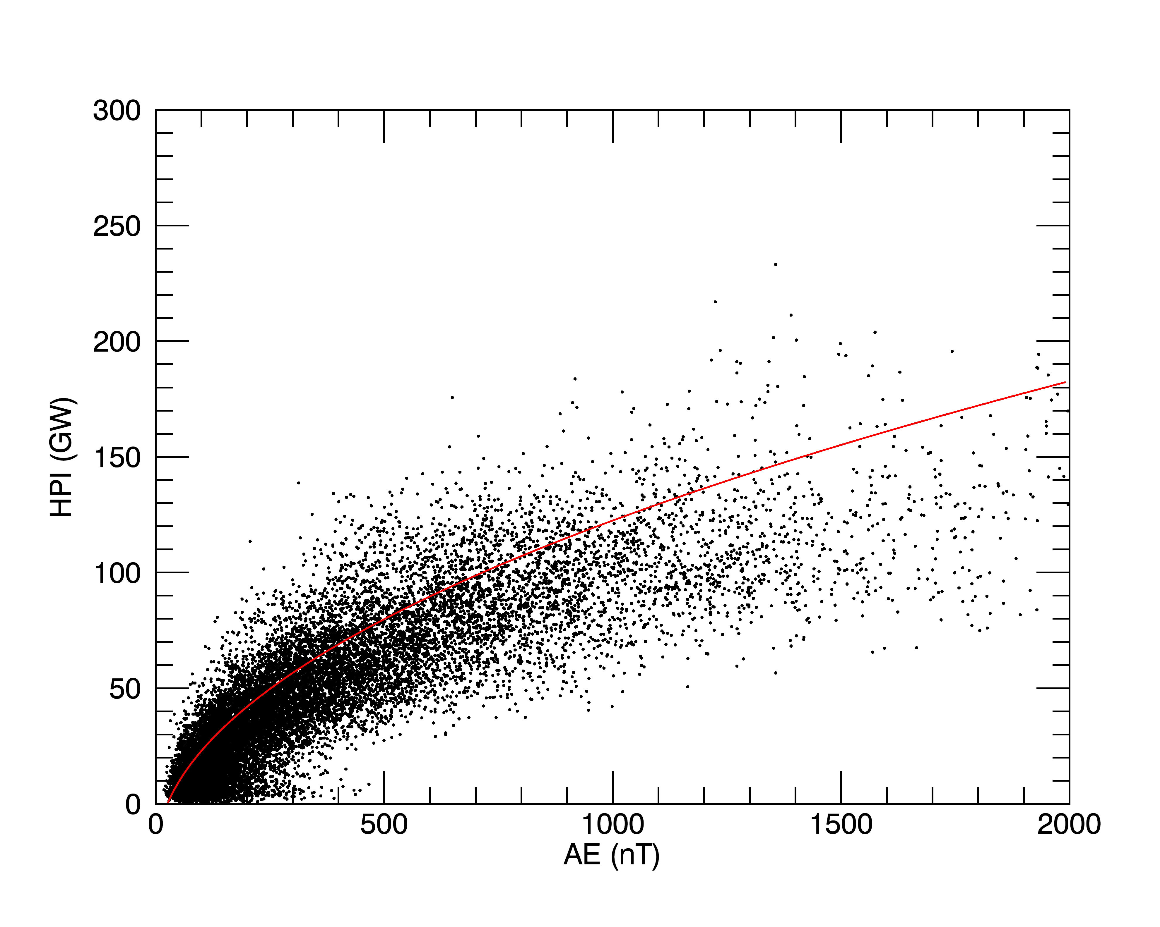
Relation between modeled HPI from particle precipitation and AE (30 days times 720 points per day)
From ‘A relation between the energy deposition by electron precipitation and geomagnetic indices during substorms’, by Ostgaard et al. (2002), based on POLAR FUV and X-ray imaging data)

Slide 11
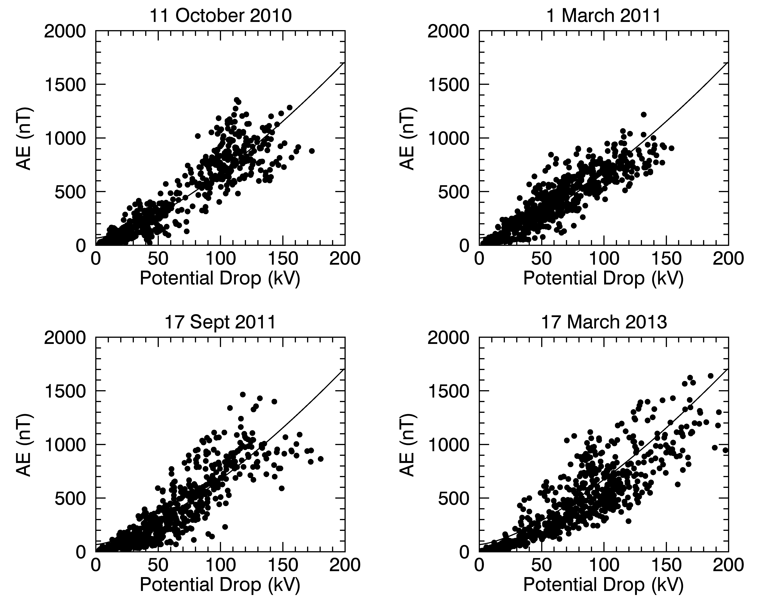
Relation between modeled cross polar cap potential and AE
Weimer, D. R., N. C. Maynard, W. J. Burke, and C. Liebrecht (1990), Polar cap 637 potentials and the auroral electrojet indices, Planet. and Space Sci., 38, Issue 9, pp. 638 1207-1222, https://doi.org/10.1016/0032-0633(90)90028-O.

Slide 12
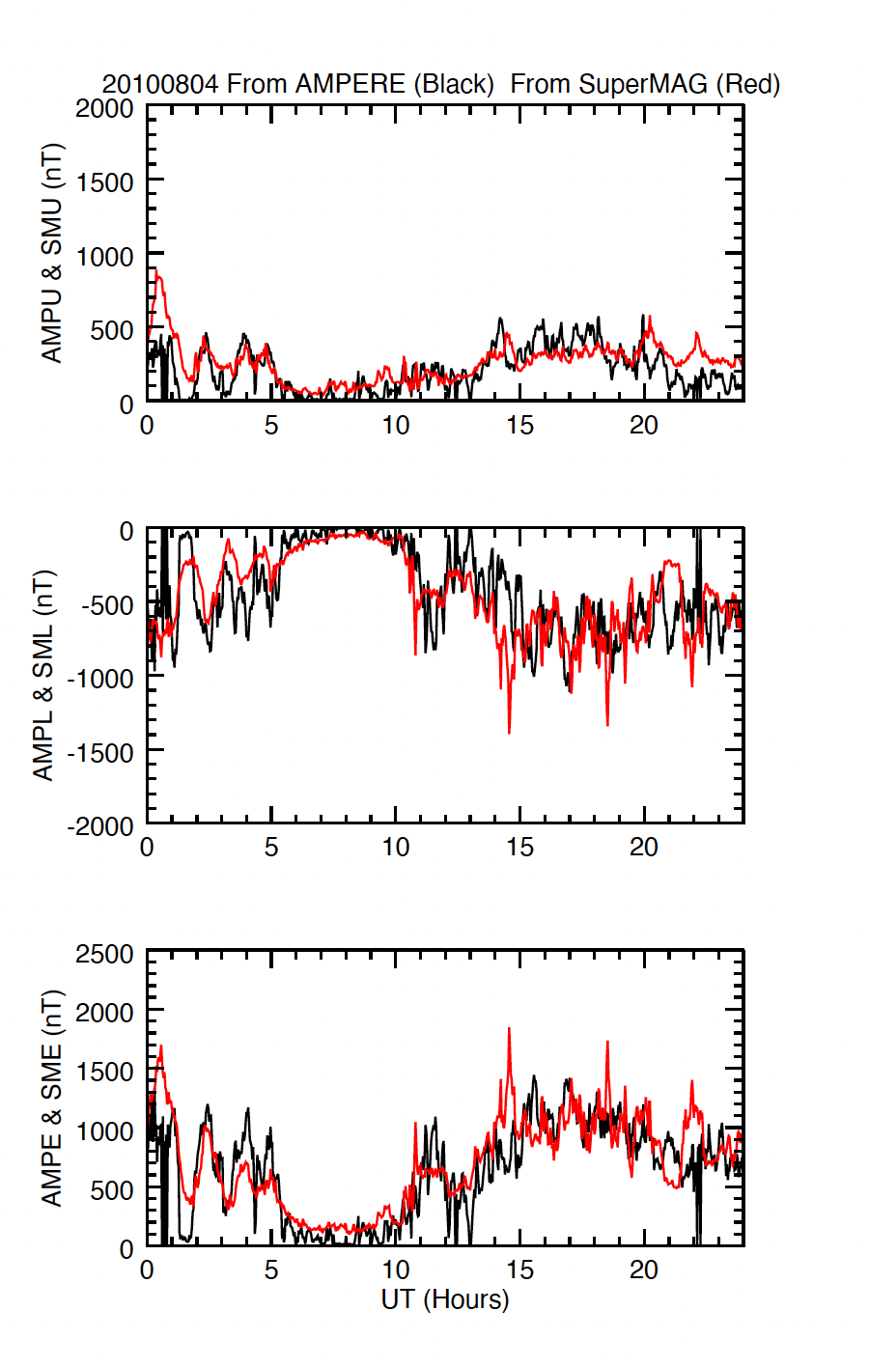
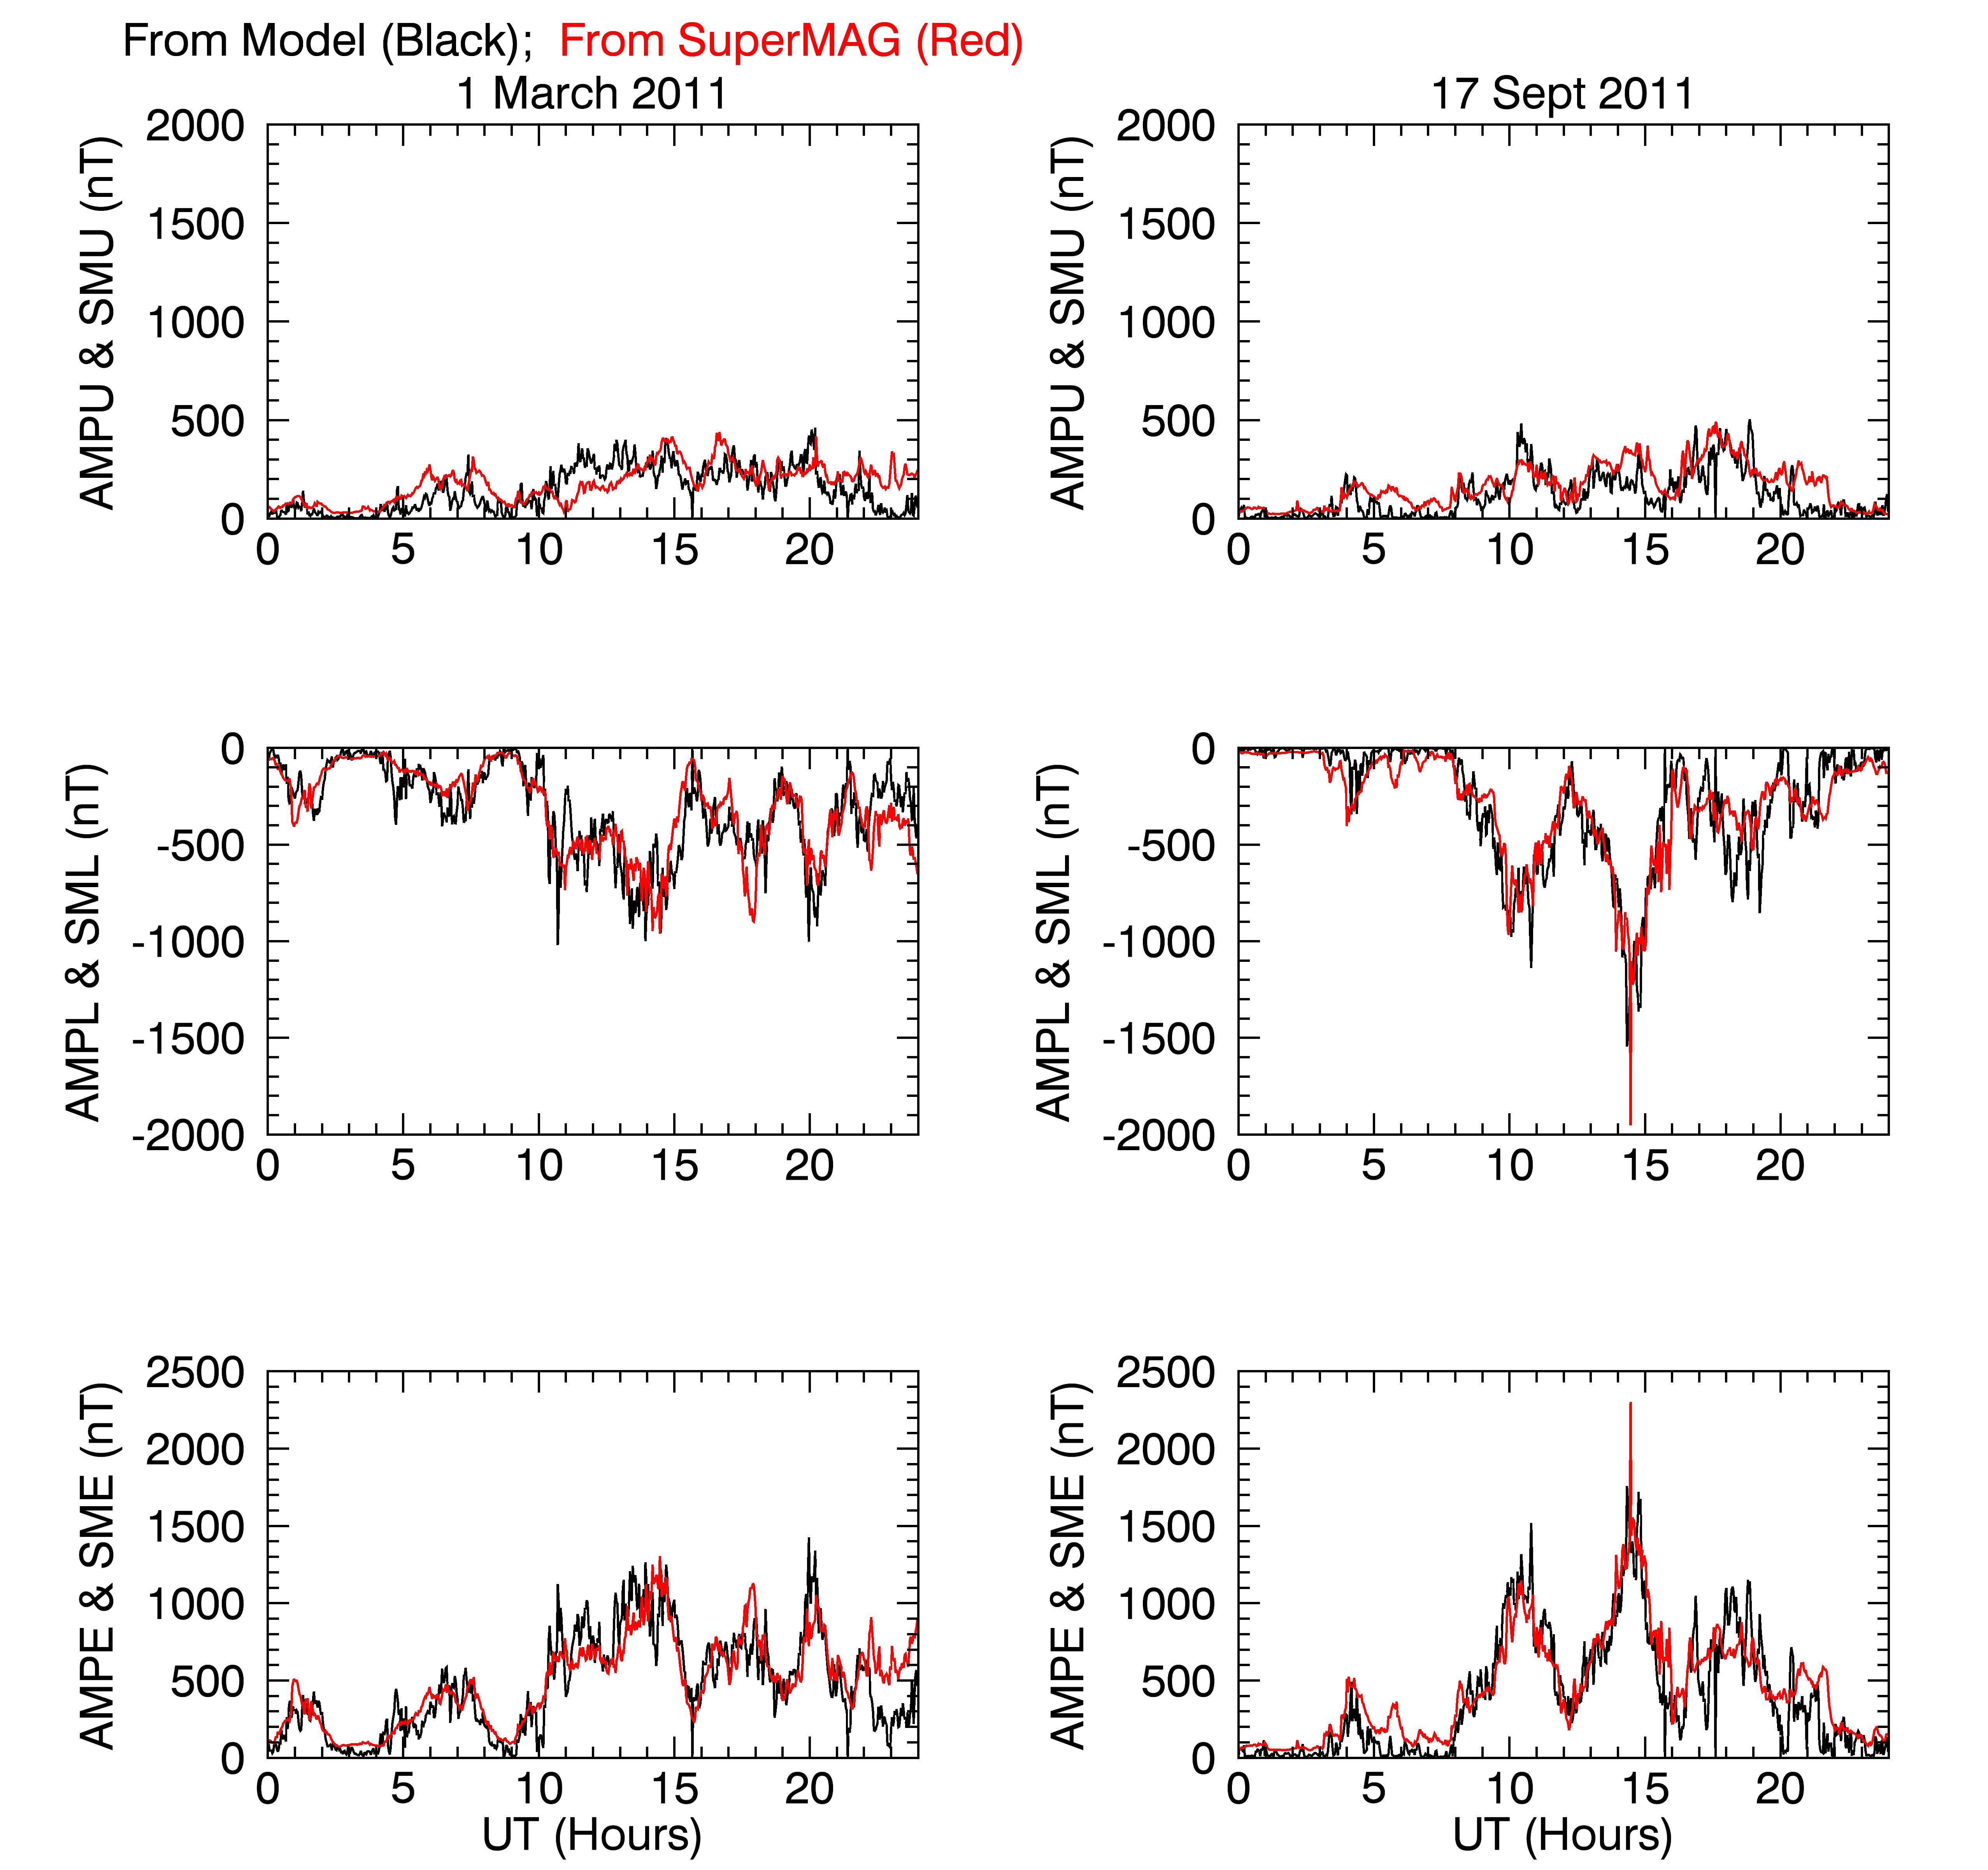
4 August 2010

Slide 13
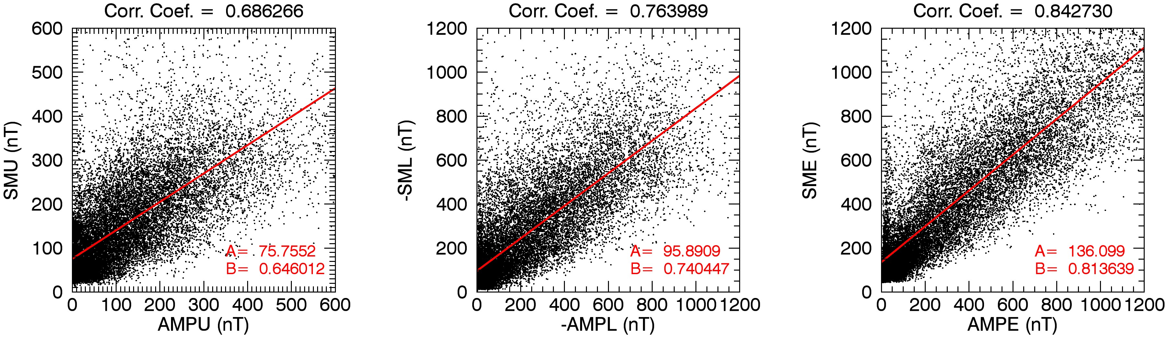

Slide 14
Validation through Use (over ~120 days)
Energy Flux Validation Studies
Ground-based Mag Comparisons
AMPERE AE Simulations
AMPERE SuperMAG Simulations
Impulsive Joule Heat Events Study
Joule Heat Case Study
Storm Current-Voltage Study
Poynting Flux-Joule Heating Comparison study
AMPERE-MMS Study
AMPERE THEMIS Study
AMPERE-Van Allen Probes Study
AMPERE Substorm Study
AuroraPHILE model comparisons (from Dibyendu Sur)
AMPERE GNSS Phase Study
AMPERE-SCIPS Study
(Dinsmore and Mathews)
AMPERE-STEVE Study
E-Region Ionospheric Specificaton
F-Region Modeling Study
Improved RO Inversion
Ionospheric HF Ray Tracing Study

Slide 15
AMPERE-Derived ELectrodynamic Properties of the High-latitude Ionosphere (ADELPHI)
*AMPERE data after September 2017 currently in production.

Slide 16
Conclusions
Global maps of field-aligned currents can be used to specify high latitude precipitating particle energy flux, conductances, electric fields, currents, Joule heating, and Poynting flux.
Limited validation has been conducted on local values of precipitating particle energy flux and conductances.
Validation on global parameters over many geomagnetically active days shows that the model:
  Reproduces the relation between HPI and AE observed by Ostgaard et al. (2002) using Polar satellite data;
  Reproduces the relation between cross polar cap potential and AE observed by Weimer et al. (1990) using Dynamics Explorer satellite data;
  Reproduces the SuperMAG magnetic indices with a correlation coefficient of 0.7-0.8 over 30 geomagnetically active days;
  Produces results that are self-consistent (with some exceptions) with the input field-aligned current distributions.
Validation has also been conducted through use in a number of focused studies of specific events and phenomena, and in correlative and comparative studies with data and other models (validation through use).

