Slide 1
HYPERS Simulations of Solar Wind Interactions with Earth’s Magnetosphere
Yuri Omelchenko¹⁻³
¹Space Science Institute, Boulder, CO
²Trinum Research, Inc., San Diego, CA
³Palomar College, San Marcos, CA
L.-J. Chen⁴ and J. Ng^{4,5}
⁴NASA GSFC
⁵University of Maryland
Thanks to M. Kuznetsova, M. El Alaoui, L. Rastaetter, M. Petrenko (CCMC Team)
CCMC Workshop, College Park, Maryland, June 6-9, 2022

Slide 2
Talk Outline
Science focus on ion kinetics and turbulence
HYPERS: HYbrid Parallel Event-Resolved Simulator
HYPERS validation on laboratory plasmas
HYPERS studies of space plasmas:
Foreshock waves and turbulence
Moon’s wake
High-speed jets (HSJs) and dayside reconnection
Ionospheric flows and magnetotail reconnection

Slide 3
LWS: Science Questions
Q1: Global effects of ionospheric outflows on the magnetosphere
Q2: “Dungey” cycle: substorm dynamics, reconnection and ion energization
Q3: Interactions of extreme solar wind drivers with the magnetosphere
Multiscale/multiphysics models are needed!

Slide 4
HYPERS is AI-Driven
Fields and particles are updated by EMAPS on their own local timescales (“as needed”) => exceptional stability + accuracy + speed
The user defines physical accuracy (maximum change per update), not timesteps
The Cartesian mesh can be uniform or stretched
Variety of boundary conditions and setups

Slide 5
EMAPS: (E)vent-driven (M)ulti-(A)gent (P)lanning (S)ystem
In press, Springer Lecture Notes in Physics,
Space plasma simulation: approaches, codes and applications
Y.A. Omelchenko and H. Karimabadi
“EMAPS – An Intelligent Agent-Based Technology
for Simulation of Multiscale Systems”

Slide 6
Cell-Averaged PIC Δt’s

Slide 7
Field Δt’s

Slide 8
Lab Physics (2012-2018)
Field-Reversed Configurations (FRCs)
Spheromak merging
FRC collisions with magnetic mirrors
Magnetized laser plasmas

Slide 9
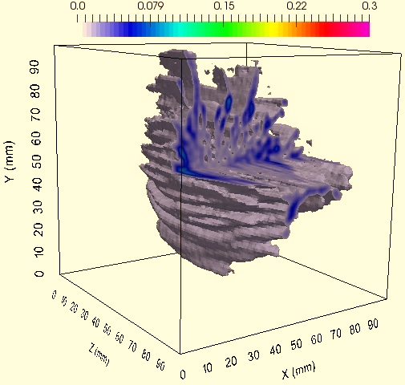
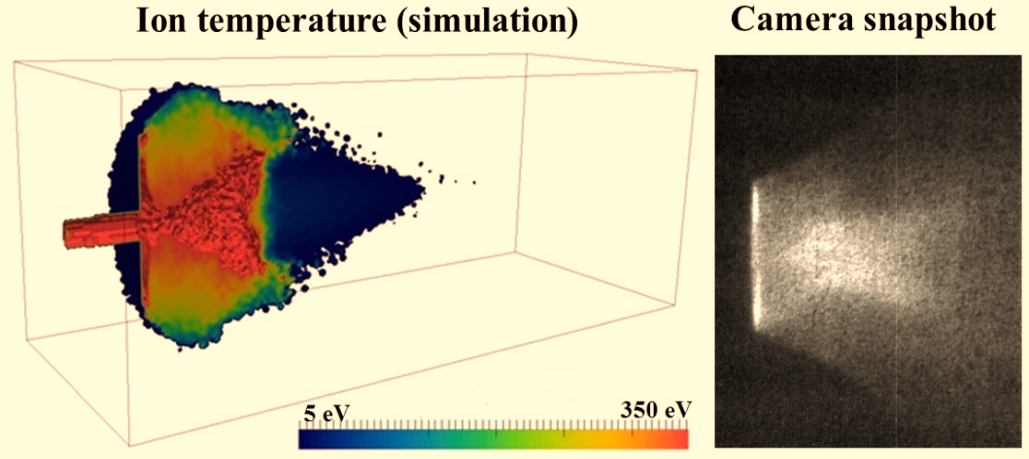
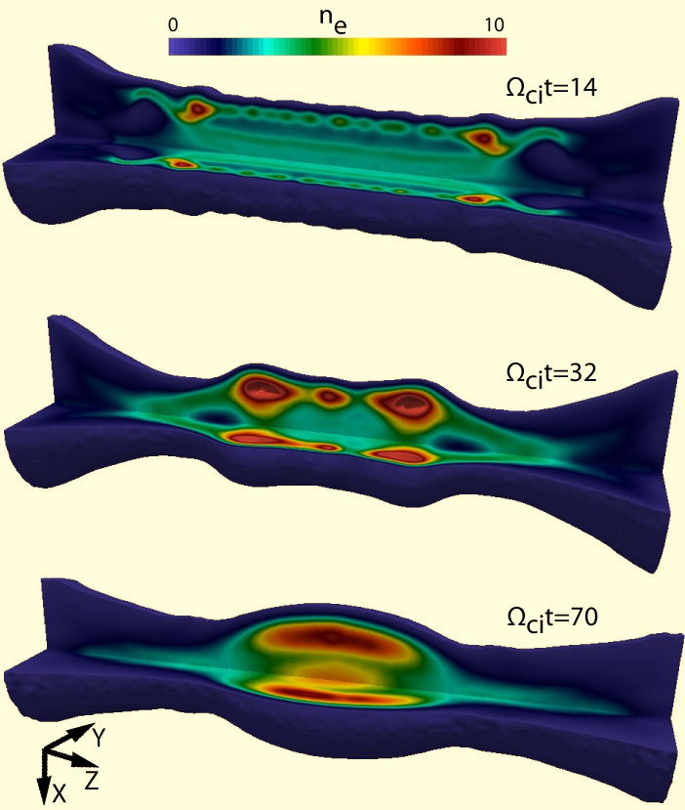
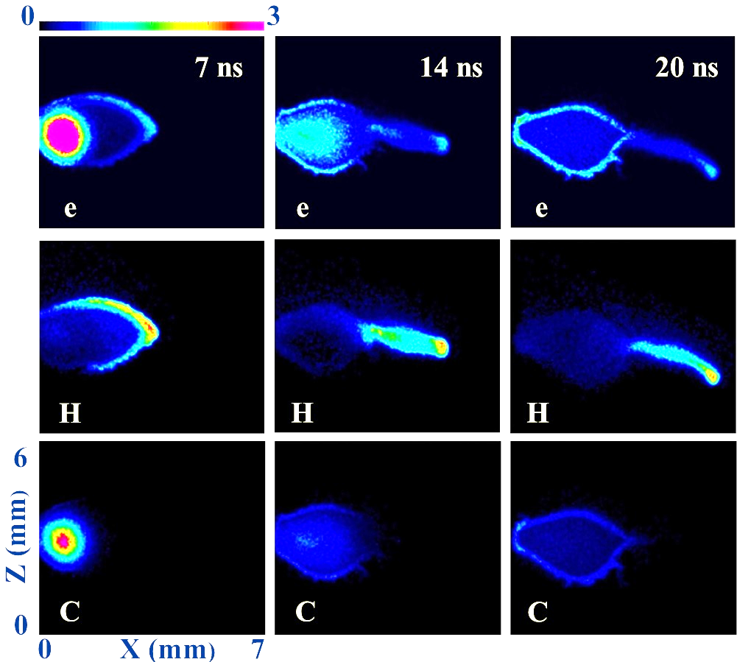

Slide 10
Space Physics (2019-2022)
Moon’s wake
Earth’s foreshock
HSJs & dayside reconnection
O⁺ outflows & tail reconnection

Slide 11
High-Speed Jets (HSJs)
Q: What are HSJs? A: HSJs are solar wind dynamic pressure enhancements in the magnetosheath.
Q: Why are HSJs important? A: HSJs impinge on the magnetopause and affect reconnection.
Q: When are HSJs observed? A: They are more often observed under high-Mach/quasi-radial IMF conditions.
Q: What is the jet origin? A: In our simulations HSJs arise due to the turbulent action of magnetic field (“magnetokinetic” mechanism)

Slide 12
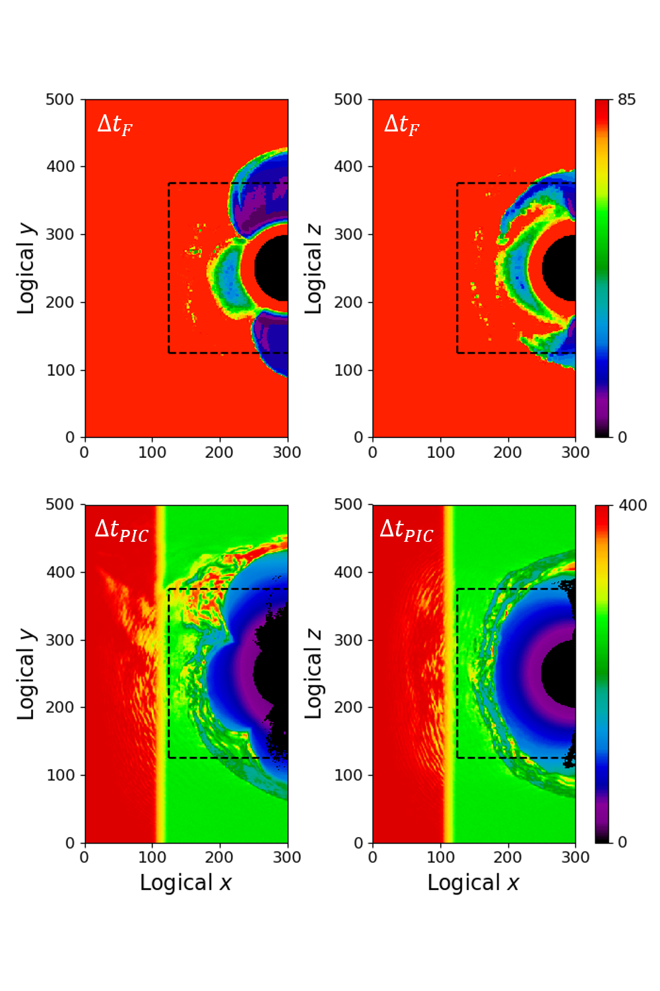
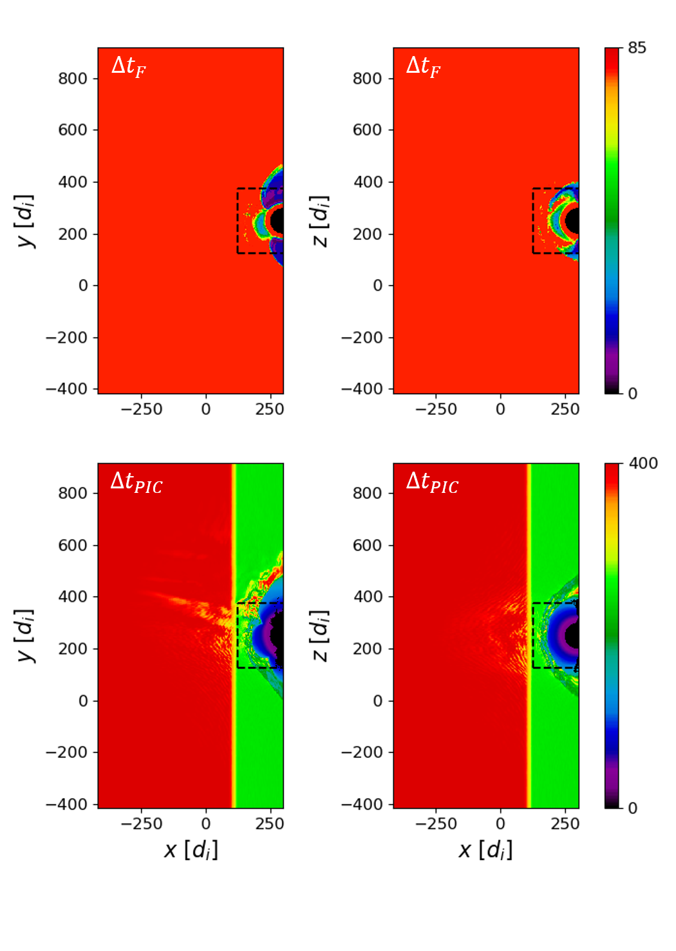
Asynchronous integration
Logical mesh
Physical mesh

Slide 13
Dynamic Pressure & Density
SW
NW

Slide 14
360-Degree Views
SW
NW

Slide 15
"Magnetokinetic" HSJs
SW
NW

Slide 16
Ion Temperature

Slide 17
Y2021:
Four papers have been published in JASTP, JGR, GRL, and Phys. Plasmas
One more paper on comparing quasi-radial IMF SW and NW cases is under review in JGR

Slide 18
Work in progress:
3D simulations of O⁺ outflows
with
C. Mouikis and V. Roytershteyn

Slide 19
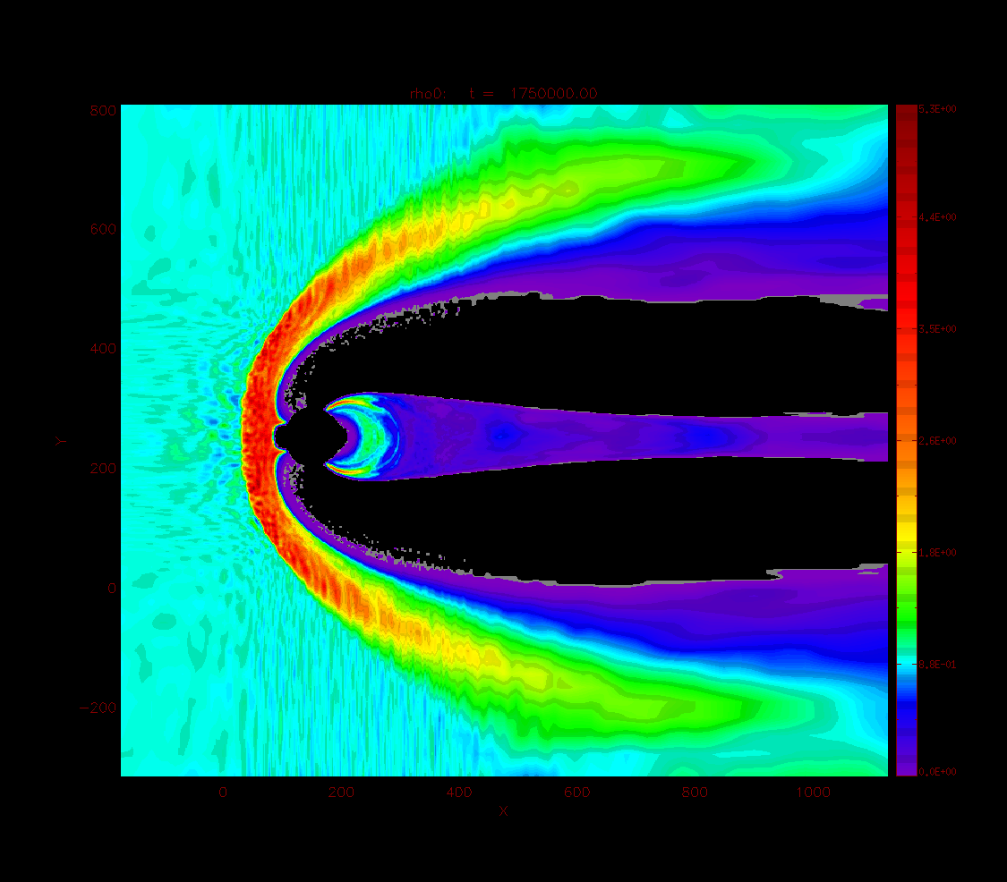
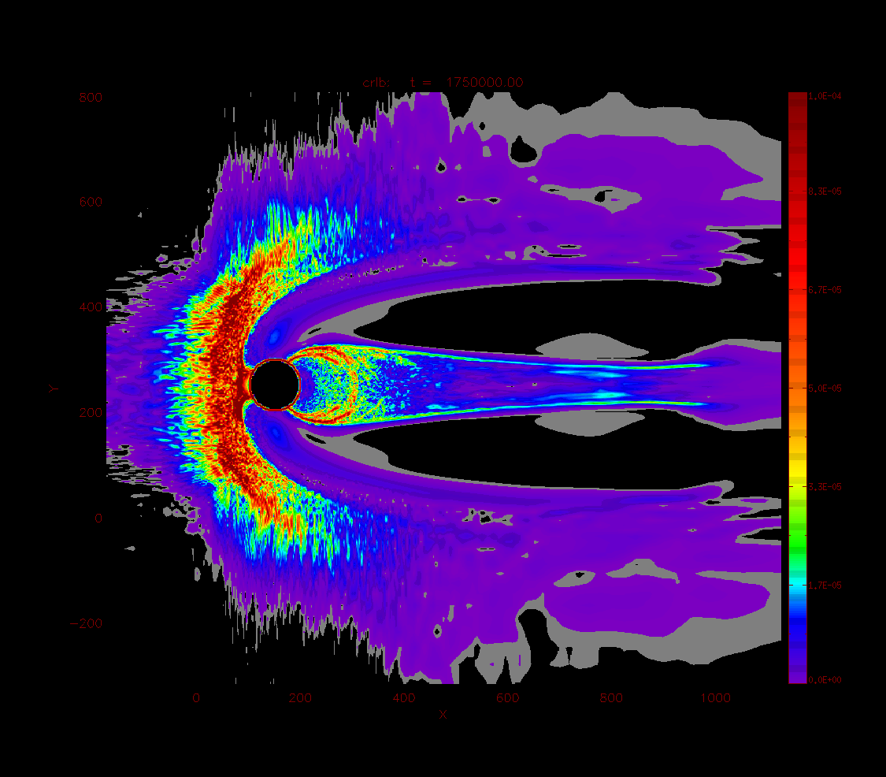
No outflow – no reconnection
Proton density
|curl B|

Slide 20
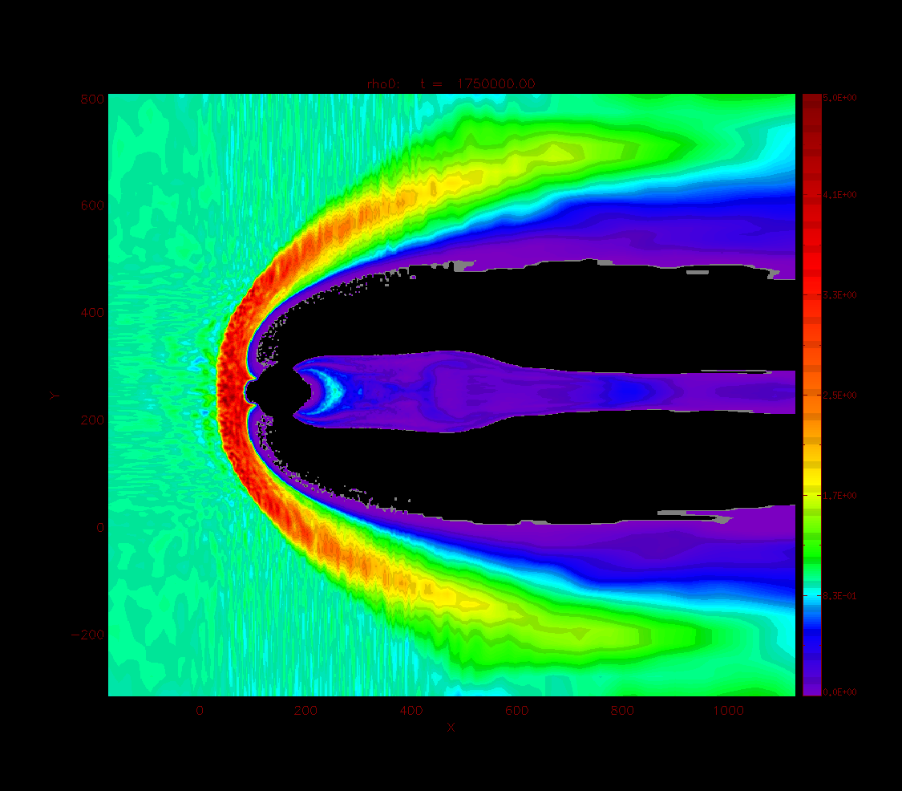
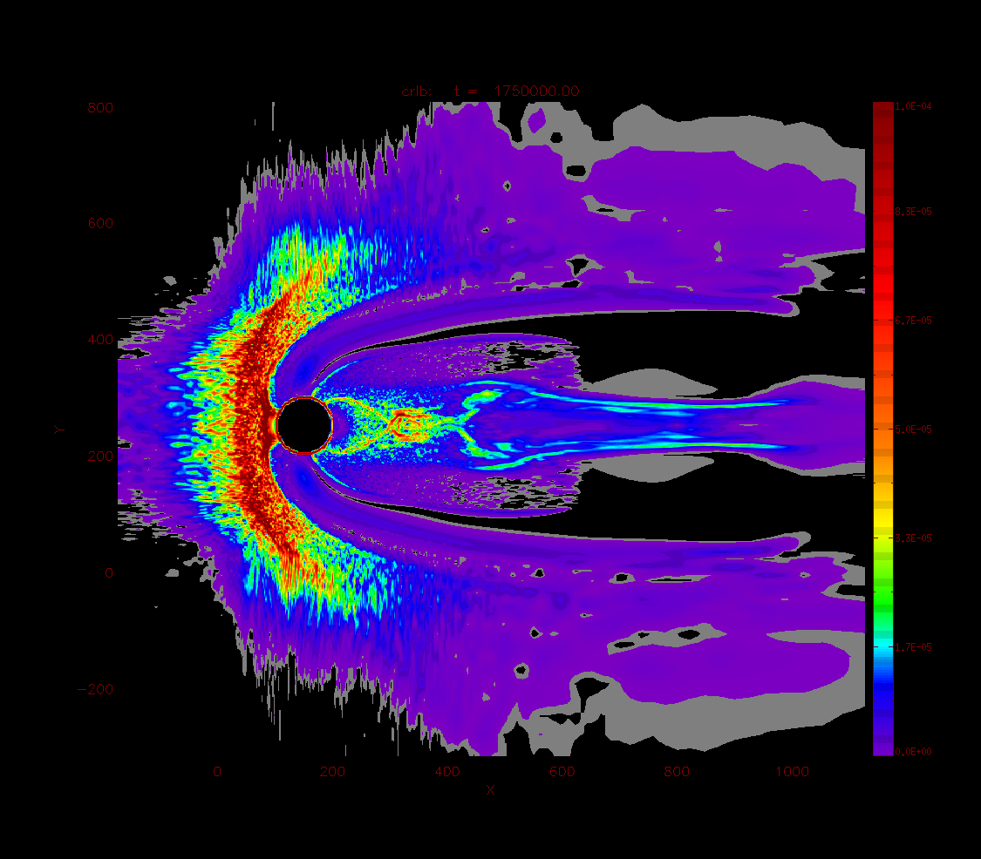
Reconnection with O+ outflow
Proton density
|curl B|
O+ induced reconnection

Slide 21
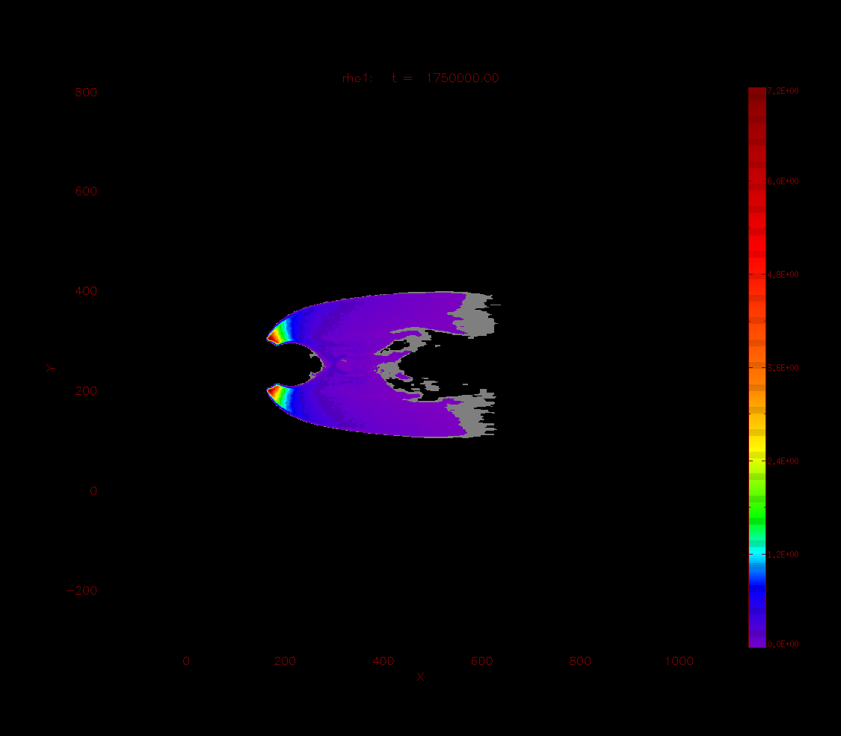
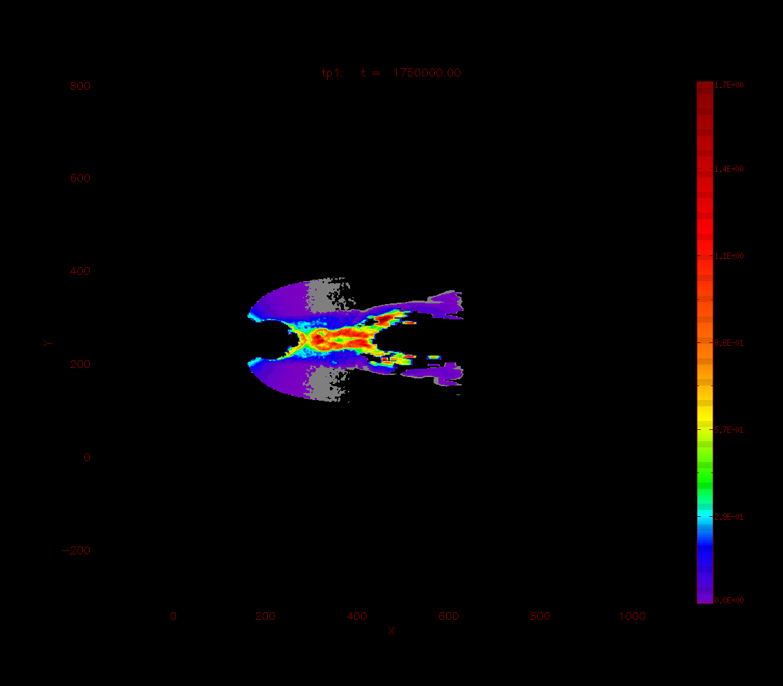
O+
Density
Perp temperature

Slide 22
Wrapping up … things to do
EMAPS is a generic matrix
for embedding physics components
on their own timescales
Gyro-free particles
Ionospheric module
Coupling with MHD
XHYPERS, SW drivers, chemistry, …

Slide 23
Thank you!
Omelchenko, Y.A., L.-J. Chen, J. Ng, “3D Space-Time Adaptive Hybrid Simulations of Magnetosheath High-Speed Jets”, J. Geophys. Res. Space Physics 126, e2020JA029035, 2021.
Omelchenko, Y.A., V. Roytershtyen, L.-J. Chen, J. Ng, H. Hietala, HYPERS simulations of solar wind interactions with the Earth’s magnetosphere and the Moon, J. Atmos. Sol.-Terr. Phys. 215, 105581, 2021.
Ng, J., L.-J. Chen, and Y. Omelchenko, “Bursty magnetic reconnection at the Earth’s magnetopause triggered by high-speed jets”, Phys. Plasmas 28, 092902, 2021 (cover page).
Chen, L.-J., J. Ng, Y. Omelchenko, and S. Wang, “Magnetopause Reconnection and Indents Induced by Foreshock Turbulence”, Geophys. Res. Lett. 48, e2021GL093029, 2021.

