Slide 1
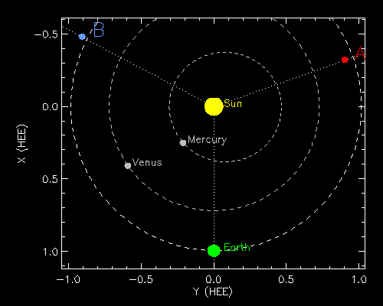
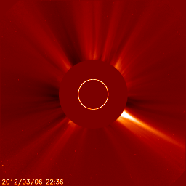
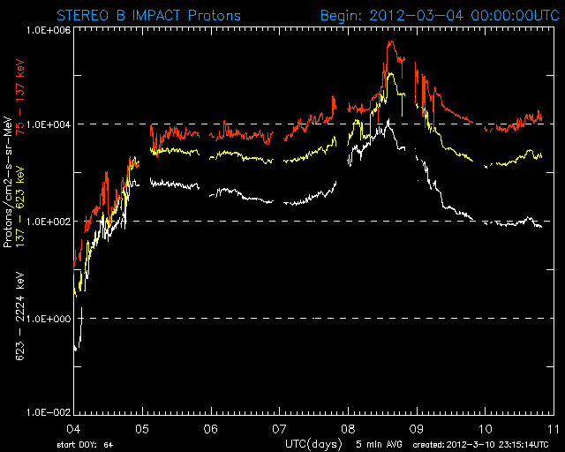
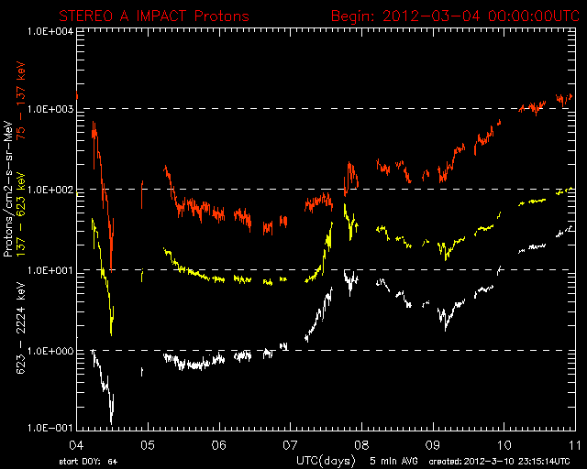
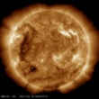
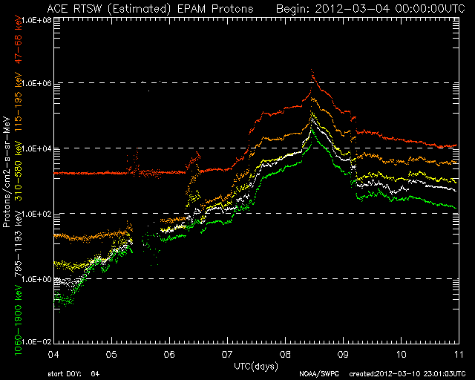
STEREO (and ACE) real-time multipoint perspectives of SEPs at 1 AU that inspired SEPMOD development
STB
STA
Caption:
Real-time multipoint SEP
Events, early March. 2012
Data plots from NOAA SWPC
Earth/ACE
SOHO/LASCO, SDO/AIA images

Slide 2
*SEPMOD is based on the shock source/observer magnetic connection concept of heliosphere-wide SEP event behavior (e.g. Kallenrode, Heras et al., Aaran et al., Lario et al.) SEPMOD was developed using the shock and field line Information from WSA-ENLIL-cone models. Ease of use for multipoint data interpretation and fast forecasting has been a goal of its approach. Descriptions and sample applications can be found in Space Weather (Luhmann et al., 2014, 2018).
*The original version of SEPMOD is currently available for ROR at CCMC- with user interfaces and results access developed by Leila Mays. This version is also being applied at CCMC by K. Whitman and L. Mays as part of the SRAG iSEP project featuring real-time event model testing. SRAG’s scoreboard is also providing input to the M2M Project .
*Modifications that are being developed and/or tested as part of the above include a user option to change SEPMOD’s shock source spectral shape, and/or its dependence on shock parameters (collaboration with Maher Dayeh at SWRI)), and enabling an existing ‘flare source’ option to mimic contributions from inside the ENLIL boundary (21.5 Rs)
* In addition to iSEP real-time run use, SEPMOD has recently been applied to modeling multipoint events sampled at L1, STEREO-A, PSP, SolO, and Bepi-Colombo (Palmerio et al., 2022), and at Mars by MAVEN.

Slide 3
*SEPMOD is based on the shock source/observer magnetic connection concept of heliosphere-wide SEP event behavior (e.g. Kallenrode, Heras et al., Aaran et al., Lario et al.) SEPMOD was developed using the shock and field line Information from WSA-ENLIL-cone models. Ease of use for multipoint data interpretation and fast forecasting has been a goal of its approach. Descriptions and sample applications can be found in Space Weather (Luhmann et al., 2014, 2018).
*The original version of SEPMOD is currently available for ROR at CCMC- with user interfaces and results access developed by Leila Mays. This version is also being applied at CCMC by K. Whitman and L. Mays as part of the SRAG iSEP project featuring real-time event model testing. SRAG’s scoreboard is also providing input to the M2M Project .
*Modifications that are being developed and/or tested as part of the above include a user option to change SEPMOD’s shock source spectral shape, and/or its dependence on shock parameters (collaboration with Maher Dayeh at SWRI)), and enabling an existing ‘flare source’ option to mimic contributions from inside the ENLIL boundary (21.5 Rs)
* In addition to iSEP real-time run use, SEPMOD has recently been applied to modeling multipoint events sampled at L1, STEREO-A, PSP, SolO, and Bepi-Colombo (Palmerio et al., 2022), and at Mars by MAVEN.

Slide 4
*SEPMOD is based on the shock source/observer magnetic connection concept of heliosphere-wide SEP event behavior (e.g. Kallenrode, Heras et al., Aaran et al., Lario et al.) SEPMOD was developed using the shock and field line Information from WSA-ENLIL-cone models. Ease of use for multipoint data interpretation and fast forecasting has been a goal of its approach. Descriptions and sample applications can be found in Space Weather (Luhmann et al., 2014, 2018).
*The original version of SEPMOD is currently available for ROR at CCMC- with user interfaces and results access developed by Leila Mays. This version is also being applied at CCMC by K. Whitman and L. Mays as part of the SRAG iSEP project featuring real-time event model testing. SRAG’s scoreboard is also providing input to the M2M Project .
*Modifications that are being developed and/or tested as part of the above include a user option to change SEPMOD’s shock source spectral shape, and/or its dependence on shock parameters (collaboration with Maher Dayeh at SWRI)), and enabling an existing ‘flare source’ option to mimic contributions from inside the ENLIL boundary (21.5 Rs)
* In addition to iSEP real-time run use, SEPMOD has recently been applied to modeling multipoint events sampled at L1, STEREO-A, PSP, SolO, and Bepi-Colombo (Palmerio et al., 2022), and at Mars by MAVEN.

Slide 5
*SEPMOD is based on the shock source/observer magnetic connection concept of heliosphere-wide SEP event behavior (e.g. Kallenrode, Heras et al., Aaran et al., Lario et al.) SEPMOD was developed using the shock and field line Information from WSA-ENLIL-cone models. Ease of use for multipoint data interpretation and fast forecasting has been a goal of its approach. Descriptions and sample applications can be found in Space Weather (Luhmann et al., 2014, 2018).
*The original version of SEPMOD is currently available for ROR at CCMC- with user interfaces and results access developed by Leila Mays. This version is also being applied at CCMC by K. Whitman and L. Mays as part of the SRAG iSEP project featuring real-time event model testing. SRAG’s scoreboard is also providing input to the M2M Project .
*Modifications that are being developed and/or tested as part of the above include a user option to change SEPMOD’s shock source spectral shape, and/or its dependence on shock parameters (collaboration with Maher Dayeh at SWRI)), and enabling an existing ‘flare source’ option to mimic contributions from inside the ENLIL boundary (21.5 Rs)
* In addition to iSEP real-time run use, SEPMOD has recently been applied to modeling multipoint events sampled at L1, STEREO-A, PSP, SolO, and Bepi-Colombo (Palmerio et al., 2022), and at Mars by MAVEN.

Slide 6
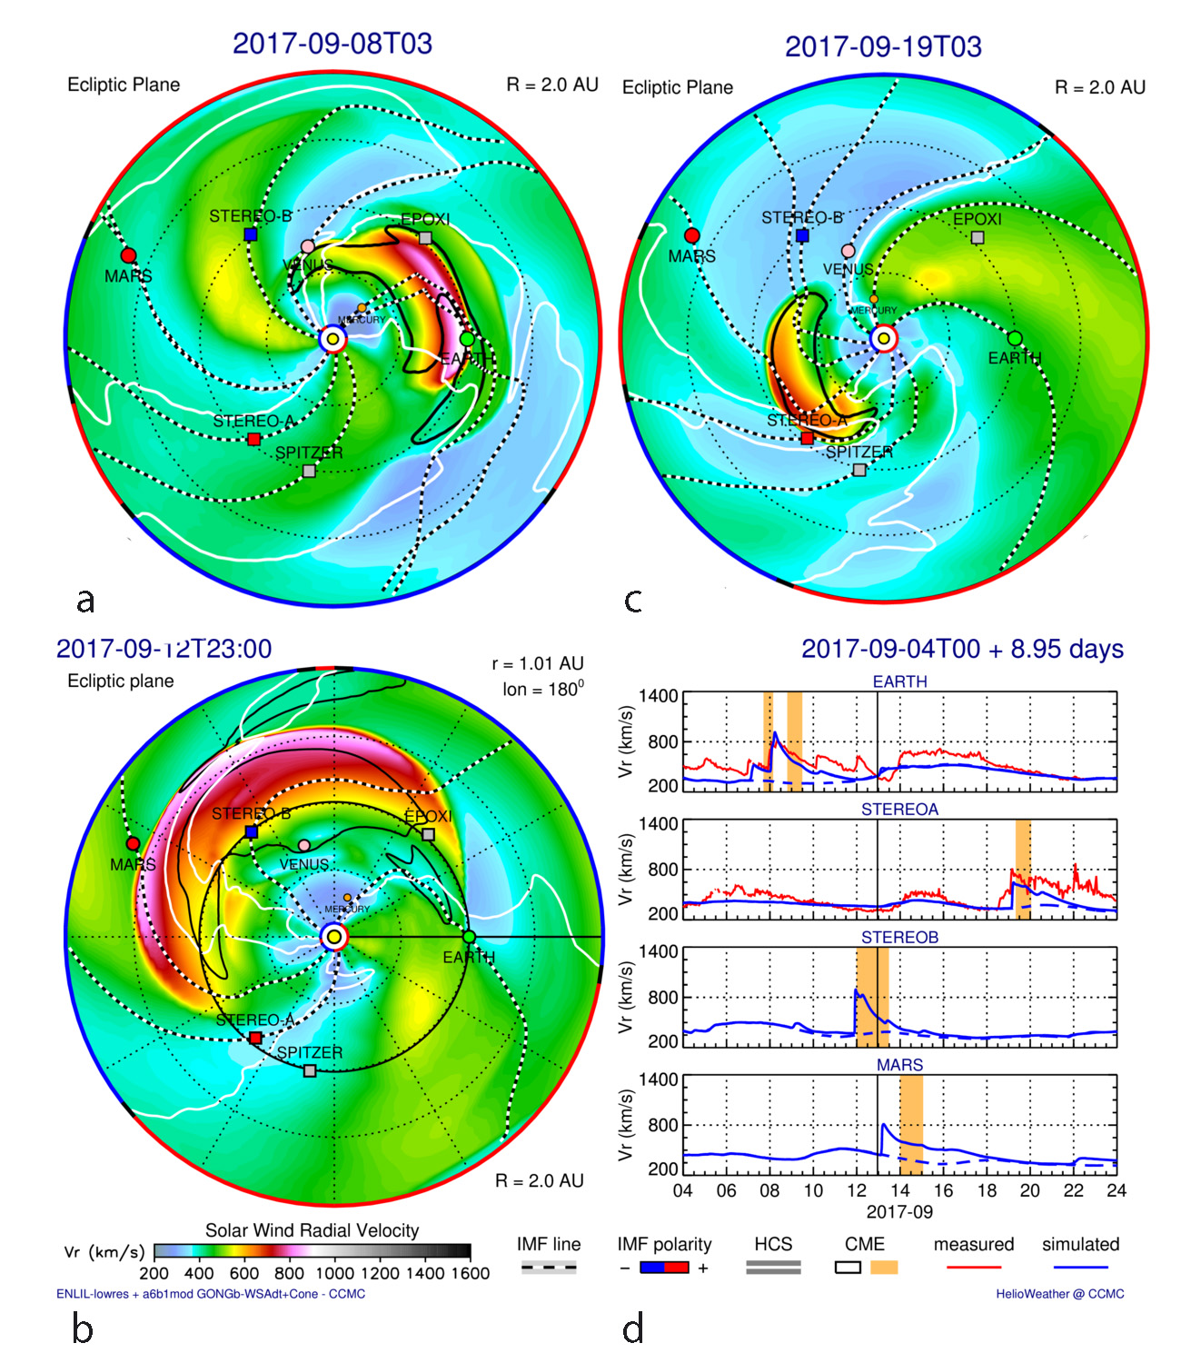
Importance of the
Heliospheric model:
WSA-ENLIL-cone CME
results for Sept 2017
-> The heliospheric simulation’s
ability to capture IMF, SIR/CIRs
and ICME shocks/compressions
determines the SEPMOD results
-> Often, multiple heliospheric
shocks/compressions are present
and interacting during active times
->WSA-ENLIL is routinely run in
‘real time’ for potential Earth-
Impacting events, but may not
include ALL CMEs (e.g. farside)

Slide 7
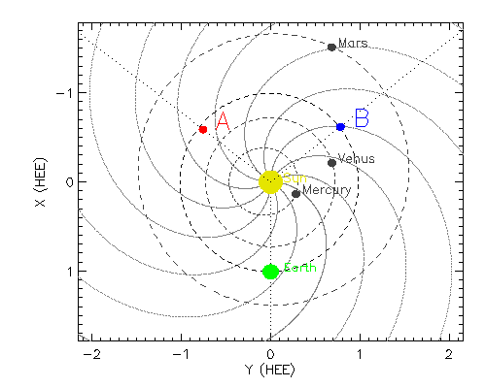
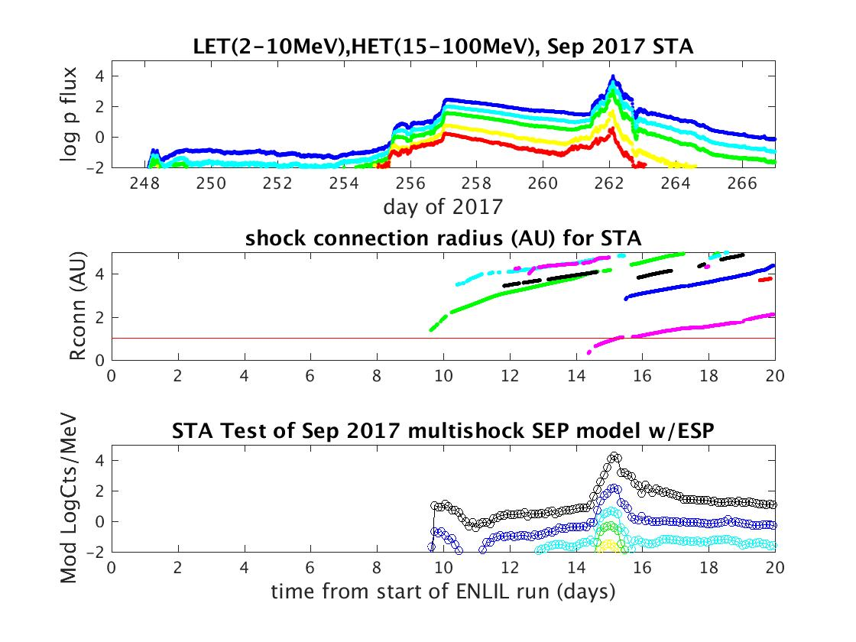
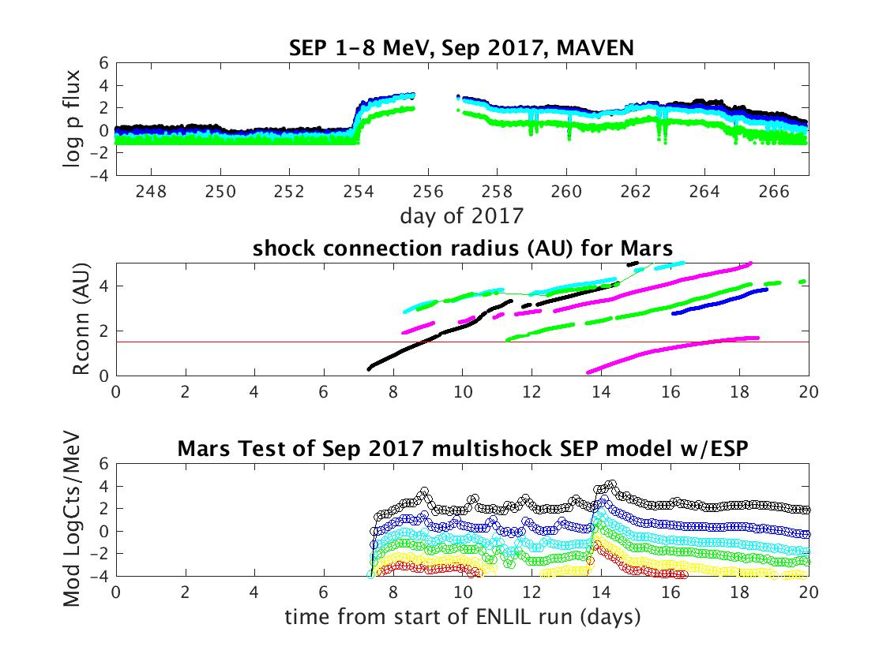
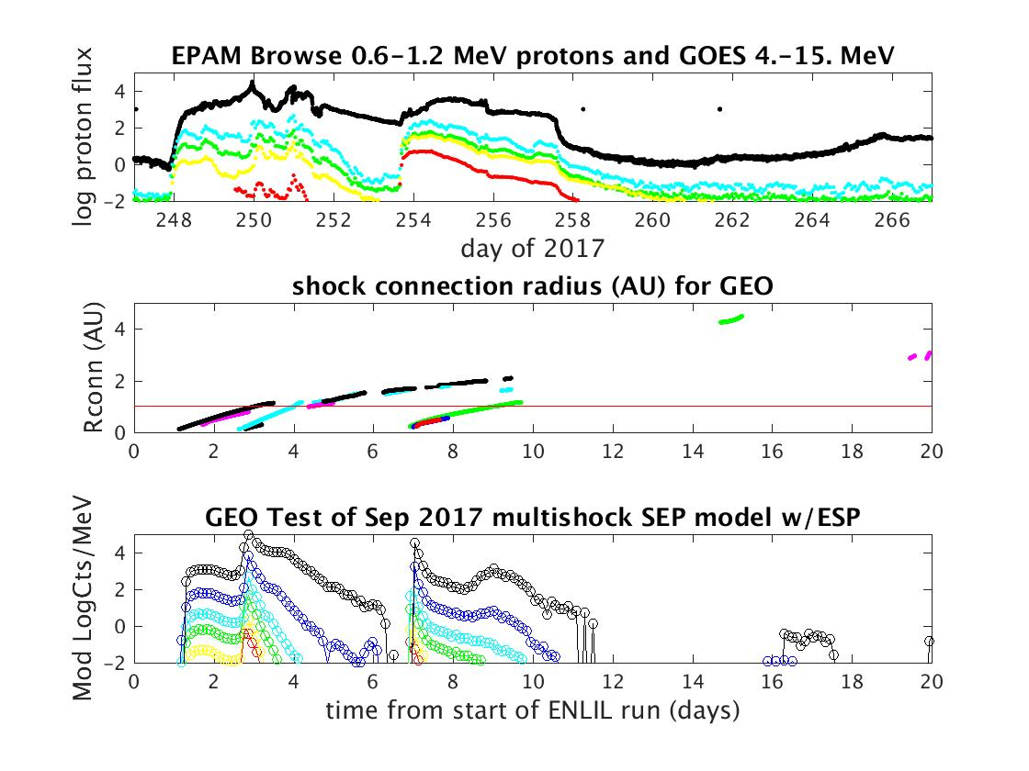
September 2017 case
STA
MAVEN
From Luhmann et al., Space Weather, 16, 557– 568. https://doi.org/10.1029/2018SW001860
ACE+GOES

Slide 8
Test of Tools for CME & SEP Predictions Across the Inner Heliosphere (E. Palmerio)
• Observation and model-based predictions of coronal mass ejections (CMEs) and solar energetic particle (SEP) events are a central goal of space weather forecasters
• The current presence of spacecraft throughout the inner heliosphere allows tests of prediction model capabilities at both the Earth and other locations of interest (e.g. other spacecraft, Mercury, Venus, Mars…)
• Widespread CME and SEP events during Nov–Dec 2020 provided an opportunity to apply some currently available CCMC modeling resources
• In particular, STEREO-A was located ~60° east of the Sun–Earth line, approximating future observations from the L5 location that are designed to complement those from upstream (L1).
MODELS RUN AT CCMC
• WSA–Enlil–SEPMOD modeling chain
• 5 modeled eruptions between 2020
Nov 26 and Dec 7
• Remote-sensing observations from
Earth and STEREO-A
• In-situ observations from Parker Solar
Probe, STEREO-A, Mars, Earth,
BepiColombo, and Solar Orbiter
Fig. 2: WSA–Enlil–SEPMOD results at STEREO-A
• Reasonable modeling results were obtained for all ICME shock arrival times at all locations.
• The best approximations to the SEP events were obtained for ‘observers’ located within a few tens of degrees from the CME source region
*The STEREO-A L5-like observations provided both CME characterization enhancements (imaging) and in-situ (shock arrival and SEP event) model validations
• This study demonstrates an existing potential for real-time, operational forecasts
Fig. 1: Snapshots (Vr) of the WSA–Enlil simulation for Run4, with CMEs indicated
Reference: Palmerio et al.: “CMEs and SEPs During November–December 2020: A Challenge for Real-Time Space Weather Forecasting”, Space Weather, 20, e2021SW002993, doi:10.1029/2021SW002993, 2022.

Slide 9
Future plans:
- Participate in SHINE challenge (all-clear forecasts) (L. Mays, K. Whitman)
- Apply the model to new MAVEN events at Mars (C.O. Lee et al.), + other
planetary space weather applications
- Experiment with heliospheric models including ICME ‘ejecta’
Long Term Perspective :
- Continue to work with SRAG/iSEP, CCMC
- Collaborations, e.g. interest in improved ‘solar/coronal source’ (<21.5 Rs)
descriptions, creating useful visualizations, experimenting with other
heliospheric simulations……..
Our thanks for the support provided by the CCMC and the iSEP project!
(report presented to the CCMC Workshop, June 2022, by Janet Luhmann)

