Slide 1
Arik Posner
NASA SMD/Heliophysics Division
CCMC W/S, June 7, /2022
Radiation Forecasting for Mars Exploration:
The bare essentials

Slide 2
Bare Essentials Quick Outline:
1: Fix our problem at home.
2: Look around the (right) corner.
3: Fix our problem at Mars.
Notes:
Quick outline: there are three essentials.

Slide 3
Bare Essentials Quick Outline:
1: Fix our problem at home.
2: Look around the (right) corner.
3: Fix our problem at Mars.
Notes:
Beyond metrics for individual systems, to my knowledge there are no long-term trends of metrics published in the peer-reviewed literature.

Slide 4
Anything wrong here?
SEPEM Protons
(4 – 300 MeV) based on GOES
Solar Energetic Particle Environment Modeling (SEPEM) Reference Data Set (RDS)
Sandberg et al., GRL, 2014; Rodriguez et al., SWJ, 2016; Jiggens et al., SWJ, 2019.
Notes:
The Nov. 4, 2001 X flare led to a SPE with the first particles arriving at near light speed at the white vertical line, ~1630UT. Shown is a spectrogram based on data downloaded from the SEPEM reference data set. SEPEM uses and “cleans up” GOES proton data, with questionable success. The spectrogram at onset is unphysical as low-energy protons cannot have arrived at 1 AU.

Slide 5
Anything wrong here?
SEPEM Protons
(4 – 300 MeV) based on GOES
Excerpt from GOESN-ENG-048 Calibration and Data Handbook:
“… since most measured proton spectra have large γ values, the neglect of the spurious response is not important..”
Solar Energetic Particle Environment Modeling (SEPEM) Reference Data Set (RDS)
Sandberg et al., GRL, 2014; Rodriguez et al., SWJ, 2016; Jiggens et al., SWJ, 2019.
Notes:
The Nov. 4, 2001 X flare led to a SPE with the first particles arriving at near light speed at the white vertical line, ~1630UT. Shown is a spectrogram based on data downloaded from the SEPEM reference data set. SEPEM uses and “cleans up” GOES proton data, with questionable success, as others have tried before. The spectrogram at onset is unphysical as low-energy protons cannot have arrived at 1 AU.

Slide 6
Solar Energetic Particle Environment Modeling (SEPEM) Reference Data Set (RDS)
Sandberg et al., GRL, 2014; Rodriguez et al., SWJ, 2016; Jiggens et al., SWJ, 2019.
Two bottom panels show the comparison of SOHO/COSTEP-EPHIN with the GOES SEPEM RDS.
“assumption[s for GOES calibration are] typically violated … at the onset of a SPE when there may be a very hard spectrum…” [Kress et al., 2021]
Electrons
(0.2 – 9 MeV)
Protons
(4 – 300 MeV)
Appendix in Posner, SWJ, 2007; Kühl et al., SWSC, 2021; Cautionary note in Kress et al., SWJ, 2021.
Notes:
“The spurious response is not important”? Well, all scoreboarding depends on when the measurements define the particle onset or threshold crossing. Assumptions of a soft spectrum at the onset are dangerous, in particular for radiation safety of polar flight routes. There is considerable confusion caused by GOES data, which is widely used scientifically.

Slide 7
Energetic Proton Telescope with Passive Shielding
Green: Valid Particle entering through Aperture
Notes:
GOES high-energy measurements are from EPEAD and HEPAD. What I show exemplifies the problem with passive shielding.

Slide 8
Energetic Proton Telescope with Passive Shielding
Black: Invalid particles, pass through Passive Shielding
Not rejected.
In SEPs with protons >60 MeV: Invalid Particles Overwhelm Count Rates, likely in all channels.
Notes:
Passive shielding leaves high-energy particles entering the system unaccounted for. The results are unphysical. Better technology is available and their immediate implementation is essential.

Slide 9
Bare Essential 1: Fix the problem at home!
We (SEP Scoreboard) need accurate high-energy proton measurements.
Notes:
If we don’t get that, most SEP scoreboarding results are questionable.

Slide 10
Bare Essentials Quick Outline:
1: Fix our problem at home.
2: Look around the (right) corner.
3: Fix our problem at Mars.
Notes:
Missing information also hampers radiation safety.

Slide 11
Nominal Magnetic Connection Longitude from Earth/Mars
Posner et al., SWJ., 2021;
Li, Zhanng & Feng, ApJ, 2016.
Notes:
The table shows likelihoods of nominal solar wind speeds/speed ranges occurring at Earth, which are most of the time in the 300-450km/s range. The table further shows where on the solar disk as viewed from Earth or Mars the magnetic foot point is located: Generally near the W limb for Earth, and mostly behind the W limb for Mars.

Slide 12
SEP Proton Forecast Systems and their Inputs
Acronym | Rem. Sens. Input | Rem. Sens. Input | In situ/Other Input | Reference
protons | X rays | Type II/IV radio bursts | Human forec. | Balch, 2008
UMASEP | X rays | - | Relativ. protons | Nunez, 2011
ESPERTA | X rays | Type III radio bursts |  | Laurenza et al., 2009
pps | X rays | Flare radio flux |  | Smart & Shea, 1979
REleASE | - | - | Relativ. electrons | Posner, 2007
Posner et al., “A Multi-Purpose Heliophysics L4 Mission, SWJ, 2021.

Slide 13
SEP Proton Forecast Systems and their Inputs:
Are they robust with respect to Behind-the-Limb Activity?
Acronym | Rem. Sens. Input | Rem. Sens. Input | In situ/Other Input | Reference
protons | X rays | Type II/IV radio bursts | Human forec. | Balch, 2008
UMASEP | X rays | - | Relativistic protons | Nunez, 2011
ESPERTA | X rays | Type III radio bursts |  | Laurenza et al., 2009
pps | X rays | Flare radio flux |  | Smart & Shea, 1979
REleASE | - | - | Relativistic electrons | Posner, 2007
Posner et al., SWJ, 2021.

Slide 14
Behind-W-Limb Flares and SEP Proton Intensity Dependence on SW Speed
Vsw = 300 km/s
500 vs 300 km/s
Slow solar wind can lead to a higher risk of radiation exposure from “unseen” solar activity.
Posner et al., SWJ., 2021.
Notes:
How bad can behind-the-limb particle events become for the Earth-moon system? The Strauss-based 2D simulation shows that those events can, under slow solar wind conditions, have a maximum intensity of ~50% of an ideally connected SPE. This poses significant danger to Lunar exploration. Moreover, the usefulness of relying on solar observations from Mars becomes questionable.

Slide 15
Fast Mars Round Trips and SWx Safety Zones
Unsafe
Draft Trajectory 1: 6/25/2035 – 7/29/2036 (VGA)
Draft Trajectory 2: 12/3/2036 – 1/7/2038 (no VGA)
Trajectory data c/o N. Hatten (NASA/GSFC)
SWx Safety Zone supported by L1 only
Notes:
The left side shows the relative locations of the Earth-moon system, the Sun, and Mars explorers on short-term round trips to Mars. The right hand side shows how much of these regions is actually “protected” by solar flare monitors based on the Sun-Earth line. Much of the inner heliosphere is deemed unsafe, including the Earth-moon system itself, and parts of the Mars trajectories.

Slide 16
Posner et al., SWJ., 2021, subm. Richardson et al., Sol. Phys., 2014.
Notes:
How does that change if we add a “Multi-purpose Heliophysics L4 mission”?

Slide 17
Bare Essential 2: L4 enables safe Mars Exploration!
Unsafe
Unsafe
SWx Safety Zone supported by L1 only
SWx Safety Zone supported by L1 and L4
Notes:
Everything. Both the Earth-moon system AND the entire Mars return trip end up in the SWx safe zone.

Slide 18
Bare Essential 2: Looking around the right corner
We need an L4 mission to enable safe Lunar and Mars exploration!
Notes:
Bare essential 2. Simple.

Slide 19
Bare Essentials Quick Outline:
1: Fix our problem at home.
2: Look around the (right) corner.
3: Fix our problem at Mars.
Notes:
Now how about long-term Mars exploration?

Slide 20
Long-term Stays at Mars
Our suggested solution for short-term Mars round-trips will not be sufficient for long-duration stays at Mars.
Astronauts that stay at Mars long-term will go through solar conjunction and will leave the SWx safe zone.
A solution for radiation protection independent from Earth is essential.
Radiation forecasting that depends on solar remote sensing is not useful from Mars, as the relevant processes occur mostly behind the solar limb as viewed from Mars.
This currently leaves REleASE as the best option and would require stationing a spacecraft appropriately equipped at Mars-Sun L1.
Notes:
Read slide.

Slide 21
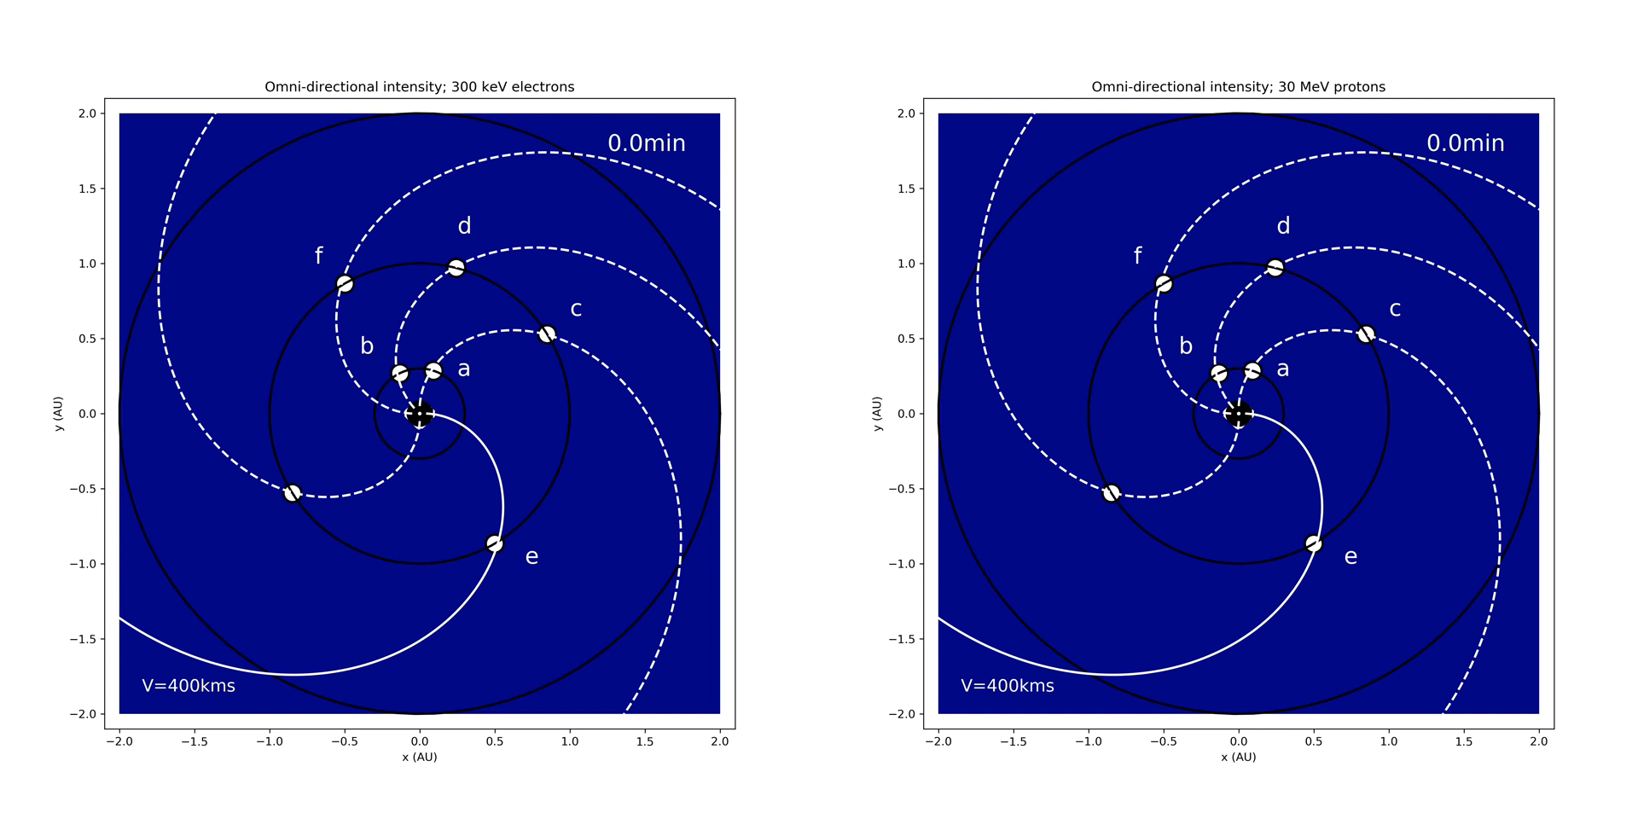
300 keV electrons vs 30 MeV protons
Notes:
The 2D simulation of relativistic electrons alongside dangerous 30 MeV protons (i.e., penetrating enough to pose hazard, highest intensity of penetrating energy range). Electrons reach all locations in the heliosphere well ahead of protons, allowing their forecast through REleASE.

Slide 22
Warning Time Analysis From SEP Simulations of a Two‐Tier REleASE System Applied to Mars Exploration
Effectiveness of a two‐tier Relativistic Electron Alert System for Exploration was analyzed with 2‐D solar particle event modeling
System would protect astronauts from sudden solar particle radiation exposure during entire two‐way transit between Earth and Mars
A two‐tier warning system that exploits the Hohmann‐Parker effect would be placed at Earth‐Sun L1 and Mars‐Sun L1 Lagrange points
Posner & Strauss, SWJ, 2020.
Notes:
We studied the advance warning time on a round trip mission to Mars based on Earth-Sun L1 and Mars-Sun L1 particle measurements, using the Hohmann-Parker effect and conclude that ~30min of advance warning time can be maintained everywhere on the journey.

Slide 23
Galactic Cosmic Ray vs SEP Exposure
Posner & Strauss, SWJ, 2020.
Average Individuals
Worst Case
Per SEP Event
Hohm. Transfers
Fast Transfers
Out-of-Shelter Exposure
Vulnerable Individuals
In Shelter
Notes:
In a worst-case scenario, the dose savings are significant, on the order of the entire dose received in a radiation shelter over the duration of the event, practically cutting the exposure in half. Importantly, this does would otherwise be received within 30 minutes, potentially causing onset of acute radiation sickness.

Slide 24
Bare Essential 3: Establish a Mars-Sun L1 Monitor
Monitor should as a minimum use the Particle Instrument developed under Bare Essential 1 to accurately monitor energetic protons and electrons.
Mars-Sun L1 would have many other possible scientific uses.
Notes:
Bare essential 3: Establish Mars-Sun L1 radiation monitor.

