Slide 1
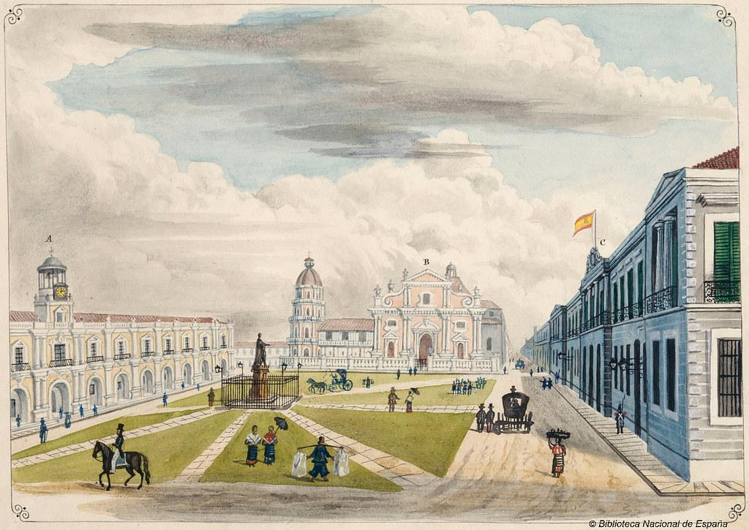
s
Combining Physics and ML models for full energy-range SEP Prediction
Soukaina Filali Boubrahimi

Slide 2
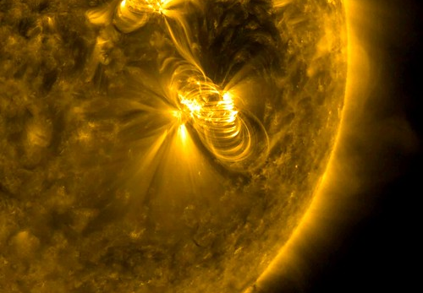
Outline
SEP Parent Events
>100 MeV SEP Model
SEP Modeling Challenges
Proposed Solutions

Slide 3
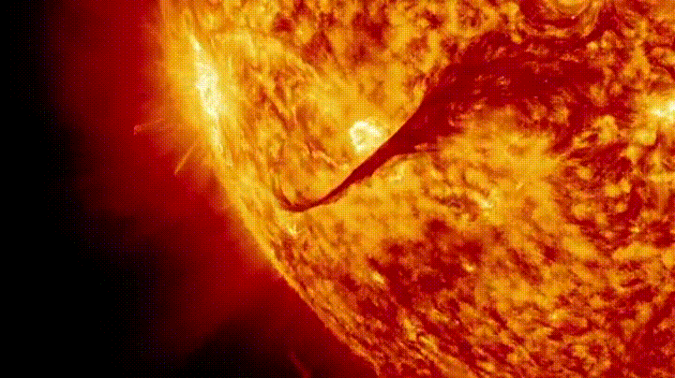
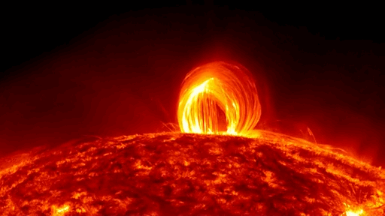
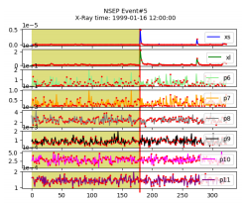
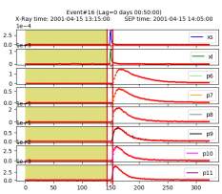
SEP Parent Events
Solar energetic particle (SEP) events are related to both solar flares and and coronal mass ejections (CMEs)
Solar flares produce impulsive SEP events
Fast and wide CMEs produce gradual SEP events
SEP
EVENT
NO
EVENT

Slide 4
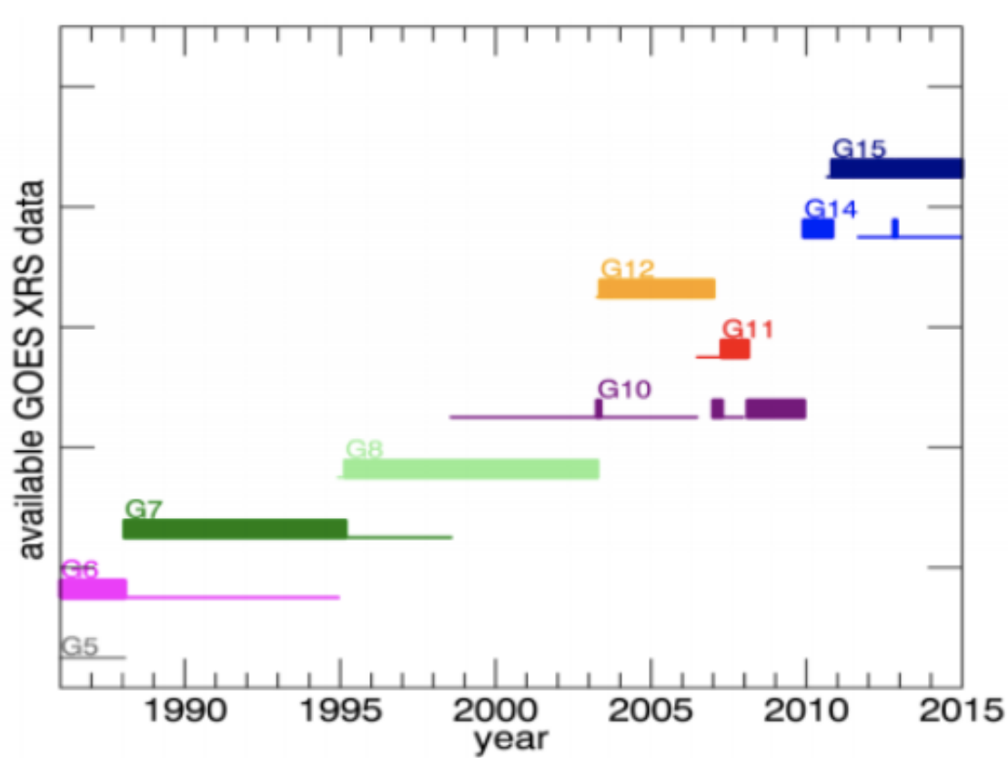
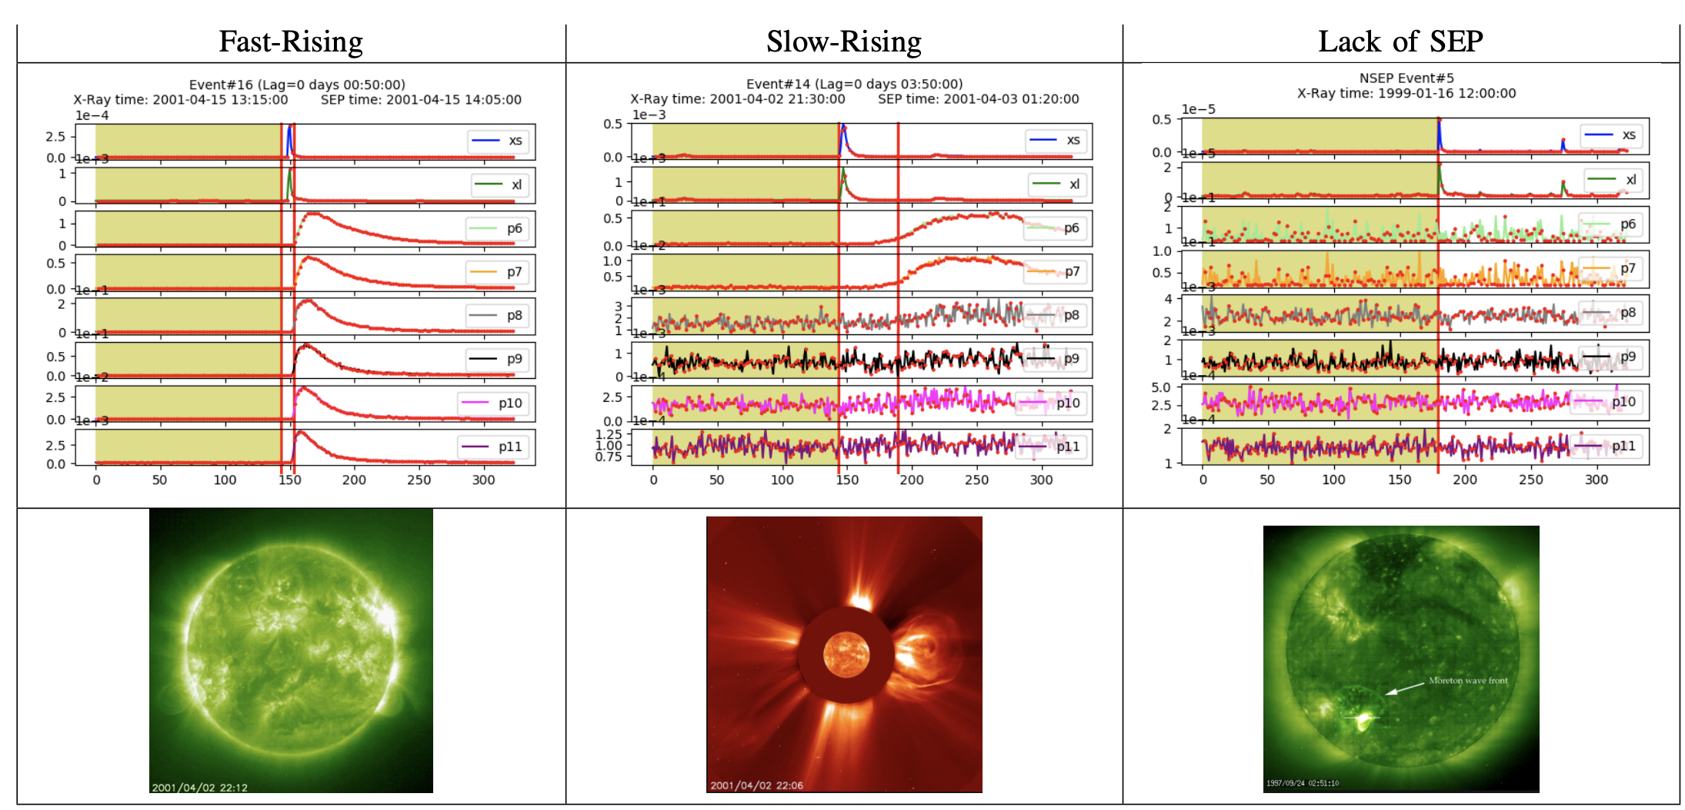
SEP Parent Events
Problem: Predicting >100 MeV Solar Energetic Particles events using multivariate time series representing the proton and X-ray within different energy levels.

Slide 5
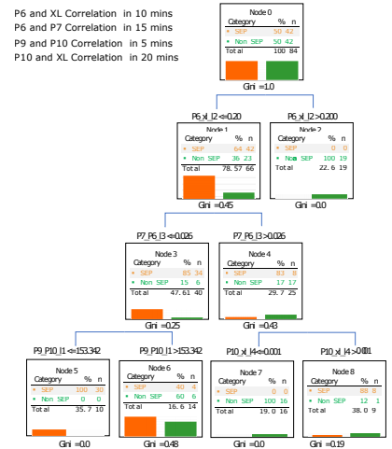
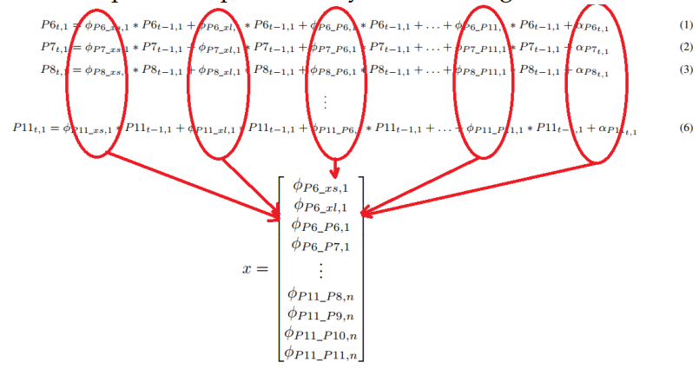
Problem: Predicting Solar Energetic Particles using multivariate time series
representing the proton and xray within different energy levels.
>100 Mev SEP Prediction Model
Approach: Use Vector AutoRegressive (VAR) model to produce
features and a decision tree model for the classification.
SEP
EVENT
NO
EVENT
S. F. Boubrahimi, B. Aydin, P. Martens and R. Angryk, "On the prediction of >100 MeV solar energetic particle events using GOES satellite data," 2017 IEEE International Conference on Big Data (Big Data), Boston, MA, 2017, pp. 2533-2542.

Slide 6
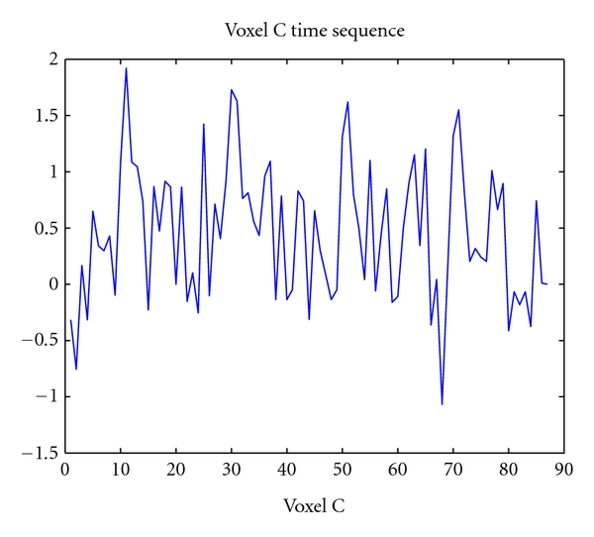
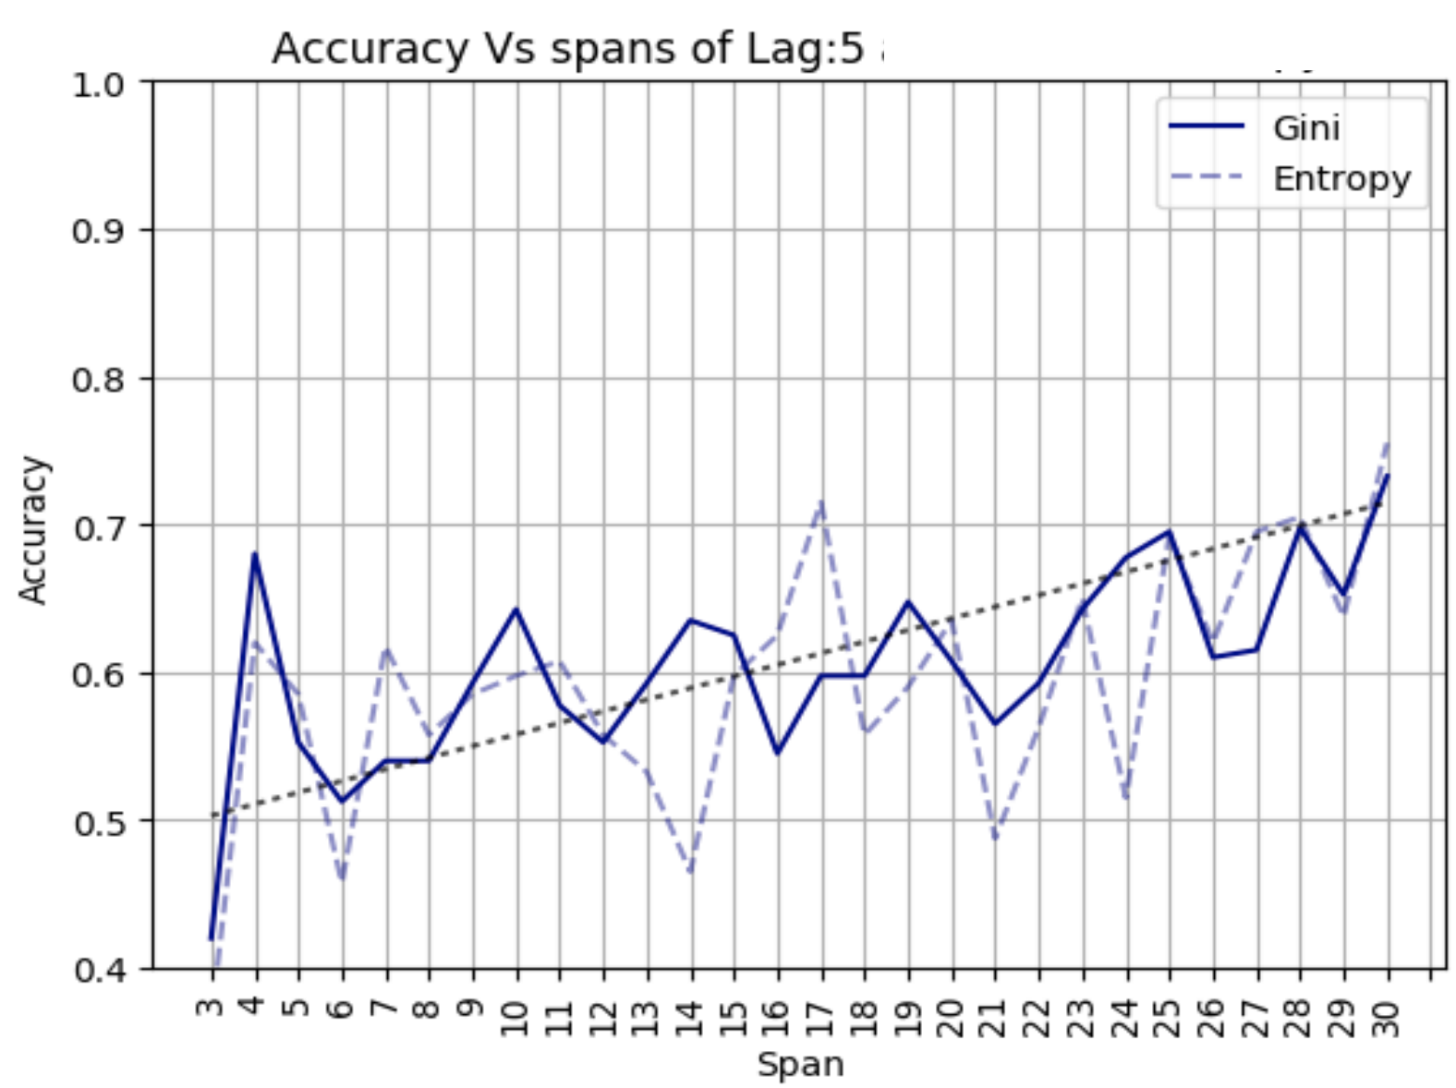
>100 MeV SEP Events
Model
Time series data-driven SEP modeling necessitate a hyperparameter search over the (1) span of the data (2) number of parameter dependencies.
lookback
Span
S. F. Boubrahimi, B. Aydin, P. Martens and R. Angryk, "On the prediction of >100 MeV solar energetic particle events using GOES satellite data," 2017 IEEE International Conference on Big Data (Big Data), Boston, MA, 2017, pp. 2533-2542.

Slide 7
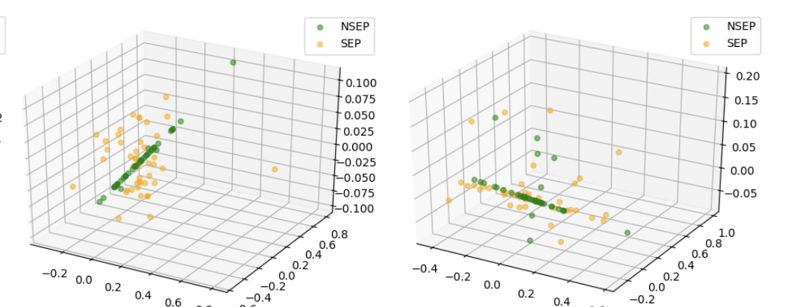
>100 MeV SEP Events
Model
PCA visualization reveals a good separation between the classes.
PCA is used to plot the full feature space with the 254 dimensions of the lag 5 and span 30.
However, the main problem is Overfitting!
S. F. Boubrahimi, B. Aydin, P. Martens and R. Angryk, "On the prediction of >100 MeV solar energetic particle events using GOES satellite data," 2017 IEEE International Conference on Big Data (Big Data), Boston, MA, 2017, pp. 2533-2542.

Slide 8
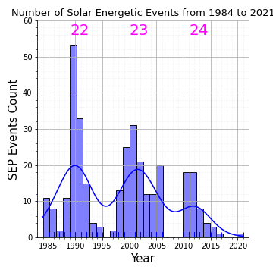
SEP Modeling Challenges (1)
Animation by Krystofer Kim
Solar energetic particle (SEP) events are scare
The SEP catalog contains a few hundreds (∼350 events) of SEP event.
Cycle 24 contains the lowest volume of SEP events data across solar cycles 22, 23, and 24.
Solar energetic particle (SEP) events suffer from a high-class imbalance between the four classes:
>10 MeV
>30 MeV
>60 MeV
>100 MeV

Slide 9
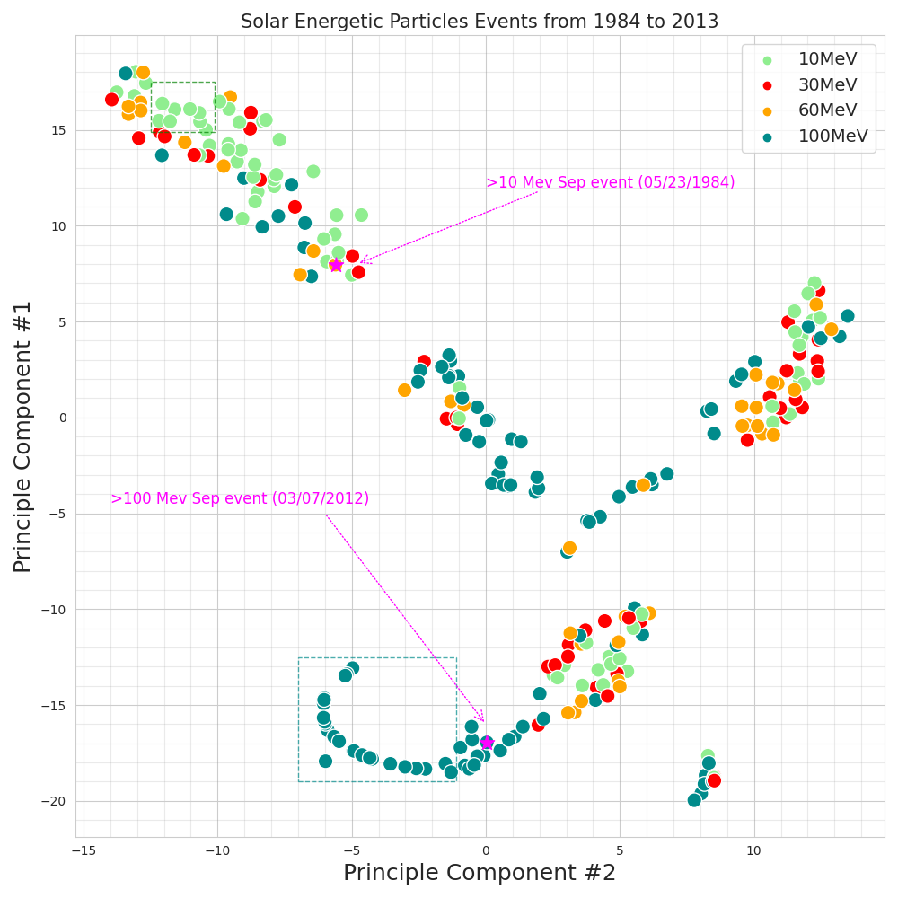
SEP Modeling Challenges (1)
The majority of SEP events occur in the two extremes:
>10 MeV
>100 MeV
The less common SEP events are:
>30 MeV
>60 MeV

Slide 10
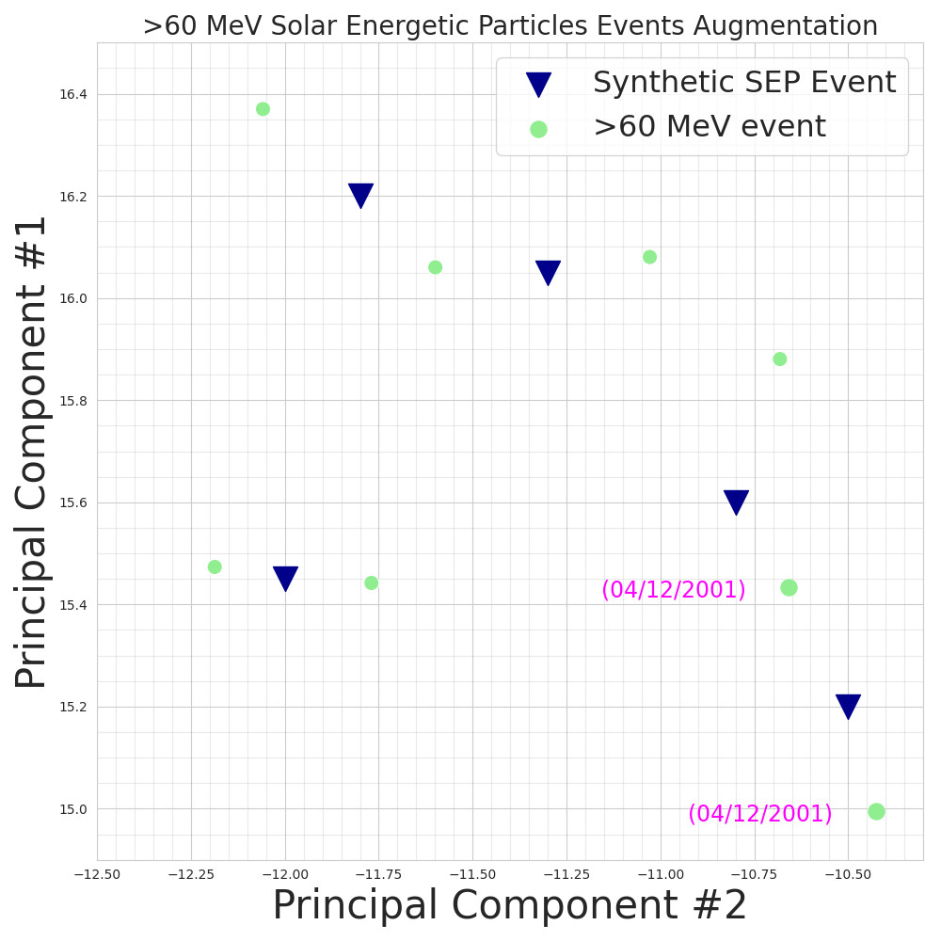
SEP Modeling Solution (1)
Data augmentation for producing sufficient high quality data volumes to train robust SEP models.
Time series data generation can produce synthetic SEP catalogs.
Synthetic SEP
Events Catalog
Real SEP
Events Catalog
Hybrid SEP
Events Catalog

Slide 11
SEP Modeling Challenges (2)
According to the “No free lunch (NFL)” theorem:
“There is no model that dominates over all types of learning problems.
Different predictive models may be useful in representing different aspects of the problem”
Ensemble model can be used as a comprehensive solution that combines physics and ML models prediction.
The next step is to train the ensemble model to learn an optimal weight vector that it can assign to each model.

Slide 12
Conclusion
Insufficient SEP events data volume can lead to overfitting (high variance) data-driven model
Data augmentation can increase the SEP events catalog size
There is “no solution fits all” for predicting SEP events at all energy ranges
SEP physics and ML model ensembling can increase both the interpretability and forecasting accuracy

Slide 13
Questions?

