Slide 1
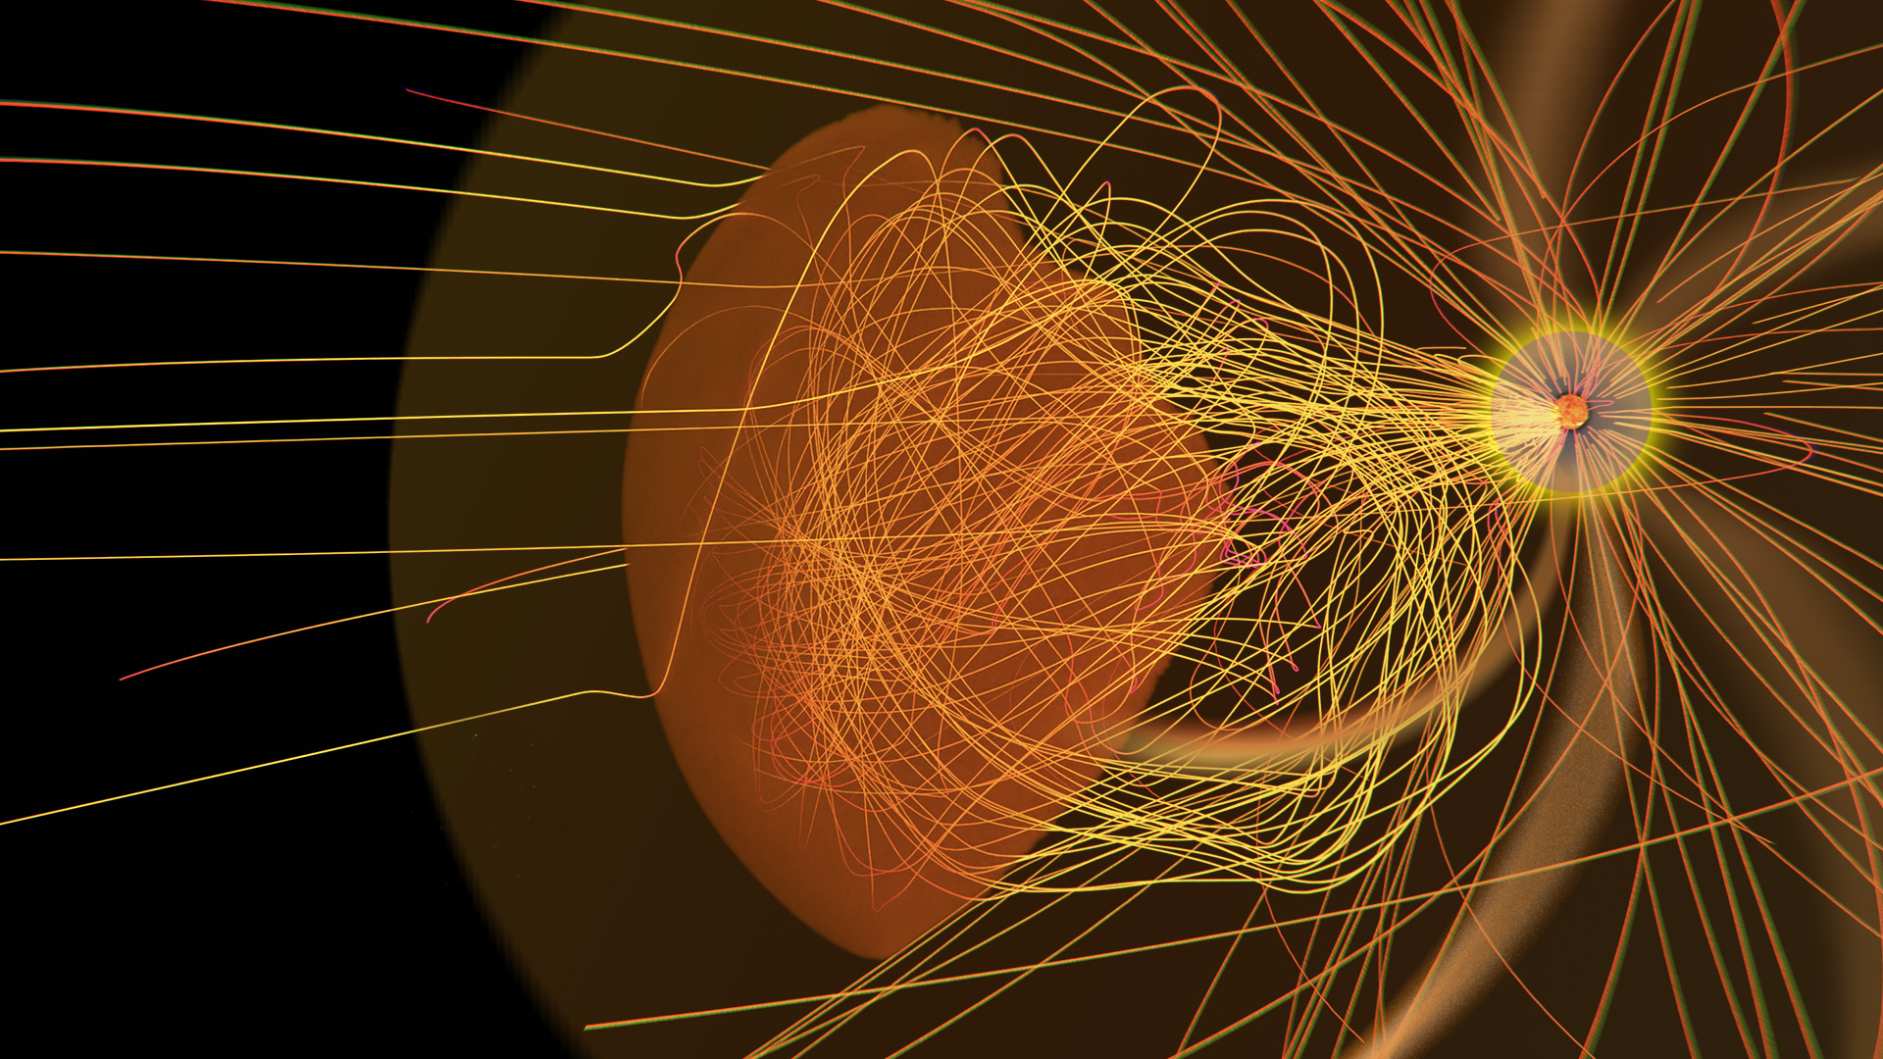
GAMERA-Helio
A new addition to the CCMC family of inner heliosphere models
Elena Provornikova¹, Slava Merkin¹, Eric Winter¹, Kareem Sorathia¹, Jeff Garretson¹, Brent Smith¹,
Parisa Mostafavi¹, Nick Arge², Sarah Gibson³,
Anna Malanushenko³, Kalman Knizhnik⁴
¹ Johns Hopkins Applied Physics Laboratory
² NASA GSFC
³ NCAR, HAO
⁴ Naval Research Laboratory

Slide 2
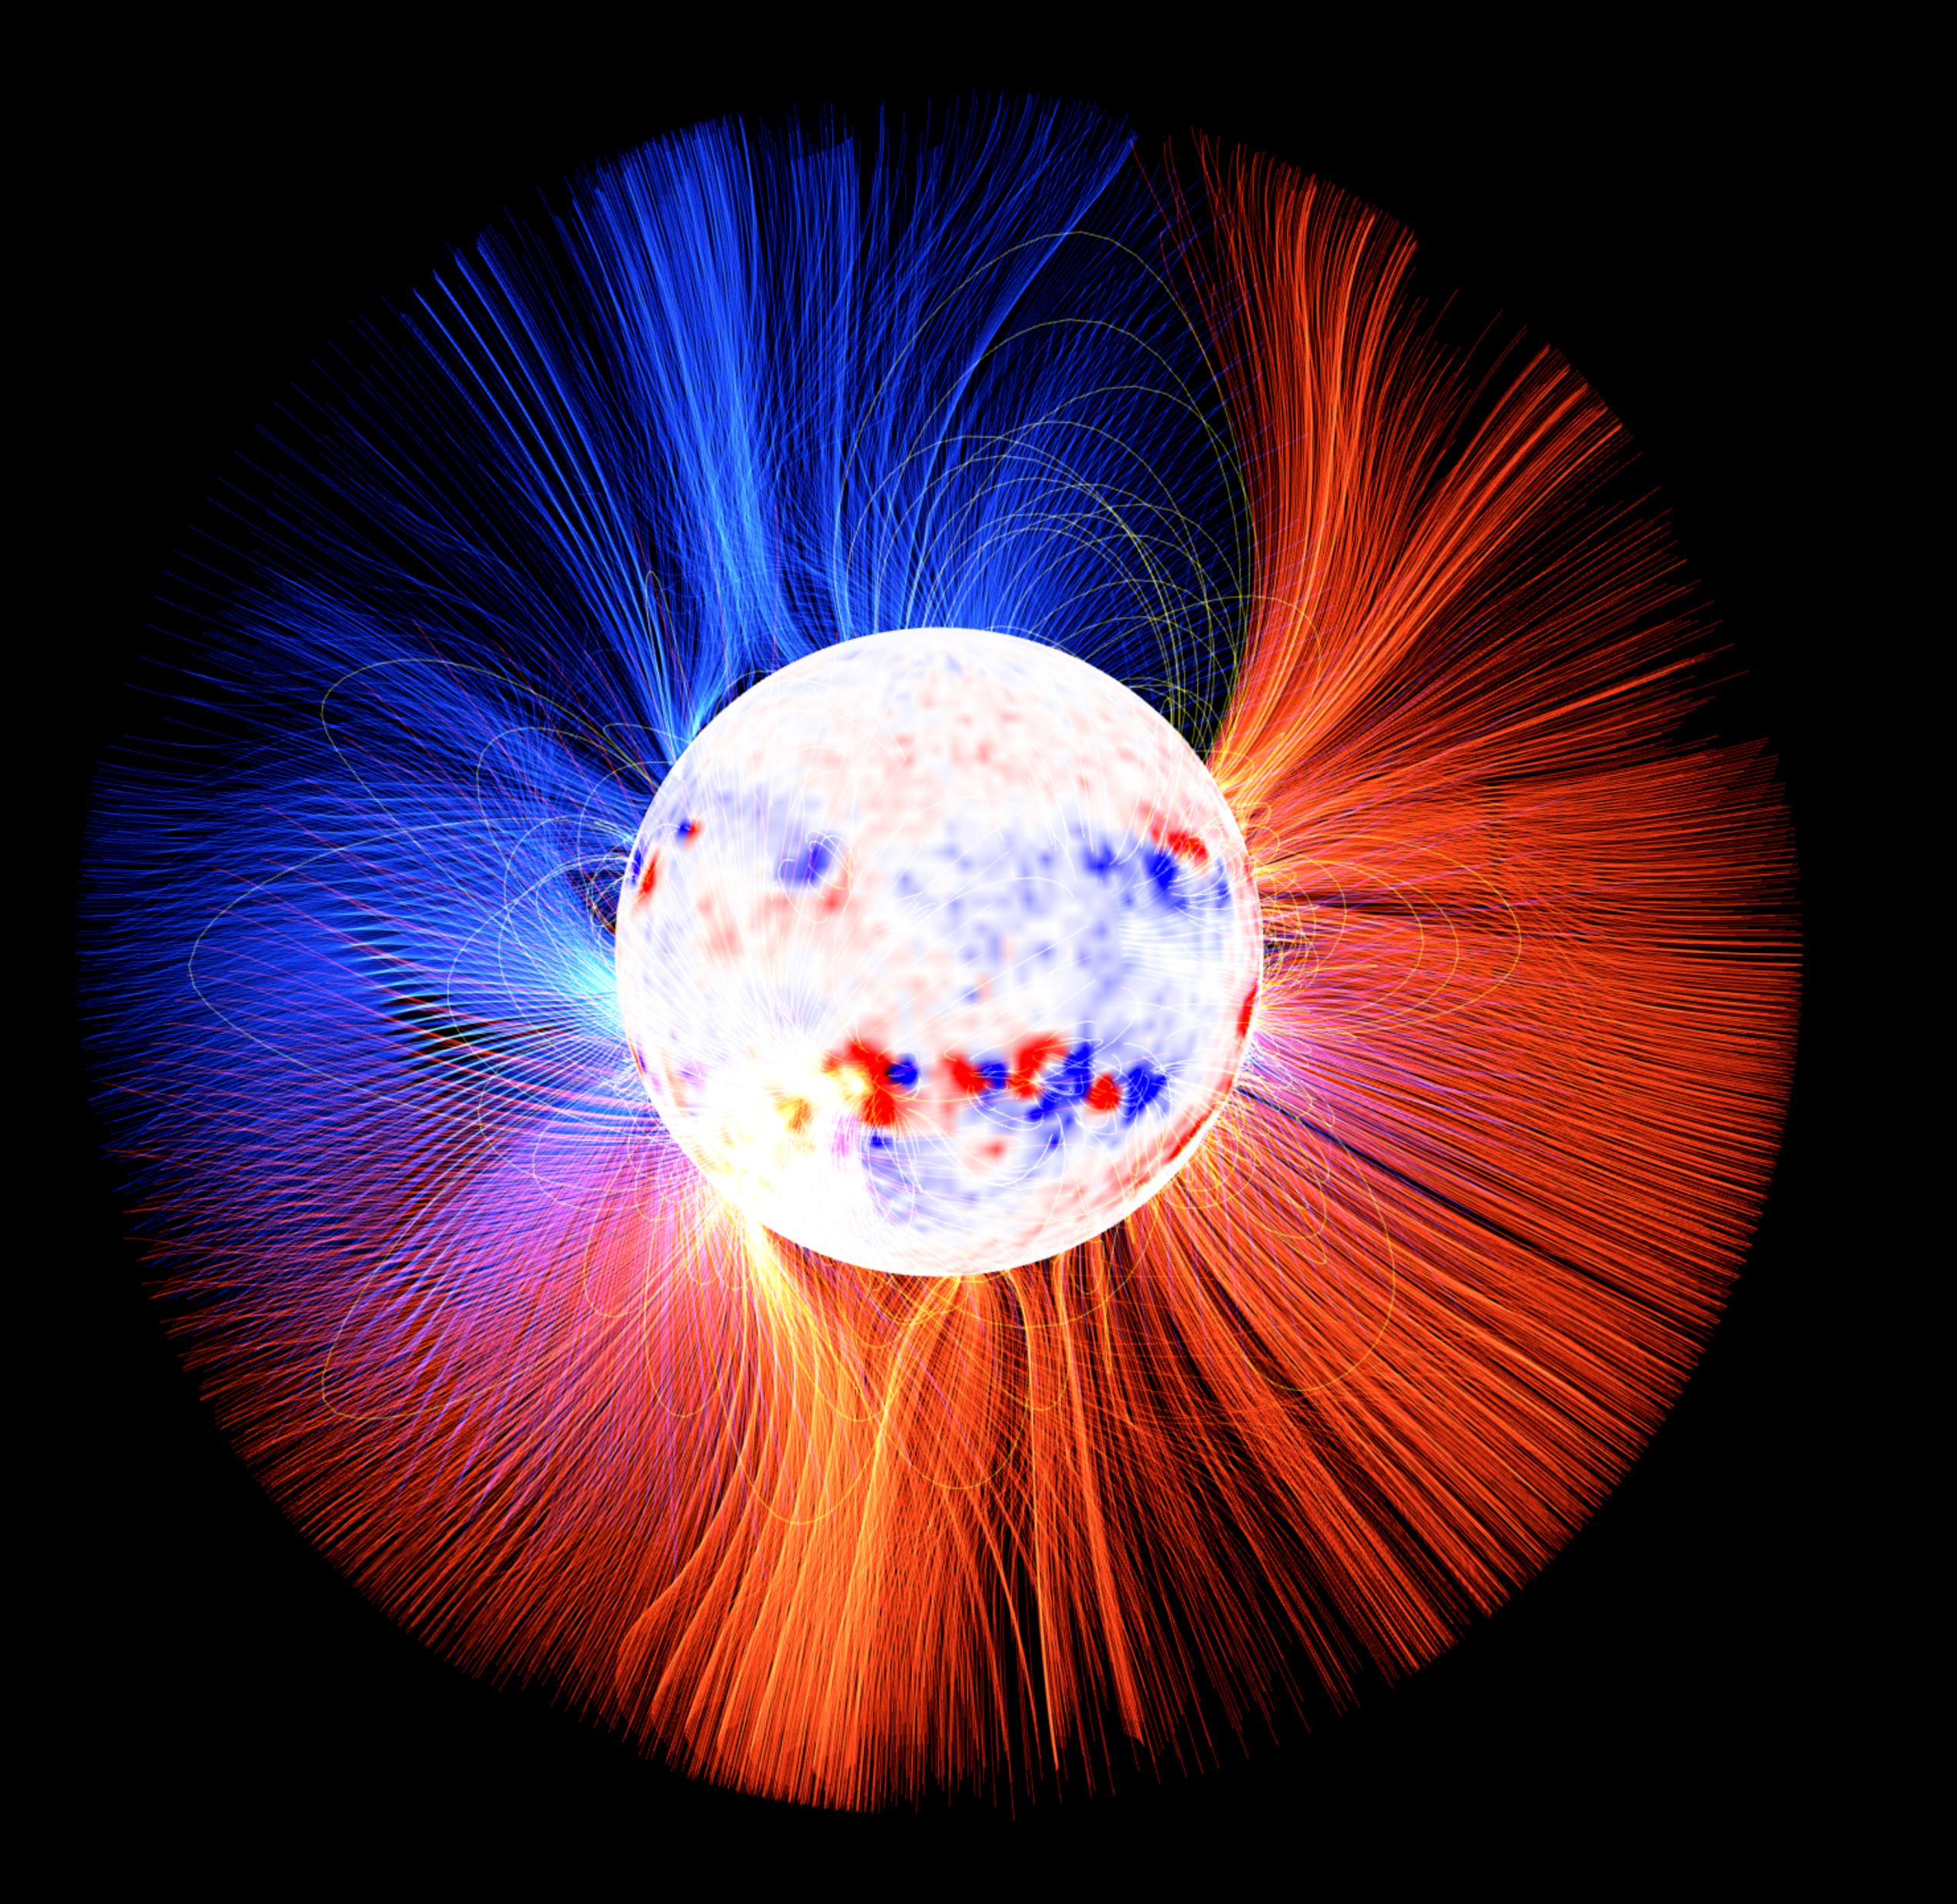
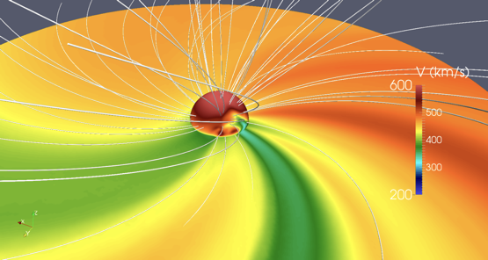
GAMERA-Helio
Inner Heliosphere Model
ADAPT
Driven by WSA-ADAPT output at 21.5 R_{s} (Wallace et al. 2020; Arge et al. 2004)
At the inner boundary 21.5 R_{s} density is calculated from an empirical relation, temperature is from the total pressure balance
Simulation with given boundary conditions proceeds until steady state solution is reached
Heritage of LFM-Helio: Merkin et al. 2011, 2016a, 2016b
Three current capabilities of GAMERA-Helio:
  Steady state including high-resolution simulations
  Evolution of interplanetary CMEs with internal magnetic field
  Time-dependent simulations (in development)
WSA outer coronal boundary
Image credit A. Kollberg&S.H. Nikkilä
GAMERA solar wind simulation

Slide 3
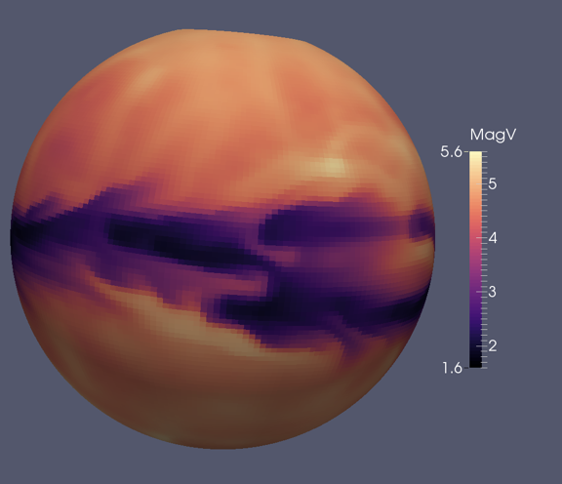
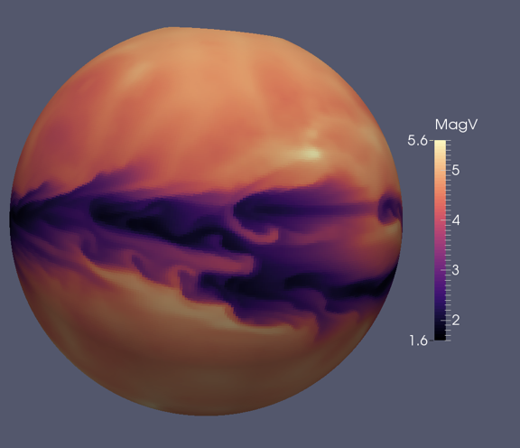
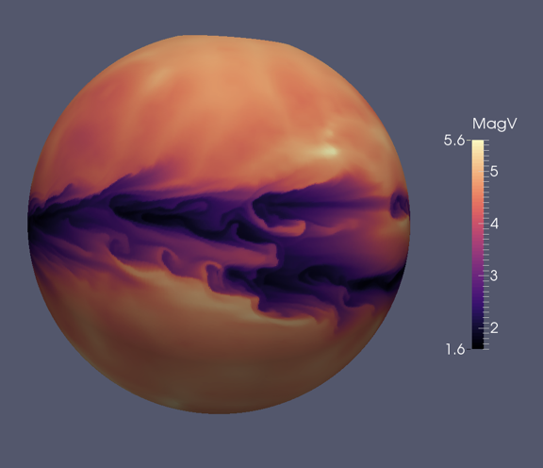
Steady state GAMERA-Helio simulations
Pushing resolution of inner heliosphere simulations
Low to high resolution
256x128x256
512x256x512
1024x512x1024

Slide 4
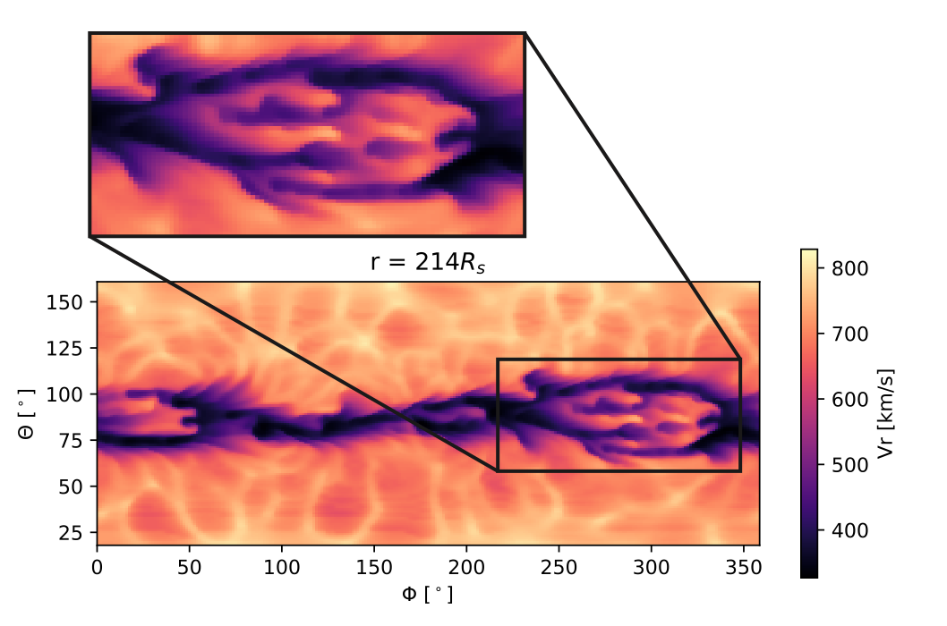
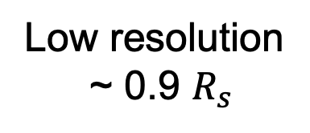
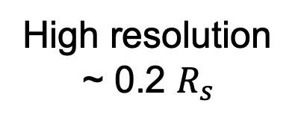
Low resolution
~ 0.9 $R_{s}$
High resolution
~ 0.2 $R_{s}$
Mostafavi et al. 2021

Slide 5
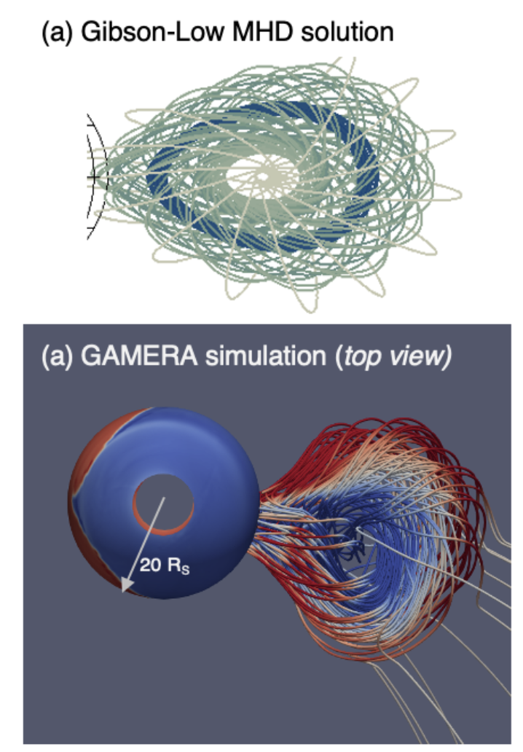
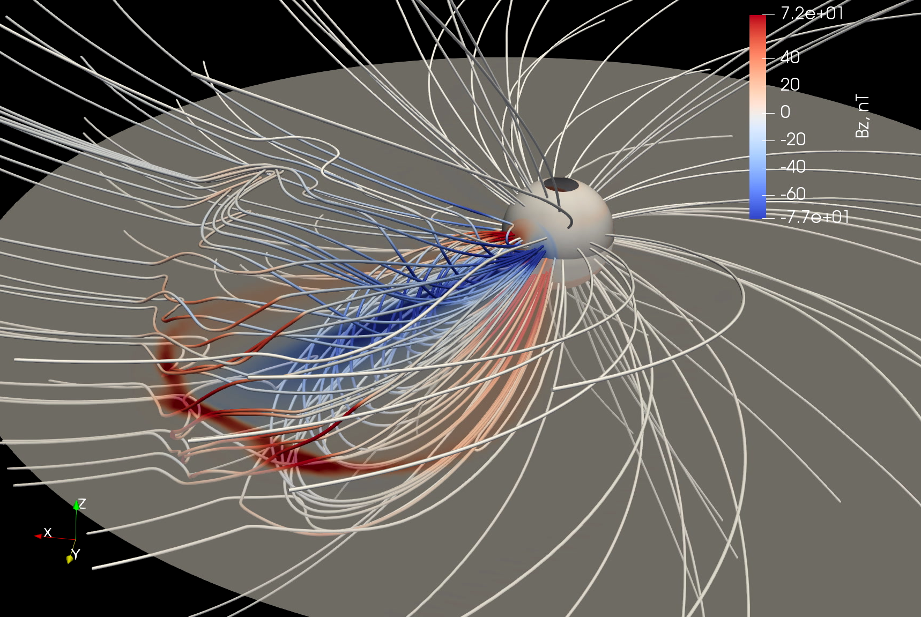
GAMERA + Gibson&Low: simulations of flux rope CMEs in the inner heliosphere
GAMERA-G&L coupling
Simulation of the April 3, 2010 CME with data constrained CME flux rope producing extended region of negative Bz is consistent with Wind observations at 1 AU
Parameterized Gibson-Low CME model with magnetic flux rope (Gibson &Low 1998)
CME is emerged into the solar wind through the GAMERA inner boundary at 21.5 R_{S} and propagates up to 1 AU
Provornikova et al. (in prep)
Ensemble simulations with GAMERA-G&L model allow us to explore a range of different scenarios for CME-solar wind interactions, various CME topologies (arcade, flux rope, tethered spheromak, spheromak), CME geometries and speeds.

Slide 6
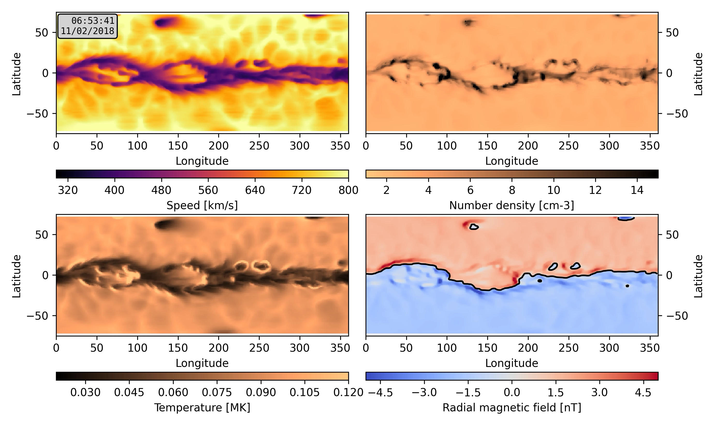
Toward time-dependent GAMERA-Helio model
Preliminary results: longitude-latitude maps at 1 AU
Changing WSA-ADAPT maps (goal 2-hr cadence, preliminary runs with 1-day cadence)
Picked 27 day period around the first Parker Solar Probe encounter 2018:11:06
Main challenge: boundary conditions treatment
Applying tangential electric field at the inner boundary to evolve B_{r}
Work in development

Slide 7
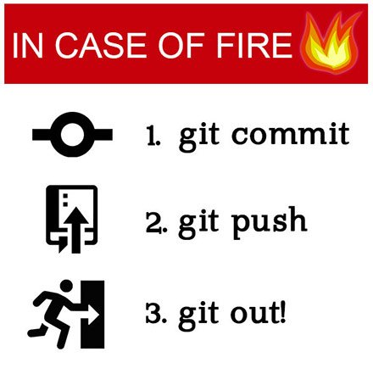
Using best software development practices
Collaborative code development
Version control using Bitbucket repositories
Following well-defined branching policies with reviews of pull-requests before committing to the main branch
Creating tags for releases to CCMC
Automatic nightly builds. Slack Bot reports success/issue detection from automatic tests.

Slide 8
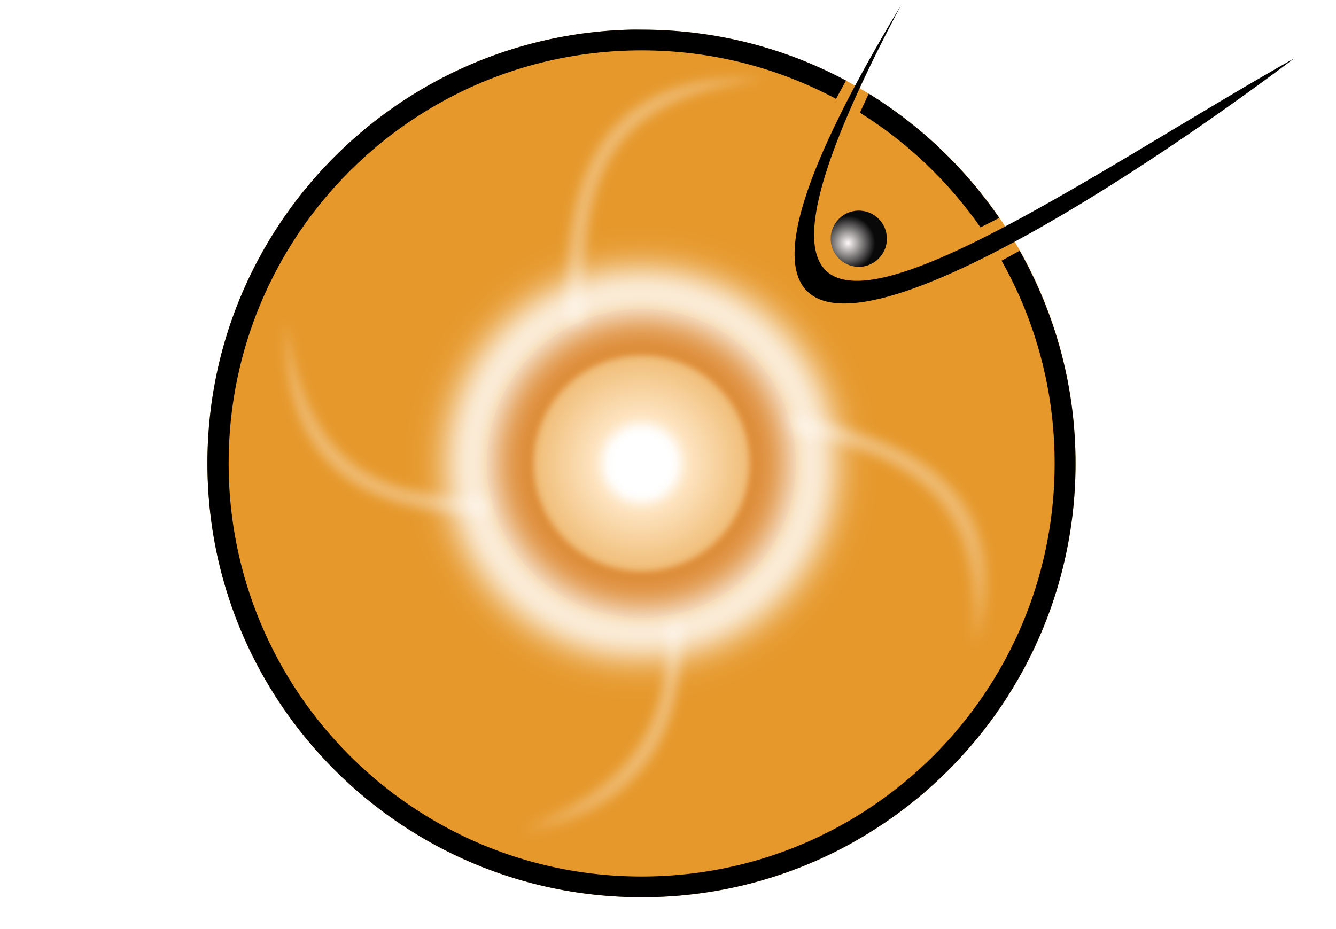
Onboarding to CCMC
CCMC staff have access to the GAMERA repo
Developed user-friendly quick start cases, both serial and MPI, verifying the code build, pre-processing and quick-look visualization
  Low resolution steady-state inner heliosphere simulation for a selected WSA map
Assisting CCMC team to build and run quick start cases
Wiki documentation describing steps to build and run the prepackaged test case on Pleiades
Communication with CCMC:
  Bi-weekly tag-ups between GAMERA team of scientists and science software engineers and CCMC team
  Dedicated science software engineer from GAMERA side leading the onboarding process

Slide 9
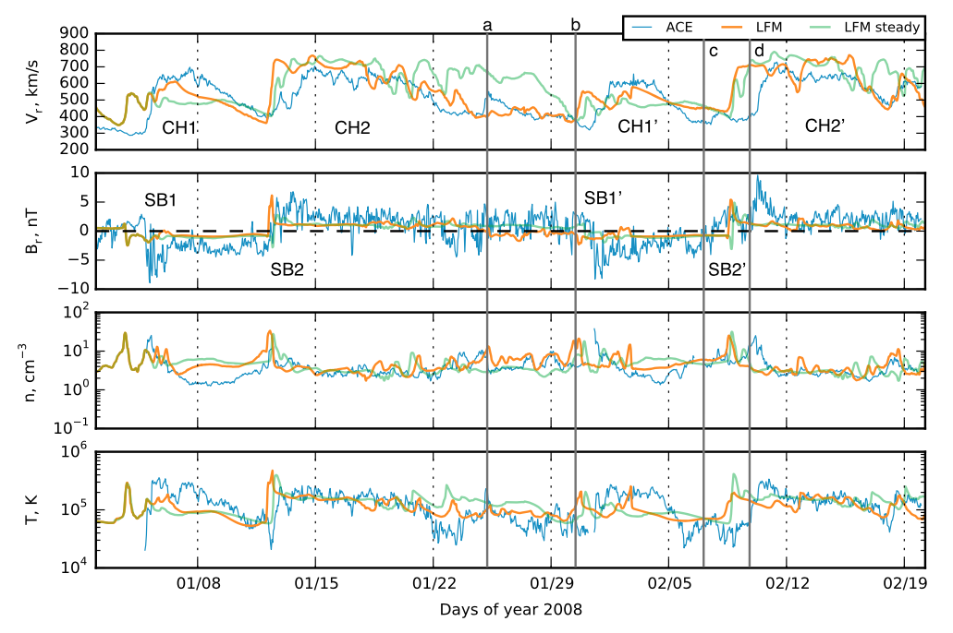
Next steps for GAMERA-Helio at CCMC
  Implementing model-data comparison tools to compare GAMERA-Helio with ACE, STEREO, PSP and Solar Orbiter measurements along trajectories with automatic data ingestion from NASA CDAWeb
  Deliver time-dependent GAMERA-Helio to CCMC
Merkin et al. 2016

Slide 10
Summary
Three capabilities of the GAMERA-Helio:
  Steady-state simulations in the inner heliosphere including unprecedently high-resolution runs
  Evolution of a CME with internal magnetic field in the inner heliosphere
  Time-dependent inner heliosphere simulations (in development)
Current onboarding at CCMC
Tagged versions of GAMERA released to CCMC
Quick start test cases with documented steps to configure, build, run and visualize both serial and MPI simulations
Next steps:
  Model-data comparison with automatic data ingestion from NASA CDAWeb
  Deliver to CCMC time-dependent GAMERA-Helio

