Slide 1

How can ENLIL help us in heliophysics research?
Laura Rodríguez-García
ESA NPI PhD student at Universidad de Alcalá (Madrid, Spain)
Solar Orbiter EPD Instrument team member
CCMC Workshop 2022
Notes:
1

Slide 2
ENLIL can help in the estimation of …
Magnetic footpoint
IP magnetic field line length
CME driven-shock/IP shock connectivity
ICME arrival (front or flank arrival, interaction with other ICMEs, out of the ecliptic arrival, etc.)
IP status (SEP onset)
CME parameters constraint (GCS)

Slide 3
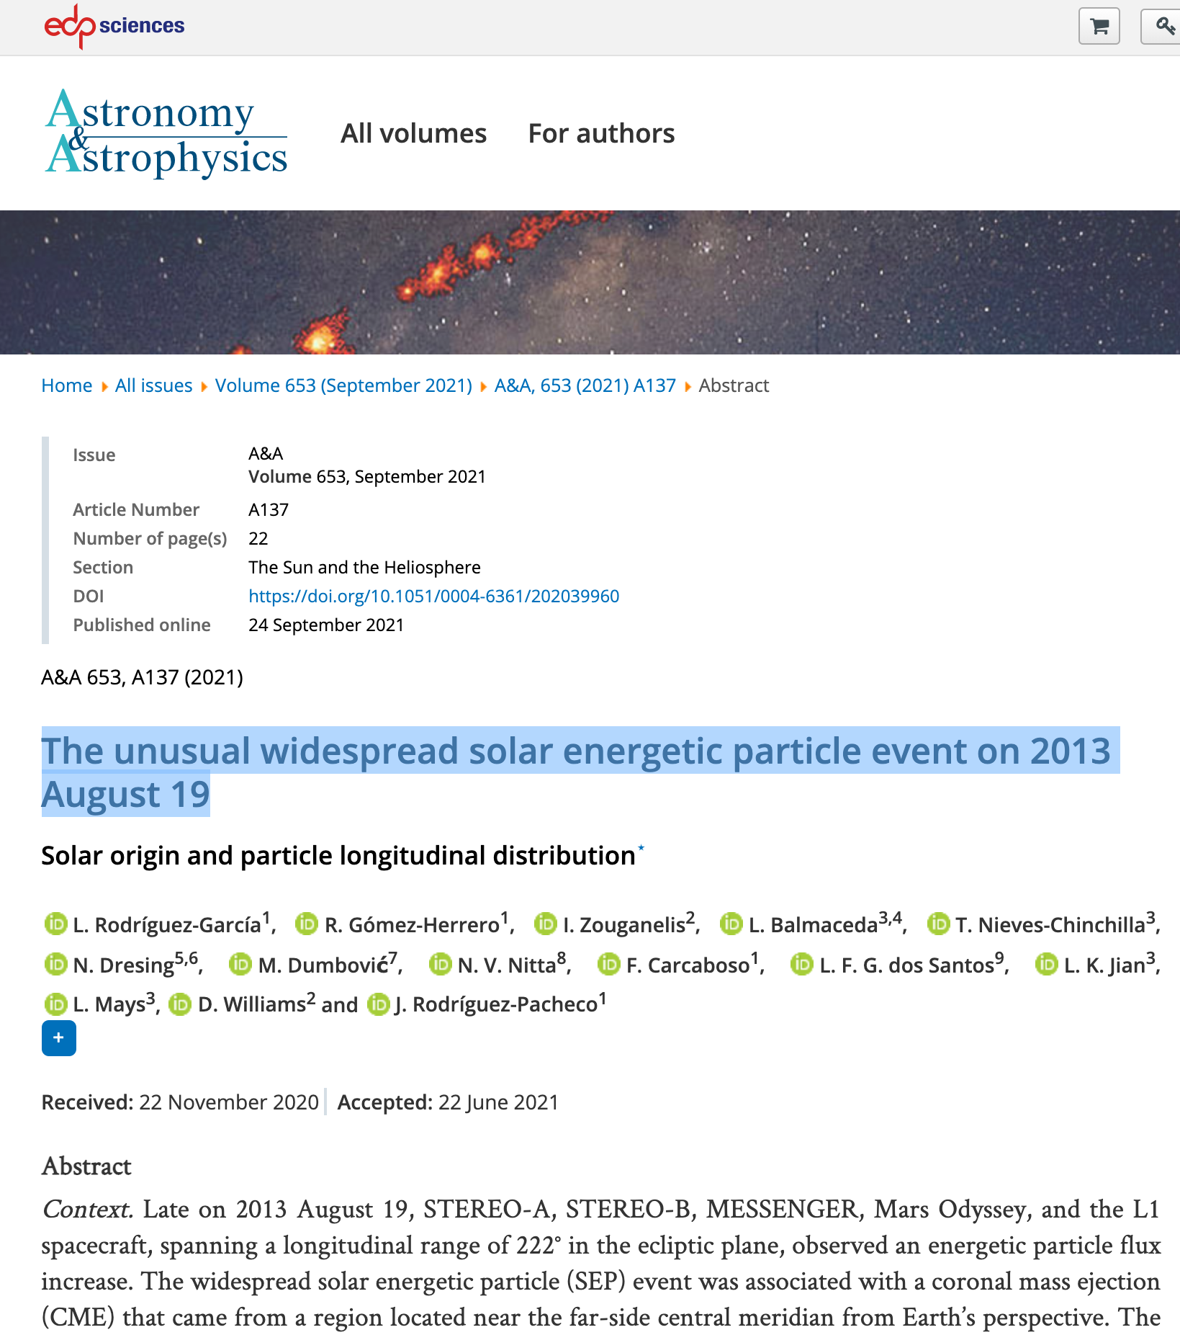

The unusual solar energetic particle event on 2013 August 19
https://www.aanda.org/articles/aa/abs/2021/09/aa39960-20/aa39960-20.html
Notes:
Gradual increase at STEREO-B. Anisotropies increase around the time ENLIL predicts IP shock connection
ICME flank arrival at STB, flux-rope signatures only during 8 hours, as predicted by ENLIL

Slide 4
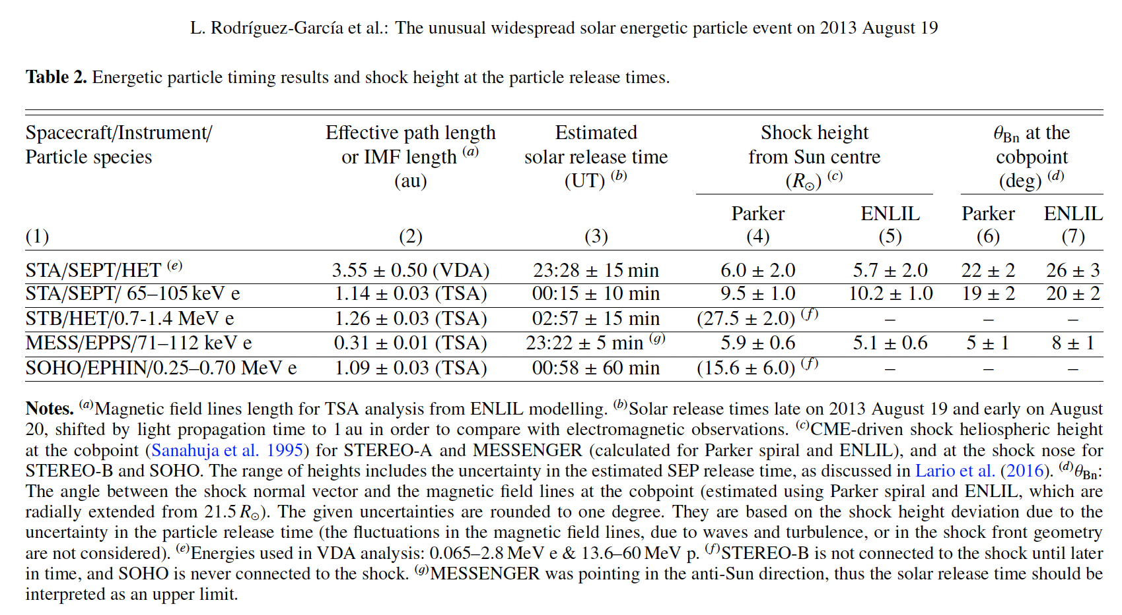
ENLIL magnetic field line length used for time shifted analysis (TSA) analysis
Notes:
Based on the onset observed in situ and knowing the IMFL length we could derive the estimated released time to compare with the solar flare timing

Slide 5
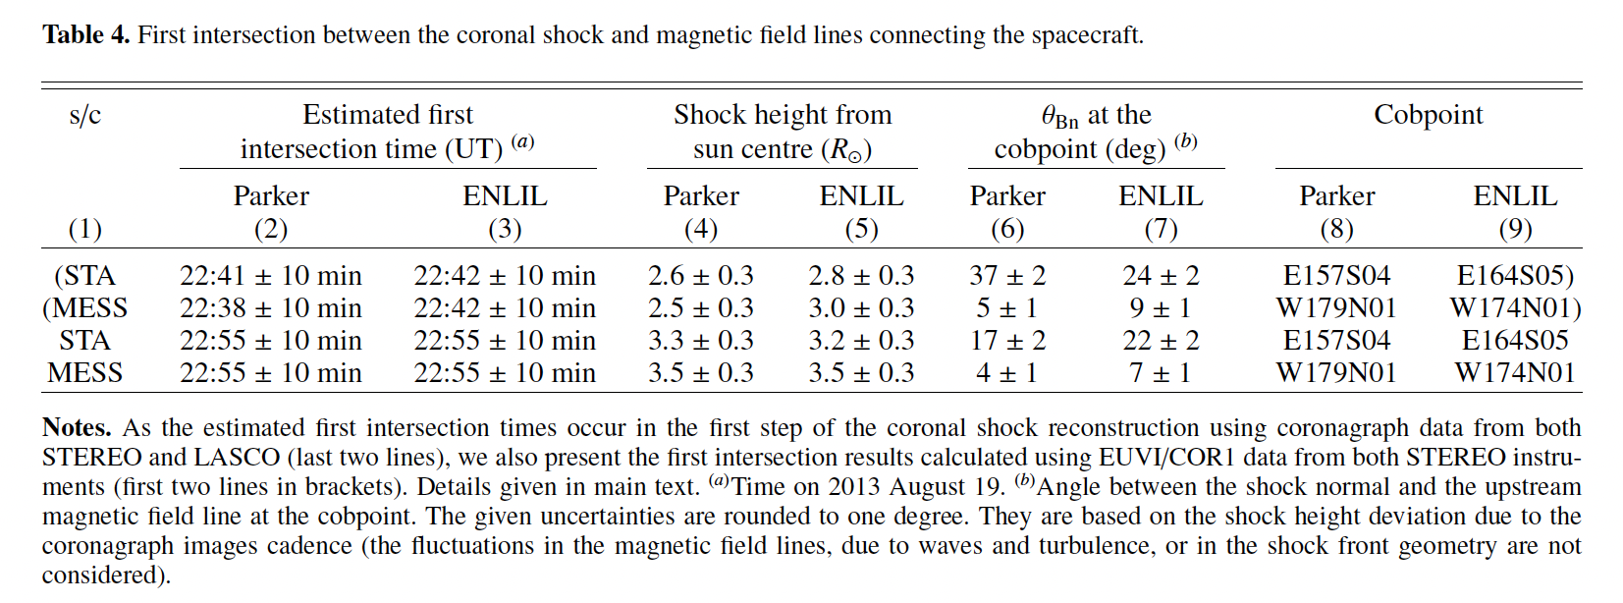
ENLIL field lines used for deriving CME-driven shock connectivity
ENLIL lines radially extended from 20 Rs to be intersected with the shock 3D reconstruction
Notes:
Use of ENLIL (radially extended from 20 Rs and Parker magnetic field lines) to estimate the connection of the spacecraft

Slide 6
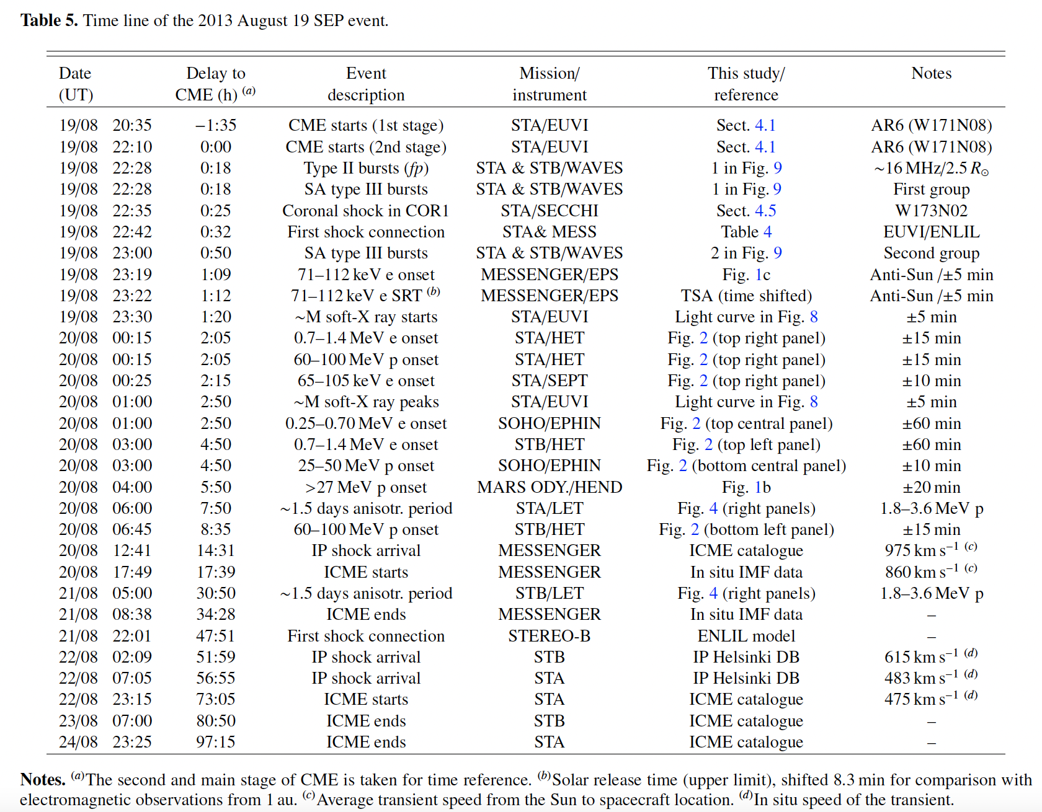
ENLIL IP shock connectivity
Notes:
Table showing the late connection of STB to the shock, shock files from ENLIL

Slide 7
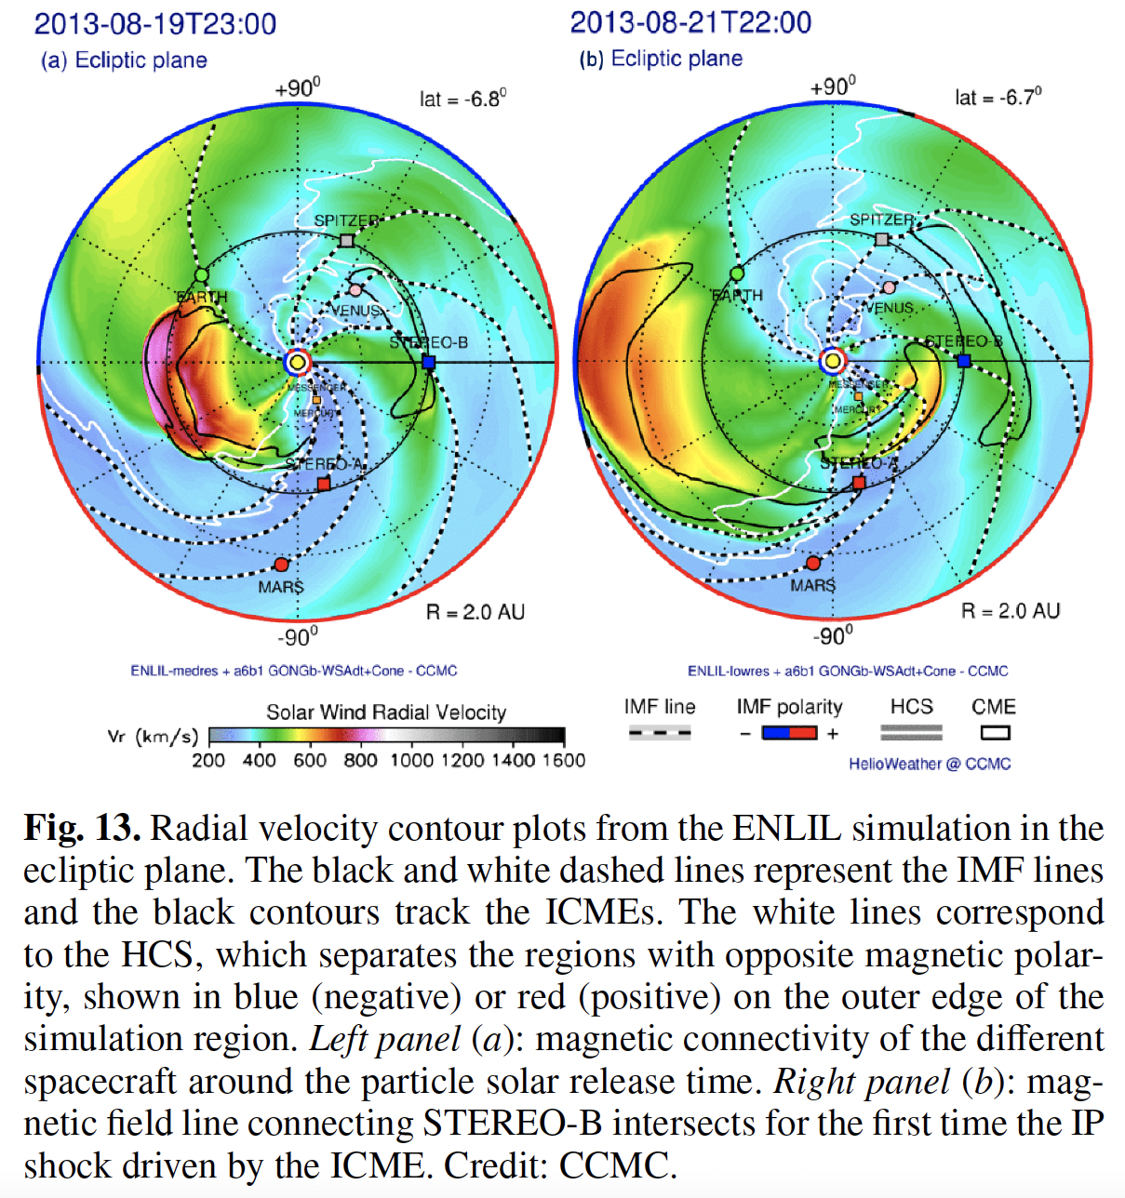

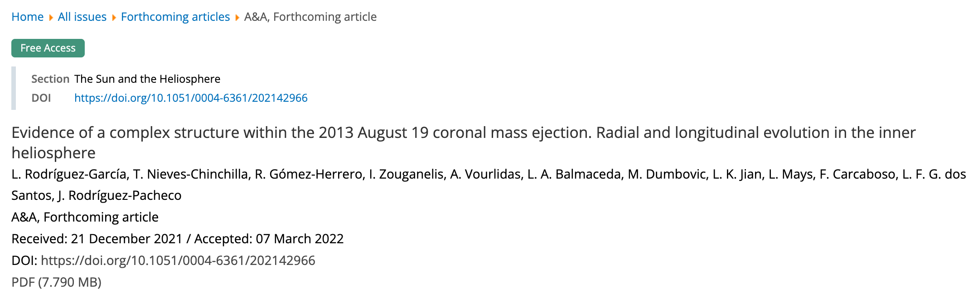
IP status and ICME arrival
https://www.aanda.org/component/article?access=doi&doi=10.1051/0004-6361/202142966
Notes:
IP status prior to the SEP onset, ICME arrival (flank arrival to STB)
Low resolution was better for the flank arrival to derive the shock parameters

Slide 8
Results/Lessons learnt
ENLIL in agreement with a late connection of the IP shock with STEREO-B
ENLIL in agreement with a flank arrival of the ICME at STEREO-B (very wide ICME)
Low resolution run estimated the shock parameters at STEREO-B better than medium resolution run (ICME flank geometry)
CME speed at the apex better matched the ICME time arrival in situ that the CME speed at the bulk (ICME arrival)
Notes:
The derived shock parameters fluctuate significantly, while the low resolution match insitu data more closely
Flank arrival, even they are 80 degrees apart, wide CME

Slide 9
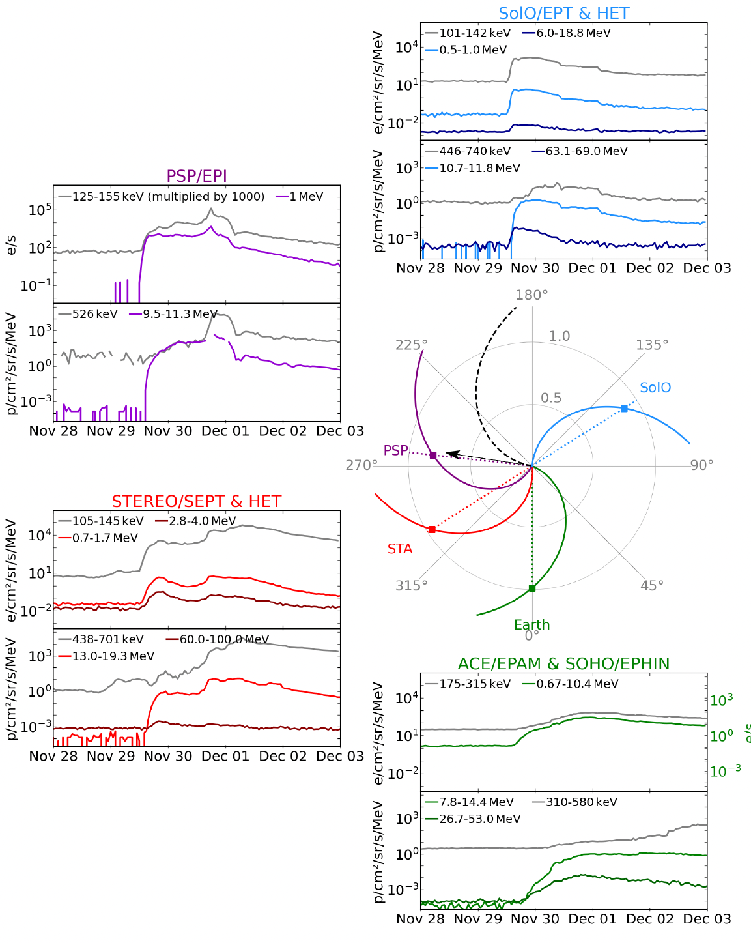

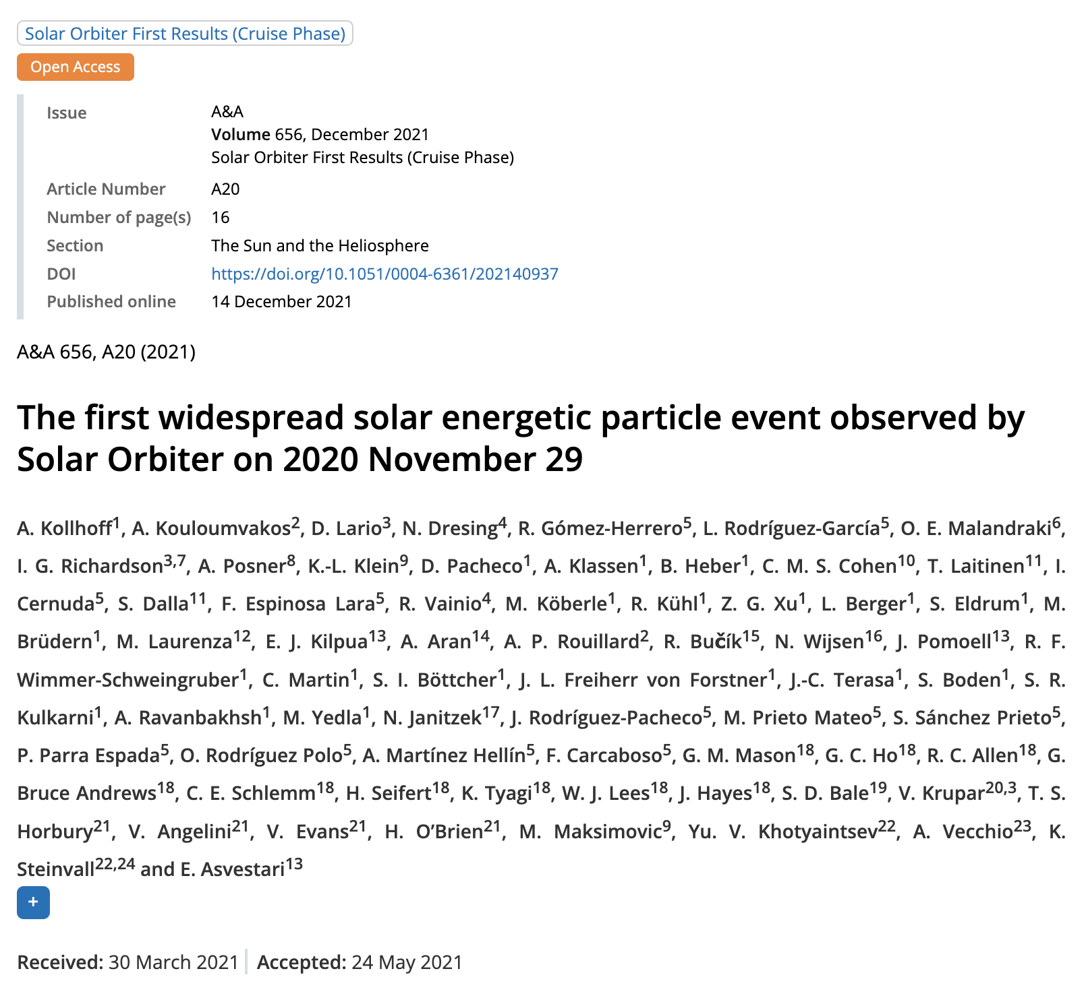
The first widespread solar energetic particle event in the solar cycle 25 (I)
https://www.aanda.org/articles/aa/full_html/2021/12/aa40937-21/aa40937-21.html

Slide 10
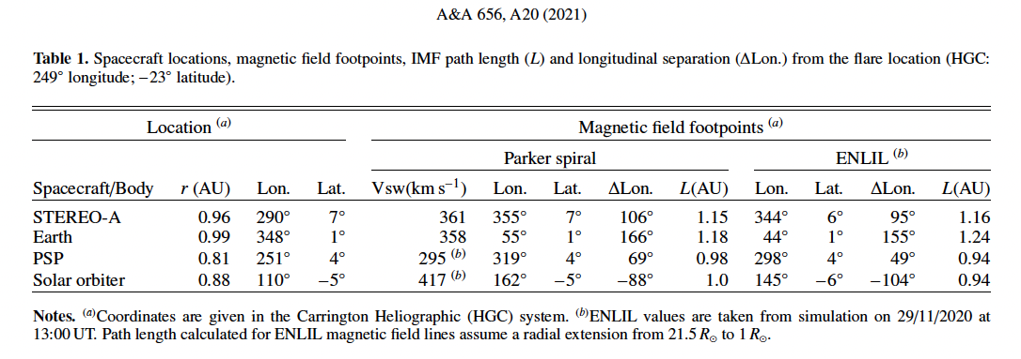
Magnetic footpoint estimations
Footpoint difference between ENLIL and Parker spiral higher for PSP: solar wind speed update and previous disturbing ICME (see next study)

Slide 11

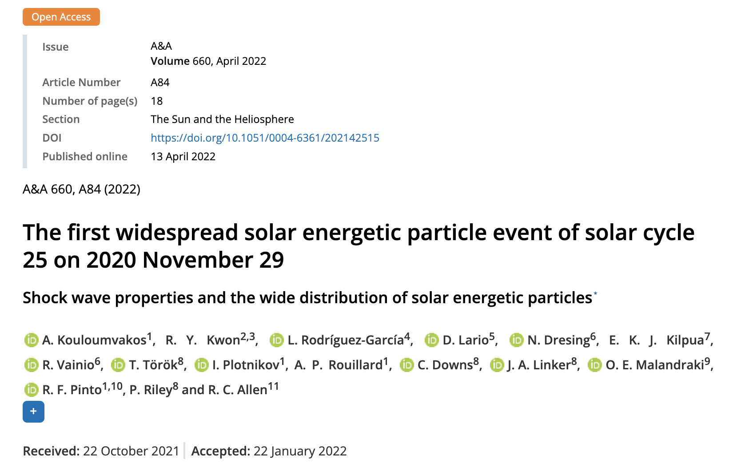
The first widespread solar energetic particle event in the solar cycle 25 (II)
Shock wave properties and the wide spread of the solar energetic particles
https://www.aanda.org/articles/aa/abs/2022/04/aa42515-21/aa42515-21.html

Slide 12
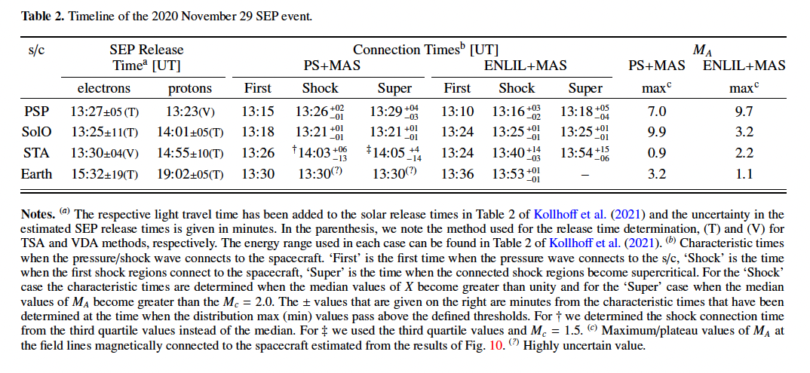
CME-driven shock connectivity
Notes:
we consider the temporal evolution of the shock parameters at the connected field lines and the SEP properties, the connectivity estimates from the ENLIL+MAS model seem more consistent with observations than the PS+MAS. For example, the maximum MA values are observed at PSP-connected field lines, moderate values are found on SolO and STEREO-A connecting lines, and Earth-connected lines are associated with weak shock strength regions (Table 2). This seems broadly consistent with the apparent ordering of the maximum SEP intensities observed from the different instruments during the SEP event.

Slide 13
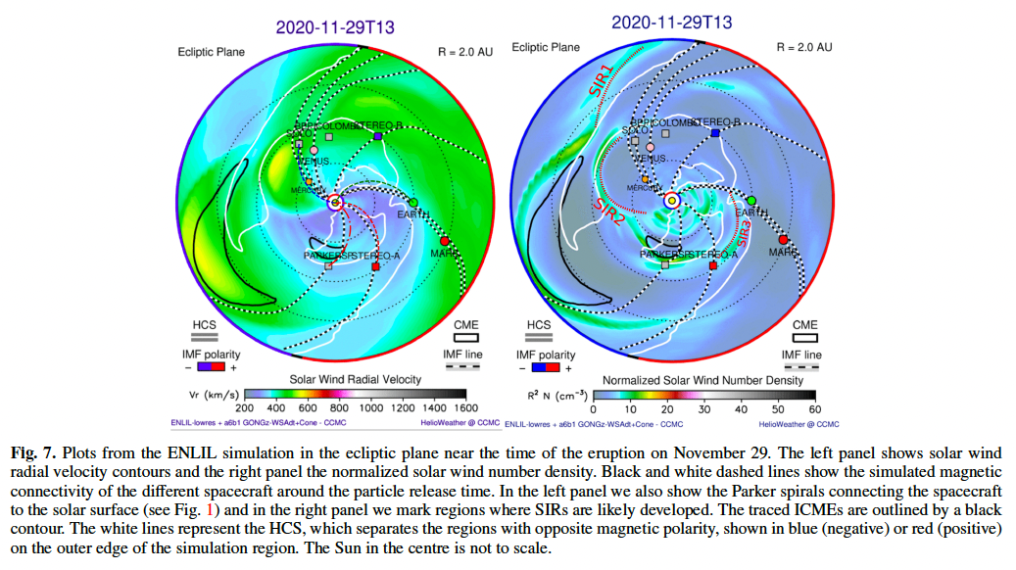
IP status: ICME and SIRs

Slide 14
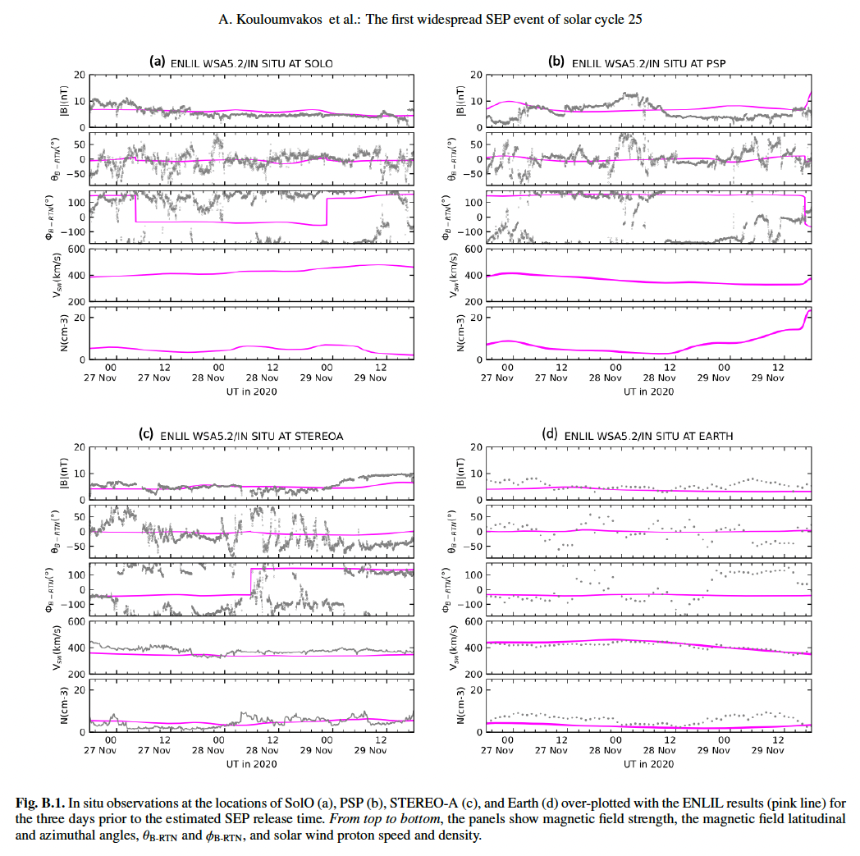
ENLIL-in situ data comparison

Slide 15
Results/Lessons learnt
Background solar wind and previous IP disturbances (ICME, SIR) modified the shape of the lines and the footpoints
In situ measurements support the ENLIL+MAS estimated connecting times to supercritical part of the shock
ENLIL is an alternative for the magnetic footpoint estimation to Parker spiral
ENLIL gives an overview of the IP status at the SEP onset time

Slide 16


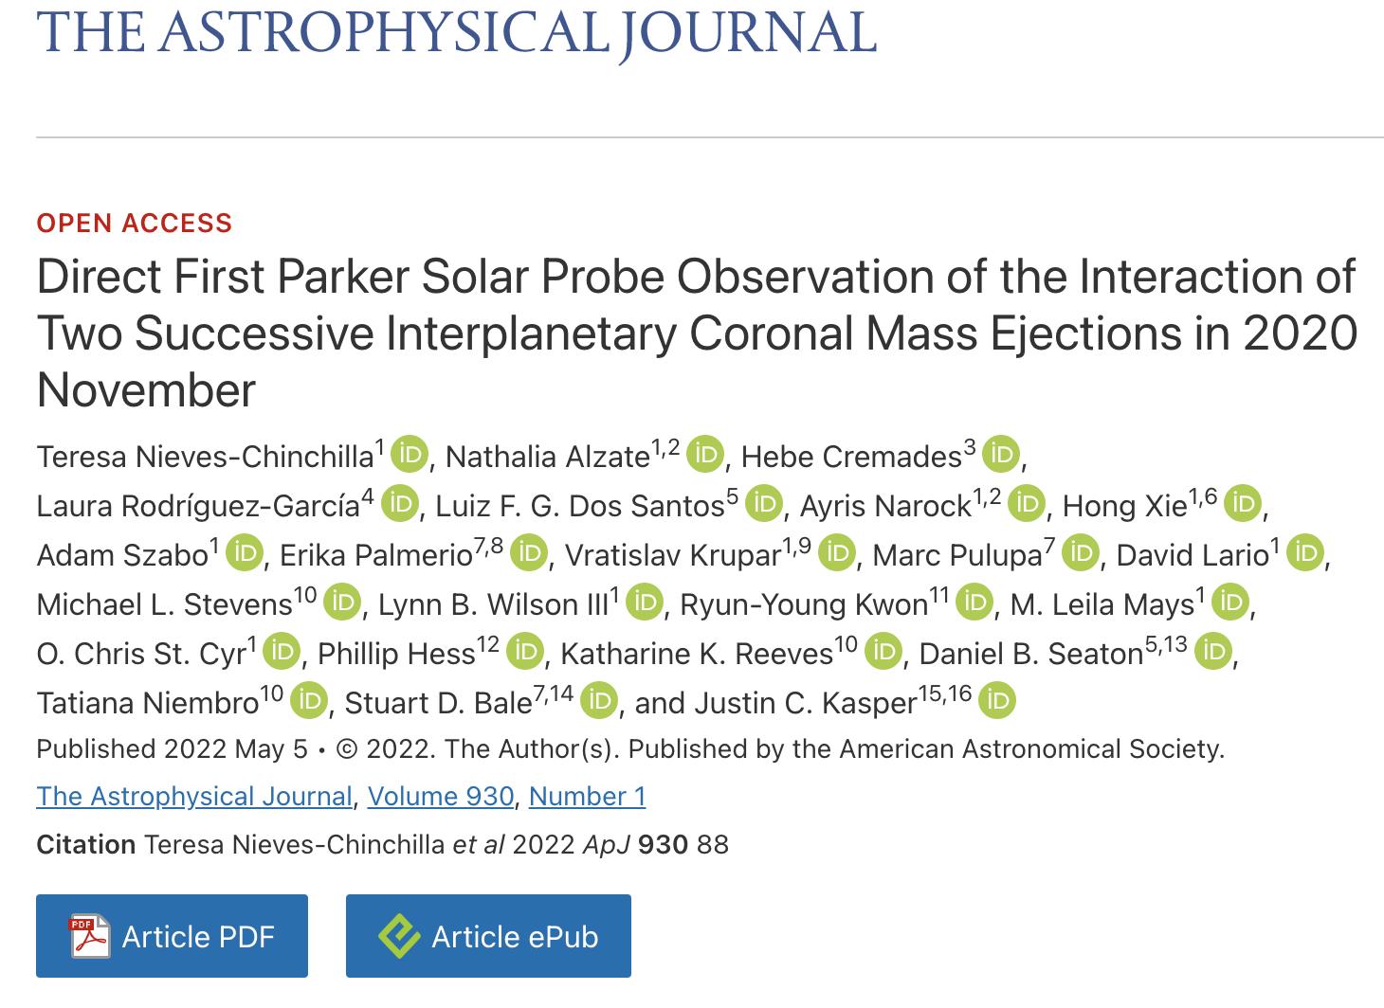
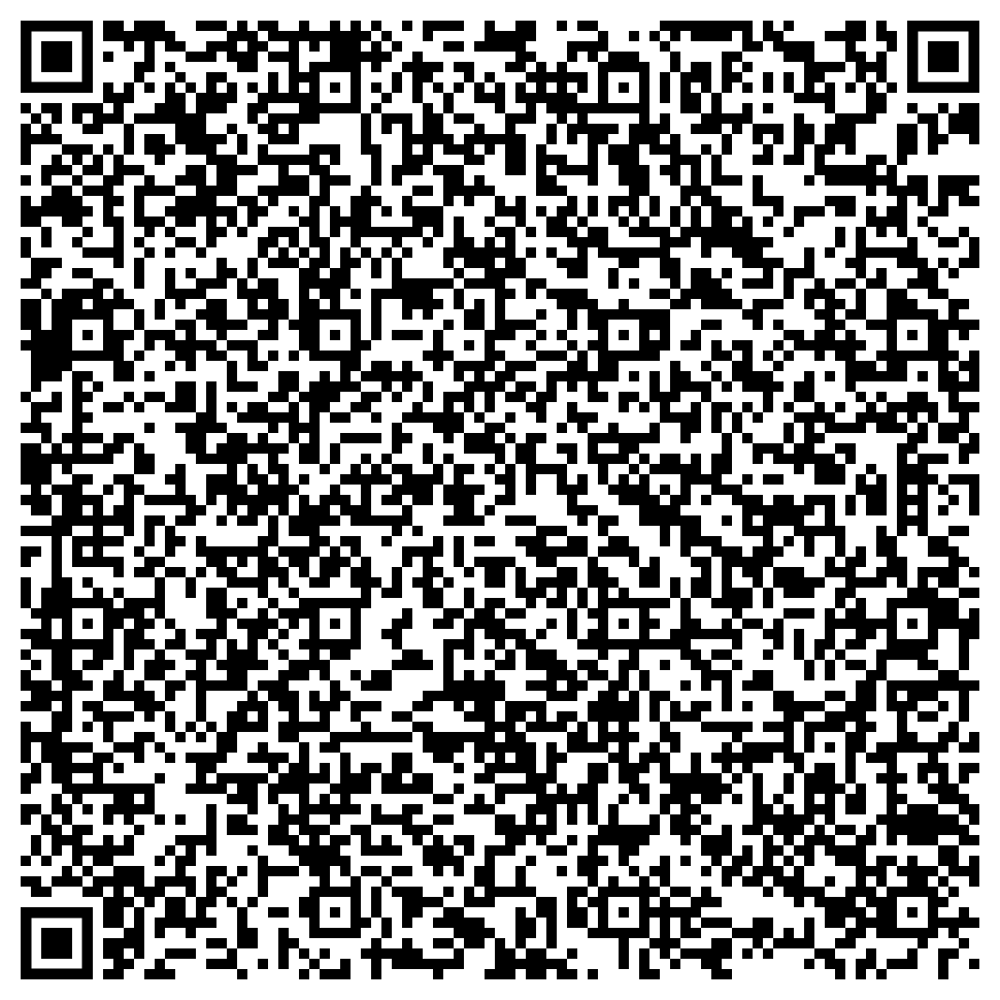
Interaction of two successive ICMEs in November 2020
https://iopscience.iop.org/article/10.3847/1538-4357/ac590b/meta

Slide 17
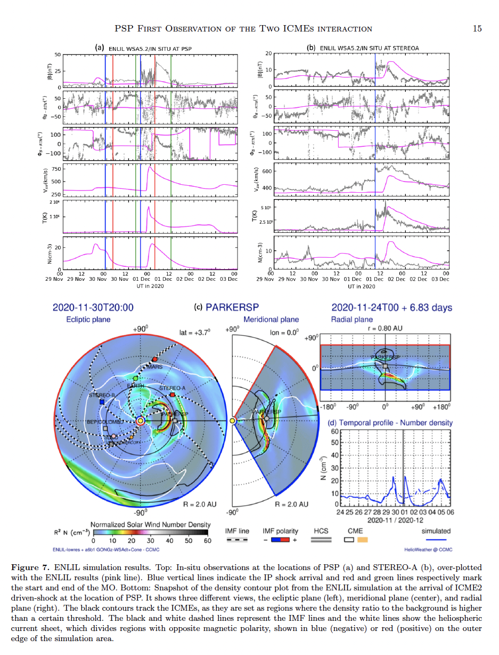
ICME interaction
Notes:
Interaction starts around 12 hours in the meridional view but around 23 hours in the ecliptic plane

Slide 18
ICME interaction
Notes:
Interaction starts around 12 hours in the meridional view but around 23 hours in the ecliptic plane. Not well reproduced the ICME interaction magnetic field

Slide 19
Results/Lessons learnt
ENLIL plots in agreement with the interaction of two magnetic flux-ropes around PSP location
3D view of this interaction
ICME magnetic field particularly not well simulated in the interaction of the two ICME (in addition to the lack of internal magnetic field)
Good to use in combination with DBM model for bulk structure arrival time
Good to constrain the CME 3D reconstructed parameters

Slide 20
Summary: applications
#1 Magnetic footpoint
#2 IMF line length for TSA analysis
#3 CME driven-shock/IP shock connectivity
#4 ICME arrival (front or flank arrival, interaction with other ICMEs, out of the ecliptic arrival, etc.)
#5 IP status (previous ICME, previous SIRs, etc. )
#6 3D reconstructed CME parameters constraint

Slide 21
Summary: take home messages
Low resolution run estimated the shock parameters at STEREO-B better than medium resolution in a flank arrival
CME speed at the apex better matched the ICME time arrival in situ that the CME speed at the bulk
ENLIL gives an alternative for the magnetic footpoint estimation with respect to the use of the Parker spiral
ICME magnetic field particularly not well simulated in the interaction of the two ICMEs
Good to use in combination with DBM model
Good to constrain the 3D CME reconstruction

Slide 22

Thank you for your attention!
Contact:
l.rodriguezgarcia@edu.uah.es

