Slide 1
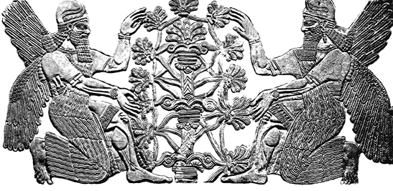
ENLIL and Heliospheric Space Weather
Dusan Odstrcil (GMU & NASA/GSFC)
In collaborations with: N.Arge, J. Davies, S. Jones, J. Luhmann, L. Mays, V. Pizzo
Community Coordinated Modeling Center (CCMC) Workshop, College Park, MD, June 6-10 2022

Slide 2
2021-10-28 CME Prediction by NOAA/SWPC
WSA-ENLIL-Cone — Heliospheric Space Weather in 2024 (Data from 2013)

Slide 3
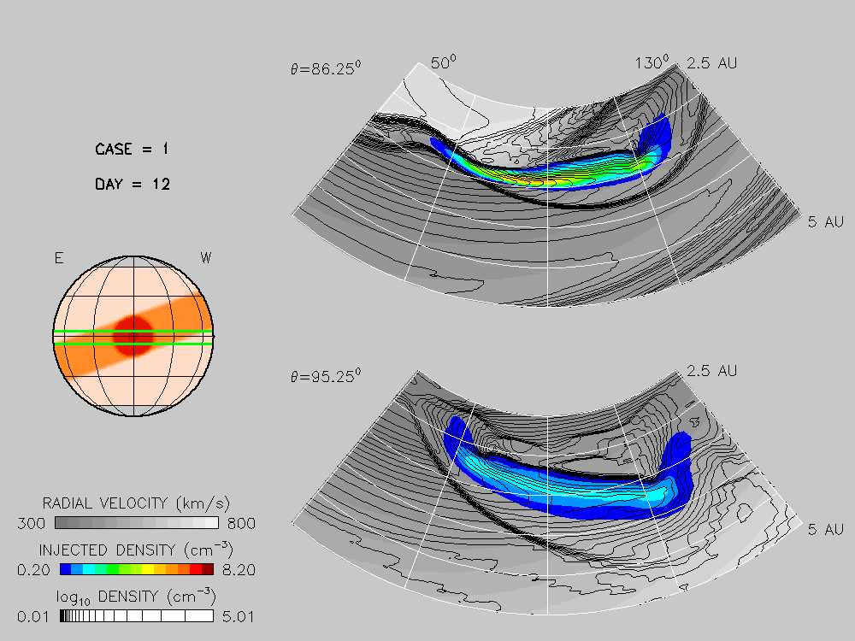
2021-10-28 CME Prediction by NOAA/SWPC
Propagation of a CME-like Disturbance in Structured BSW
{ Odstrcil and Pizzo, 1999 ]

Slide 4
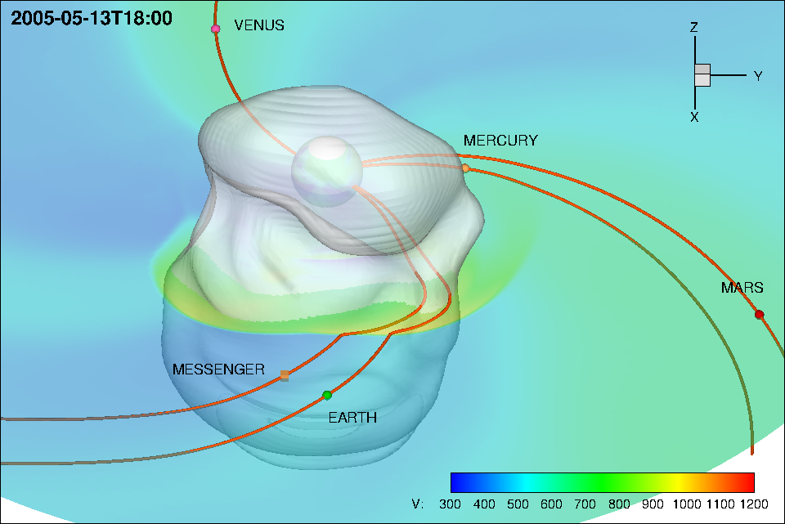
2005-05-13 ICME – Side View
2005-05-13 CME — IMF Coompression and Draping
ICME axis is very close to the Sun-Earth direction
Bz cannot be generated by shock compression and/or IMF draping

Slide 5
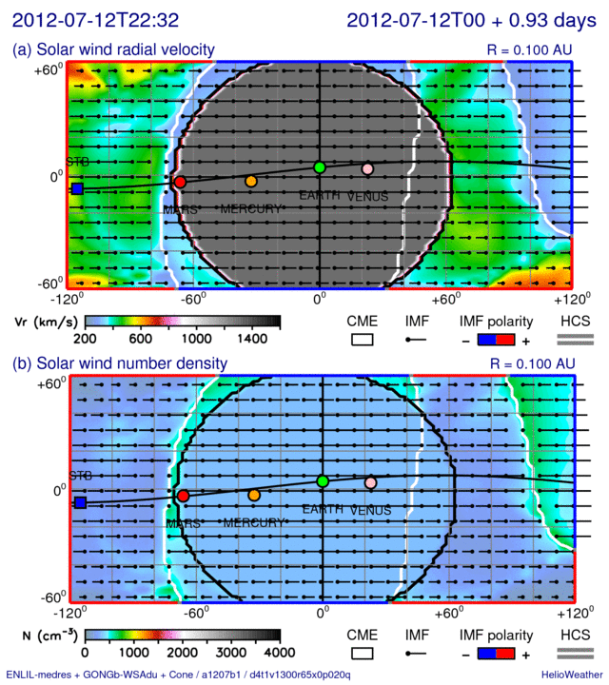
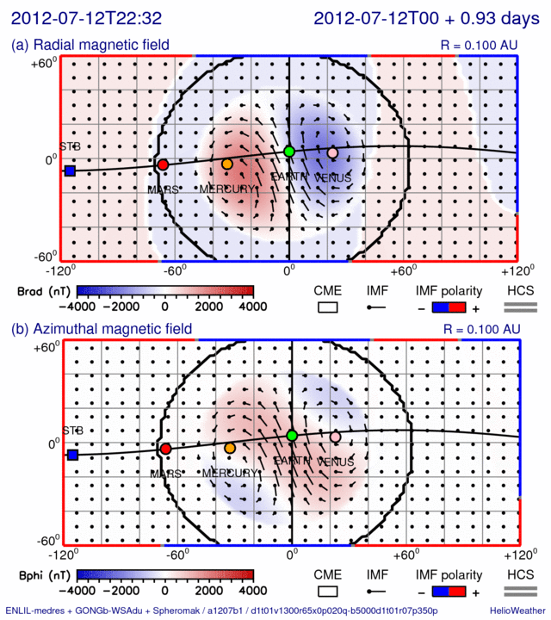
Launching a Spheromak — Boundary Conditions — 2012-07-12 CME

Slide 6
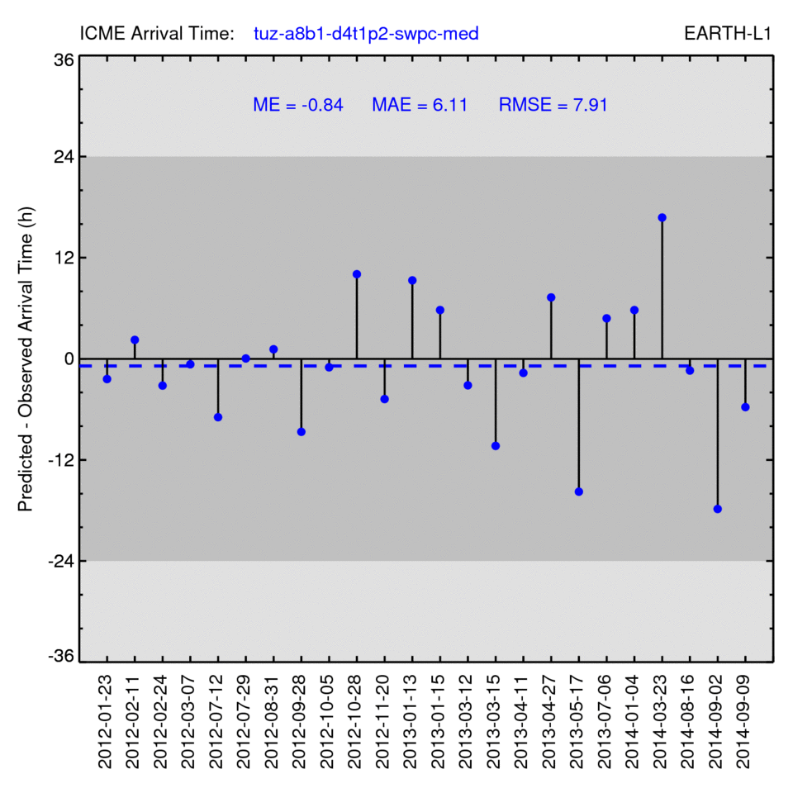
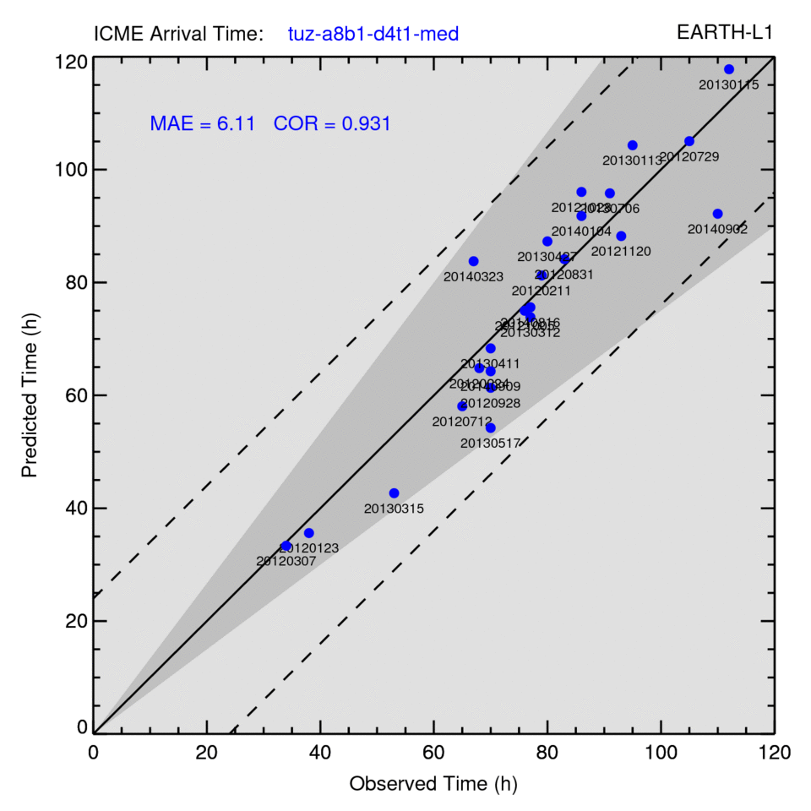
Operational Prediction Accuracy — 24 CME Events from the SWPC List

Slide 7
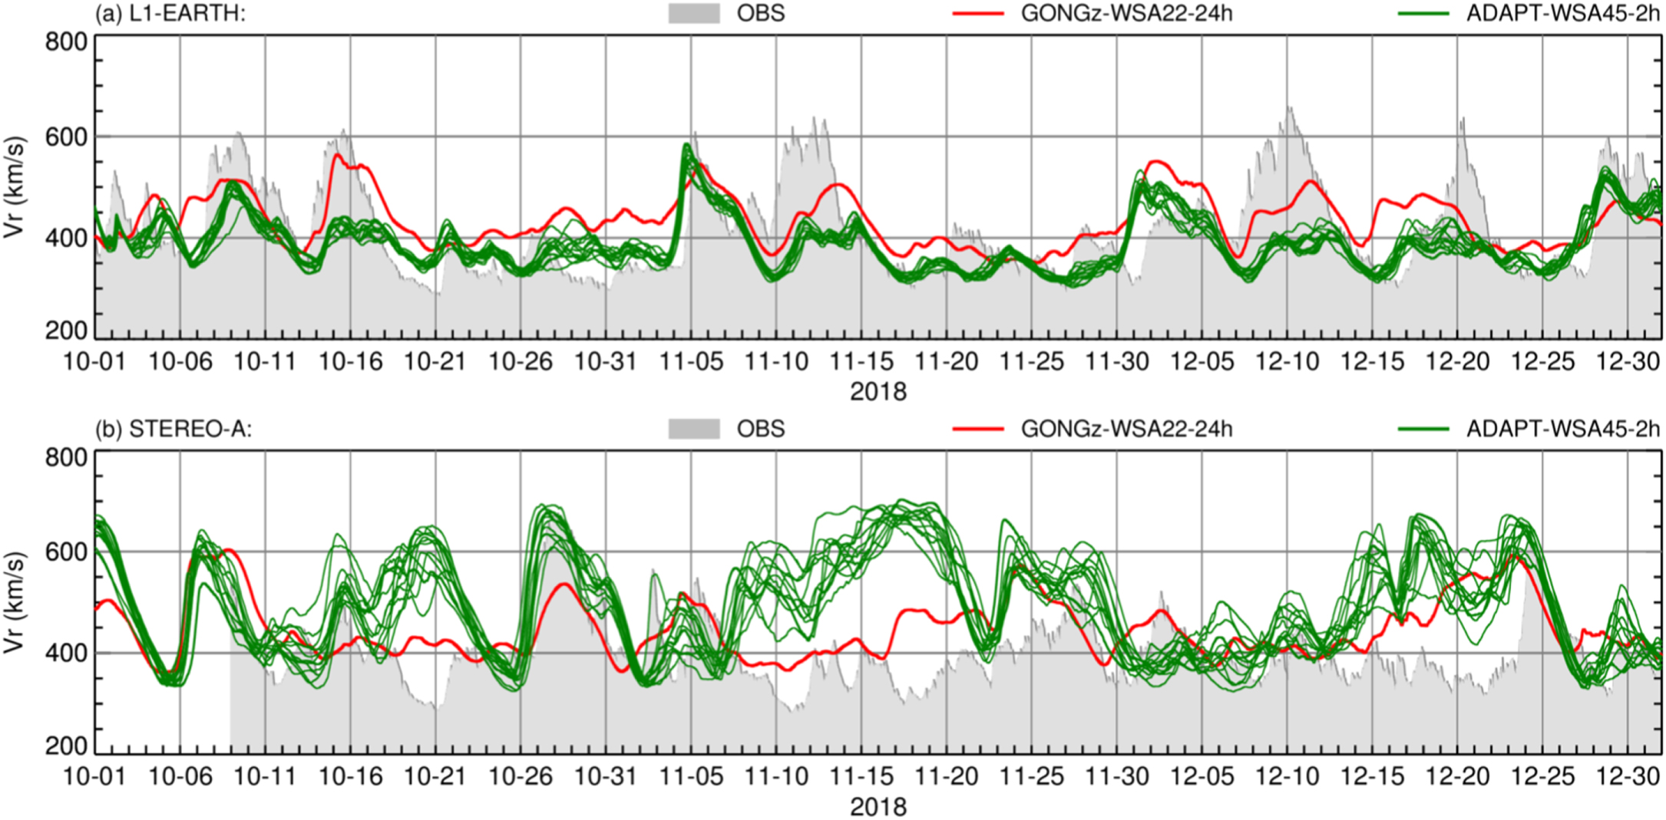
2021-10-28 CME Prediction by NOAA/SWPC
Solar Wind Predictions in Late 2018. — Using WSA vs ADAPT-WSA
Solar wind radial velocity at L1 point (top) and STEREO-A (bottom) predicted by ENLIL using two different WSA maps. Measured values are shown by gray lines, predictions using the GONGz-WSA-2.2 maps with 24 h cadence by red lines, and 12 predictions using the ADAPT-WSA-4.5 maps with 2 h cadence by green lines.

Slide 8
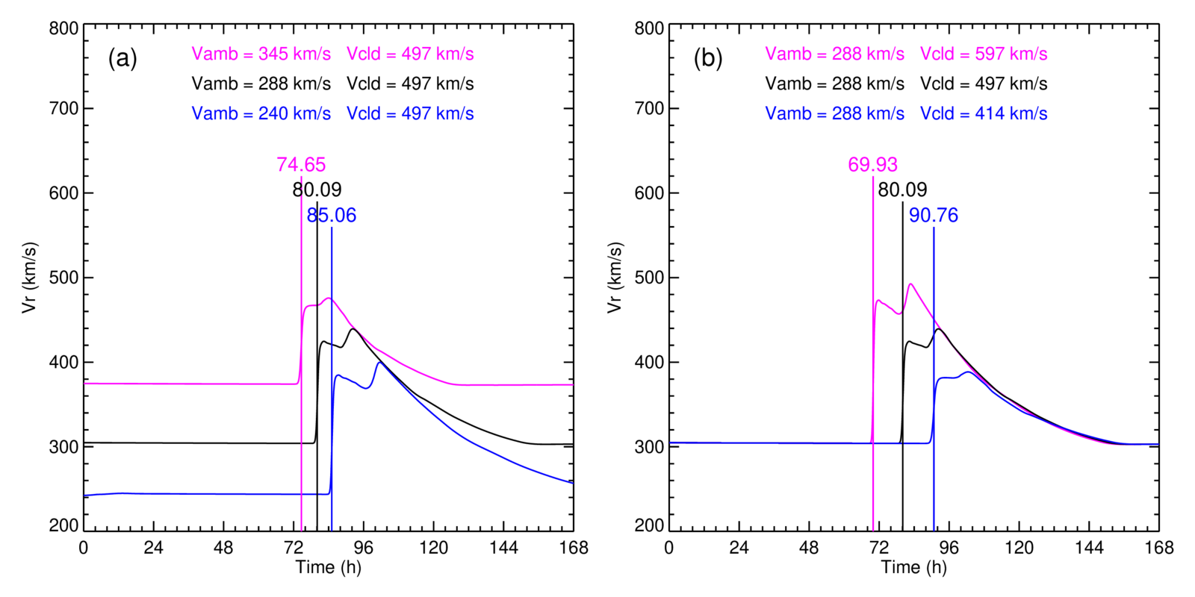
2021-10-28 CME Prediction by NOAA/SWPC
Importance of the BSW and CME Speed. — Variation by 20%
Evolution of the radial velocity at Earth for a slow CME propagating in three different backgrounds (b) and three slow CMEs propagating in the same background. Parameters and ToA values are indicated by different colors.

Slide 9
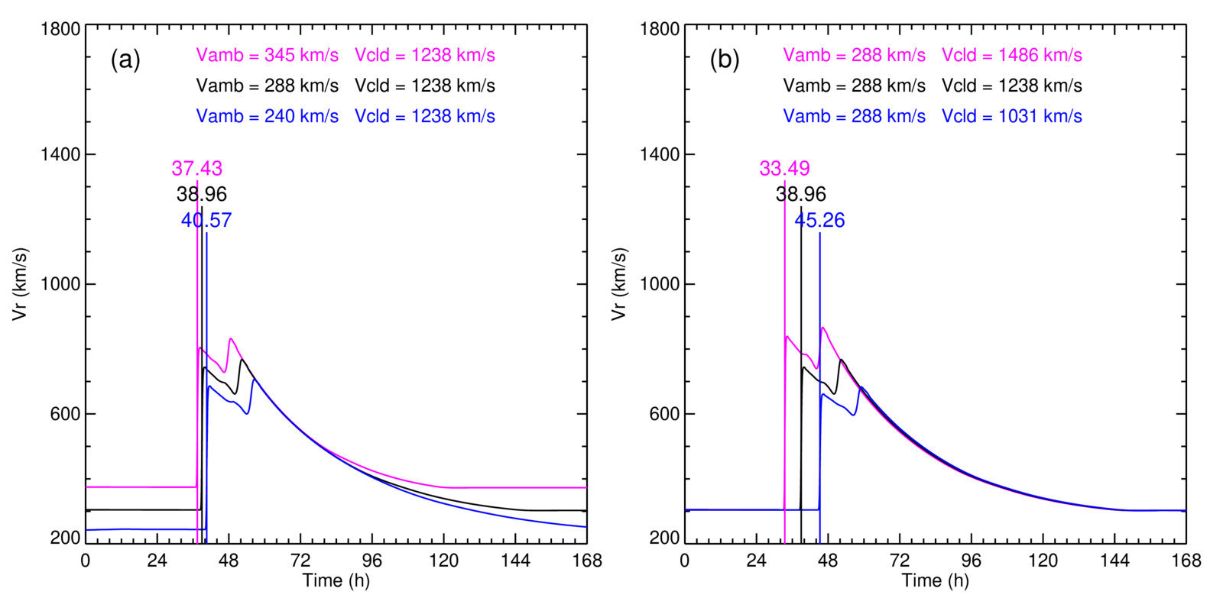
2021-10-28 CME Prediction by NOAA/SWPC
Importance of the BSW and CME Speed — Variation by 20%
Evolution of the radial velocity at Earth for a fast CME propagating in three different backgrounds (b) and three fast CMEs propagating in the same background. Parameters and ToA values are indicated by different colors.

Slide 10
2021-10-28 CME Prediction by NOAA/SWPC
Detection of the CME Leading Edge

Slide 11
CMEs in July 2012. — Tracing Possible SEP Contribution

Slide 12
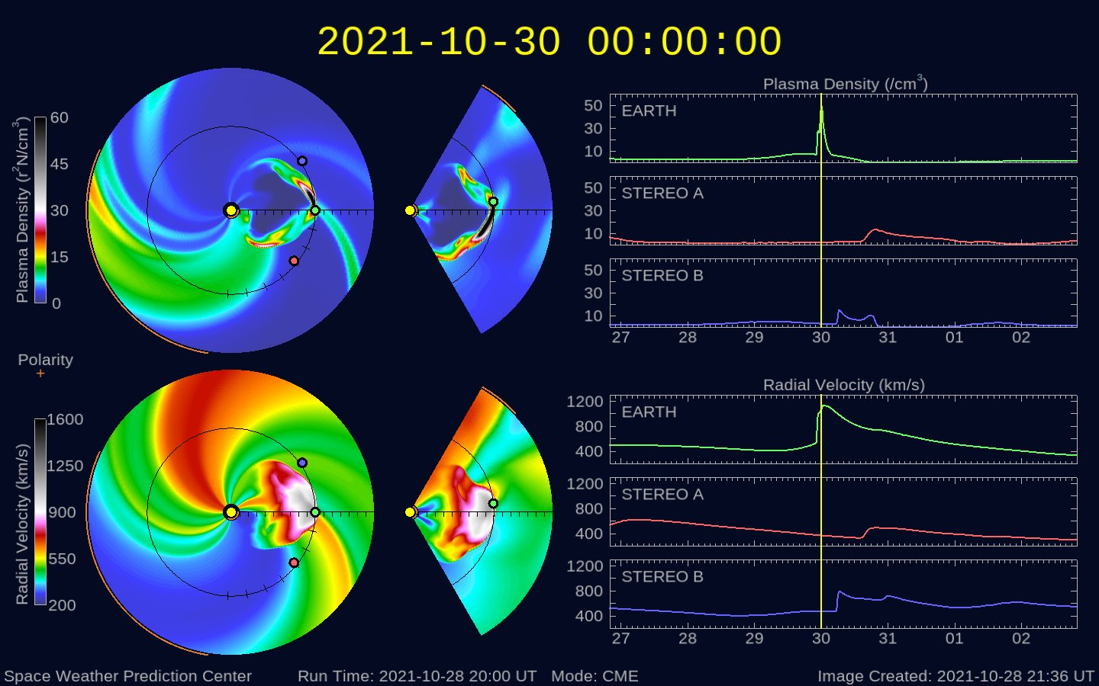
2021-10-28 CME Prediction by NOAA/SWPC
2021-10-28 CME Prediction by NOAA/SWPC
Huge difference in the predicted arrival time: -32.28 h

Slide 13
Predicted Solar Wind Density (left) and Total White-Light Brightness (right)

Slide 14
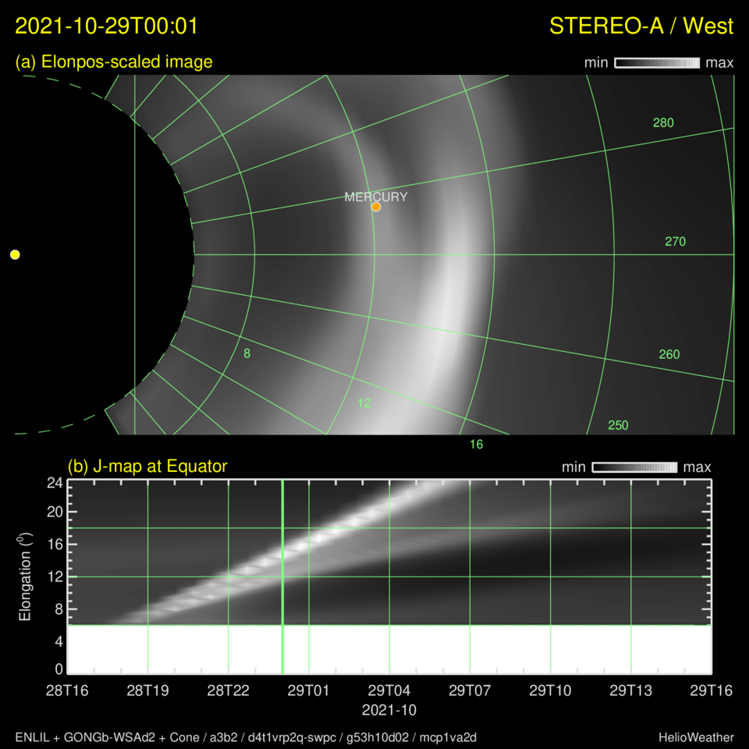
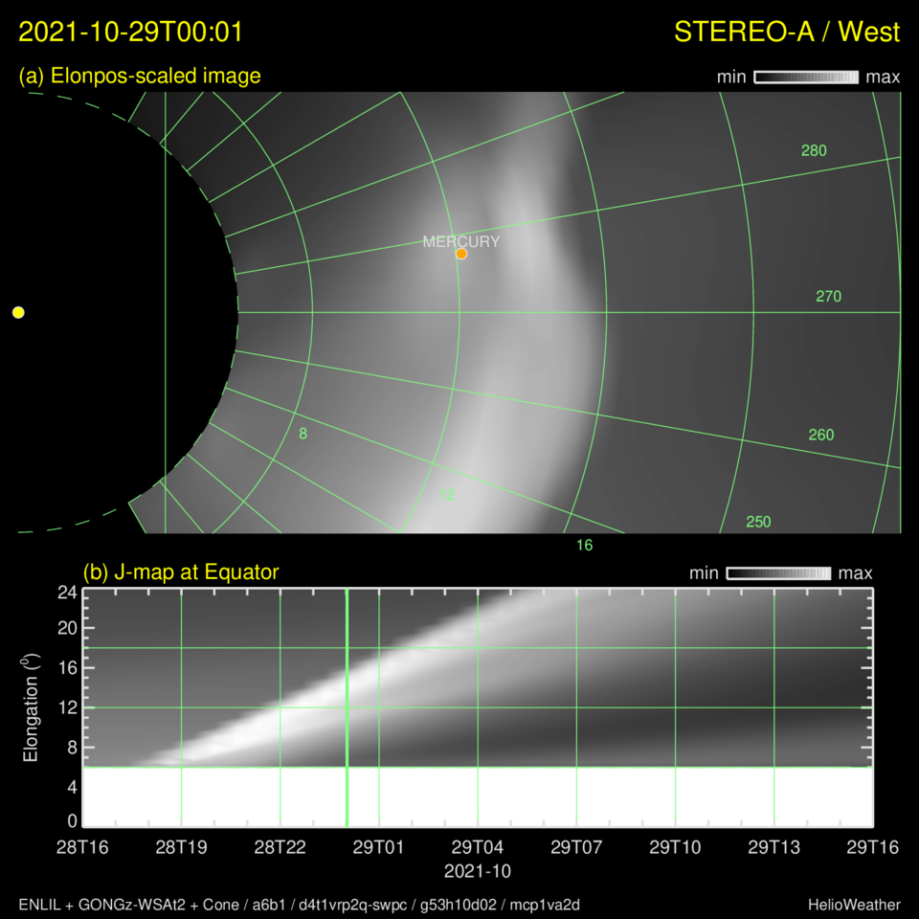
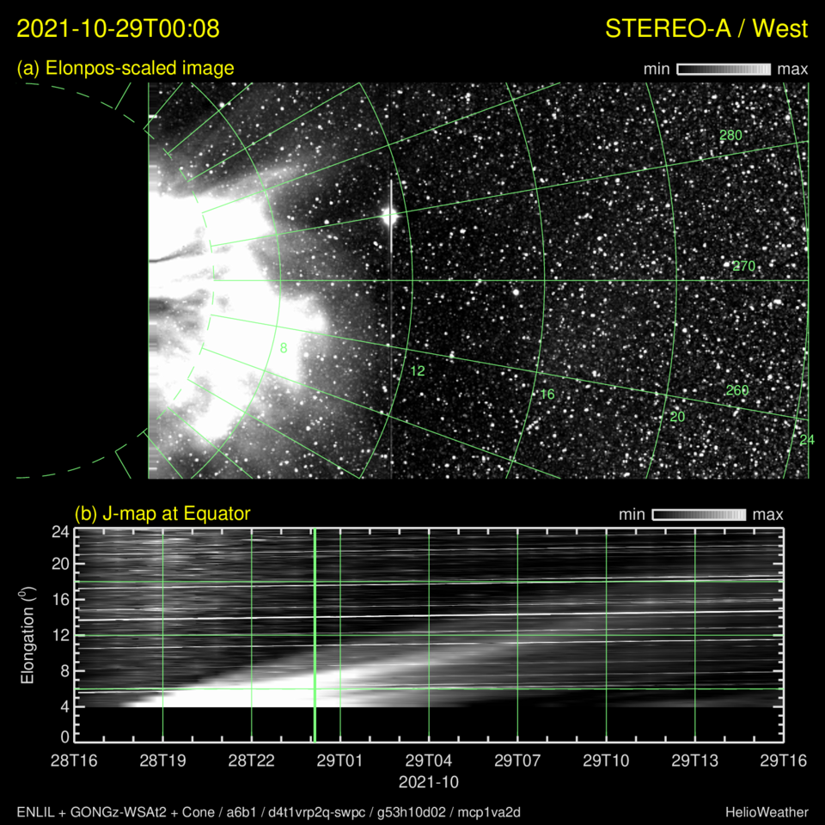
Prediction vs Observation — White-Light Images & J-Maps
Run: d22b-a3b2-swpc
Run: t22z-a6b1-swpc
Observation: HI-1A
J-maps (time-elongation) plots at positional angle (PA) can track CME-driven disturbances
Interactions with a background streams can distorted CME-driven disturbances
Additional J-maps with PA above and below the Sun-Earth direction might be needed

Slide 15
E N D

