Slide 1
WSA in Research
Jamie Staeben
June 7th, 2022, CCMC Workshop
Nick Arge, Shaela Jones
NASA GSFC Code 671

Slide 2
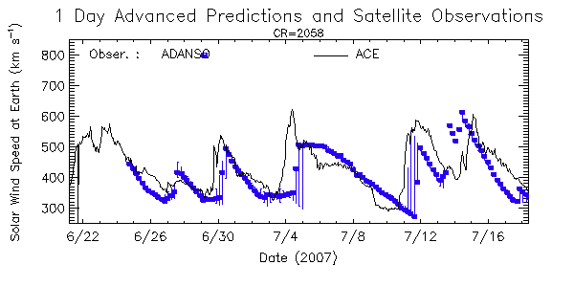
Wang-Sheeley-Arge (WSA) Model
Uses photospheric field maps as input, different input maps yield different coronal solutions and solar wind predictions
WSA can run many input maps quickly producing a large quantity of predictions
Questions: how can we determine which predictions are best and how can we quantify their performance?
Coronal Model Solutions overlaid on input map
Solar Wind Predictions

Slide 3
WSA Predictive Metric (WSA-PM)
Calculates a numerical score value to assign to individual predictions
Ranks different predictions to determine the best input maps to be used for forecasting
Calculate skill scores to quantitatively evaluate model performance against baseline forecasting models
WSA-PM Formula accounts for accuracy of both velocity and IMF polarity predictions
P(t): IMF polarity
V(t): Solar wind velocity
N: Number of elements in window

Slide 4
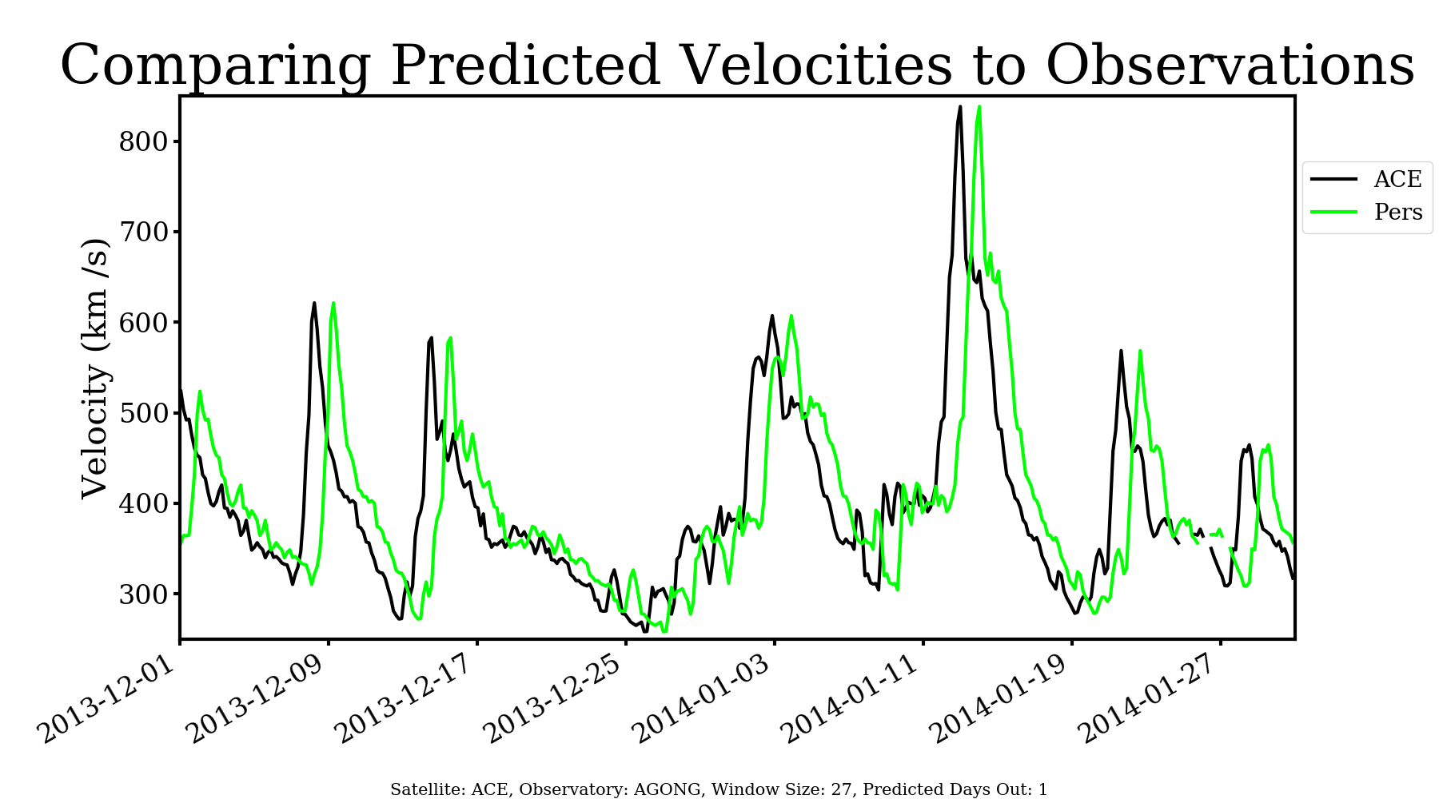
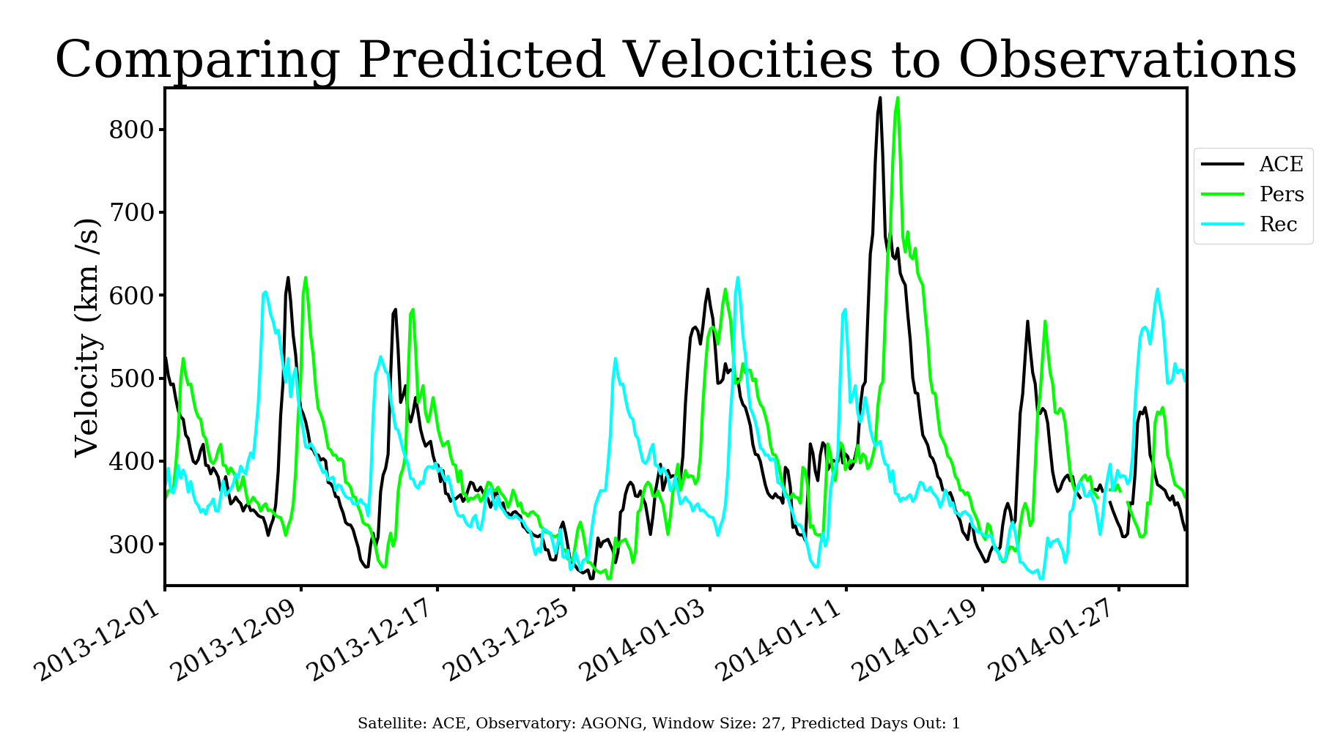
Skill Scores and Baseline Models
Persistence: predictions for the future are based on observations today
Recurrence: predictions are based on one Carrington Rotation (~27 days) in the past
Notes:
We have to flip the wpm baseline and realization compared to standard skill formula because for WSAPM the BIGGER the BETTER

Slide 5
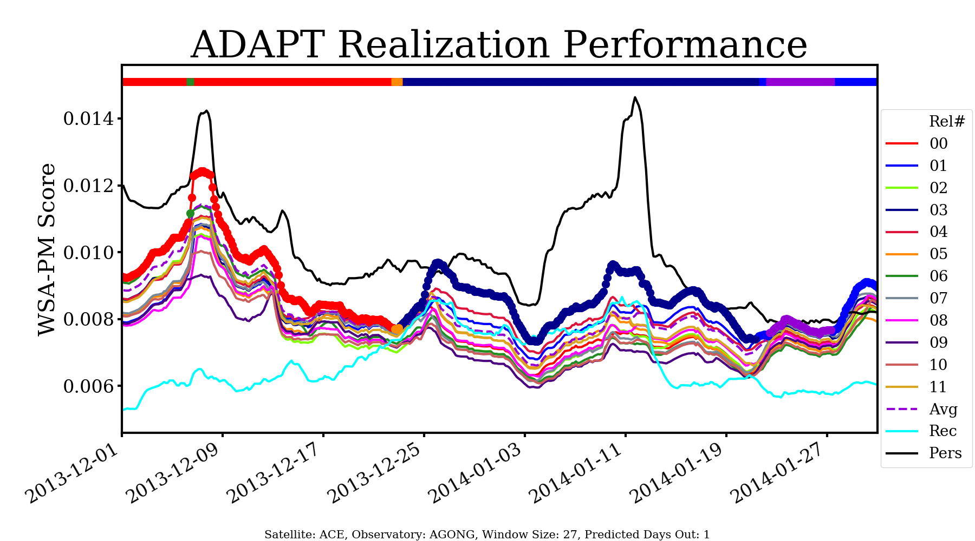
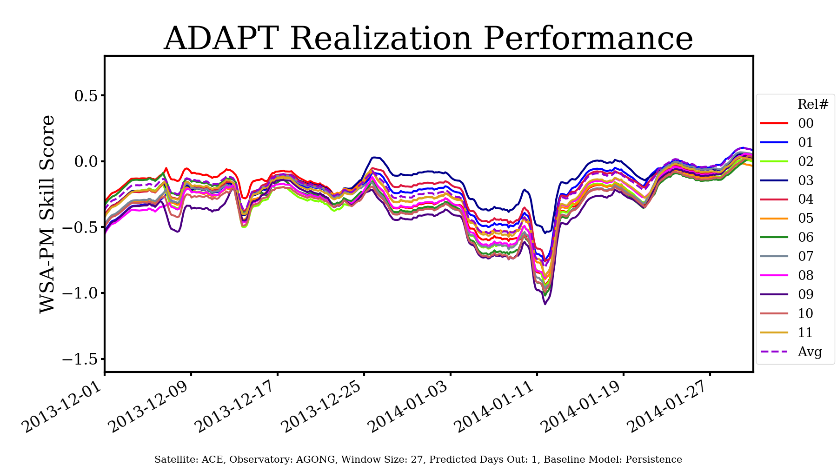
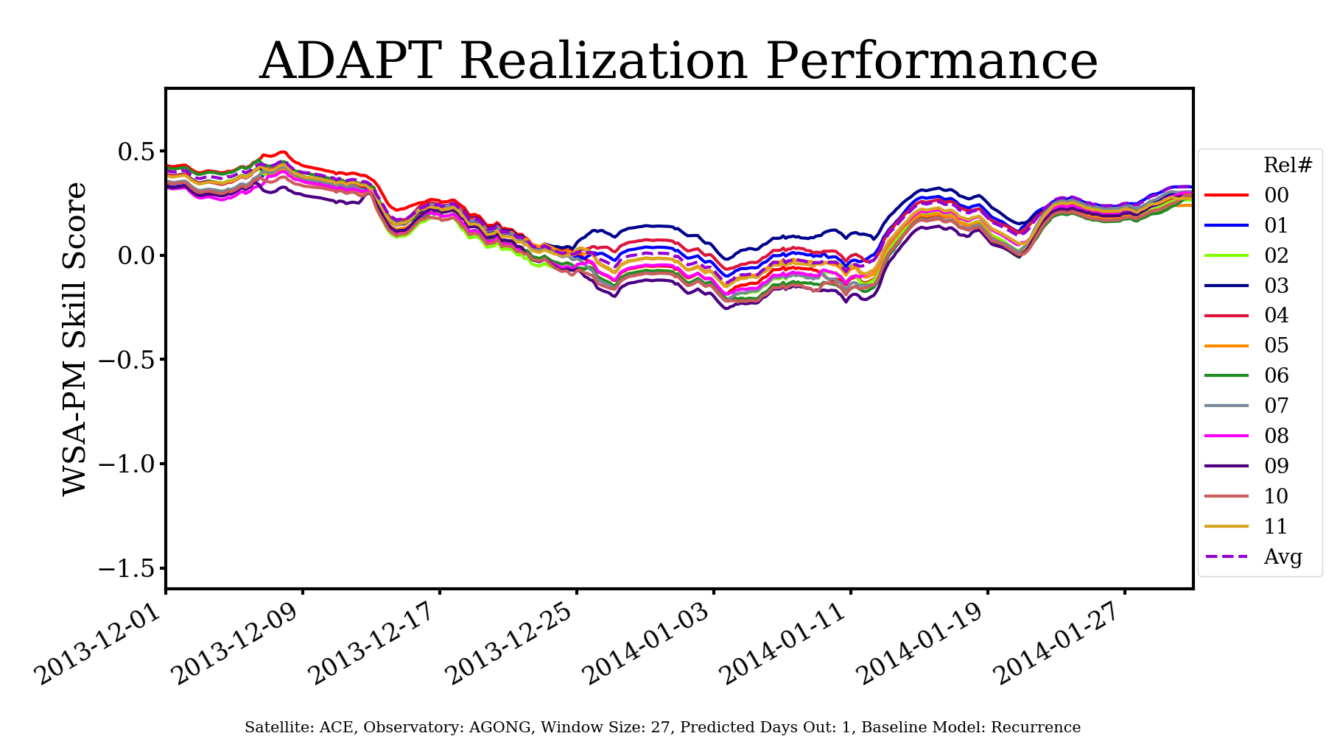
ADAPT Input Maps
WSA-PM score plot
WSA utilizes the Air Force Data Assimilative Photospheric Flux Transport (ADAPT) model input maps to create more realistic distributions of the far side of the sun
Using ADAPT, 12 realizations are produced when running WSA
WSA-PM skill plot using persistence as baseline
WSA-PM skill plot using recurrence as baseline
WSA-PM can determine the best performing realization, and thus which input map to use for forecasting

Slide 6
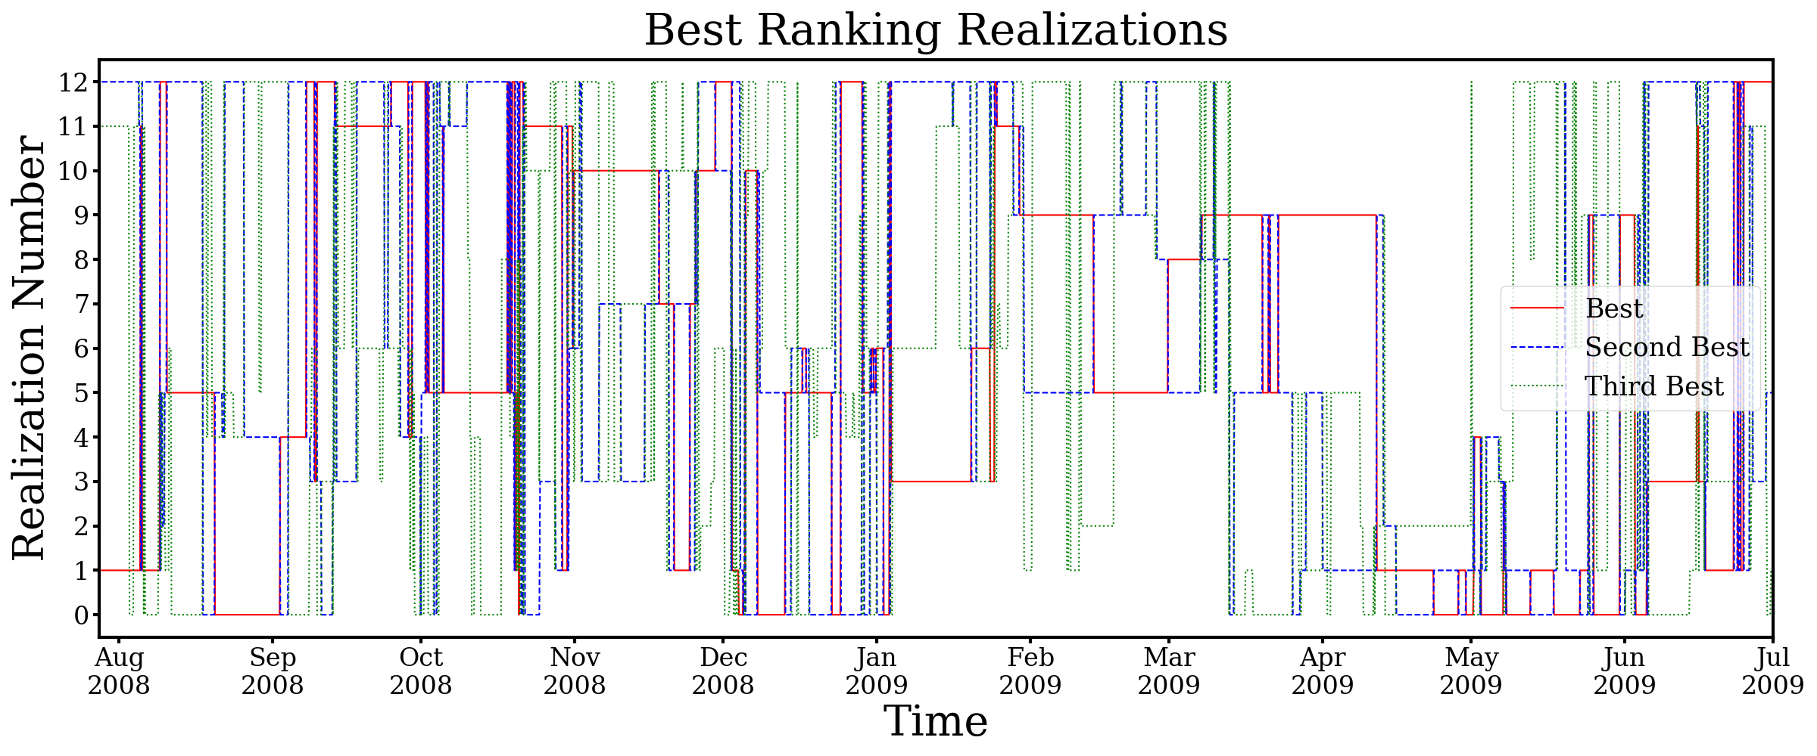
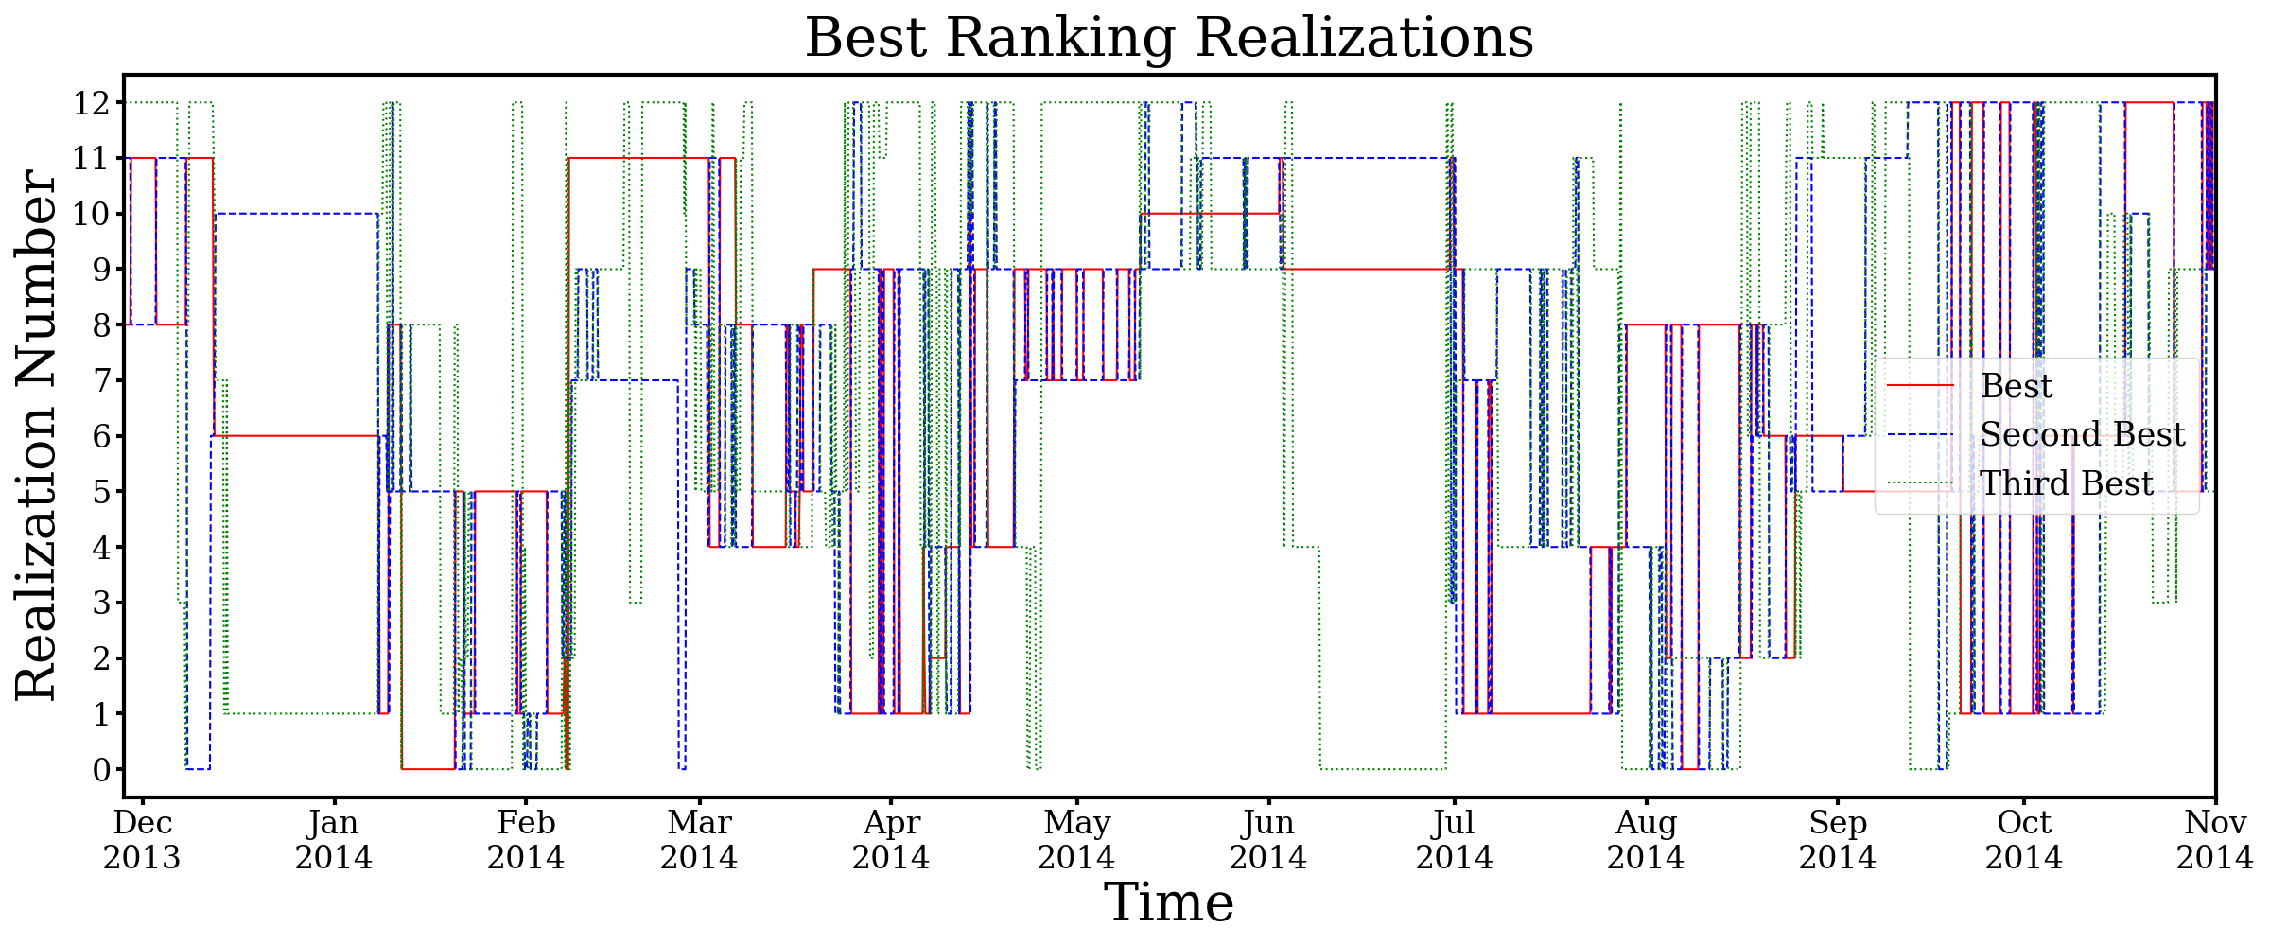
WSA Consistency and the Solar cycle
Solar Minimum
11-year solar cycle set of WSA predictions from 12/2008-12/2019
Goal: Measure consistency of WSA ADAPT realization performance during minimum and maximum
Solar Minimum (07/2008-07/2009)
Solar Maximum (11/2013-11/2014)
Solar Maximum

Slide 7
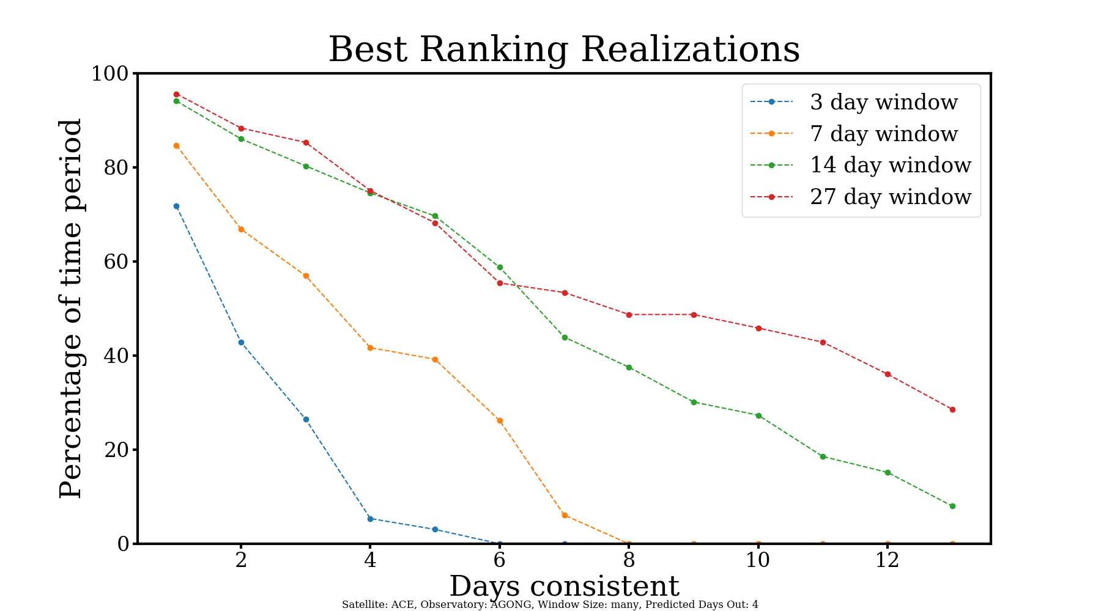
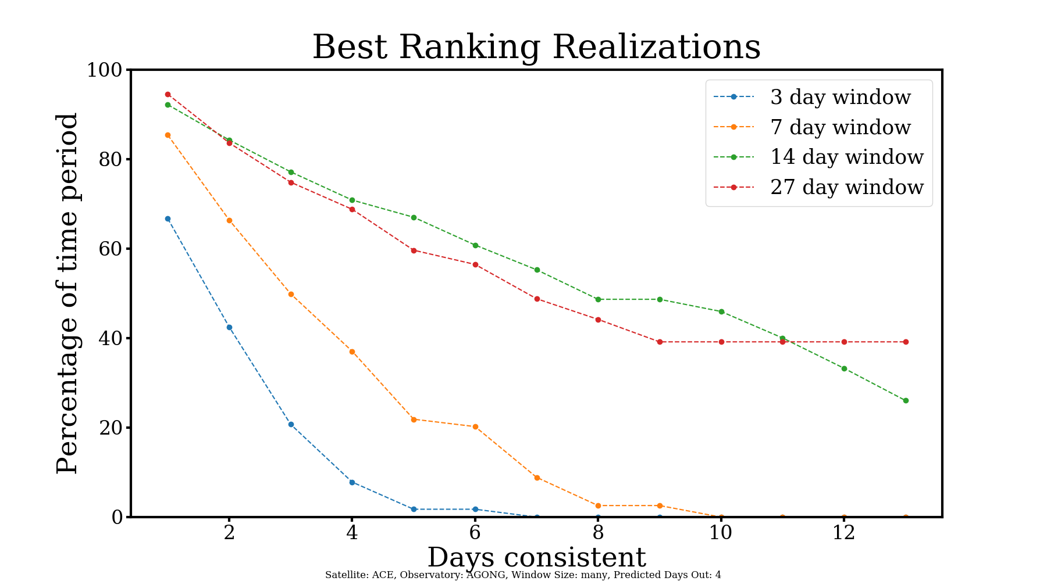
Consistency Results
Solar Minimum (11/2013-11/2014)
27 day WSA-PM window
# days best realization stays on average | 3 day advance prediction | 4 day advance prediction | 5 day advance prediction | 3-5 day advanced predictions averaged
Solar Min: | 5.15 | 3.95 | 4.08 | 4.39
Solar Max: | 4.48 | 3.54 | 5.02 | 4.35
Solar Maximum (07/2008-07/2009)
Method: Percentage of the time period the best realization has been or will continue to be the best for x number of days

Slide 8
Summary Results
For 4-day advance predictions using a 27 day WSA-PM window size
Solar Minimum | Solar Maximum
53.41% | 48.81%
74.36% | 80.08%
64.84% | 72.77%
Best realization has been or will be the best for at least 7 days or more:
At any given moment, the best realization is still in the top 3 best realizations 7 days later
At any given moment, the best realization was still in the top three best realizations for 7 consecutive days later

Slide 9
Conclusions
During both minimum and maximum, best realization stayed consistent for one week ~50-80% of the time, depending on analysis method
Overall, there were not significant differences between maximum and minimum
Future Work:
Analyze other parts of the solar cycle, such as declining phase
Analyzing velocity and IMF polarity predictions separately
Test these results in practice by running WSA-PM on a set of predictions that switches based on the best realization

