Slide 1
Wang-Sheeley-Arge (WSA)
Model
CCMC 2022 Workshop
College Park, Maryland
June 7, 2022
C. Nick Arge & WSA Team
NASA, Goddard Space Flight Center, Greenbelt, MD, USA

Slide 2
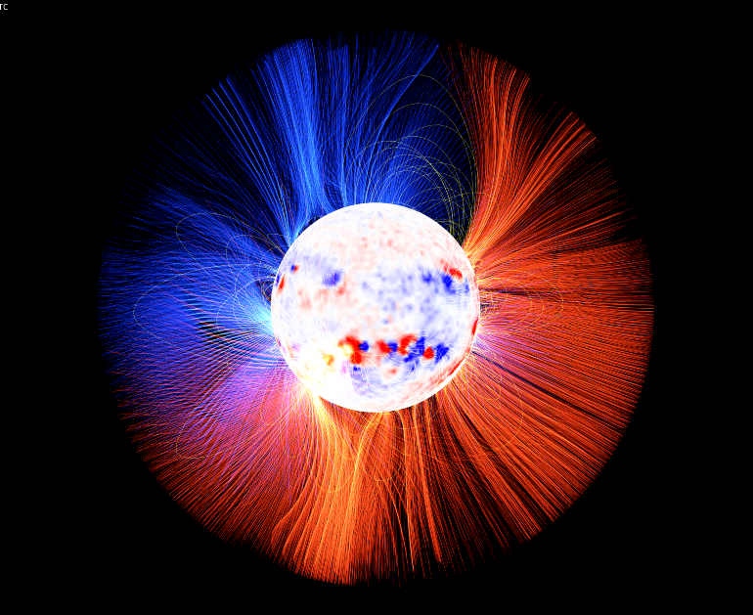
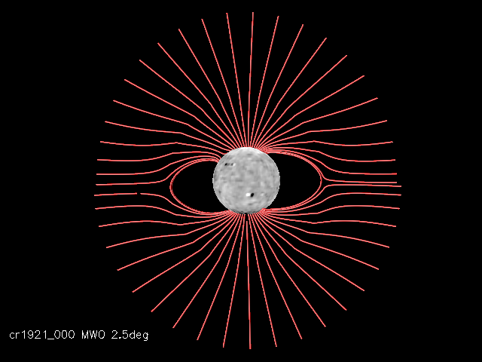
WSA Model Overview
WSA Model
Combined empirical and physics-based model of the corona and solar wind.
Input: ground/space based magnetic field maps
Output: WSA model provides:
Coronal magnetic field
Solar wind (SW) speed & IMF polarity
Sun-spacecraft magnetic field connectivity
Inner B.C. for advanced MHD SW models
Enlil, MS-FLUKSS, Gamera, EUHFORIA
Research Applications
Coronal and solar wind studies
Supports NASA mission & community research objectives and needs
Supports operational forecasting needs
(Image courtesy A.Kollberg & S. Nikkilä)
Source Surface
Schatten Current Sheet Model
Solar Wind Model
PFSS Model
Outer model boundary
Source Surface
Notes:
Insert figure showing WSA wind predictions

Slide 3
WSA Team and Collaborators
Civil Servants:
C. Nick Arge - 671
David Simpson - 587
Contractors/Post Docs
Shaela Jones – 671/CUA
Daniel da Silva * – 671/UMBC
Michael Kirk – 671/ASTRA(now CS)
Marta Casti – 671/CUA
Samantha Wallace – 671/USRA
Students
Jamie Staeben* – ADNET/Univ. of VA.
Sarah Kovac - NMSU
Andrew Leisner – GMU
Chris Rura – CUA
Jaime Landeros* – ADNET/Cal. Poly Pomona
Summer Interns
External Collaborators
NOAA/SWPC
AFRL/USSF
University of Michigan
New Mexico State University
Predictive Science Inc. (PSI)
University of Alabama
HAO
APL
UC Berkeley
Many others!
* Presenting

Slide 4
WSA Software Development Strategy
Plan
Build
Release
Operate
Using contemporary software development strategies to ensure delivery of a quality WSA model.
Continuous Integration
Continuous Delivery
Code
Test
Deploy
WSA v5.3
WSA v5.3
Asynchronous, continuous development of the WSA model to deliver both research and operational products to the heliophysics community.
Able to control the scientific quality of WSA, while at the same time allowing a broad group of researchers, students, and postdocs to contribute.
Notes:
Using contemporary software dev standards that industry has been using for the last 15 years.
We’re doing things one step more – in scientific software….stop at continuous integration ….we have a come up with a deployment strategy via docker
Make plan
Then do code building testing
Constantly updating and improving the code
Continuous delivery service
can hand them a container using docker containers
get to a new release version
asynchronous – big changes while at the same time updating little/small things
One person doesn’t need to know about development of other routines that were incorporated
Docker – nice way to just use WSA not have to develop it.

Slide 5
Mission & Operational Support
CCMC
Forecasts in support of NASA mission needs (since ~2005)
Train students and forecasting staff on model
NASA Spacecraft missions such as PSP and SolO
Predicts magnetic connectivity of spacecraft with solar source
SolO needs advanced forecasts to support its observing campaigns
SRAG
Improve forecasts of space radiation risk
Sun-spacecraft magnetic connectivity forecast tool
NOAA/SWPC, UK Met office, & Korean Space Weather Center (KSWC)
Forecasts in support of civil forecast needs
Coordinate with forecasters to support their operational needs
WSA being upgraded from v2.2 to v5.3 in 2022
Recently brief NOAA/SWPC forecasters on model improvements/new forecast tools
USAF-557th Weather Wing & USSF
Used in support DoD research and development forecasting needs
See Daniel da Silva’s presentation

Slide 6
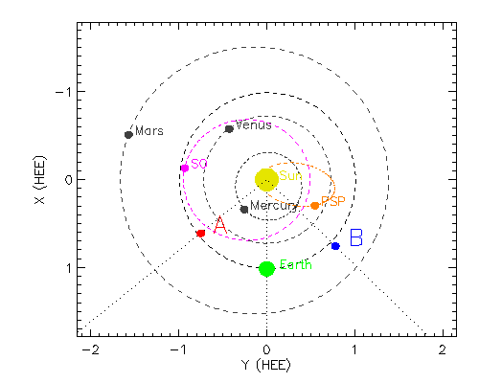
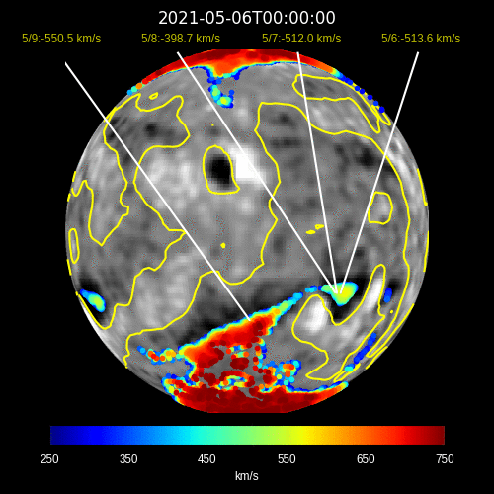
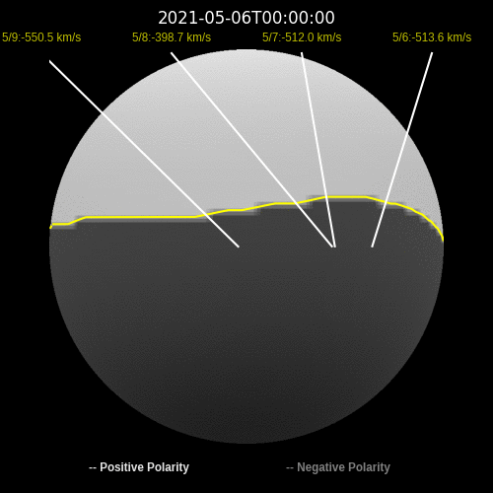
WSA Simulations for Solar Orbiter
May 2021
WSA Predictions at SolO Earth May 2021
Satellite Locations May 2021
Predicted SW speed & IMF polarity at SolO + Coronal holes
Coronal Field at 5Rs +
SW connectivity
SO
Sun
PSP
Earth
Solar Orbiter needs predictions several days in advance of the spacecraft-Sun magnetic connectivity to support their remote sensing campaigns.

Slide 7
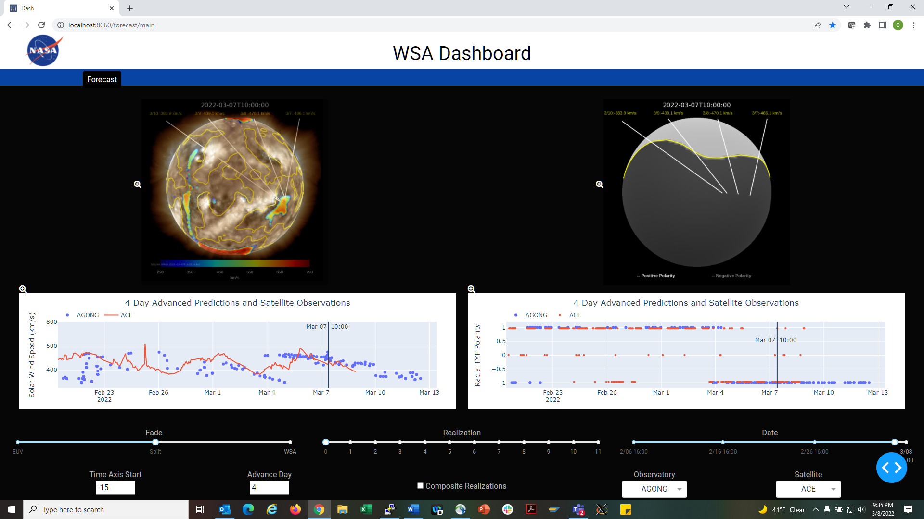
WSA Dashboard
Forecast tool that summarizes WSA coronal and solar wind predictions.
Predicted SW speed at spacecraft
Sources of SW
WSA corona hole solution vs EUV observations.
Predicted magnetic connectivity relative to heliospheric current sheet.
See Jaime Landeros’ presentation
CCMC is onboarding it to serve the community
To be evaluated by NOAA/SWPC forecasters

Slide 8
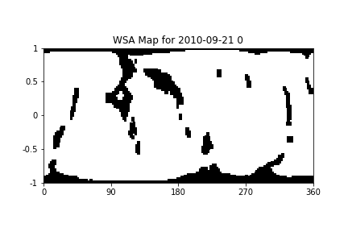
Research Support
CCMC
code available for runs on demands (~1100 WSA+Enlil run requests in 2019-2021)
WSA Team supports
numerous specialized research run requests & model development efforts
development of quantitative & objective methods for
ranking magnetic field input maps & evaluating model predictive performance
National/International research efforts
LWS, SWQU, AFOSR
ISFM
ISSI
General community research support
20 WSA related AGU abstracts (2021)! (>20/year since 2019)!
13 journal papers (2021)! (about 10 per/year since 2019)
Supports student/postdoctoral research and career development
See Jamie Staeben’s presentation
WSA coronal holes provided for ISIS team effort.

Slide 9
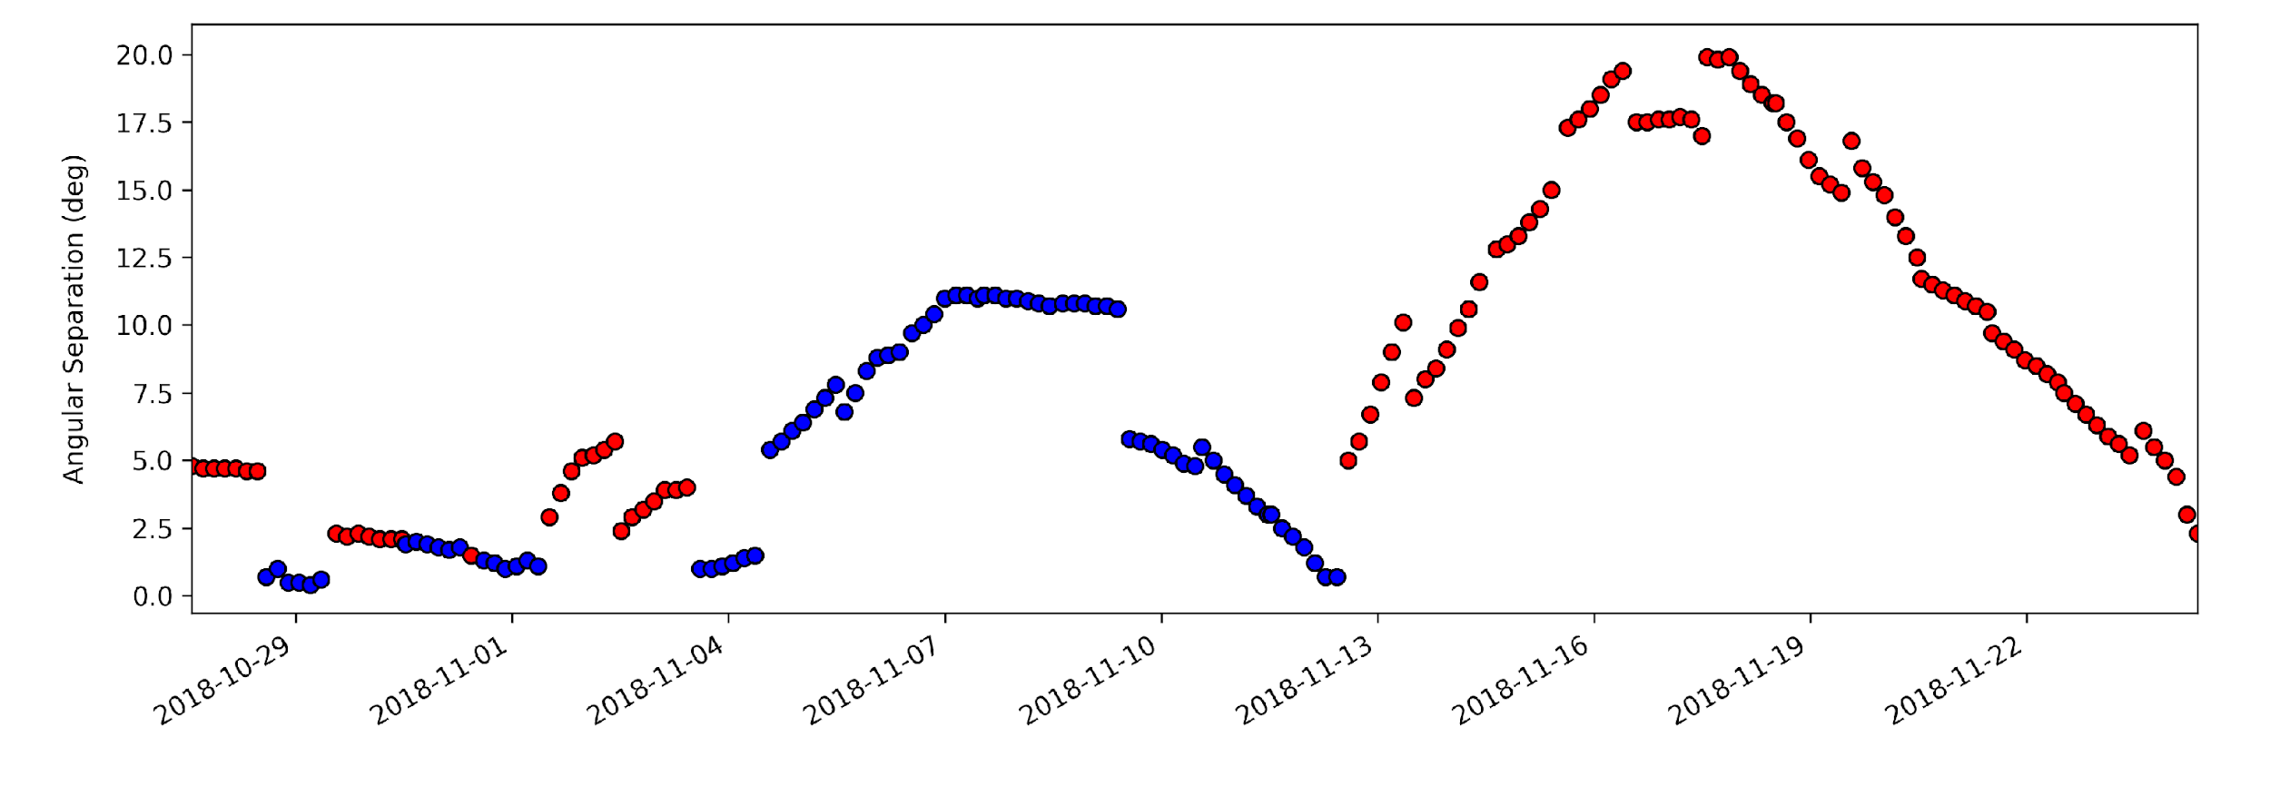
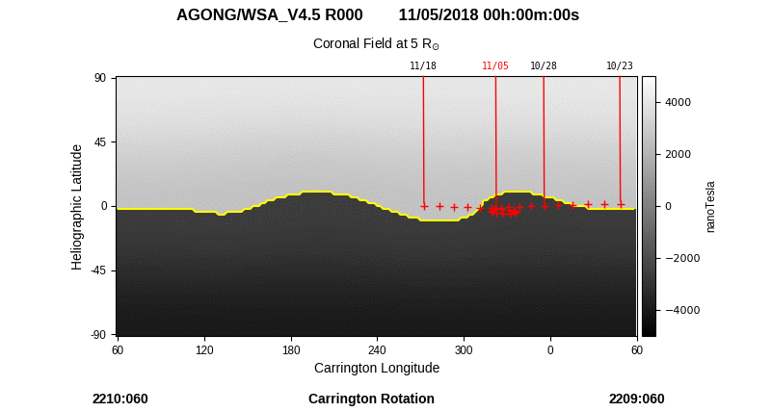
Modeling the First Two Parker Solar Probe Encounters With ADAPT-WSA
New WSA Data Product
Minimum Angular Separation From Heliospheric Current Sheet
Sources of solar wind – PSP Encounter 1
Inward (-)
Outward (+)
Degrees
Heliographic Latitude
inbound
co-rotation
outbound
Global Coronal Field for 11/05/2018
Outward (+)
WSA used to support PSP science
Provided magnetic connectivity of PSP with its solar sources
Allowed interpretation of PSP solar wind observations
Heliographic Latitude
Inward (-)
Carrington Longitude
NASA NPP Scientist: Wallace et al., 2022, accepted
Notes:
LEFT: WSA derived coronal holes and spacecraft connectivity to the solar surface for perihelion of Encounter 1, November 5, 2018.

Slide 10
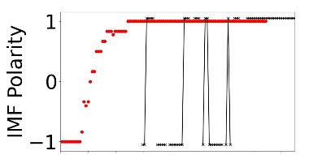
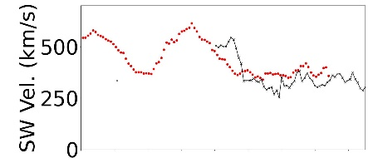
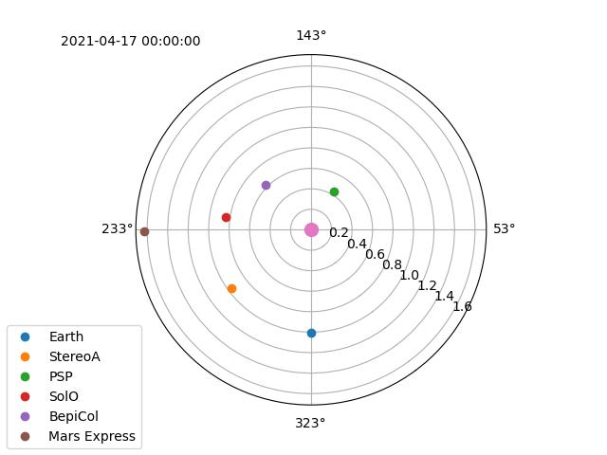
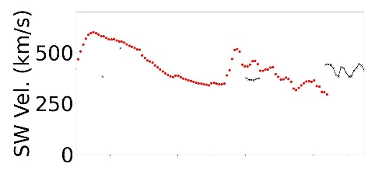
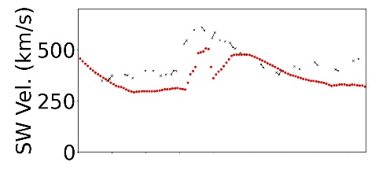
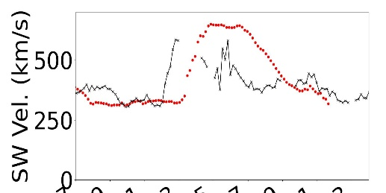
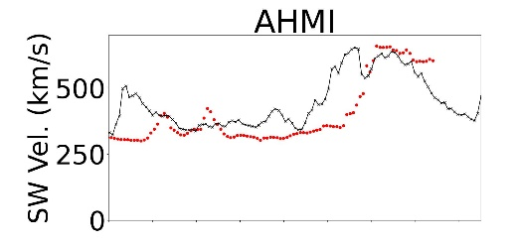
Magnetic Connectivity for the 19 April 2021 SEP Event
International collaborative effort to study this event
WSA Team to select best possible coronal model to drive Enlil
used in situ satellite data
Uniquely wide-spread satellite distribution allowed team to probe global performance of model.
How to determine best overall global fit? Working on developing global metric.
BepiColombo
PSP
SolO
Bepi-Colombo
SolO
PSP
Mars Express
Mars
STEREO-A
Earth
STEREO-A
ACE
Shaela Jones leading effort

Slide 11
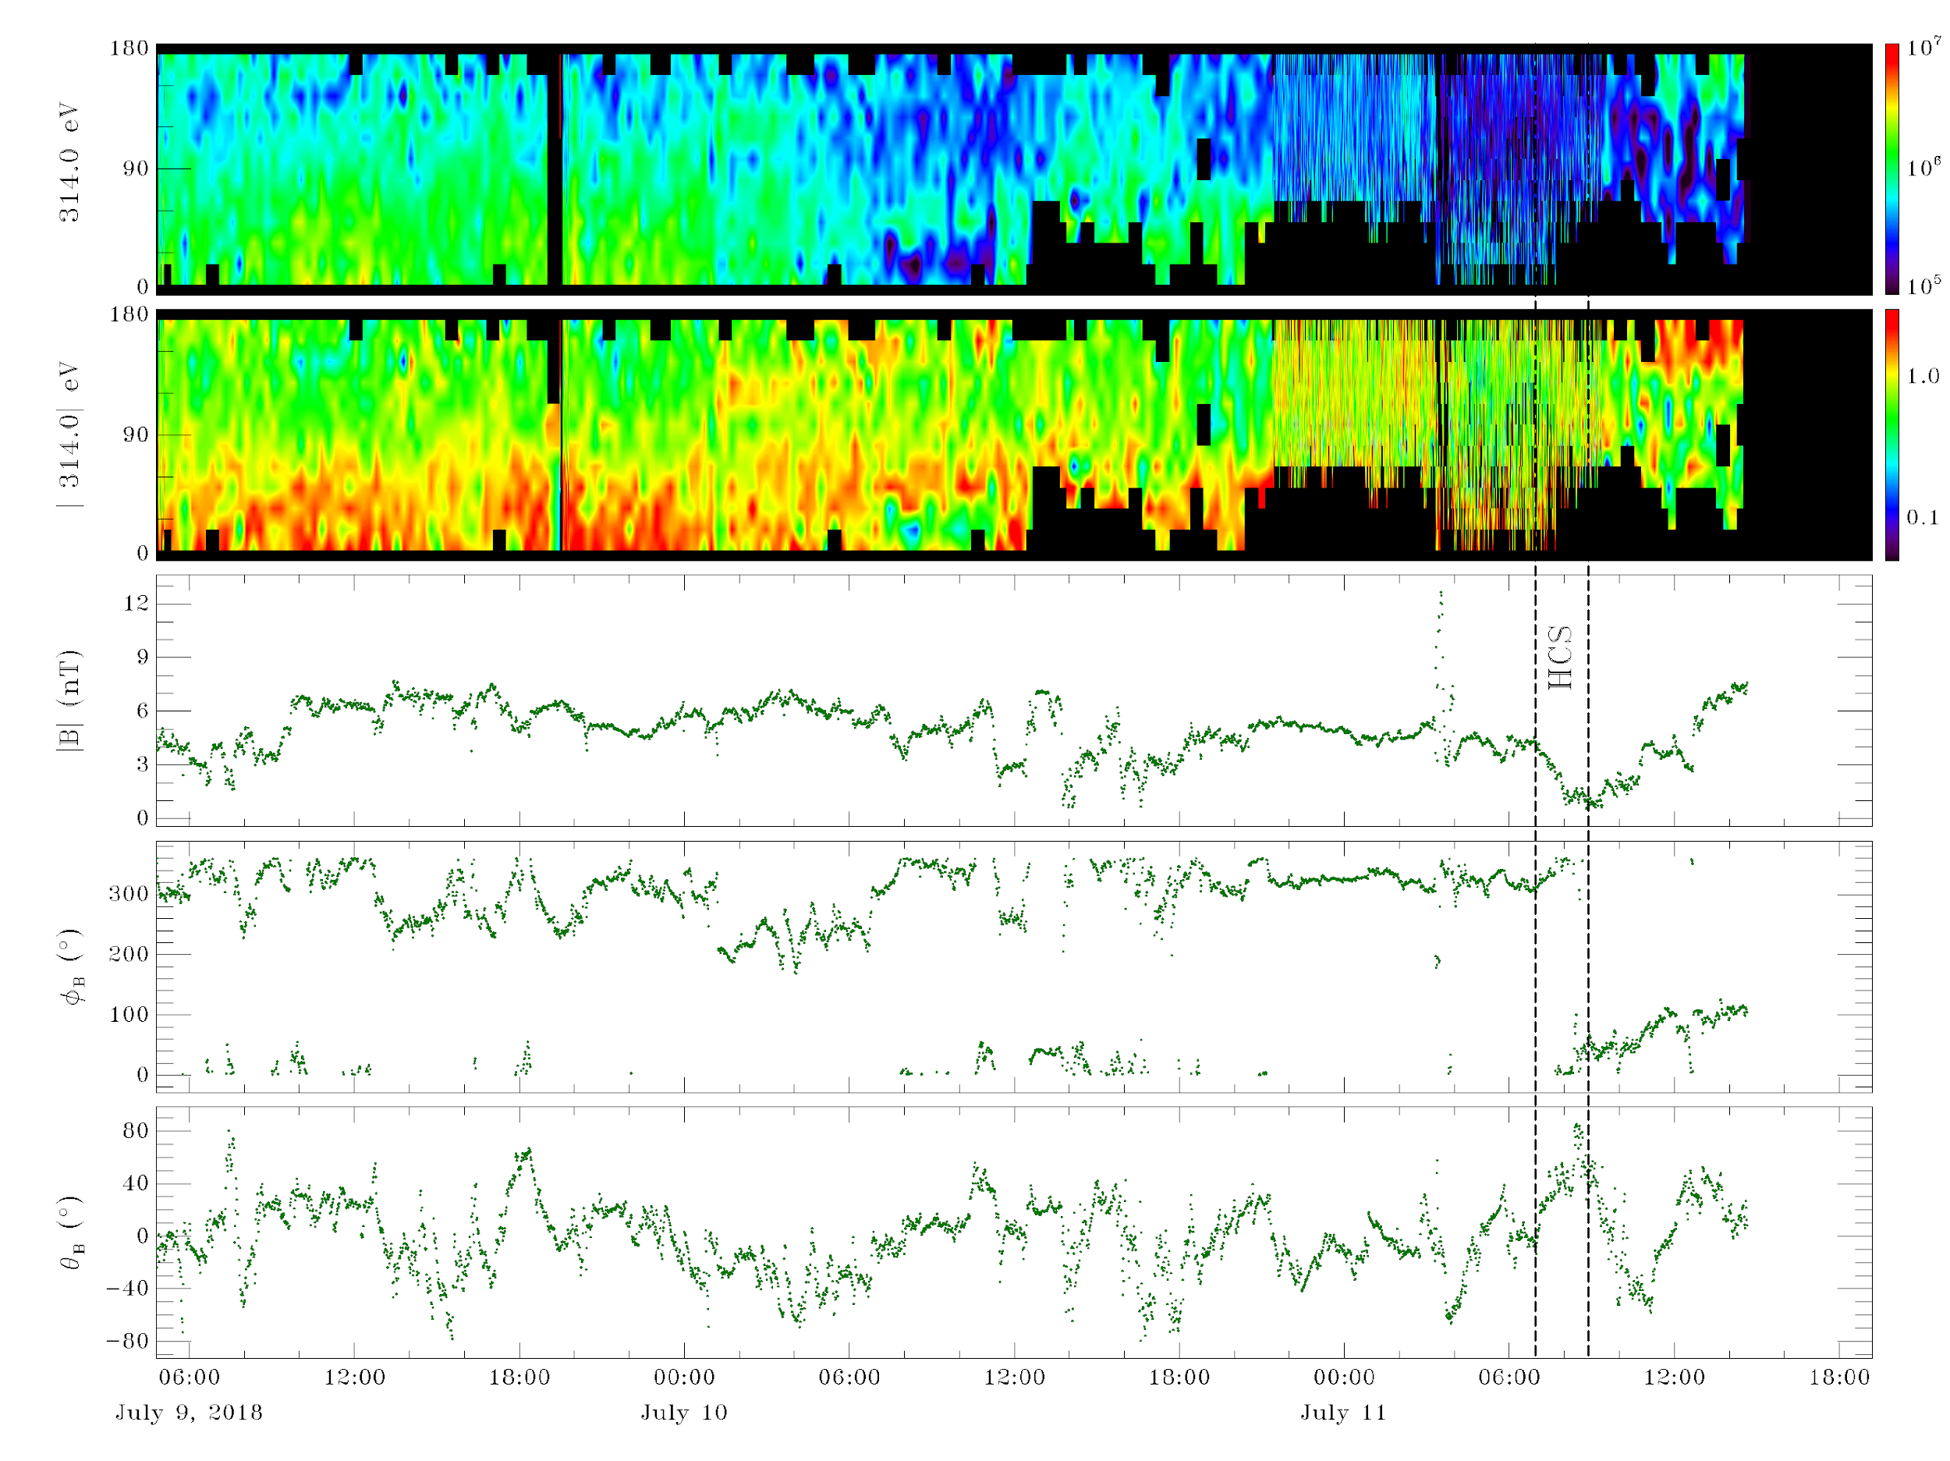
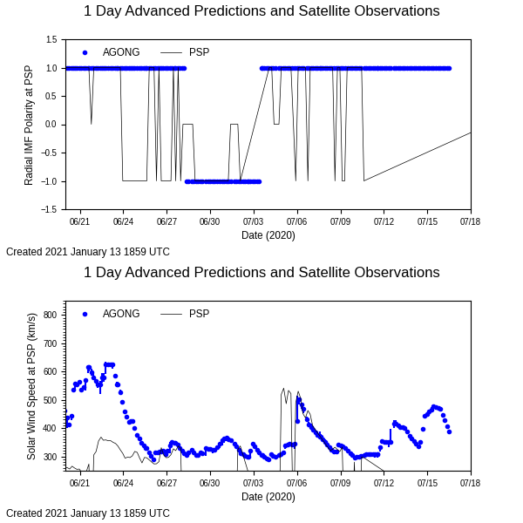
Using WSA to Support Observations of Venusian Aurorae
S. Kovac, C. Gray, C. N. Arge, N. Chanover, J. McAteer, C. Churchill, M. E. Hill, A. Szabo
PSP VGA 3 Observations (Kovac et al, 2022, ApJ)
Terrestrial Emission
Venusian Emission
Heliospheric current sheet crossing
Observing Window
WSA used to provide context for the solar wind conditions during times of auroral Emission on Venus
This work has now been vastly expanded to previous Venusian observations
For every detection of emission, there is a heliospheric current sheet crossing
WSA helps to identify a new source of Venusian auroral emission!
(Sarah Kovac, PhD Dissertation, NMSU, 2022)

Slide 12
Summary
WSA is widely used by the heliosphysics community for both research and space weather forecasting purposes.
It is used
To support NASA missions or other NASA efforts/services such as the CCMC & SRAG.
To support national/international basic and applied research efforts.
As the key driver to multiple advanced MHD solar wind models.
Operationally at multiple national/international space weather agencies.
Available for runs on demand to the community!

