Slide 1
ADAPT
Carl J. Henney¹, Sam J. Schonfeld², Kathleen Shurkin¹, C. Nick Arge³, Shaela I. Jones^{3,4}
AFRL/Space Vehicles Directorate, KAFB, NM
ISR, Boston College, Chestnut Hill, MA
NASA Goddard Space Flight Center, Greenbelt, MD
Catholic University of America, Washington, DC

Slide 2
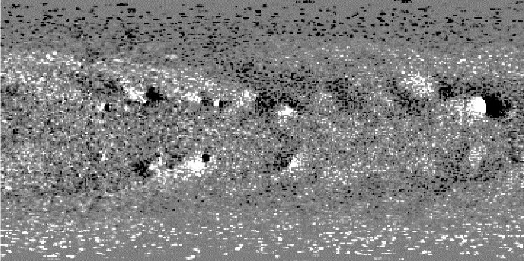
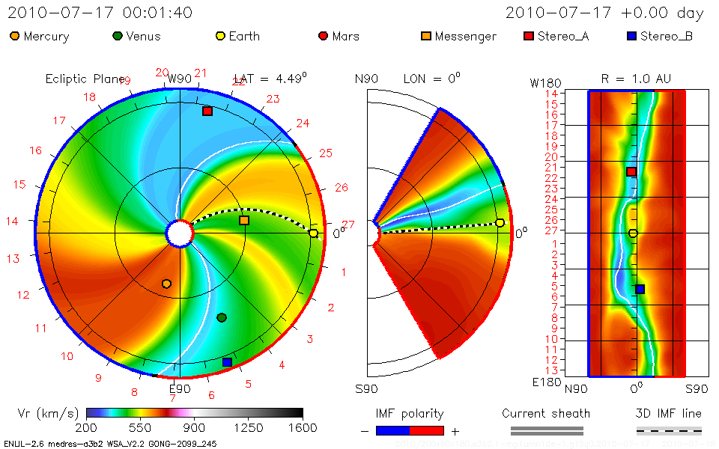
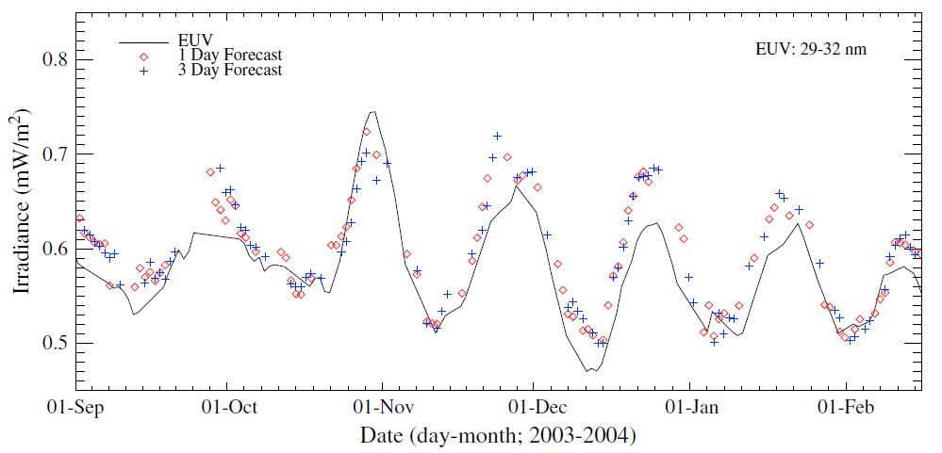
ADAPT Project Overview
ADAPT: Air Force Data Assimilative Photospheric Flux Transport
Start: 2007 with AFOSR funding
Original Goal: to generate synchronic global solar magnetic maps, by combining NSO’s Worden & Harvey magnetic flux transport with Los Alamos National Laboratory’s data assimilation framework, for input to coronal & solar wind models
Extended Capabilities: ADAPT maps now drive the SIFT (Solar Indices Forecasting Tool) model to forecast F_{10.7}, Mg II core to wing ratio, SSN (sunspot number), and bands of EUV/FUV irradiance 1 - 7 days in advance
R2O: CCMC & NOAA/SWPC study completed, see Mays et al. 2020, NASA/NOAA MOU Annex Final Report: Evaluating Model Advancements for Predicting CME Arrival Time, NASA/NOAA MOU Annex, 36 pp.
Near-future Activities: new AFOSR start in FY22 to investigate:
polar flux redistribution based on polar coronal hole obs
methods to assimilate data from SDO/HMI with SO/PHI
benefits of 24-hr mean (quasi-4D variational DA) global maps
WSA-Enlil
Arge & Odstrcil
EUV (29-32 nm)
Irradiance (mW/m²)

Slide 3
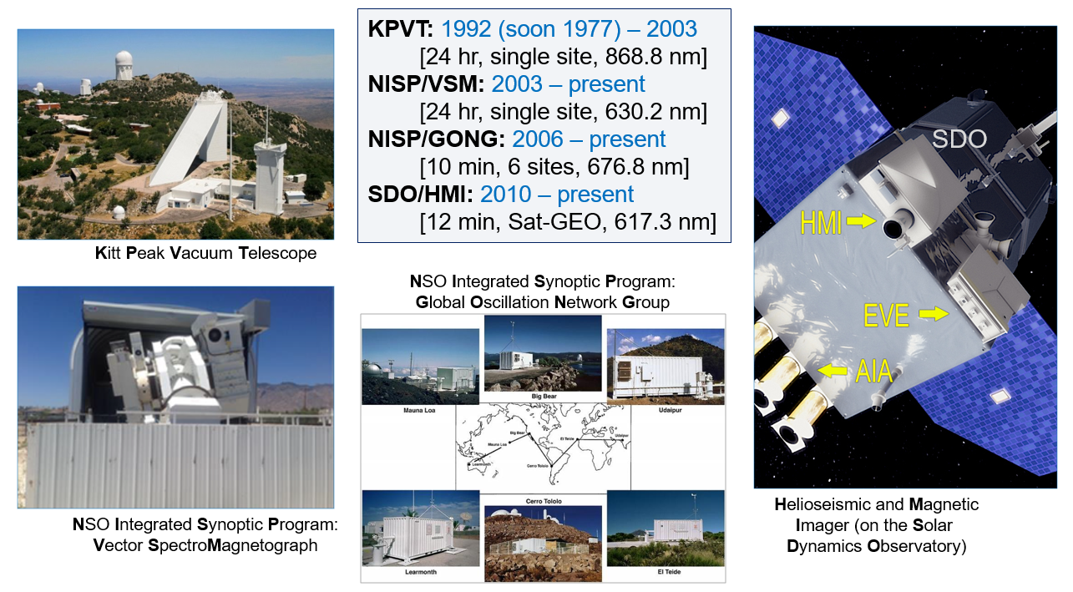
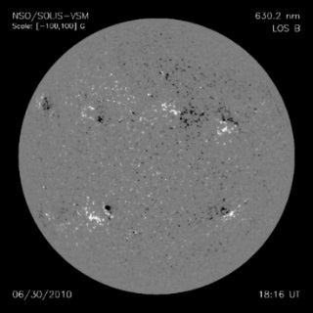
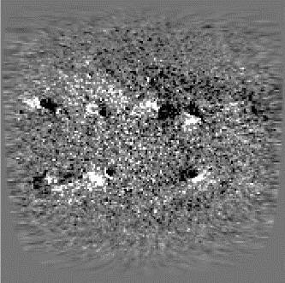
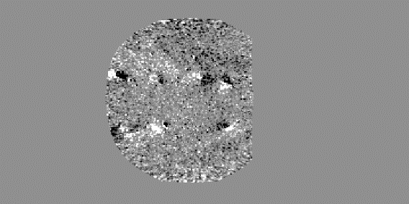
ADAPT Model: development modeling framework
Observed Input Sources
Sky frame at obs_time
Magnetogram data & uncertainty remapped into heliographic coordinates: longitude vs. latitude (180 x 180 deg)
Global Composite Input (GCI): aligns all B_{r} input data (far & near; e.g., SDO/HMI & SO/PHI) within model frame (i.e., 360x180; Carrington)
30 June 2010 NSO SOLIS/VSM
Observed polar data (i.e., above +/-70 deg) are not assimilated into the model ensemble
Model ensemble from previous time step
Model ensemble at obs_time
Ensemble currently includes 12 realizations
Forward Modeling
Differential Rotation
Meridional Circulation
Supergranulation
Data Assimilation using EnLS Method
Earlier (prototype framework) version running 24/7 at NSO

Slide 4
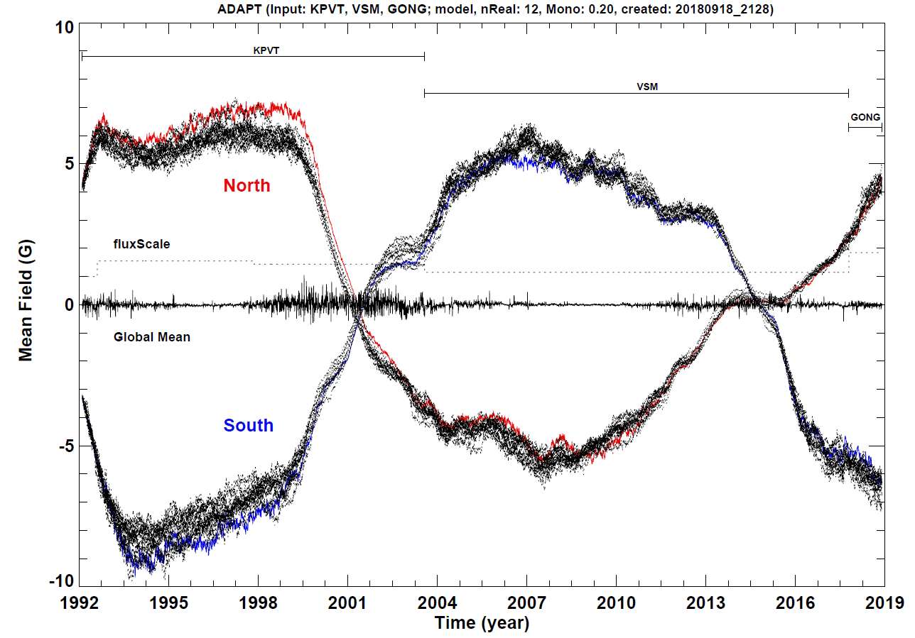
ADAPT Model Feedback: polar field
Mean for 70° to 90°
Note: initial “seed map” begins with the best estimates of the polar field strength, with no additional data for all future time steps.
Polar uncertainty driven by supergranulation

Slide 5
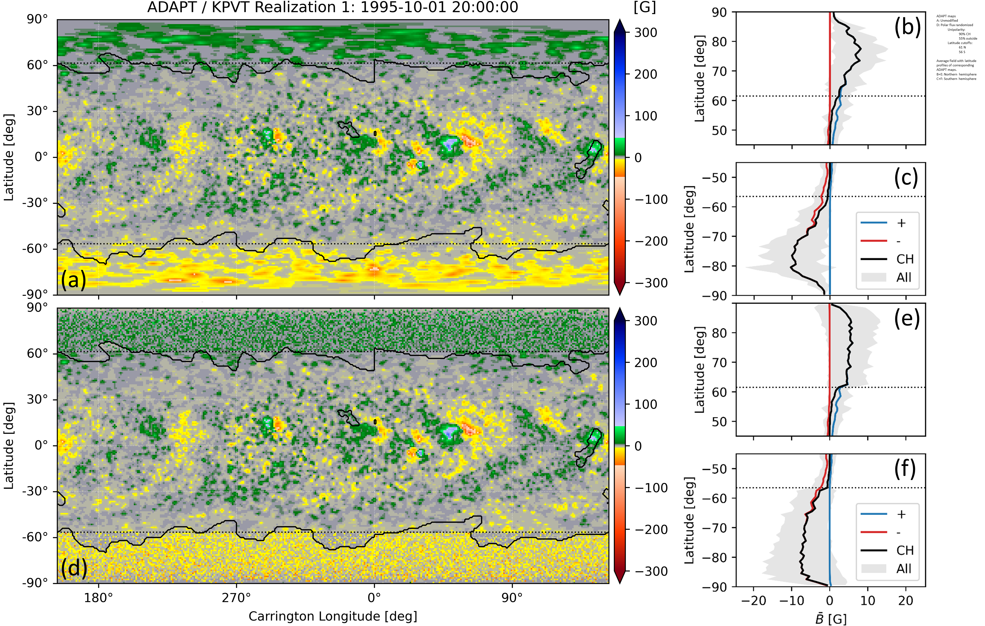
Polar Flux Redistribution based on Coronal Holes
Flux distribution in ADAPT maps above ~70 degrees driven by supergranulation (i.e., random walk)
Method conserves +/- polarities, net & total flux
defined unipolarity to be:
90% in CH
55% background
Method highlights from Schonfeld et al. 2022 include:
Modified polar fields improve model & obs CH agreement
Reduce ensemble variability
2x field strength beneficial
Modeled CH depend strongly on low latitude fields
Coronal hole boundaries from Harvey & Recely (2002).
See Schonfeld et al. 2022 , ApJ, in press (arXiv e-prints, arXiv:2204.13676)

Slide 6
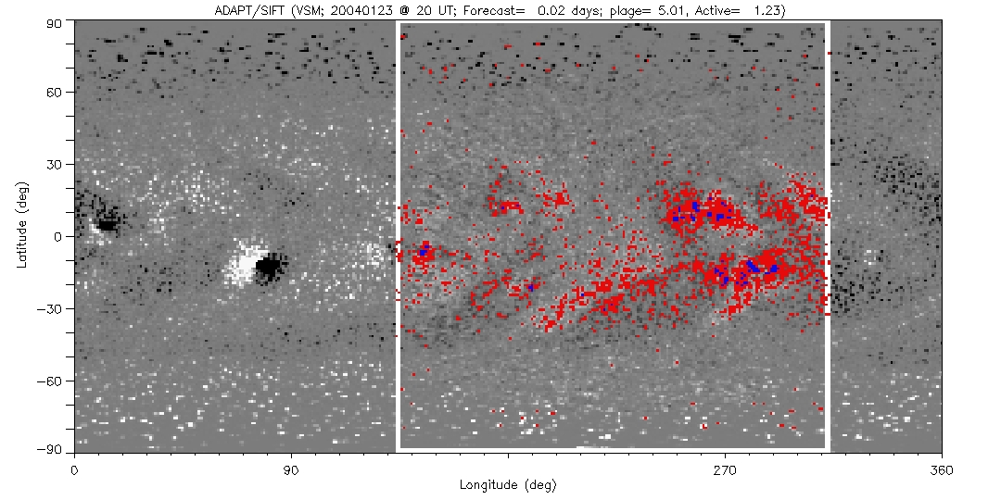
Extended Applications: F10.7, Mg II, EUV, & FUV
The SIFT (Solar Indices Forecasting Tool) F10.7 & VUV empirical models use the near-side magnetic field estimates from future ADAPT maps:
$F_{model}=m_{0}$ + $m_{1}S_{w}$ + $m_{2}$ $S_{s}$
+90
ADAPT Global Magnetic Map
where
$$S_{w}=\frac{1}{\sum{ω_{θ}}}\sum_{\text{2}\text{5}\text{G}< \left|{\text{B}}_{r}\right|}^{\left|{\text{B}}_{r}\right|<\text{150}\text{G}}{\left|{\text{B}}_{r}\right|ω_{θ}}$$
Latitude
Weak Field Sum
and
$$S_{s}=\frac{1}{\sum{ω_{θ}}}\sum_{\text{1}\text{50}\text{G} ≤ \left|{\text{B}}_{r}\right|}{\left|{\text{B}}_{r}\right|ω_{θ}}$$
-90
0
360
Strong Field Sum
Longitude
Area
Earth-side Window
Unsigned Radial Magnetic Field
Total Window Area
And, besides a Earth-side window, ADAPT/SIFT could also forecast EUV for Mars, Jupiter, or an other location.
For more on the F_{10.7} & VUV modeling, see: Henney et al. 2015, Space Weather, 13

Slide 7
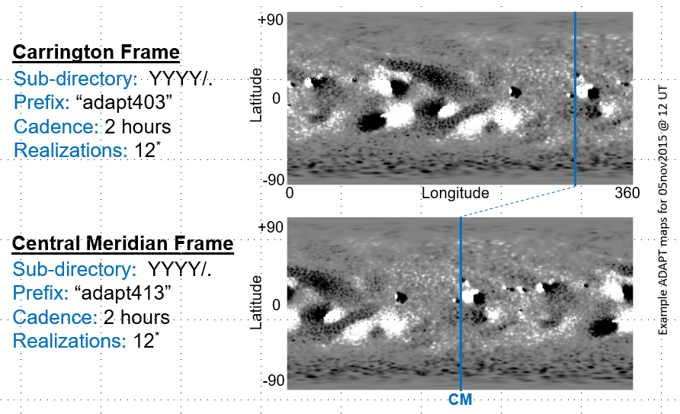
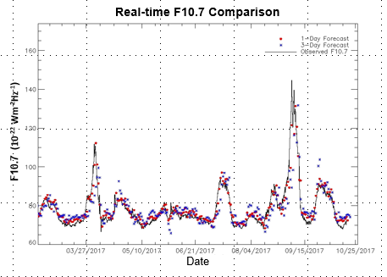
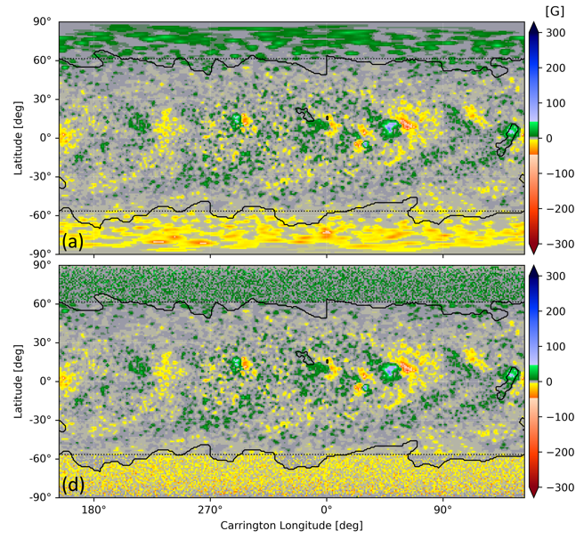
Summary
ADAPT & SIFT prototyping:
running 24/7 at the National Solar Observatory
near real-time ADAPT maps at: www.nso.edu/data/nisp-data/adapt-maps/
SIFT F10.7 , Mg II, & SSN forecasts at: www.nso.edu/data/nisp-data/sift-forecasts/
Near-future Activities:
Follow up on Schonfeld et al. 2022, continue work with polar flux redistribution with reversed active regions
Explore data assimilation methods for combining NSO/GONG, SDO/HMI, and SO/PHI
Continue study on the benefits on 24 hr mean global maps (quasi-4D variational DA)
Selected References:
S. J. Schonfeld, C. J. Henney, S. I. Jones, C. N. Arge, Solar Polar Flux Redistribution Based on Observed Coronal Holes, ApJ, in press, arXiv e-prints, arXiv:2204.13676
M. L. Mays, P. J. MacNeice, A. Taktakishvili, C. P. Wiegand, J. Merka, E. T. Adamson, V. J. Pizzo, D. A. Biesecker, A. R. Marble, D. Odstrcil, C. J. Henney, C. N. Arge, S. I. Jones-Mecholsky, and S. Wallace 2020, NASA/NOAA MOU Annex Final Report: Evaluating Model Advancements for Predicting CME Arrival Time, NASA/NOAA MOU Annex, 36 pp.
Henney, C. J., Hock, R., Schooley, A., Toussaint, W., White, S. M., and C. N. Arge 2015, Forecasting Solar Extreme and Far Ultraviolet Irradiance, Space Weather, 13, 141.
The ADAPT model development is supported by AFRL, along with AFOSR tasks 18RVCOR126 and 22RVCOR012. This work utilizes data produced collaboratively between AFRL/ADAPT and NSO/NISP.

