Slide 1
CCMC 2022 Workshop: Open Science Discussion
Co-Chairs: Reinhard Friedel and Lan Jian
Community Facilitators: Yue Deng, Vania Jordanova, Agnit Mukhopadhyay, Tuija Pulkkinen, Aaron Ridley, and Michael Wiltberger
CCMC Support: Rebecca Ringuette and Yihua Zheng
Notes:
The CCMC would like to gather input from the community on how we can best support open science in heliophysics. Rebecca start.

Slide 2
Discussion Format
These Slides
The discussion chair and co-chair will ensure the discussion is focused and productive.
The facilitators will present a few suggestions and ideas for a series of discussion questions to get the discussion started.
All, please contribute and discuss ideas and suggestions in a professional manner.
Everyone can help us take notes, especially action items, on each topic. Just scan the QR code for a live link!
Live Notes

Slide 3
What is FAIR and Open Science?
FAIR = Findable, Accessible, Interoperable, and Reusable
Findable: The object can be easily found by both people and machines, typically via metadata (data that describes the object).
Accessible: The object can be easily accessed by both humans and machines, typically via internet downloads and APIs.
Interoperable: The object can be easily used with other objects.
Reusable: The object can be easily reused to replicate previous efforts or built upon in new ways.
We achieve “Open Science” when these standards are applied to the entire scientific process and collaboration is made welcome and enabled.
https://doi.org/10.1038/sdata.2016.18, https://science.nasa.gov/open-science-overview
Notes:
Reiner takes over here.

Slide 4
CCMC Services Supporting Open Science
New Website: Updated, more user-friendly website now online!
DONKI: Open access to experimental space weather notifications.
iSWA: Customizable cygnet-based dissemination system for space weather data and selected model outputs.
ROR/IR: Provides and facilitates community access to heliophysics models for custom or real-time executions.
Scoreboards: Coordinate and record comparisons of forecasting results.
Modeling Challenges: Coordinate and host results for modeling challenges in various domains.
CMR (CCMC’s Model Registry): Ongoing improvements to simplify the findability of models and their outputs.
Kamodo: Model agnostic interface to model output data, including complex visualizations, flythroughs, and interactive analysis capabilities.
Notes:
Rebecca this slide

Slide 5
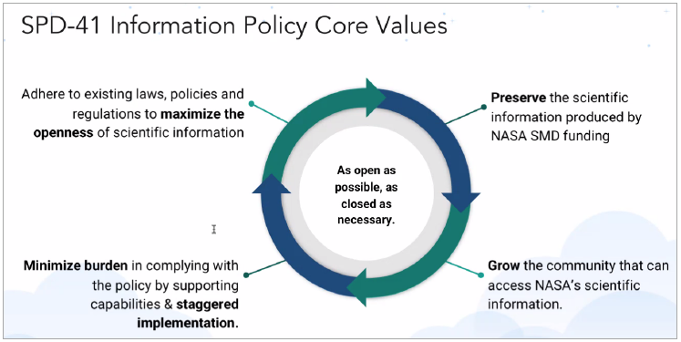
Open Science Policies
FYI here, NOT for discussion!
How can CCMC help with this?
New Proposed changes in SPD-41a:
Data | Software | Publications
Scientific data should be FAIR and shall be made publicly available with a clear, open, and accessible data licence no later than the publication of the research, and be citable. | Research Software shall be publicly available no later than the publication of the research, assigned a permissive software licence, and be citable. | Manuscripts versions of as-accepted manuscripts be deposited in a NASA repository and made publicly available within 12-months. Publishing as open access is supported and posting preprints is encouraged.
Mission data shall be openly available with no period of exclusive access. | Mission software shall additionally be developed openly in a publicly accessible, version-controlled platform that allows for contributions and engagement from the community. | Mission publications shall additionally be made publicly available at the time of their publication. Science workshops and meetings shall be open to broad participation and documented in public repositories.
All future awards will need to be in compliance with SPD-41, the scientific information policy for SMD.
Integrated into ROSES 22 & SALMON
PIs should include these costs in proposal
Open Science activities will be considered in reviews of proposals
SPD-41a, based on RFI feedback, will be adopted no earlier than June 2022

Slide 6
Discussion Questions
(Aaron Ridley) Open source: What opportunities should CCMC offer to maximize return on open source software and open access data? Should CCMC pilot open source projects (e.g., community-wide projects/challenges on model improvements, plug and play with code portions)?
(Rebecca Ringuette) What should CCMC’s role be in addressing requirements for open science and reproducibility?
(Michael Wiltberger) Should CCMC host results of simulations performed outside of CCMC and utilize CCMC and other tools for visualization and analysis of those results? What should the requirements be for simulation outputs to be hosted by CCMC?
(Vania Jordanova) Several journals are requiring simulation outputs to be accessible for the publications using them. What role should CCMC take in this area? Should CCMC generate DOIs for runs that are used in papers/publications?
(Chair/co-chair) Of the action items collected, what should CCMC’s priorities be? (Last 10 minutes.)
Notes:
Reiner take this slide: not wanting to get buried in debating merits of open source/science, just what CCMC can do to help support the community.

Slide 7
Discussion Format
These Slides
You can get to these slides and the live notes here:
Also from the [discussion folder] link in the
digital program.
Live Notes

Slide 8
Open Source: What opportunities should CCMC offer to maximize return on open source software and open access data? Should CCMC pilot open source projects (e.g., community-wide projects/challenges on model improvements, plug and play with code portions)? Aaron Ridley
Wants to encourage development of models
Wants to respect model developers as being the authors of the models (even if open source)
Definitely not in mandate to develop models
So, how to:
encourage community development of open source?
have access with runs-on-request to community-developed augmentations to models that are running at CCMC?

Slide 9
What should CCMC’s role be in addressing requirements for open science and reproducibility? Rebecca Ringuette
Reproducibility vs repeatability: goal is reproducibility.
Executable papers as an example, but too small for model outputs:
Easily copy and build upon other’s work (Binder, DeepNote, etc), but 5 GB limit.
Host a repository for published analysis code + model outputs? If not at CCMC, how to keep together?
Need compute next to data without duplicating large model outputs.
Need instant online access to download model outputs.
Collaborate with CfHA, ESIP (Earth Science Information Partners), and data science for heliophysics vocabulary harmonization and to improve findability of our modeling resources?
What tools and services to improve and how? What new services to offer (e.g. modeling challenges, ML/AI research, ensemble modeling)?

Slide 10
Should CCMC host results of simulations performed outside of CCMC and utilize CCMC and other tools for visualization and analysis of those results? What should the requirements be for simulation outputs to be hosted by CCMC? Michael Wiltberger
Thoughts on where the data should be stored and CCMC’s role in facilitating access and discovery
What is the proper balance between CCMC and the community
What plotting and analysis tools should be colocated with the data?
How should this interface with NASA’s Year of Open Science (2023)?
Input from solicitations
ROSES calls for open source tools and methods
HDEE has special calls for model output

Slide 11
Several journals are requiring simulation outputs to be accessible for the publications using them. What role should CCMC take in this area? Should CCMC generate DOIs for runs that are used in papers/publications? Vania Jordanova
What model outputs to keep and for how long? (permanence vs storage costs)
Model codes eventually can’t run anymore, so model outputs not completely replaceable.
What model outputs should be created for a high-quality library (real-time runs, research runs, etc)?
Which outputs should be assigned a DOI (a persistent, standardized, unique identifier)?
A DOI is a useful indicator of where the object could be found (e.g., by binding the DOI to a URL of the object), but should be kept updated (linked to the new URL if it changes)

Slide 12
Of the action items collected, what should CCMC’s priorities be? (Last 10 minutes.)

Slide 13
Thank you for the discussion!

Slide 14
backup

Slide 15
Emerging Open Science Methodologies Advances in data, software, and computing are enabling transformational, interdisciplinary science, changing the realm of possible questions.
Open science is transparent and accessible knowledge that is shared and developed through collaborative networks.
We need connect the community of Open Science (e.g., open data, open source software, open access) to that of Heliophysics.

